Slide 1
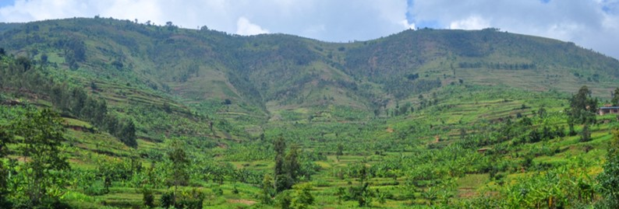
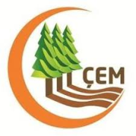
Decision Support for Mainstreaming and Scaling up of Sustainable Land Management
Country Presentation
TURKEY
Ozlem YAVUZ
Deputy Director General
National Project Coordinator
Workshop on the DS-SLM Project
24 – 26 April 2019
Ankara,Turkey

Slide 2
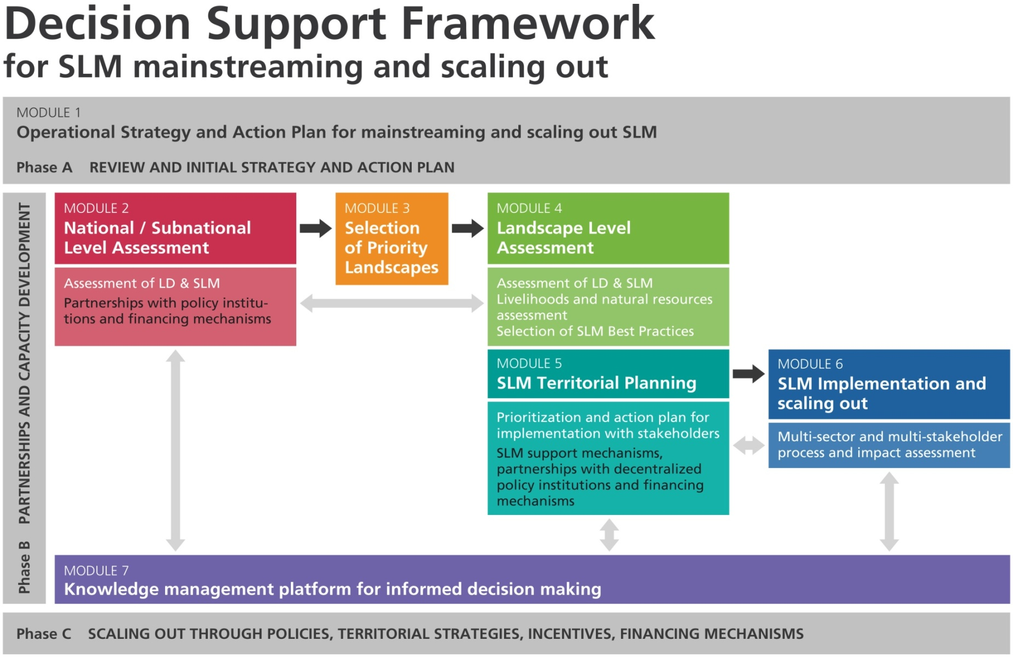

Slide 3
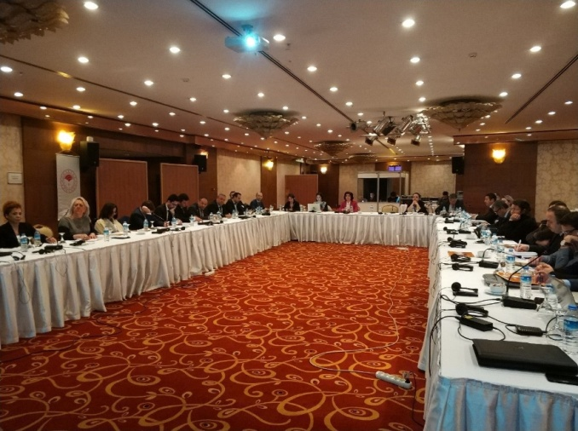
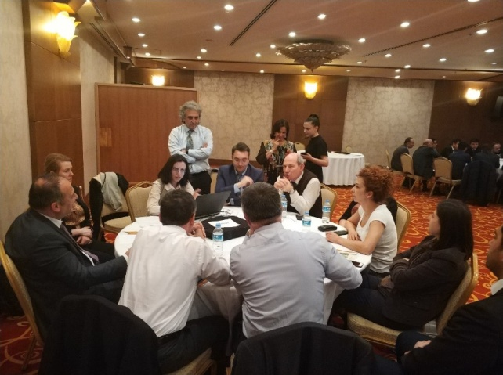
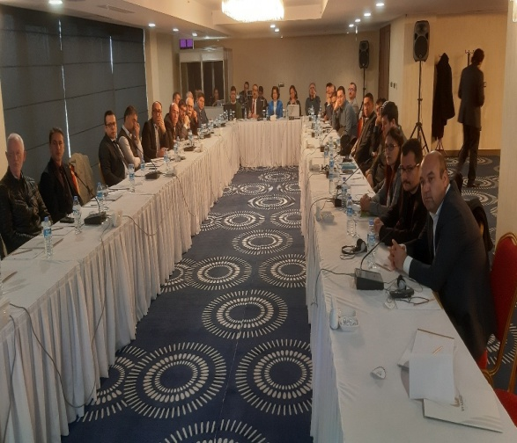
Module 1. Operational Strategy and Action Plan for mainstreaming and scaling out SLM
“SLM Upscaling Strategy” formulated through 2 workshops at local and national level (Karaman and Ankara) in March 2019.

Slide 4
Module 2. National / Subnational Level Assessment
Land Efficiency and Change of Vegetation Monitoring (Collect Earth Method)
A new open-source software (Collect Earth Method) was developed using Google databases and a change in land cover and greening tendency was followed. Approximately 65.000 monitoring points were made across to Turkey
Distribution of Greening and Desertification Trends by Land Use Classes (2001-2016)
Land Use Class | Unit | Forest | Open area | Residential | Agriculture | Other | Total
Greening | ha. | 1.065.600 | 104.400 | 20.400 | 516.000 | 24.000 | 1.730.400
 | % | 61.6 | 6.0 | 1.2 | 29.8 | 1.4 | 100.0
Desertification | ha. | 199.200 | 44.400 | 224.400 | 150.000 | 97.200 | 715.200
 | % | 27.9 | 6.2 | 31.4 | 21.0 | 13.6 | 100.0

Slide 5
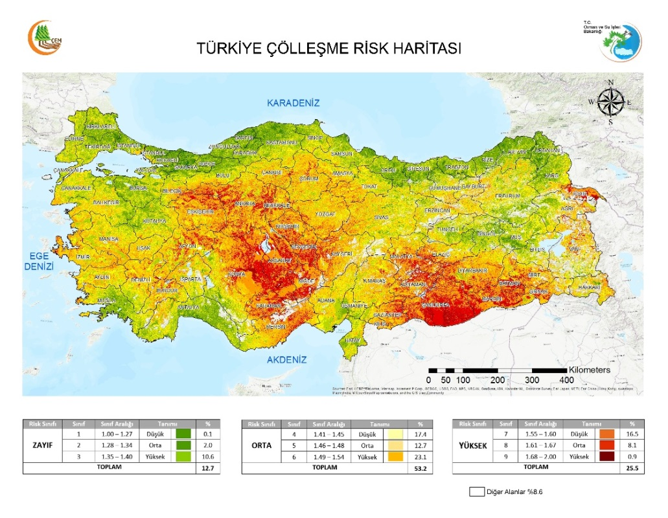
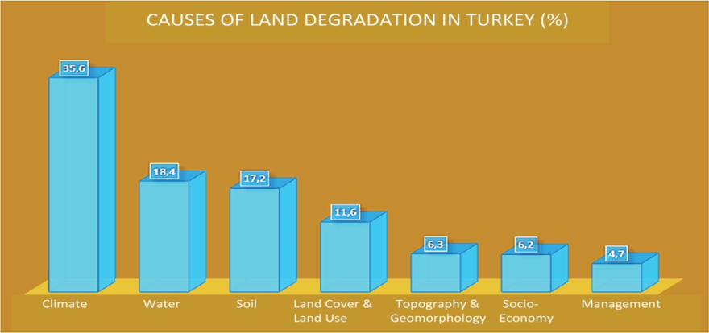
Module 2. National / Subnational Level Assessment
There are already well-established assessment tools and risk maps based on models for drought and desertification at different scales ranging from small watersheds up to large river basins and regions of Turkey for National Evaluation of DLDD for DS-SLM implementation .
7 Criteria 48 Indicator

Slide 6
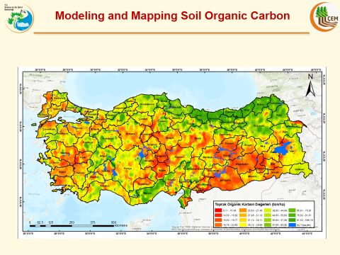
Notes:
Mevcut Stok = 3.516 milyar ton C karbon miktari
2030 hedefi 3,675 milyar ton’dur

Slide 7
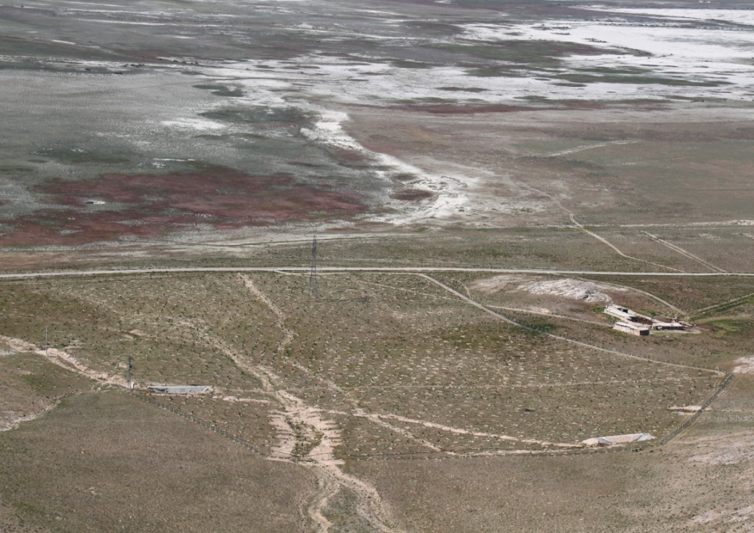
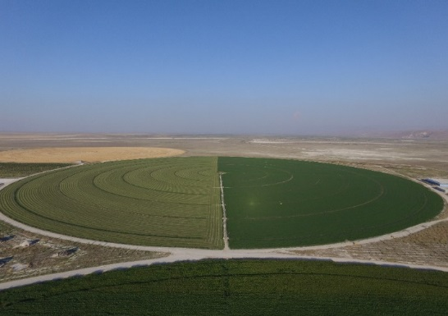
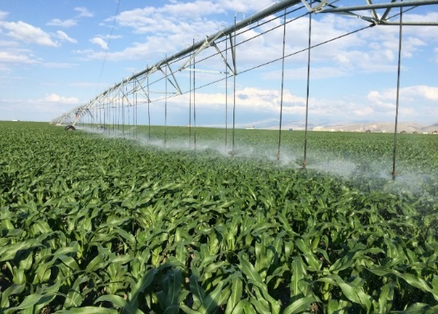
Module 3. Selection of Priority Landscapes
Selected area of-Karapinar basin to work with private sector(UNSPED Agriculture Inc.)
SELECTED LANDSCAPE
BEFORE
AFTER
Notes:
Alanın seçilme nedeni : geçmişte önemli bir sulak alan olması, zamanla kurutularak, erozyona açık bir alan olması sebebiyle, üzerinde hiçbir işleme yapılmamış, çölleşmeye terk edilmiş bir arazidir.sahanın batısında, 1970’ li yıllara kadar, Akgöl sulak alanı var iken, günümüzde beslenme havzalarına yapılan barajlar sonucu, gölün kurumasına neden olmuştur. Gölün kuruması ile bu topraklar kuraklığın etkisi ile tuzlanmış ve çoraklaşmıştır. Civar köy halkından duyduğuma göre bu arazide hiç bir bitki örtüsü olmayıp rüzgarlı günlerde tozdan göz gözü görmez hal alırmış bu nedenle arazi rüzgar erozyonu ile giderek vasfını kaybetmiştir.

Slide 8
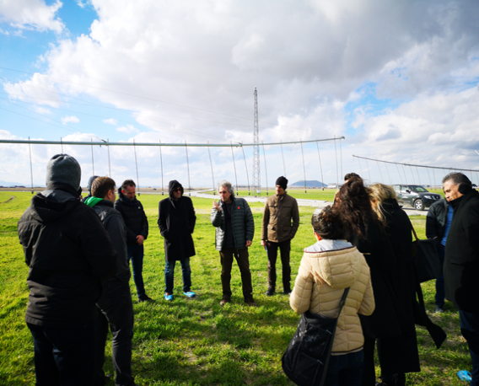
Module 4. Landscape Level Assessment
Subnational assessment : By using these evaluative means to get concentrated at subnational scale, DS-SLM implementation in Turkey has particularly focused upon region of the Central Anatolia, The Great Konya Basin, where there are wide range of DLDD issues. Region is drought prone, in where wind erosion and low land soil salinity and alkalinity pose a great risk.
Best practices
To review and list all SLM technologies and approaches applied by different Institutions according to LUS/LMS.
In cooperation with WOCAT team organize a technical training to introduce SLM assessment tools and methods as well as selection pilot sites for upscaling best SLM practices.
Notes:
Modül 4 (kapsamında; Alt ulusal ölçekte yoğunlaşmak için bu değerlendirme araçlarını kullanarak, Türkiye'deki DS-SLM uygulaması, çok çeşitli DLDD konularının bulunduğu Orta Anadolu Bölgesi Konya Havzasına odaklanılmıştır. Bölge kuraklık eğilimlidir; burada rüzgar erozyonu ve tuzluluk ve alkalilik büyük bir risk oluşturur.

Slide 9
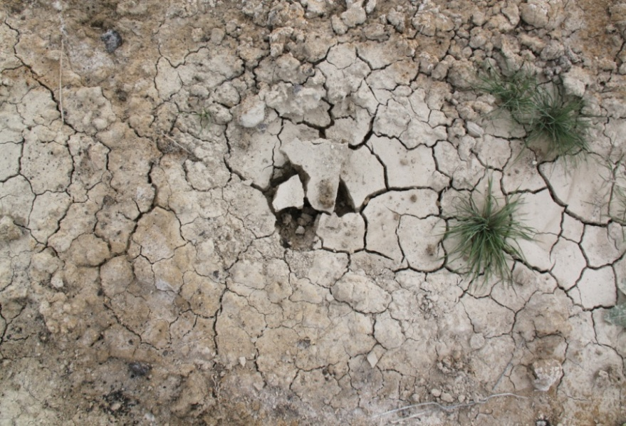
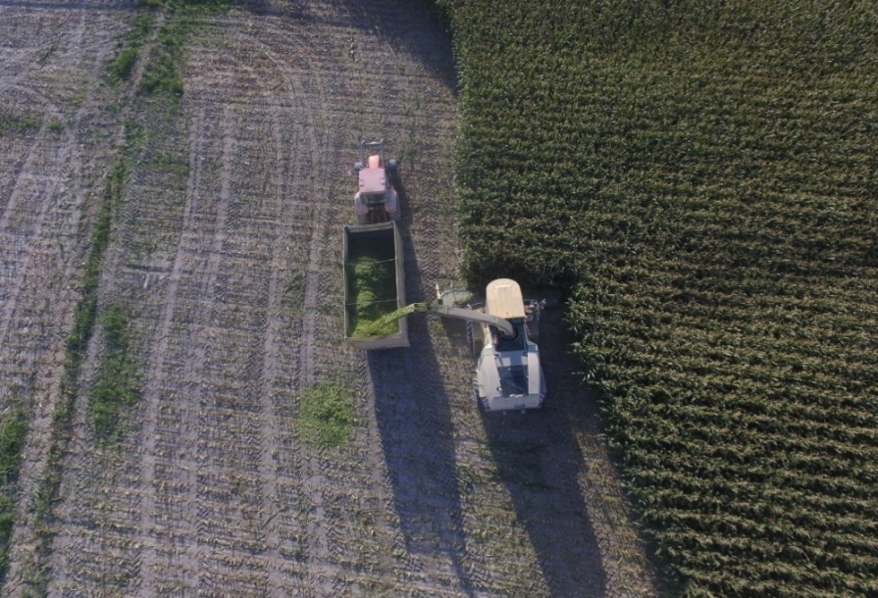
Module 5: SLM Territorial Planning
A showcase farm where many SLM best practices are currently in place was chosen to understand how successfully SLM technologies and approaches are planned to cope with DLDD.
Another central concern here was to scrutinize how much costly SLM implementation might be in such a fragile ecosystem. Although farm is “techno-economic feasibility”, most of the SLM practices and approaches, showcased in the Farm, are commonly used in the territory by small-holder farmers.
Notes:
Modul 5. Alansal SAY uygulamalari

Slide 10
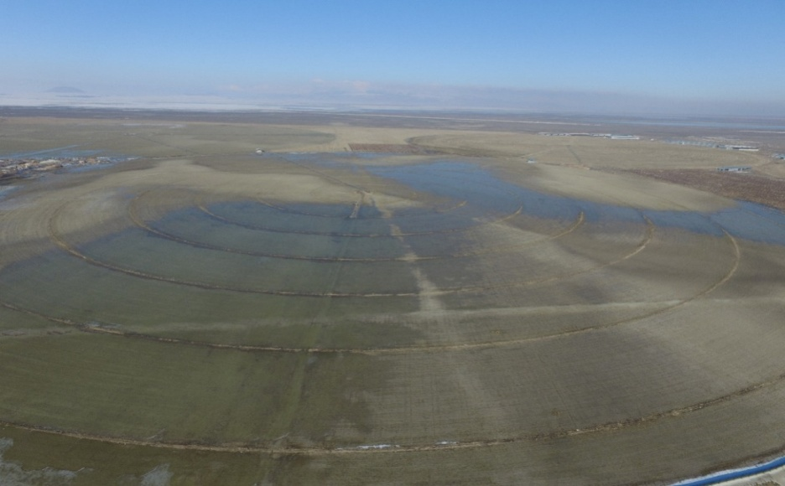
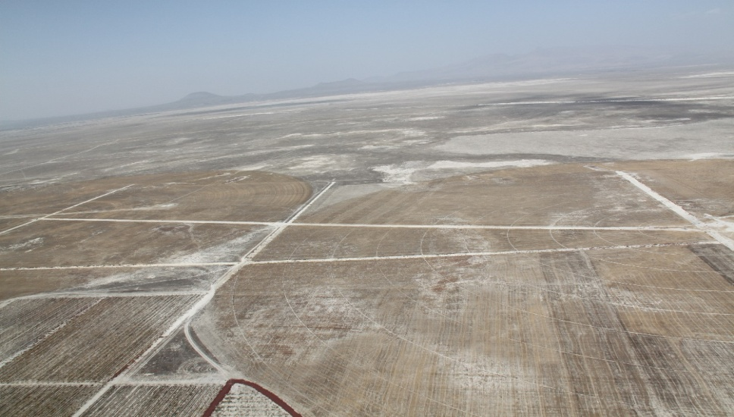
SLM TECHNOLOGİES
1- A Sustainable Drainage System for Saline Soils
Photo 1. The waterlogging in the area of UNSPED farm which restricts the available air and inhibits plant growth to a great extent
Photo 2. An open drainage ditch was constructed to a designed cross section, alignment and grade to serve as integral parts of a surface or subsurface drainage system that met the conservation and land use needs.

Slide 11
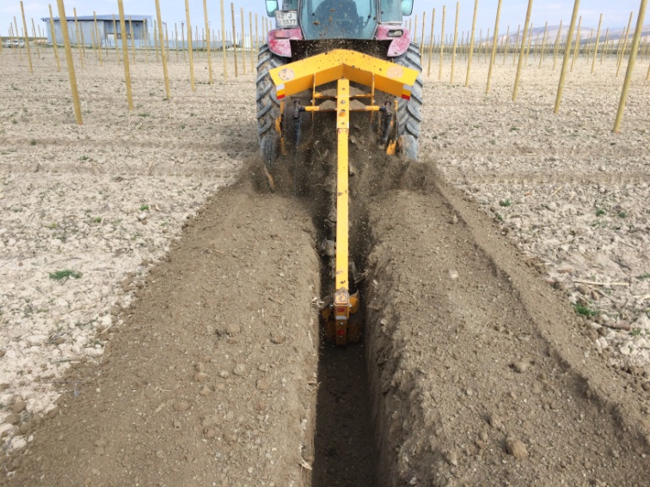
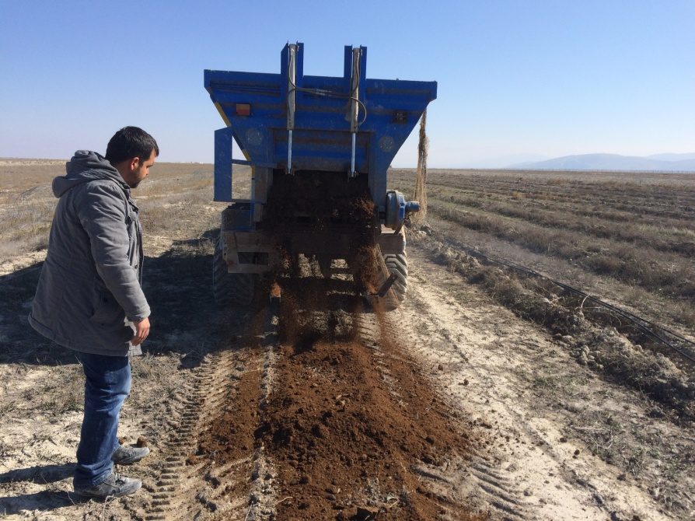
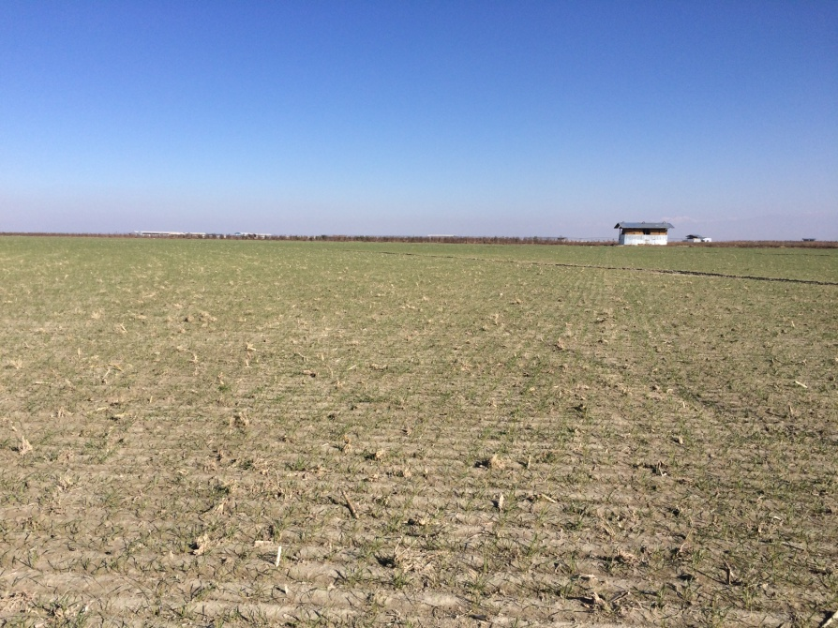

Slide 12
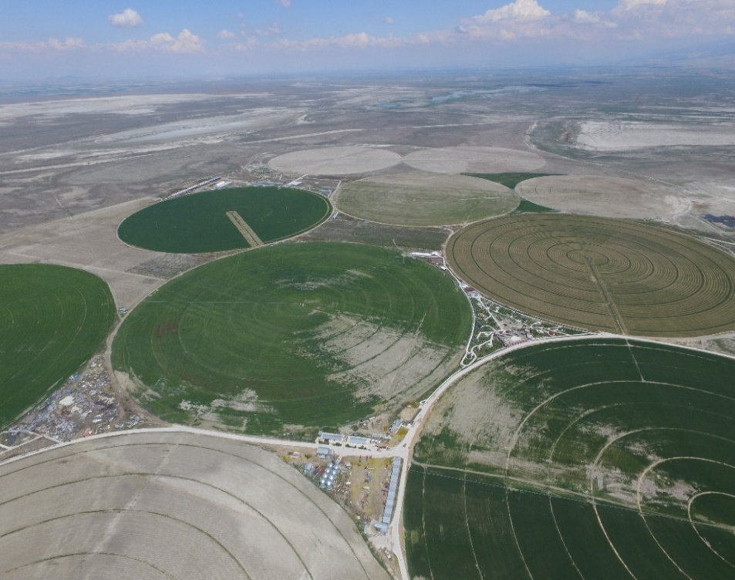
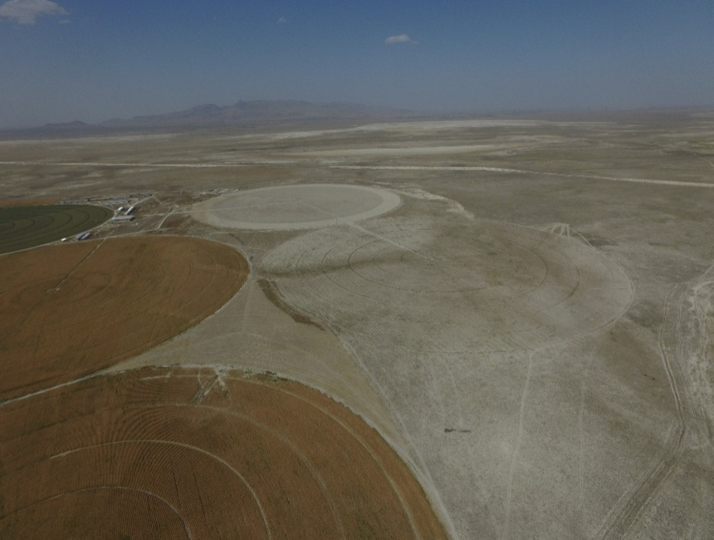
2-Growing barley in the salt-affected soils of ancient saline lake bottom
Photo 1. Planning and construction of a modern central pivot irrigation system in the UNSPED farm with an effective system of surface and subsurface drainages
Photo 2. Barley cultivation to improve soil “health” by improving soil structure, enhancing soil tilth and water infiltration for very first 3 years of the reclamation of the saline soils
Notes:
tuzdan etkilenen topraklarda arpa yetiştiriciliği

Slide 13
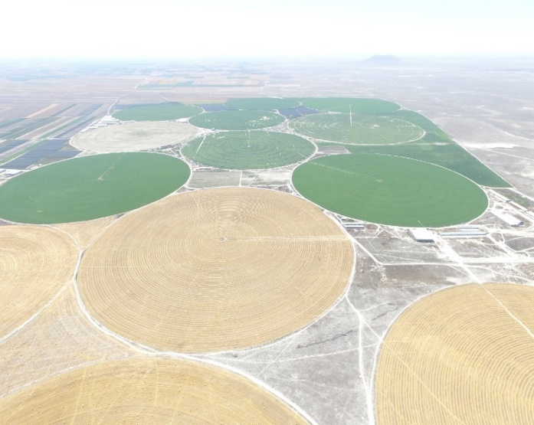
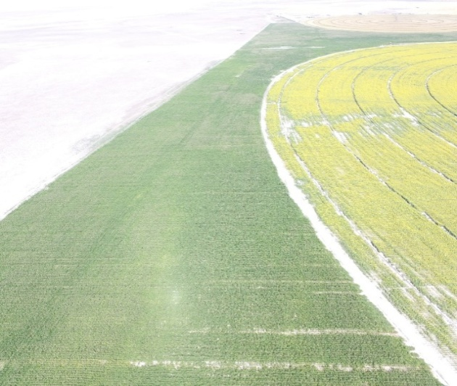
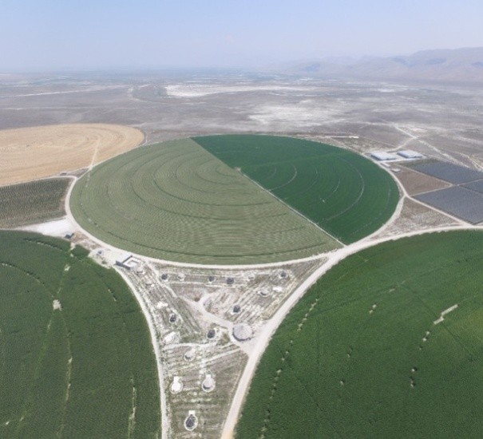
3-Planting Salt-Tolerant Crops in Rotations to Manage Saline Soils
Photo 1. Circular patterns of plots of wheat – alfalfa in rotation under the center pivot sprinkler irrigation system
Photo 2. In a rotation basis the different plots are allocated for wheat, corn and sunflower
Photo 3. Particularly, Alfalfa is an excellent choice to help further lower the saline water table
Notes:
Tuzlu Toprakları Yönetmek İçin Rotasyonlara Tuz Toleranslı Bitkileri Dikmek

Slide 14
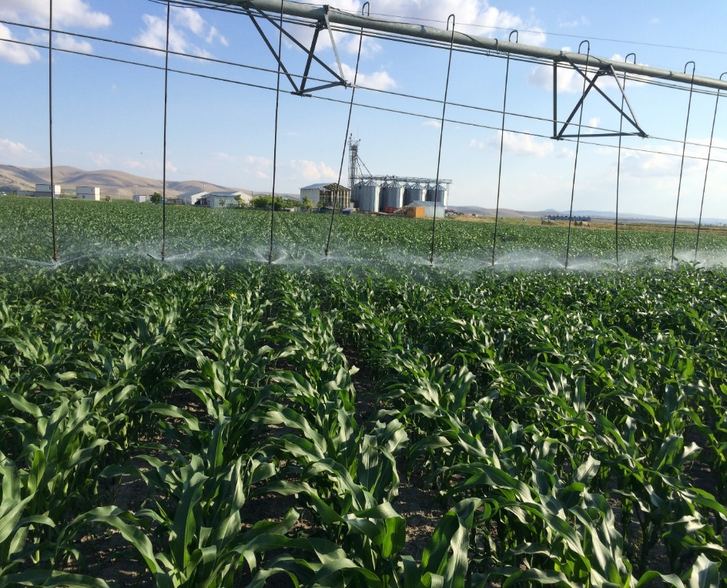
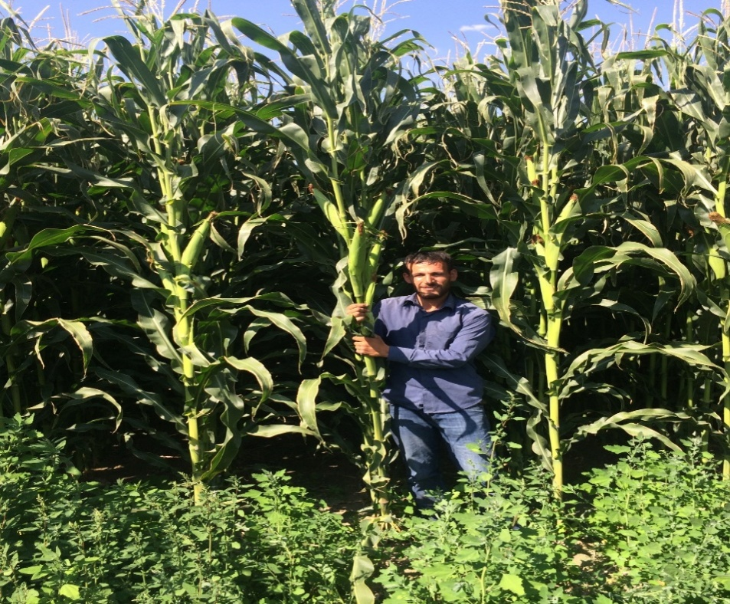
Photo 4. Even when salinity reduced the plant size of wheat up to 50%, little to no decline in grain yields have been noted
Photo 5. Rotation from Alfalfa to Corn produced a significant yield increase

Slide 15
Module 6. SLM Implementation and Scaling out
There are relevant policy tools, territorial strategies, incentives and financing mechanisms.
The case of Turkey- financing mechanisms
ÇATAK incentive programme
(technical + financial assistance)

Slide 16
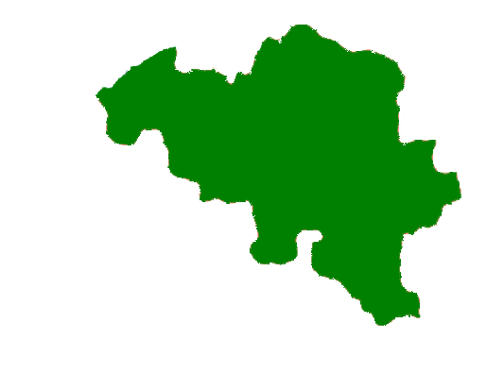
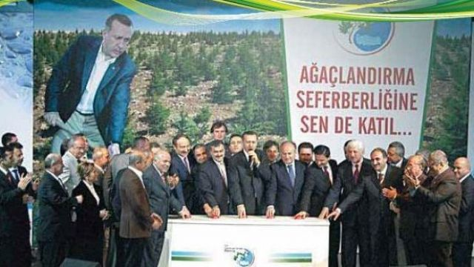
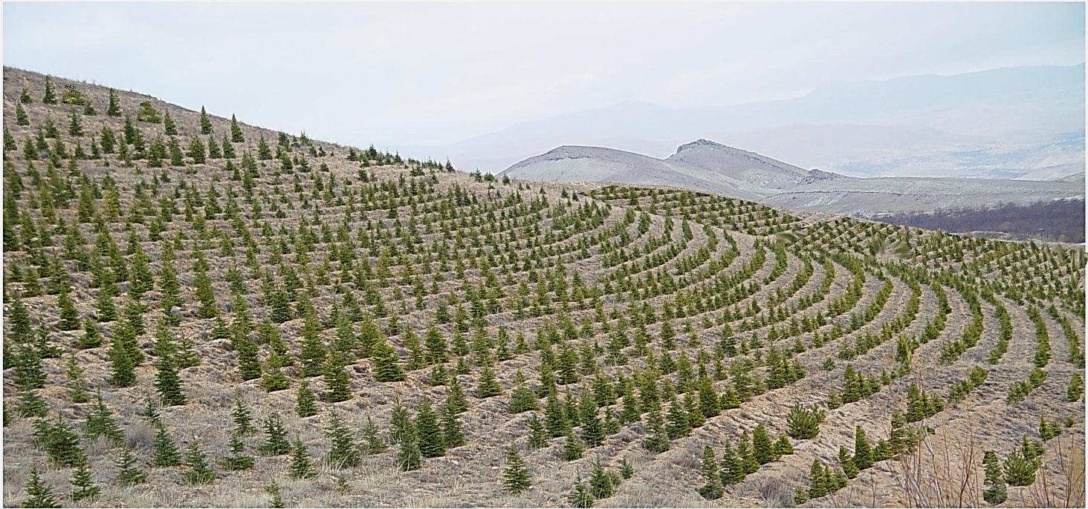
Additionally to these SLM Implementations
WE COMPLETED AFFORESTATION AND EROSION CONTROL MOBILIZATION (2008-2012)
Land area of Belgium
(3 million hectare)
In the scope of mobilization In 5 years A record was broken with 2.4 million hectares by exceeding the targets of 2.3 million hectare
Works of Afforestation,
Erosion control and
Rehabilitation of degraded forests that are held approximately square of Belgium.
16/68

Slide 17
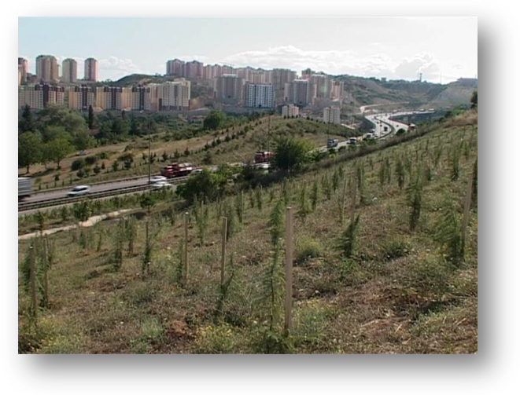
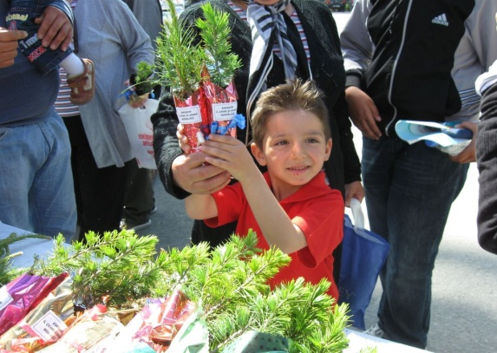
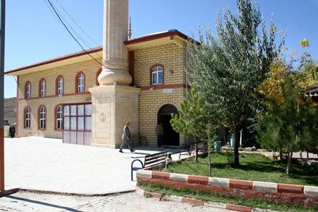
SCHOOLS, HOSPITALS, AND SANCTURIES ARE AFFORESTRATED
109 million seedlings were distributed to public free of charge.
8.135 km of highway,
2.262 km of village road,
27.000 schoolyards,
1.095 health centers and hospital gardens,
9.826 places of worship and cemeteries were afforested.

Slide 18
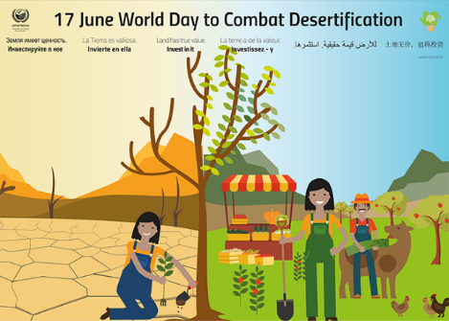
2019 WORLD DAY TO COMBAT DESERTIFICATION
2019 World Day to Combat Desertification will be held in Turkey
18/68

Slide 19
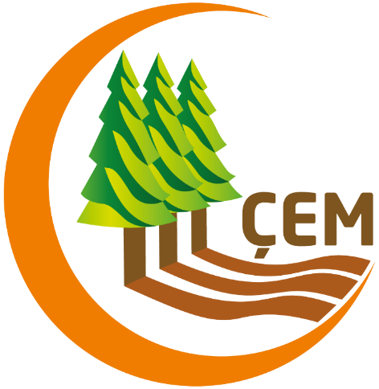
Thank you
cem.gov.tr
cemgovtr
cemgovtr
cemgovtr

