Slide 1
Reporting of SLM practices in PRAIS4
Notes:
Tat

Slide 2
PRAIS 4 Reporting Manual
Section 7: Implementation Framework
Subsection 7.4: Action on the ground
https://www.unccd.int/resources/manuals-and-guides/prais4-reporting-manual
https://prais4-reporting-manual.readthedocs.io/en/latest/index.html
Notes:
Tat

Slide 3
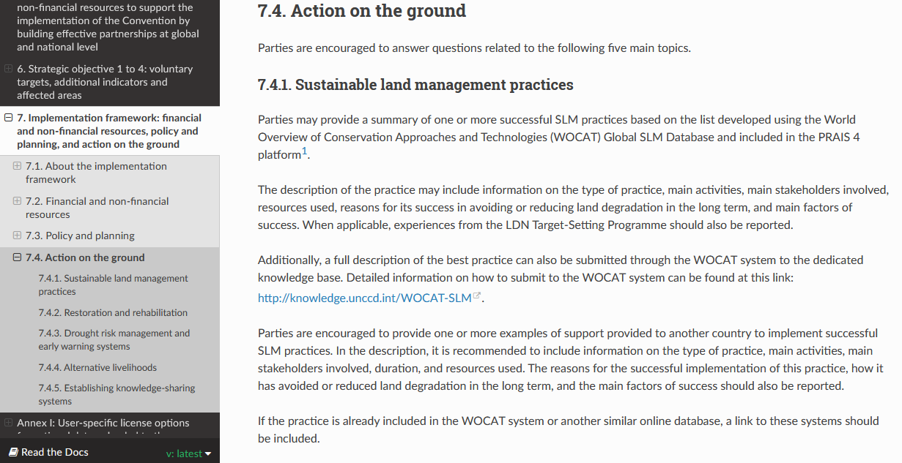
PRAIS 4 Reporting Manual
ACTION ON THE GROUND
https://prais4-reporting-manual.readthedocs.io/en/latest/implementationFramework.html#action-on-the-ground
Notes:
Tat

Slide 4
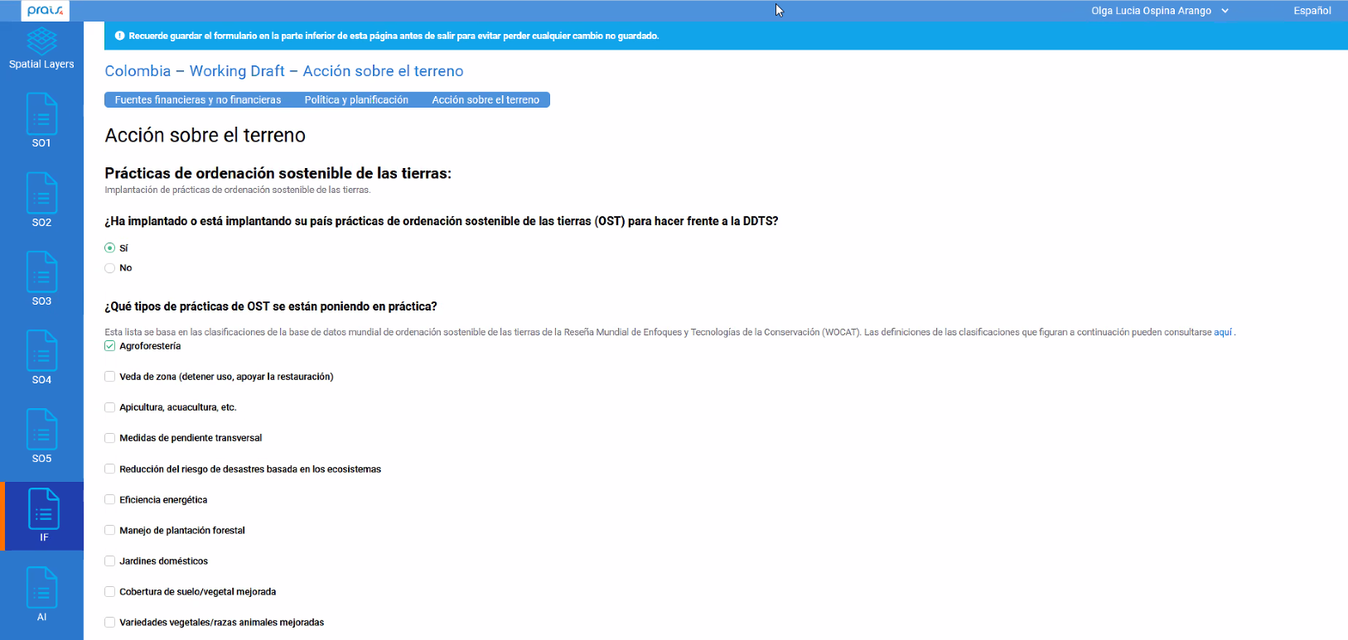
SLM practices in PRAIS 4 platform
1- Have you implemented SLM practices to combat land degradation?
If YES is selected a list of practices appears
2- What types of SLM are being implemented? Categories (types of SLM) are based on WOCAT classification.
Notes:
Tat

Slide 5
SLM practices in PRAIS 4 platform
2- What types of SLM are being implemented? Categories (types of SLM) are based on WOCAT classification.
Notes:
Tat

Slide 6
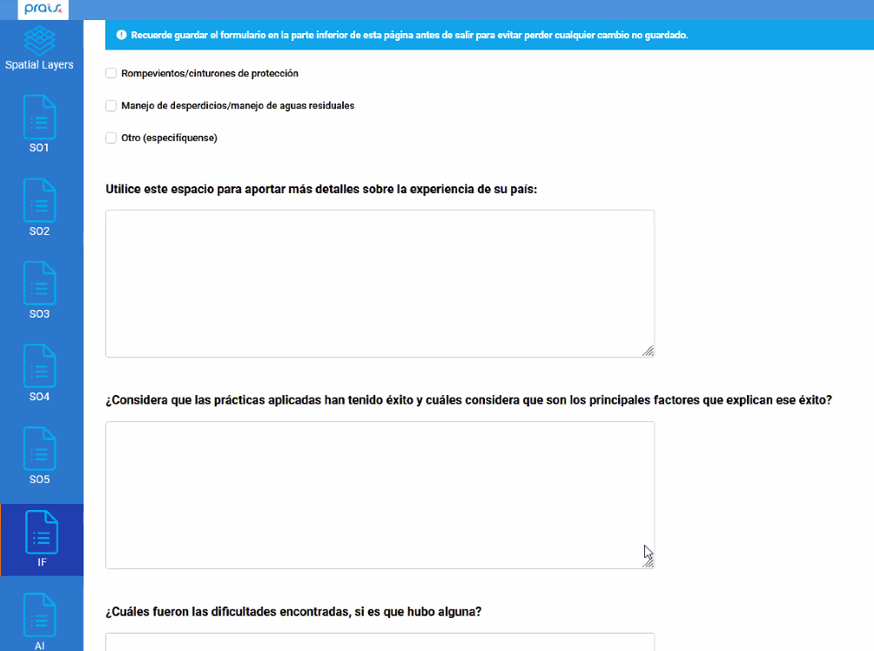
SLM practices in PRAIS 4 platform
3- Details and description on the experience
4- Have they been successful? Factors explaining the success
Notes:
Tat

Slide 7
SLM practices in PRAIS 4 platform
5- Were there diffciulties? Which?
6- Lessons learnt
Notes:
Tat

Slide 8
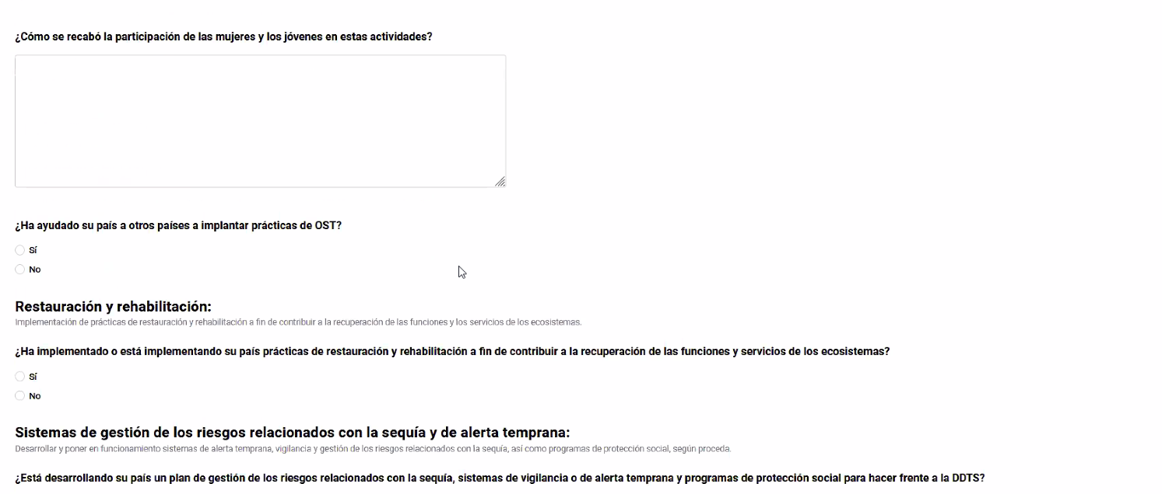
SLM practices in PRAIS 4 platform
7- Participation of Youth and women
8- Collaboration with other countries
Notes:
Tat

Slide 9
PRAIS 4 SLM Reporting
If the practice is already included in the WOCAT system or another similar online database, a link to these systems should be included
https://www.unccd.int/resources/manuals-and-guides/prais4-reporting-manual
https://prais4-reporting-manual.readthedocs.io/en/latest/index.html
Notes:
Tat

