Slide 1
Google Earth Engine for informed decision making
WOCAT Apps for Convergence of Evidence
LDN TOOLBOX TRAINING
Nairobi, 2-6 October 2023
Ingrid Teich

Slide 2
GOOGLE EARTH ENGINE
Cloud Computing to map and monitor land degradation
earthengine.google.com/signup

Slide 3
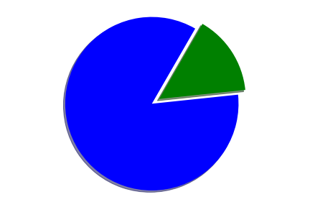
The Classic Remote Sensing Workflow
Data science!
Data Prep
Download data
Odd file formats
Metadata
Bad/missing data
Clouds & shadows Atmosphere & haze Calibration
...
This can be done once ..
...so scientists can focus on this.
And at a OMG Speed !!!!!
https://spatialthoughts.com/
Thanks →

Slide 4
GEE is a public data catalog, compute infrastructure, geospatial APIs and an interactive app server
Datasets
Compute
Apps
APIs
Petabyte scale catalog of public and free to use geospatial datasets
Google's cloud platform for planetary-scale analysis of Earth science data
Full-featured JavaScript, Python and REST APIs
Dynamic, publicly accessible user interfaces for Earth Engine analyses

Slide 5
Datasets
> 70 Petabytes of Earth observation data
Climate & Weather, Imagery, Geophysical
https://developers.google.com/earth-engine/datasets/
~1 Petabyte/month
~100 datasets / year

Slide 6
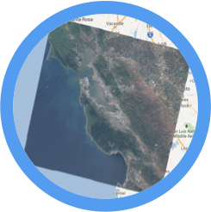
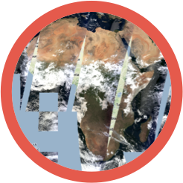
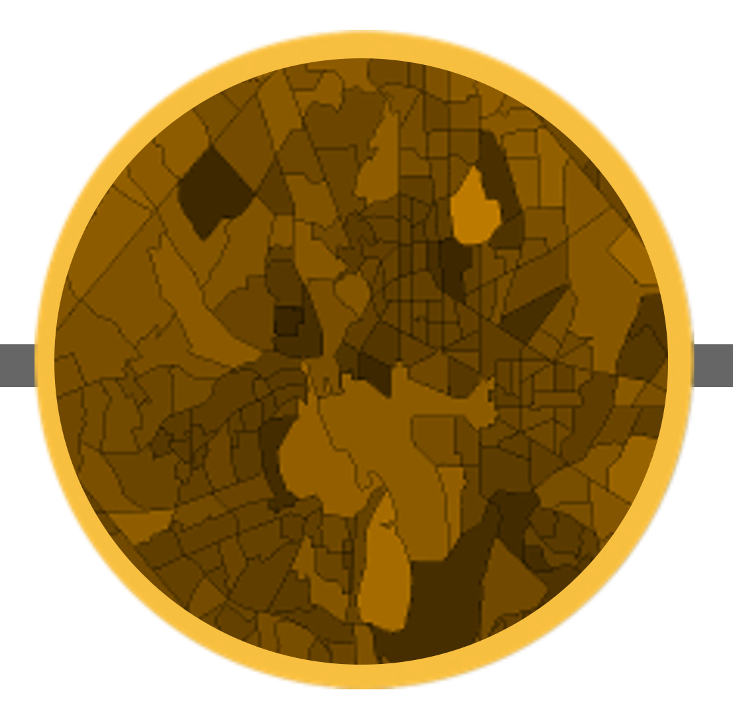
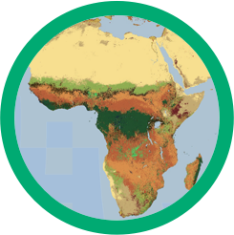
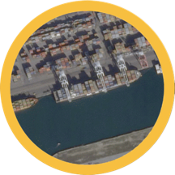
The Earth Engine Data Catalog
Landsat & Sentinel 1, 2
10-30m, weekly
MODIS
250m daily
Vector Data
WDPA, Tiger
Terrain &
Land Cover
Weather & Climate
NOAA NCEP, OMI, ...
> 900 public datasets
... and upload your own vectors and rasters
> 5 million images
> 4000 new images every day
Notes:
Landsat data. Whatever USGS has, Earth Engine has. Landsats 1-8. Raw, TOA reflectance, surface reflectance. Sentinels 1-2. TOA reflectance. SAR data from Sentinel-1 processed to backscattering coefficients. Most MODIS terrestrial composites. Global DEMS at a variety of resolutions. Multiple land cover datasets. Atmosphere and climate data. And growing daily. There is a one or two day latency between scene acquisition and when it is ingested to the catalog.

Slide 7
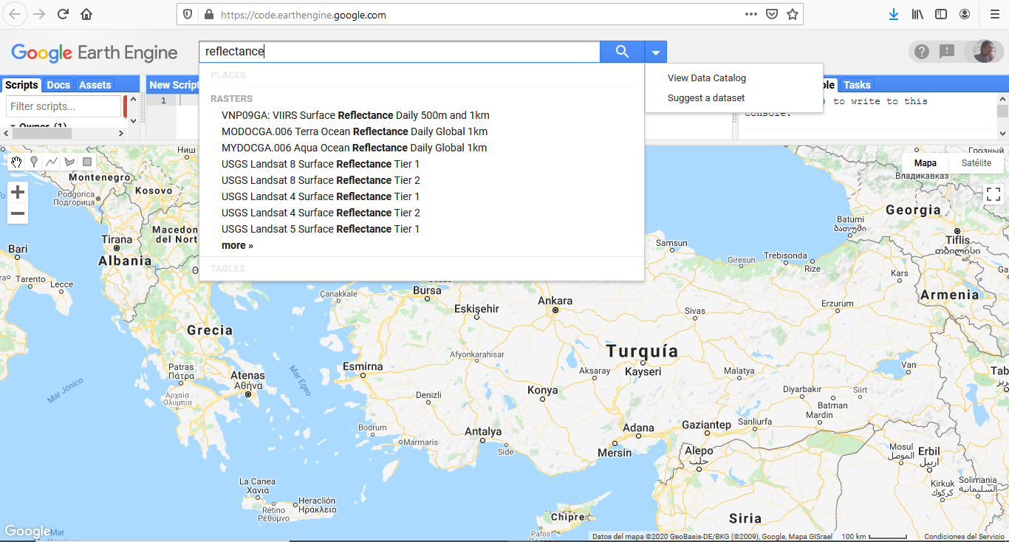
Just search!

Slide 8
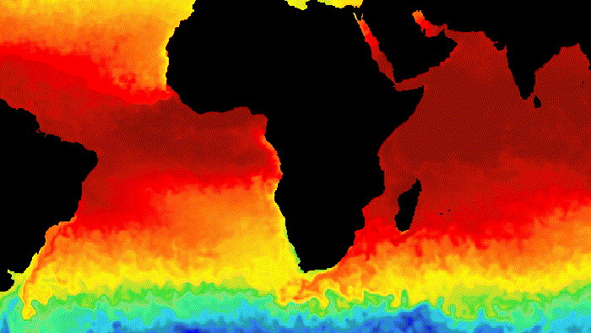
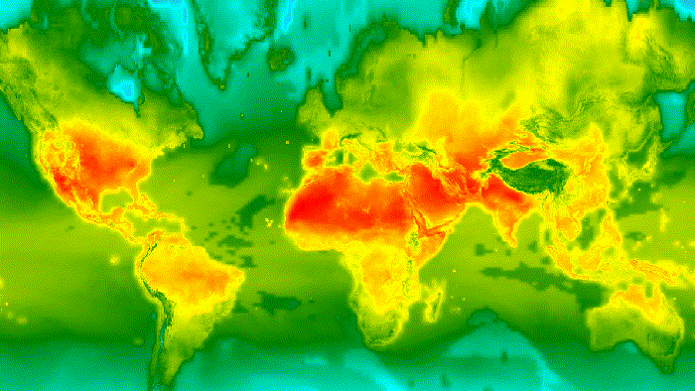
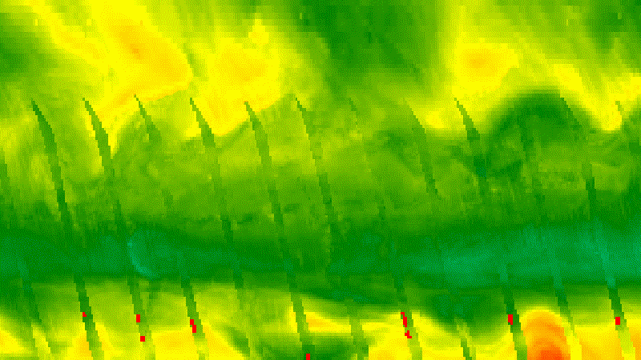
CLIMATE & WEATHER
SURFACE TEMPERATURE
CLIMATE
ATMOSPHERIC
Land and sea surface temperature products derived from several spacecraft sensors, including MODIS, ASTER, and AVHRR, in addition to raw Landsat thermal data
Climate models generate both long-term climate predictions and historical interpolations of surface variables.
Atmospheric datasets such as ozone data from NASA's TOMS and OMI instruments and the MODIS Monthly Gridded Atmospheric Product.

Slide 9
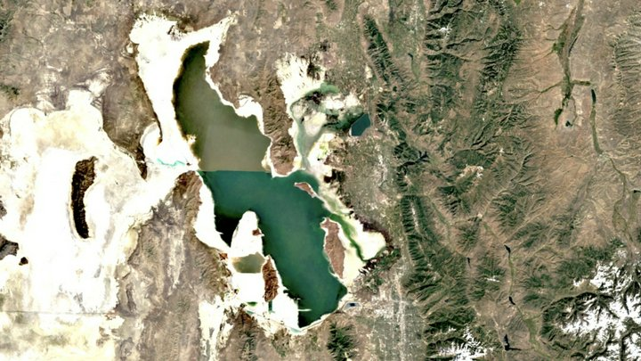
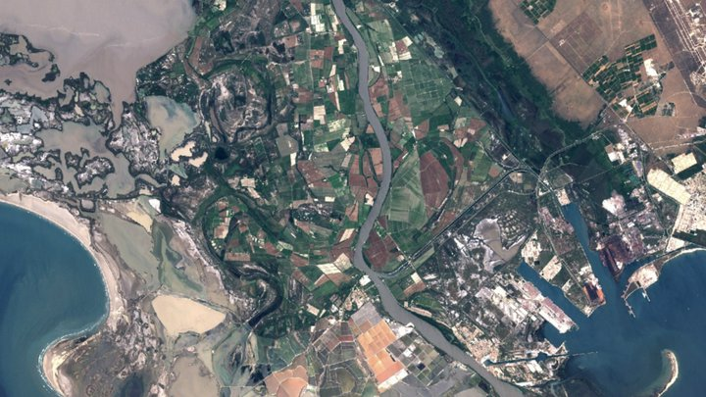
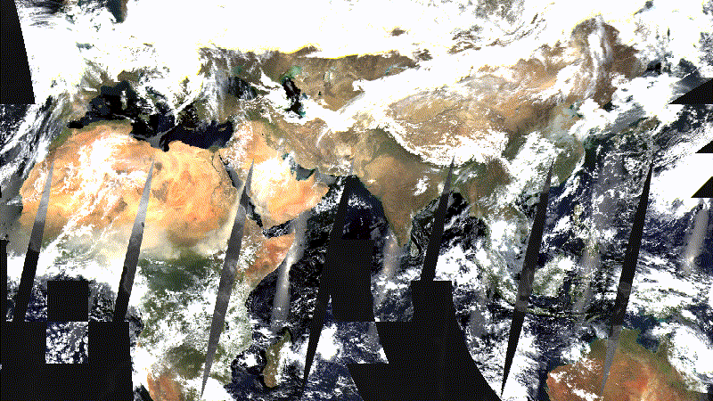
IMAGERY
LANDSAT
SENTINEL
MODIS
Landsat satellites image the entire Earth's surface at a 30-meter resolution about once every two weeks, including multispectral and thermal data.
Weather radar images from Sentinel-1A and -1B, high-resolution optical images from Sentinel 2A and 2B & ocean and land data for environmental and climate monitoring from Sentinel 3.
MODIS Images of the Earth daily since 1999, including daily imagery, 16-day BRDF-adjusted surface reflectance, and products such as vegetation indices and snow cover.

Slide 10
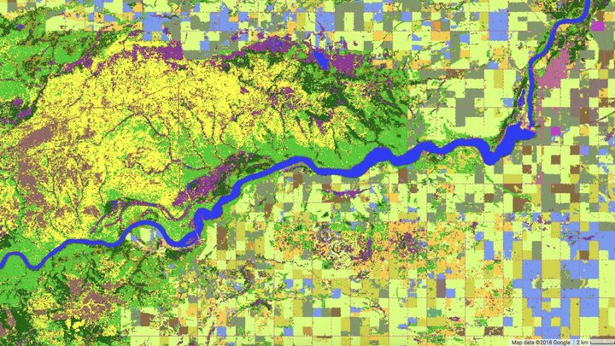
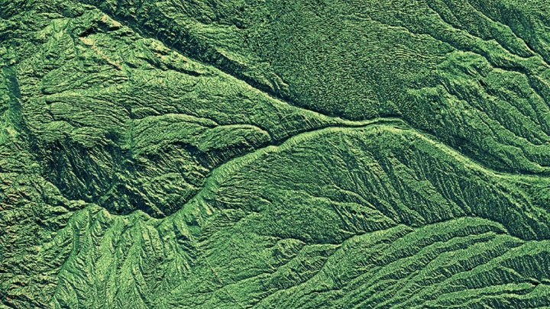
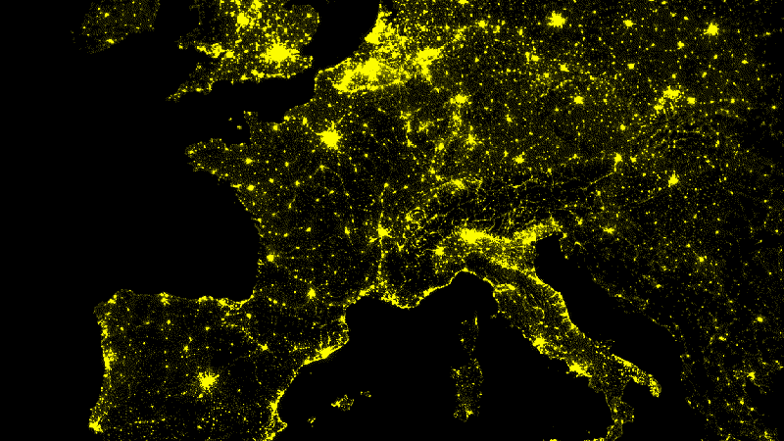
GEOPHYSICAL
LAND COVER
TERRAIN
MANY OTHER
Wide variety land cover datasets, including global products such as NASA's MODIS-derived annual land cover maps and ESA's GlobCover, as well as higher-resolution national products.
Several global DEMs such as SRTM data at 30-meter resolution, regional DEMs at higher resolutions, and derived products such as the WWF's HydroSHEDS hydrology database.
Many other datasets, such as Cropland data including cropland extent, crop dominance, and watering sources or night-time lights at approximately 1-kilometer resolution since 1992

Slide 11
GEE is a public data catalog, compute infrastructure, geospatial APIs and an interactive app server
Datasets
Compute
Apps
APIs
Petabyte scale catalog of public and free to use geospatial datasets
Google's cloud platform for planetary-scale analysis of Earth science data
Full-featured JavaScript, Python and REST APIs
Dynamic, publicly accessible user interfaces for Earth Engine analyses

Slide 12
Compute
No need to have a super computer or large-scale commodity cloud computing resources
Planetary scale geospatial analysis for everyone https://doi.org/10.1016/j.rse.2017.06.031

Slide 13
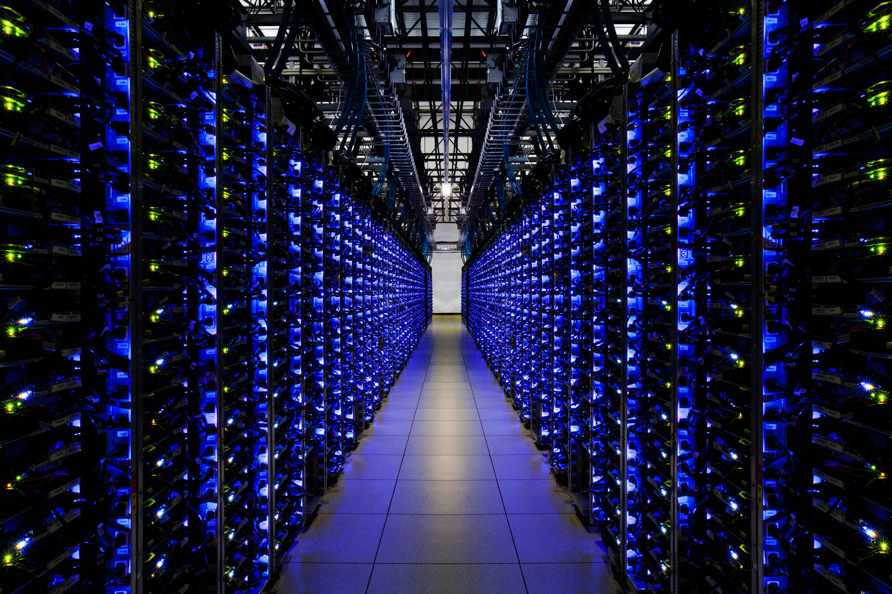
Google computational infrastructure
A high-performance, intrinsically parallel computation service
GEE makes it easy to access high-performance computing resources for processing very large geospatial datasets
Notes:
You need compute power colocated with the data.

Slide 14
COMPUTATION PLATFORM
ON-THE-FLY
COMPUTATION PLATFORM
BATCH
Interactively visualize data, serve queries, and preview analysis results.
Large-scale parallel computation to run big jobs at arbitrary scale and scope

Slide 15
GEE is a public data catalog, compute infrastructure, geospatial APIs and an interactive app server
Datasets
Compute
Apps
APIs
Petabyte scale catalog of public and free to use geospatial datasets
Google's cloud platform for planetary-scale analysis of Earth science data
Full-featured JavaScript, Python and REST APIs
Dynamic, publicly accessible user interfaces for Earth Engine analyses

Slide 16
APIs
Google CI is accessed and controlled through an Internet-accessible application programming interface (API) and an associated web-based interactive development environment (IDE) that enables rapid prototyping and visualization of results
https://developers.google.com/earth-engine/guides

Slide 17
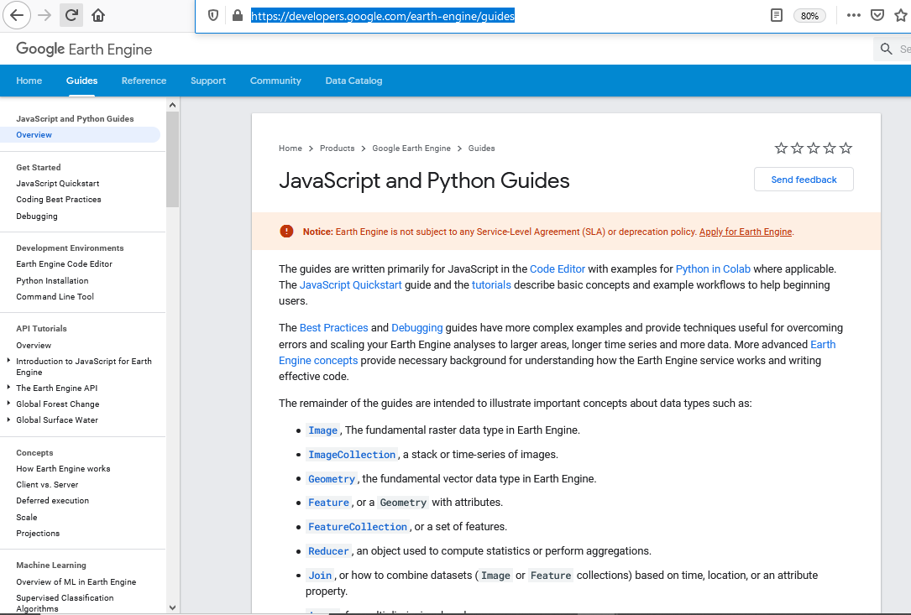
Full-featured JavaScript, Python and REST APIs.
You need an API to be able to implement your geospatial workflows

Slide 18
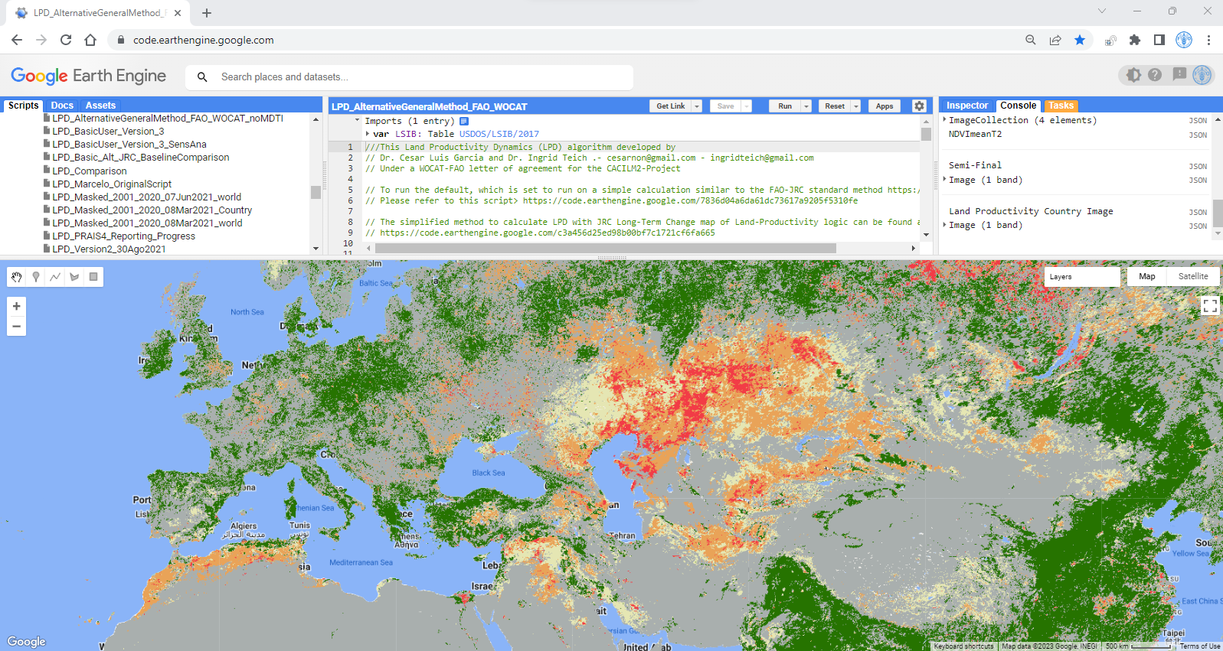
EARTH ENGINE CODE EDITOR
YOUR CODE
ASSESTS
MAP
for JavaScript, but there's also a Python API
INSPECTOR
upload your own data
query the layers on the map
SCRIPTS
Git repository and examples to help get started
including layer tools, geometry tools, etc.
Notes:
Where the magic happens. This is the online IDE at code.earthengine.google.com running inside a Chrome browser. All you need to use Earth Engine is an internet connection. Note the Scripts tab (Git repository and examples to help get started), Docs tab (API reference docs), Assets tab (upload your own data), Inspector tab (query the layers on the map), Console tab (messages), Tasks tab (execute long running tasks), Code Editor (for JavaScript, but there's also a Python API), Map (including layer tools, geometry tools, etc. The image displayed in this slide is from the Image Collection > Linear Fit example), Get Link button (send it to your friends!), Search bar, Help button

Slide 19
GEE is a public data catalog, compute infrastructure, geospatial APIs and an interactive app server
Datasets
Compute
Apps
APIs
Petabyte scale catalog of public and free to use geospatial datasets
Google's cloud platform for planetary-scale analysis of Earth science data
Full-featured JavaScript, Python and REST APIs
Dynamic, publicly accessible user interfaces for Earth Engine analyses

Slide 20
GEE apps
Dynamic, publicly accessible user interfaces for Earth Engine analyses.
https://www.earthengine.app/

Slide 21
GEE Apps
Dynamic, shareable user interfaces for Earth Engine analyses, for experts and non-experts alike to use.
Accessible from the application-specific URL generated at time of publishing.
No Earth Engine account is required to view or interact with a published App.
Can take advantage of most of the same functions used in the Code Editor

Slide 22
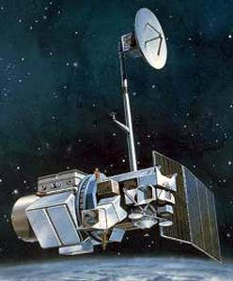
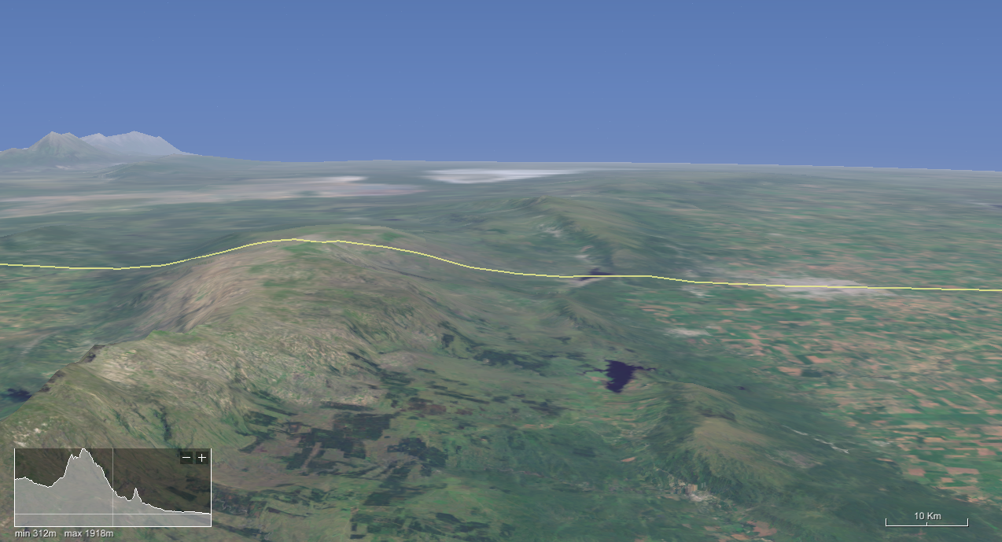
Satellite
Scanning the surface

Slide 23
The result is a series of images made by pixels that represent the intensity of radiation (mean within the pixel area) that is reflected in each band

Slide 24
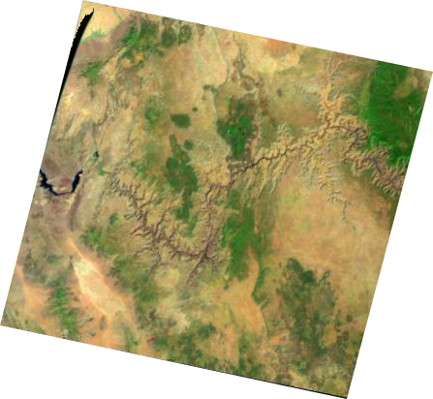
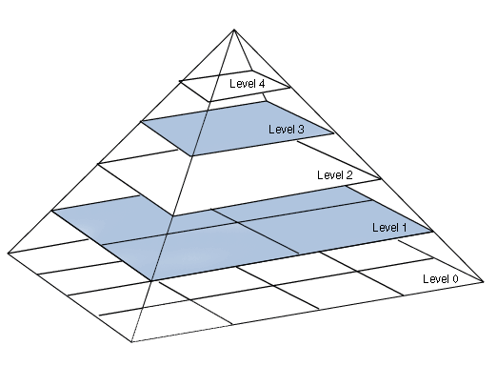
TILES ON THE FLY
RE SAMPLED using the mean
Images .are separated in tiles when a process is sent to GEE
When a process is done results are shown in the corresponding TILE level

Slide 25
On top of all, the community and resources available are amazing. :
Earth Engine User Guide
Earth Engine Data Catalog
Tutorials and Education Material
Case Studies
Google Outreach – Information and Tools
Awesome GEE – A selected list of resources
SpatialToughts – Very nice courses and learning materials
eefabook – New collaborative Book –

Slide 26
Link to join the Repo:
https://code.earthengine.google.com/?accept_repo=users/wocatapps/Kenya

Slide 27
CONVERGENCE OF EVIDENCE
Cloud computing / User friendly apps
LOCAL
Data / Expert Knowledge / SLMs
GLOBAL
Earth Observations / Datasets
The most likely explanation (hypothesis, inference, explanation, conclusion or best guess) about the status of LD at a given location that can be updated / improved with additional local information

Slide 28
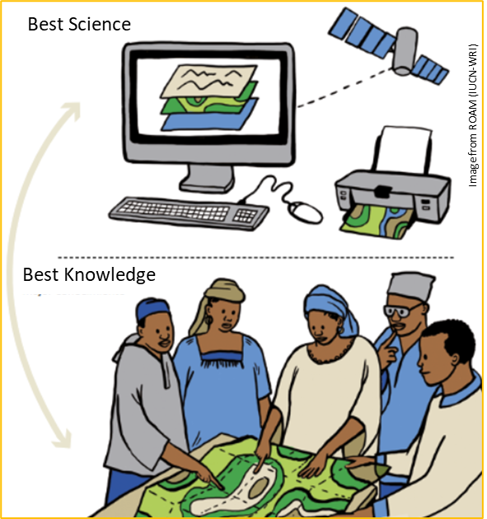
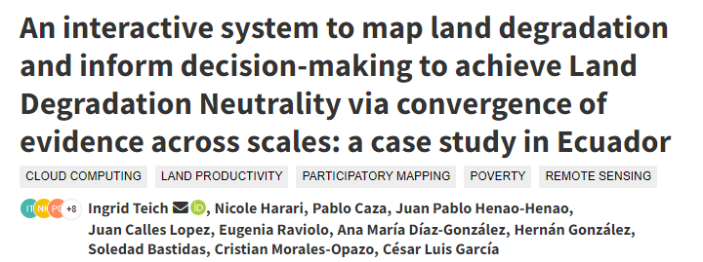
HOW CAN WE INTEGRATE KNOWLEDGE USING THE PRINCIPLE OF CONVERGENCE OF EVIDENCE ?
Co-development and integration of context-relevant tools and datasets
Participatory process involving all-level stakeholders
Validation of data by local experts / field verification
Develop user friendly, dynamic and flexible systems that do not provide all the answers (take advantage of cloud computing!)

Slide 29
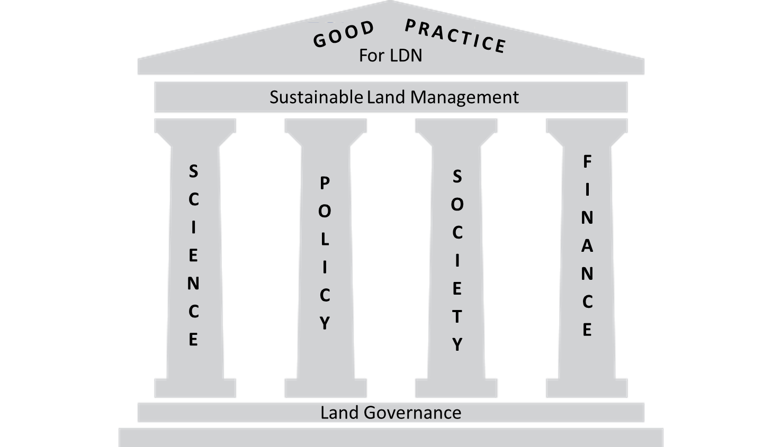
Towards informed decision making Apps for Convergence of Evidence
https://www.wocat.net/en/ldn/wocatapps/
Visualization and comparison of maps
Land cover Transition Analysis with national data
Statistics, charts and tables at different spatial scales
Advance Multicriteria Analysis
Support to Participatory Mapping process
Objective: to support projects design and implementation, investment allocation, decision making for Land Use Planning and restoration priorities, SLM implementation strategies and monitoring towards national commitments.

Slide 30
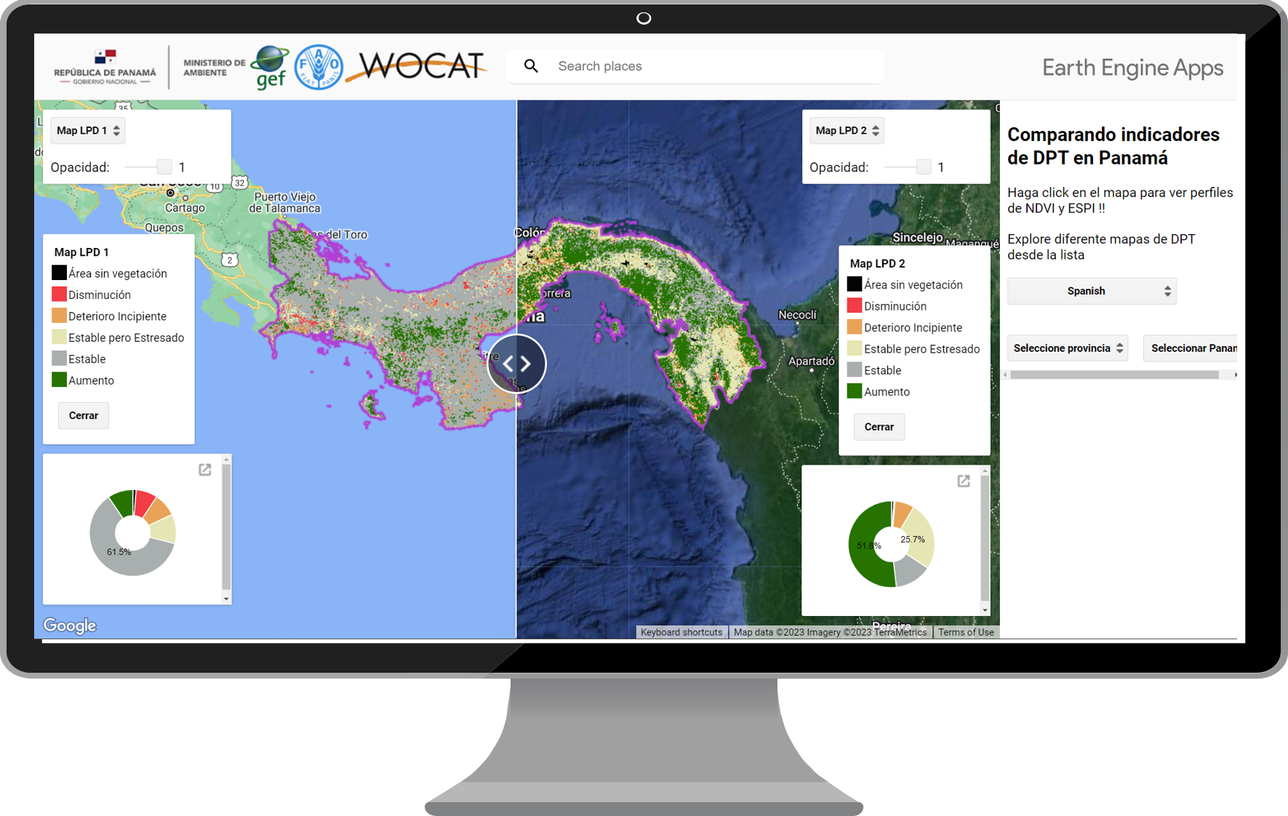
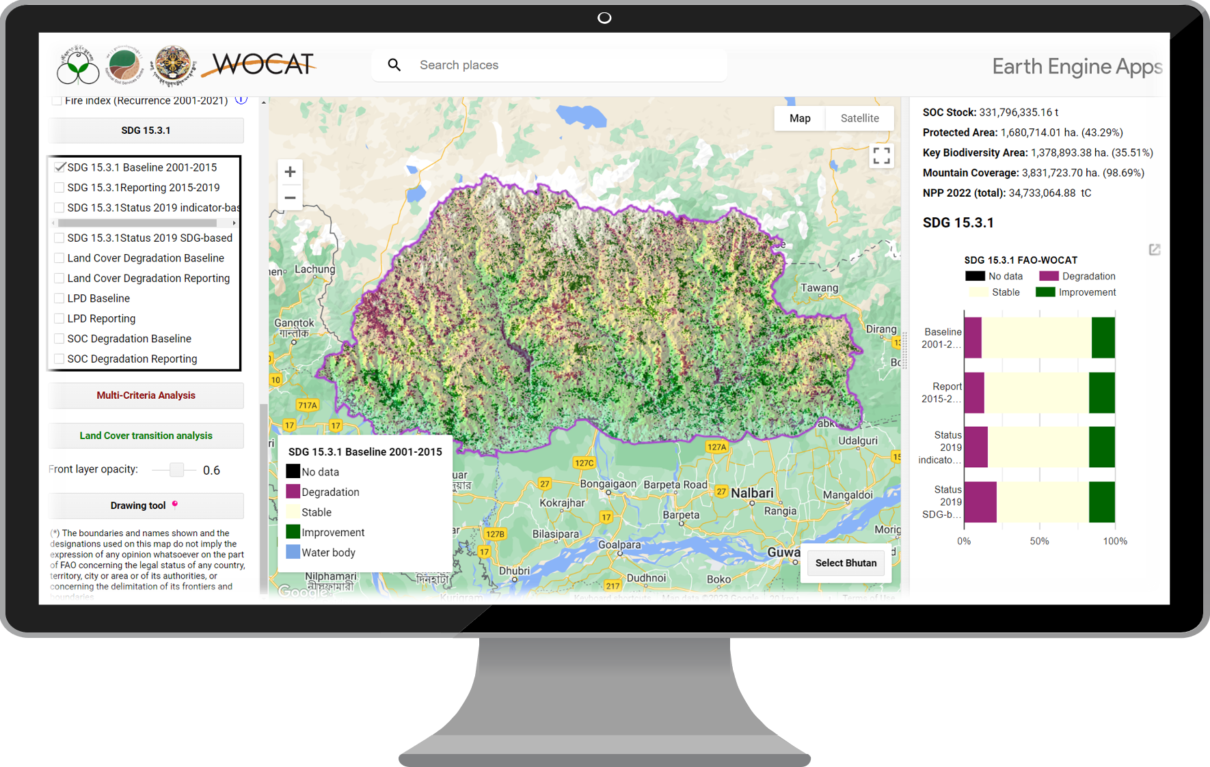
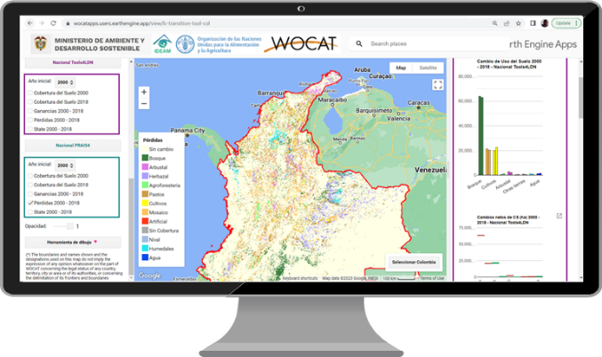
FAO WOCAT APPS FOR CONVERGENCE OF EVIDENCE
https://www.wocat.net/en/ldn/wocatapps/
LAND COVER TRANSITION ANALYSIS TOOLS
LPD COMPARISON TOOLS
(LDN) DSS
To compare alternative land cover datasets and re-categorizations as well as alternative land cover transition matrices.
To compare alternative land cover datasets and re-categorizations as well as alternative land cover transition matrices.
Used as LDN Decision Support Systems (LDN DSS) by different countries, are spatially explicit interactive tools that include datasets of each SDG Indicator 15.3.1 sub-indicator, as well as the final land degradation maps

Slide 31
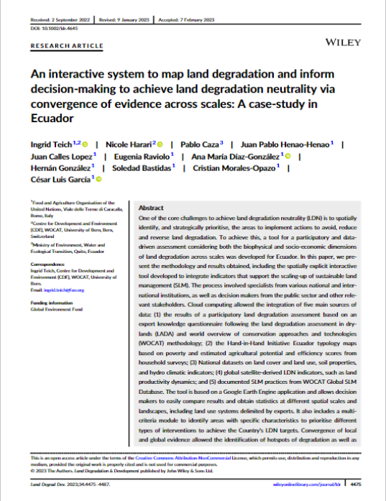
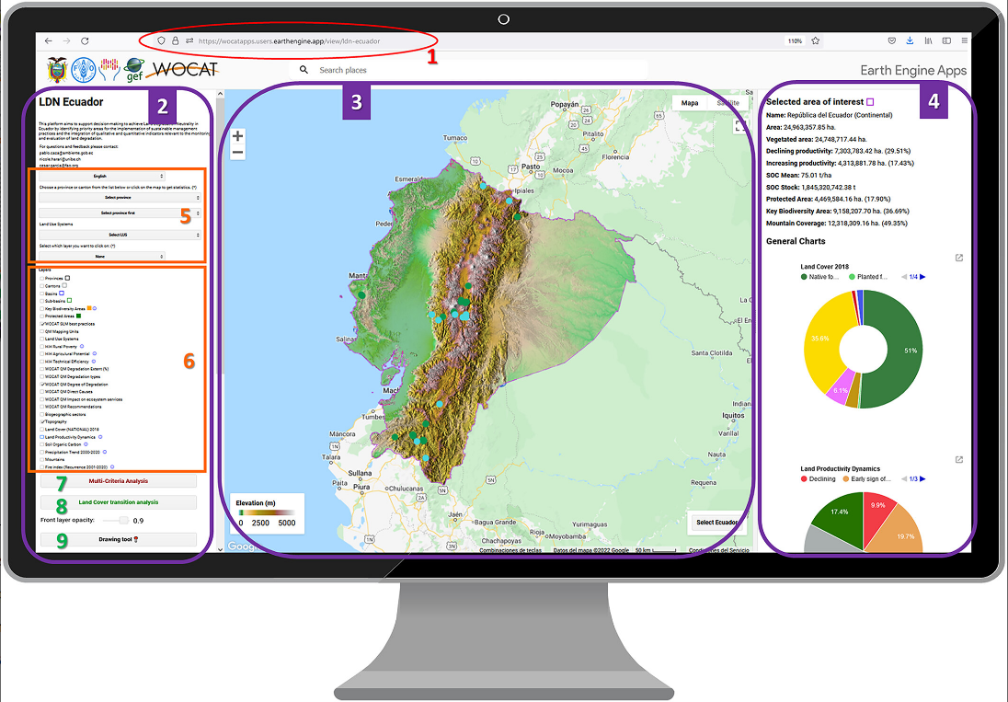
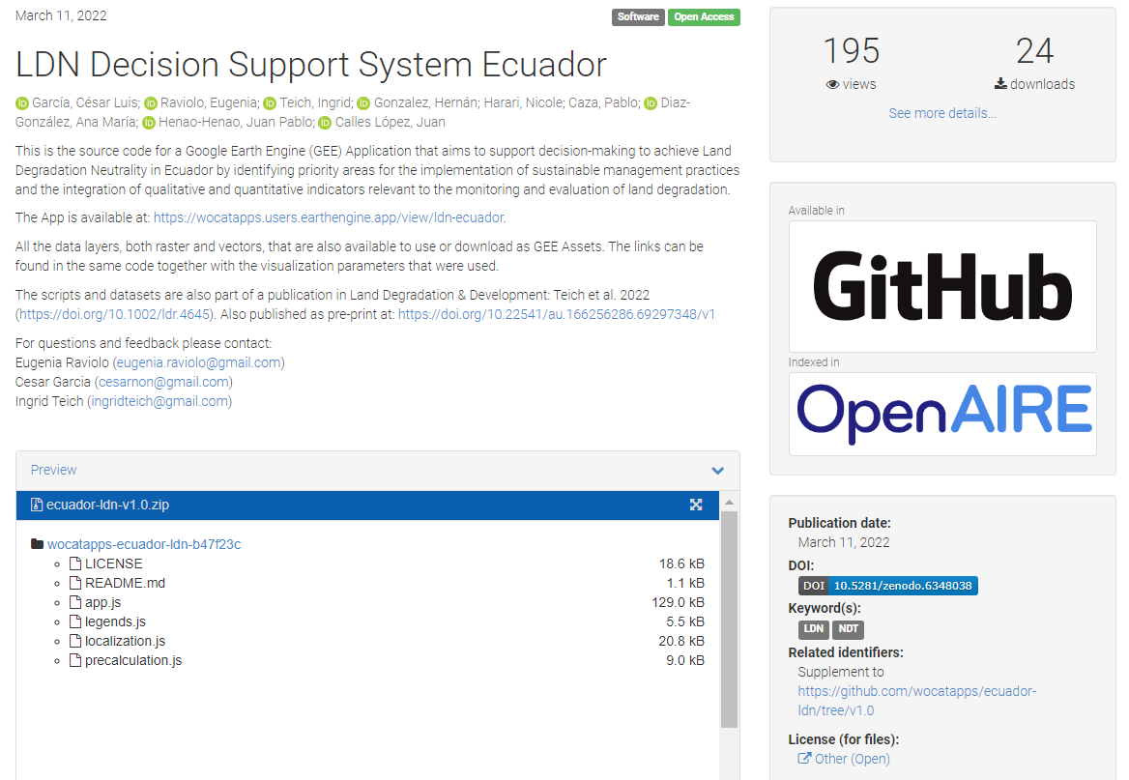
FAO WOCAT APPS FOR CONVERGENCE OF EVIDENCE
https://doi.org/10.1002/ldr.4645
https://doi.org/10.5281/zenodo.6348037

Slide 32
WORKING SESSION
KENYA DSS

Slide 33
01
02
WORKING SESSION
03
04
EXPLORE the APP (5 mins)
Visualize the different layers & statistics
MULTICRITERIA EXERCISE (10 mins)
LAND COVER TRANSITIONS EXERCISE (10 mins)
PARTICIPATORY MAPPING EXERCISE (10 mins)

Slide 34
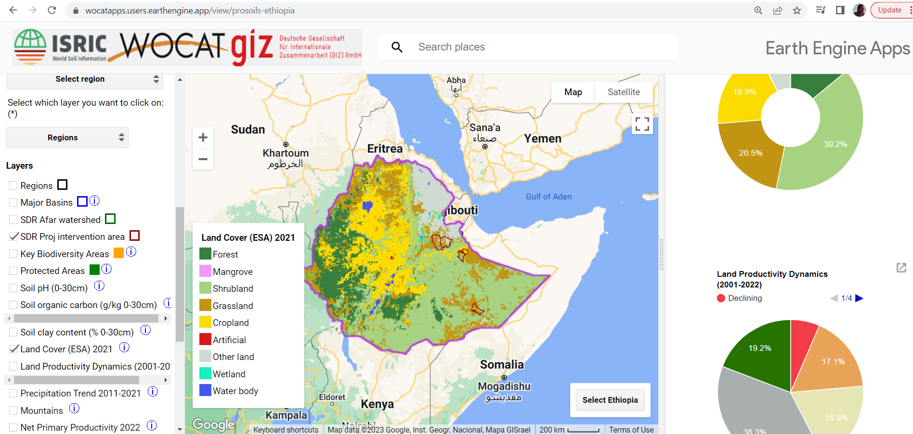
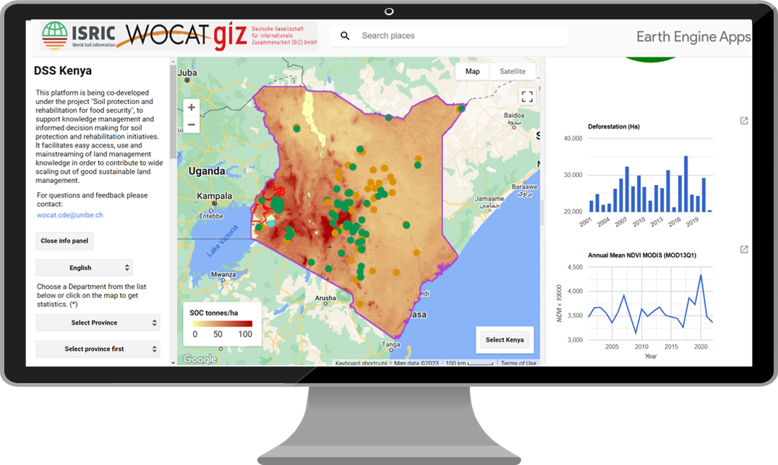
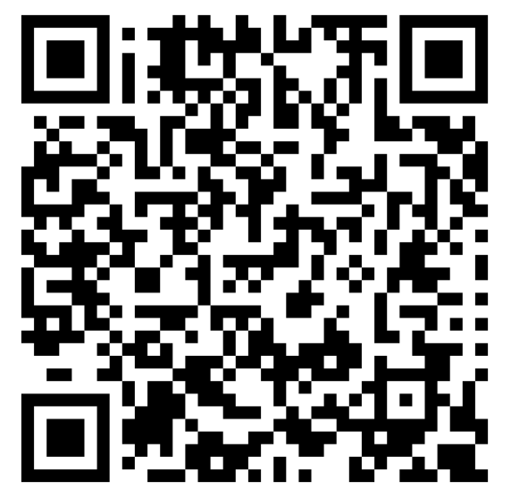
01
EXPLORE THE APP
https://wocatapps.users.earthengine.app/view/prosoils-ethiopia
https://wocatapps.users.earthengine.app/view/dss-kenya
Please use one link and take some minutes to explore the app, you can:
Choose different study areas
Visualize different layers (left panel)
Check the statistics (right panel)

Slide 35
MULTICRITERIA EXERCISE
02
How many hectares of forests that are part of KEY BIODIVERSITY AREAS but are NOT in protected areas have declining productivity or with early signs of decline ? What would you recommend to do with these areas?
What is the land cover in Kilifi county (Kenya) that has the highest average SOC/ha? How many ha does this land cover have in Kilifi county? Which proportion of this land cover has declining or early signs of decline of productivity?
Please think of 1 or 2 combinations of criteria that would be important or useful for you/your sector

Slide 36
LAND COVER TRANSITIONS EXERCISE
03
EASY
MEDIUM
Which percentage of land area was degraded due to land cover change between 1995 and 2020?
How many ha of forests were converted to croplands between 2000 and 2020?
in Kenya?
ONLY FOR THE BRAVE ONES
and in Wajir County?
If you have any questions, please ask!

Slide 37
PARTICIPATORY MAPPING EXERCISE
04
If you were working for a project on Sustainable Rangeland Management and have to select 1 SUB COUNTY for the implementation of SRM practices, which one would you choose? Why?
If you would have to prioritize two counties to AVOID FOREST degradation, which ones would you choose? Why?
Please identify a hotspot of degradation and draw a polygon. Download it and visualize it in Google Maps.
If you have a GIS covert it to a shapefile and visualize it in the DSS
If not, you can use this ID: users/ingridteich/Urbanexp

Slide 38
Time for feedback
Please share your experience using the DSS
THANK YOU!

