Slide 1
WOCAT – a global network on SLM
LDN ToolBox Training: WOCAT database
06 October 2023
Ingrid Teich, Senior Research Scientist, Centre for Development and Environment, University of Bern, Switzerland
Photo: Taamallah Houcine

Slide 2
Do you know WOCAT?

Slide 3
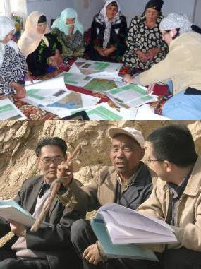
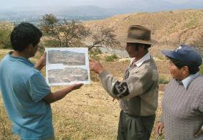
Introduction WOCAT
WOCAT – World Overview of Conservation Approaches and Technologies
Founded: 1992
...a global network of specialists working in the field of sustainable land management (SLM)
...a framework for knowledge management and decision support for SLM

Slide 4
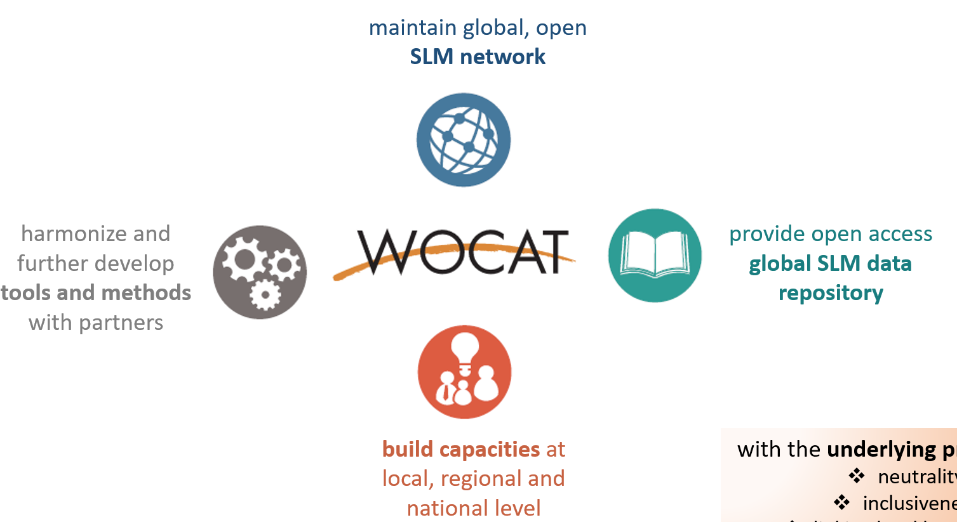
Introduction WOCAT
WOCAT's mission is to support innovation and decision-making in SLM:
Over the past 30 years, WOCAT and its partners have developed a set of standardized tools and methods for SLM knowledge management and decision support. These are now used in over 50 countries around the globe.

Slide 5
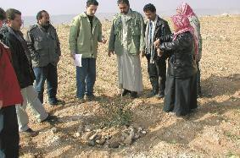
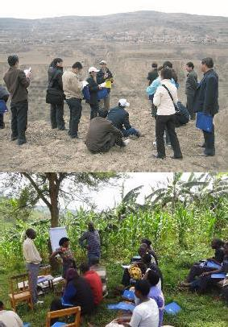
Target groups
SLM specialists at the field level, including technical staff, extension workers, agricultural advisors and project implementers.
SLM specialists at the (sub)national level, including planners, project designers, policy makers and researchers.
SLM specialists at the regional and global level, including international programme planners and donors.
Target beneficiaries and ultimate beneficiaries:
Land users and the public benefit from more
secure ecosystem services.

Slide 6
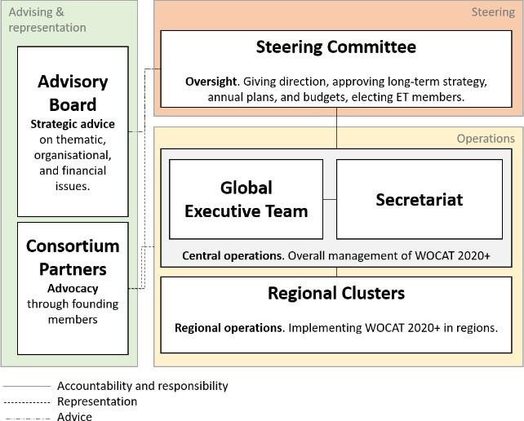
WOCAT Network
Founded in 1992
New format in 2014
New WOCAT 2020+ initiative
With 7 consortium partners
2023 new MDBF
WOCAT 2020+ is a network of organizations and individuals interested in advancing sustainable land management, with relevant expertise and accepting the vision, mission, overall goal and objectives of WOCAT2020+.

Slide 7
WOCAT & UNCCD
2014: UNCCD selects WOCAT as the primary recommended database for SLM best practices and adaptation measures. Agreement between UNCCD and WOCAT signed. Data previously reported through the PRAIS were transferred to the WOCAT SLM Database.
2019: UNCCD Decision19/COP.14:
2020: UNCCD-WOCAT Partnership extended to boost the uptake of SLM practices around
the world through a strengthened global partnership.
2022: Decision 9/COP.15 - Collaboration with the Global Environment Facility
Decision 11/COP.15 - Improving the procedures for communication of information as well as the quality and formats of reports to be submitted to the Conference of the Parties
Decision 19/COP.15 - Interfacing science and policy: The Science-Policy Interface, the dissemination and accessibility of best practices, and the UNCCD Knowledge Hub
Decision 20/COP.15 - Policy-oriented recommendations resulting from the cooperation with other intergovernmental scientific panels and bodies
Decision 24/COP.15 - Follow-up on policy frameworks and thematic issues: Gender

Slide 8
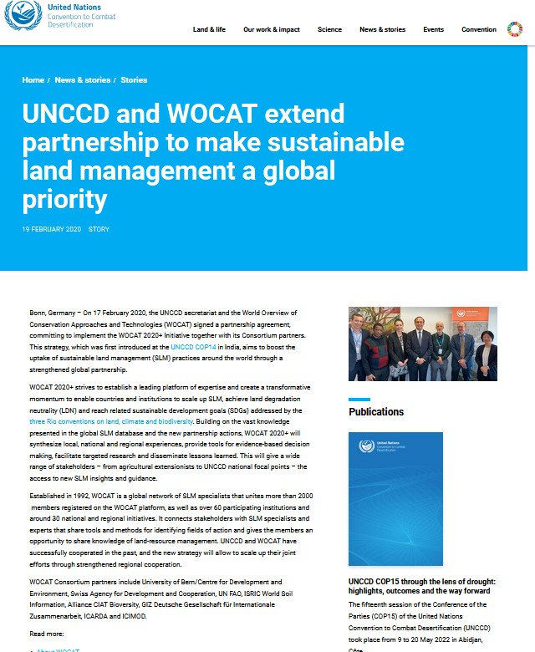
UNCCD-WOCAT collaboration
Areas of collaboration:
SLM best practices / UNCCD reporting
Land Degradation Neutrality
UN Decade on Ecosystem Restoration
work across 3 UN Conventions
Great Green Wall Initiative
G20 Global Land Initiative
Joint projects:
Gender-responsive SLM
Economics of SLM (with GM, GIZ/ELD)
Sand and Dust Storms and Drought
Tenure-LDN nexus (with FAO)

Slide 9
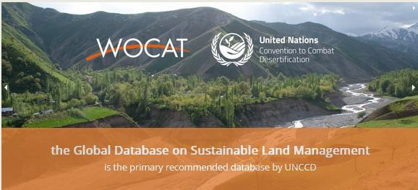
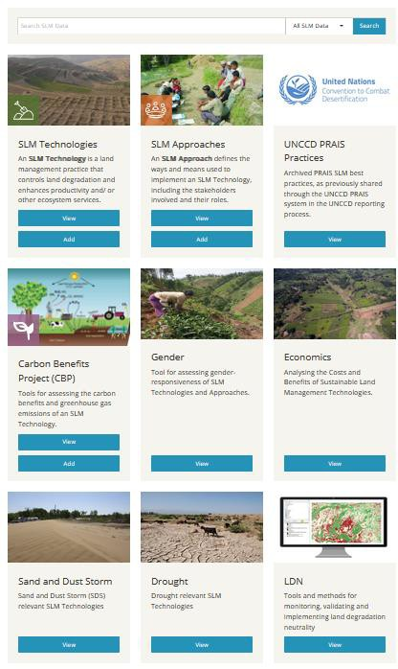
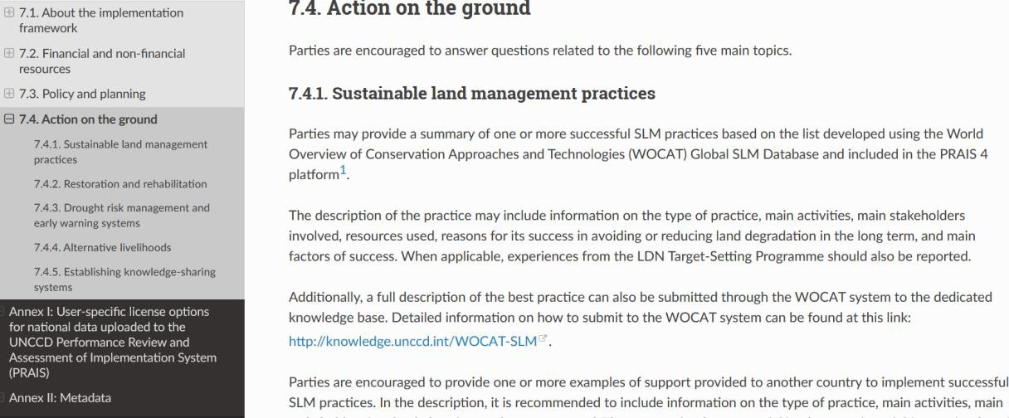
UNCCD Reporting process
https://qcat.wocat.net
UNCCD parties and other reporting agencies are encouraged to enter and share SLM best practices in the WOCAT SLM Database, and report in PRAIS under “Implementation Framework”/”Actions on the ground” (see 7.4.1 of the reporting manual)

Slide 10
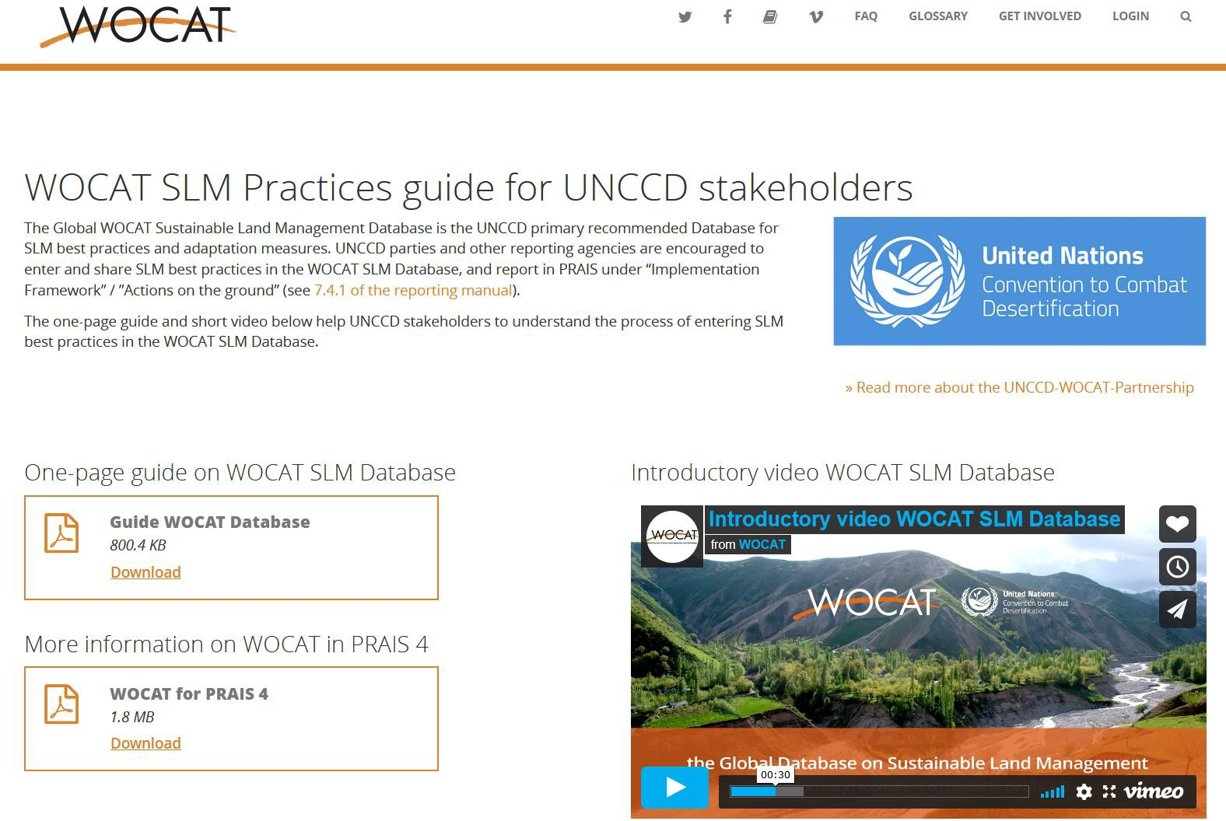
UNCCD Reporting process
Guidelines
Short video
https://www.wocat.net/library/media/60/

Slide 11
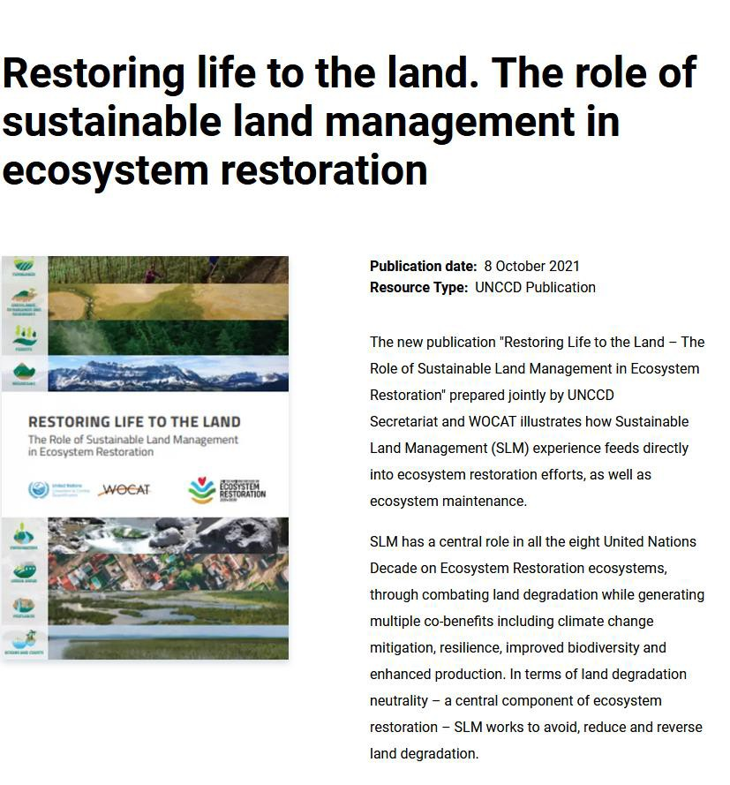
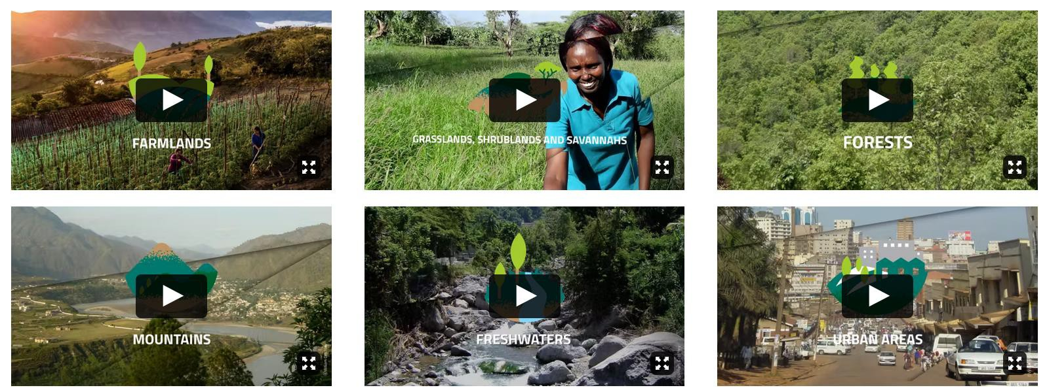
UNCCD-WOCAT collaboration
UN Decade on Ecosystem Restoration
Publication promoted at Decade launch
Short videos on SLM solutions for different ecosystems shared on UNCCD social media / WOCAT website

Slide 12
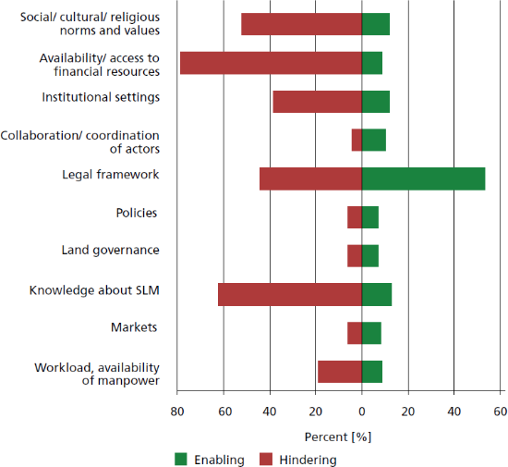
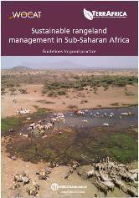
Promoting / hindering SLM?
What are the main conditions that hinder the implementation of SLM technologies?
?
Favorable (green) and unfavorable (red) conditions for the implementation of applied technologies in an approach, as percentage of the 233 approaches in the global WOCAT database. Multiple responses are possible.
Guidelines for rangeland management, Liniger et. al 2022
a

Slide 13
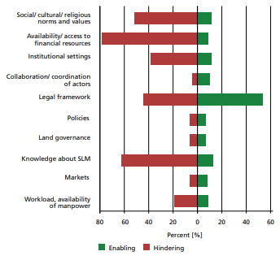
Promoting / hindering SLM?
What are the main conditions that hinder the implementation of SLM technologies?
Favorable (green) and unfavorable (red) conditions for the implementation of applied technologies in an approach, as a percentage of the 233 approaches in the global WOCAT database. Multiple responses are possible.
Guidelines for rangeland management, Liniger et. al 2022

Slide 14
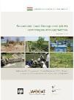
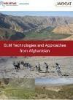
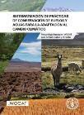
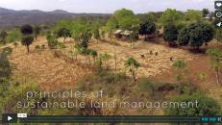
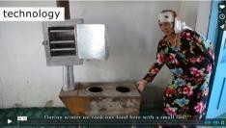
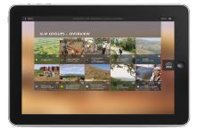
Solid and easily accessible WOCAT knowledge products
WOCAT and its partners have produced...
... a global online database of SLM technologies, SLM approaches and SLM mapping
... books, fact sheets and brochures at global, regional and national levels: summary books, practice inventories books, practice inventories, guidelines for different users in different formats
... videos on SLM: a voice for land users implementing SLM in their fields
... tablet application:
promotion and education

Slide 15
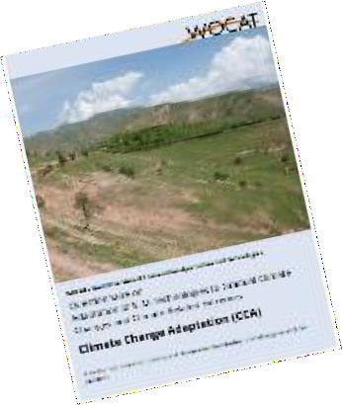
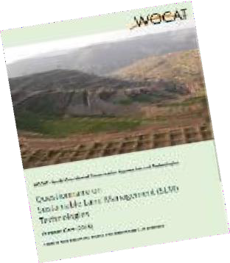
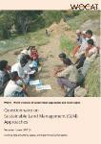
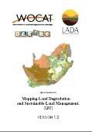
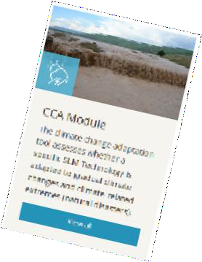
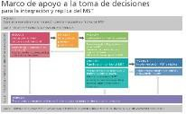
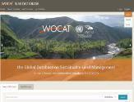
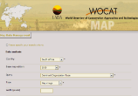
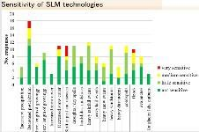
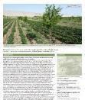
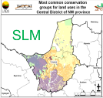
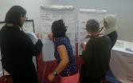
WOCAT tools and methods
documentation, evaluation and dissemination of good practice
global issues (climate change)
help with decision support
scaling up & adoption of SLM
spatial assessment

Slide 16
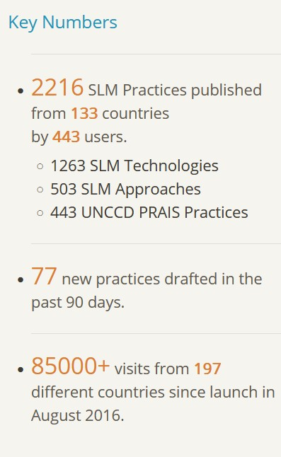
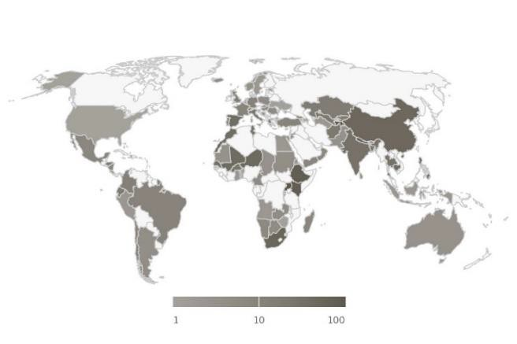
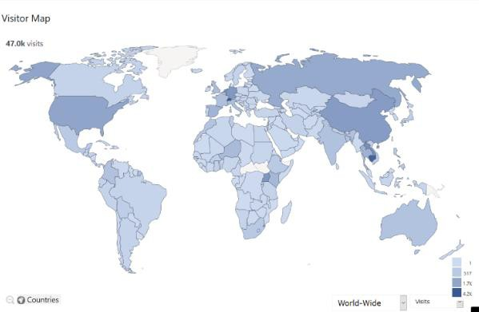
WOCAT Global SLM Database
Main features of the WOCAT Global SLM Database:
free upload and worldwide sharing of countries’ good SLM practices in English, Spanish, French, Portuguese, Russian and Chinese
free access to 2000+ proven, field-tested SLM practices from over 130 countries
database filter to find relevant SLM practices for specific landscapes, land uses etc.
possibility to integrate national SLM good practices in national/project/global platforms through API
https://qcat.wocat.net
SLM good practices in Database
Database Visitors

Slide 17
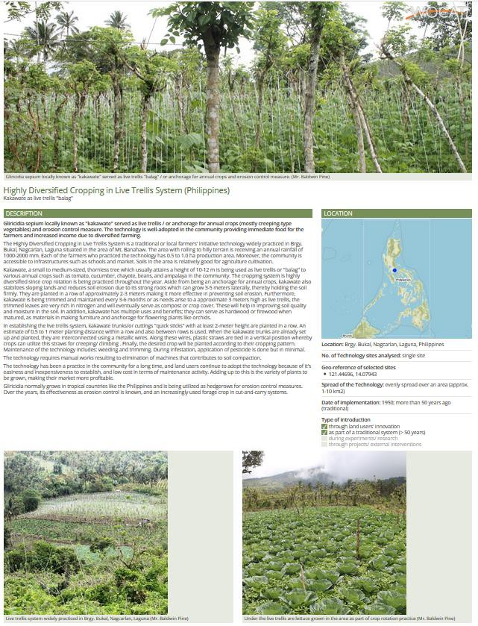
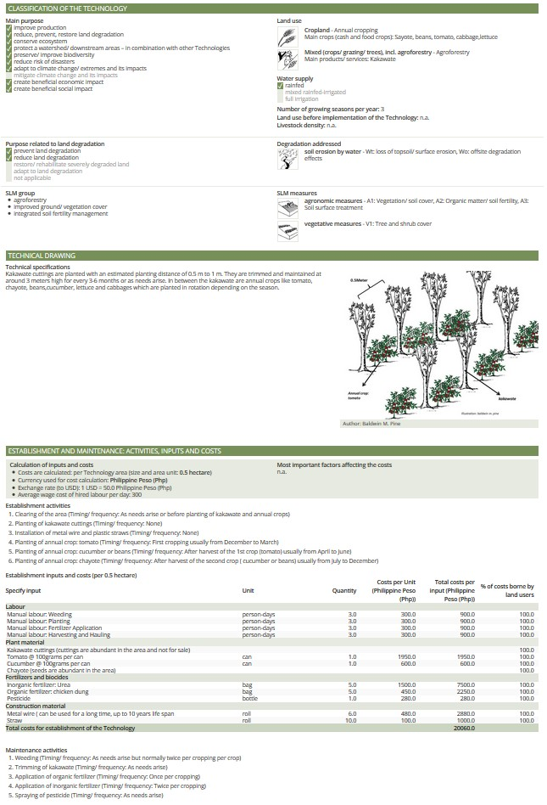
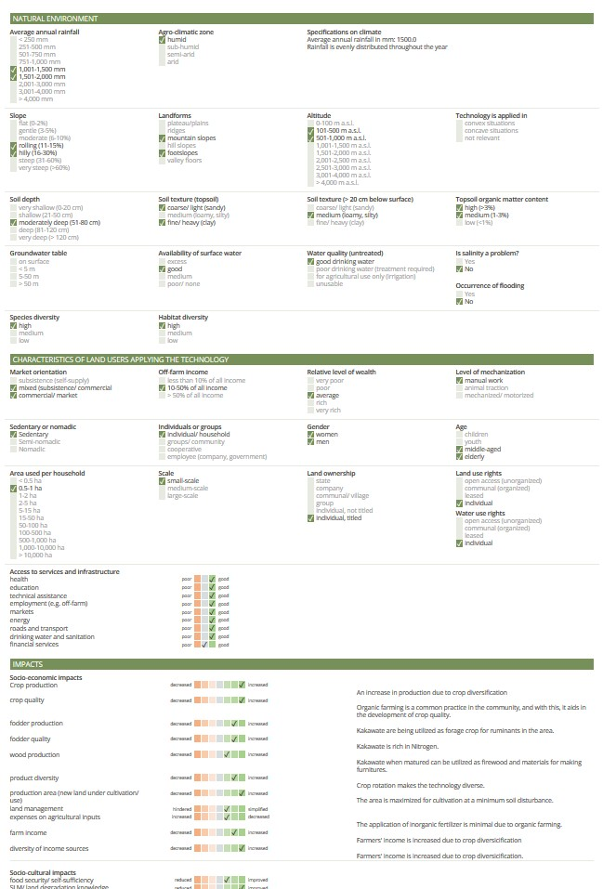
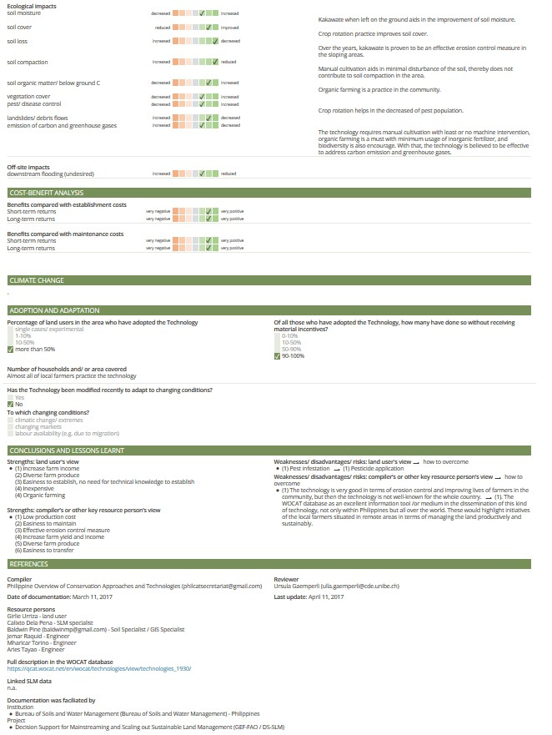
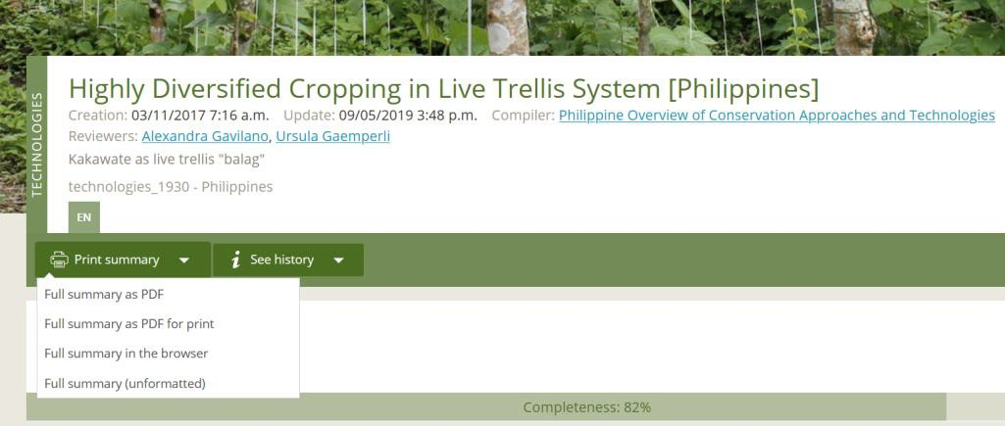
SLM Technology / Approach Summary
automatically generated
in all (available) languages
used for good practices compilations; learning materials for e.g. extension services; knowledge products, etc.
Where?
Impacts? Benefits?
What?
How?
Technical specificati Costs?
ons?

Slide 18
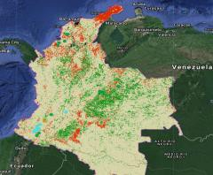
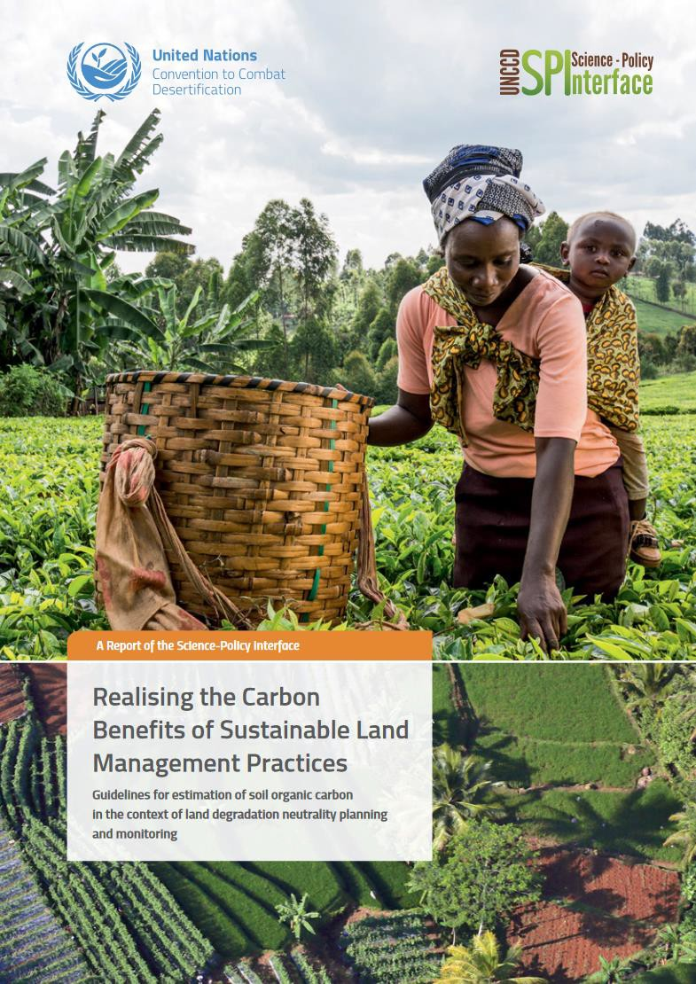
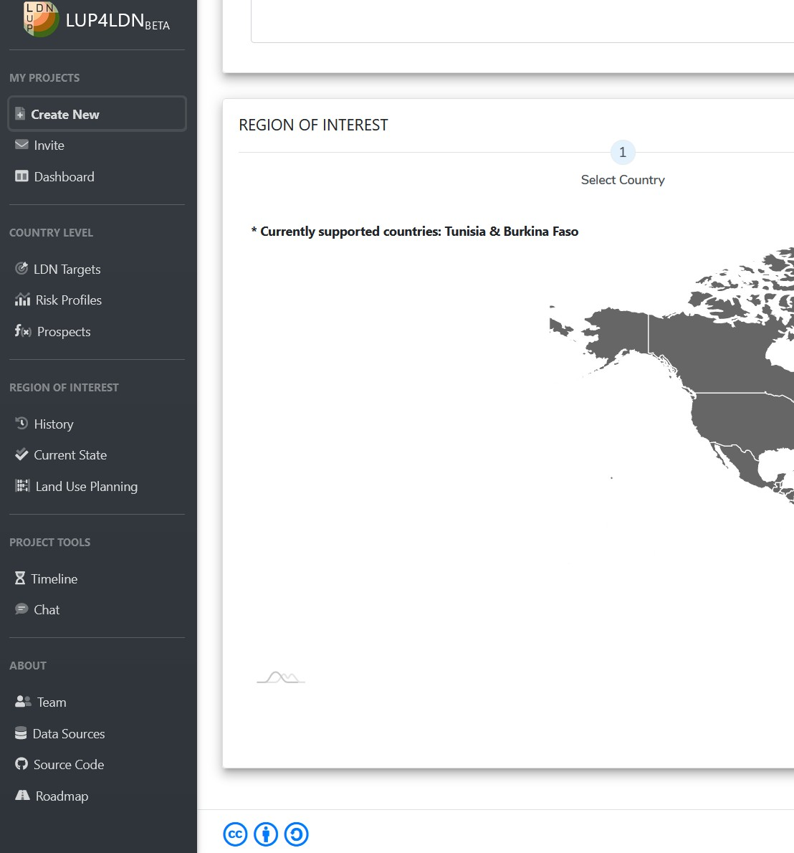
Global WOCAT SLM Database:
Linked tools, applications and databases

Slide 19
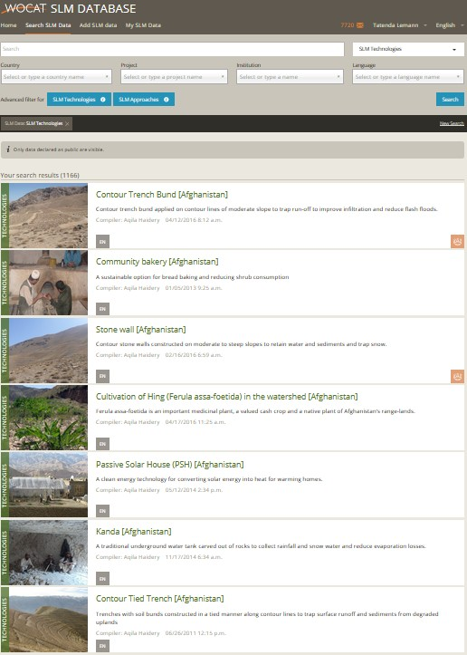
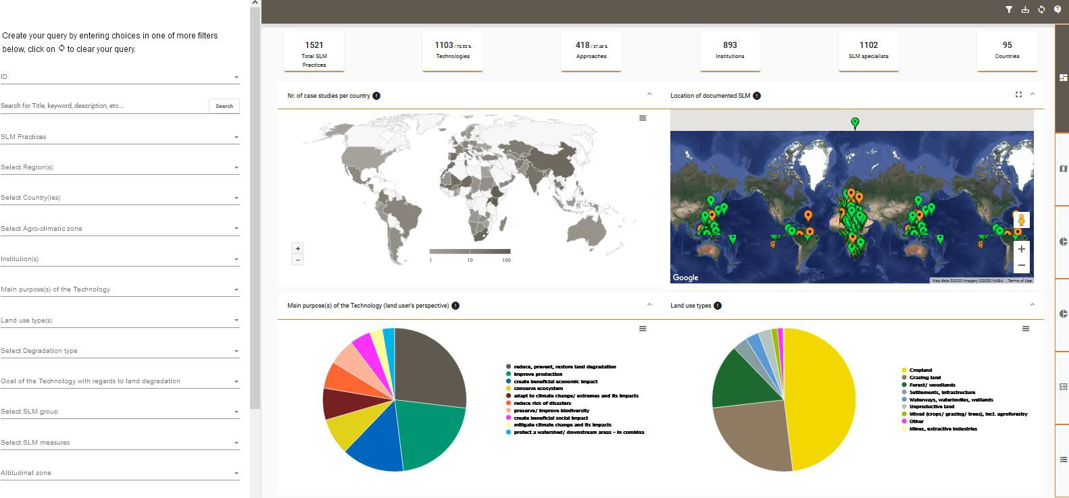
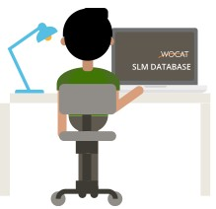
WOCAT Global SLM Database
Available through API

Slide 20
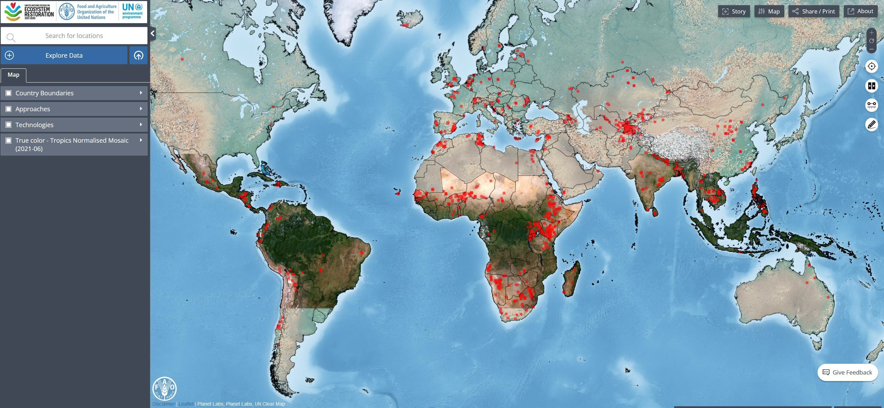
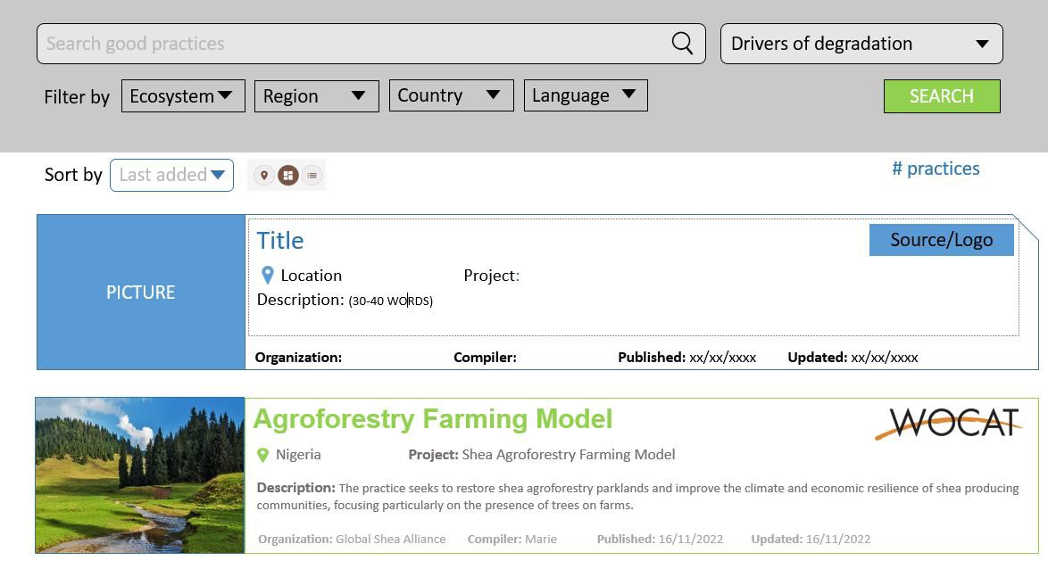
Information shared through WOCAT is also included in other platforms:
Framework for Ecosystem Restoration Monitoring (FERM)

Slide 21
Information shared through WOCAT is also included in other platforms:
Water Harvesting Explorer

Slide 22
SLM Technology
WOCAT definition:
"agronomic, vegetative, structural and/or management measures that prevent and control land degradation and improve productivity on the ground"
27

Slide 23
SLM Technology
agroforestry
shelterbelts
multi-storey
cropping
grass strips
stone wall terraces
infiltration ditches
M. Zöbisch
F. Turkelboom
L. Meng
A. Mercado
HP. Liniger
HP. Liniger
HP. Liniger
J. Rondal
forest protection
no-till technology
FMNR (Farmer Managed Natural Regeneration)
cut and carry
area closure
composting
D. Danano
D. Danano
W. Critchley
W. Critchley

Slide 24
SLM Approach
WOCAT Definition:
“support resources that contribute to the introduction, implementation, adaptation and application of SLM technologies on the ground; provide an enabling environment”
29

Slide 25
SLM Approaches
soil management initiative
Productive Development and food security
zabré women’s
agroecological programme
promote innovation by farmers
applied research and knowledge transfer
pr
Ait Lhaj A.
FMNR implementation approach
M. Gurtner
R. Chatelain
W. Critcheley
D. Gandhi ₃₀
SOWAP
transition from a centralised to local initiative
comprehensive development of watersheds
integrated development of rural communities
farmers' initiative in a favourable environment
N. Güdel
M. Gurtner
P. Niederer
Photo: Thomas Kalyta

Slide 26
Associated modules
https://explorer.wocat.net/

Slide 27
Climate Change Adaptation Module
to assess whether SLM Technologies are or can be further adapted to gradual climate changes and climate- related extremes.
focuses on individual SLM Technologies and not on areas or landscapes.

Slide 28
Gender
add gender lens to SLM Technologies and Approaches and assess their gender- responsiveness
evaluate how gender responsiveness of SLM can be improved, stepping up adoption and dissemination, making SLM beneficial for women and men alike
Participation in high-level roundtables and side events at COP15 to promote tool and present data

Slide 29
Costs and benefits of SLM

Slide 30
Sand and Dust Storms and Drought
Screening and enhancement of WOCAT data on SDS and drought-relevant SLM practices
Linking WOCAT API with SDS
and drought toolbox
Supporting UNCCD Sec. in enhancement of filter for SDS and drought-relevant SLM practices in a co-design process

Slide 31
Exercise on the WOCAT database
https://qcat.wocat.net
https://explorer.wocat.net/

Slide 32
Exercise on the WOCAT database
https://qcat.wocat.net https://explorer.wocat.net/
How many technologies has Kenya documented?
From which countries do you find technologies and approaches that are relevant for your context?
Do you find any technologies that are relevant for land degradation neutrality?

Slide 33
QT & QA - Questionnaires

Slide 34
QT - Questionnaires
Introduction to the questionnaire
General information
Description of SLM technology
Classification of SLM technology
Technical specifications, implementation activities, inputs and costs
Natural and human environment
Impacts and conclusions
References and links

Slide 35
Who should complete the questionnaires?
A team of SLM specialists - including land users - with different backgrounds and experiences, who know the details of the technology/approach (technical, financial, socio-economic).
... using existing documents and seeking advice from other SLM specialists and
SLM specialists and land users where possible.
If you intend to fill in the questionnaire from the office, you will tend to do so based on your preconceived ideas, which are not always correct.

Slide 36
Review and quality assurance process

Slide 37
Documentation et processus de révision
Signup for a WOCAT account and login to the WOCAT SLM
Database: https://qcat.wocat.net/

Slide 38
Documentation and review process

Slide 39
Documentation and review process
https://qcat.wocat.net/en/wocat/
Optimized for Chrome and Firefox
English, French, Spanish, Russian, Lao, Khmer, Portuguese, Afrikaans, Arabic, Thai

Slide 40
Contact us!
Ingrid Teich: ingrid.teich@unibe.ch
www.wocat.net
wocat.cde@unibe.ch
<<<
@WOCATnet
@wocatnet
Photo: Hanspeter Liniger

