Slide 1
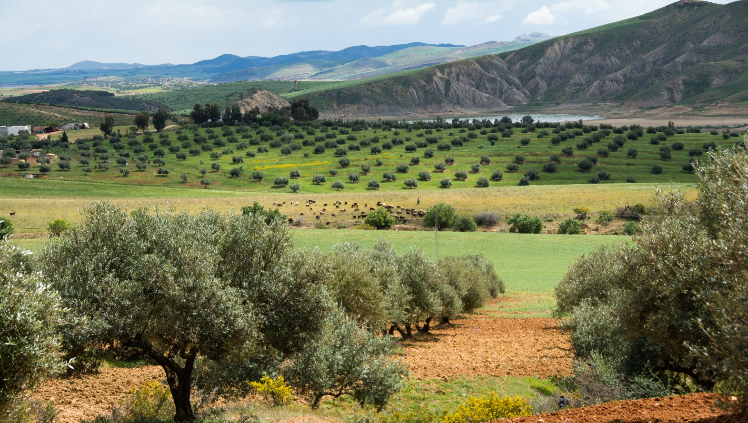



International online course on “Water Harvesting for Sustainable Crop Production under Climate Change”
Introduction Part 1
Rima Mekdaschi Studer, Hanspeter Liniger
10.6.2022
Photo: Hanspeter Liniger
Water Harvesting Lab
WHLab

Slide 2


What is WOCAT?
The World Overview of Conservation Approaches and Technologies (WOCAT) is a global Network established in 1992.
WOCAT supports the compilation, documentation, evaluation, sharing, dissemination, and application of sustainable land management (SLM) knowledge.
In 2014, WOCAT was officially recognized by the UNCCD as the primary recommended Global SLM Database for best SLM practices.
Network of organizations and individuals
Consortium Partners
Consortium Partners
Funding Partners
Funded by
https://www.wocat.net/
Notes:
Nicole

Slide 3
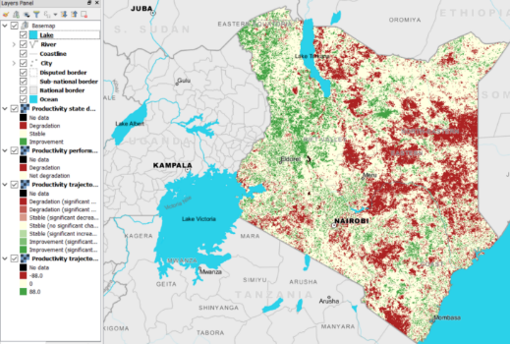
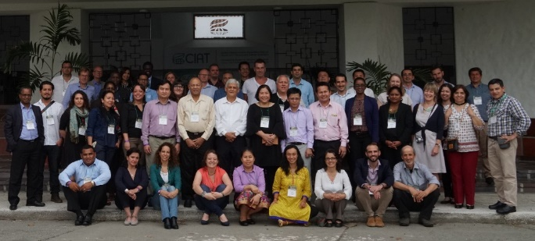
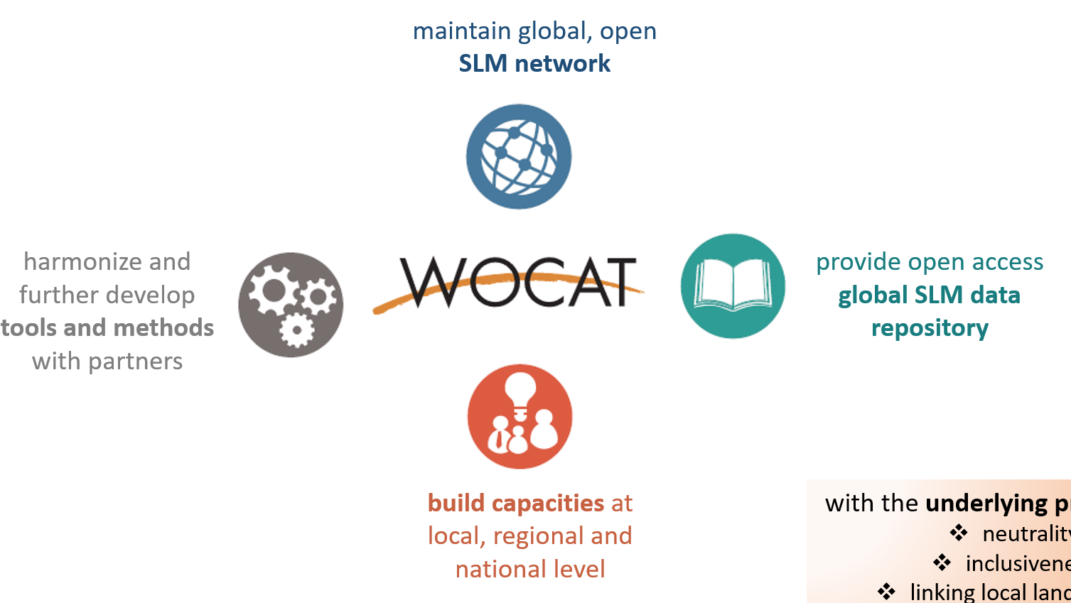

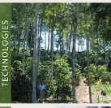


WOCAT
to support innovation and decision-making in SLM by:

Slide 4

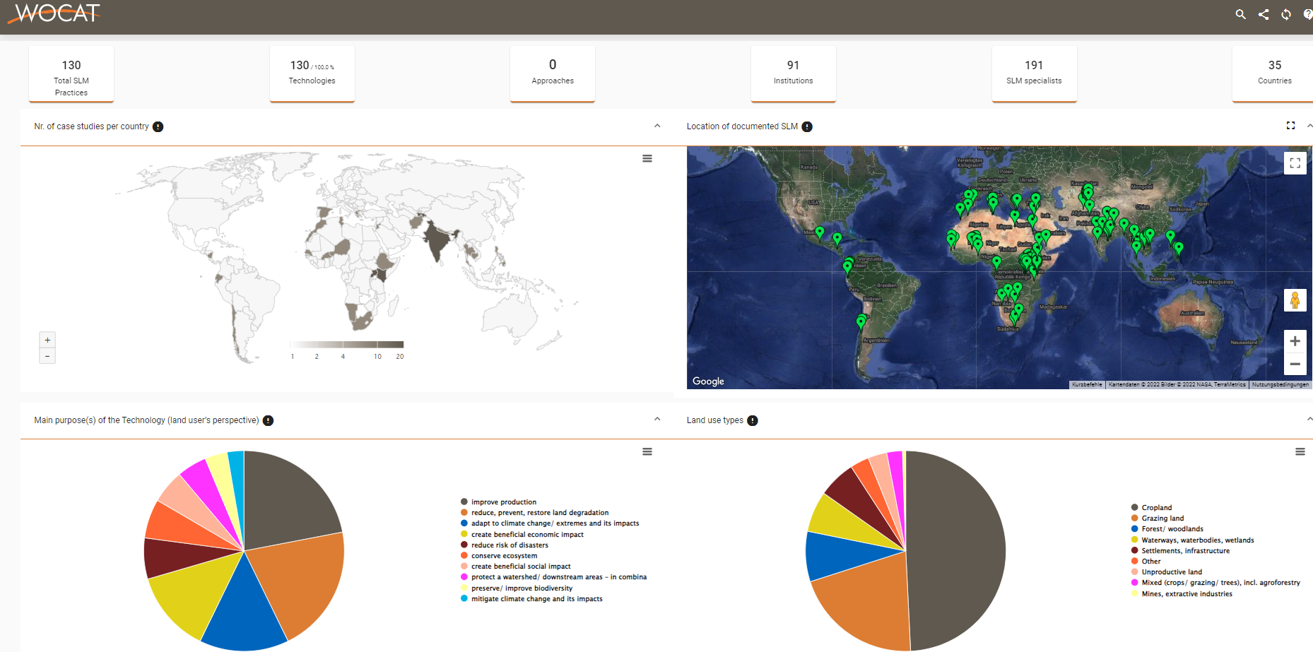
https://explorer.wocat.net/
Filter for Technology group:
Water harvesting
Information/data used for: synthesis products e.g. WH guideline
linked & integrated into other platforms & tools e.g. WH explorer

Slide 5

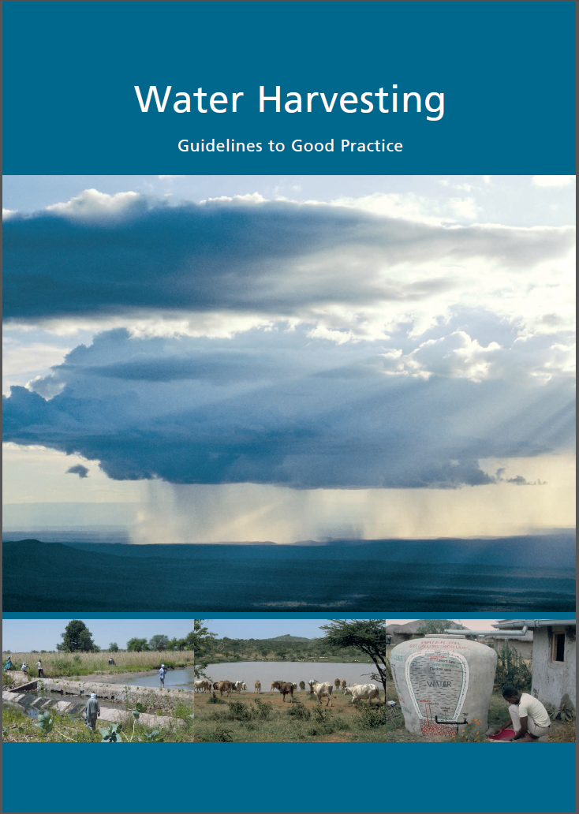




Water Harvesting (WH) –
Guidelines to Good Practice
Knowledge products
concepts behind water harvesting
harmonised classification system
overview of 4 water harvesting groups
selection of good practices (WOCAT format)
Note: the following presentation is based on the publication:
Mekdaschi Studer, R. and Liniger, H. 2013. Water Harvesting: Guidelines to Good Practice. Centre for Development and Environment (CDE), Bern; Rainwater Harvesting Implementation Network (RAIN), Amsterdam; MetaMeta, Wageningen; The International Fund for Agricultural Development (IFAD), Rome. https://www.wocat.net/library/media/25/
Also available in French: La collecte de l’eau - Directive pour de bonne practiques

Slide 6
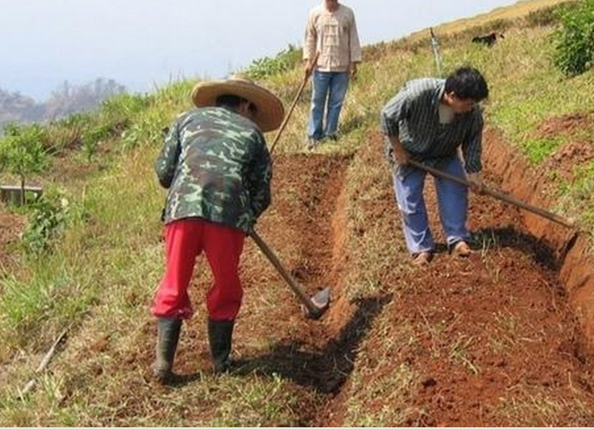
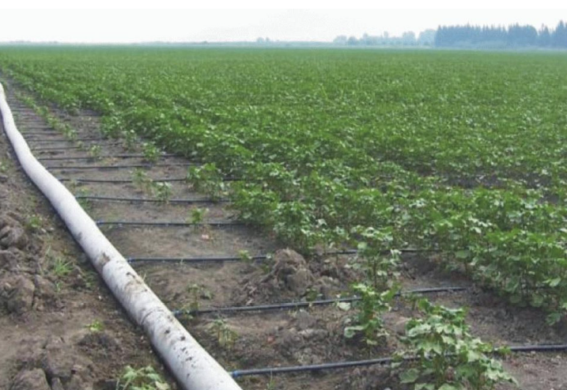
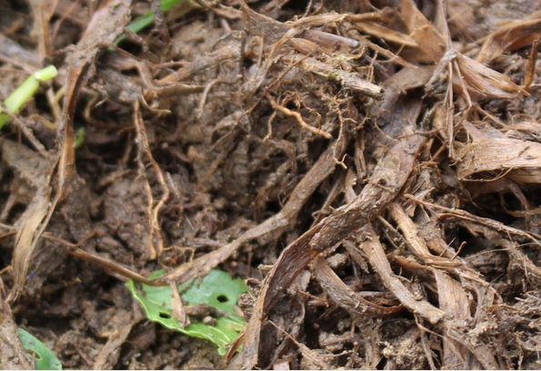
Rainfed farming: Challenges
Arid, semi-arid, sub-humid and even in humid regions:
Water for production: rainfall less than crop water requirements;
Actual yields less than the potential;
Highly variable rainfall, long dry seasons, recurrent droughts, as well as floods - exacerbated by CC;
Impact of variable rainfall strongly affected by the nature of the soil and the stage of the growing period;
Water management, water losses;
Land degradation due to soil erosion by wind and water;
Poor management of soil fertility contributes to low rainwater use efficiency.

Slide 7
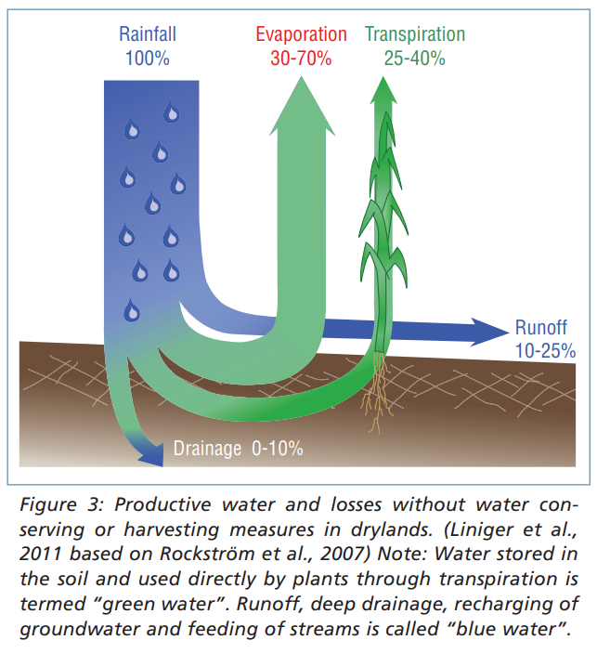
Water losses
Rainfall losses can be transformed into:
  productive “green water”:
    runoff feeds water harvesting systems that store water directly in the soil profile
    soil water directly used by transpiration for plant growth
  useful “blue water”:
    water collected in water bodies and thus made available for irrigation.
    increased groundwater availability
Source: Mekdaschi Studer, Liniger 2013

Slide 8
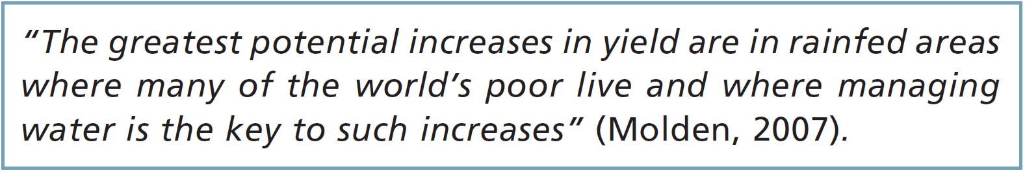
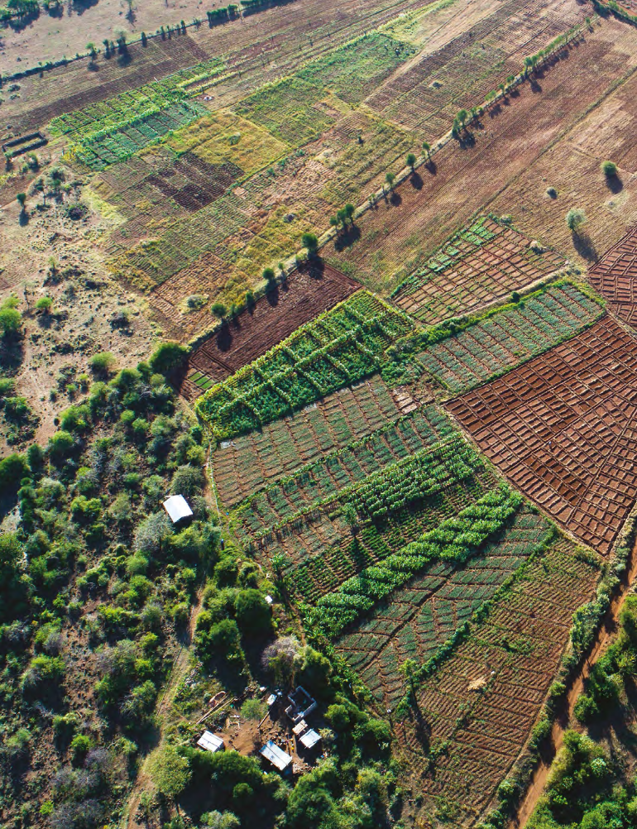
Rainwater harvesting
It is time to scale-up the ‘good practices’ of water harvesting …, after decades of almost exclusive focus on mastering fresh water flows in rivers and lakes through investments in irrigation infrastructure. Water harvesting offers under-exploited opportunities for the predominantly rainfed farming systems of the drylands in the developing world (IFAD, SDC 2013 preface WH publication)
East Africa and Southeast Asia are hotspots for water harvesting. “We estimate that the adoption of water harvesting in these cropland areas can increase crop production up to 60–100% in Uganda, Burundi, Tanzania and India” (Piemontese et al., 2020).
An increasing demand for Rainwater Harvesting in the regions of United States is expected to drive the market for more advanced Rainwater Harvesting. (Rainwater Harvesting Market Report 2020-2025). https://www.marketwatch.com/
Photo: Hanspeter Liniger
Photo: Hanspeter Liniger
Photo: Hanspeter Liniger

Slide 9
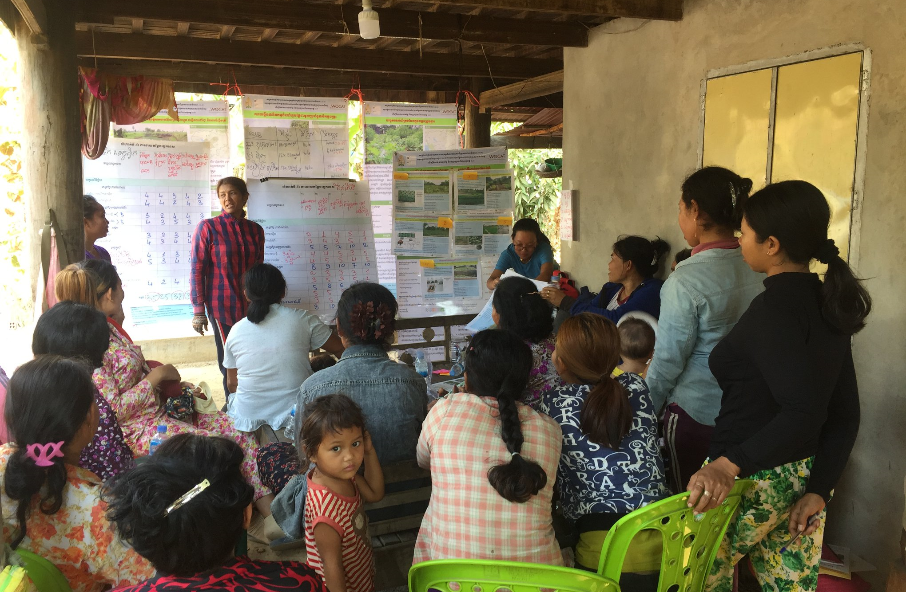
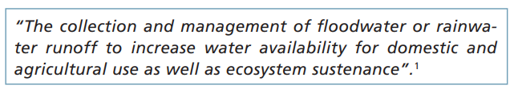
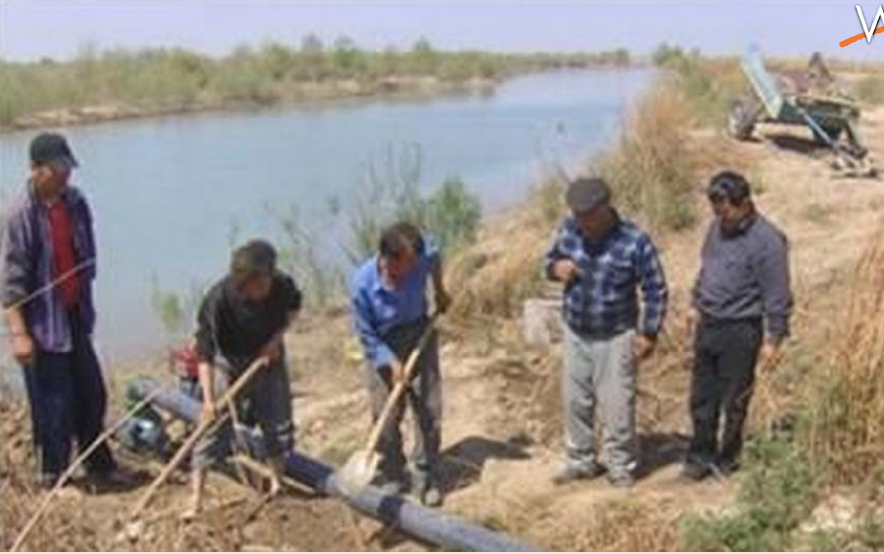
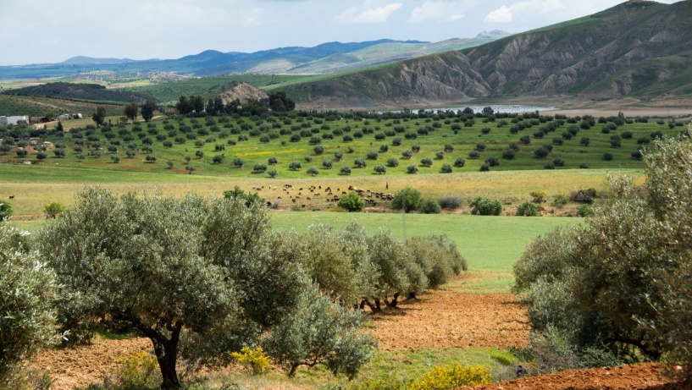
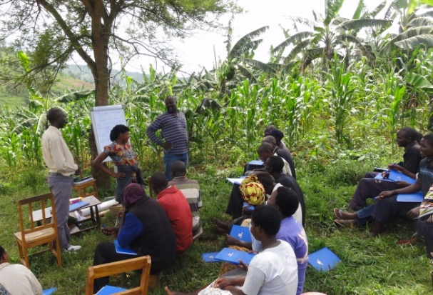
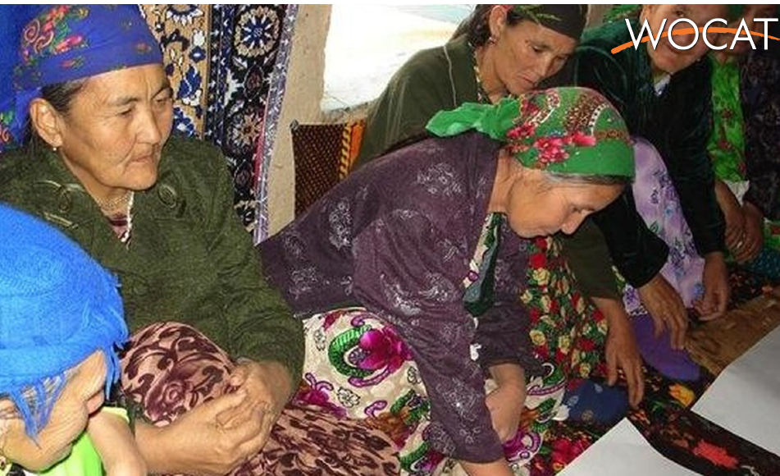
Rainwater harvesting: Definition and Aim
Aim: to collect water from areas of surplus or where it is not used, store it and make it available, where and when there is water shortage.
Increase water availability by either
impeding and trapping surface runoff, and
maximising water runoff storage or
trapping and harvesting sub-surface water
deliberately reallocating water resource within a landscape, and over time
great potential when combined with in situ water management (keep RW in place) as well as improved soil and water conservation measures
Source: Mekdaschi Studer, Liniger 2013

Slide 10
Benefits and Constraints of WH
Pros | Cons
Offers under-exploited opportunities for rainfed farming systems of the drylands | Depends on amount and variability of rainfall
Buffering water variability | Difficult to ensure sufficient quantity of water needed
Overcoming dry spells and coping with extreme events (flooding, soil erosion, siltation) | May take up productive land
Harvesting nutrients | High investment costs and labour requirements
Reducing production risks and increasing resilience | Upstream rainwater harvesting may affect downstream water availability and use
Increasing food production and security | Shared catchments and infrastructure may create rights issues (upstream-downstream, farmers and herders)
Improving access to clean and safe domestic water | Long –term institutional support may be necessary
Improving water availability for livestock
Reducing women’s work load
Possibility of growing higher-value crops
Providing alternative to full irrigation
Source: Mekdaschi Studer, Liniger 2013

Slide 11
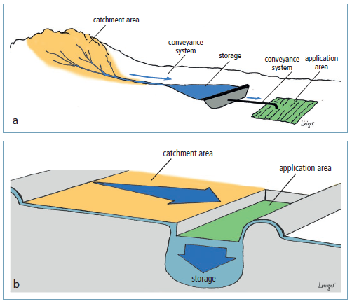
Principles of WH
  capture precipitation falling in one area and transfer it to another, thereby increasing the amount of water available in the latter
  capture potentially damaging rainfall/ runoff and translate it into plant growth or water supply
  composed of:
    catchment or collection area: high runoff coefficients (e.g. clay or shallow soils, compacted soils, roads)
    conveyance system
    storage component
    application area or target: e.g. deep soils with high water infiltration and storage capacity
  catchment to application area ratio (C:A): degree of concentration of rainfall / runoff
Source: Mekdaschi Studer, Liniger 2013

Slide 12
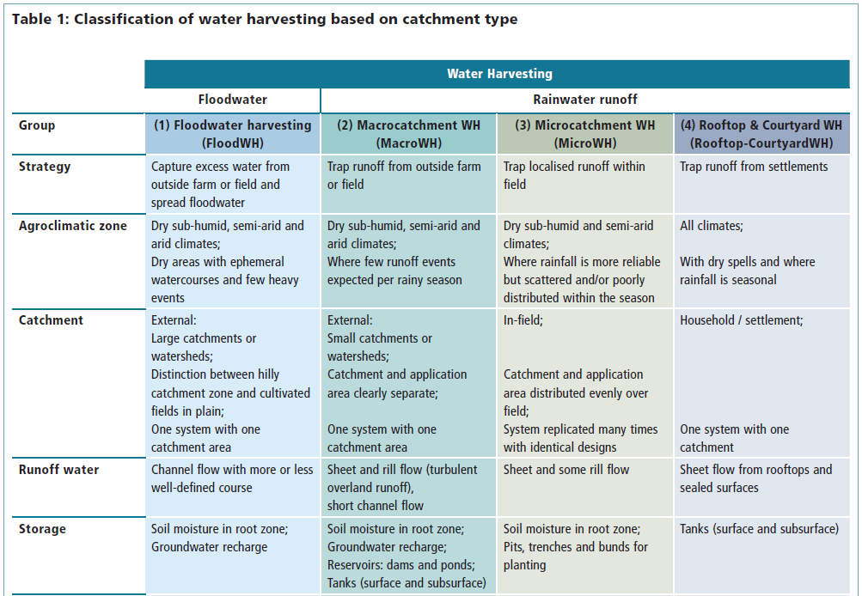
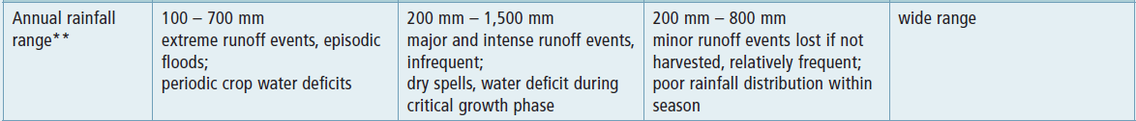
Classification and categorisation
The two most frequently used criteria are catchment type and size, and the method of water storage
Source: Mekdaschi Studer, Liniger 2013

Slide 13
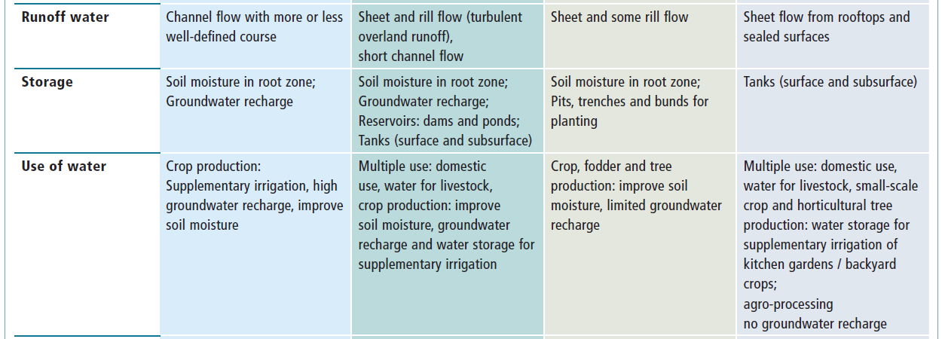
Classification and categorisation
Source: Mekdaschi Studer, Liniger 2013

Slide 14
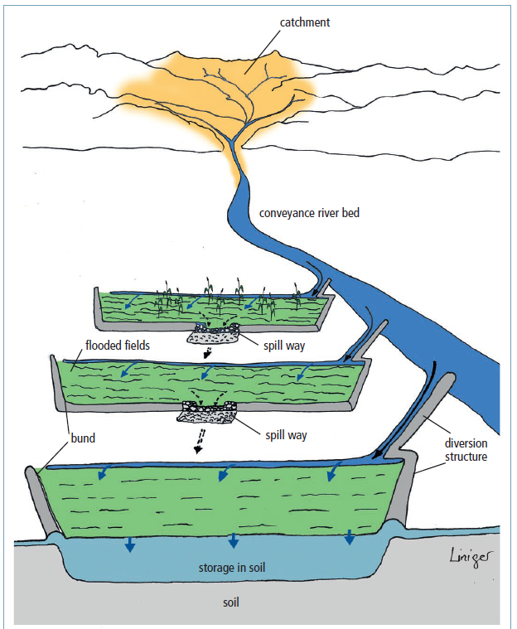
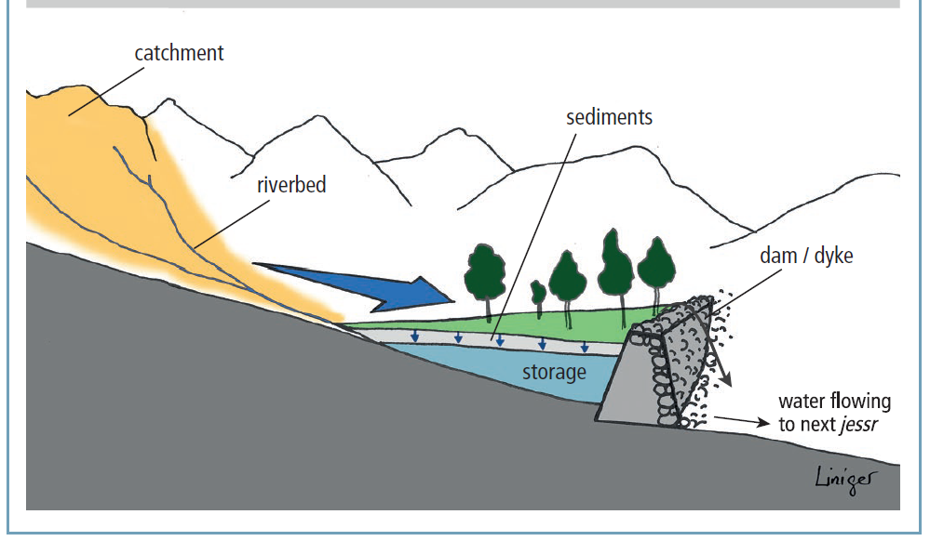
Floodwater harvesting
Floodwater diversion / off-streambed system
channel water either floods over the river/ channel bank
onto adjacent plains -wild flooding
or is forced to leave
its natural course and conveyed to nearby fields
spate irrigation
Floodwater harvesting within streambed
water flow is dammed and as a result, is ponded within the streambed. The water is forced to infiltrate and the accumulated soil water is used for agriculture
Source: Mekdaschi Studer, Liniger 2013

Slide 15
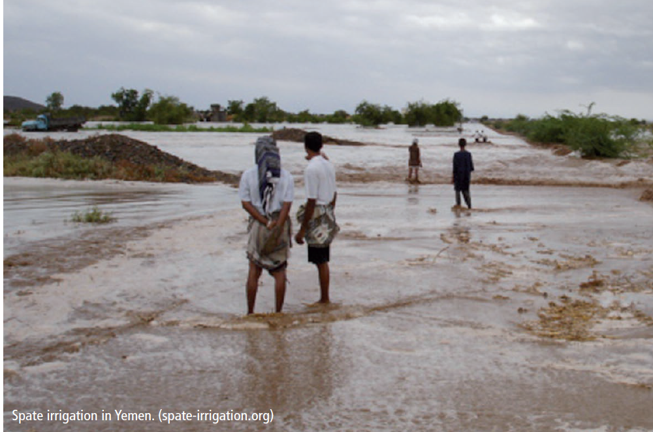
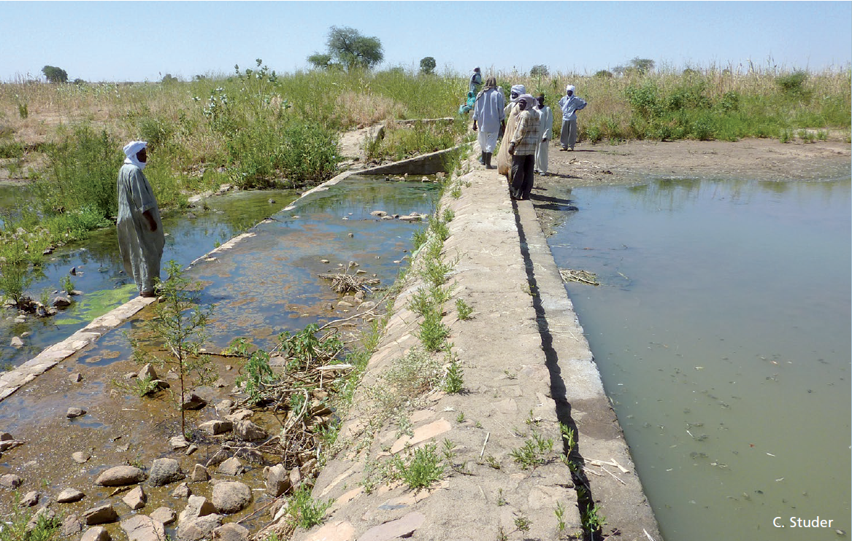
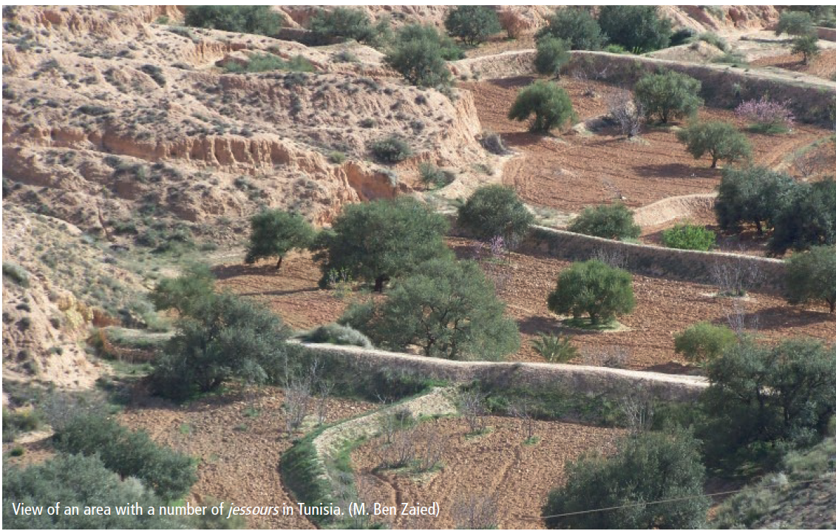
Floodwater harvesting
Principles (see also Table 1)
Floodwater captured from outside farm or field, large watersheds (no control over catchment area)
Water/ runoff stored in soil or groundwater
One system with one catchment area (large distant catchment)
Distinction between hilly catchment zone and cultivated fields in plain
Catchment: application area ratio 100:1 – 10,000:1
Often ‘self-fertilizing’ through sediment build-up
(Traditional) engineering skills needed
Integrated watershed management (local authority & large communities)
Defined water use rules
Practices
Flood recession farming, spate irrigation, water spreading weirs/ bunds, ‘warping’ dams, jessour, tabia and rock dams
Source: Mekdaschi Studer, Liniger 2013

Slide 16
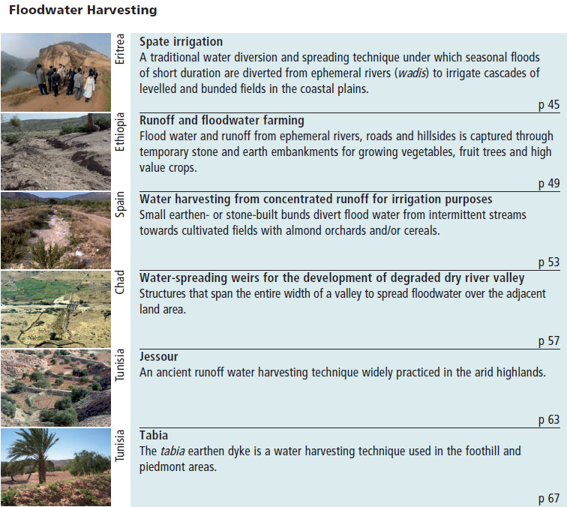
Case studies floodwater
Source: Mekdaschi Studer, Liniger 2013

Slide 17
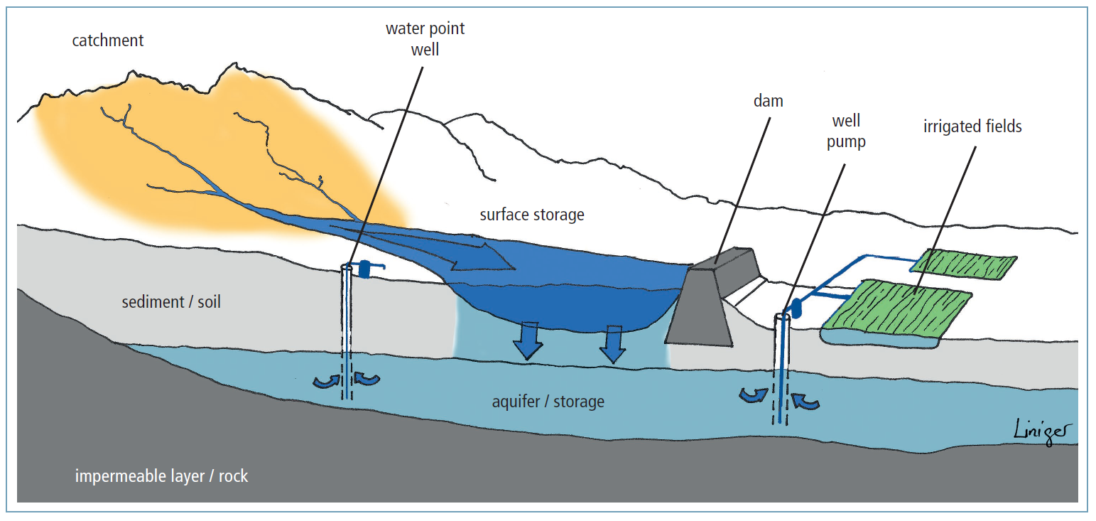
Macrocatchment cross-section
Harvesting runoff water from a natural catchment such as the slope of a mountain or hill
Source: Mekdaschi Studer, Liniger 2013

Slide 18
Macrocatchment WH
  Principles (see also Table 1)
  Runoff trapped from outside farm or field, small watersheds (no control over catchment area)
  Runoff (overland or rill flow) collected from shallow soils or sealed and compacted surfaces: i) overland flow directed and spread, ii) runoff collected through barriers and storage facilities
Water stored in reservoirs, root zone & groundwater
One system with one catchment area
Catchment and application area clearly separate
Catchment: application area ratio 10:1 - 100:1
Nutrients from accumulated sediments and animal droppings
Suitable for annual and perennial crops tolerant to temporary
waterlogging or rapidly maturing on residual moisture
Managed by community or individually
Practices
Hillside conduit, large semi-circular bunds, road run-off, gully reclamation,
ponds, pans, dams (surface, sand and percolation dams ), wells
Kanda rock catchment, Afghanistan., C. Studer
Small check dam, Rajastan India. (HP. Liniger)
Sand dam Embu, Kenya. (HP. Liniger)
Source: Mekdaschi Studer, Liniger 2013

Slide 19
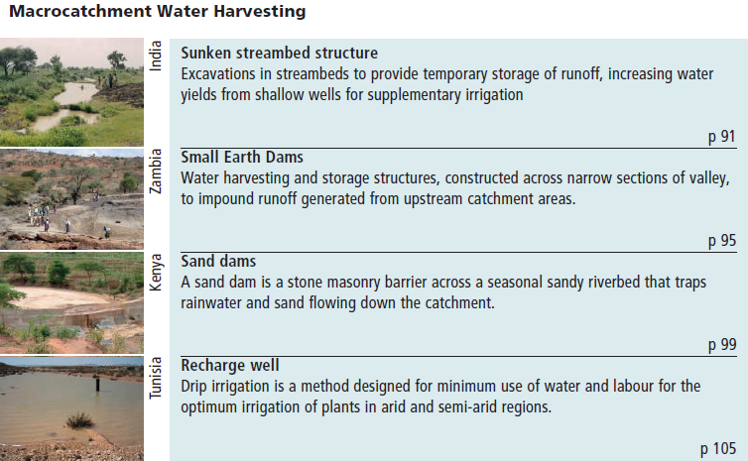
Case studies macrocatchment
Source: Mekdaschi Studer, Liniger 2013

Slide 20
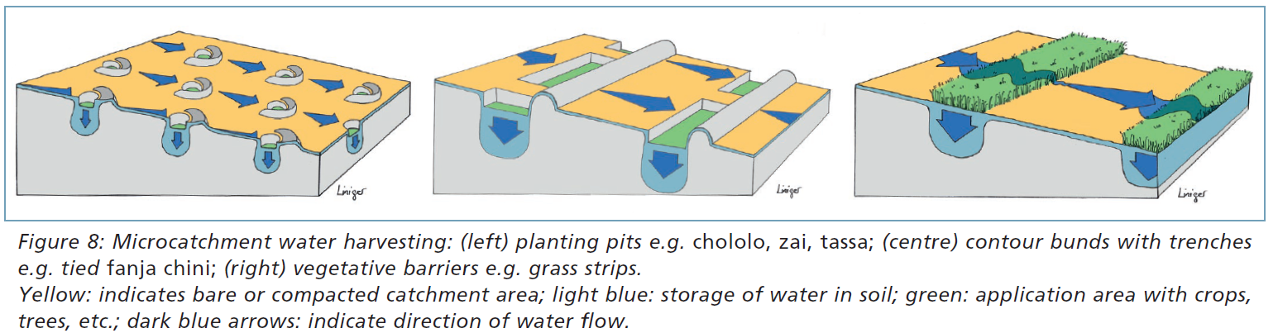
Microcatchments
Collecting surface runoff ( sheet and sometimes rill flow) from small catchments of short length
Source: Mekdaschi Studer, Liniger 2013

Slide 21
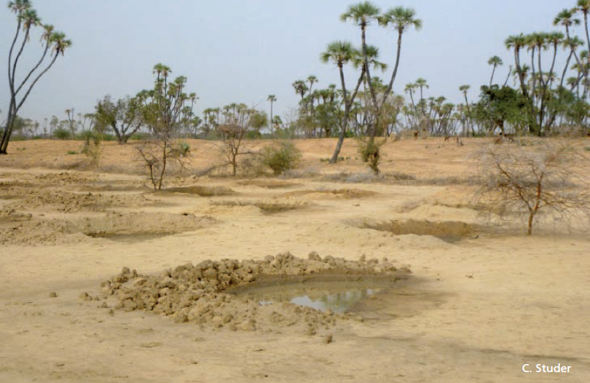
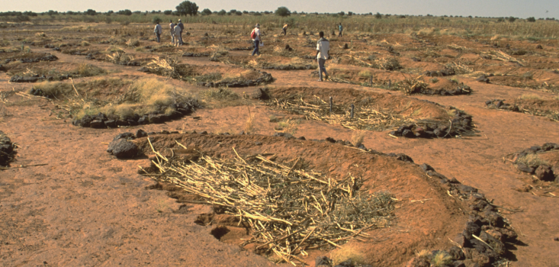
Microcatchment WH
Principles (see also Table 1 above)
Localized runoff trapped within field
Catchment area generally bare with sealed, crusted and
compacted soils
Water stored in soil within field
Catchment and application area distributed evenly over field
System replicated many times with identical designs
Catchment: application/storage area ratio 1:1: 10:1
Needs fertility management
Managed individually or by community
Practices
Planting pits, micro-basins/trenches (Vallerani), small semi-circular/ triangular bunds, eyebrow terraces, vegetative strips, contour bunds and ridges, trenches, stone lines
Microcatchments with eyebrow terraces, Orissa, India. (HP. Liniger)
Down-slope contour bunds in Cape Verde (HP. Liniger).
Source: Mekdaschi Studer, Liniger 2013
Demi-lunes with mulching, Niger. (HP. Liniger)

Slide 22
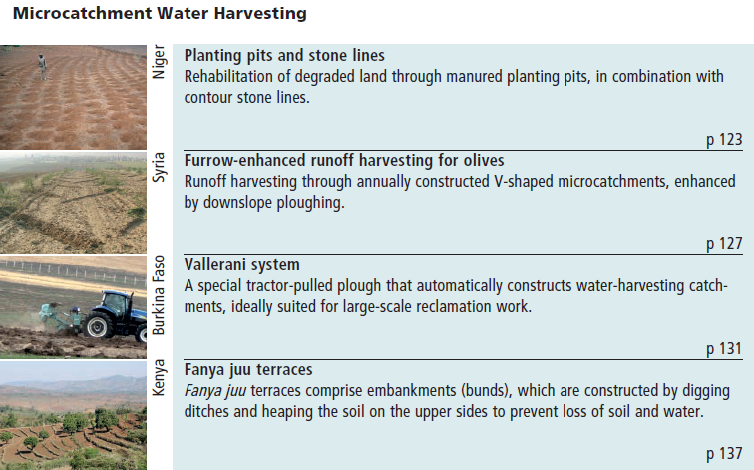
Case studies microcatchment
Source: Mekdaschi Studer, Liniger 2013

Slide 23
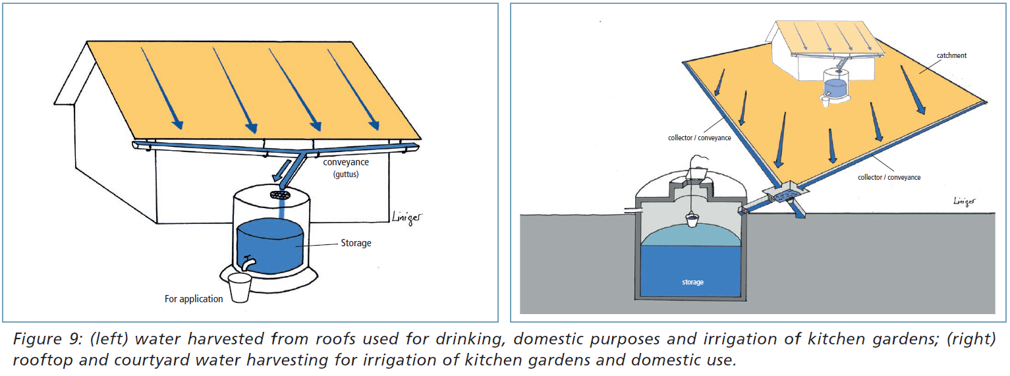
Rooftop/Courtyard WH
Volume captured: effective area of the roof and local annual rainfall. Between 80 – 85 percent of rain can be collected and stored
The slope and permeability affects the amount of rainwater that can be collected.
Source: Mekdaschi Studer, Liniger 2013

Slide 24
Rooftop/Courtyard WH
Principles (see also Table 1 above)
Runoff trapped from household or settlements (roofs or compacted/ paved courtyards)
Sheet flow from rooftops (houses, public buildings, greenhouses, etc. and sealed surfaces
Surface and subsurface tanks
One system with one catchment
May recharge groundwater if an infiltration well is built
Managed individually or by community
Practices
Roof catchments of different materials (sheets, tiles, organic roofs, plastic), courtyard catchments of compacted/ paved surfaces
Water tank, Nepal. RAIN
Corrugated iron sheets for roofing. (HP. Liniger)
Courtyard water harvesting, Palestine. (N. Harari)
Source: Mekdaschi Studer, Liniger 2013

Slide 25
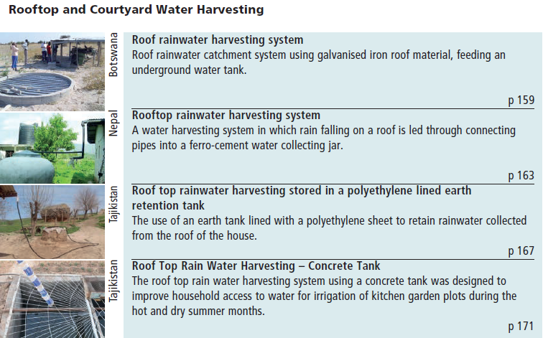
Case studies rooftop & courtyard WH
Source: Mekdaschi Studer, Liniger 2013

Slide 26
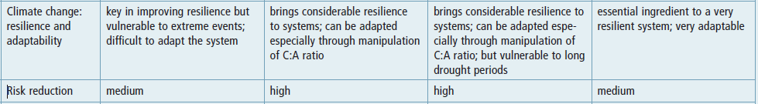
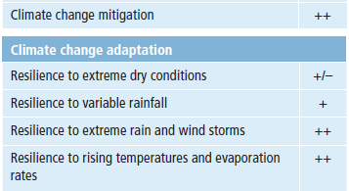
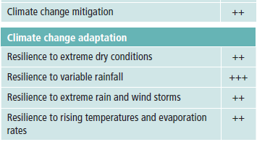
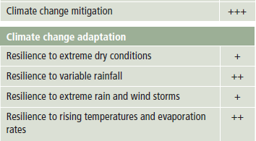
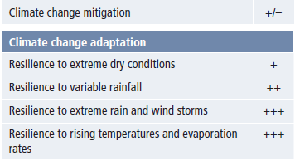

WH applicability
WH and climate change adaptation and mitigation
Source: Mekdaschi Studer, Liniger 2013

Slide 27
WH part of integrated water resource management
Water management strategies:
Management of excess water from rainfall or seasonal flooding through controlled drainage and water storage for future use; suitable for sub-humid conditions as well as semi-arid and arid conditions (floodwater harvesting).
Increasing rainwater capture and availability, making use of surface runoff; suitable for dry sub-humid to arid conditions (rainwater harvesting).
In situ water conservation: improving direct water infiltration and reducing evaporation; soil and water conservation practices (e.g. conservation agriculture, mulching, composting, terraces); suitable for sub-humid to semi-arid conditions.
Increasing water use efficiency (e.g. good agronomic practice, including use of best-suited planting material and fertility management).
Source: Mekdaschi Studer, Liniger 2013

Slide 28
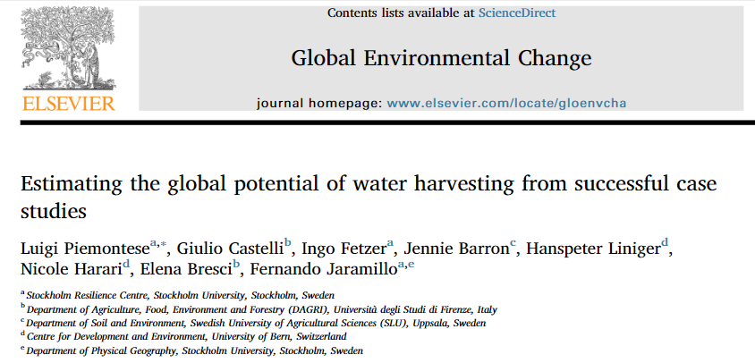
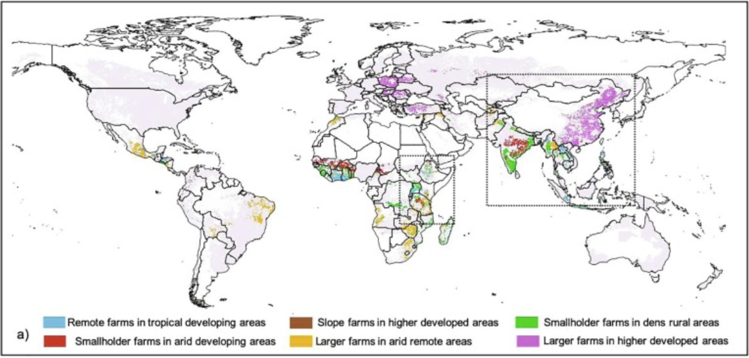
Six “archetypes” for successful water harvesting
Researchers identified 167 examples of successful water harvesting across the world (WOCAT database)
All cases helped define six “archetypes” crucial for successful water harvesting
→ Where in the world can we find the same social-ecological conditions as in the 167 case studies?
The archetypes cover large portions of Africa, Central America and Asia, and minor representations in South America and Eastern Europe

Slide 29
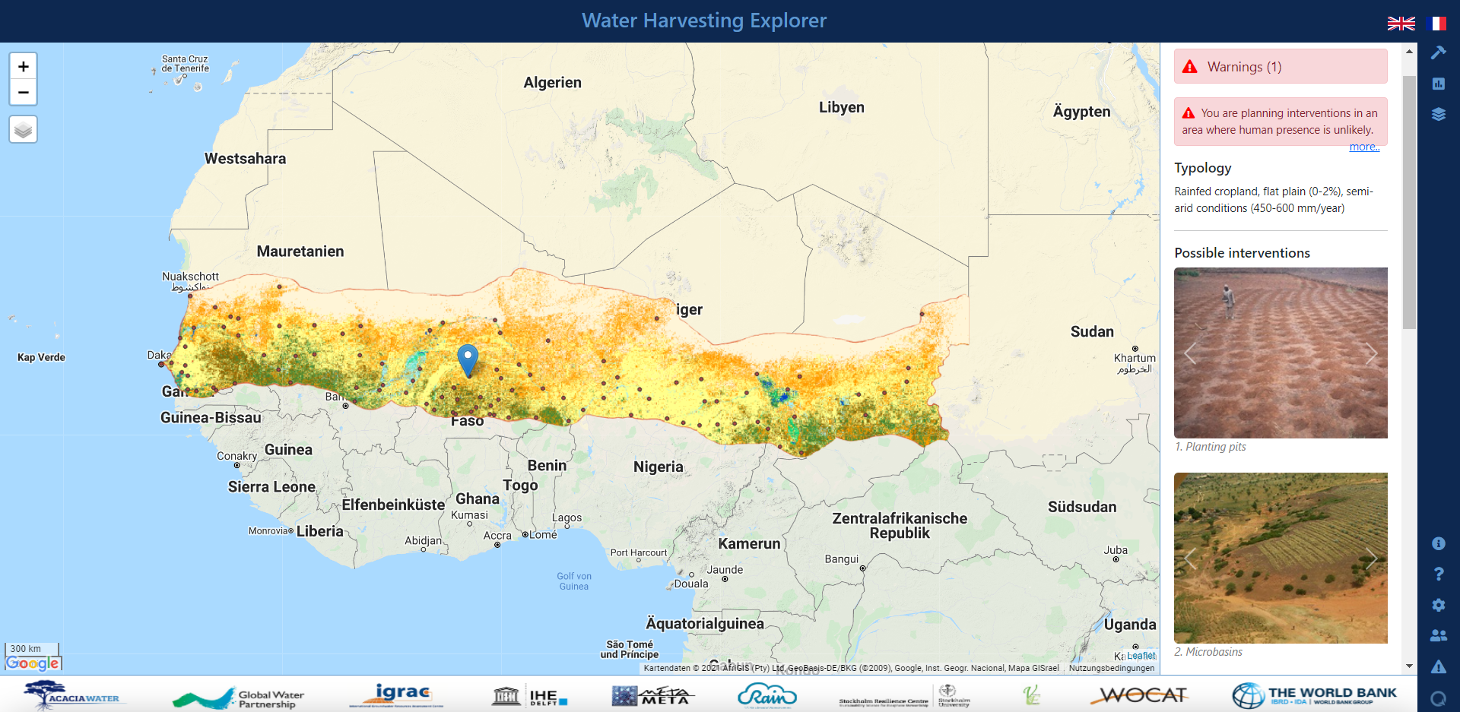
Water harvesting explorer
A decision support webtool for small scale water storage intervention planning in the Western Sahel, available in EN and FR; https://sahel.acaciadata.com/
Intervention inspector: click on the map to show possible interventions
Survey: Assess the enabling conditions identify possible hindering factors
Layers: e.g. land cover, average annual precipitation, river network
The WOCAT cases show successful implementation at precise locations (geo-referenced)

Slide 30
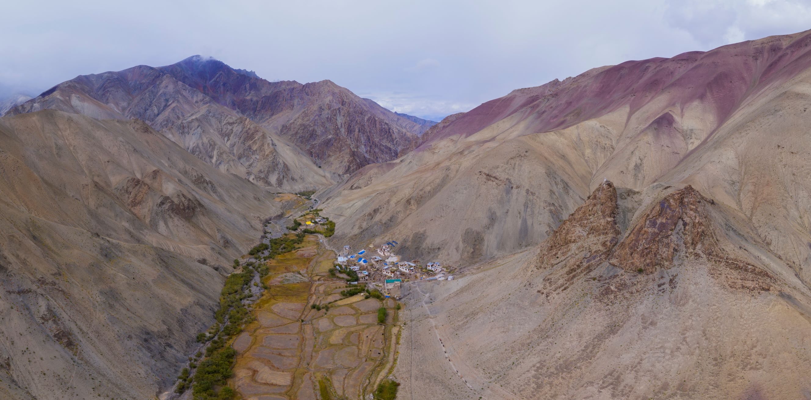
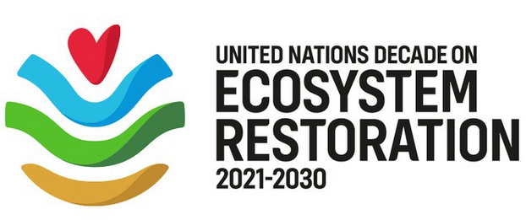


Thank you
Supporting partner of:
Photo: Hanspeter Liniger
Water Harvesting Lab
WHLab

