Slide 1
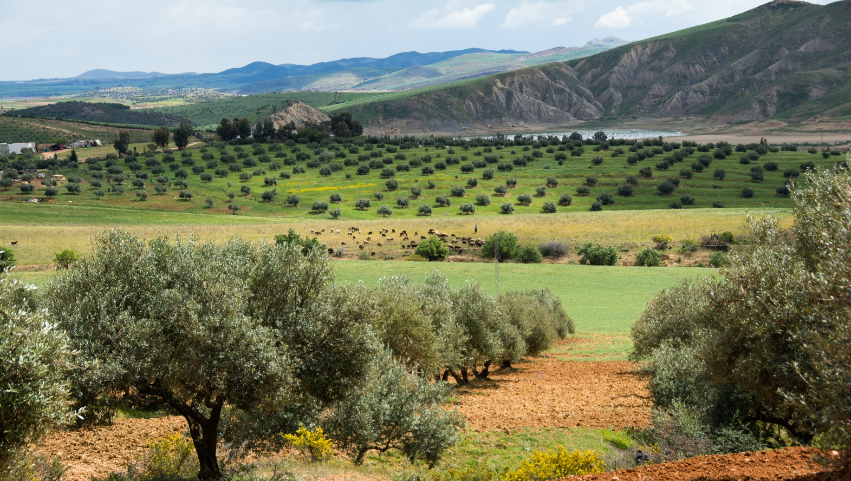



International online course on “Water Harvesting for Sustainable Crop Production under Climate Change”
Introduction Part 2
Rima Mekdaschi Studer and Hanspeter Liniger
Photo: Hanspeter Liniger
Water Harvesting Lab
WHLab

Slide 2


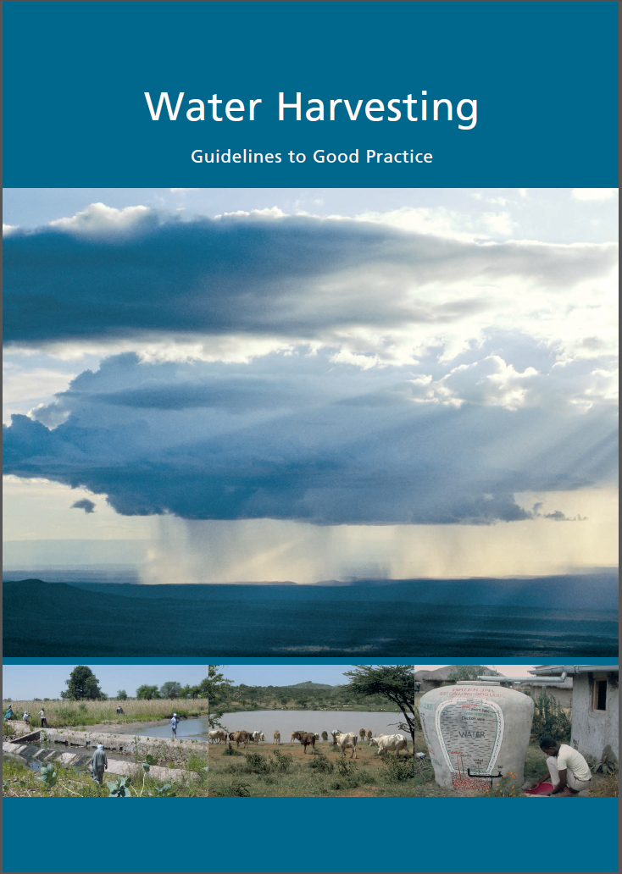




Water Harvesting (WH) - Guidelines to Good Practice
Knowledge products
concepts behind water harvesting
harmonised classification system
overview of 4 WH groups
selection of good practices (standardized WOCAT format)

Slide 3
Major technologies

Slide 4
Benefits and Constraints of WH
Pros | Cons
Offers under-exploited opportunities for rainfed farming systems of the drylands | Depends on amount and variability of rainfall
Buffering water variability | Difficult to ensure sufficient quantity of water needed
Overcoming dry spells and coping with extreme events (flooding, soil erosion, siltation) | May take up productive land
Harvesting nutrients | High investment costs and labour requirements
Reducing production risks and increasing resilience | Upstream rainwater harvesting may affect downstream water availability and use
Increasing food production and security | Shared catchments and infrastructure may create rights issues (upstream-downstream, farmers and herders)
Improving access to clean and safe domestic water | Long –term institutional support may be necessary
Improving water availability for livestock
Reducing women’s work load
Possibility of growing higher-value crops
Providing alternative to full irrigation

Slide 5
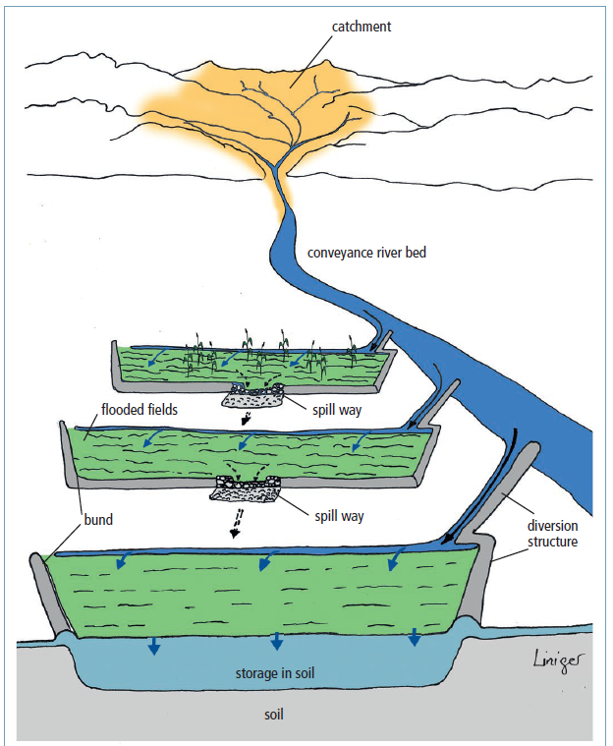
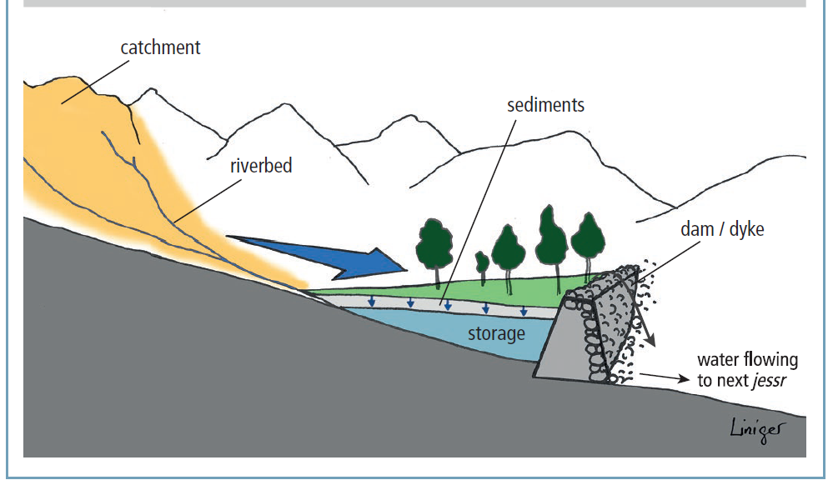
Floodwater harvesting
Floodwater diversion / off-streambed system
channel water either floods over the river/ channel bank
onto adjacent plains -wild flooding
or is forced to leave
its natural course and conveyed to nearby fields
spate irrigation
Floodwater harvesting within streambed
water flow is dammed and as a result, is ponded within the streambed. The water is forced to infiltrate and the accumulated soil water is used for agriculture

Slide 6
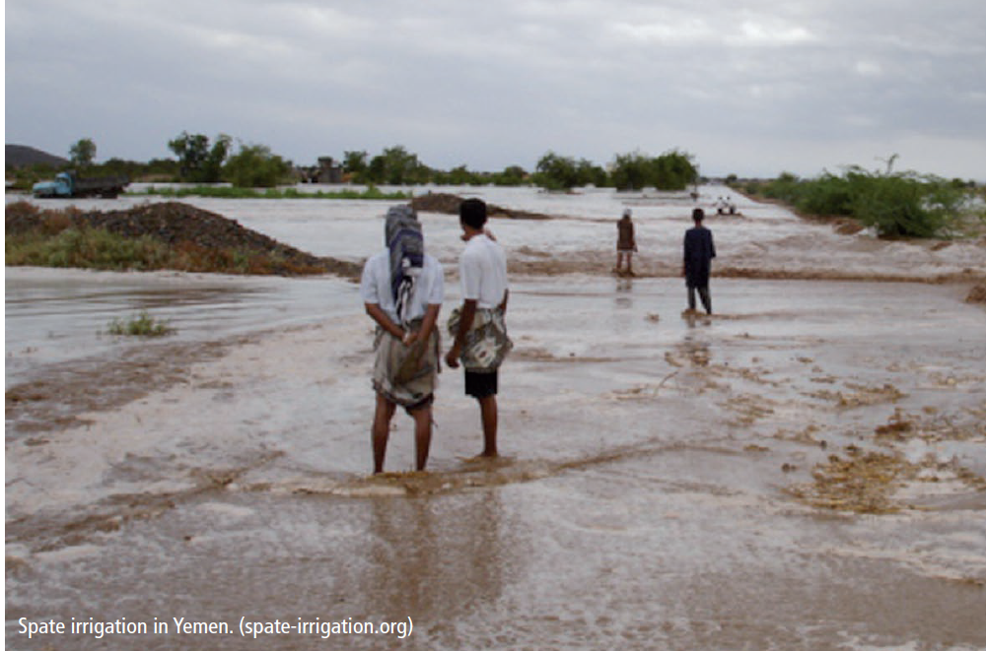
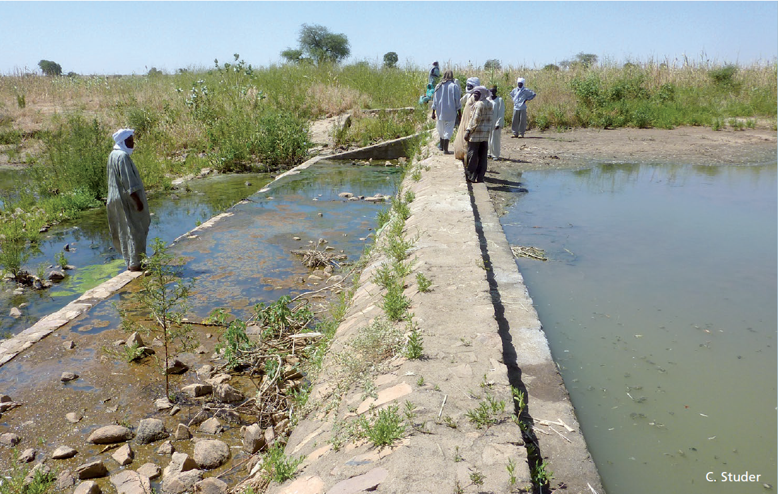
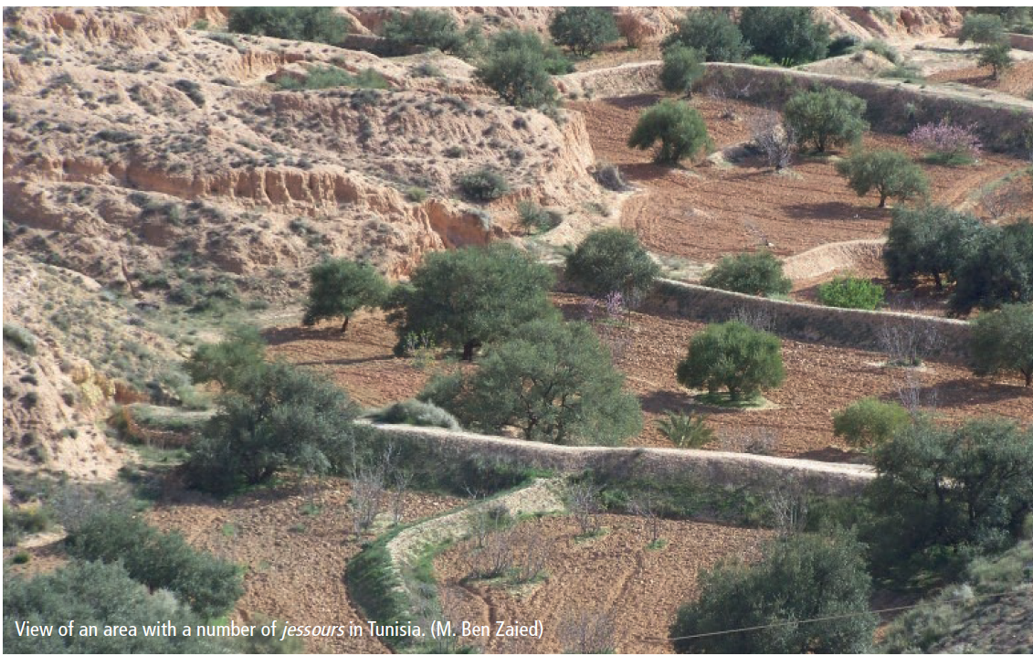
Floodwater harvesting
Principles:
Floodwater captured from outside farm or field, large watersheds (no control over catchment area)
Water/ runoff stored in soil or groundwater
One system with one catchment area (large distant catchment)
Distinction between hilly catchment zone and cultivated fields in plain
Catchment: application area ratio 100:1 – 10,000:1
Often ‘self-fertilizing’ through sediment build-up
(Traditional) engineering skills needed
Integrated watershed management (local authority & large communities)
Defined water usage rules
Practices:
Flood recession farming, spate irrigation, water spreading weirs/ bunds, ‘warping’ dams, jessour, tabia and rock dams

Slide 7
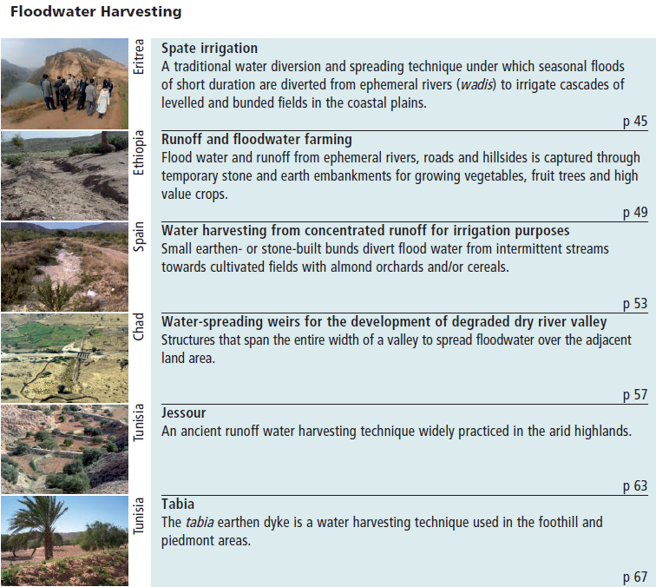
Case studies floodwater

Slide 8
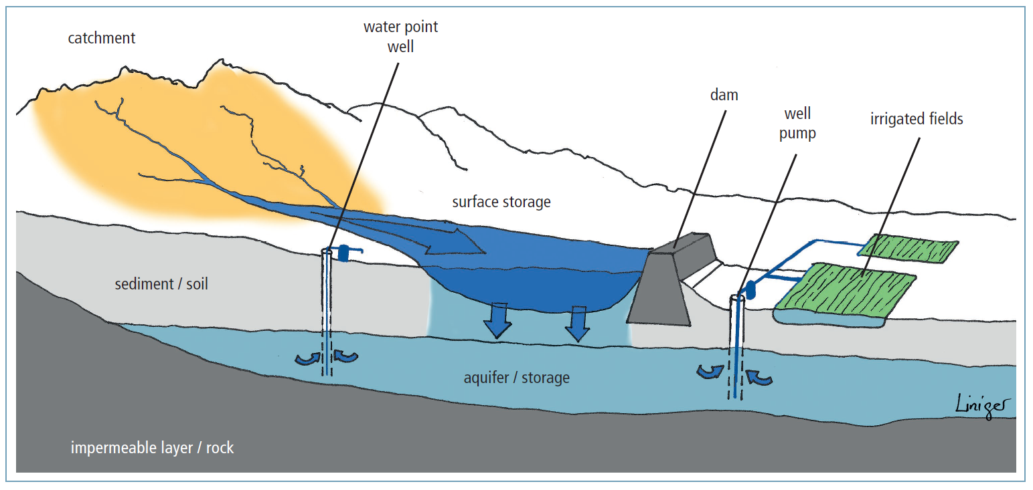
Macrocatchment cross-section
Harvesting runoff water from a natural catchment such as the slope of a mountain or hill

Slide 9
Macrocatchment WH
  Principles:
  Runoff trapped from outside farm or field, small watersheds (no control over catchment area)
  Runoff (overland or rill flow) collected from shallow soils or sealed and compacted surfaces: i) overland flow directed and spread, ii) runoff collected through barriers and storage facilities
Water stored in reservoirs, root zone & groundwater recharge
One system with one catchment area
Catchment and application area clearly separate
Catchment: application area ratio 10:1 100:1
Nutrients from accumulated sediments and animal droppings
Suitable for annual and perennial crops tolerant of temporary
waterlogging or rapidly maturing on residual moisture
Managed by community or individually
Practices:
Hillside conduit, large semi-circular bunds, road run-off, gully reclamation,
ponds, pans, dams (surface, sand and percolation dams ), wells
Kanda rock catchment, Afghanistan., C. Studer
Small check dam, Rajastan India. (HP. Liniger)
Sand dam Embu, Kenya. (HP. Liniger)

Slide 10
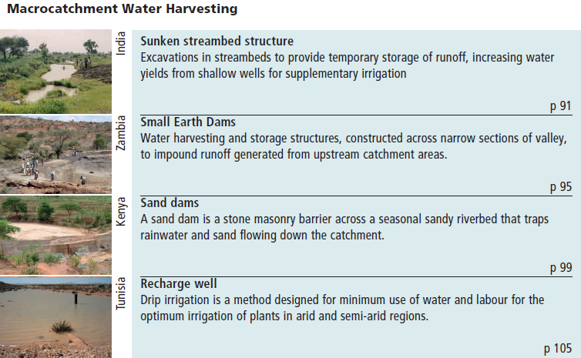
Case studies macrocatchment

Slide 11
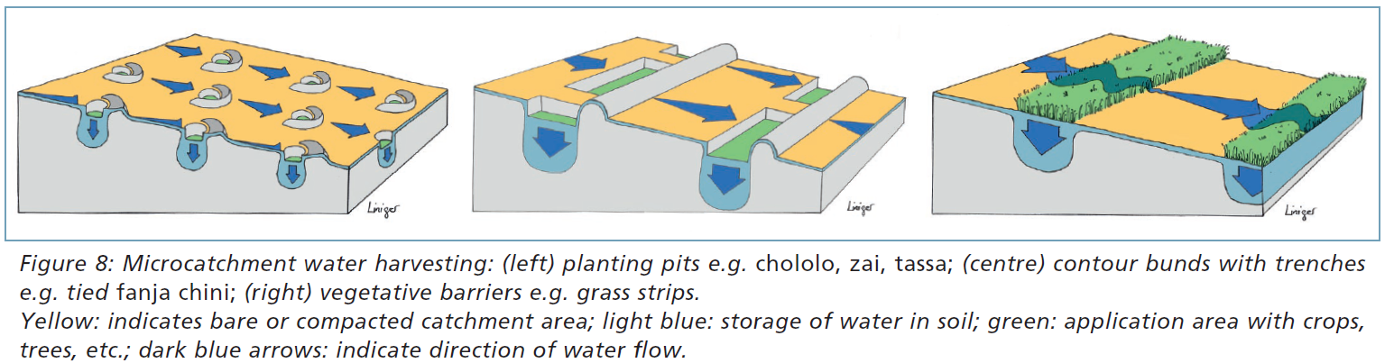
Microcatchments
Collecting surface runoff ( sheet and sometimes rill flow) from small catchments of short length

Slide 12
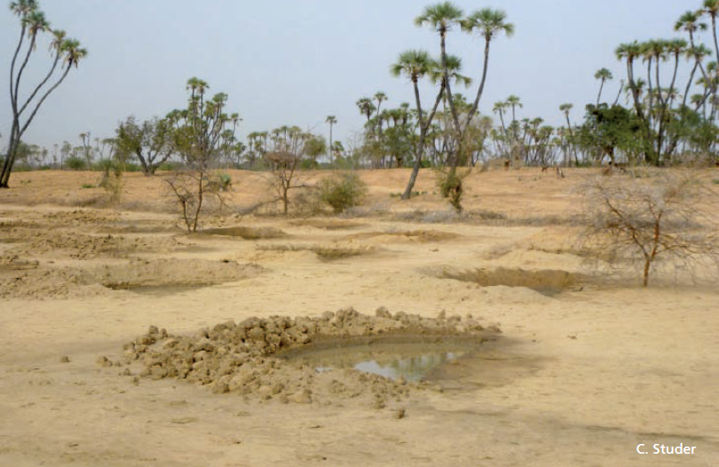
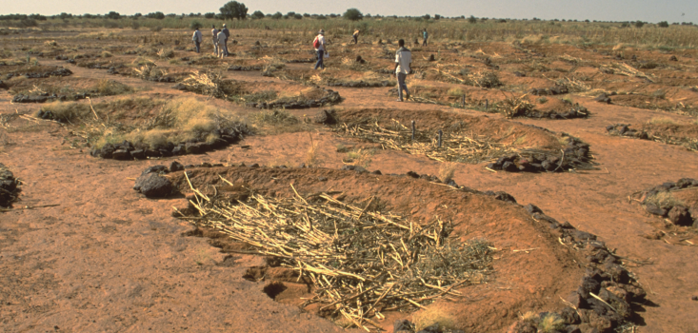
Microcatchment WH
Principles
Localized runoff trapped within field
Catchment area generally bare with sealed, crusted and
compacted soils
Water stored in soil within field
Catchment and application area distributed evenly over field
System replicated many times with identical designs
Catchment: application/storage area ratio 1:1: 10:1
Needs fertility management
Managed individually or by community
Practices
Planting pits, micro-basins/trenches (Vallerani), small semi-circular/ triangular bunds, eyebrow terraces, vegetative strips, contour bunds and ridges, trenches, stone lines
Microcatchments with eyebrow terraces, Orissa, India. (HP. Liniger)
Down-slope contour bunds in Cape Verde (HP. Liniger).
Demi-lunes with mulching, Niger. (HP. Liniger)

Slide 13
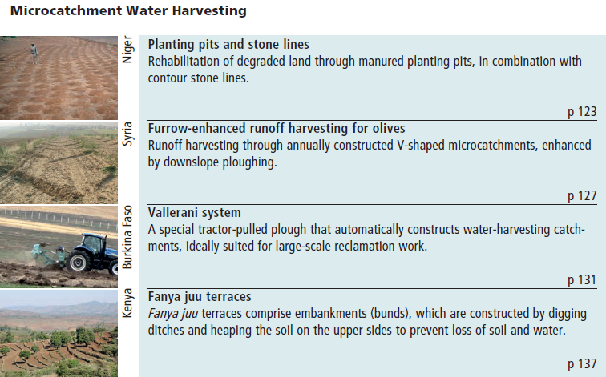
Case studies microcatchment

Slide 14
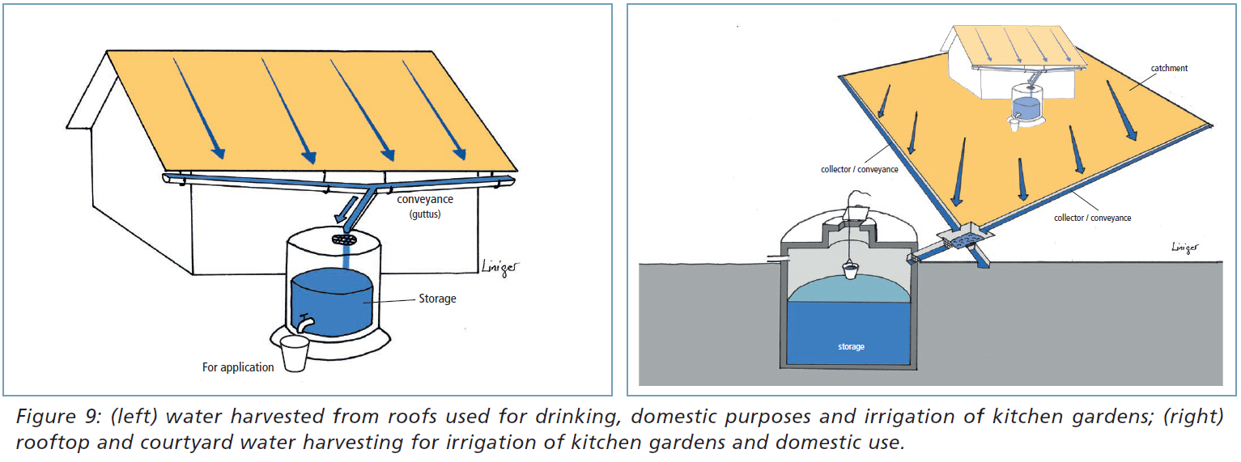
Rooftop/Courtyard WH
Volume captured: effective area of the roof and local annual rainfall. Between 80 – 85 percent of rain can be collected and stored
The slope and permeability affects the amount of rainwater that can be collected.

Slide 15
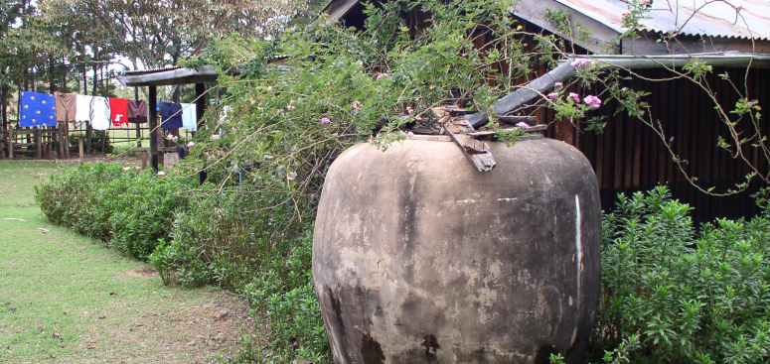
Rooftop/Courtyard WH
Principles:
Runoff trapped from household or settlements (roofs or compacted/ paved courtyards)
Sheet flow from rooftops (houses, public buildings, greenhouses, etc. and sealed surfaces
Surface and subsurface tanks
One system with one catchment
May recharge groundwater if an infiltration well is built
Managed individually or by community
Practices:
Roof catchments of different materials (sheets, tiles, organic roofs, plastic), courtyard catchments of compacted/ paved surfaces
Water tank, Nepal. RAIN
Corrugated iron sheets for roofing. (HP. Liniger)
Courtyard water harvesting, Palestine. (N. Harari)

Slide 16
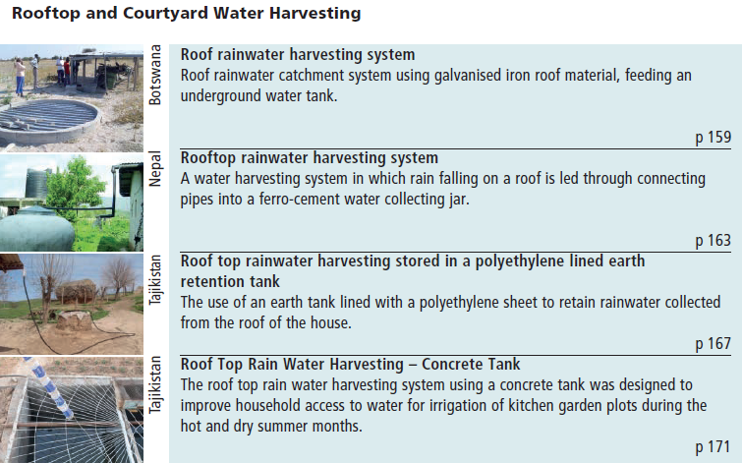
Case studies rooftop & courtyard WH

Slide 17
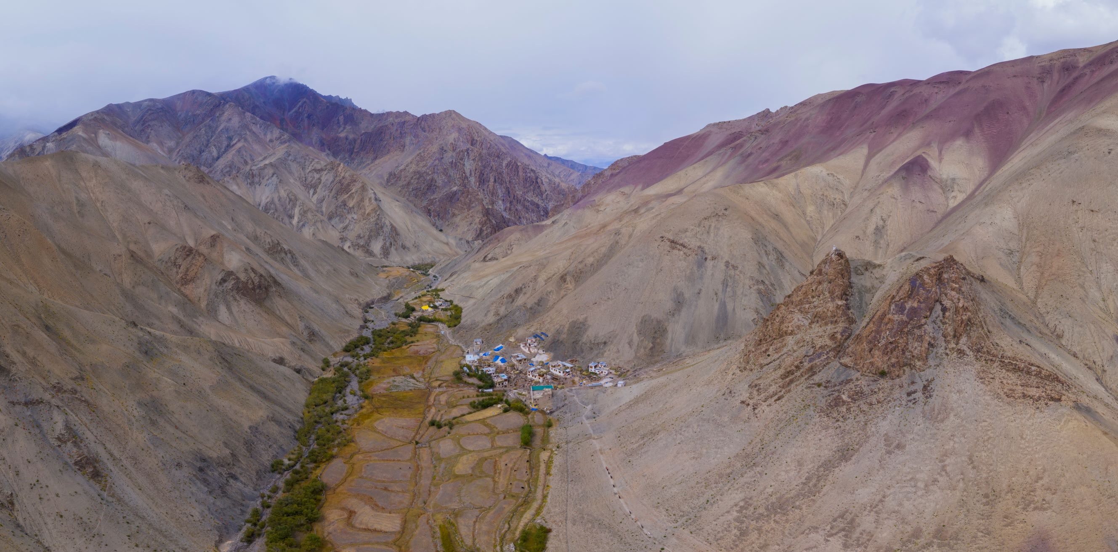
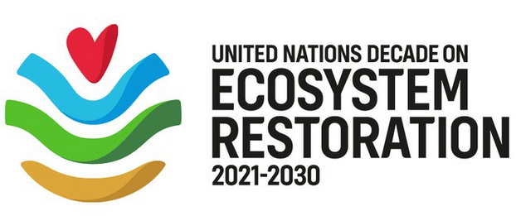
Thank you
Supporting partner of:
Photo: Hanspeter Liniger
Water Harvesting Lab
WHLab

