Slide 1
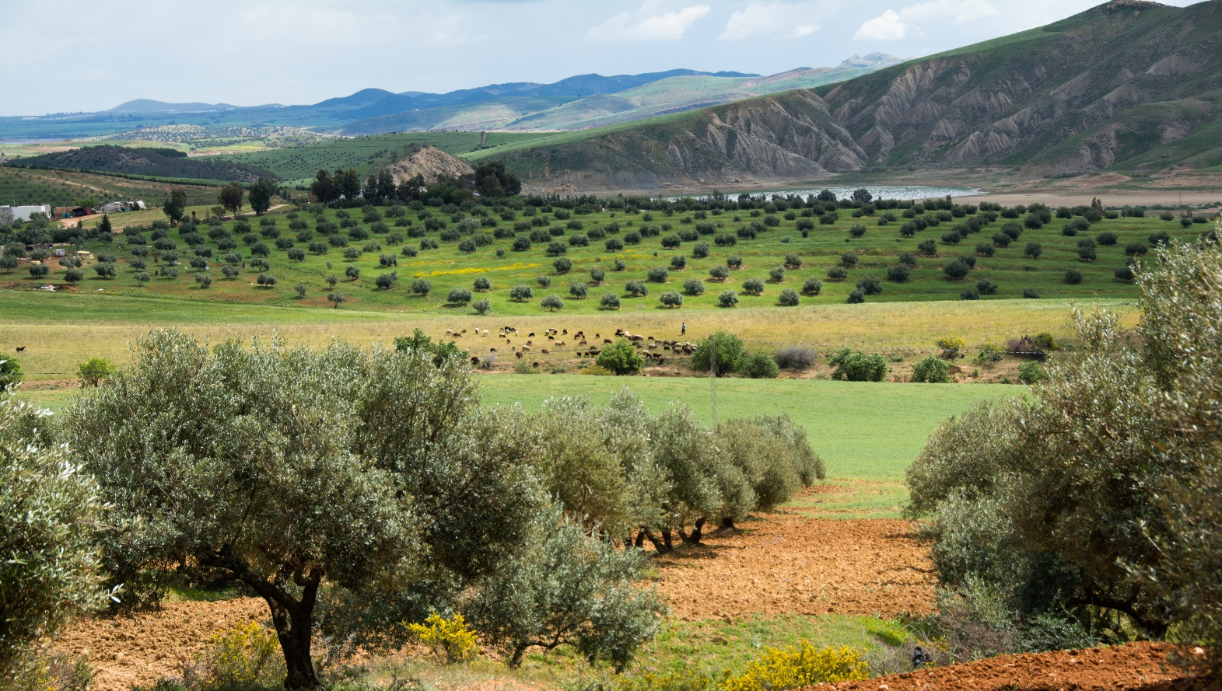



International online course on “Water Harvesting for Sustainable Crop Production under Climate Change”
Introduction Part 3
Rima Mekdaschi Studer and Hanspeter Liniger
Photo: Hanspeter Liniger
Water Harvesting Lab
WHLab

Slide 2


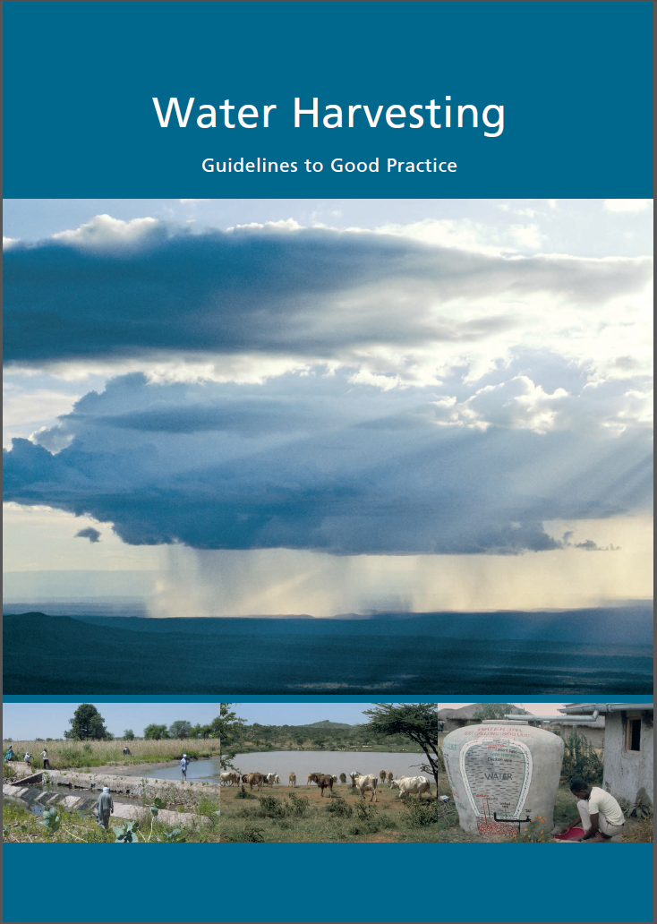




Water Harvesting (WH) - Guidelines to Good Practice
Knowledge products
concepts behind water harvesting
harmonised classification system
overview of 4 WH groups
selection of good practices (standardized WOCAT format)

Slide 3
‘Physical’ suitability of WH

Slide 4
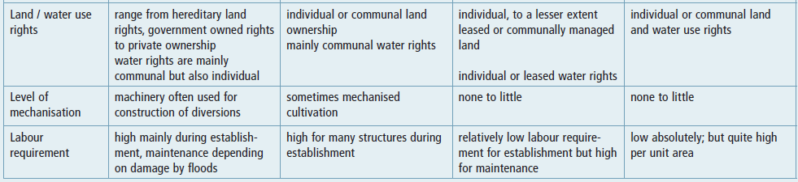
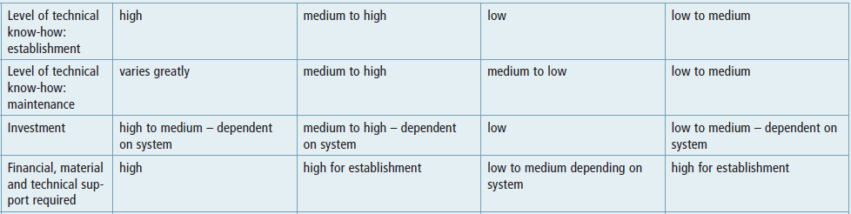
‘Socio-economic’ suitability of WH

Slide 5
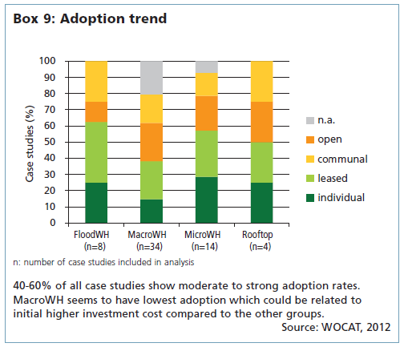
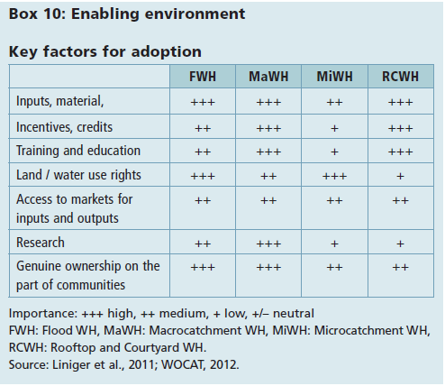
Adoption and upscaling

Slide 6
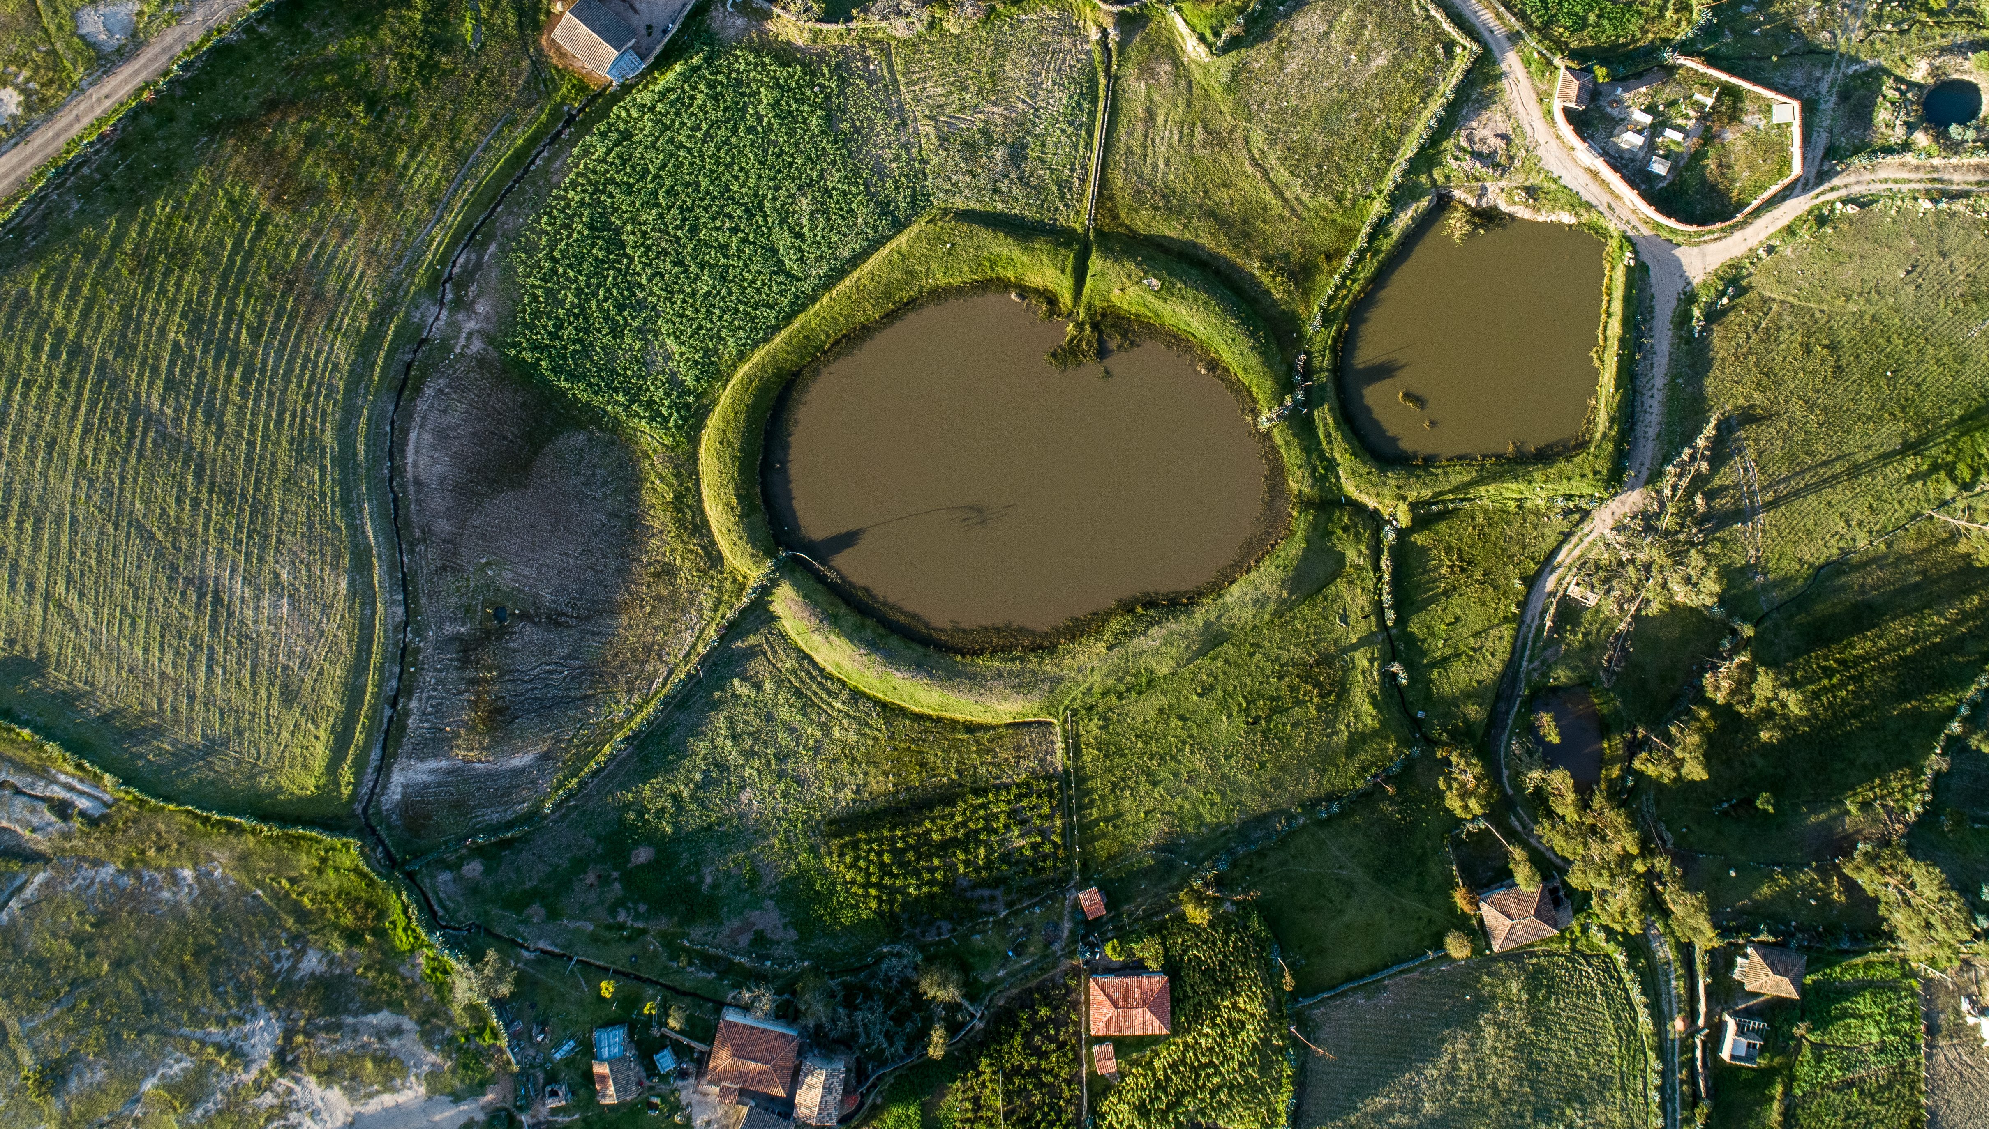
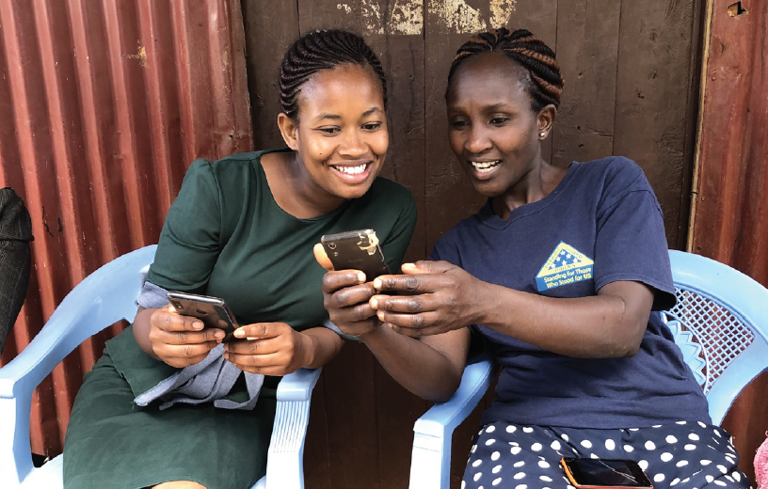
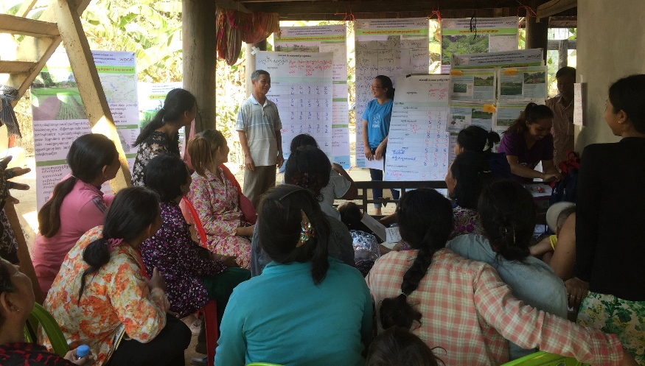
Adoption
Securing an enabling environment
Profitable for users and local community
Simple and inexpensive as much as possible (cost-efficiency)
Easily manageable
Secure land and water rights and access to market
Rapid and sustained payback (e.g. yield increase, tenure rights)
Participation of resource users at all stages
Gender sensitive and inclusive
Skills and experience to adapt and fine-tune to the local natural, socio-economic and cultural environment
Awareness raising, promotion and training
Change from subsistence farming to more market-oriented production (higher value crops)
Produce value added products (processing)
Ministerio de Ambiente, Agua y Transición Ecológica, Ecuador
Benjamin Gräub
Royal University of Agriculture Cambodia

Slide 7
Approaches
Ways and means of support to apply SLM on the ground, of providing enabling environment
Approaches for adoption of WH good practices
Extension, advisory services and training
Learning for sustainabililty (Lfor S)
Promoting frarmer innovation (PFI)
Farmer Field Schools (FFS)
Water user associations / groups
Participatory land use planning (PLUP)
Integrated watershed management (IWM)
Multiple-use water services (MUS)
Payment for ESS
Mekdaschi Studer and Liniger. 2013. Water harvesting – gidelines to good practice
Liniger et al. 2011. SLM in practice – guidelines and best practices for SSA

Slide 8
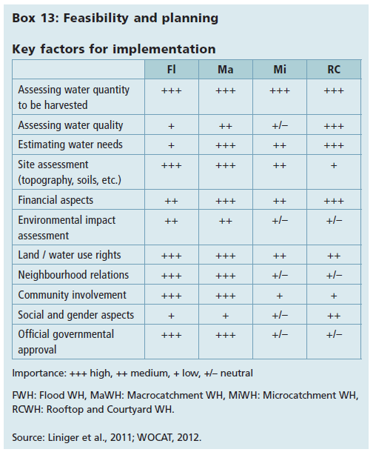
Planning

Slide 9
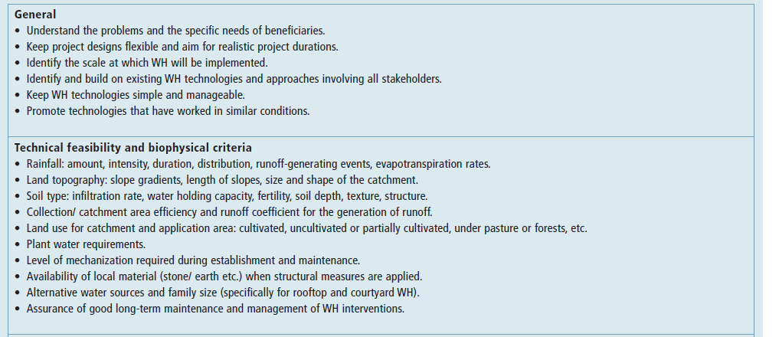
Project planning key elements

Slide 10
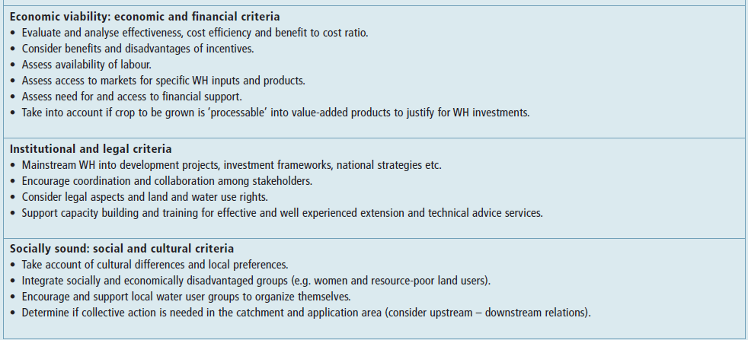
Project planning key elements

Slide 11
Up-scaling
Institutional, policy and legal frameworks
Local participaton
Collaboration and partnerships
Capacity building and
Strenthening of instutional capacities
Monitoring and evaluation
Research
Multi-stakeholder negotiation approach
Regional planning

Slide 12


Thank you
Supporting partner of:
Photo: Hanspeter Liniger
Water Harvesting Lab
WHLab

