Slide 1





Accelerating Land Degradation Neutrality: Lessons, Innovations and Partnerships
Bridging Field Evidence and National Reporting Through
WOCAT Tools
Ingrid Teich
Senior Research Scientist
WOCAT- CDE

Slide 2



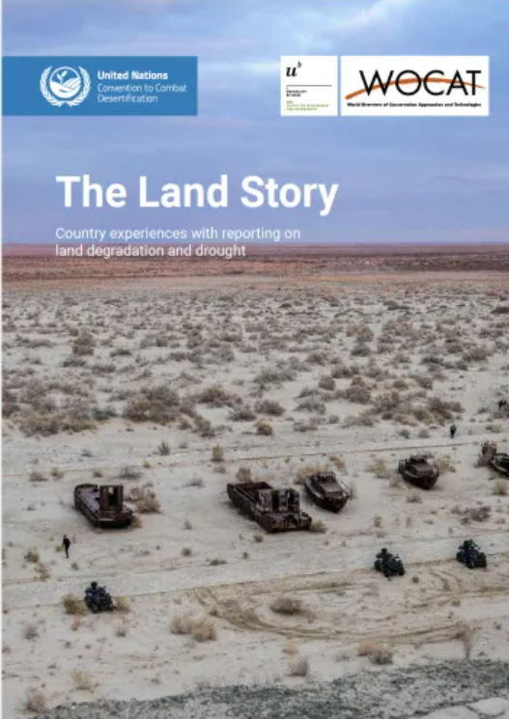
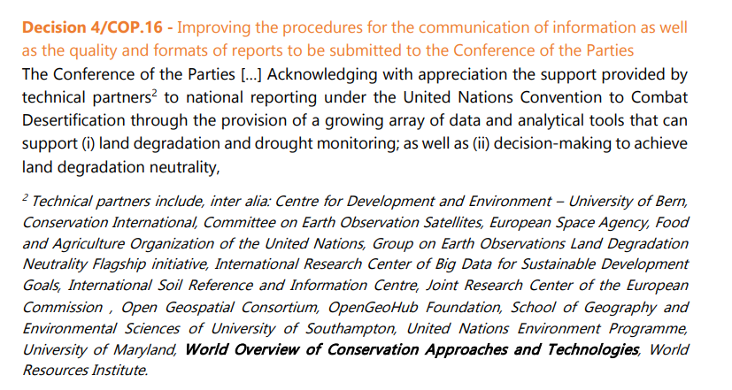
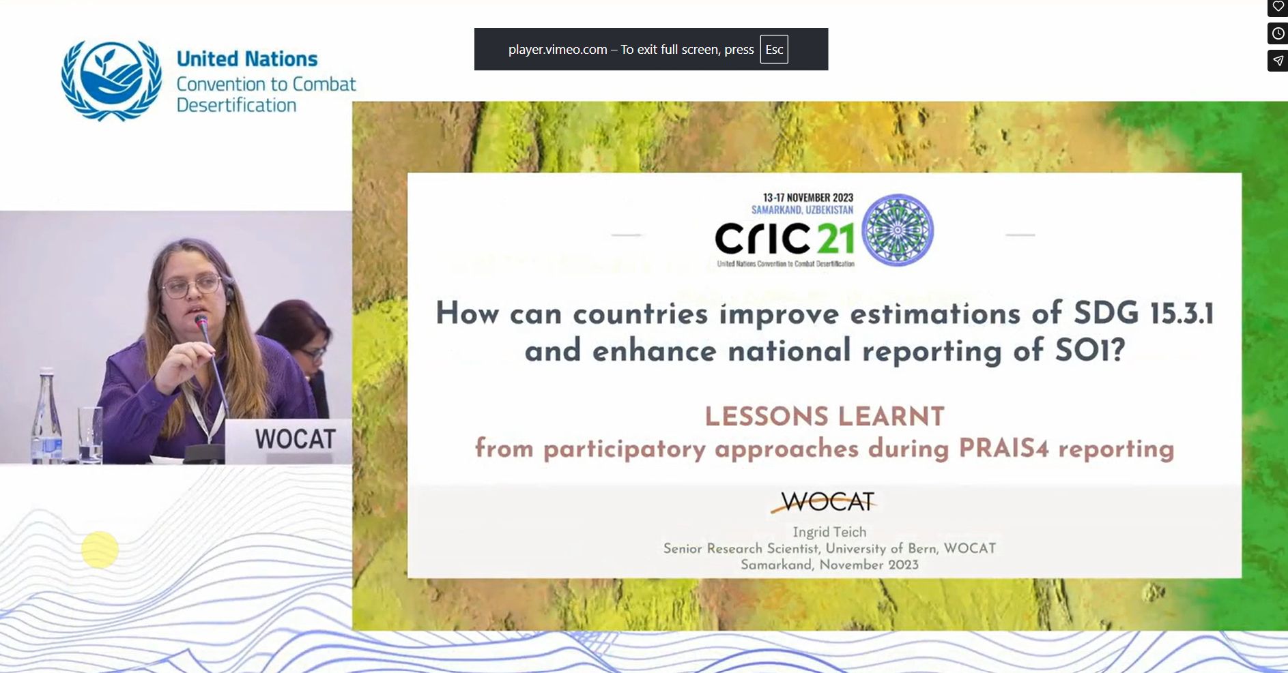
Building on lessons learnt and addressing specific challenges
2023, Samarkand
2024, Riyadh
Colombia, Panama, BiH, Bhutan, Ecuador, Turkiye
Haiti, Spain, Botswana, Mongolia, South Africa, Colombia, Panama, BiH, Bhutan, Ecuador, Turkiye and others

Slide 3
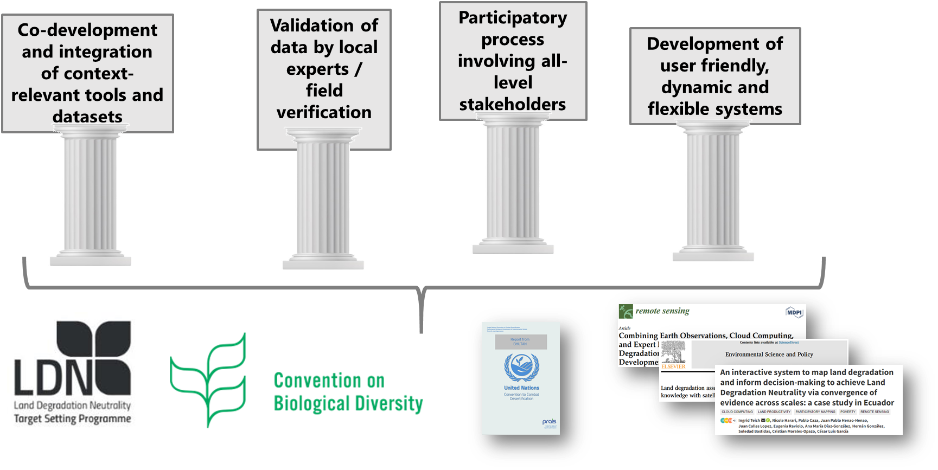
The successful results were based on

Slide 4
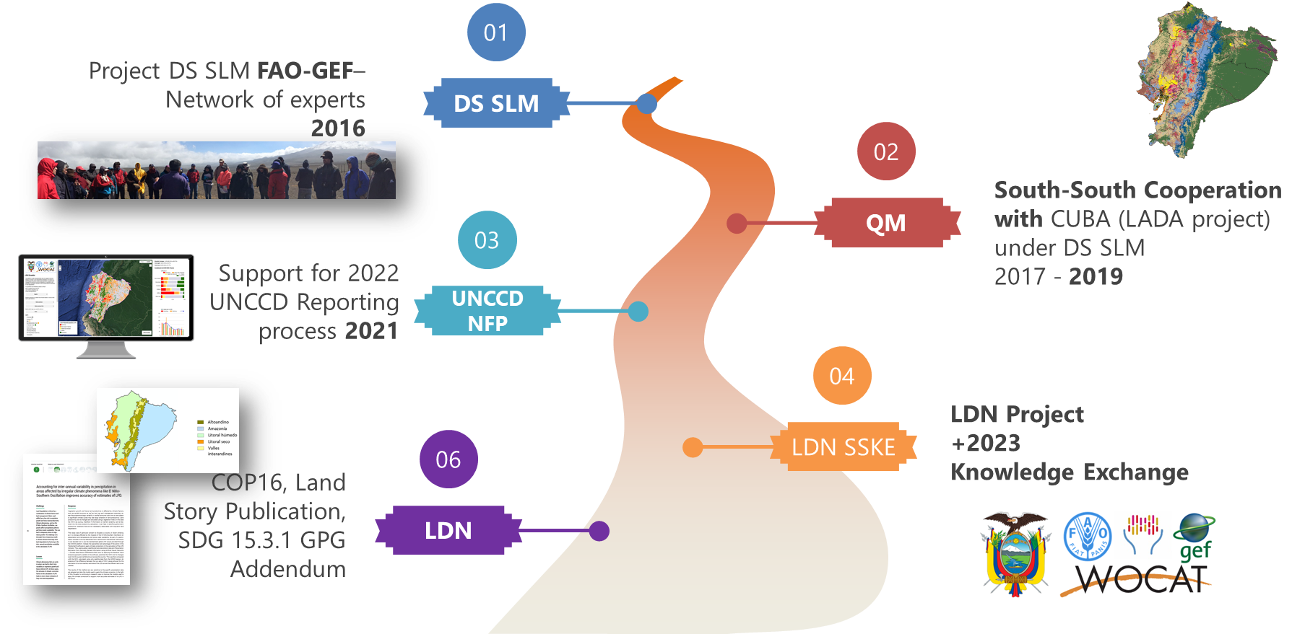
Long Term Processes are crucial: Ecuador example

Slide 5
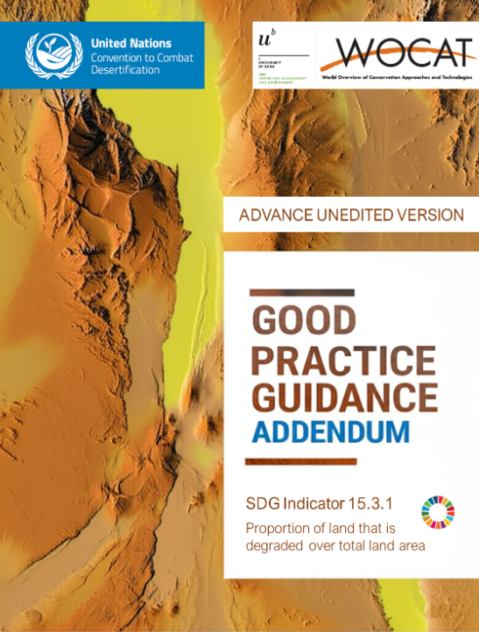



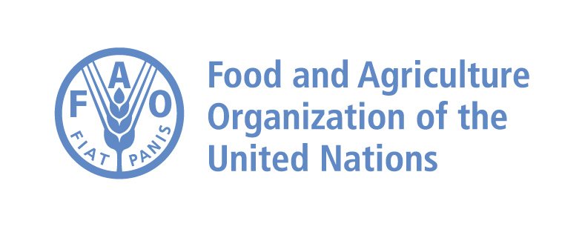






The GPG Addendum – SDG Indicator 15.3.1
A Collaborative Approach
Definition of the Periods and data used for each indicator and metric in each period
Clarification and explicit methodology to compare baseline and period assessments
Counterbalancing and LDN
High resolution datasets
Workflows and Tools co-produced with countries and end - users

Slide 6
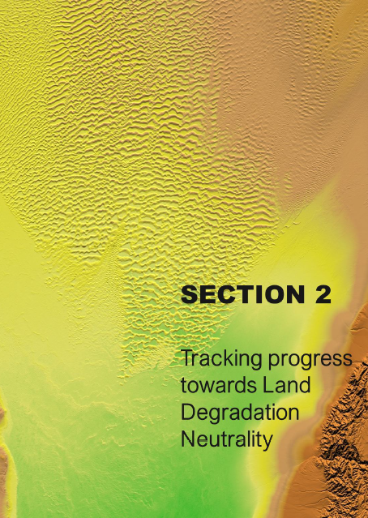
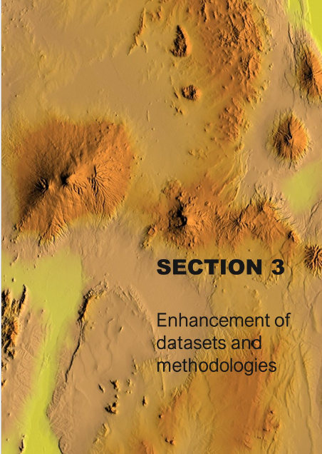
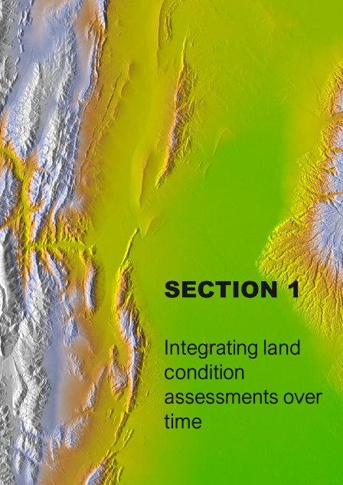
The GPG Addendum – SDG Indicator 15.3.1
Section 1
Section 2
Section 3
INTEGRATING LAND CONDITION ASSESSMENTS OVER TIME
TRACKING PROGRESS TOWARDS LDN
ENHANCEMENT OF DATASETS AND METHODOLOGIES
Focusses on the timeframe of the data used to assess land condition in each reporting period, on how to integrate the period assessment with the baseline, as well as providing additional guidelines on how to interpret and visualize changes over
This section responds to the need for guidance on incorporating the improved land component and the neutrality mechanism into target setting, LDN intervention planning, prioritizing areas for investment, and tracking progress towards LDN.
Introduces new datasets related to land cover, land productivity, and soil organic carbon (SOC), and discusses various methods and experiences in comparing and selecting the most representative datasets for different contexts.

Slide 7
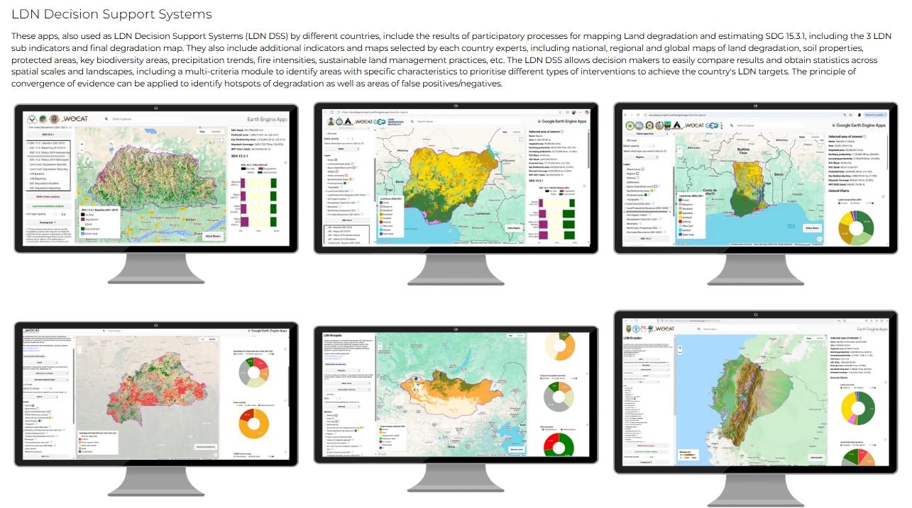
LDN Decision Support Systems

Slide 8
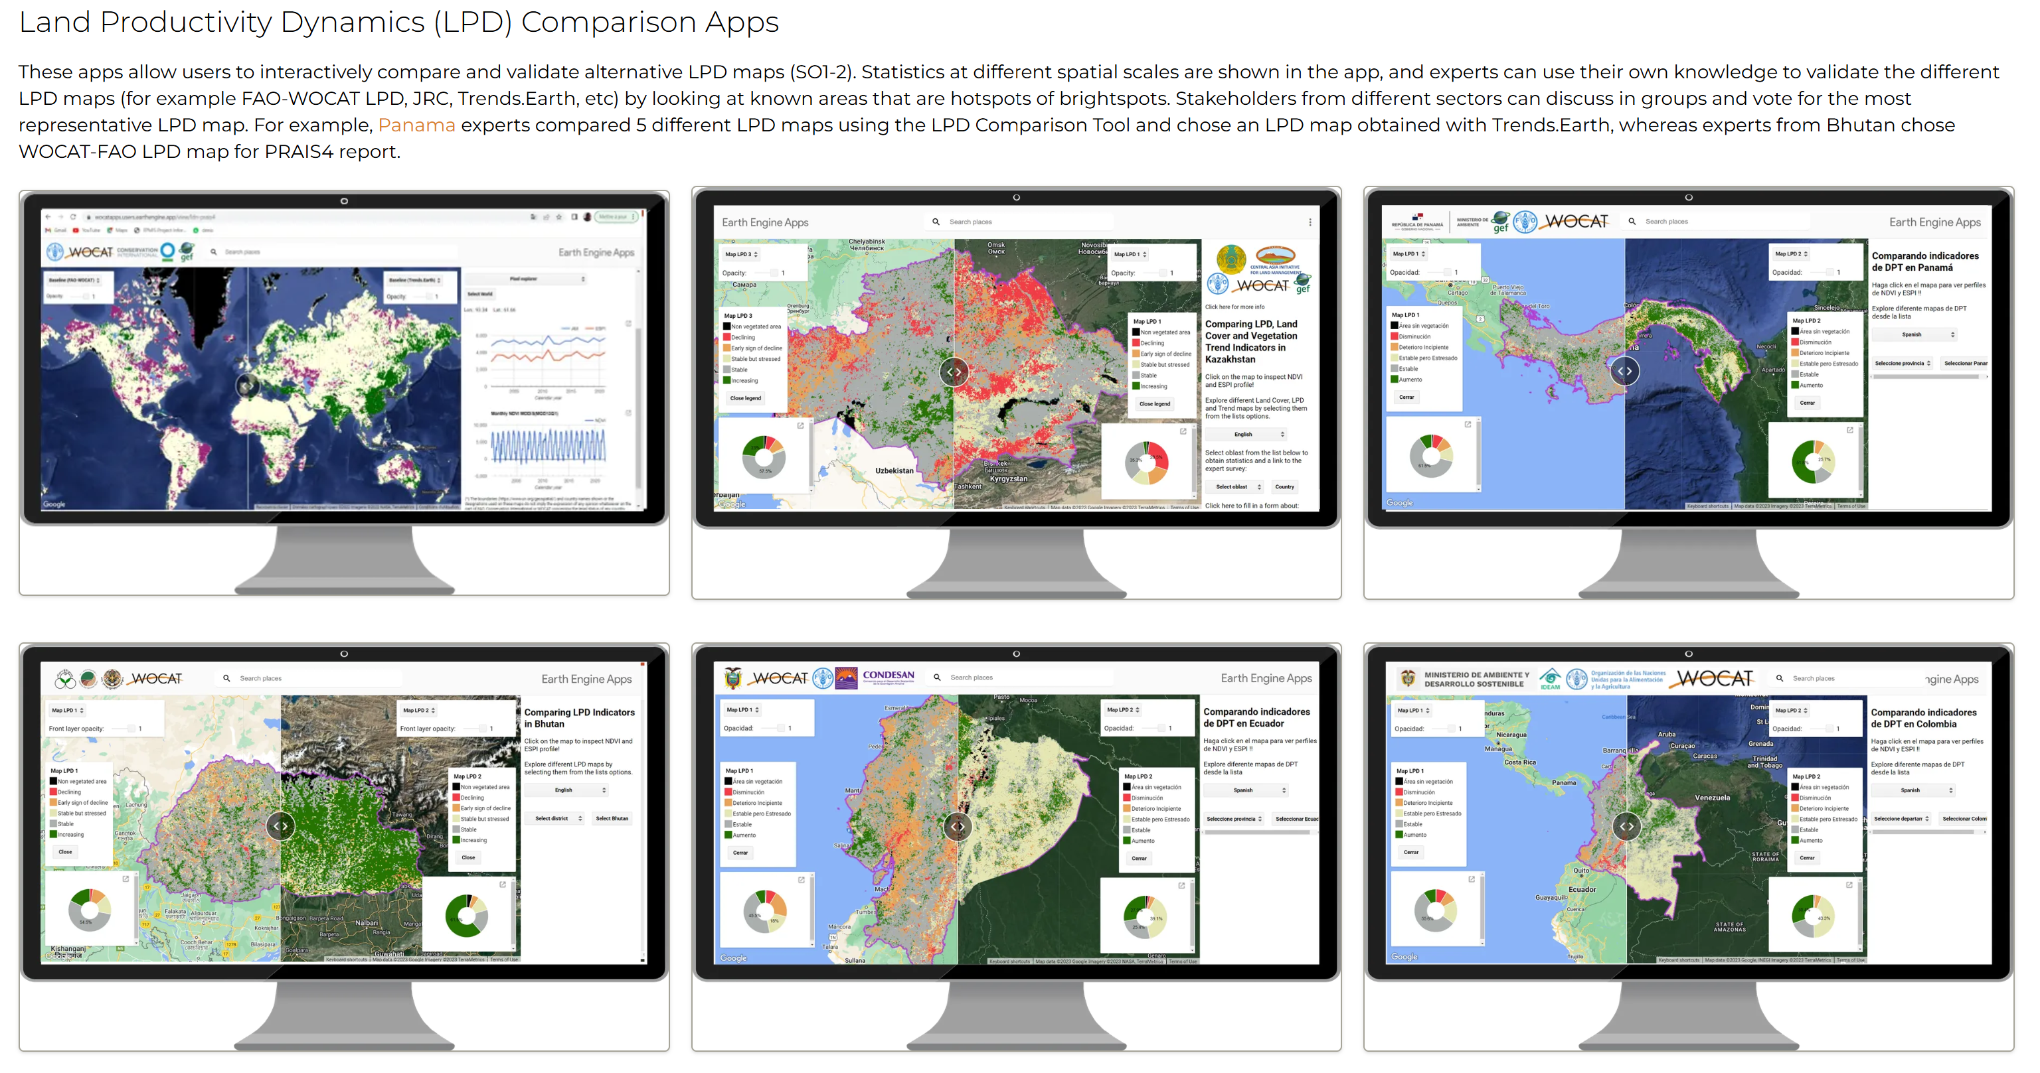



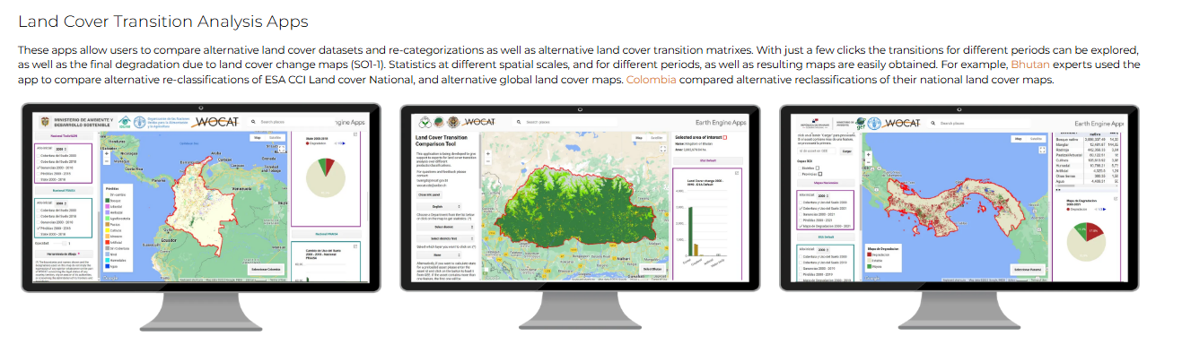
LPD Comparison Apps
Land Cover Transition Apps

Slide 9
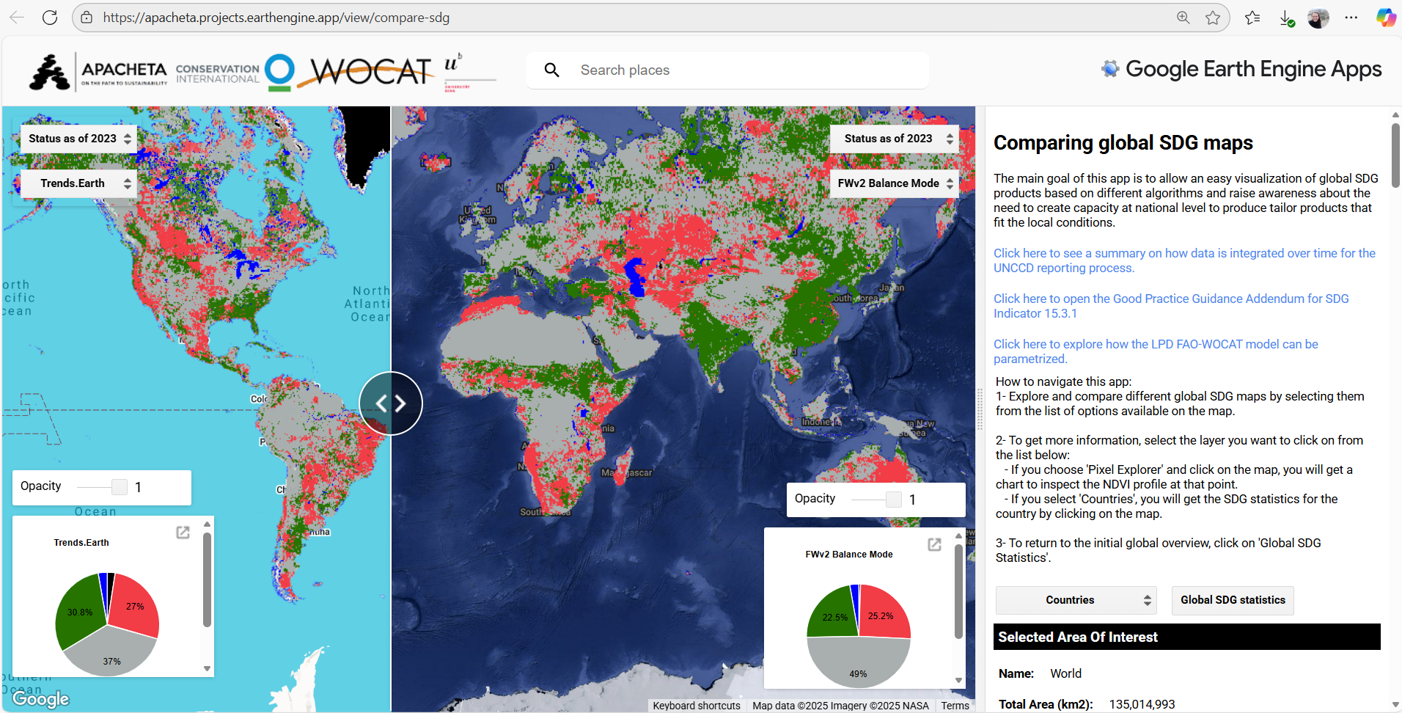
Global App for SDG 15.3.1

Slide 10
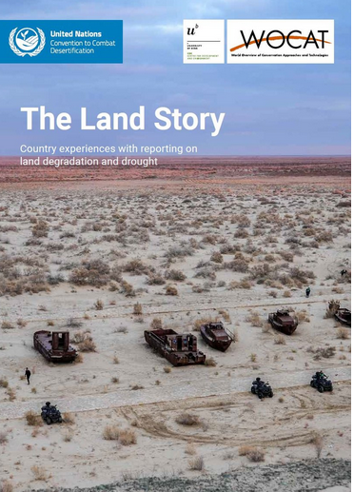
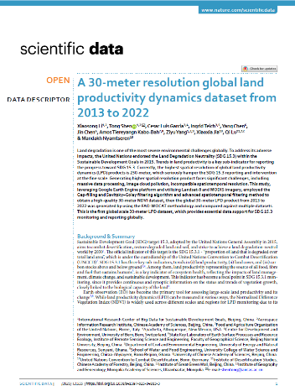
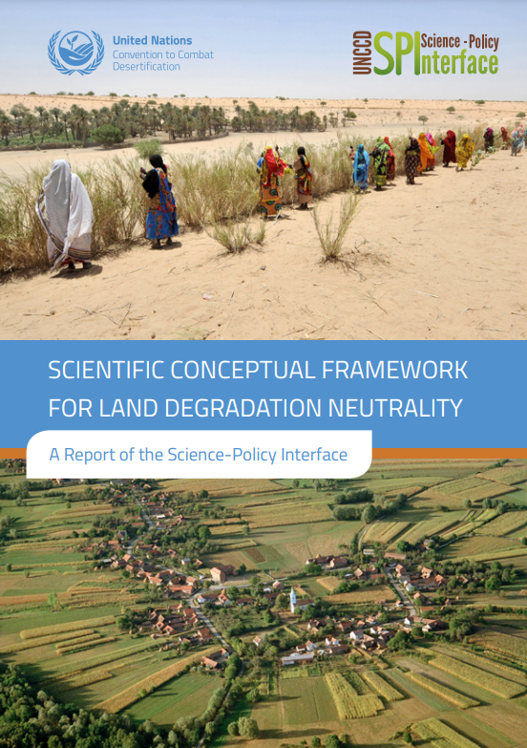
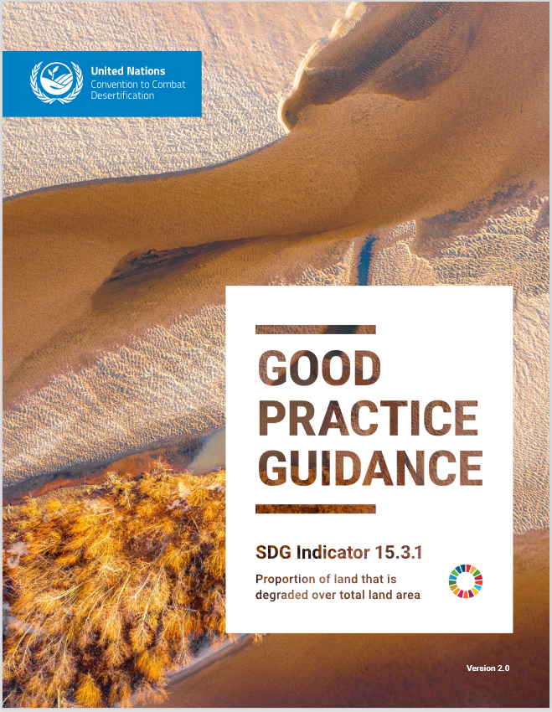
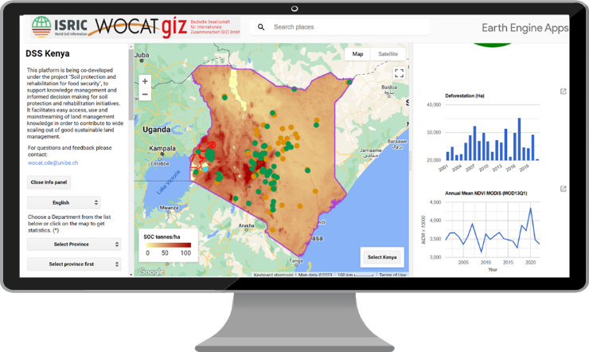
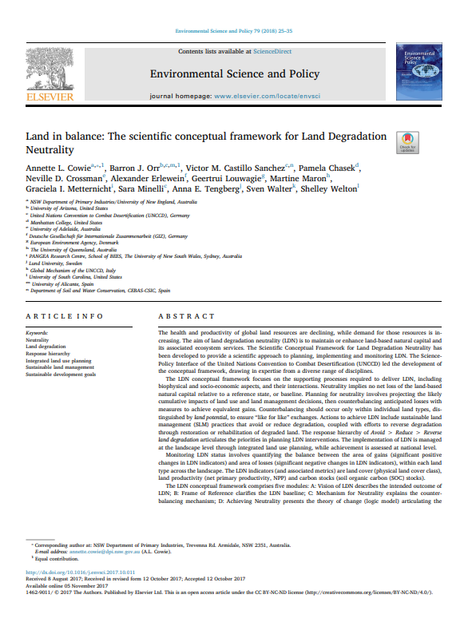
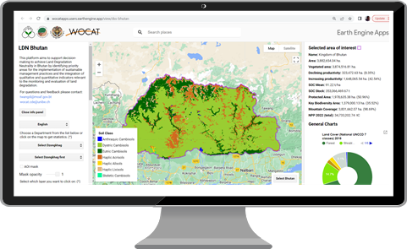
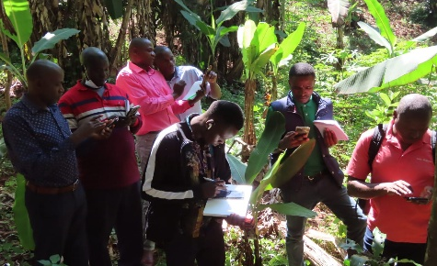
A step further towards achieving LDN
FROM THEORY TO ACTION
New technologies and data
+
People-centered processes
fostering co-creation, discussion, analysis, and prioritization to ensure context-driven and actionable solutions
Notes:
Achieving Land Degradation Neutrality (LDN) has proven to be a challenge for everyone—but especially for countries and the experts working within them, who were tasked with translating what began as a theoretical framework into real-world practice. At the start of this journey, there were virtually no concrete examples to guide implementation. Yet LDN is not just about promoting Sustainable Land Management (SLM); it requires a true landscape approach—one grounded in spatial data and participatory planning, supported by rigorous methods to monitor gains and losses in natural capital over time. That’s why LDN sits at the very heart of the science-policy interface. National processes such as LDN target setting and UNCCD reporting demand Earth observations, maps, land degradation assessments, and a strong foundation of evidence-based decision-making. And while we live in an era rich in data, the enabling environment for informed decisions is still weak. Achieving LDN has demanded strengthening the science-policy interface across all levels—subnational, national, and global.
WOCAT has been instrumental in moving from theory to action. Beyond the theoretical papers, guidelines, and frameworks, WOCAT has supported countries in translating these into practical implementation—through technical assistance, knowledge exchange, the production of datasets and tools, and the continuous refinement of methodologies to reflect national needs. These needs, have been repeatedly expressed at CRICs and COPs, and WOCAT has played a key role in supporting the UNCCD in responding to those voices with concrete solutions.. This commitment is clearly reflected, for example, in the co-publication of The Land’s Story, where successful country experiences are showcased.

Slide 11


Thank you

