Slide 1


Slide 2

INSIGHTS TO THE NEW GUIDANCE TO MONITOR LAND DEGRADATION AND SDG 15.3.1
March 17th, 2026

Slide 3




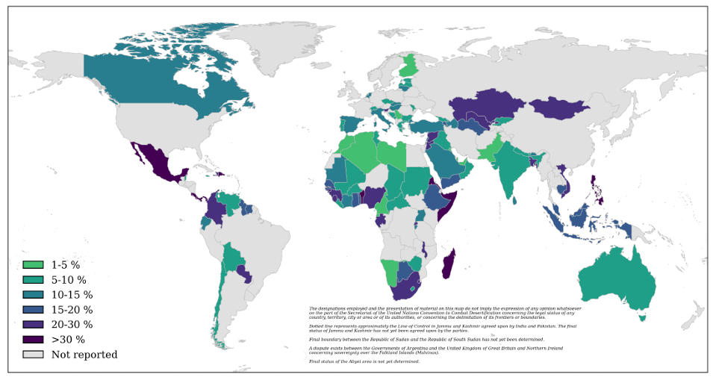
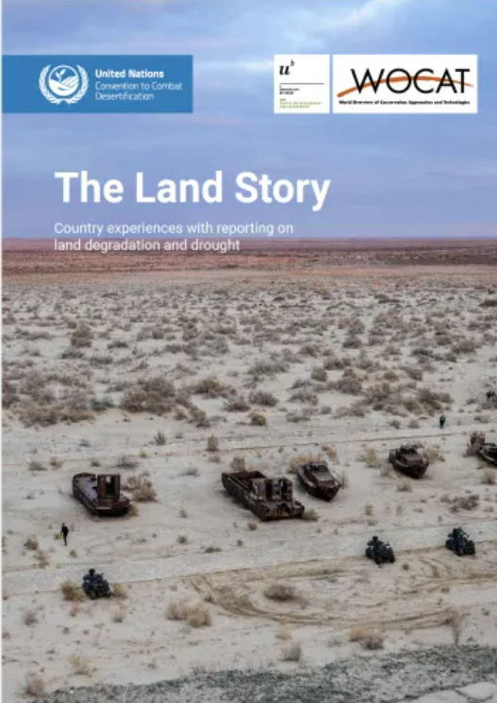
Building on lessons learnt and addressing specific challenges
2022 Reporting Process

Slide 4

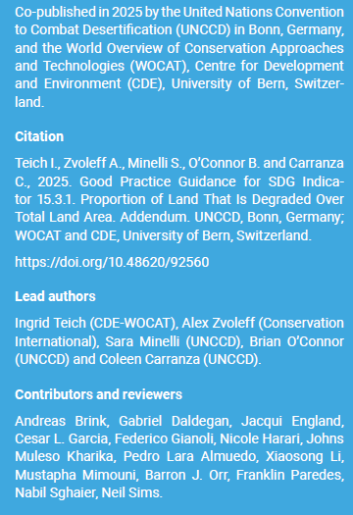









The GPG Addendum – SDG Indicator 15.3.1
A Collaborative Approach

Slide 5
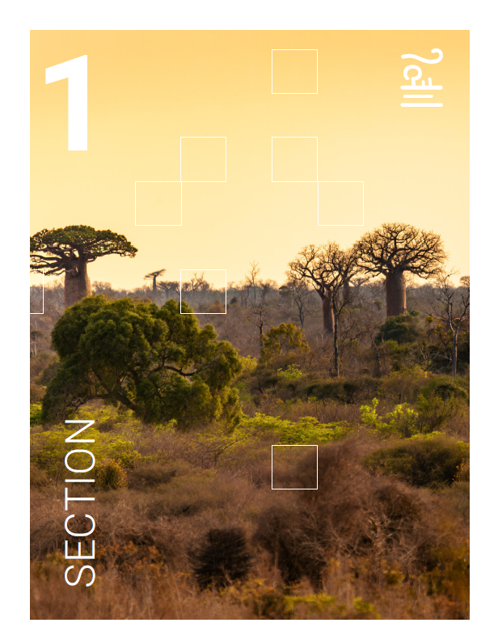
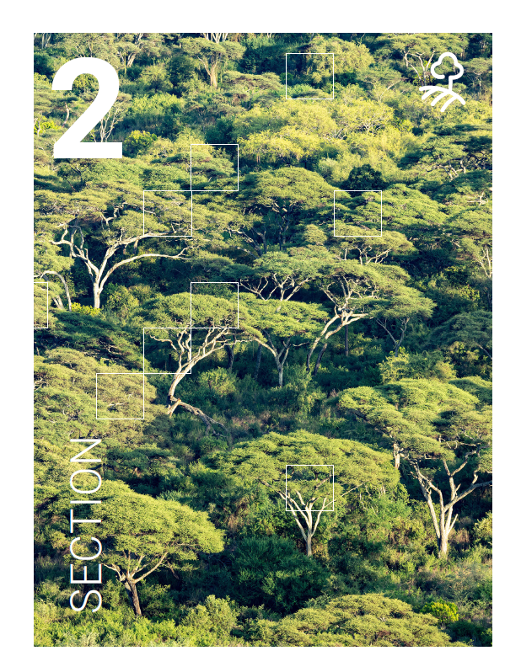

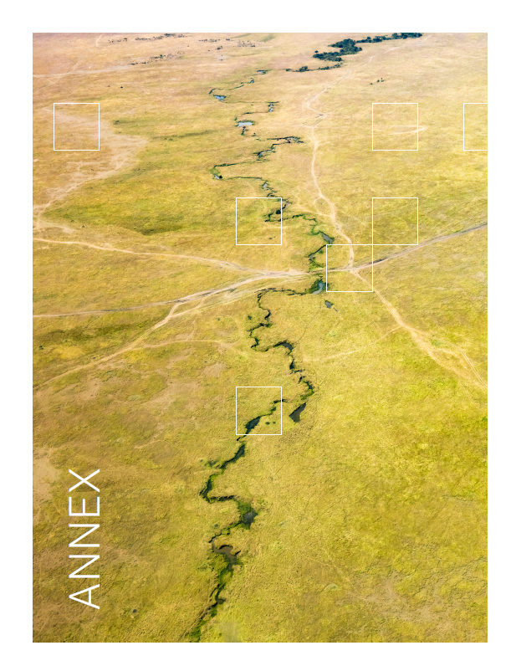
The GPG Addendum – SDG Indicator 15.3.1
Section 1
Section 2
Section 3
INTEGRATING
LAND CONDITION ASSESSMENTS OVER TIME
ENHANCEMENT OF DATASETS AND METHODOLOGIES
TRACKING PROGRESS TOWARDS LDN
Focusses on the timeframe of the data used to assess land condition in each reporting period, on how to integrate the period assessment with the baseline, as well as providing additional guidelines on how to interpret and visualize changes over time.
This section responds to the need for guidance on incorporating the improved land component and the neutrality mechanism into target setting, LDN intervention planning, prioritizing areas for investment, and tracking progress towards LDN.
Introduces new datasets related to land cover, land productivity, and soil organic carbon (SOC), and discusses various methods and experiences in comparing and selecting the most representative datasets for different contexts.
Annex
+
LAND PRODUCTIVITY DYNAMICS ALGORITHMS

Slide 6
INTEGRATING LAND CONDITION ASSESSMENTS OVER TIME

Slide 7
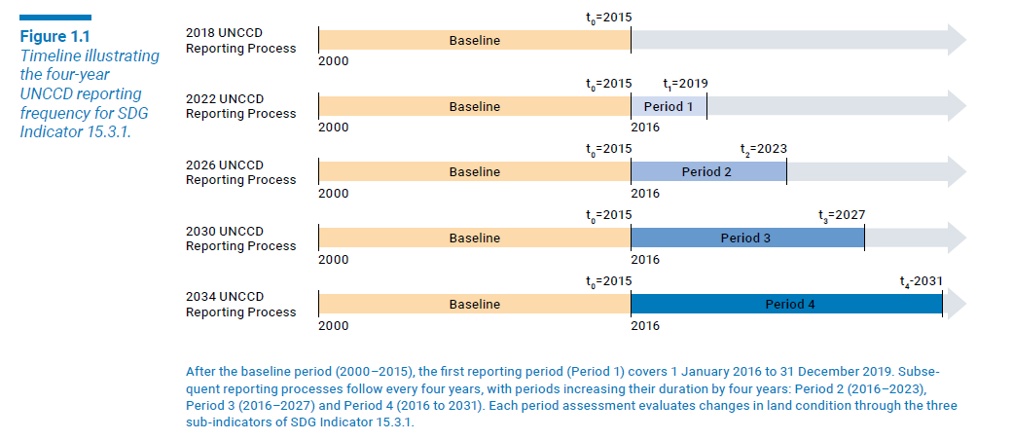
1.1 PERIOD assessment
After the baseline period (2000–2015), the first reporting period (Period 1) covers January 1, 2016, to December 31, 2019. Subsequent reporting processes follow every four years, with periods increasing their duration by four years: Period 2 spanning 2016–2023, Period 3 covering 2016–2027, and Period 4 assessing changes from 2016 to 2031. Each reporting period evaluates changes in land condition through the three sub-indicators.

Slide 8
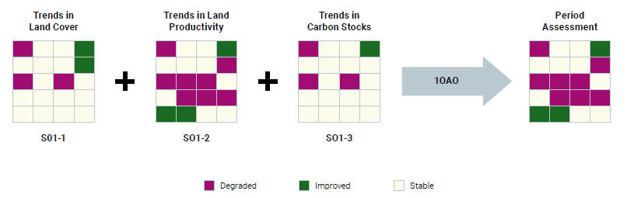
1.1 PERIOD assessment
For each reporting period a final map that shows the results of the period assessment is obtained. The “Period Assessment” is the result of the evaluation of land condition for a specific reporting period, based on the combination of the three sub-indicators (Trends in Land Cover, Trends in Land Productivity, and Trends in Carbon Stocks) by applying the one-out, all-out principle. The period assessment does not capture the degradation or improvement that occurred during the baseline period and therefore it cannot be used to estimate SDG indicator 15.3.1 on its own.

Slide 9
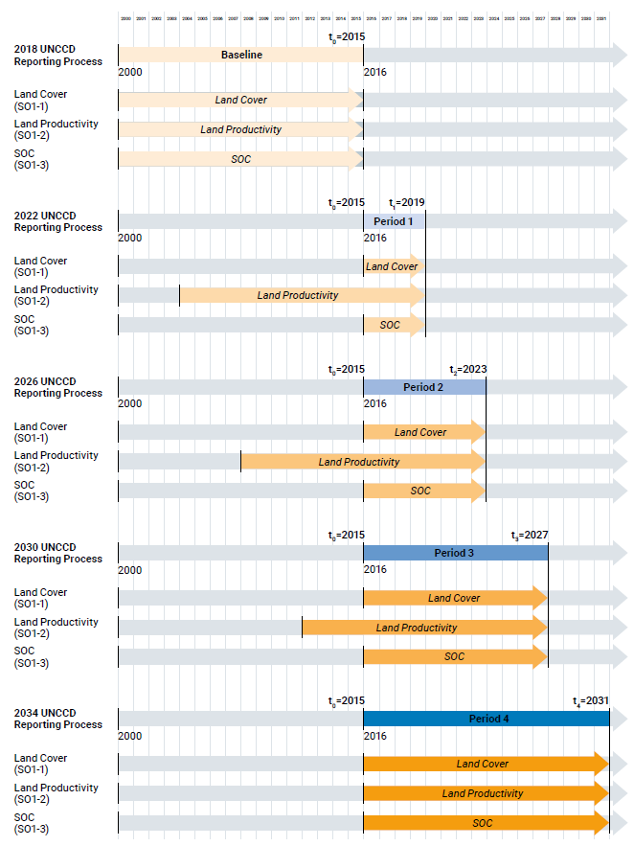
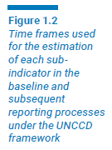
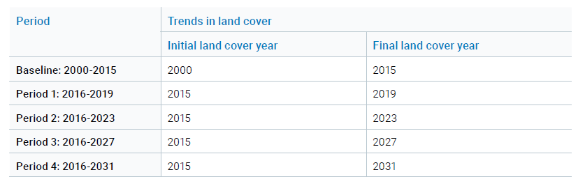
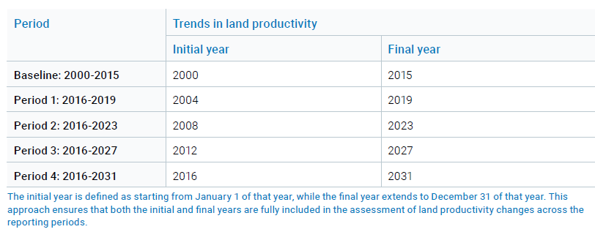
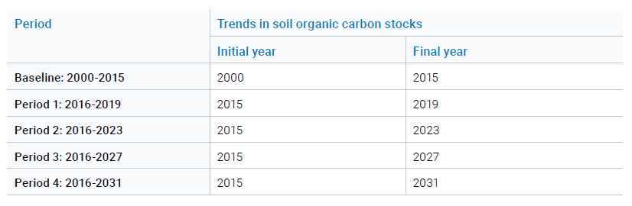
1.1 PERIOD assessment
Further clarification on the timeframes of the datasets used for Sub Indicator is included in the Addendum.

Slide 10
Is the period assessment enough to estimate the proportion of degraded land (SDG 15.3.1) in 2023?
+
STATUS
The Status is determined by combining the results of the current period assessment with the baseline assessment

Slide 11
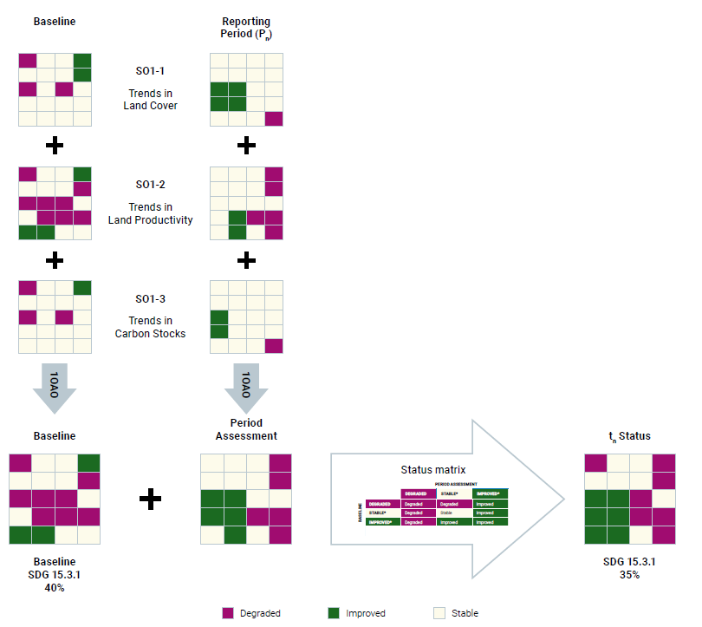
1.2 STATUS
Process of estimating land status for the baseline (2000-2015) and subsequent periods by comparing period assessments of the three Strategic Objective 1 (SO1) indicators with the baseline using the 3 x 3 Status matrix.

Slide 12
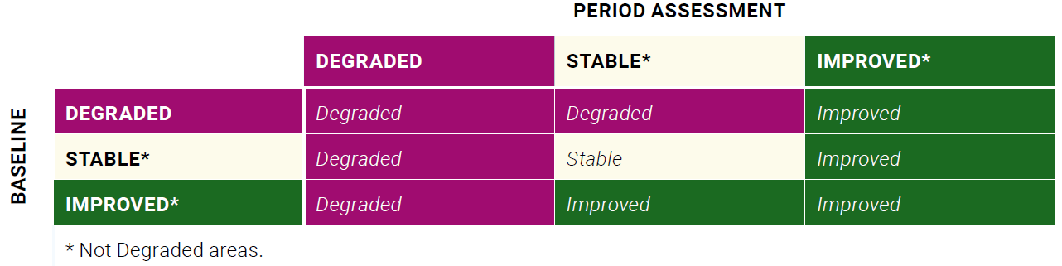
1.2 STATUS MATRIX
The “Status Matrix” allows a systematic comparison of the period assessment with the baseline to determine the status of land condition at pixel level.
The resulting map, called the Status Map, integrates the assessment of changes that occurred during the reporting period with the previous status of land condition (baseline). This approach ensures that the map reflects both past and recent changes, offering a more accurate overall assessment of land degradation and improvement over time.

Slide 13

The GPG Addendum – SDG Indicator 15.3.1
Definition of the Periods and data used for each indicator and metric in each period
Clarification and explicit methodology to compare baseline and period assessments

Slide 14
INTEGRATING LAND CONDITION ASSESSMENTS OVER TIME
Q&A

Slide 15
The GPG Addendum – SDG Indicator 15.3.1
Section 1
Section 2
Section 3
INTEGRATING
LAND CONDITION ASSESSMENTS OVER TIME
TRACKING PROGRESS TOWARDS LDN
ENHANCEMENT OF DATASETS AND METHODOLOGIES
Focusses on the timeframe of the data used to assess land condition in each reporting period, on how to integrate the period assessment with the baseline, as well as providing additional guidelines on how to interpret and visualize changes over time.
This section responds to the need for guidance on incorporating the improved land component and the neutrality mechanism into target setting, LDN intervention planning, prioritizing areas for investment, and tracking progress towards LDN.
Introduces new datasets related to land cover, land productivity, and soil organic carbon (SOC), and discusses various methods and experiences in comparing and selecting the most representative datasets for different contexts.
Annex
+
LAND PRODUCTIVITY DYNAMICS ALGORITHMS

Slide 16
TRACKING PROGRESS TOWARDS LDN

Slide 17
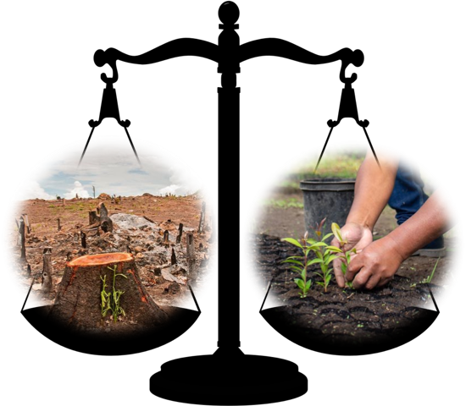
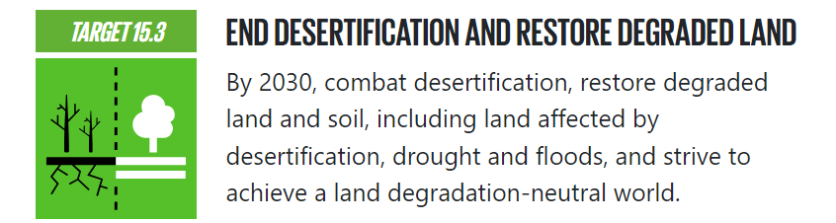

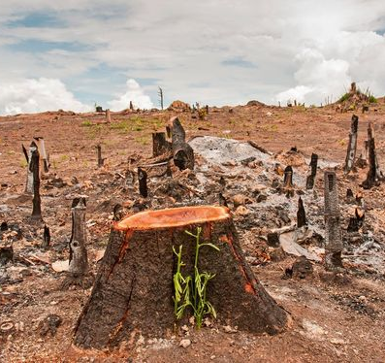
LDN
SDG target 15.3
SDG 15.3.1:
Proportion of degraded land

Slide 18
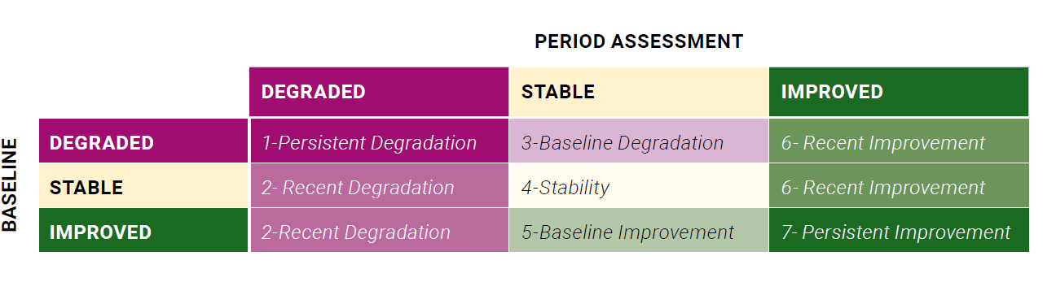
2.1 FURTHER CHARACTERIZATION
Even though the status maps categorize land condition into three broad categories (Degraded, Stable, and Improved), the underlying dynamics that lead to this final status can be more complex. Specifically, there are nine different types of changes from the baseline relative to any subsequent time period that can result in the final status, as illustrated in the 3 x 3 matrix of changes.
Table 2.1 Expanded version of the status matrix showing land condition that results from the comparison of the baseline (rows) and the period assessment (columns): degraded (purple), stable (yellow) and improved (green).

Slide 19
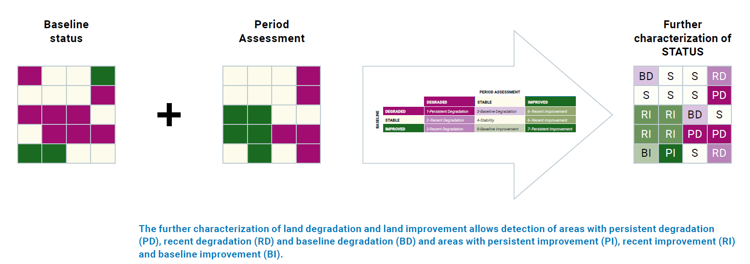
2.1 FURTHER CHARACTERIZATION of LD and IMPROVEMENT

Slide 20
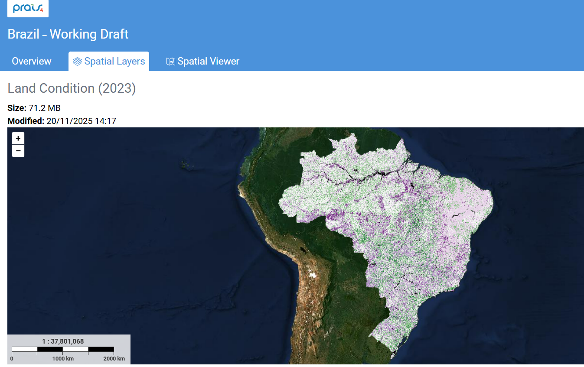
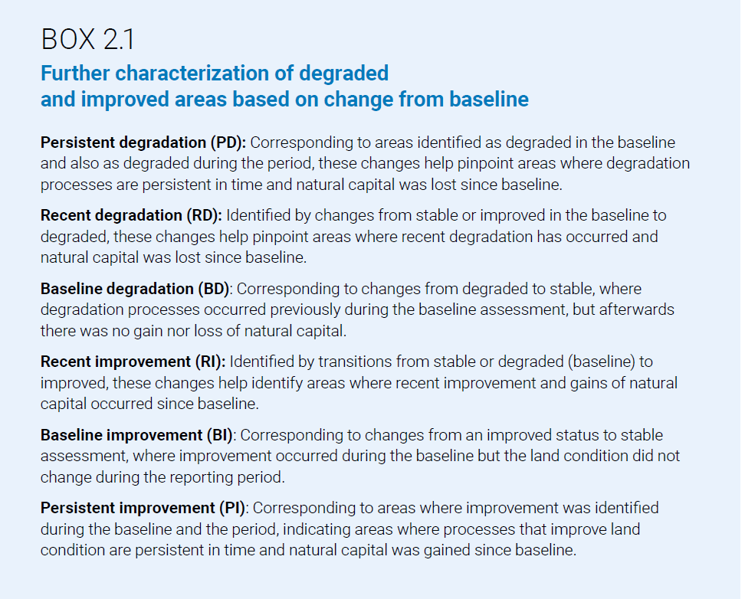
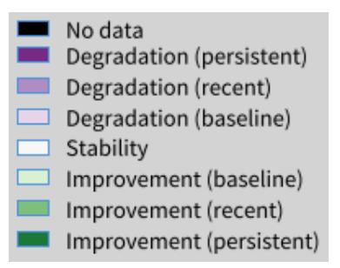
2.1 FURTHER CHARACTERIZATION

Slide 21
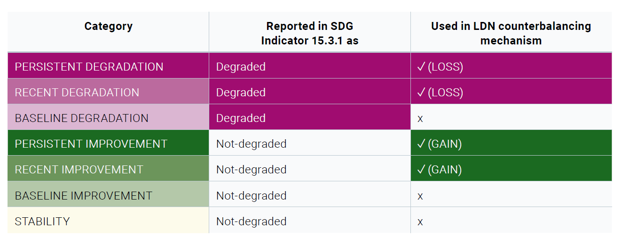
2.2 COUNTERBALANCING: MONITORING NEUTRALITY
Categories of land condition according to the expanded status characterization and their usage for estimation of SDG indicator 15.3.1 and for counterbalancing

Slide 22
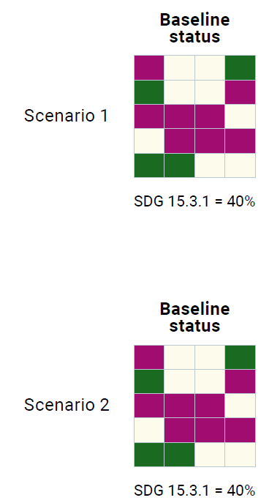
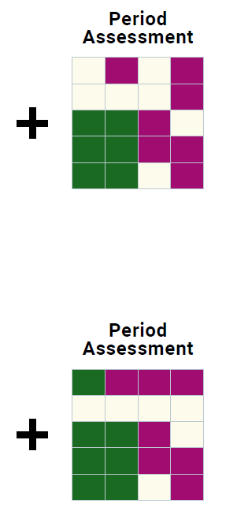
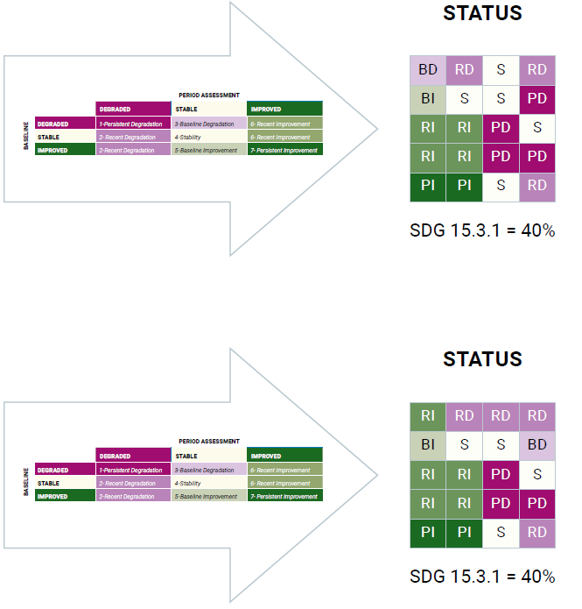
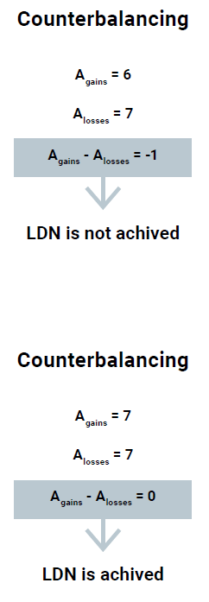


2.2.4 Step-by-step procedure to assess counterbalancing for LDN
STEP 1: Baseline assessment
STEP 2. Assessment of the reporting period
STEP 4. Calculate the difference between recent improvements and degradation for each land type
STEP 3. Expanded status matrix to calculate new status
STEP 5. Assess LDN achievement for each land type
STEP 6. Assess overall LDN achievement

Slide 23


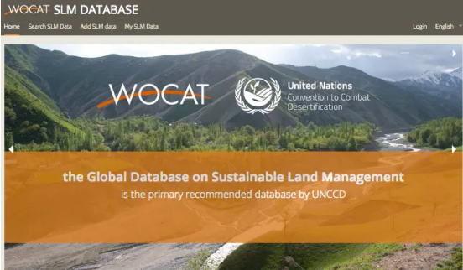
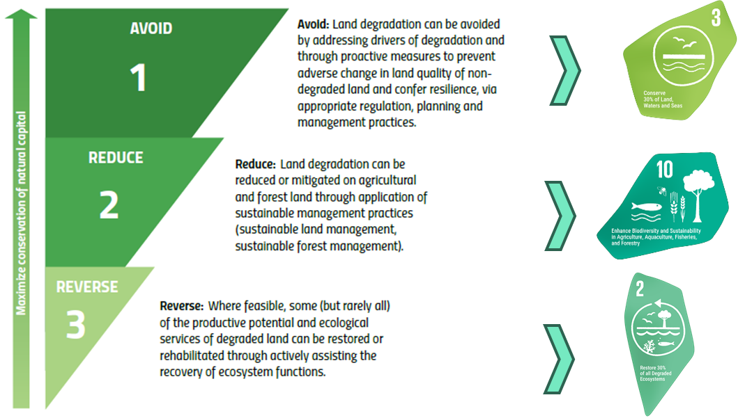
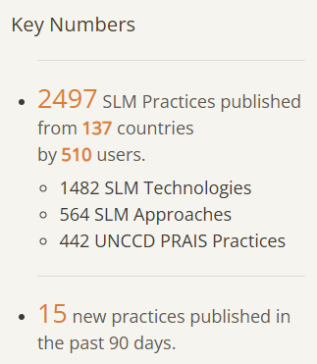

MAPPING IMPROVEMENT

Slide 24
The GPG Addendum – SDG Indicator 15.3.1
Definition of the Periods and data used for each indicator and metric in each period
Clarification and explicit methodology to compare baseline and period assessments
Enhanced understanding of land condition dynamics
Operationalization of counterbalancing
Notes:
Improved temporal consistency: A simplified approach to integrating land condition assessments over reporting processes, using clearly defined reporting periods and status mapping, enables more consistent time-series analysis of SDG Indicator 15.3.1; Enhanced understanding of land condition dynamics: By distinguishing between recent and baseline degradation and improvement, the expanded status matrix allows for a more detailed interpretation of temporal change. This facilitates better targeting of land restoration interventions;
Operationalization of counterbalancing: For the first time, detailed guidance is provided on applying the counterbalancing principle to assess progress toward LDN. This approach ensures that new degradation is matched by equivalent gains in natural capital within the same land type, thereby supporting the goal of “no net loss” and promoting land-use planning that considers progress towards LDN;

Slide 25
TRACKING PROGRESS TOWARDS LDN
Q&A

Slide 26
The GPG Addendum – SDG Indicator 15.3.1
Section 1
Section 2
Section 3
INTEGRATING
LAND CONDITION ASSESSMENTS OVER TIME
TRACKING PROGRESS TOWARDS LDN
ENHANCEMENT OF DATASETS AND METHODOLOGIES
Focusses on the timeframe of the data used to assess land condition in each reporting period, on how to integrate the period assessment with the baseline, as well as providing additional guidelines on how to interpret and visualize changes over time.
This section responds to the need for guidance on incorporating the improved land component and the neutrality mechanism into target setting, LDN intervention planning, prioritizing areas for investment, and tracking progress towards LDN.
Introduces new datasets related to land cover, land productivity, and soil organic carbon (SOC), and discusses various methods and experiences in comparing and selecting the most representative datasets for different contexts.
Annex
+
LAND PRODUCTIVITY DYNAMICS ALGORITHMS

Slide 27
ENHANCEMENT OF DATASETS AND METHODOLOGIES

Slide 28
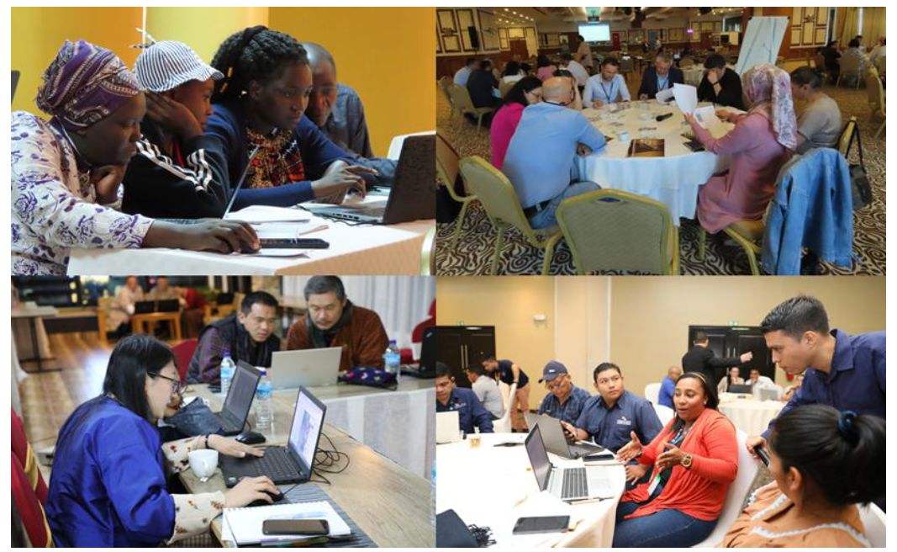



Enhancements for assessing:
3.1 Trends in land cover
3.2 Trends in land productivity
3.3 Trends in Carbon Stocks (SOC)
High resolution datasets
New Tools
Workflows
Participatory Processes

Slide 29
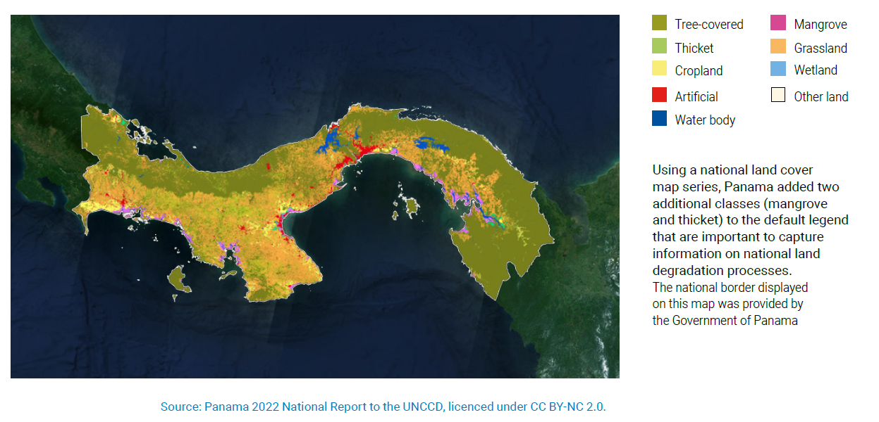
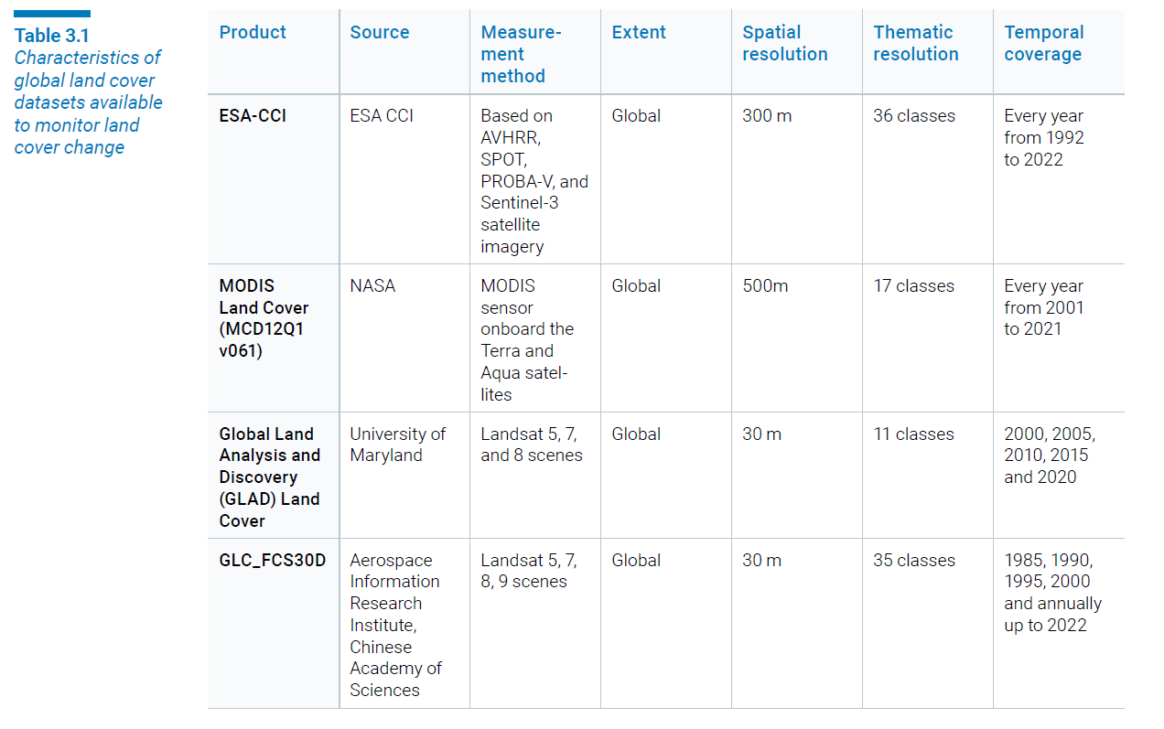
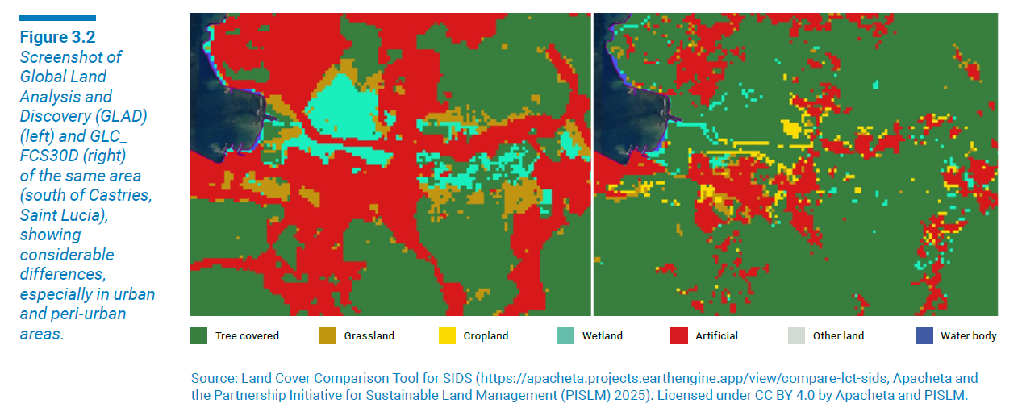
3.1 Enhancements for Assessing Trends in Land Cover
3.1.1 Identification of the best available land cover dataset
Participatory processes
New datasets

Slide 30
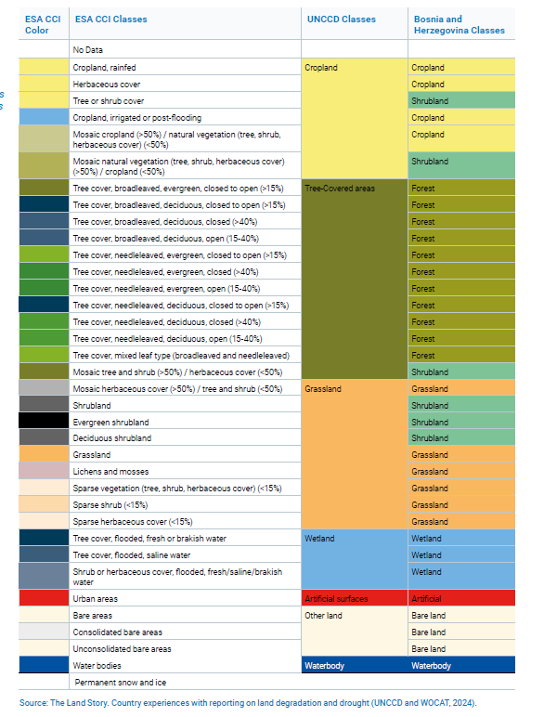
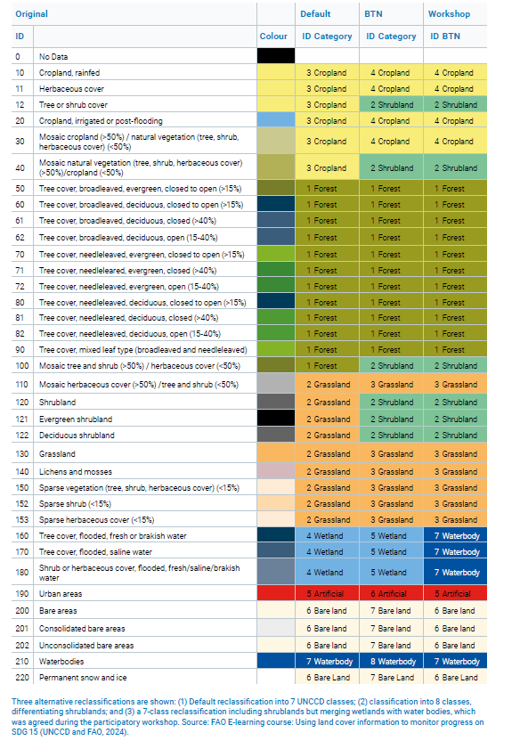
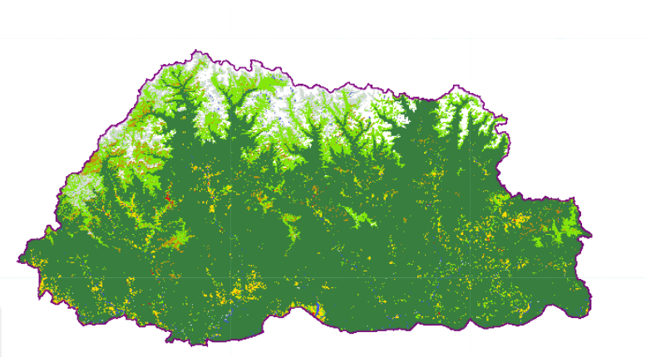
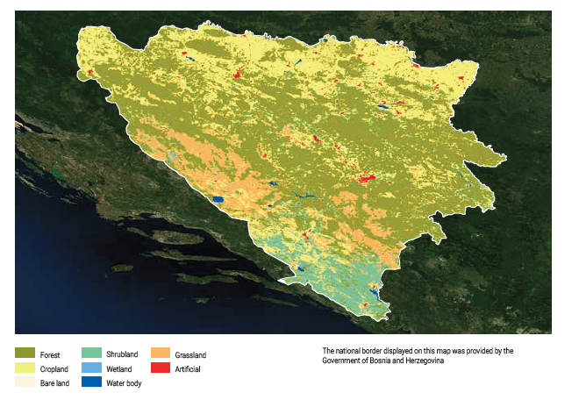
3.1 Enhancements for Assessing Trends in Land Cover
3.1.2 Selecting a land cover legend for monitoring key degradation processes
02

Slide 31
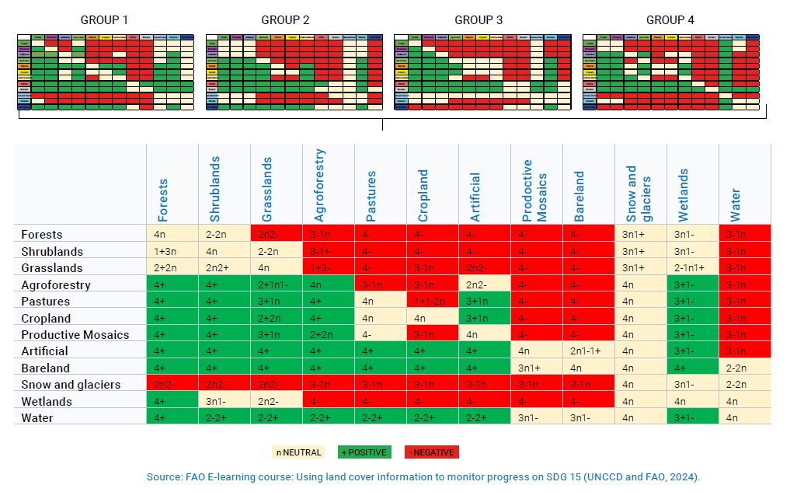
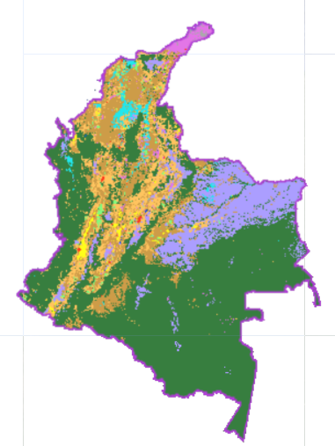
3.1 Enhancements for Assessing Trends in Land Cover
3.1.3 Defining the land cover transition matrix

Slide 32
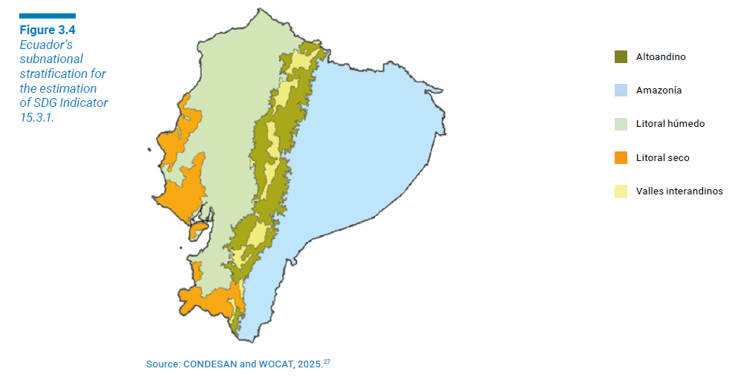
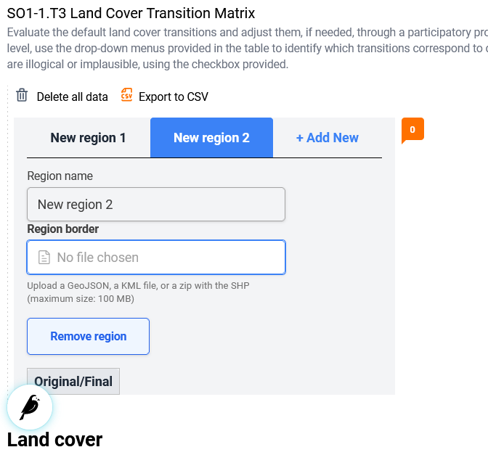
3.1 Enhancements for Assessing Trends in Land Cover
3.1.3 Defining the land cover transition matrix

Slide 33
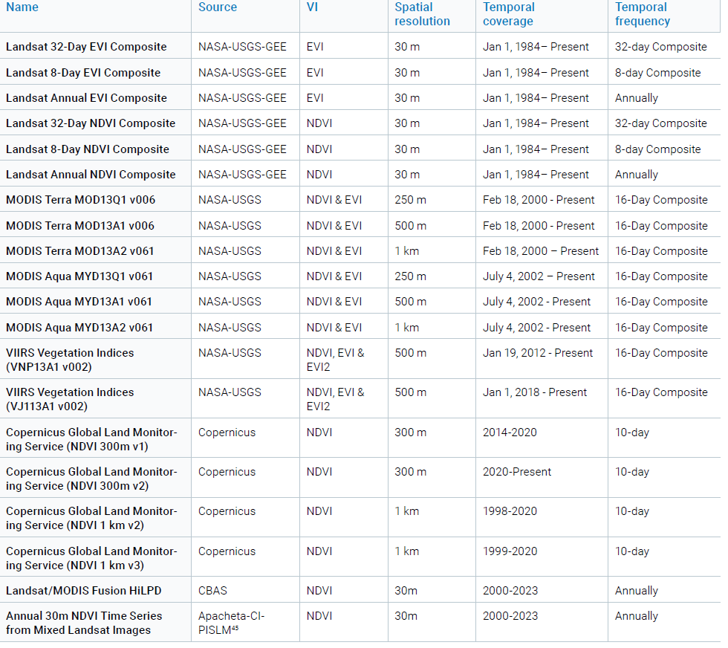
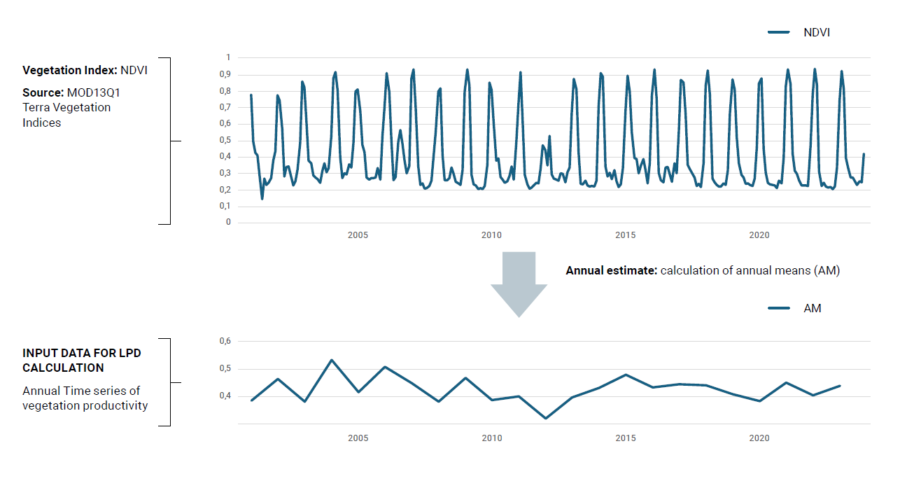
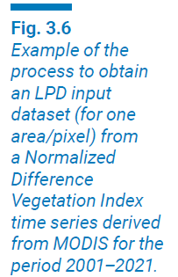
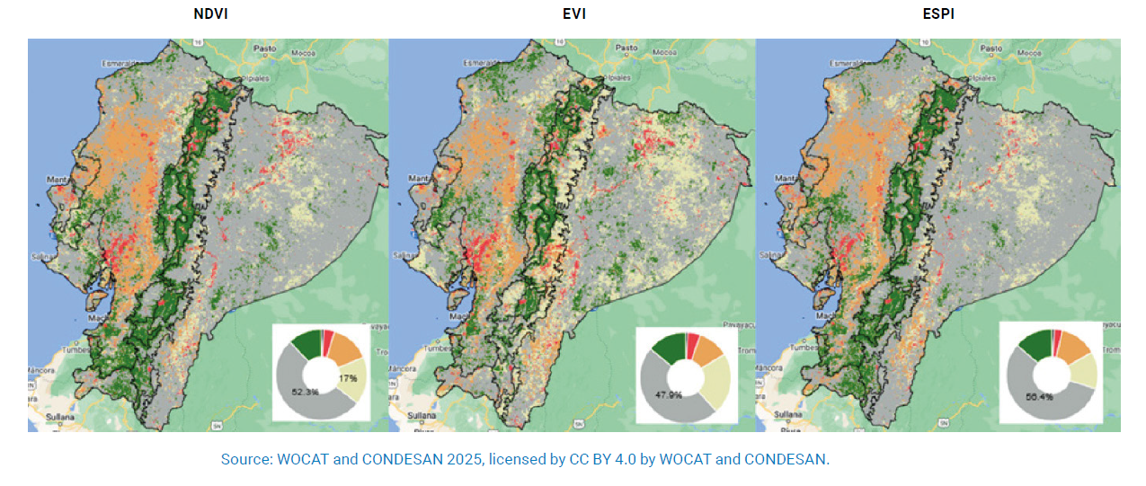
3.2 Enhancements for Assessing Trends in Land Productivity
3.2.1 The LPD input dataset
Datasets
Examples

Slide 34
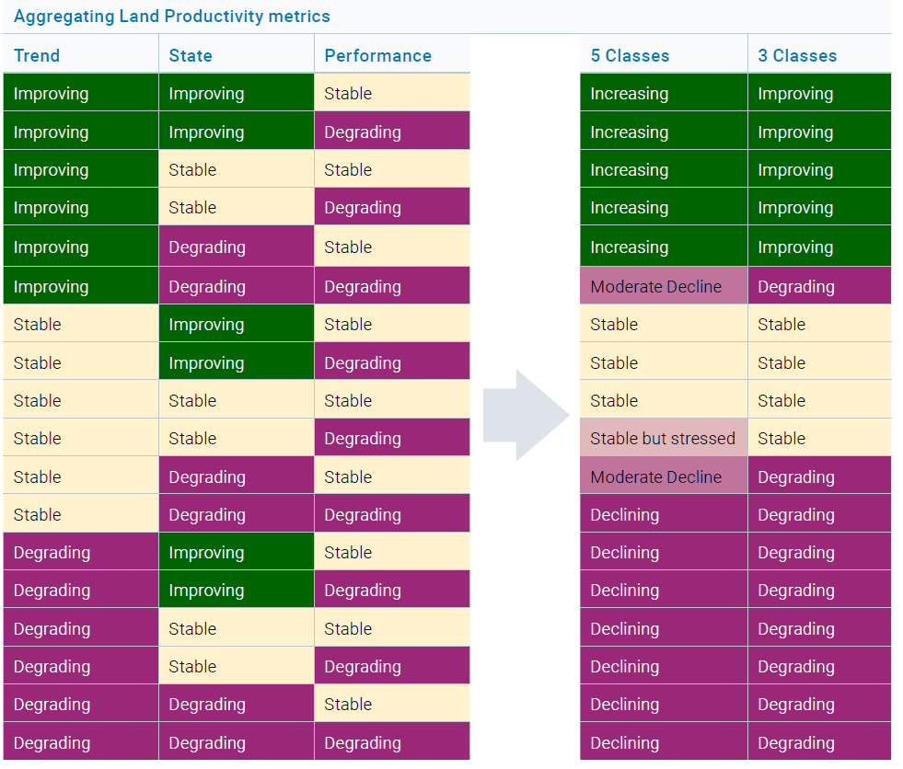
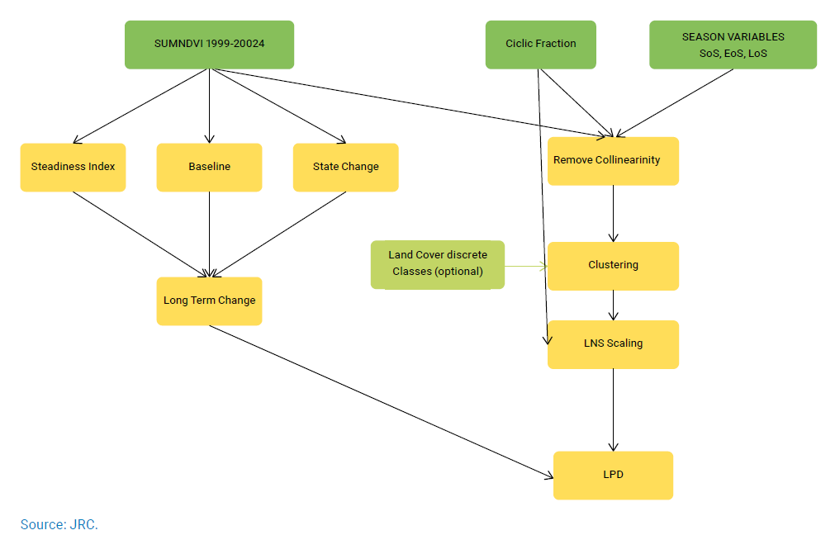
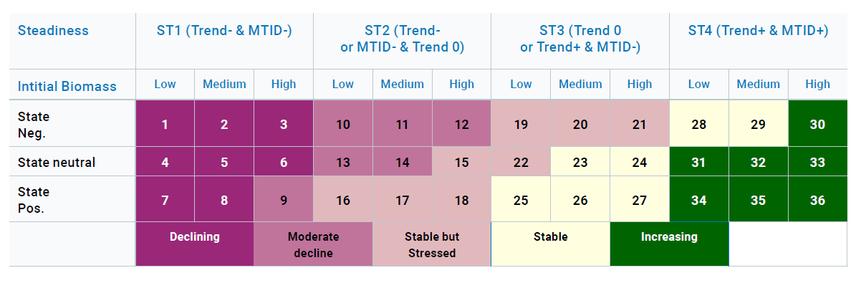
3.2 Enhancements for Assessing Trends in Land Productivity
3.2.2 The LPD algorithm: parametrizing and estimating LPD models
Trends.Earth LPD algorithm
Joint Research Centre LPD algorithm
:
FAO-WOCAT LPD algorithm

Slide 35



3.2 Enhancements for Assessing Trends in Land Productivity
3.2.3 Verifying results and selecting the most representative LPD dataset

Slide 36


3.2 Enhancements for Assessing Trends in Land Productivity
3.2.4 Workflow for selecting the most representative LPD map
Step 1: Establishing a Multidisciplinary Group of Experts
Step 2: Training and Capacity Building
Step 3: Determining the Need for a Subnational Analysis
Step 4: Exploring Alternative LPD Datasets
Step 5: Identifying Verification Data and Expert Knowledge
Step 6: Comparing the Performance of Alternative LPD Maps
Step 7: Selecting the Most Representative LPD Map

Slide 37




Annex: Default versions of globally available LPD maps
Co-authors:
Andreas Brink, Gabriel Daldegan, Cesar L. Garcia, Federico Gianoli, Ingrid Teich and Alex Zvoleff
FAO-WOCAT LPD default dataset
FAO-WOCAT LPD default dataset
Joint Research Centre default dataset
:

Slide 38



3.3 Enhancements for Assessing Trends in Carbon Stocks
3.3.1 Combined land cover/SOC method (Tier 1 and 2 methods)
STEP 1: Establish SOC reference values
STEP 2: Map land cover changes for SOC change estimation
STEP 3: Calculate SOC changes
STEP 4: Identify significant SOC changes

Slide 39

3.3 Enhancements for Assessing Trends in Carbon Stocks
3.3.1 Combined land cover/SOC method (Tier 1 and 2 methods)
Conclusion
The initial SOC stock does not influence whether an area is classified as degraded or improved.
The key drivers are the land cover transition (which determines CF) and the duration of change.
If ((CF−1) × T ) / 20 is less than –0.1, then the area is degraded.
If ((CF−1) × T ) / 20 is greater than 0.1, then the area is improving.
This reinforces the importance of accurate conversion factors and appropriate timeframes in estimating SOC trends.

Slide 40

3.3 Enhancements for Assessing Trends in Carbon Stocks
3.3.2 Alternative methods to estimate changes in SOC

Slide 41
The GPG Addendum – SDG Indicator 15.3.1
Definition of the Periods and data used for each indicator and metric in each period
Clarification and explicit methodology to compare baseline and period assessments
Enhanced understanding of land condition dynamics
Operationalization of counterbalancing
Support for country-driven approaches:
Integration with global tools and platforms
Strengthened basis for SLM and policy
Notes:
Improved temporal consistency: A simplified approach to integrating land condition assessments over reporting processes, using clearly defined reporting periods and status mapping, enables more consistent time-series analysis of SDG Indicator 15.3.1; Enhanced understanding of land condition dynamics: By distinguishing between recent and baseline degradation and improvement, the expanded status matrix allows for a more detailed interpretation of temporal change. This facilitates better targeting of land restoration interventions;
Operationalization of counterbalancing: For the first time, detailed guidance is provided on applying the counterbalancing principle to assess progress toward LDN. This approach ensures that new degradation is matched by equivalent gains in natural capital within the same land type, thereby supporting the goal of “no net loss” and promoting land-use planning that considers progress towards LDN;
Support for country-driven approaches: This addendum encourages the use of nationally verified datasets and local expertise, reinforcing national ownership of the monitoring and reporting process;
Integration with global tools and platforms: The methodologies described in the addendum will be implemented as executable code in free and open-access software such as Trends.Earth, ensuring that the guidance is not only theoretically sound but also practically implementable;
Strengthened basis for SLM and policy: By enabling the identification of spatial patterns of degradation and improvement, and quantification of changes in natural capital, this addendum empowers countries to link monitoring outcomes with real-world interventions and offers valuable tools for planning, implementing and evaluating SLM practices.

Slide 42
ENHANCEMENT OF DATASETS AND METHODOLOGIES
Q&A

Slide 43


Presentation available here: https://wocat.net/en/wocat-media-library/sdg-1531-gpg-addendum/ For questions, feel free to reach out: ingrid.teich@unibe.ch
Thank you
www.wocat.net

