Slide 1



SDG Indicator 15.3.1: Methodology and new guidance
Dr. Ingrid Teich
Senior Research Scientist (University of Bern)
WOCAT Secretariat

Slide 2

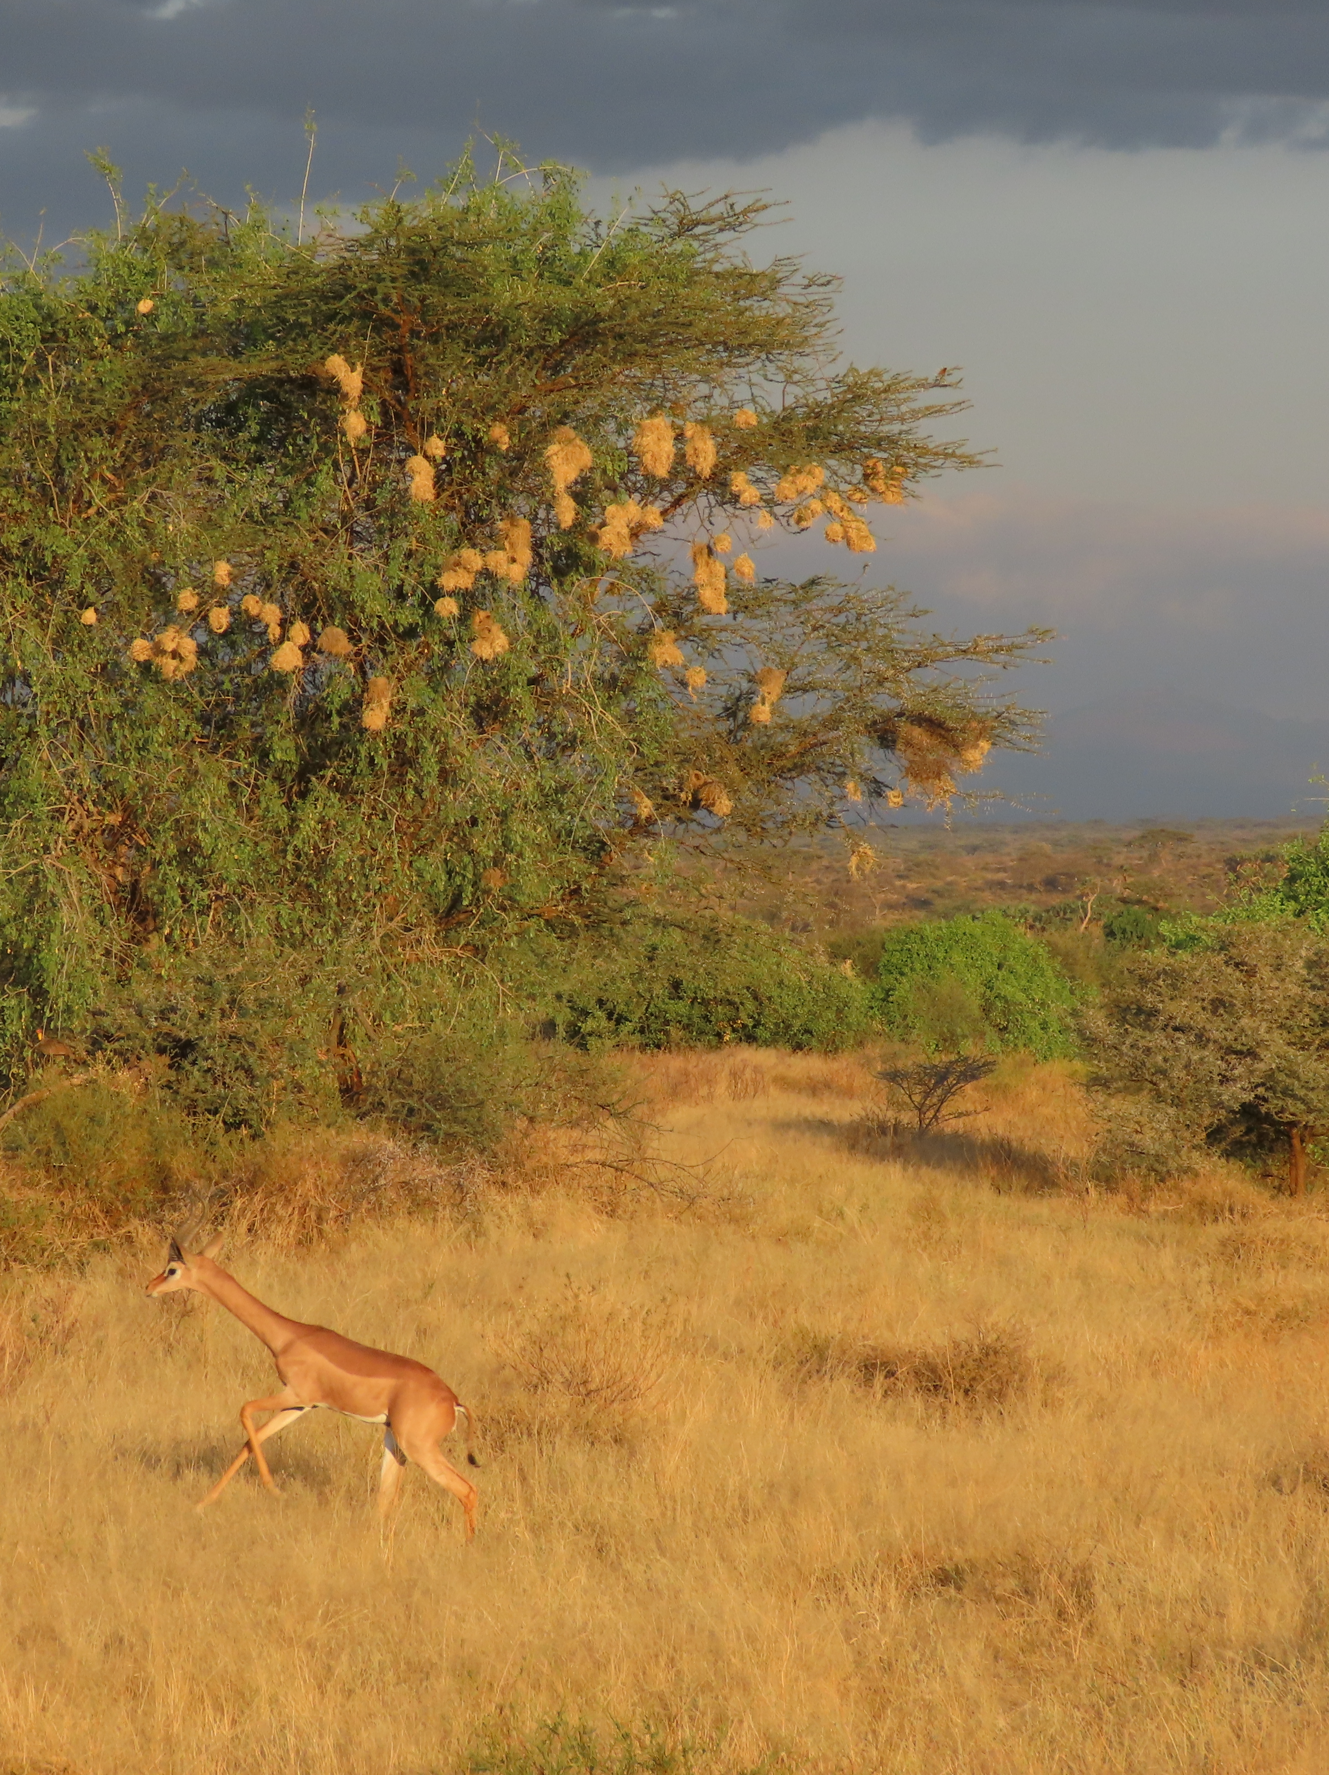
2018-2030 UNCCD Strategic Framework
STRATEGIC OBJECTIVE 1
To improve the condition of affected ecosystems, combat desertification/land degradation, promote sustainable land management and contribute to land degradation neutrality.

Slide 3
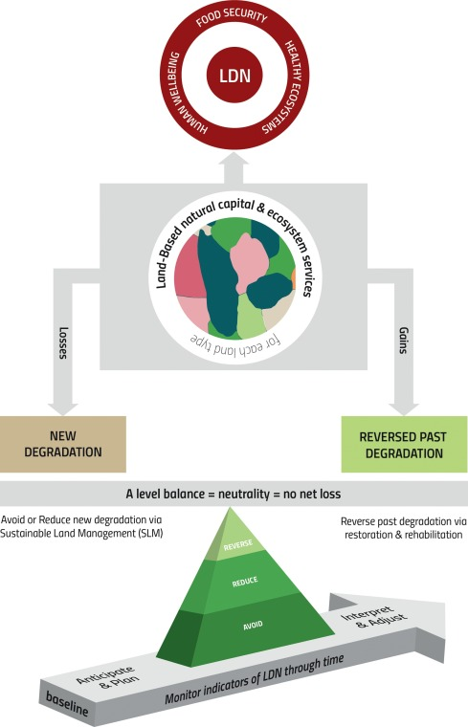
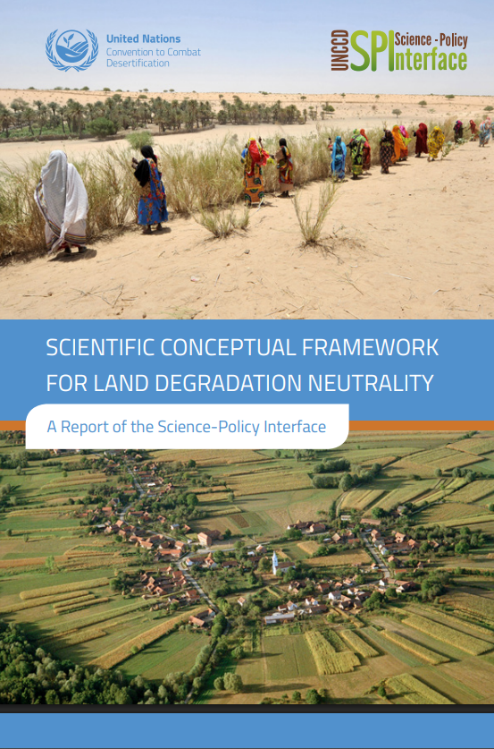
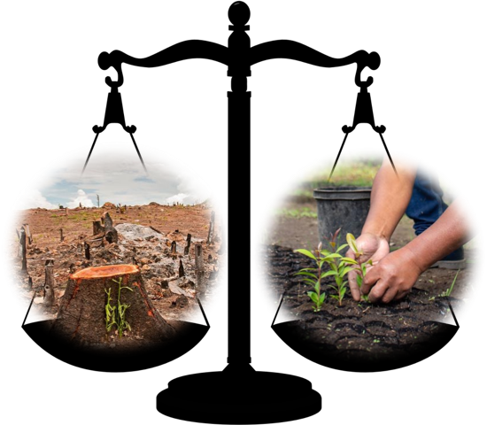
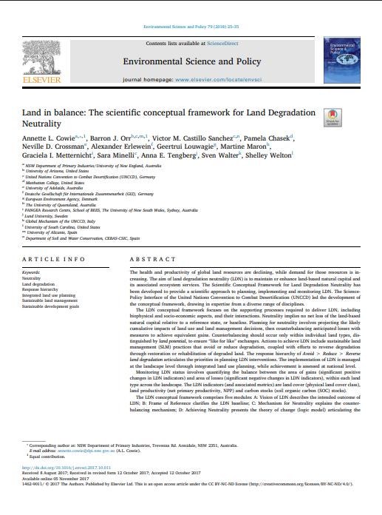
Land Degradation Neutrality
The concept of LDN was introduced into the global dialogue by the United Nations Convention to Combat Desertification (UNCCD), accepted by the international community during the Rio+20 conference in 2012 and adopted as part of the 2030 Agenda for Sustainable Development in 2015.
LDN aims to preserve the land by ensuring no net loss of healthy and productive land via a combination of measures that avoid, reduce and reverse land degradation.
Notes:
The concept of LAND DEGRADATION NEUTRALITY (LDN) was introduced into the global dialogue by the United Nations Convention to Combat Desertification (UNCCD), accepted by the international community during the Rio+20 conference in 2012 and adopted as part of the 2030 Agenda for Sustainable Development in 2015. LDN aims to preserve the land resource base by ensuring no net loss of healthy and productive land via a combination of measures that avoid, reduce and reverse land degradation. Achieving neutrality requires estimating the likely impacts of land-use and land management decisions, then counterbalancing anticipated losses through strategically planned rehabilitation or restoration of degraded land within the same land type.
Policies and programmes to halt and reverse land degradation have long suffered from the absence of a clear overarching goal and quantitative, time-bound targets to guide action and make measurable progress. In October 2015, UNCCD country Parties reached a breakthrough agreement on the land degradation neutrality (LDN) concept.
The LDN concept has been developed to encourage the implementation of an optimal mix of measures designed to avoid, reduce and/or reverse land degradation in order to achieve a state of no net loss of healthy and productive land. LDN aims to balance anticipated losses in land-based natural capital and associated ecosystem functions and services with measures that produce alternative gains through approaches such as land restoration and sustainable land management. The knowledge base for the LDN concept is still evolving.
More information:
https://www.unccd.int/sites/default/files/relevant-links/2017-08/v2_201309-unccd-bro_web_final.pdf
https://www.unccd.int/actions/achieving-land-degradation-neutrality
Lal, R.; Safriel, U.; Boer, B. 2012. Zero Net Land Degradation: A New Sustainable Development Goal for Rio+ 20; A report prepared for the Secretariat of the United Nations Convention to Combat Desertification; UNCCD: Bonn, Germany, 2012.
Orr, B.J., A.L. Cowie, V.M. Castillo Sanchez, P. Chasek, N.D. Crossman, A. Erlewein, G. Louwagie, M. Maron, G.I. Metternicht, S. Minelli, A.E. Tengberg, S. Walter, and S. Welton. 2017. Scientific Conceptual Framework for Land Degradation Neutrality. A Report of the Science-Policy Interface. United Nations Convention to Combat Desertification (UNCCD), Bonn, Germany.
Cowie, A. 2020. Guidelines for Land Degradation Neutrality: A report prepared for the Scientific and Technical Advisory Panel of the Global Environment Facility, Washington D.C.

Slide 4
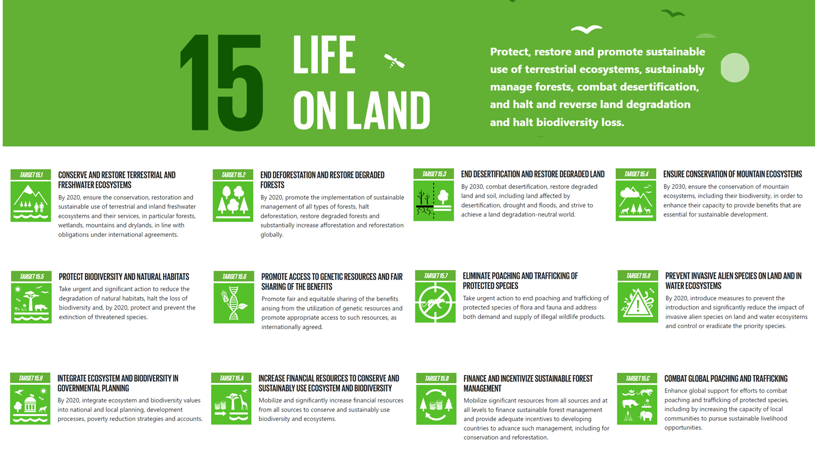

Slide 5
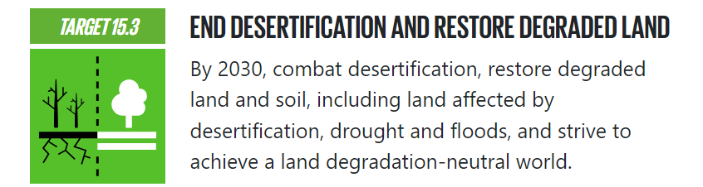

SDG indicator 15.3.1
UNCCD is the CUSTODIAN AGENCY
WHAT IS A CUSTODIAN AGENCY?
The institution responsible for compiling and verifying country data and metadata of a particular SDG indicator; and for submitting the data, along with regional and global aggregates to the United Nations Statistics Division. It also provides Technical guidance to countries.
The institution responsible for compiling and verifying country data and metadata of a particular SDG indicator; and for submitting the data, along with regional and global aggregates to the United Nations Statistics Division. It also provides Technical guidance to countries.
To monitor progress towards achieving SDG Target 15.3, one indicator was adopted.
SDG indicator 15.3.1:
Proportion of land that is degraded over total land area
The UNCCD is the Custodian Agency of SDG indicator 15.3.1
The UNCCD is the Custodian Agency of SDG indicator 15.3.1
Notes:
SDG target 15.3.1 has only one indicator: SDG Indicator 15.3.1, which is the ‘Proportion of land that is degraded over total land area’. The United Nations Convention to Combat Desertification (UNCCD) is the custodian agency for SDG indicator 15.3.1, which was proposed by the Inter-Agency and Expert Group on SDG indicators (IAEG-SDGs) and adopted by the UN Statistical Commission in March 2017 to monitor progress towards achieving SDG Target 15.3.
More information:
https://unstats.un.org/sdgs/indicators/indicators-list/
https://unstats.un.org/sdgs/iaeg-sdgs/tier-classification/
https://unstats.un.org/sdgs/report/2019/goal-15/

Slide 6

LDN and SDG target 15.3
LDN
SDG 15.3
SO1
“a state whereby the amount and quality of land resources necessary to support ecosystem functions and services and enhance food security remain stable or increase within specified temporal and spatial scales and ecosystems”
By 2030, combat desertification, restore degraded land and soil, including land affected by desertification, drought and floods, and strive to achieve a land degradation-neutral world.
To improve the condition of affected ecosystems, combat desertification/land degradation, promote sustainable land management and contribute to land degradation neutrality
Notes:
LDN: LDN Scientific Framework - https://www.unccd.int/sites/default/files/2018-09/LDN_CF_report_web-english.pdf
UNCCD Strategic Framework: https://www.unccd.int/sites/default/files/inline-files/ICCD_COP%2813%29_L.18-1716078E_0.pdf

Slide 7
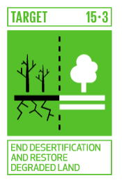
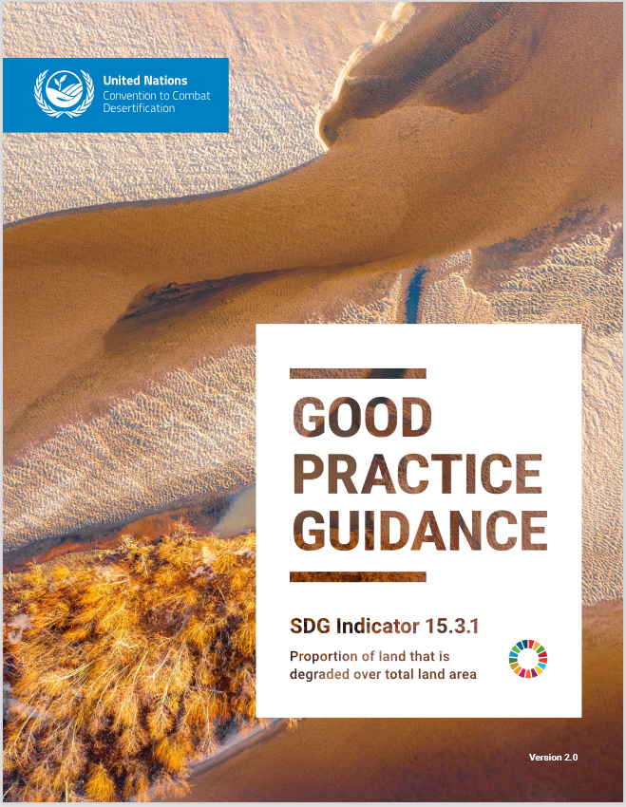
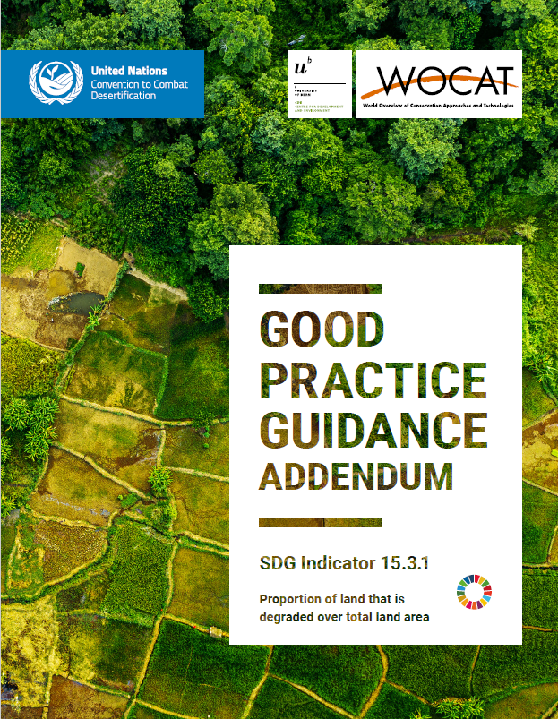
SDG 15.3.1
PROPORTION OF LAND THAT IS DEGRADED
TRENDS IN LAND COVER
TRENDS IN LAND PRODUCTIVITY
TRENDS IN CARBON STOCKS
“transformational” variable
“fast” ecological variable
“slow” ecological variable
SO1-1
SO1-2
SO1-3
“While it is difficult for a single indicator to fully capture the state or condition of the land, the sub-indicators are proxies to monitor the essential variables that reflect the capacity of the land to deliver ecosystem services” Sims et al. 2021
Notes:
By establishing and implementing relevant SLM measures, it is expected that land degradation will be avoided, reduced, or reversed (according to the UNCCD response hierarchy), enabling progress towards a land degradation neutral world (SDG 15.3). Accordingly, it is expected that these changes will eventually impact on the proportion of land that is degraded over total land area (SDG indicator 15.3.1). To assess this indicator, the Good Practice Guidance (GPG, Sims et al. 2019; Sims et al., 2021), developed by the UNCCD, recommends the calculation of three Change of State indicators: (1) Trends in land cover, (2) Trend in land productivity or functioning of the land and (3) trends in carbon stocks above and below ground. Regional and global datasets derived from global earth observation systems play an important role to obtain these indicators, particularly for assessing changes in land productivity and land cover dynamics
The results of the degradation analysis for each of the sub-indicators are integrated using a one out- all-out (1OAO) method in which a significant reduction or negative change in any one of the three sub-indicators is considered to comprise land degradation. The GPG provides details on how to calculate the extent of land degradation for reporting on SDG Indicator 15.3.1 according to the Tier I methods adopted by the UN Statistical Commission.
It is important to notice that it is difficult for a single indicator to fully capture the state or condition of the land. The sub-indicators are proxies to monitor the essential variables that reflect the capacity of the land to deliver ecosystem services, but additional sub-indicators may be required to fully assess land degradation in some areas and under certain conditions.
More information:
https://www.unccd.int/sites/default/files/documents/2021-09/UNCCD_GPG_SDG-Indicator-15.3.1_version2_2021.pdf
Teich, I., Gonzalez Roglich, M., Corso, M.L. and García, C.L. 2019. Combining Earth Observations, Cloud Computing, and Expert Knowledge to Inform National Level Degradation Assessments in Support of the 2030 Development Agenda. Remote Sens., 11: 2918.

Slide 8
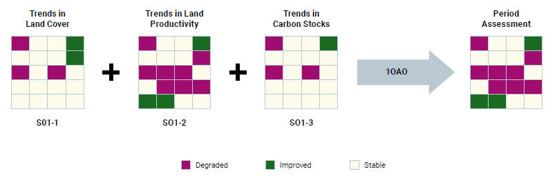
One Out All Out Principle

Slide 9

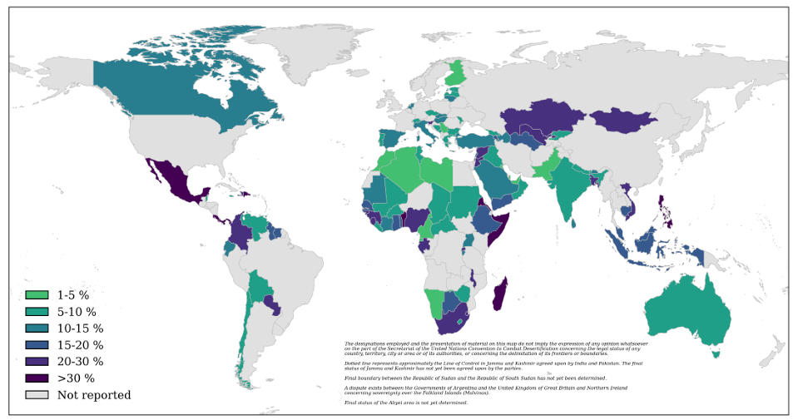
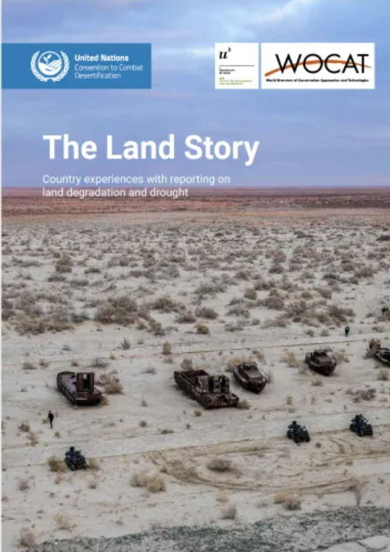
Building on lessons learnt and addressing specific challenges
2022 Reporting Process

Slide 10



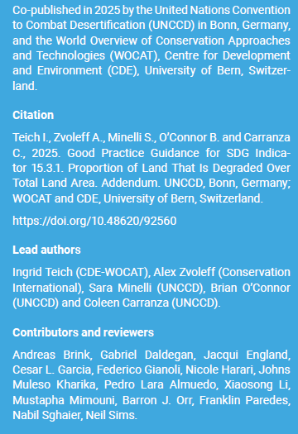








The GPG Addendum – SDG Indicator 15.3.1
A Collaborative Approach

Slide 11
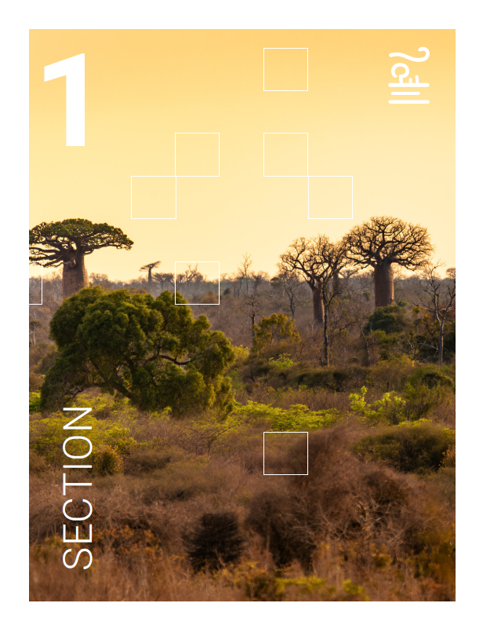
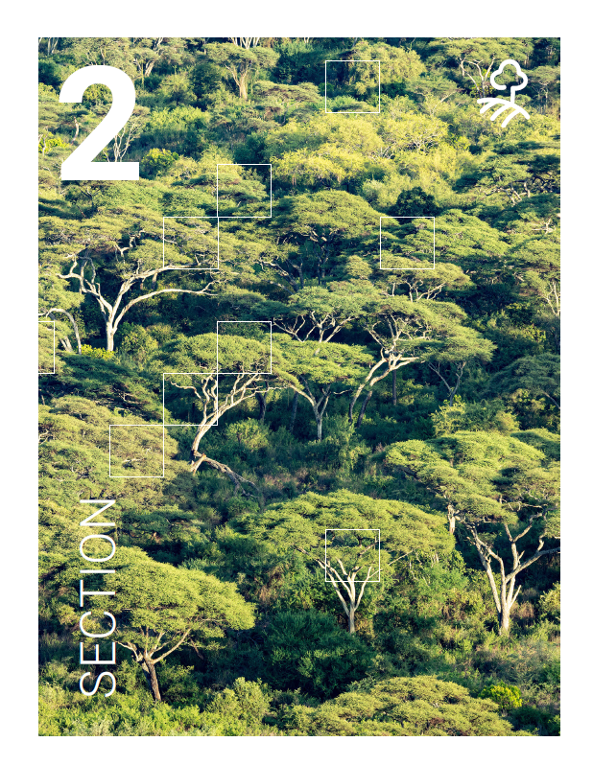

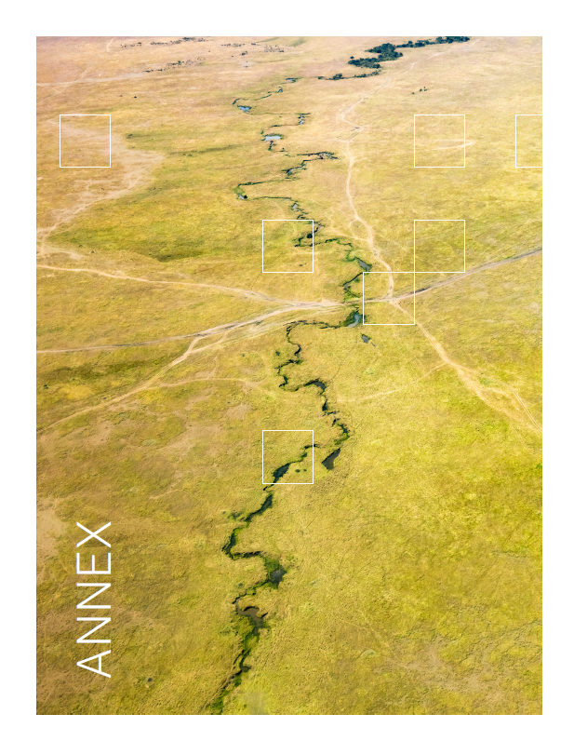
The GPG Addendum – SDG Indicator 15.3.1
Section 1
Section 2
Section 3
INTEGRATING
LAND CONDITION ASSESSMENTS OVER TIME
ENHANCEMENT OF DATASETS AND METHODOLOGIES
TRACKING PROGRESS TOWARDS LDN
Focusses on the timeframe of the data used to assess land condition in each reporting period, on how to integrate the period assessment with the baseline, as well as providing additional guidelines on how to interpret and visualize changes over time.
This section responds to the need for guidance on incorporating the improved land component and the neutrality mechanism into target setting, LDN intervention planning, prioritizing areas for investment, and tracking progress towards LDN.
Introduces new datasets related to land cover, land productivity, and soil organic carbon (SOC), and discusses various methods and experiences in comparing and selecting the most representative datasets for different contexts.
Annex
+
LAND PRODUCTIVITY DYNAMICS ALGORITHMS

Slide 12
INTEGRATING
LAND CONDITION ASSESSMENTS OVER TIME

Slide 13
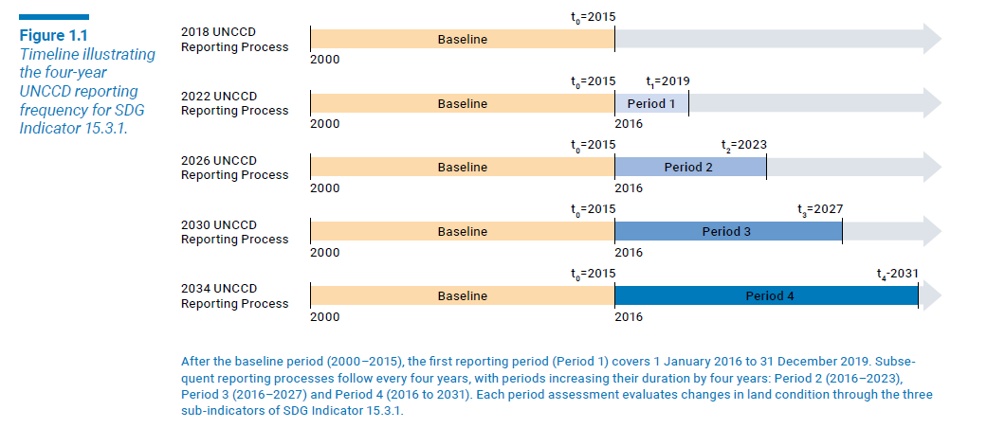
1.1 PERIOD assessment
After the baseline period (2000–2015), the first reporting period (Period 1) covers January 1, 2016, to December 31, 2019. Subsequent reporting processes follow every four years, with periods increasing their duration by four years: Period 2 spanning 2016–2023, Period 3 covering 2016–2027, and Period 4 assessing changes from 2016 to 2031. Each reporting period evaluates changes in land condition through the three sub-indicators.

Slide 14
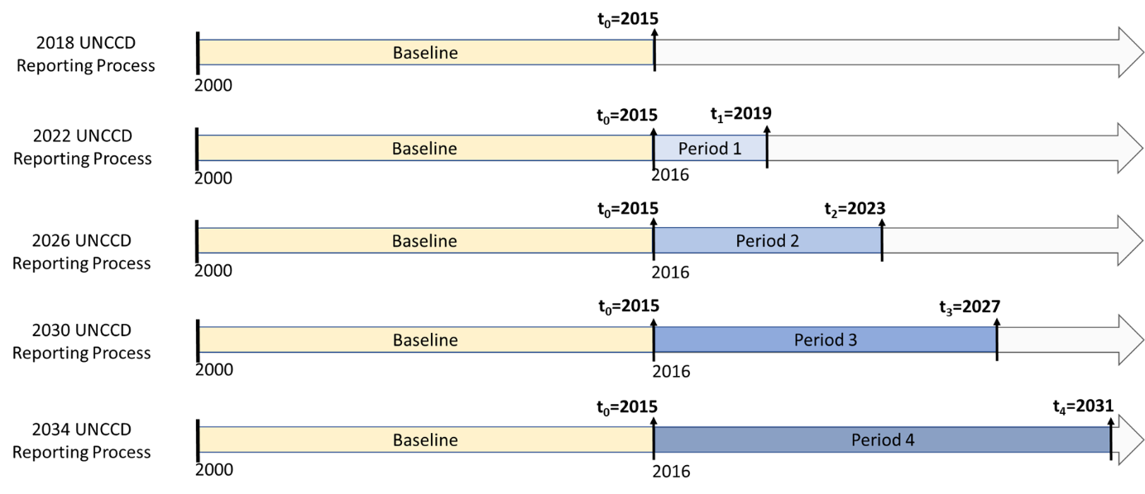
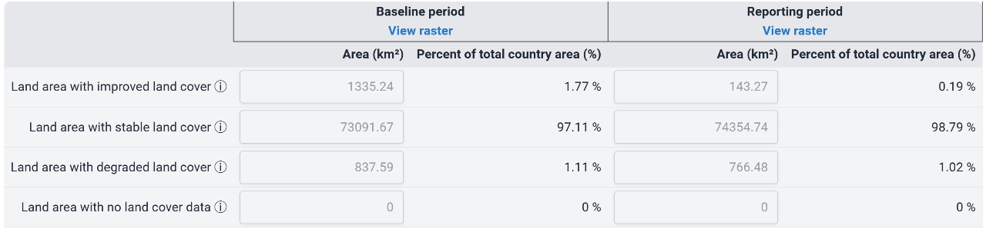
2026 Reporting process: periods for SO1-1, SO1-2 and SO1-3

Slide 15
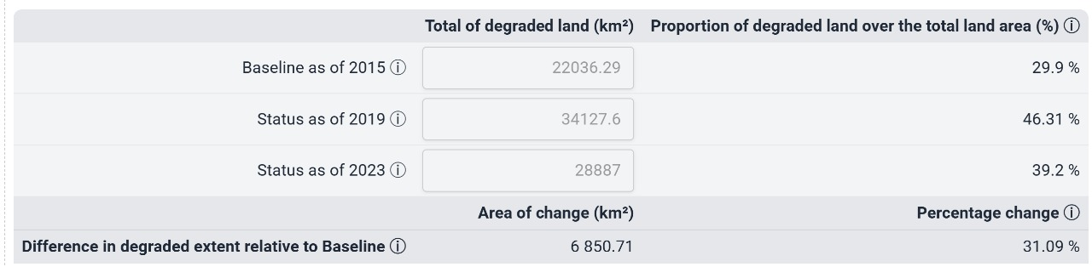
2026 Reporting process:
periods for SO1-4 (SDG 15.3.1)
It is necessary to estimate each indicator for the 3 periods!

Slide 16
1.1 PERIOD assessment
For each reporting period a final map that shows the results of the period assessment is obtained. The “Period Assessment” is the result of the evaluation of land condition for a specific reporting period, based on the combination of the three sub-indicators (Trends in Land Cover, Trends in Land Productivity, and Trends in Carbon Stocks) by applying the one-out, all-out principle. The period assessment does not capture the degradation or improvement that occurred during the baseline period and therefore it cannot be used to estimate SDG indicator 15.3.1 on its own.

Slide 17
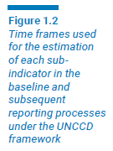
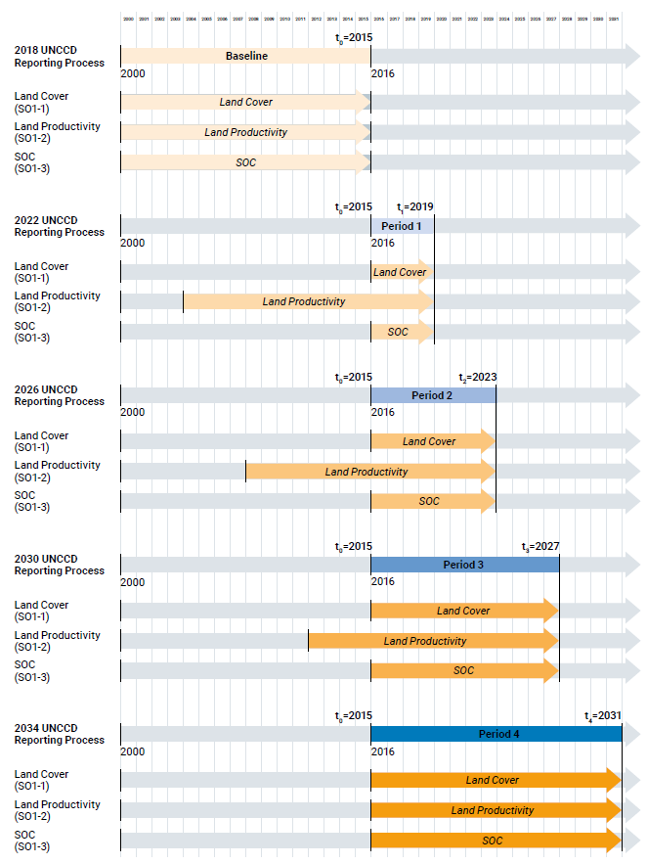
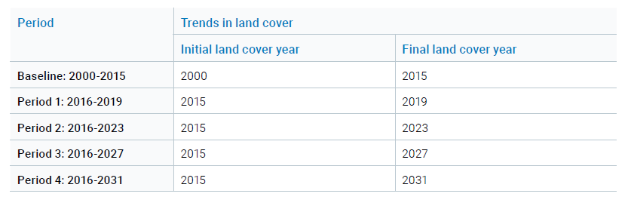
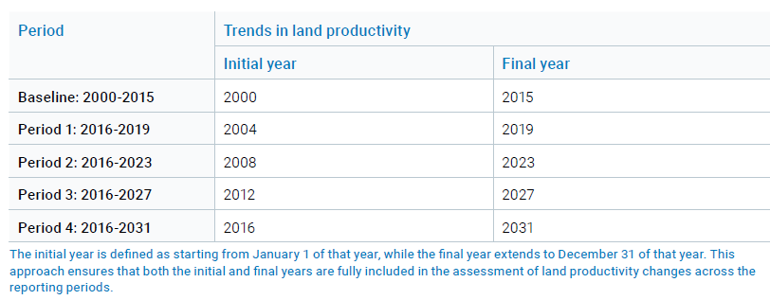
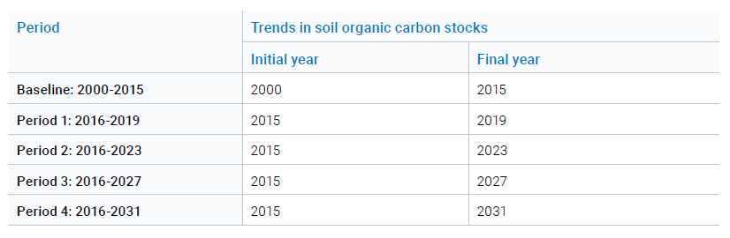
1.1 PERIOD assessment
Further clarification on the timeframes of the datasets used for Sub Indicator is included in the Addendum.

Slide 18
Is the period assessment enough to estimate the proportion of degraded land (SDG 15.3.1) in 2023?
+
STATUS
The Status is determined by combining the results of the current period assessment with the baseline assessment

Slide 19
1.2 STATUS
Status refers to the final condition of land at the end of each reporting period, classified as either degraded, stable, or improved.
The Status is determined by combining the results of the current period assessment with the baseline assessment.
This comparison is essential to account for areas identified as degraded in the baseline that have since remained unchanged in land condition. For example, if an area was classified as degraded during the baseline period but was stable afterwards, it will be assessed as stable during the period assessment. However, the land's condition is still degraded as there has been no improvement since the baseline
The resulting status map enables the estimation of SDG Indicator 15.3.1 by providing a spatially explicit view of areas that are either stable, improved, or degraded, considering also their initial condition

Slide 20
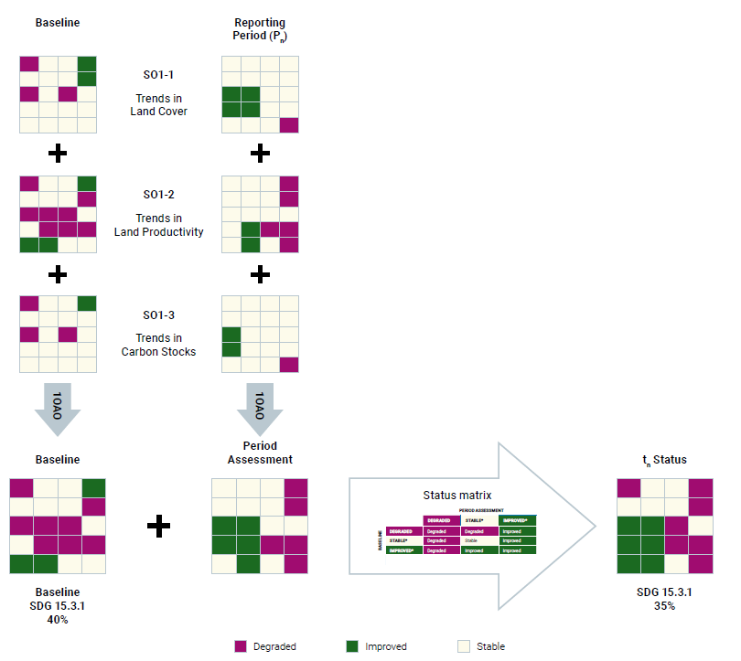
1.2 STATUS
Process of estimating land status for the baseline (2000-2015) and subsequent periods by comparing period assessments of the three Strategic Objective 1 (SO1) indicators with the baseline using the 3 x 3 Status matrix.

Slide 21
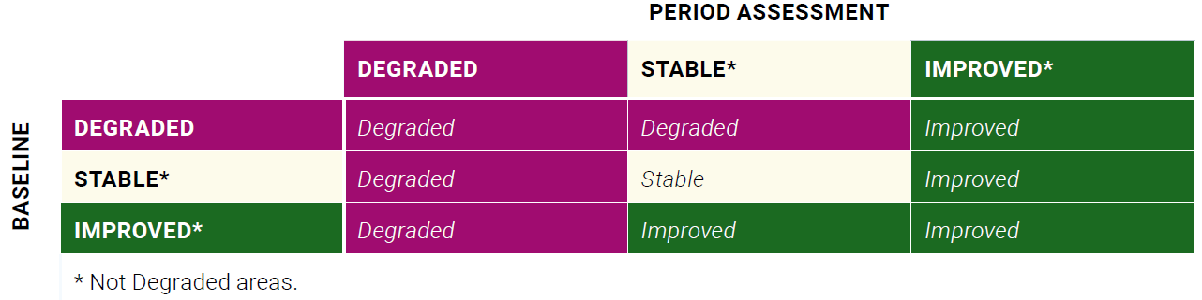
1.2 STATUS MATRIX
The “Status Matrix” allows a systematic comparison of the period assessment with the baseline to determine the status of land condition at pixel level.
The resulting map, called the Status Map, integrates the assessment of changes that occurred during the reporting period with the previous status of land condition (baseline). This approach ensures that the map reflects both past and recent changes, offering a more accurate overall assessment of land degradation and improvement over time.

Slide 22
The GPG Addendum – SDG Indicator 15.3.1
Section 1
Section 2
Section 3
INTEGRATING
LAND CONDITION ASSESSMENTS OVER TIME
TRACKING PROGRESS TOWARDS LDN
ENHANCEMENT OF DATASETS AND METHODOLOGIES
Focusses on the timeframe of the data used to assess land condition in each reporting period, on how to integrate the period assessment with the baseline, as well as providing additional guidelines on how to interpret and visualize changes over time.
This section responds to the need for guidance on incorporating the improved land component and the neutrality mechanism into target setting, LDN intervention planning, prioritizing areas for investment, and tracking progress towards LDN.
Introduces new datasets related to land cover, land productivity, and soil organic carbon (SOC), and discusses various methods and experiences in comparing and selecting the most representative datasets for different contexts.
Annex
+
LAND PRODUCTIVITY DYNAMICS ALGORITHMS

Slide 23
TRACKING PROGRESS TOWARDS LDN

Slide 24
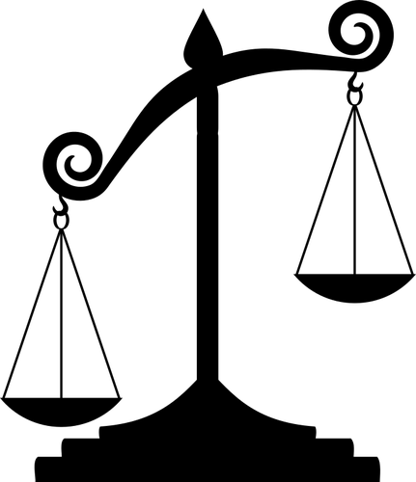
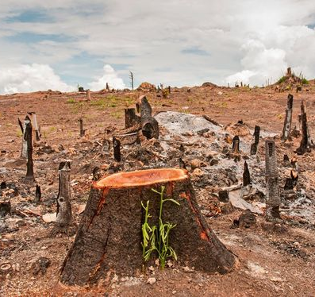
LDN
SDG target 15.3
SDG 15.3.1:
Proportion of degraded land

Slide 25
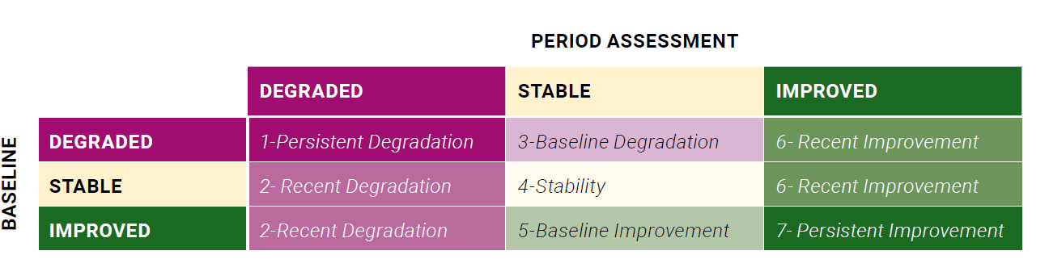
2.1 FURTHER CHARACTERIZATION
Even though the status maps categorize land condition into three broad categories (Degraded, Stable, and Improved), the underlying dynamics that lead to this final status can be more complex. Specifically, there are nine different types of changes from the baseline relative to any subsequent time period that can result in the final status, as illustrated in the 3 x 3 matrix of changes.
Table 2.1 Expanded version of the status matrix showing land condition that results from the comparison of the baseline (rows) and the period assessment (columns): degraded (purple), stable (yellow) and improved (green).

Slide 26
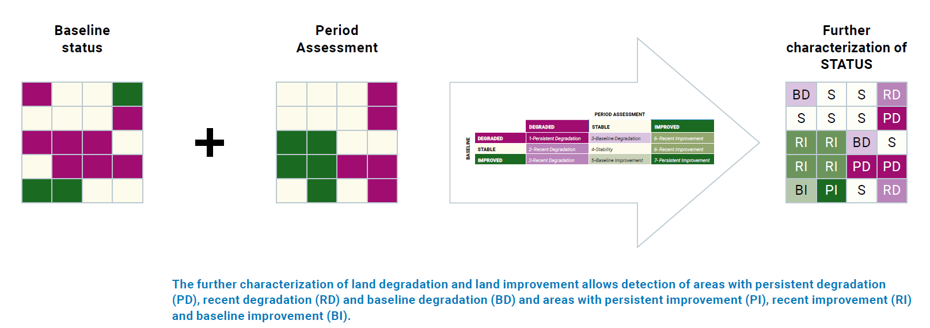
2.1 FURTHER CHARACTERIZATION of LD and IMPROVEMENT

Slide 27
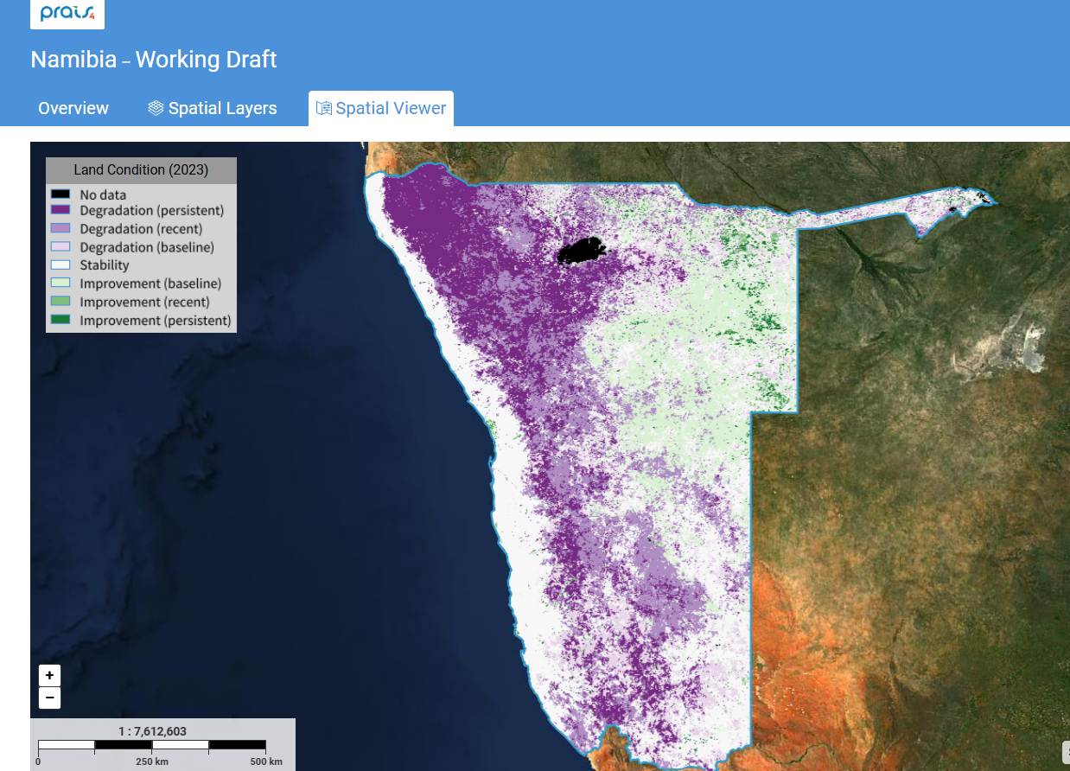
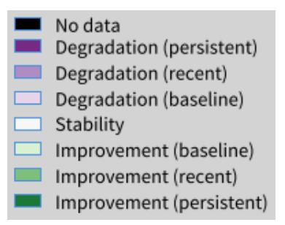
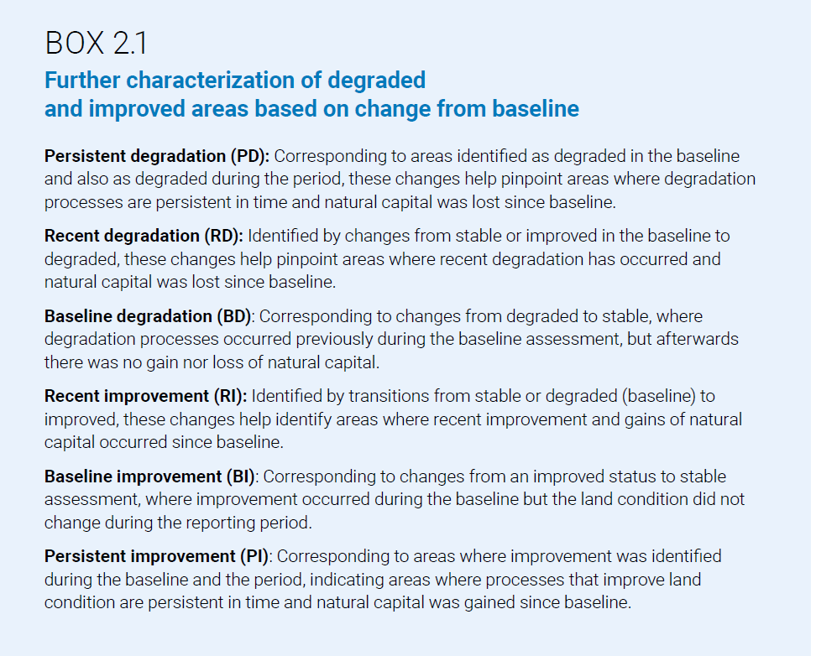
2.1 FURTHER CHARACTERIZATION

Slide 28
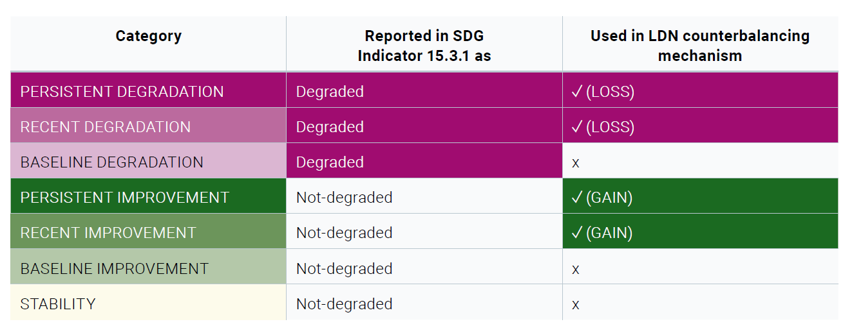
2.2 COUNTERBALANCING: MONITORING NEUTRALITY
Categories of land condition according to the expanded status characterization and their usage for estimation of SDG indicator 15.3.1 and for counterbalancing

Slide 29
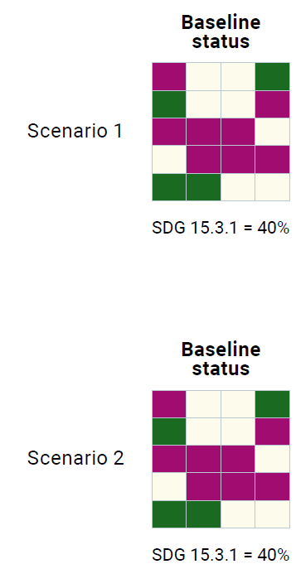
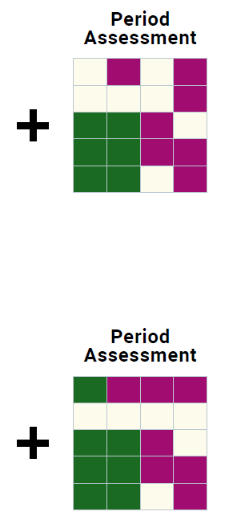
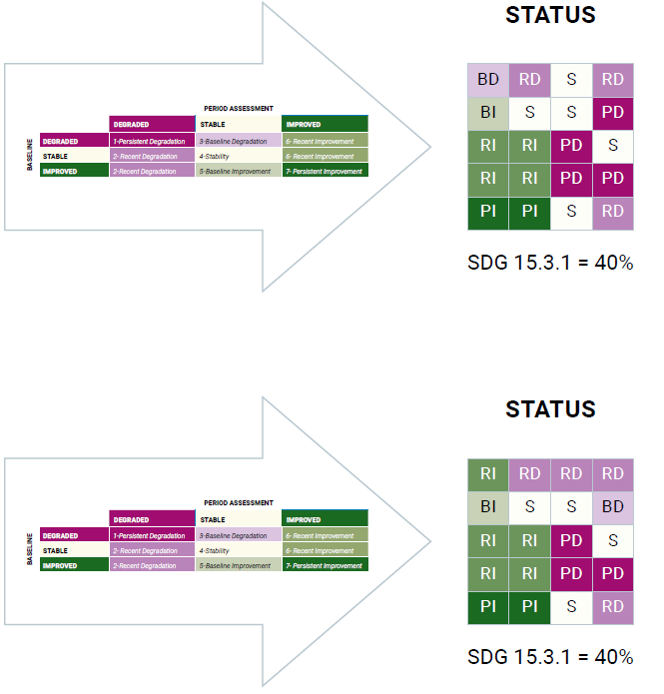
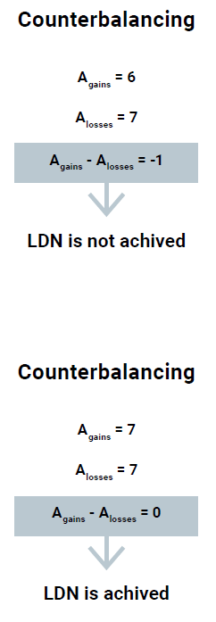


2.2.4 Step-by-step procedure to assess counterbalancing for LDN
STEP 1: Baseline assessment
STEP 2. Assessment of the reporting period
STEP 4. Calculate the difference between recent improvements and degradation for each land type
STEP 3. Expanded status matrix to calculate new status
STEP 5. Assess LDN achievement for each land type
STEP 6. Assess overall LDN achievement

Slide 30


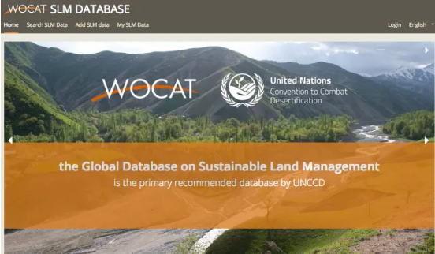
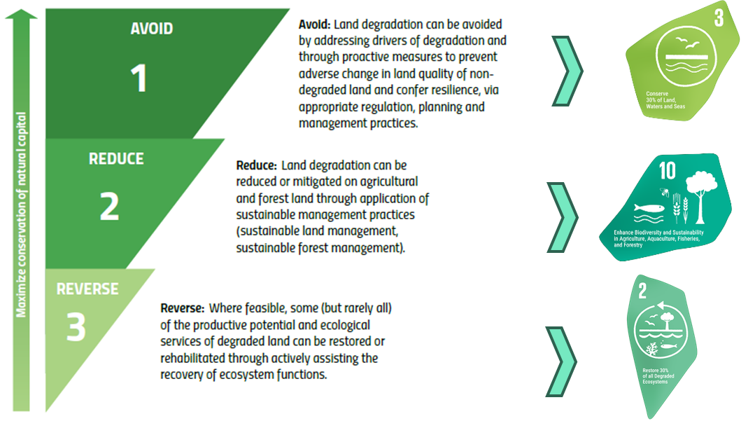
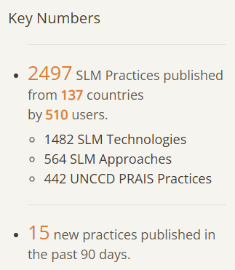

MAPPING IMPROVEMENT

Slide 31
The GPG Addendum – SDG Indicator 15.3.1
Section 1
Section 2
Section 3
INTEGRATING
LAND CONDITION ASSESSMENTS OVER TIME
TRACKING PROGRESS TOWARDS LDN
ENHANCEMENT OF DATASETS AND METHODOLOGIES
Focusses on the timeframe of the data used to assess land condition in each reporting period, on how to integrate the period assessment with the baseline, as well as providing additional guidelines on how to interpret and visualize changes over time.
This section responds to the need for guidance on incorporating the improved land component and the neutrality mechanism into target setting, LDN intervention planning, prioritizing areas for investment, and tracking progress towards LDN.
Introduces new datasets related to land cover, land productivity, and soil organic carbon (SOC), and discusses various methods and experiences in comparing and selecting the most representative datasets for different contexts.
Annex
+
LAND PRODUCTIVITY DYNAMICS ALGORITHMS

Slide 32
ENHANCEMENT OF DATASETS AND METHODOLOGIES

Slide 33
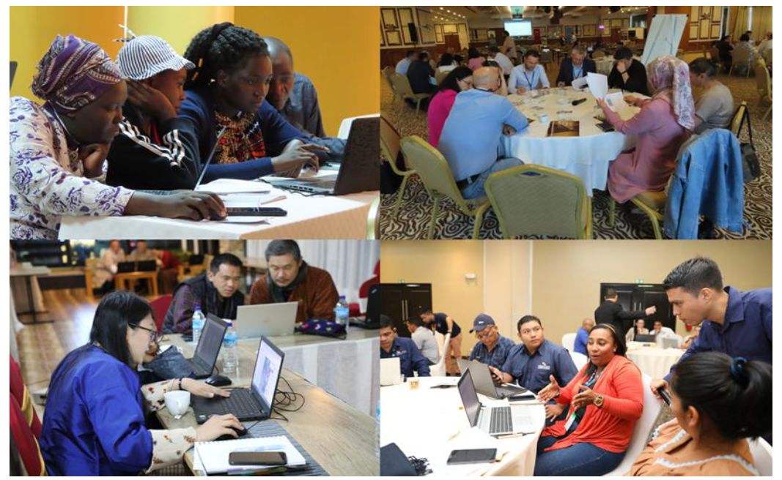



Enhancements for assessing:
  3.1 Trends in land cover
  3.2 Trends in land productivity
  3.3 Trends in Carbon Stocks (SOC)
High resolution datasets
New Tools
Workflows
Participatory Processes

Slide 34

The GPG Addendum – SDG Indicator 15.3.1
Definition of the Periods and data used for each indicator and metric in each period
Clarification and explicit methodology to compare baseline and period assessments
Enhanced understanding of land condition dynamics
Operationalization of counterbalancing
Support for country-driven approaches:
Integration with global tools and platforms
Strengthened basis for SLM and policy
Notes:
Improved temporal consistency: A simplified approach to integrating land condition assessments over reporting processes, using clearly defined reporting periods and status mapping, enables more consistent time-series analysis of SDG Indicator 15.3.1;
Enhanced understanding of land condition dynamics: By distinguishing between recent and baseline degradation and improvement, the expanded status matrix allows for a more detailed interpretation of temporal change. This facilitates better targeting of land restoration interventions;
Operationalization of counterbalancing: For the first time, detailed guidance is provided on applying the counterbalancing principle to assess progress toward LDN. This approach ensures that new degradation is matched by equivalent gains in natural capital within the same land type, thereby supporting the goal of “no net loss” and promoting land-use planning that considers progress towards LDN;
Support for country-driven approaches: This addendum encourages the use of nationally verified datasets and local expertise, reinforcing national ownership of the monitoring and reporting process;
Integration with global tools and platforms: The methodologies described in the addendum will be implemented as executable code in free and open-access software such as Trends.Earth, ensuring that the guidance is not only theoretically sound but also practically implementable;
Strengthened basis for SLM and policy: By enabling the identification of spatial patterns of degradation and improvement, and quantification of changes in natural capital, this addendum empowers countries to link monitoring outcomes with real-world interventions and offers valuable tools for planning, implementing and evaluating SLM practices.

Slide 35

Thank you
Do you have any questions?
Ingrid.teich@unibe.ch

