Slide 1
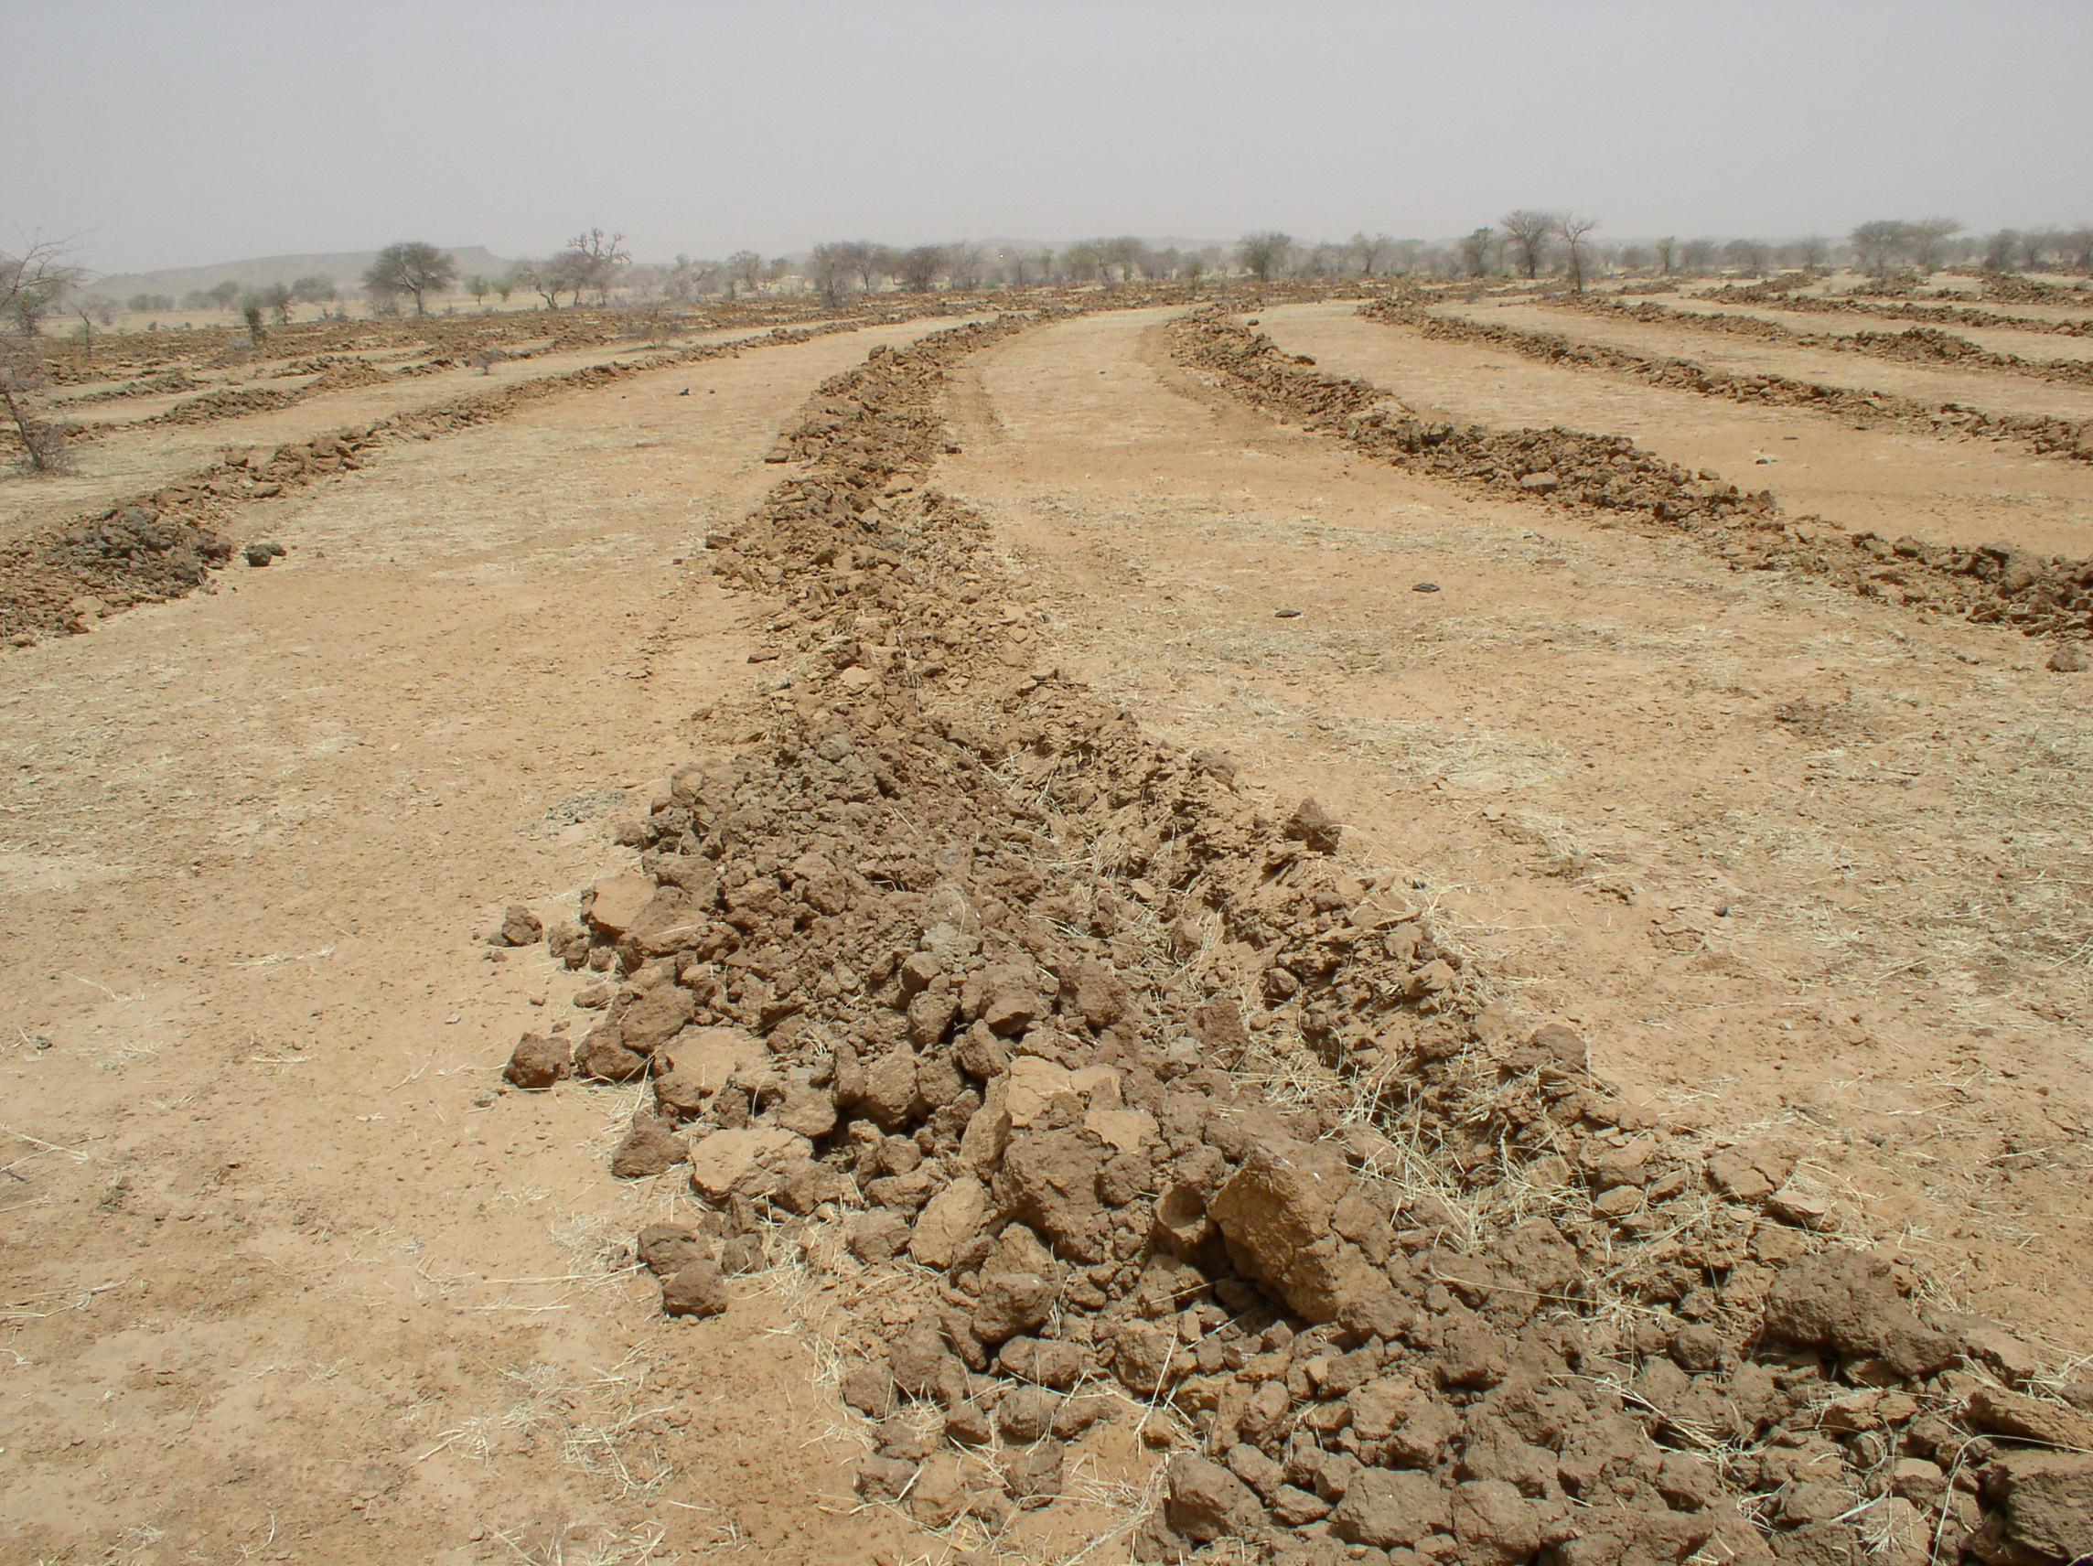




SO1-3: Trends in carbon stocks
Dr.Ingrid Teich
Senior Research Scientist
University of Bern – CDE
WOCAT Secretariat

Slide 2
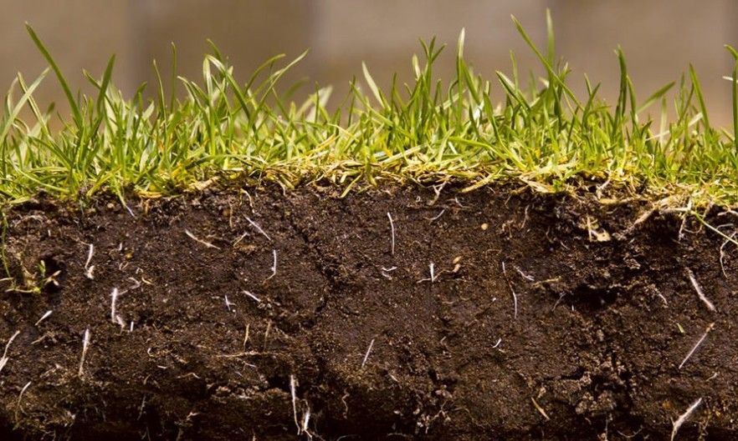
Difficult to determine changes in SOC over time
SOC maps are based on past observations (data inherited from several years) collected by different sampling campaigns, different measurement techniques and at different depths.

Slide 3

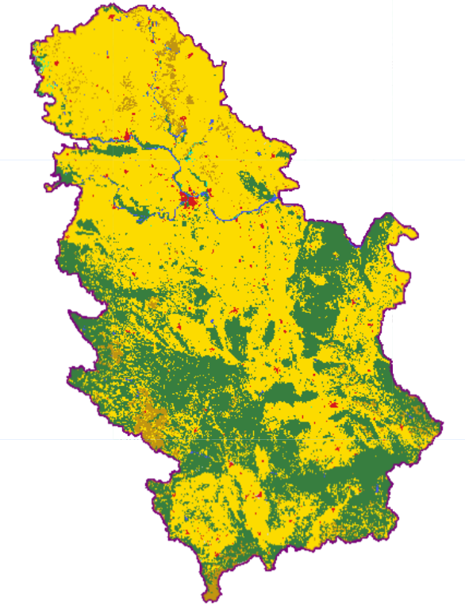
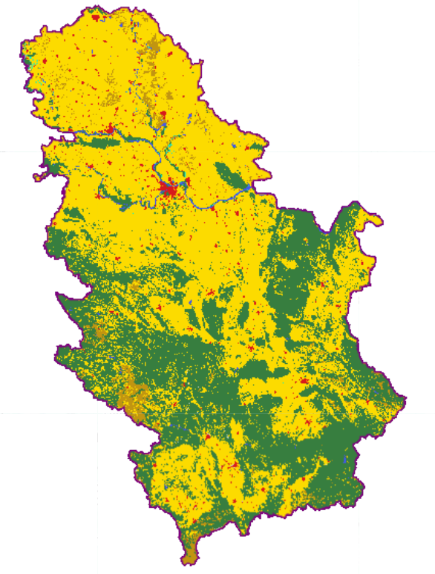
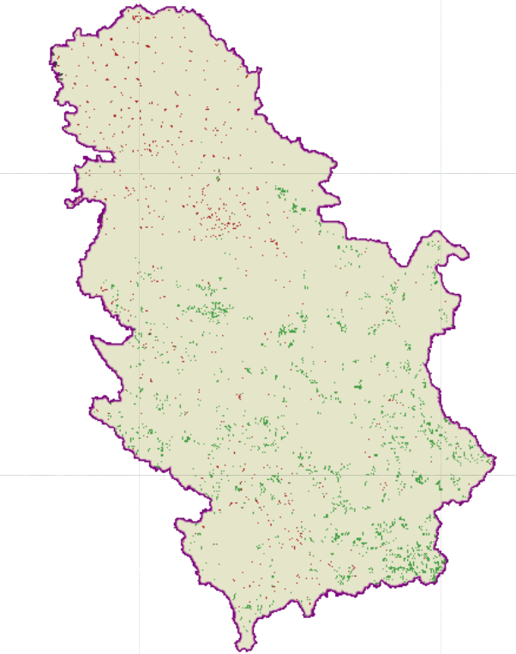
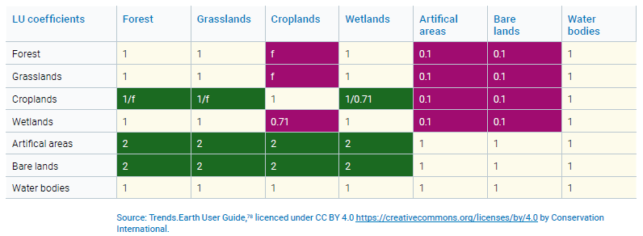
METHODOLOGY
SOIL ORGANIC CARBON CHANGES: COMBINED COVER AND COS CHANGES METHODOLOGY
INITIAL LAND COVER
FINAL LAND COVER
DEGRADATION DUE TO SOC CHANGE
CONVERSION FACTORS AT 20YEAS
CAMBIO
STEP 1: Establish SOC reference values
STEP 2: Map land cover changes for SOC change estimation
STEP 3: Calculate SOC changes
STEP 4: Identify significant SOC changes

Slide 4
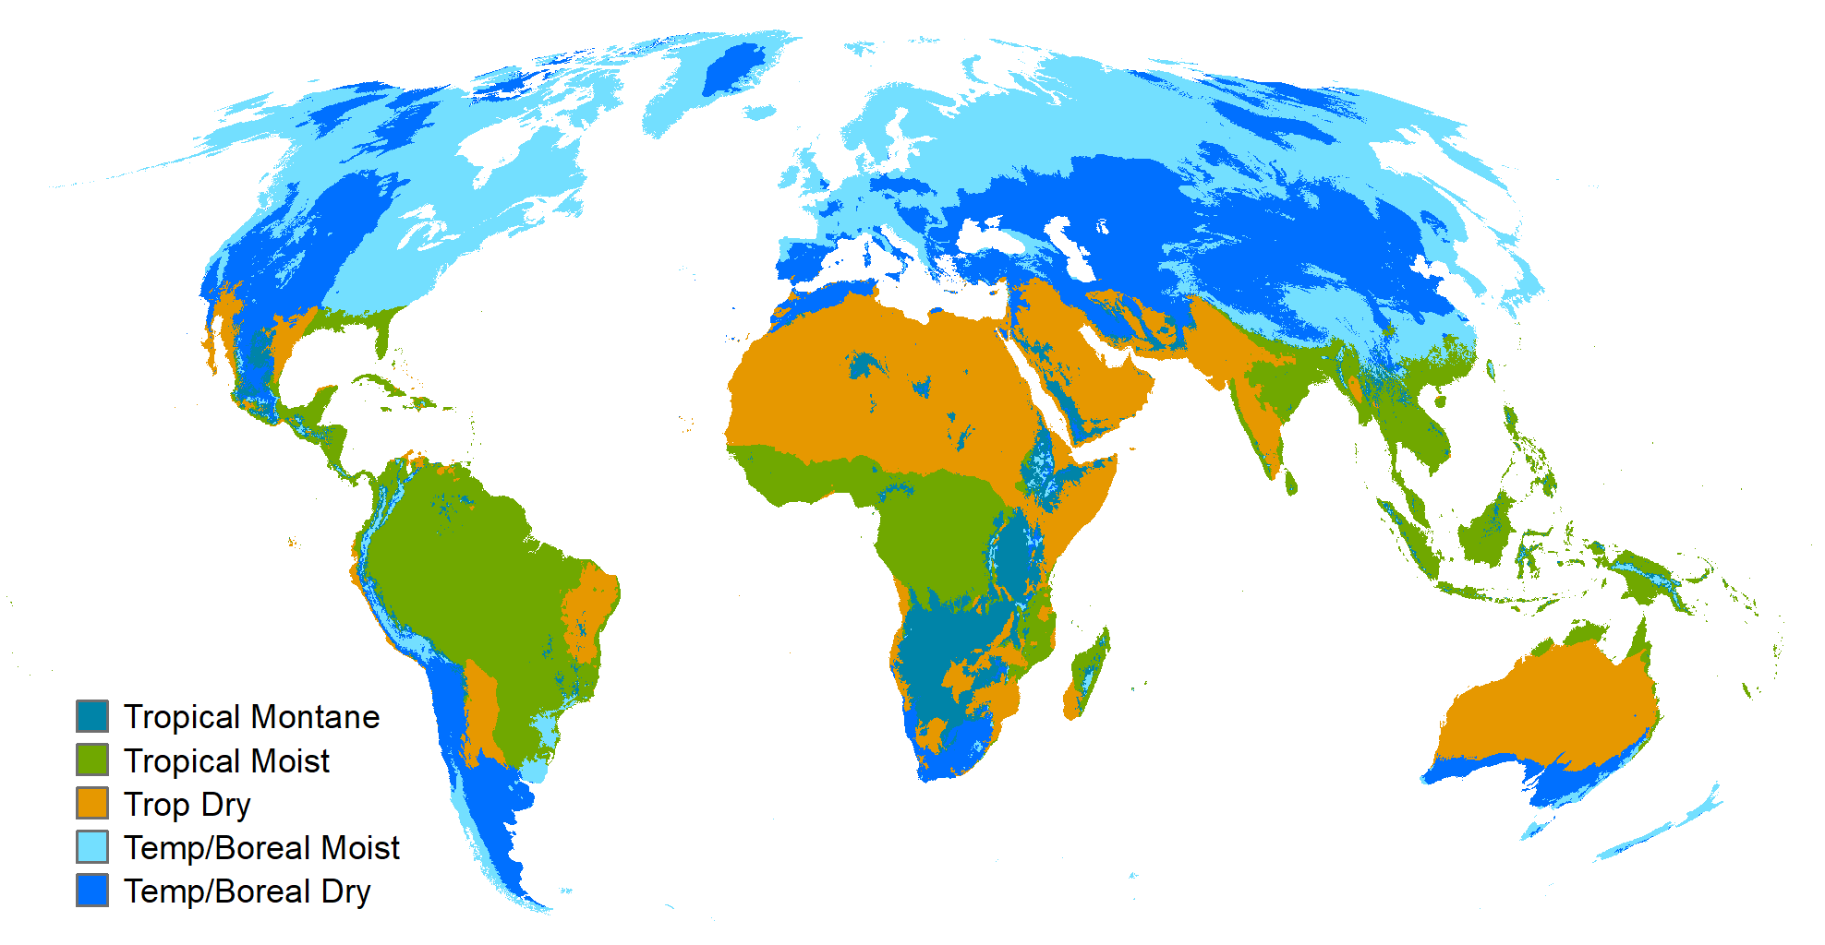
DEFAULT CONVERSION FACTORS
Tropical Montane (f = 0.64)
Tropical Moist (f = 0.48)
Tropical Dry (f = 0.58)
Temperate Moist (f = 0.69)
Temperate Dry (f = 0.80)
20 Years factors
Blanket calculations: not representative of local realities

Slide 5
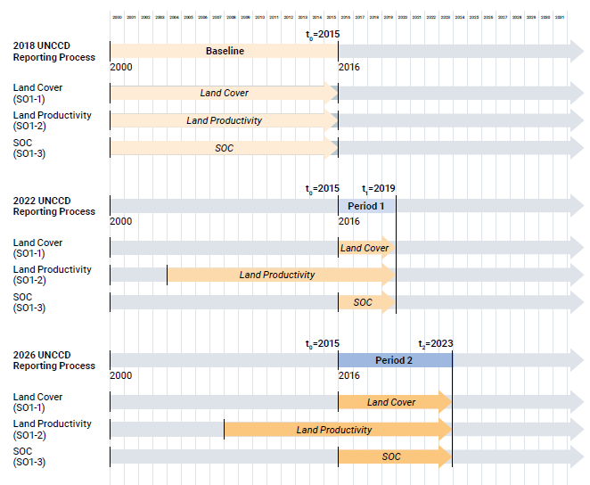
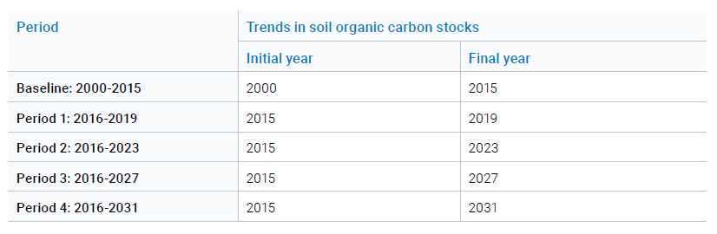
PERIODS – SOIL ORGANIC CARBON CHANGE

Slide 6
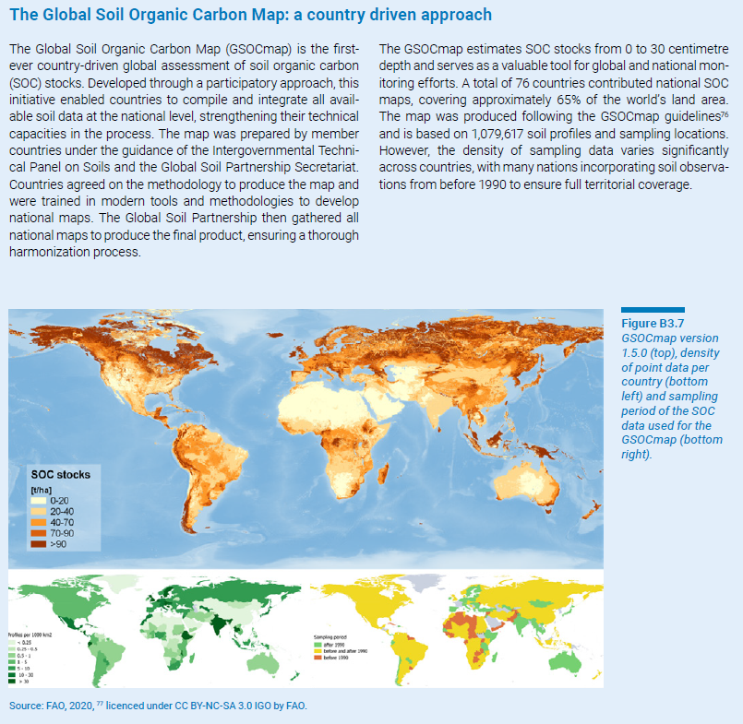
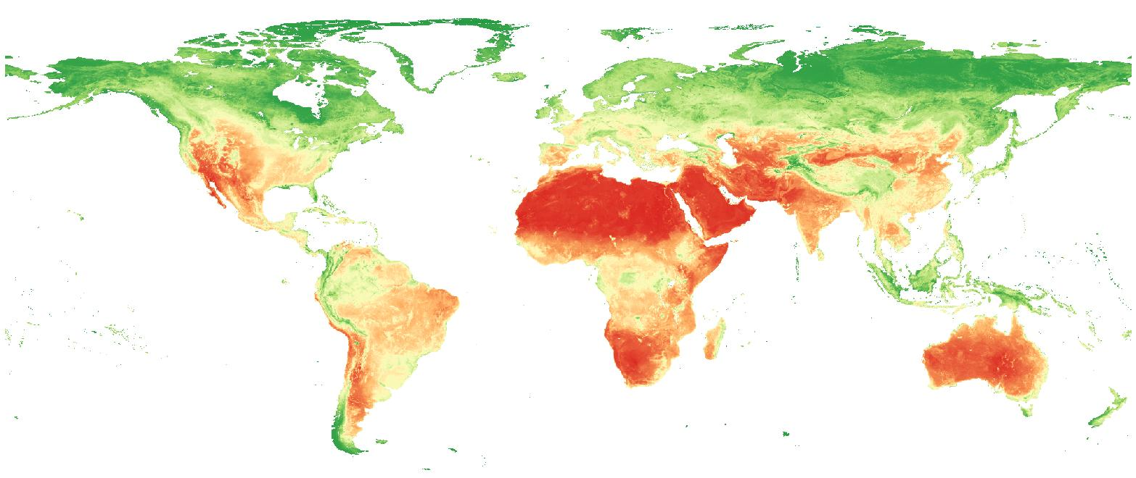
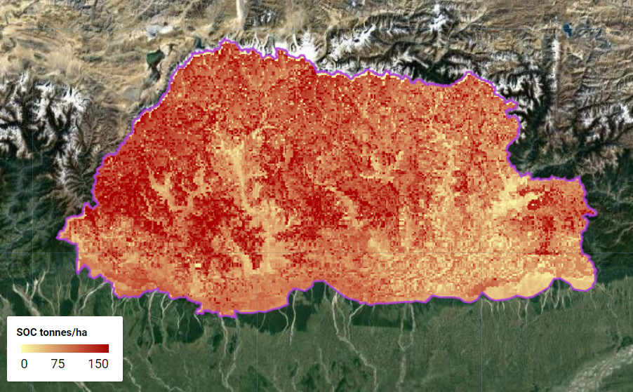
Combined land cover/SOC method
Default dataset: ISRIC SoilGrids 250m 0-30 cm SOC (ton/ha)
NATIONAL SOC MAPS

Slide 7
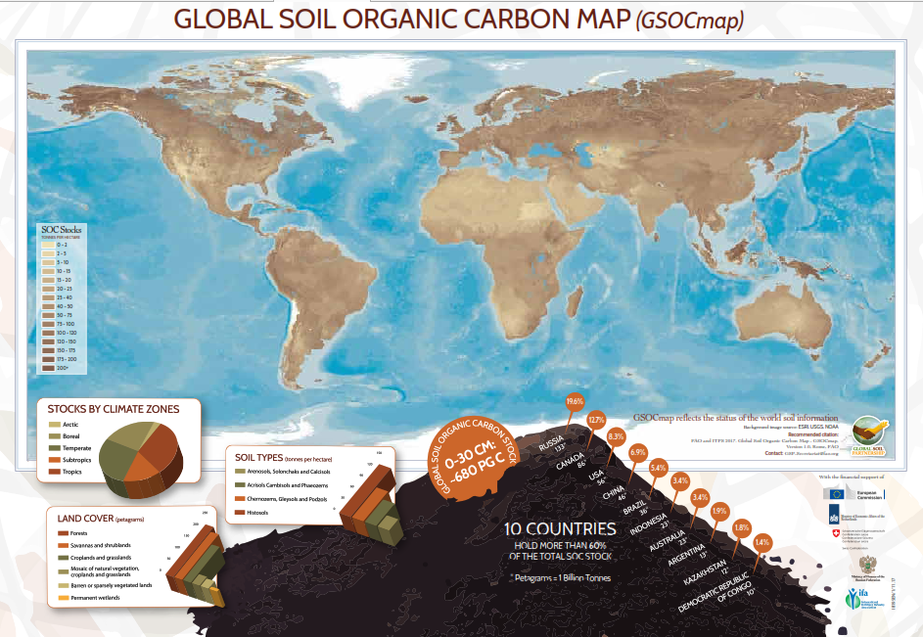
NATIONAL SOC MAPS
Best available

Slide 8
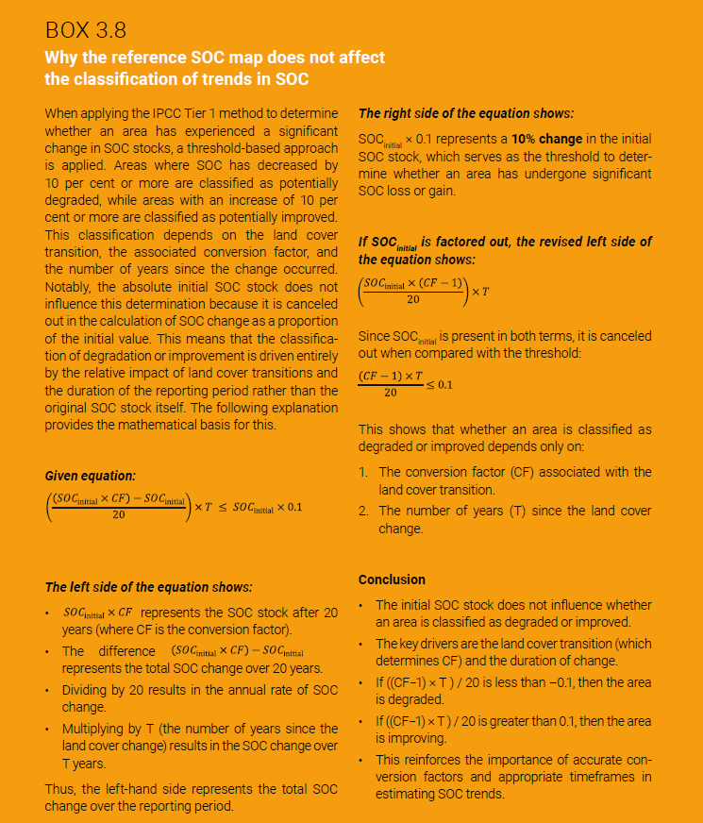
Combined land cover/SOC method
Conclusion
The initial SOC stock does not influence whether an area is classified as degraded or improved.
The key drivers are the land cover transition (which determines CF) and the duration of change.
If ((CF−1) × T ) / 20 is less than –0.1, then the area is degraded.
If ((CF−1) × T ) / 20 is greater than 0.1, then the area is improving.
This reinforces the importance of accurate conversion factors and appropriate timeframes in estimating SOC trends.

Slide 9
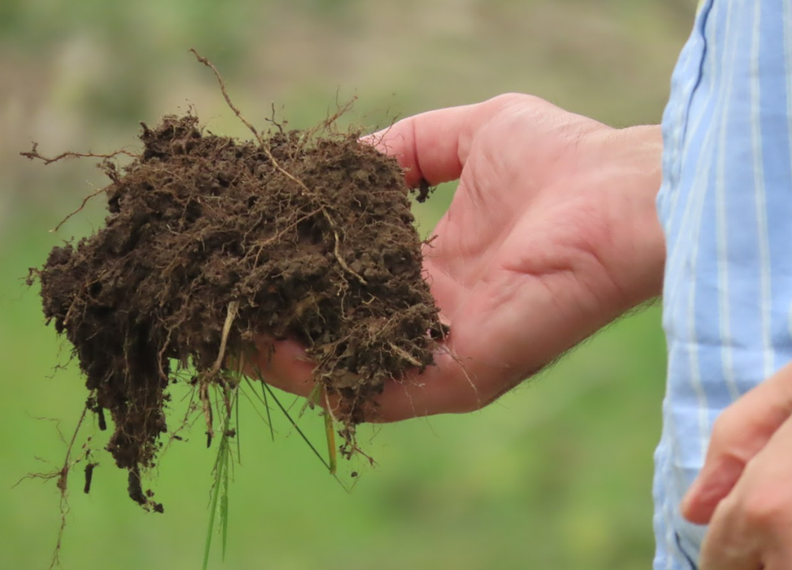
TWO PATHS
1
IMPROVE THE ESTIMATION OF LAND COVER CHANGES AND COVERSION FACTORS
2
MODELING SOC CHANGES USING OTHER VARIABLES
Key: Participatory Decision-Making Process

Slide 10
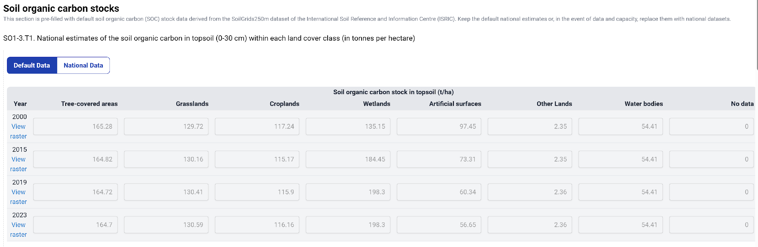
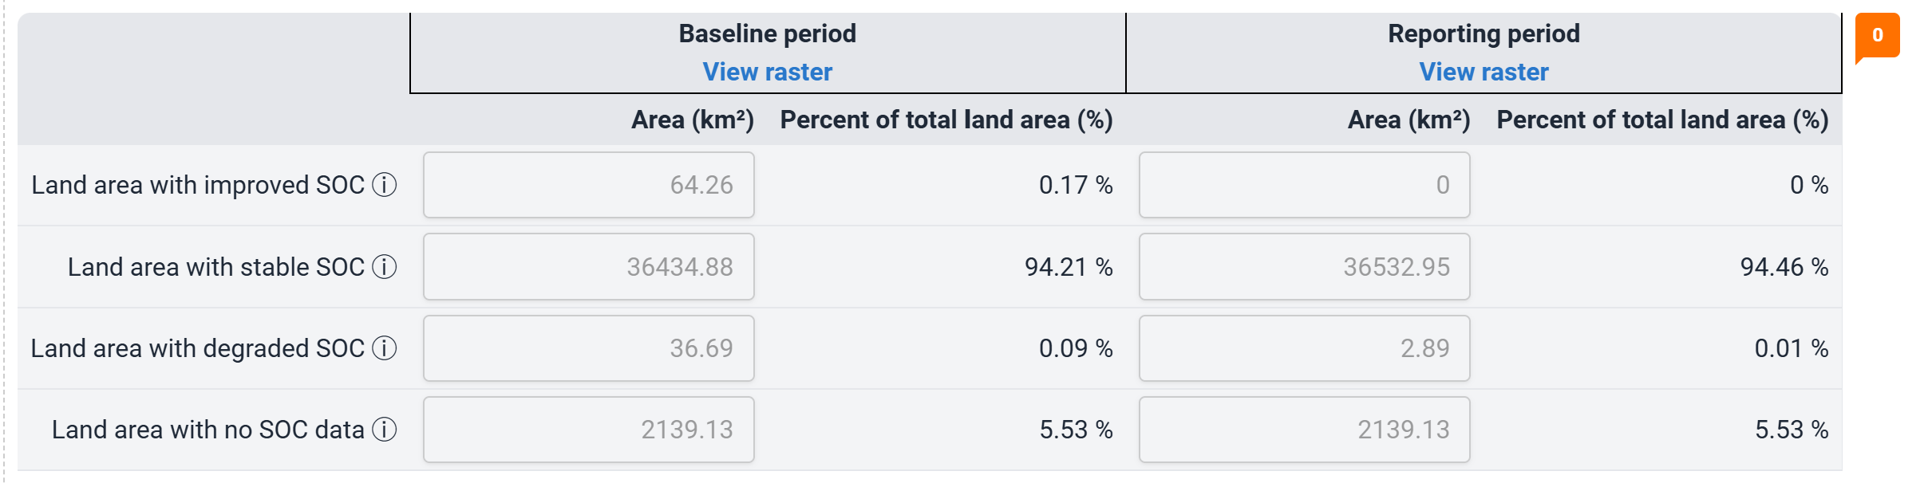

Slide 11
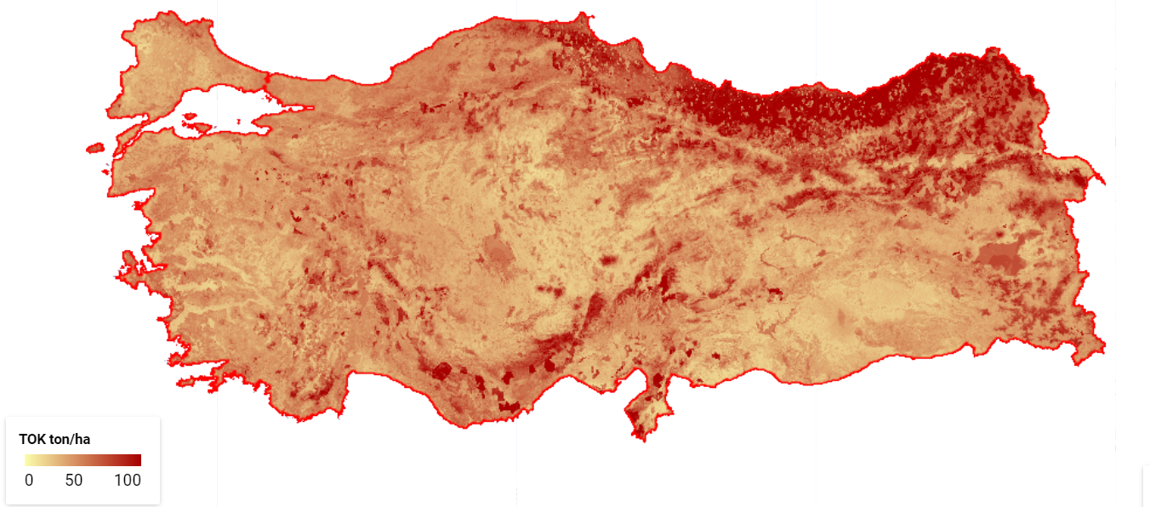
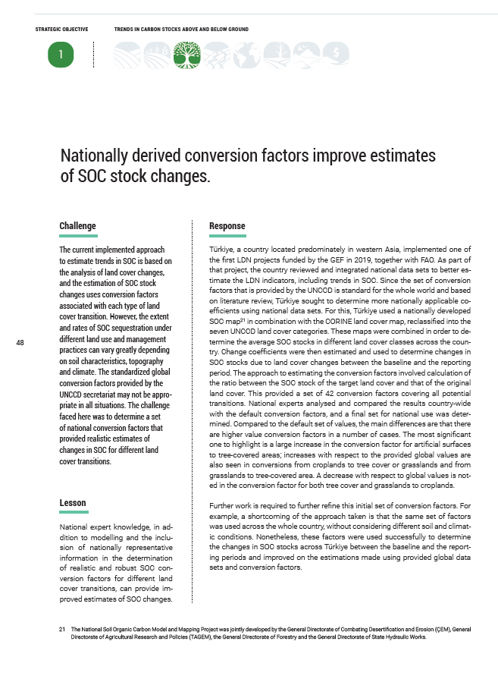
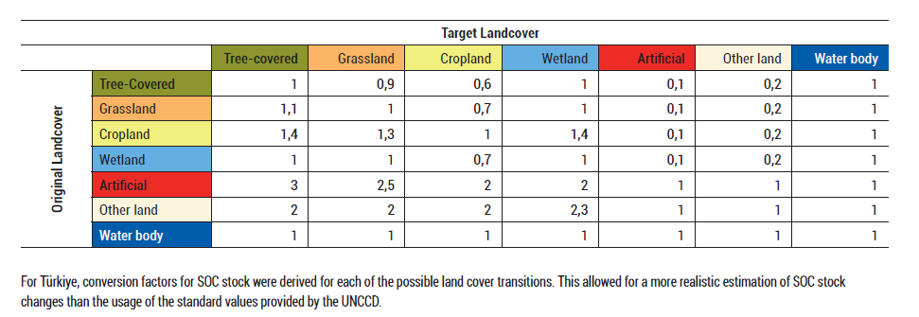
TURKEY
IMPROVE THE ESTIMATION OF LAND COVER CHANGES AND TRANSITION FACTORS
1

Slide 12
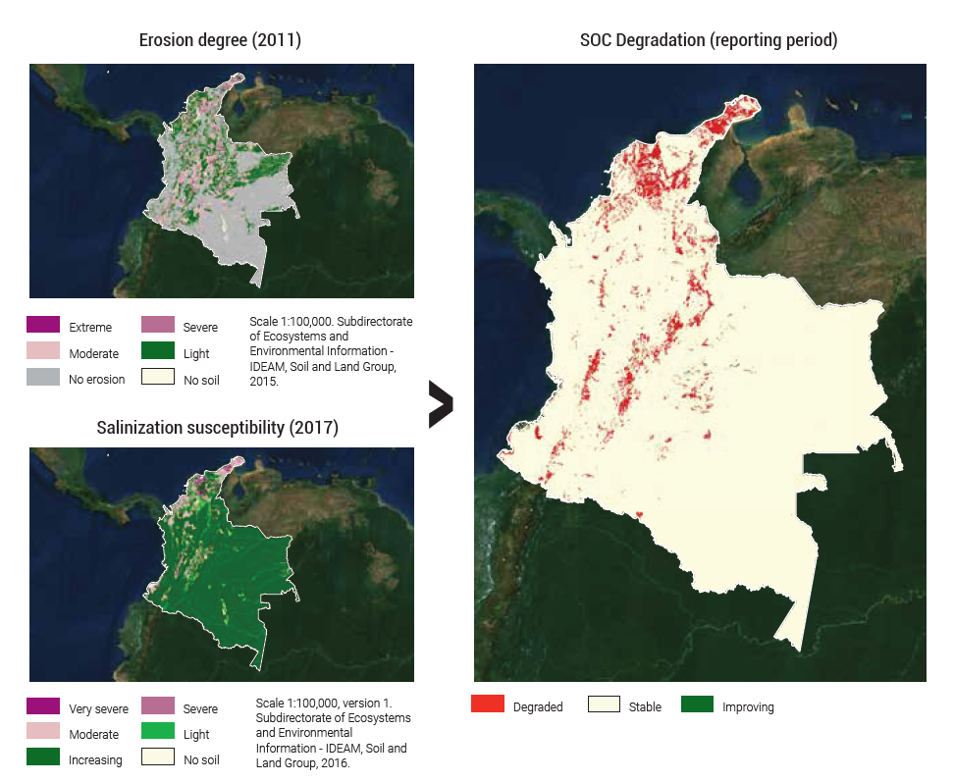
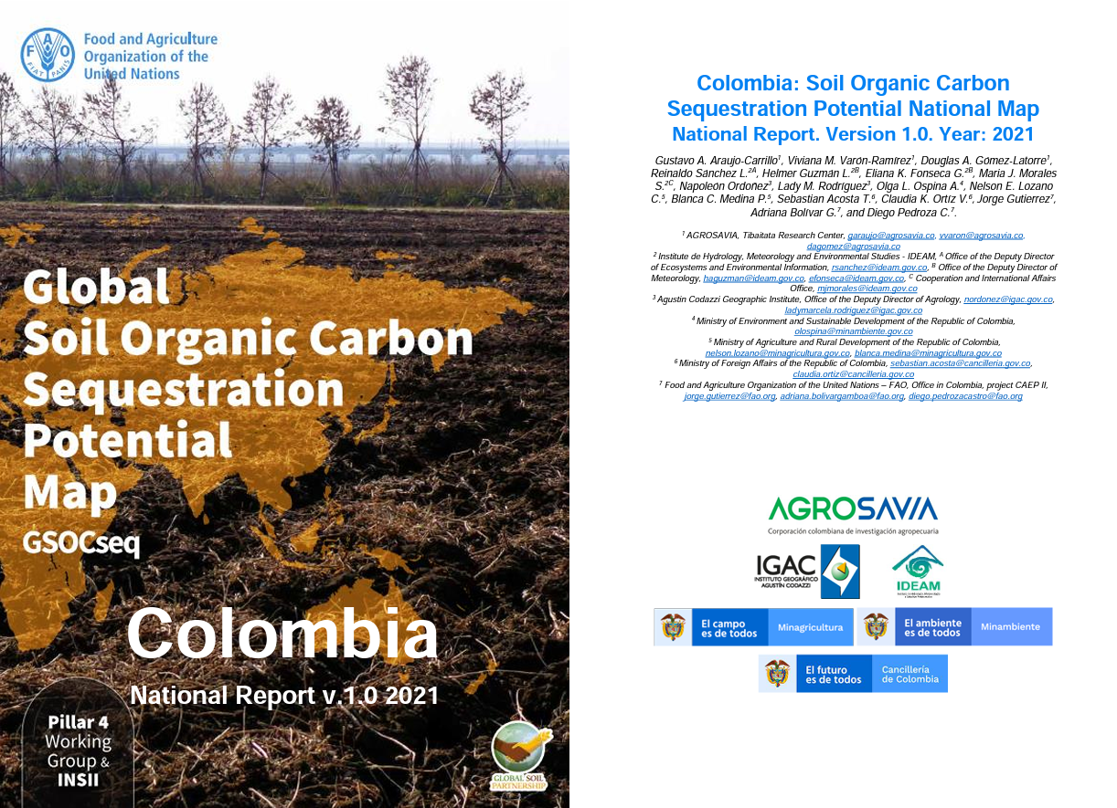
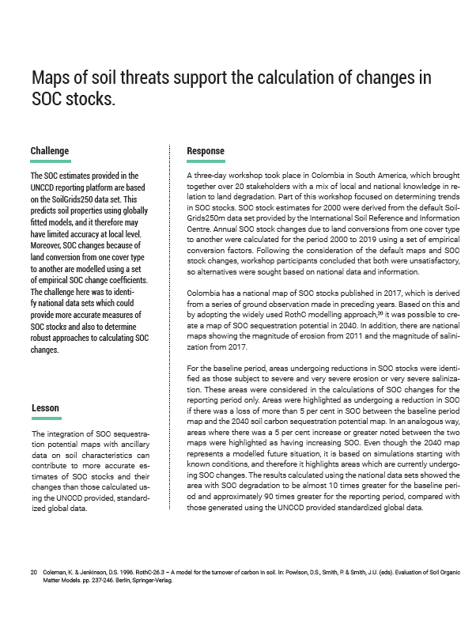
COLOMBIA
MODELING SOC CHANGES USING OTHER VARIABLES
2

Slide 13
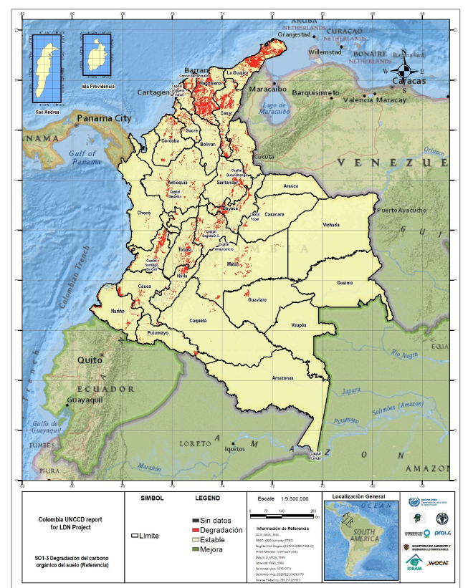
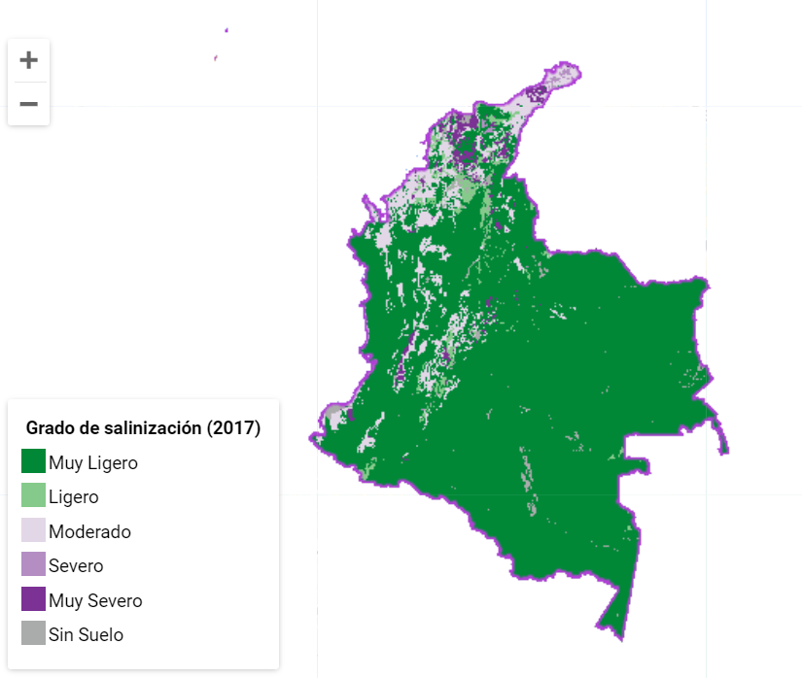
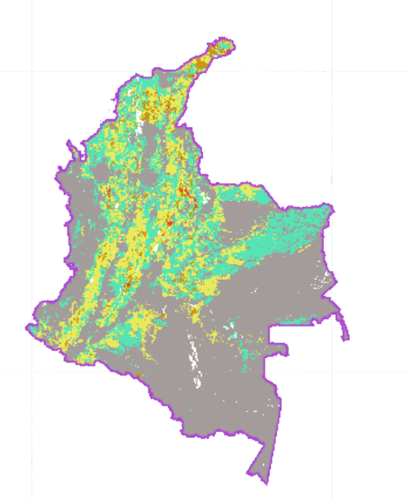
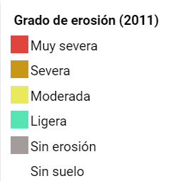
BASELINE
Salinization (2017): very severe
Erosion (2011):
Severe and very severe

Slide 14
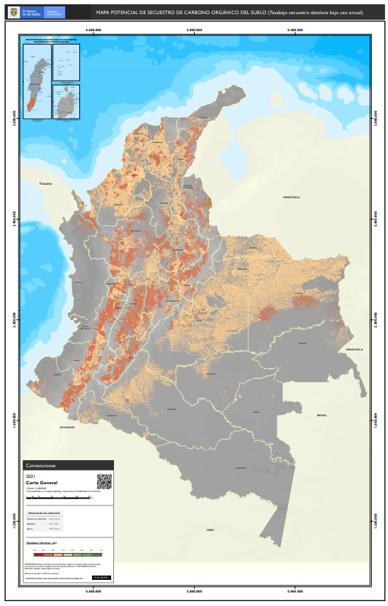
REPORTING PERIOD
COS degradation: a loss rate greater than 5% (compared to the initial value) on a business-as-usual (BAU) scenario to 2040.
COS improvement: a COS gain rate of 5% on the same conditions.

Slide 15
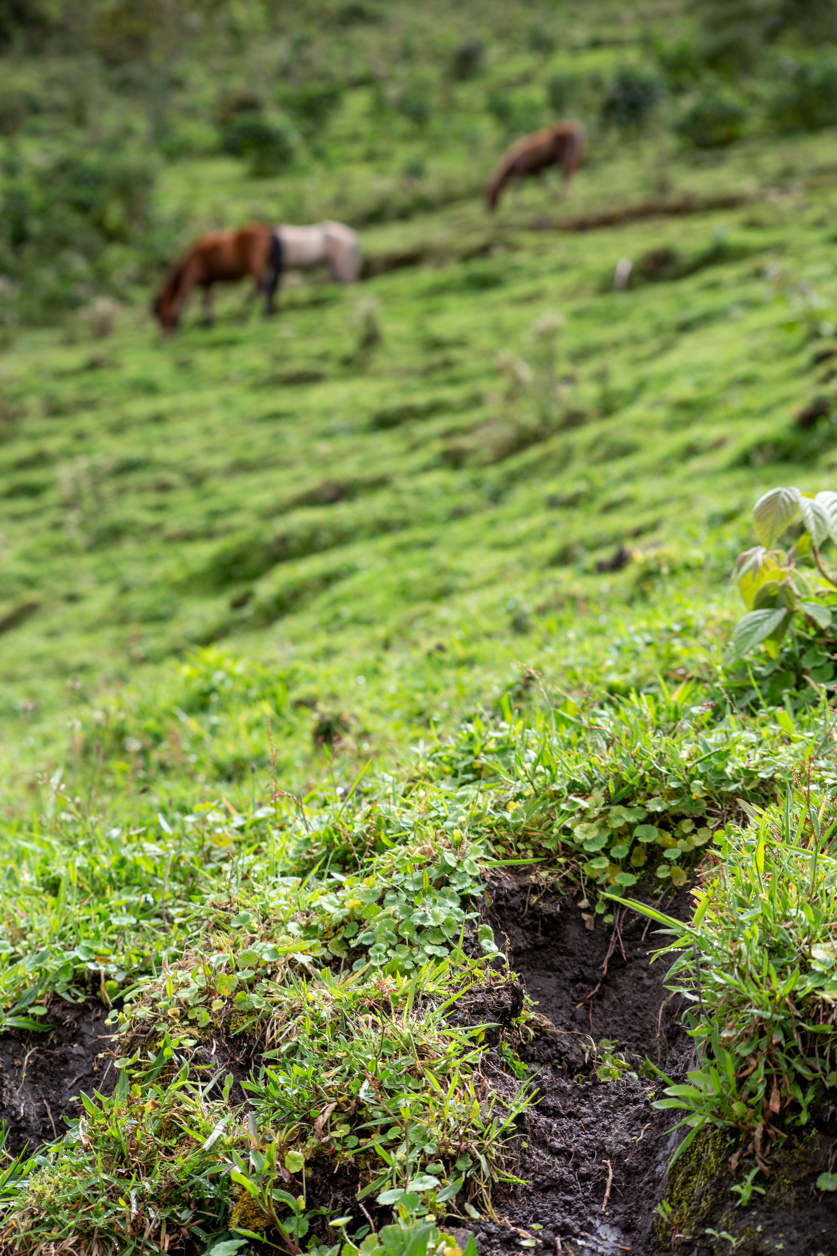
DISCUSSION
What soil properties data is available for the country?
What are the main causes of soil organic carbon (SOC) loss?
Which approach would be most appropriate?
What verification data can be used?

Slide 16
Thank you
Do you have any questions?
Ingrid.teich@unibe.ch

