Slide 1

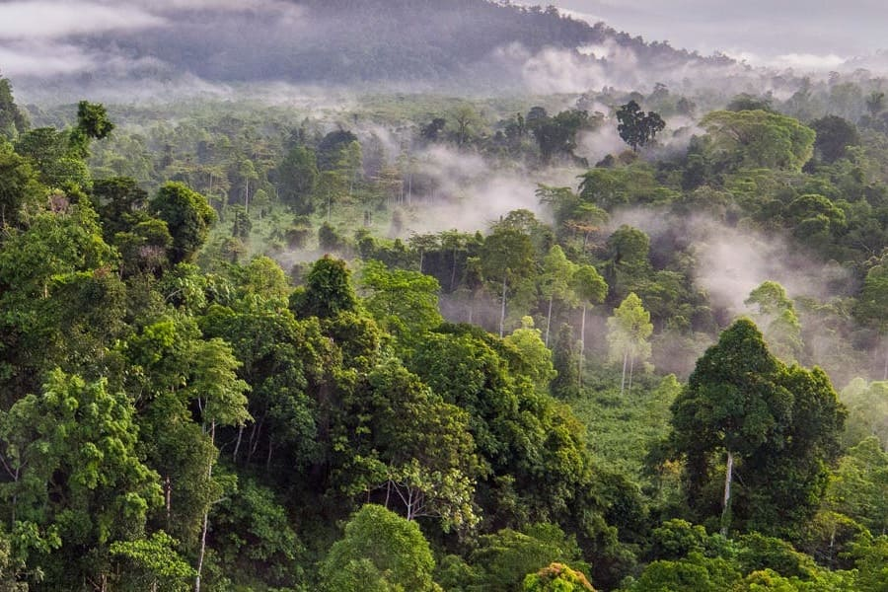


SO1-1
Trends in Land Cover
Cambodia
July 2nd 2026
Dr. Ingrid Teich
Senior Research Scientist (University of Bern)
WOCAT Secretariat

Slide 2

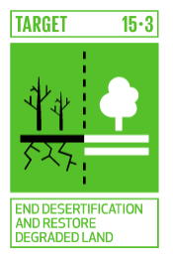


SDG 15.3.1
PROPORTION OF LAND THAT IS DEGRADED
TRENDS IN LAND COVER
TRENDS IN LAND PRODUCTIVITY
TRENDS IN CARBON STOCKS
“transformational” variable
“fast” ecological variable
“slow” ecological variable
SO1-1
SO1-2
SO1-3
“While it is difficult for a single indicator to fully capture the state or condition of the land, the sub-indicators are proxies to monitor the essential variables that reflect the capacity of the land to deliver ecosystem services” Sims et al. 2021
Notes:
By establishing and implementing relevant SLM measures, it is expected that land degradation will be avoided, reduced, or reversed (according to the UNCCD response hierarchy), enabling progress towards a land degradation neutral world (SDG 15.3). Accordingly, it is expected that these changes will eventually impact on the proportion of land that is degraded over total land area (SDG indicator 15.3.1). To assess this indicator, the Good Practice Guidance (GPG, Sims et al. 2019; Sims et al., 2021), developed by the UNCCD, recommends the calculation of three Change of State indicators: (1) Trends in land cover, (2) Trend in land productivity or functioning of the land and (3) trends in carbon stocks above and below ground. Regional and global datasets derived from global earth observation systems play an important role to obtain these indicators, particularly for assessing changes in land productivity and land cover dynamics
The results of the degradation analysis for each of the sub-indicators are integrated using a one out- all-out (1OAO) method in which a significant reduction or negative change in any one of the three sub-indicators is considered to comprise land degradation. The GPG provides details on how to calculate the extent of land degradation for reporting on SDG Indicator 15.3.1 according to the Tier I methods adopted by the UN Statistical Commission.
It is important to notice that it is difficult for a single indicator to fully capture the state or condition of the land. The sub-indicators are proxies to monitor the essential variables that reflect the capacity of the land to deliver ecosystem services, but additional sub-indicators may be required to fully assess land degradation in some areas and under certain conditions.
More information:
https://www.unccd.int/sites/default/files/documents/2021-09/UNCCD_GPG_SDG-Indicator-15.3.1_version2_2021.pdf
Teich, I., Gonzalez Roglich, M., Corso, M.L. and García, C.L. 2019. Combining Earth Observations, Cloud Computing, and Expert Knowledge to Inform National Level Degradation Assessments in Support of the 2030 Development Agenda. Remote Sens., 11: 2918.

Slide 3

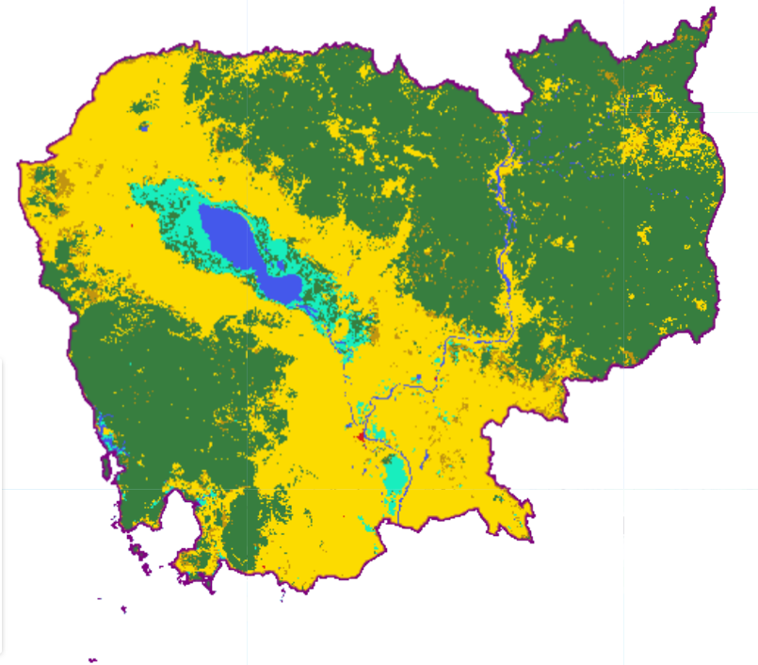
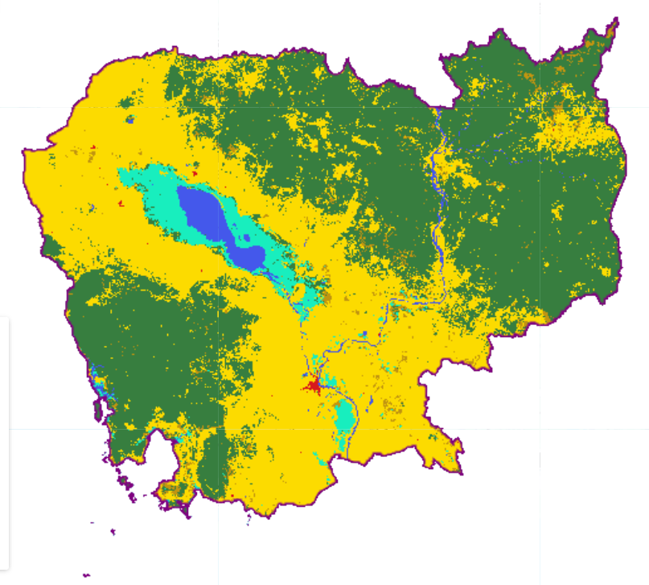
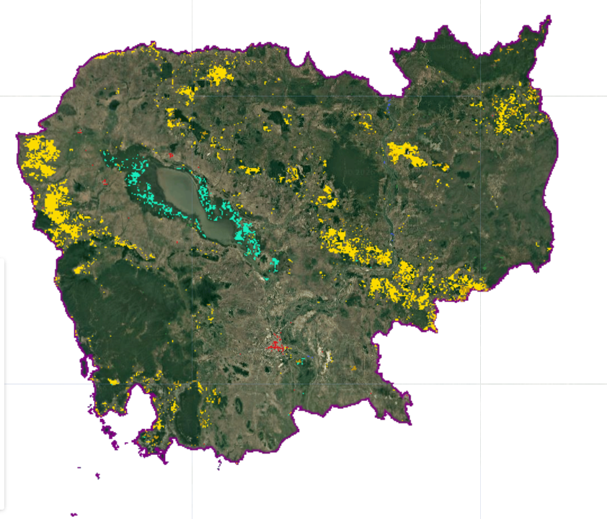
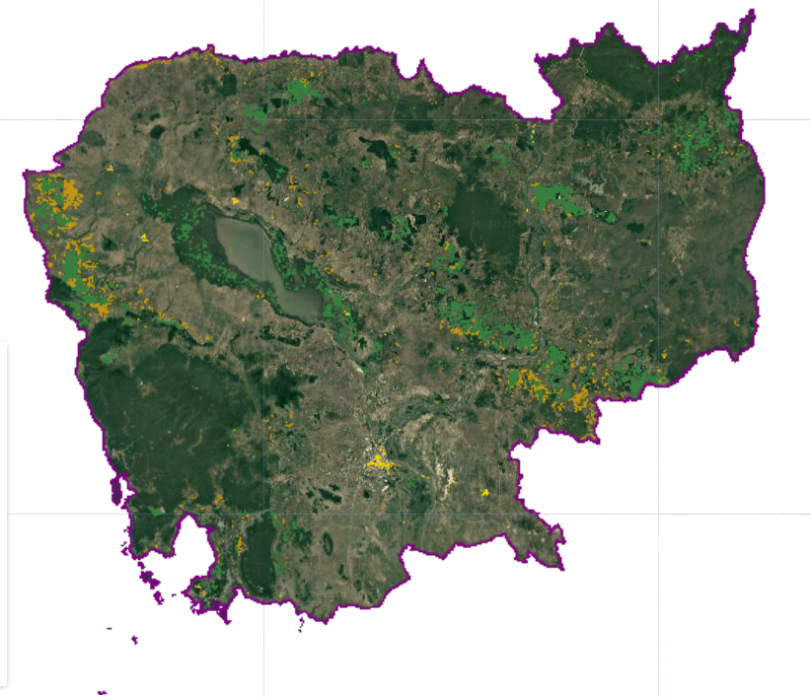
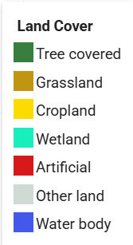
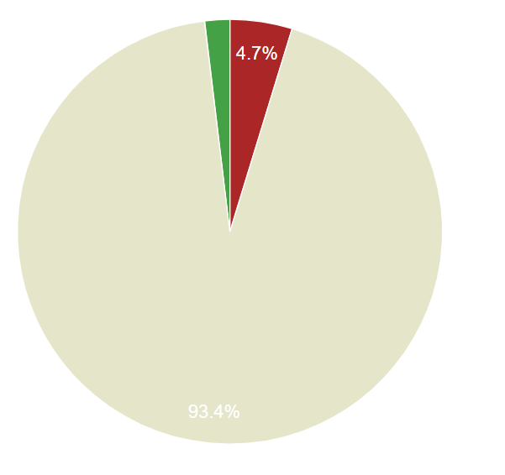
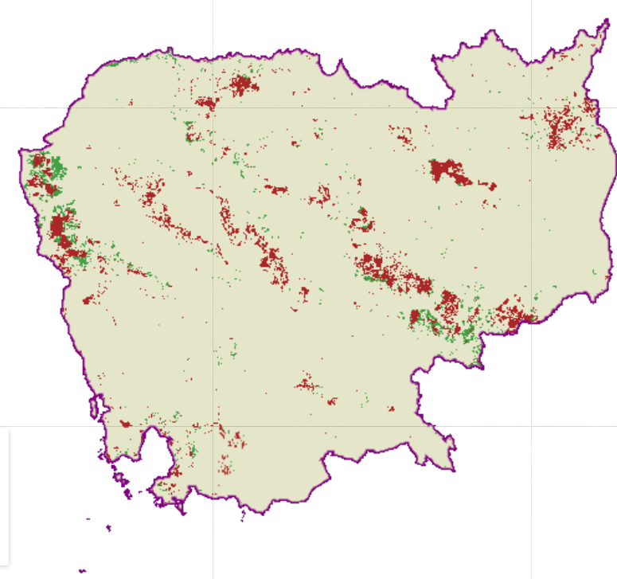
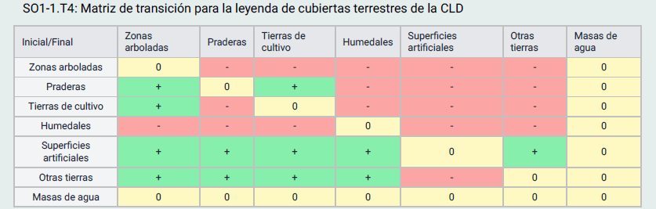
METHODOLOGY
FINAL LAND COVER
TRANSITIONS / CHANGES
INITIAL LAND COVER
GAINS
LOSSES
DEGRADATION DUE TO LAND COVER CHANGE
TRANSITION MATRIX

Slide 4
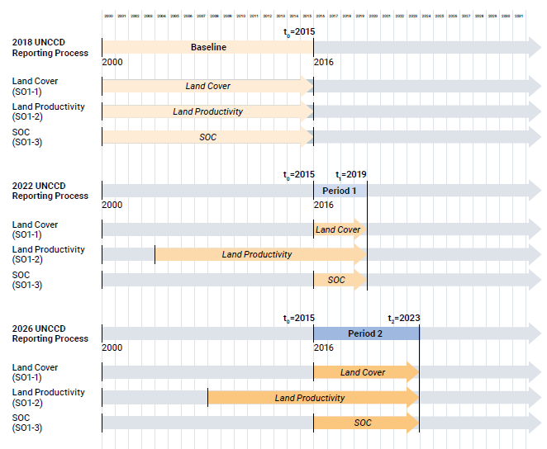
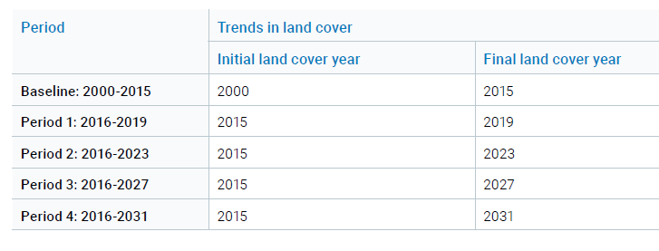
LAND COVER - PERIODS
4 Land Cover Maps
Years: 2000, 2015, 2019, 2023

Slide 5
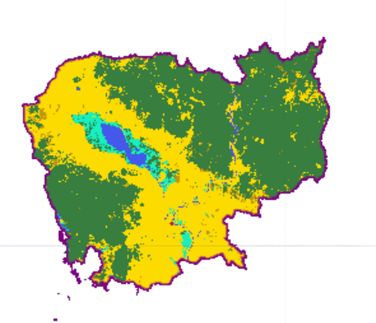
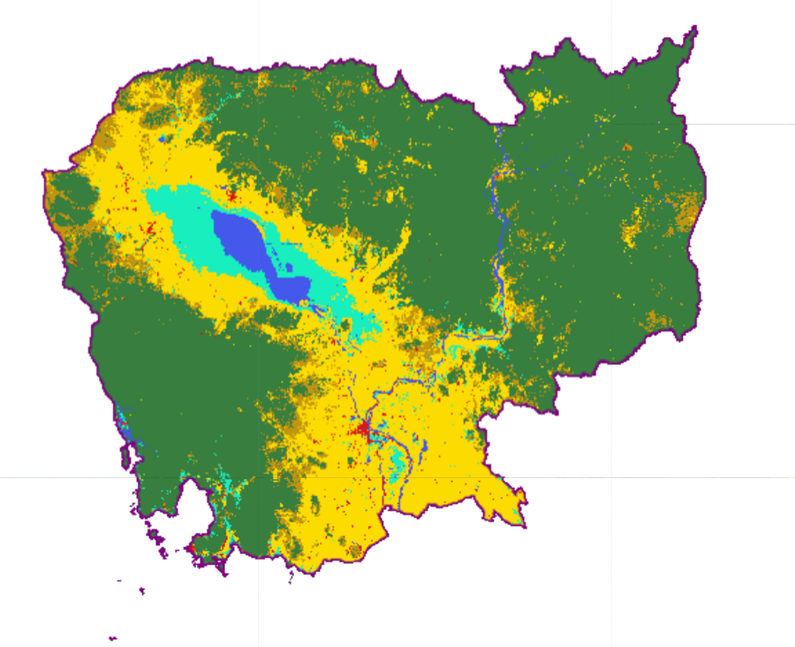
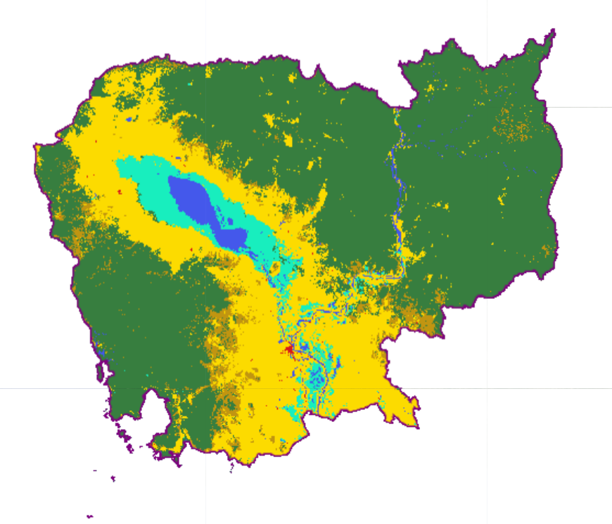
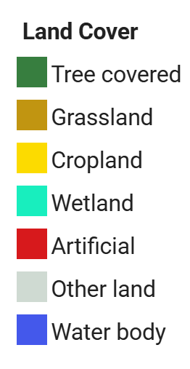
STEP 1: Identification of the best available land cover dataset
DEFAULT DATASET
ALTERNATIVE HIGH-RESOLUTION DATASETS
ESA (European Space Agency)
CCI 300 m
annually 2000-2022
GLAD (University of Maryland)
GLAD GLC 30 m
2000, 2005, 2010, 2015, 2020
CBAS (SDG Center, China)
GLC-FCS30D - 30 m
annually 2000-2022
https://maps.elie.ucl.ac.be/CCI/viewer/download/ESACCI-LC-Ph2-PUGv2_2.0.pdf
https://doi.org/10.3389/frsen.2022.856903
https://doi.org/10.5194/essd-13-2753-2021

Slide 6

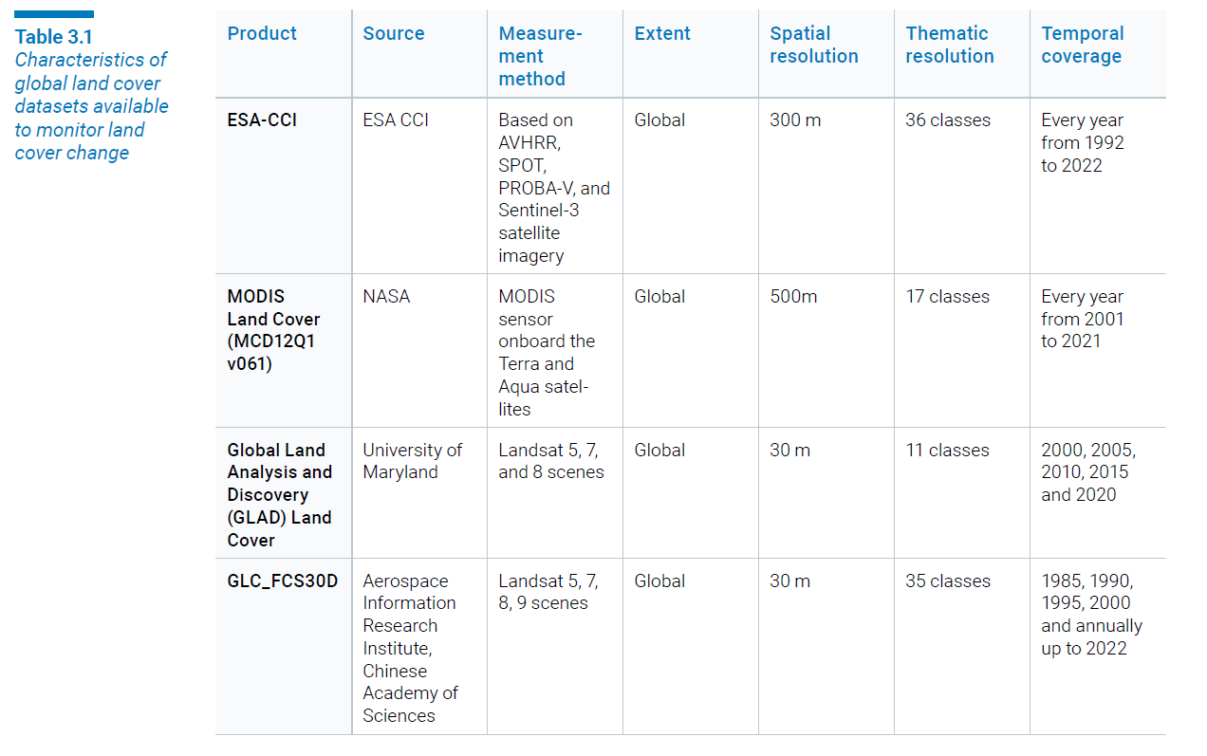
3.1 Enhancements for Assessing Trends in Land Cover
3.1.1 Identification of the best available land cover dataset

Slide 7
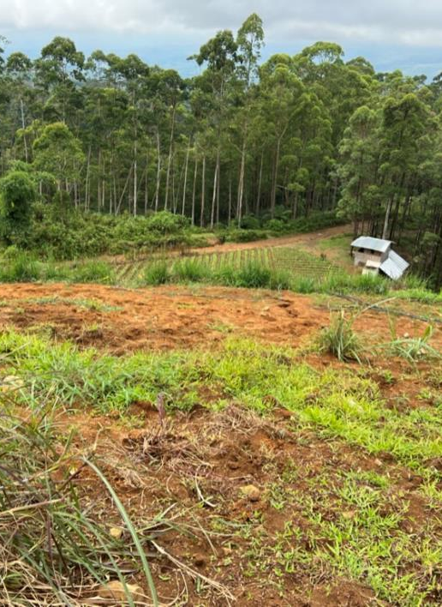
STEP 1: DATA SOURCE
Is it worth it to look for alternative land cover datasets or is the default data good enough?
What other datasets are available?
Is there a national data option that could be used? Or that can be used for improving or validating alternatives options?

Slide 8
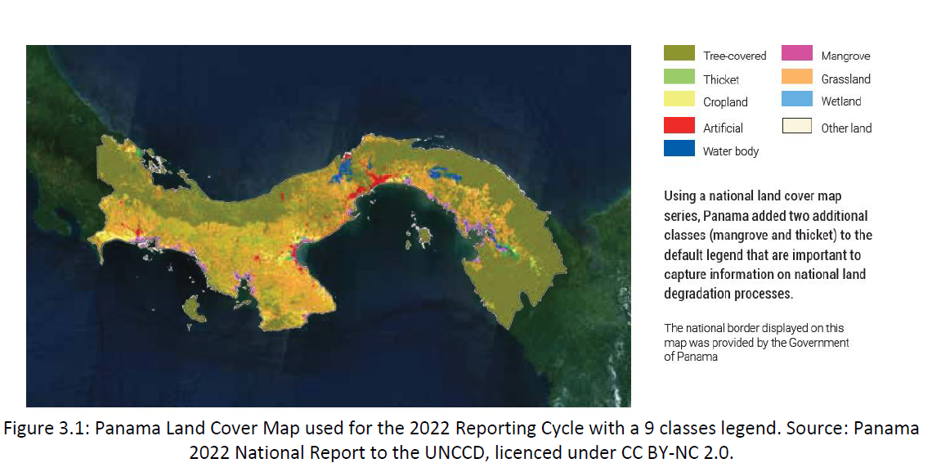
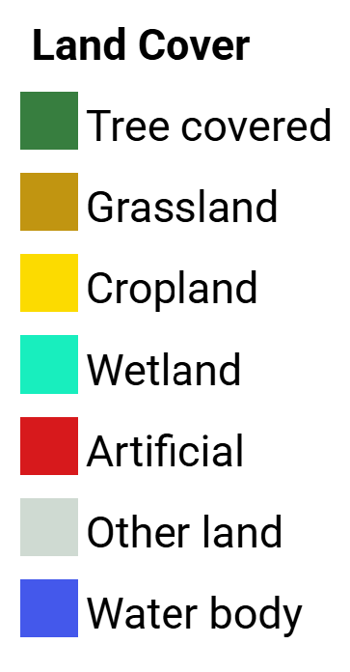
STEP 2: Selecting a land cover legend for monitoring key degradation processes
DEFAULT
ALTERNATIVES

Slide 9
DEFAULT DATA can be recategorized
ESA reclass in 2022

Slide 10
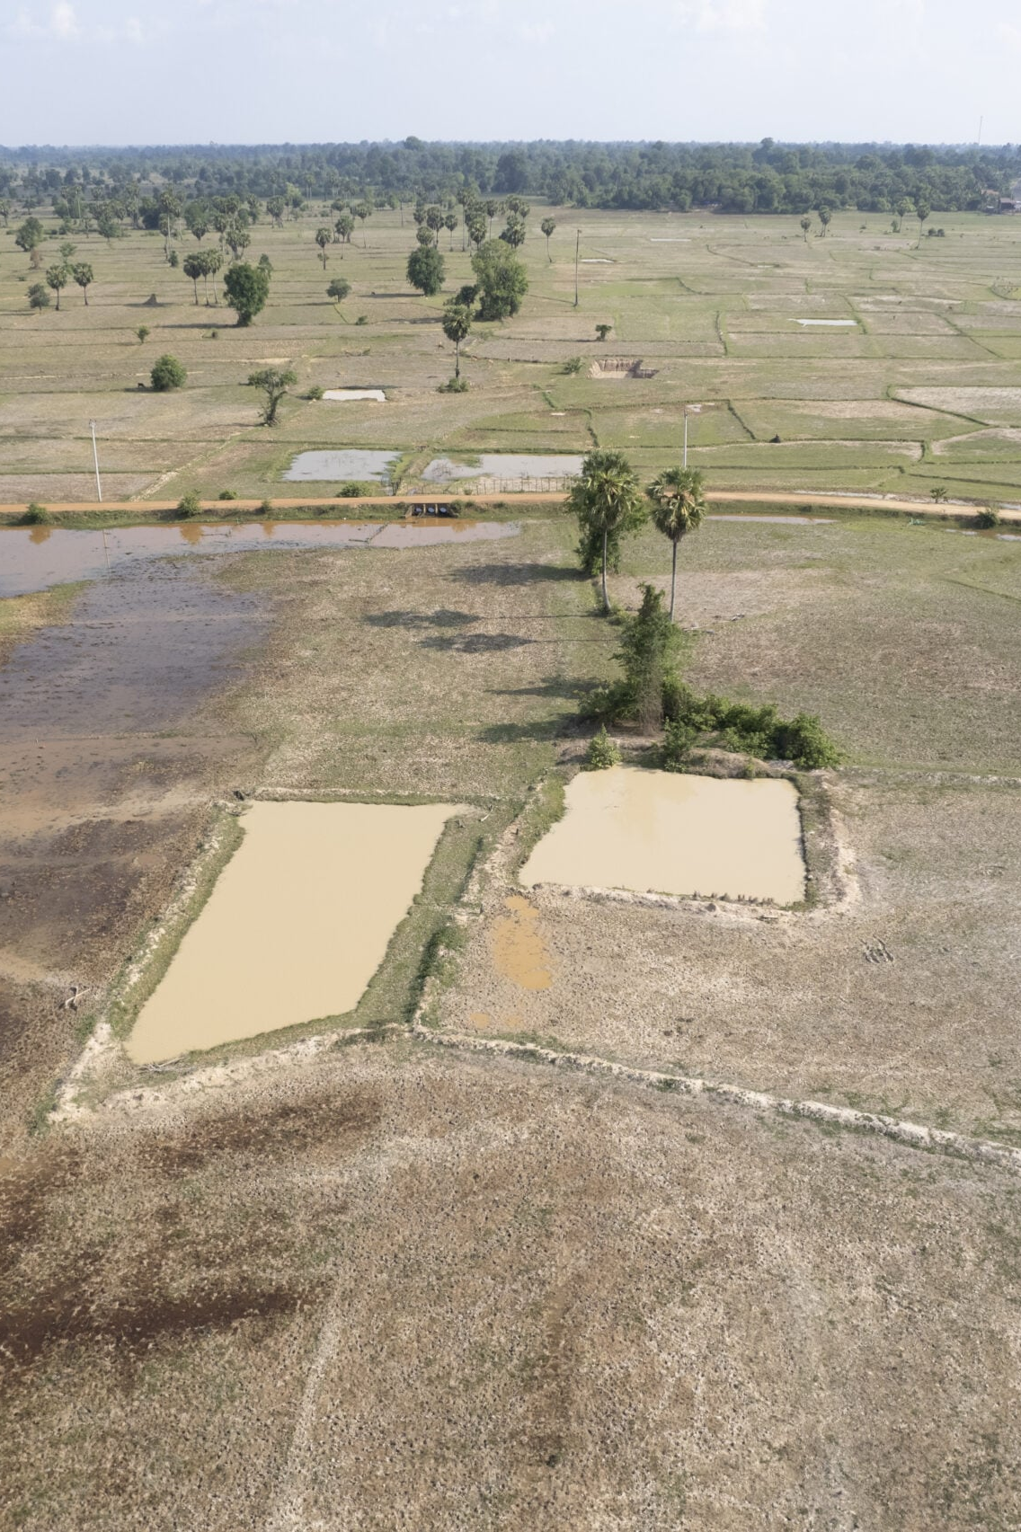
STEP 2: CATEGORIZATION
What are the main land use/cover changes related to degradation and restoration processes?
Is the 7-category legend sufficient to monitor these processes?
What other land classes would be important to monitor?

Slide 11
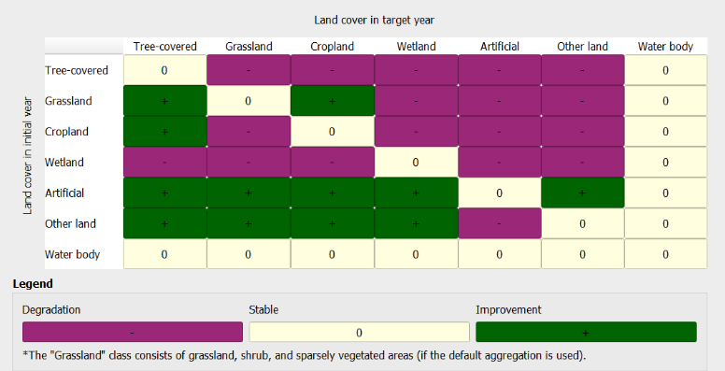
STEP 3:
Defining the land cover transition matrix
KEY: Participatory Decision-Making Process

Slide 12
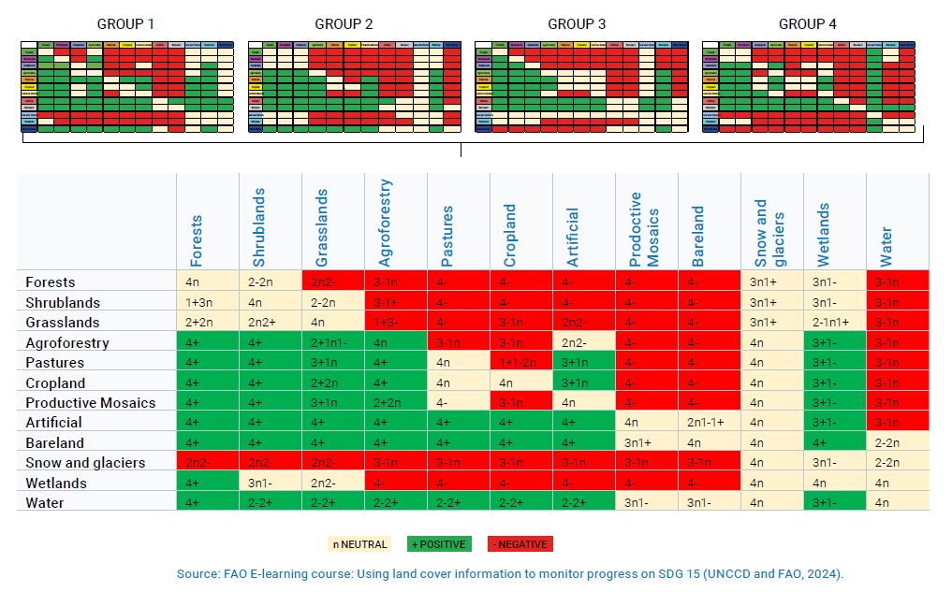
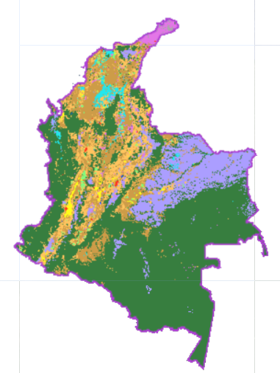
3.1 Enhancements for Assessing Trends in Land Cover
3.1.3 Defining the land cover transition matrix

Slide 13
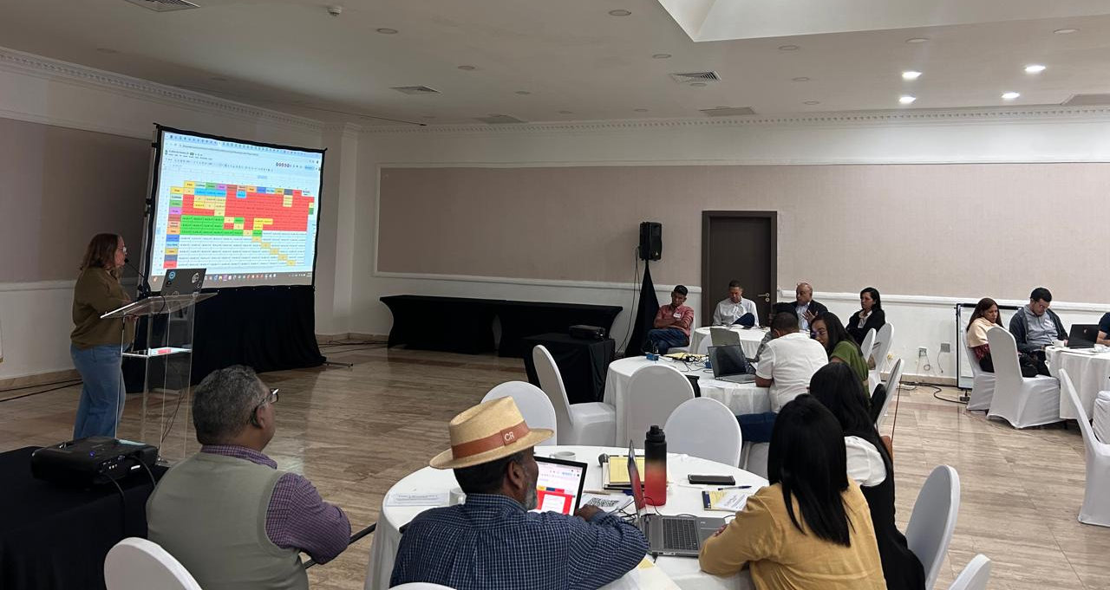
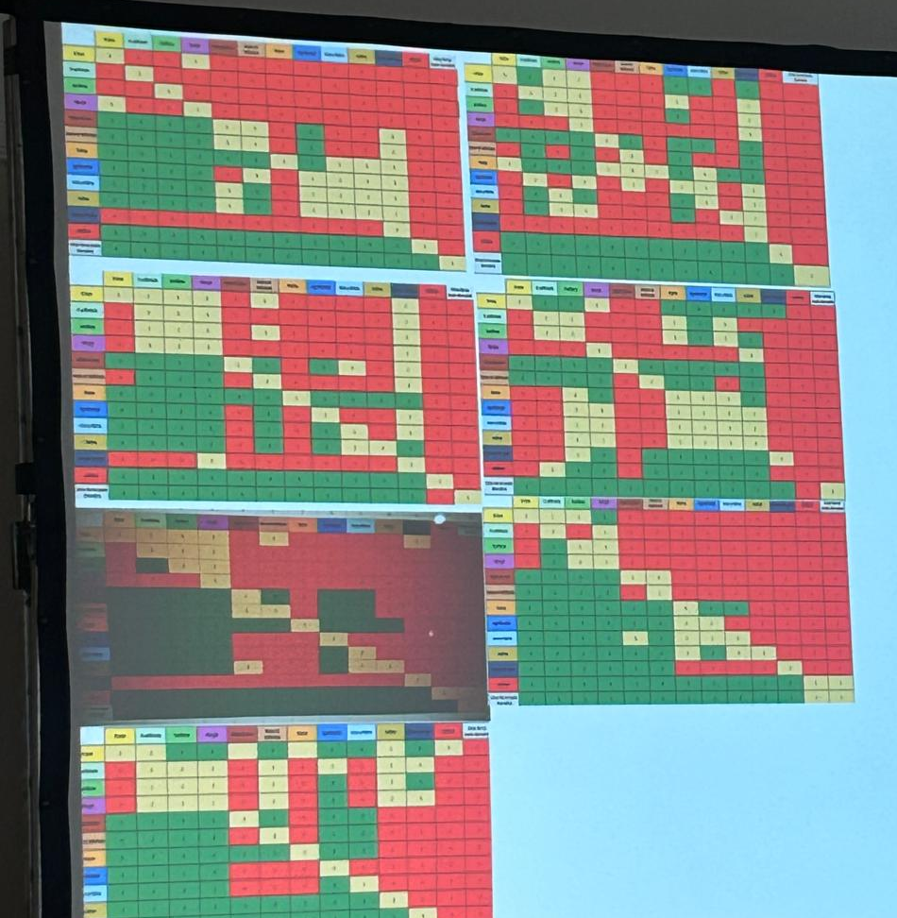
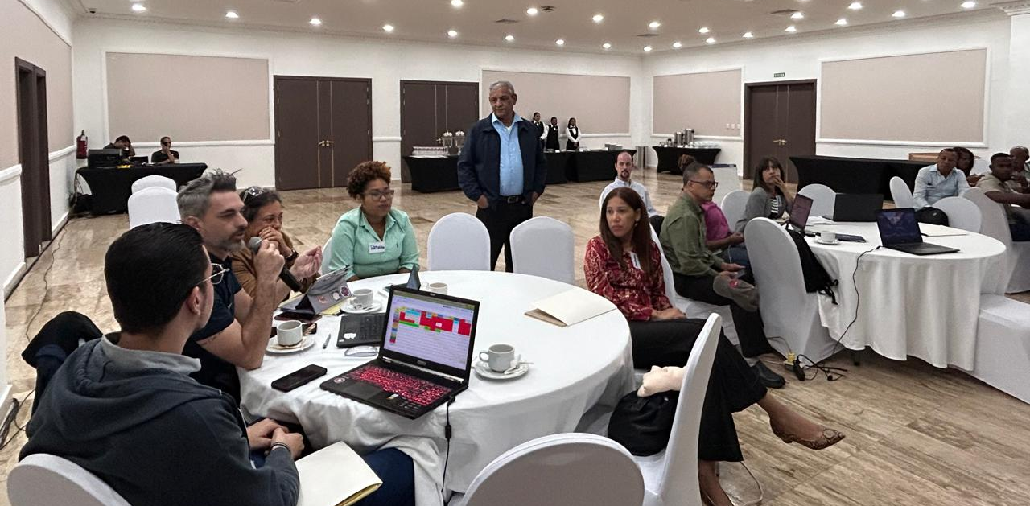
STEP 3: Defining the land cover transition matrix

Slide 14
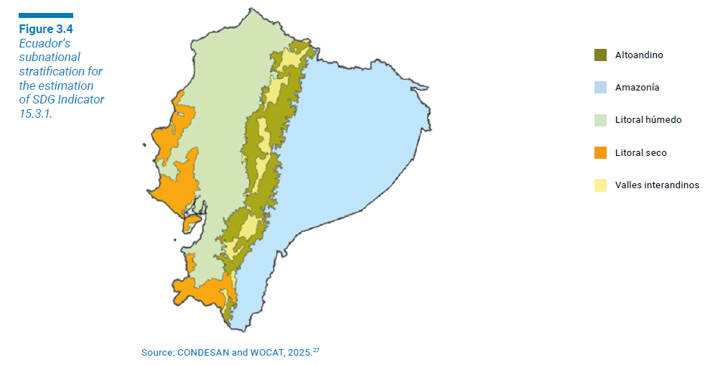
STEP 3:
Defining the land cover transition matrix
In many cases, differences in the interpretation of the same type of land cover transition arise from varying local contexts. A transition that signifies improvement in one area may represent degradation in another, depending on environmental, social, or economic conditions. Some countries are addressing this challenge by adopting a subnational approach to LDN monitoring and SDG Indicator 15.3.1 estimation. This approach acknowledges that a one-size-fits-all transition matrix is not always appropriate, particularly in countries with diverse bioclimatic conditions.

Slide 15
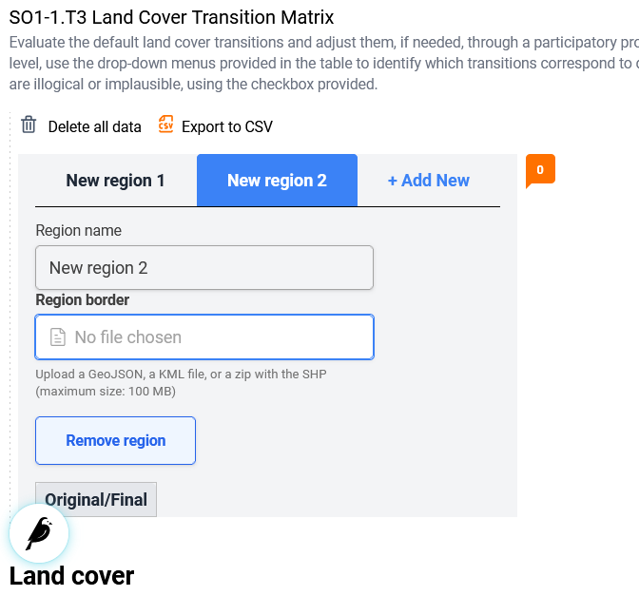
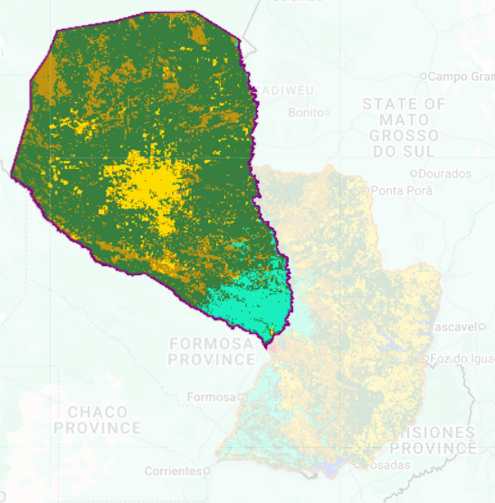
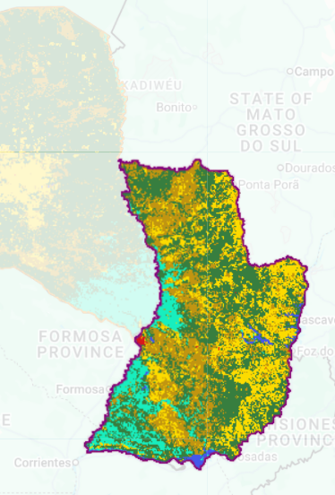
STEP 3:
Defining the land cover transition matrix
REGIÓN OCCIDENTAL
REGIÓN OCCIDENTAL
REGIÓN ORIENTAL
REGIÓN ORIENTAL

Slide 16
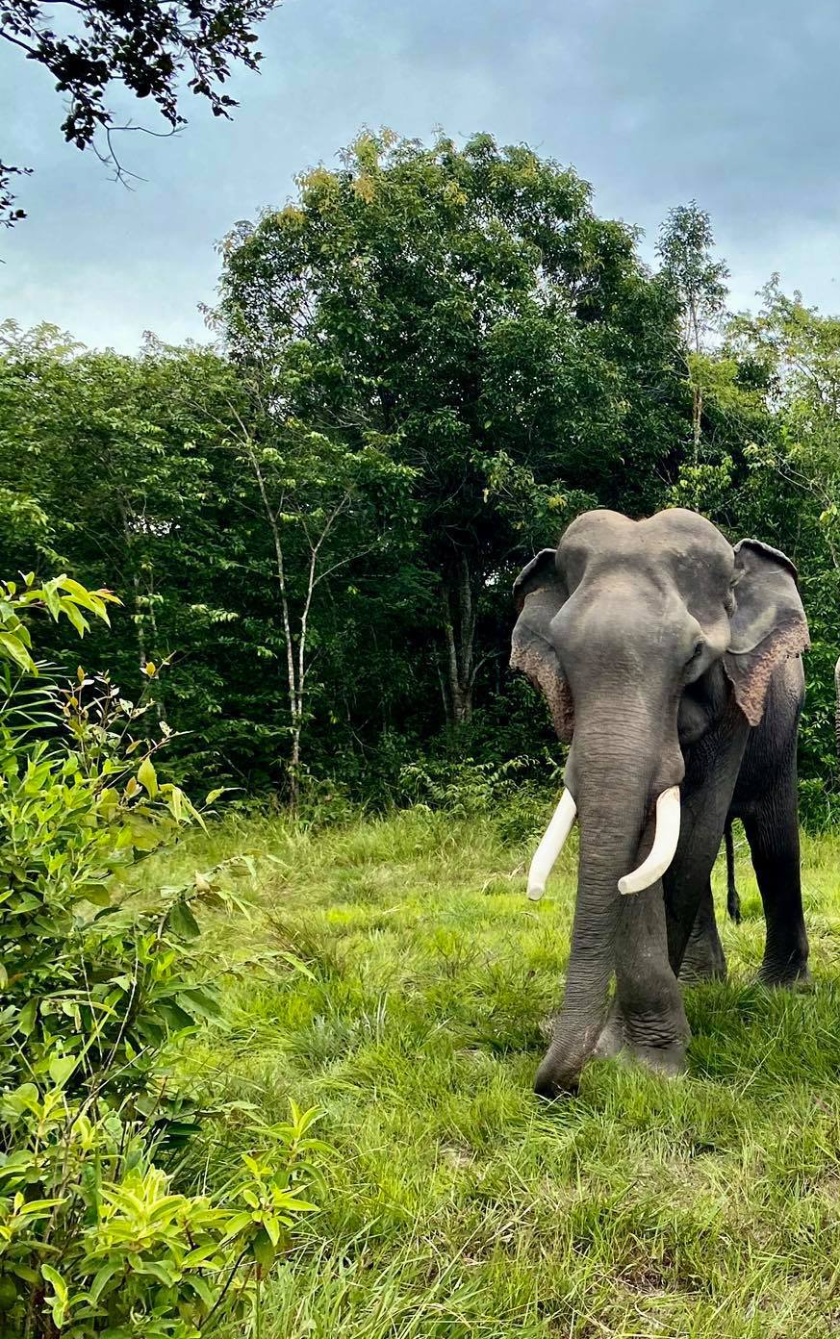
STEP 3: TRANSITION MATRIX
Does the default transition matrix represent the country?
Would it be advisable to have different matrices for different regions?
Which stakeholders should participate in this discussion?

Slide 17

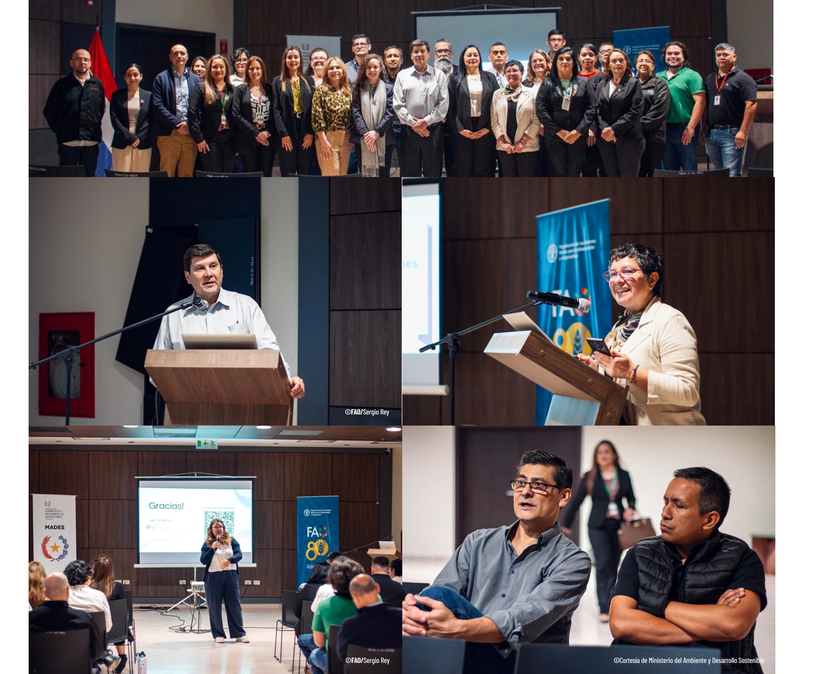
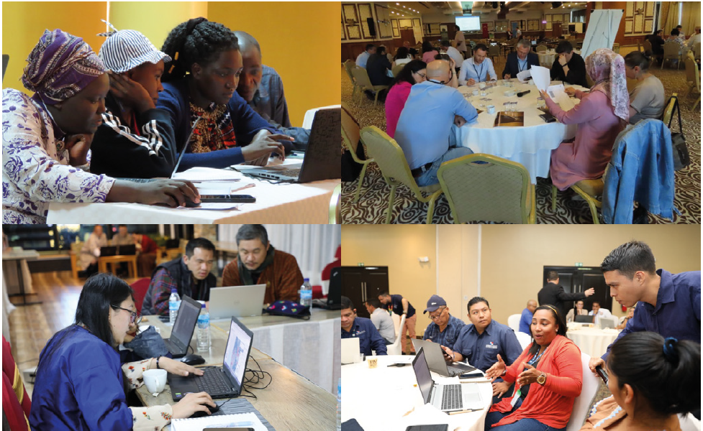
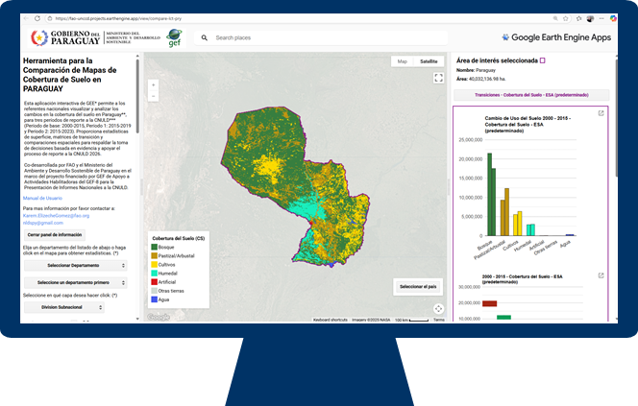
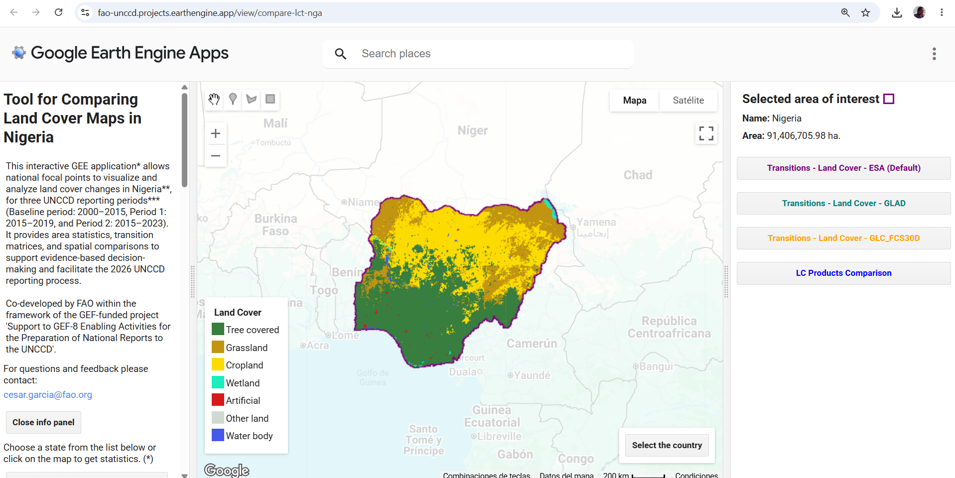
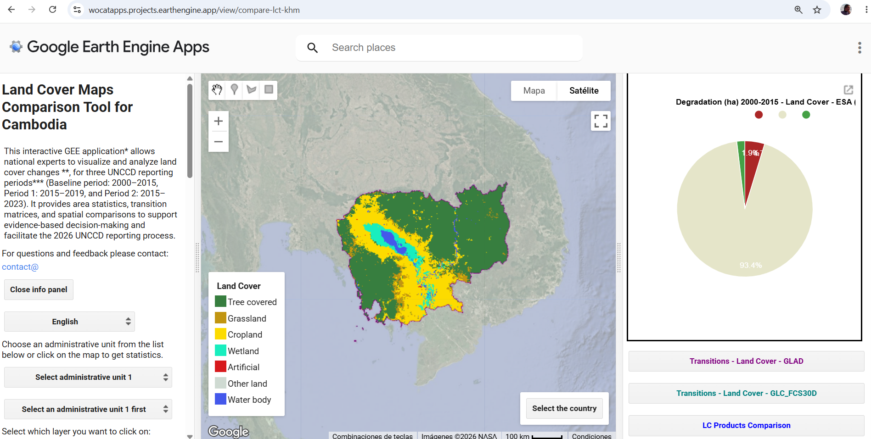
How can countries make these decisions?
FAO WOCAT PARTICIPATORY APPROACH FOR ESTIMATING SDG 15.3.1
FAO WOCAT LCT Apps

Slide 18

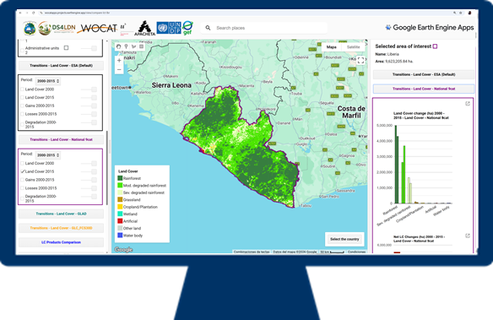
Cambodia Land Cover Comparison App
https://wocatapps.projects.earthengine.app/view/compare-lct-khm

Slide 19
Who makes the decisions?
FINAL LAND COVER
TRANSITIONS / CHANGES
INITIAL LAND COVER
GAINS
LOSSES
DEGRADATION DUE TO LAND COVER CHANGE
TRANSITION MATRIX

Slide 20
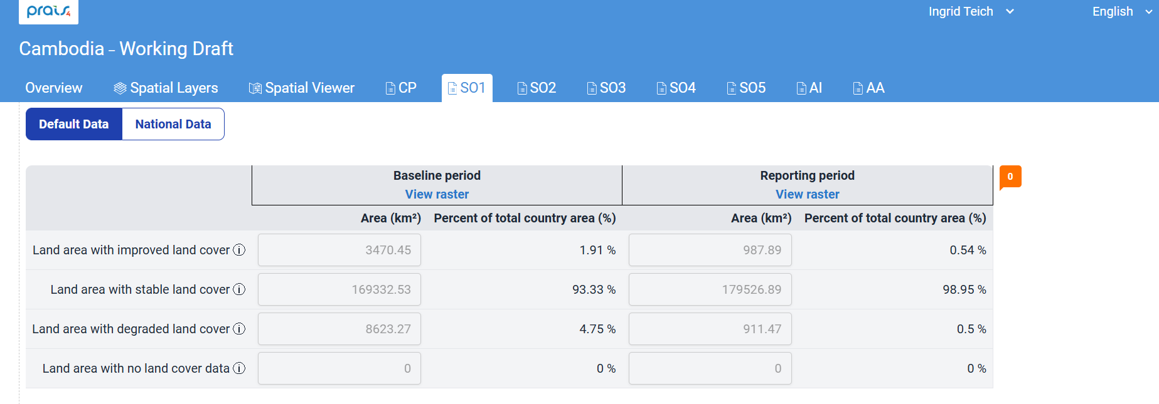
Default data in PRAIS 4

Slide 21
Lets explore the App
https://wocatapps.projects.earthengine.app/view/compare-lct-khm

Slide 22
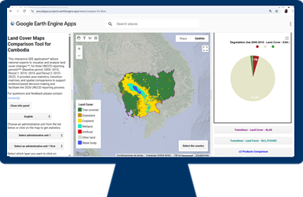
Hands on!
https://wocatapps.projects.earthengine.app/view/compare-lct-khm
Which proportion of Cambodia was degraded between 2000 and 2015 according to the default data at national level?
How many ha of croplands were converted to tree covered areas between 2000 and 2015 according to the default data set?

Slide 23
Thank you
Do you have any questions?
Ingrid.teich@unibe.ch

