Slide 1

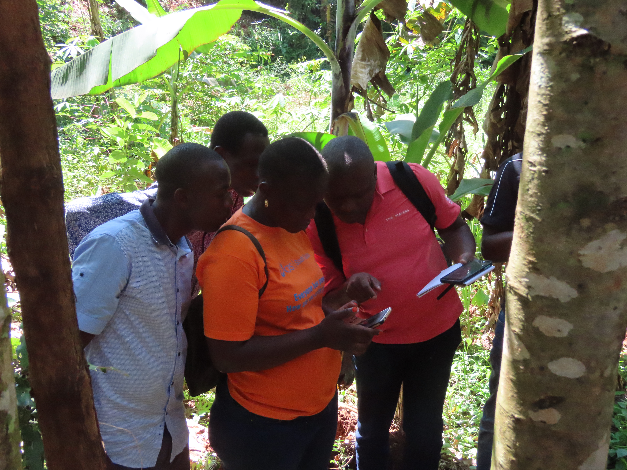




SO1-2
Trends in Land Productivity
Inception and Technical Training Workshop on the 2026 UNCCD National Reporting Process
Liberia
June 23th 2026
Dr. Ingrid Teich
Senior Research Scientist (University of Bern)
WOCAT Secretariat

Slide 2



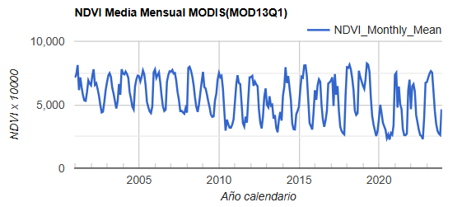
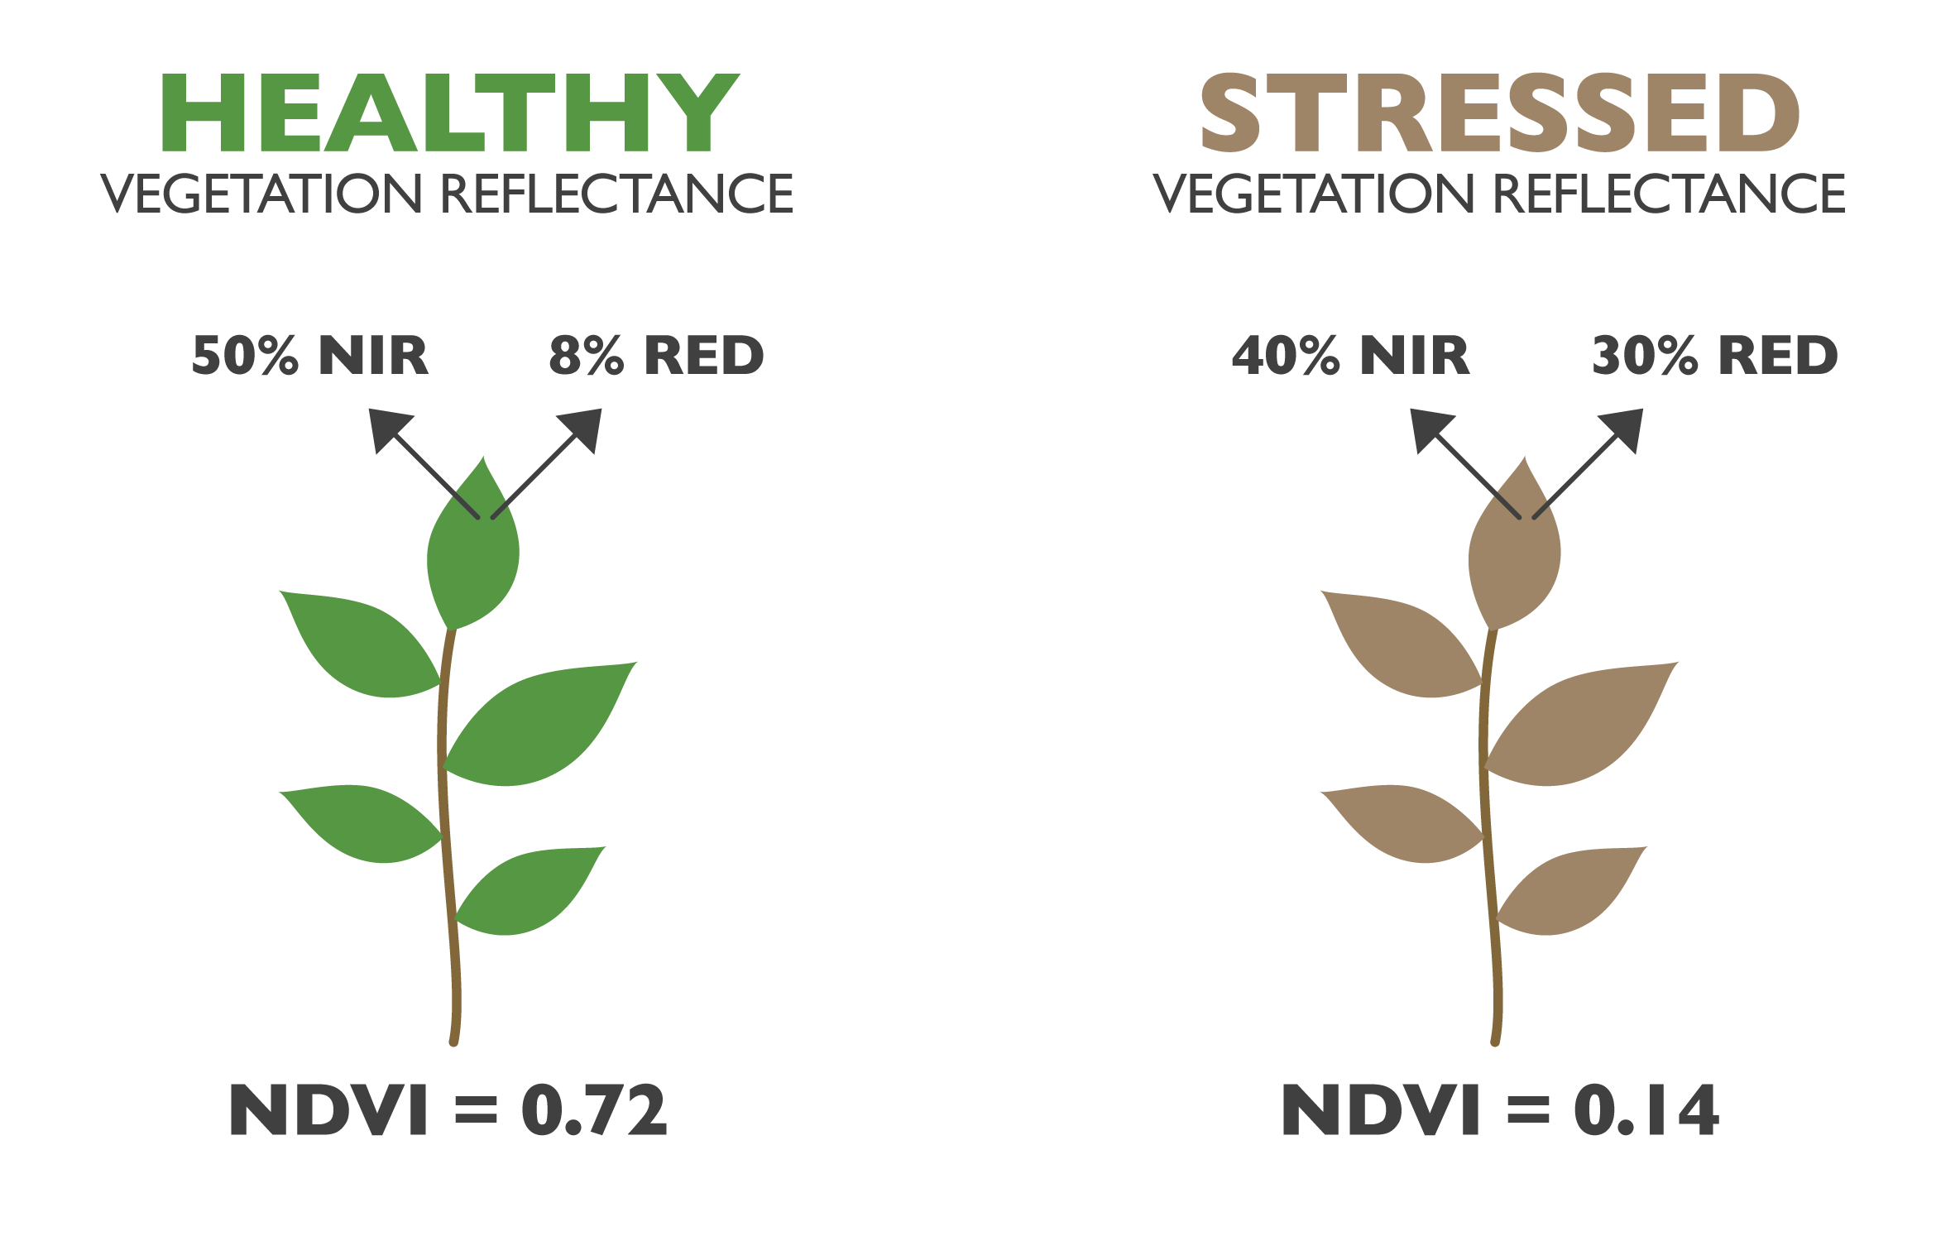
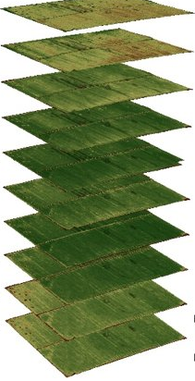
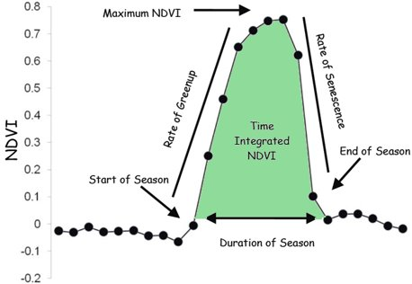
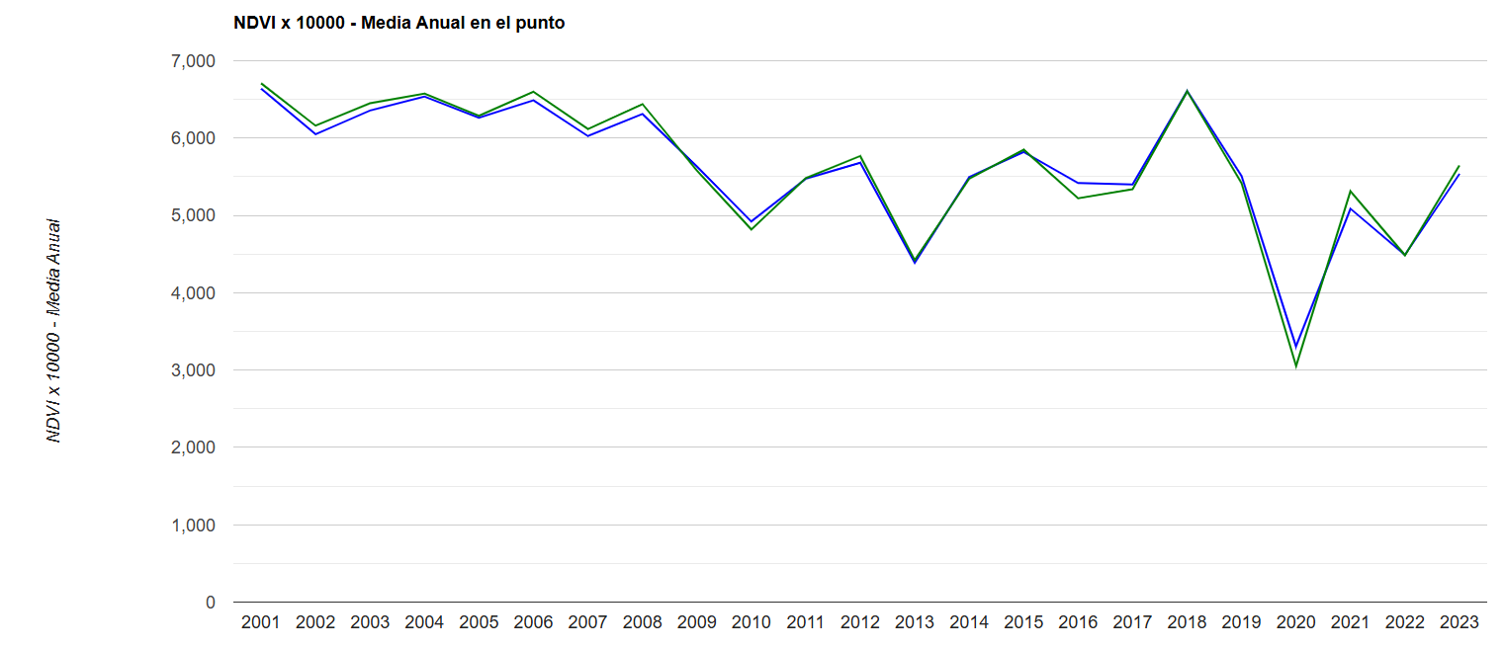
METHODOLOGY
CONSTRUCTION PRODUCTIVITY TIME SERIES
GREEN INDEX DERIVED FROM REMOTE SENSORS
ANNUAL METRIC: mean

Slide 3
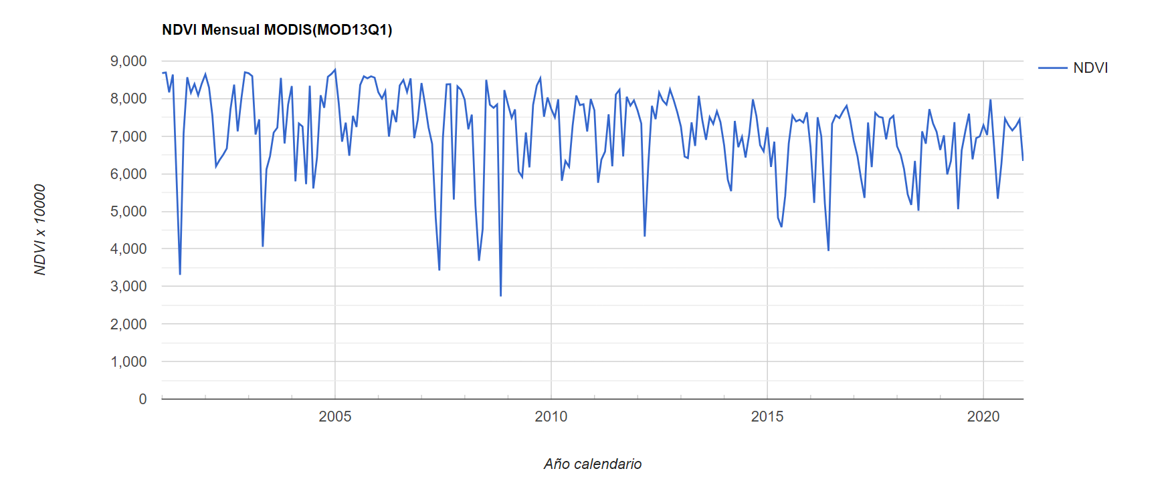

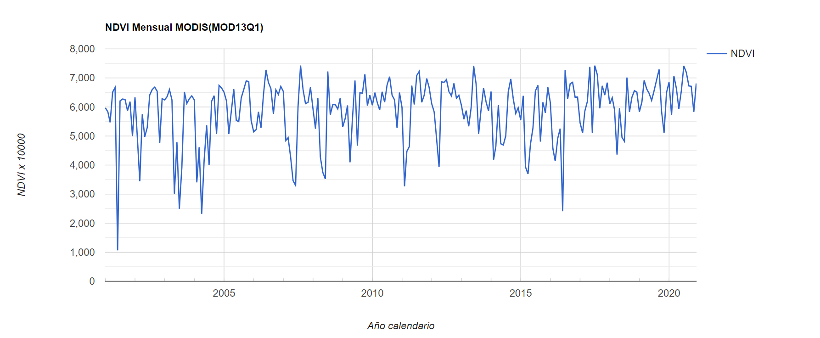
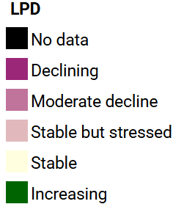
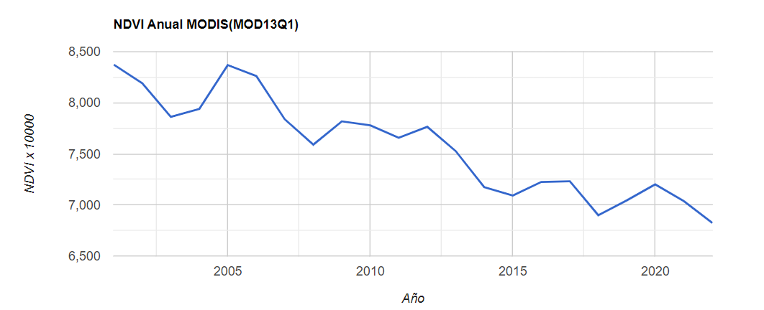
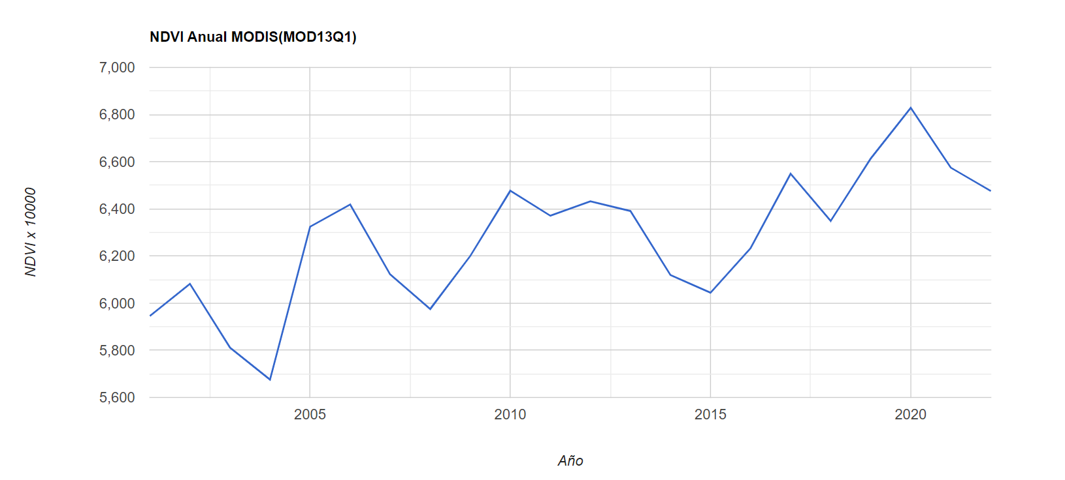
LAND PRODUCTIVITY DYNAMICS
NEGATIVE TRENDS
Loss of Productivity
DEGRADATION
POSITIVE TRENDS
Increased Productivity
IMPROVEMENT

Slide 4
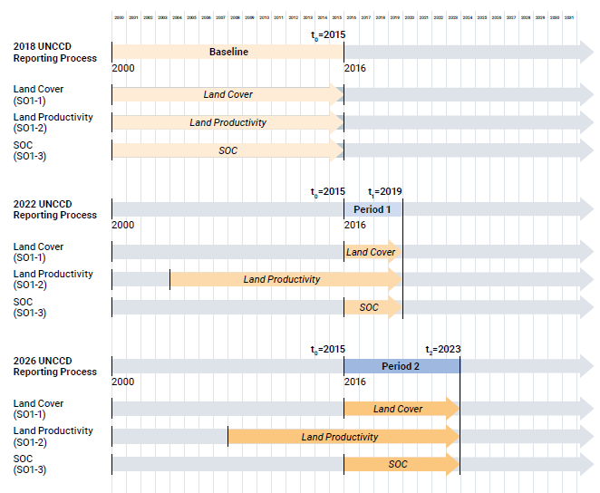
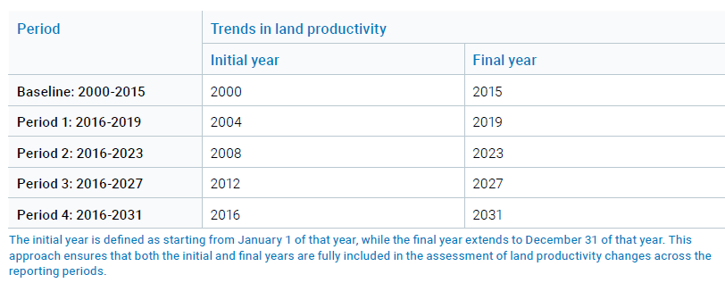
PERIODS - LAND PRODUCTIVITY
16-years moving window

Slide 5
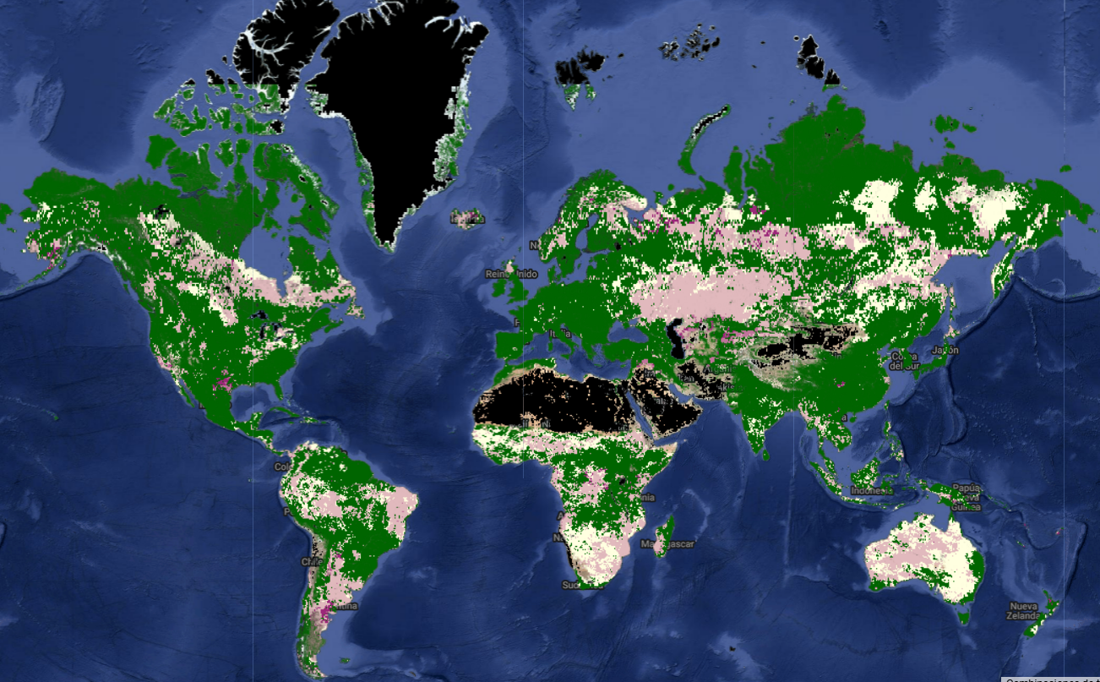
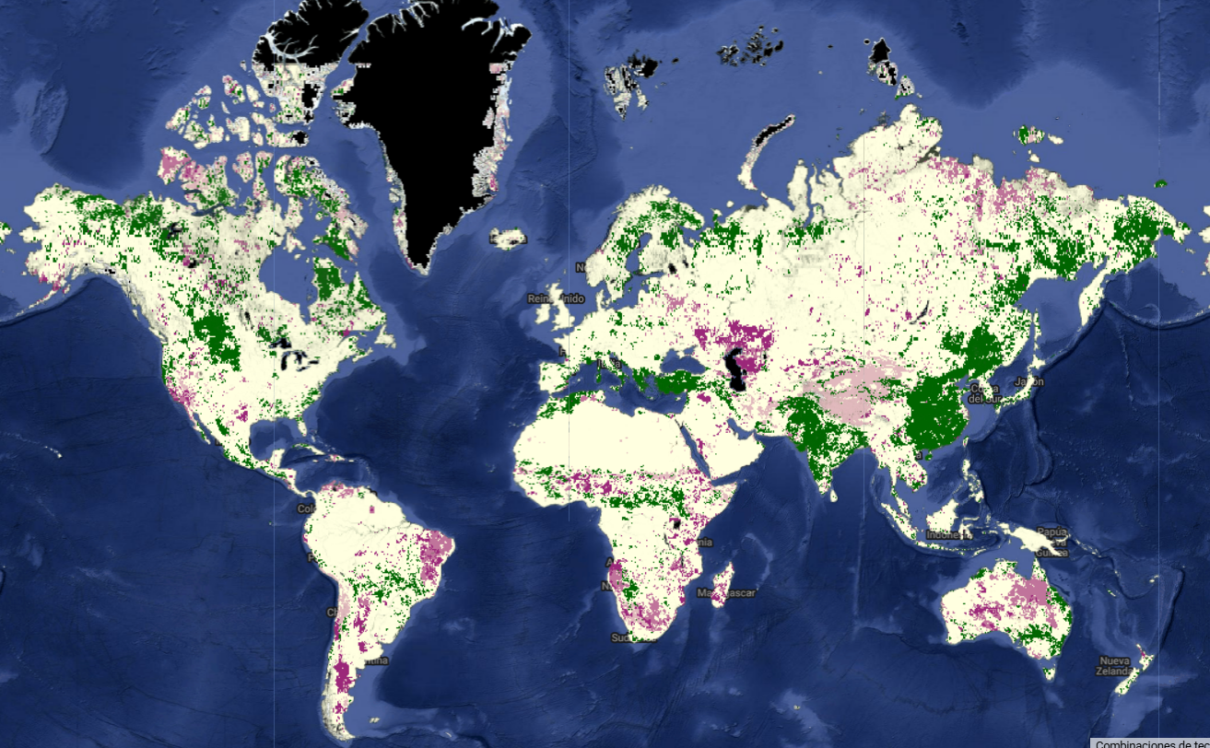
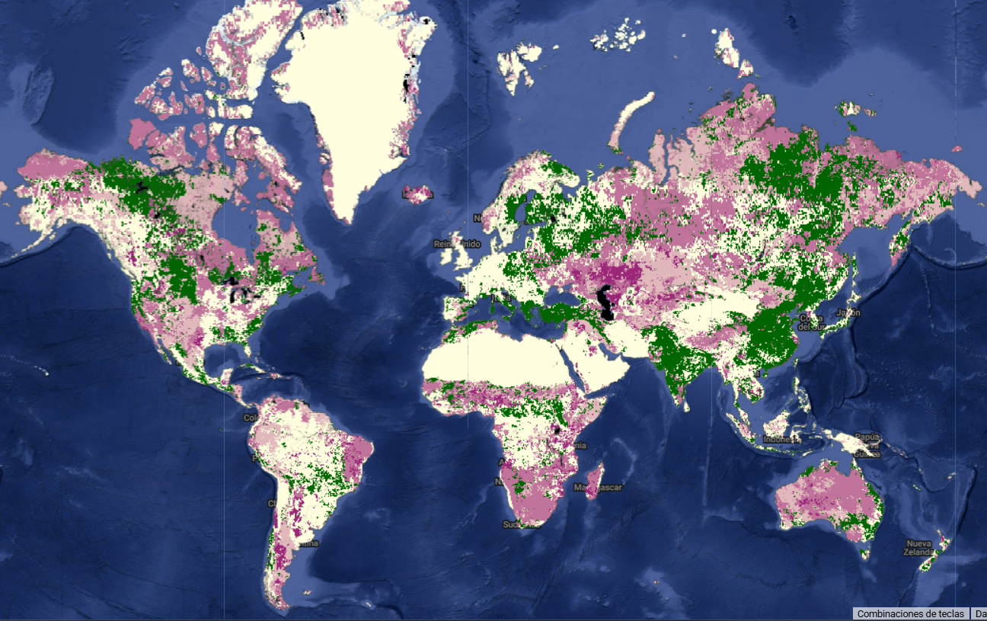
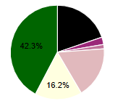
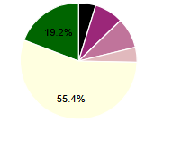
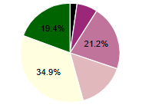
DIFFERENT LPD MODELS
PERIOD: BASELINE (2000-2015)
JRC
Trends.Earth
FAO WOCAT
4%
17 %
28%

Slide 6
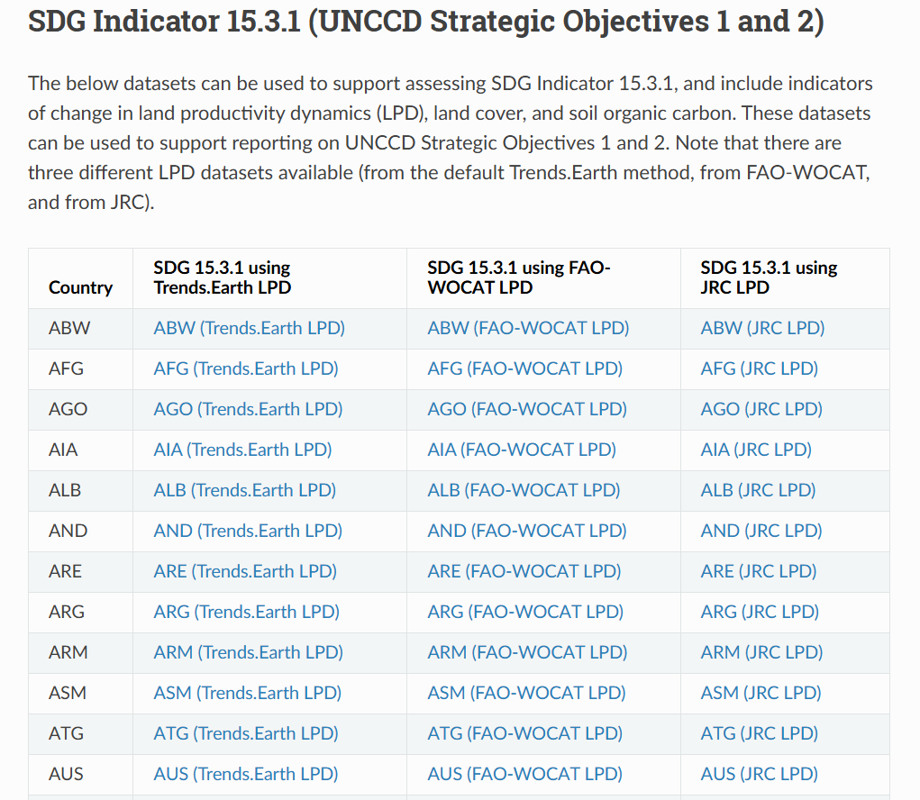

https://docs.trends.earth/en/latest/for_users/downloads/index.html

Slide 7
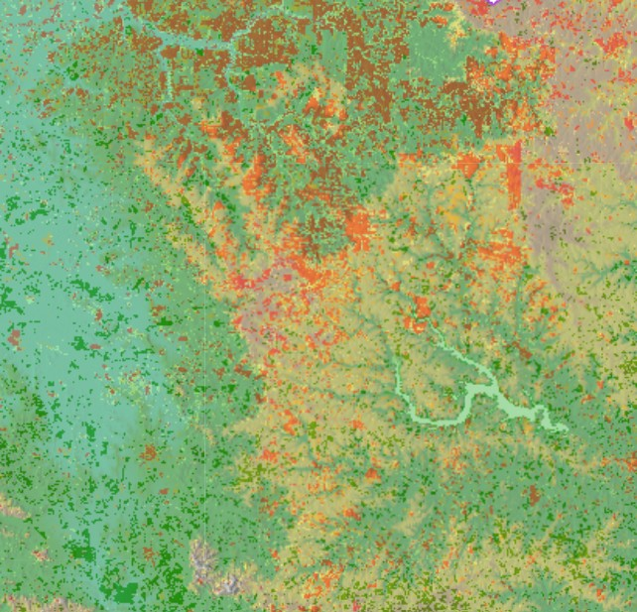
WHY SO MUCH DIFFERENCES IN THE RESULTS?
Because different data is used, it is analyzed in different ways, and each model can be parameterized, so even the same model and the same data can give different results.
LPD input data set + LPD algorithm
THIS ALLOWS US TO FIND A MODEL ADJUSTED TO THE REALITY OF EACH COUNTRY, REGION, WORK AREA

Slide 8
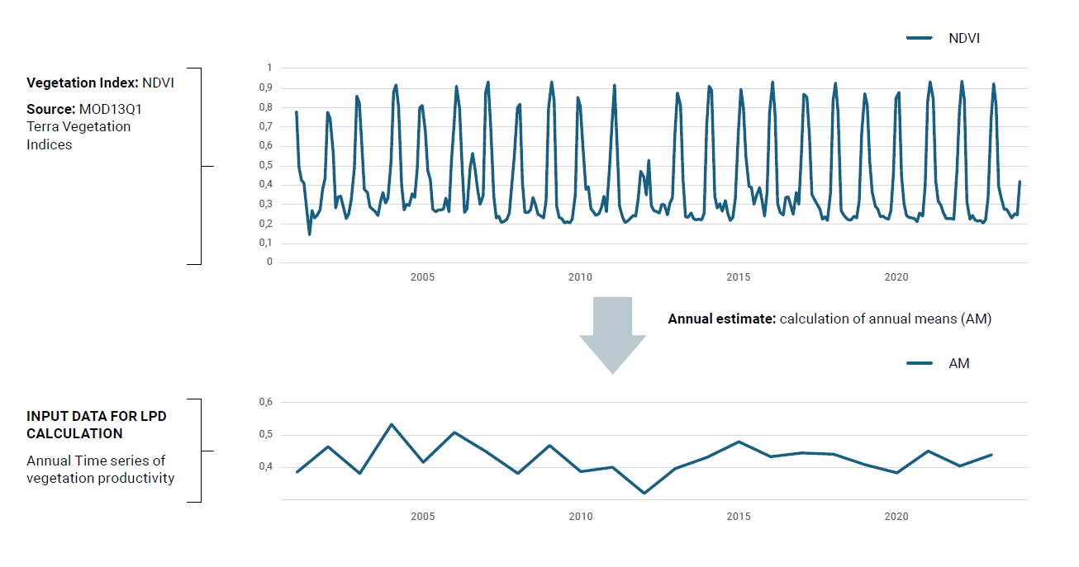
For every pixel…
LPD INPUT DATASET
LPD ALGORITHM
LPD class: i.e. STABLE

Slide 9
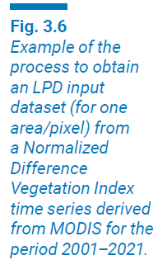
The LPD input data set

Slide 10
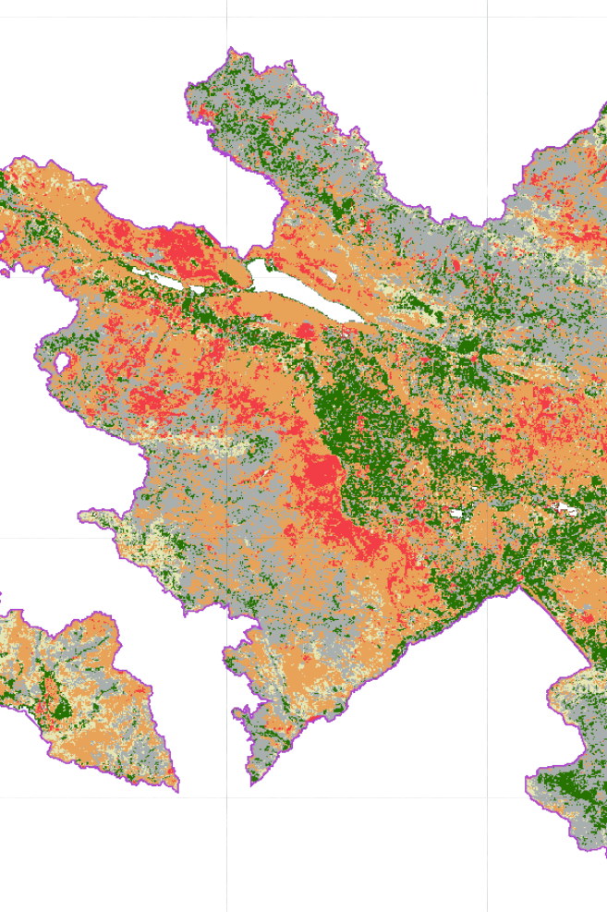
The LPD input data set
Which vegetation index will be used as proxy for productivity
Which satellite imagery dataset will be used for the input data
How annual estimates will be calculated

Slide 11
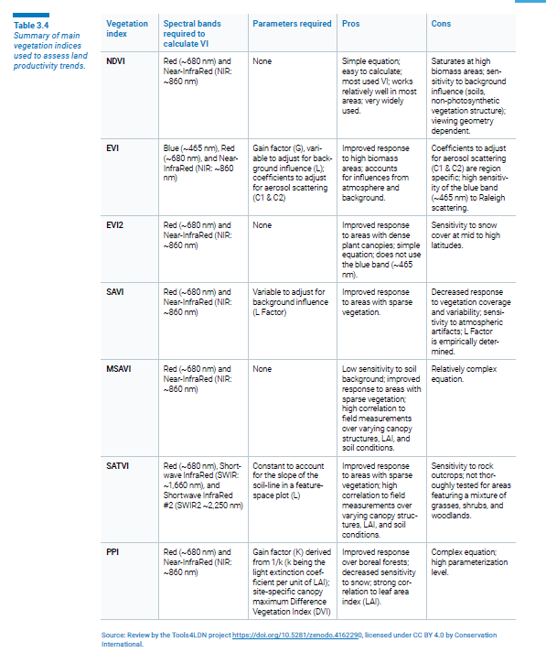

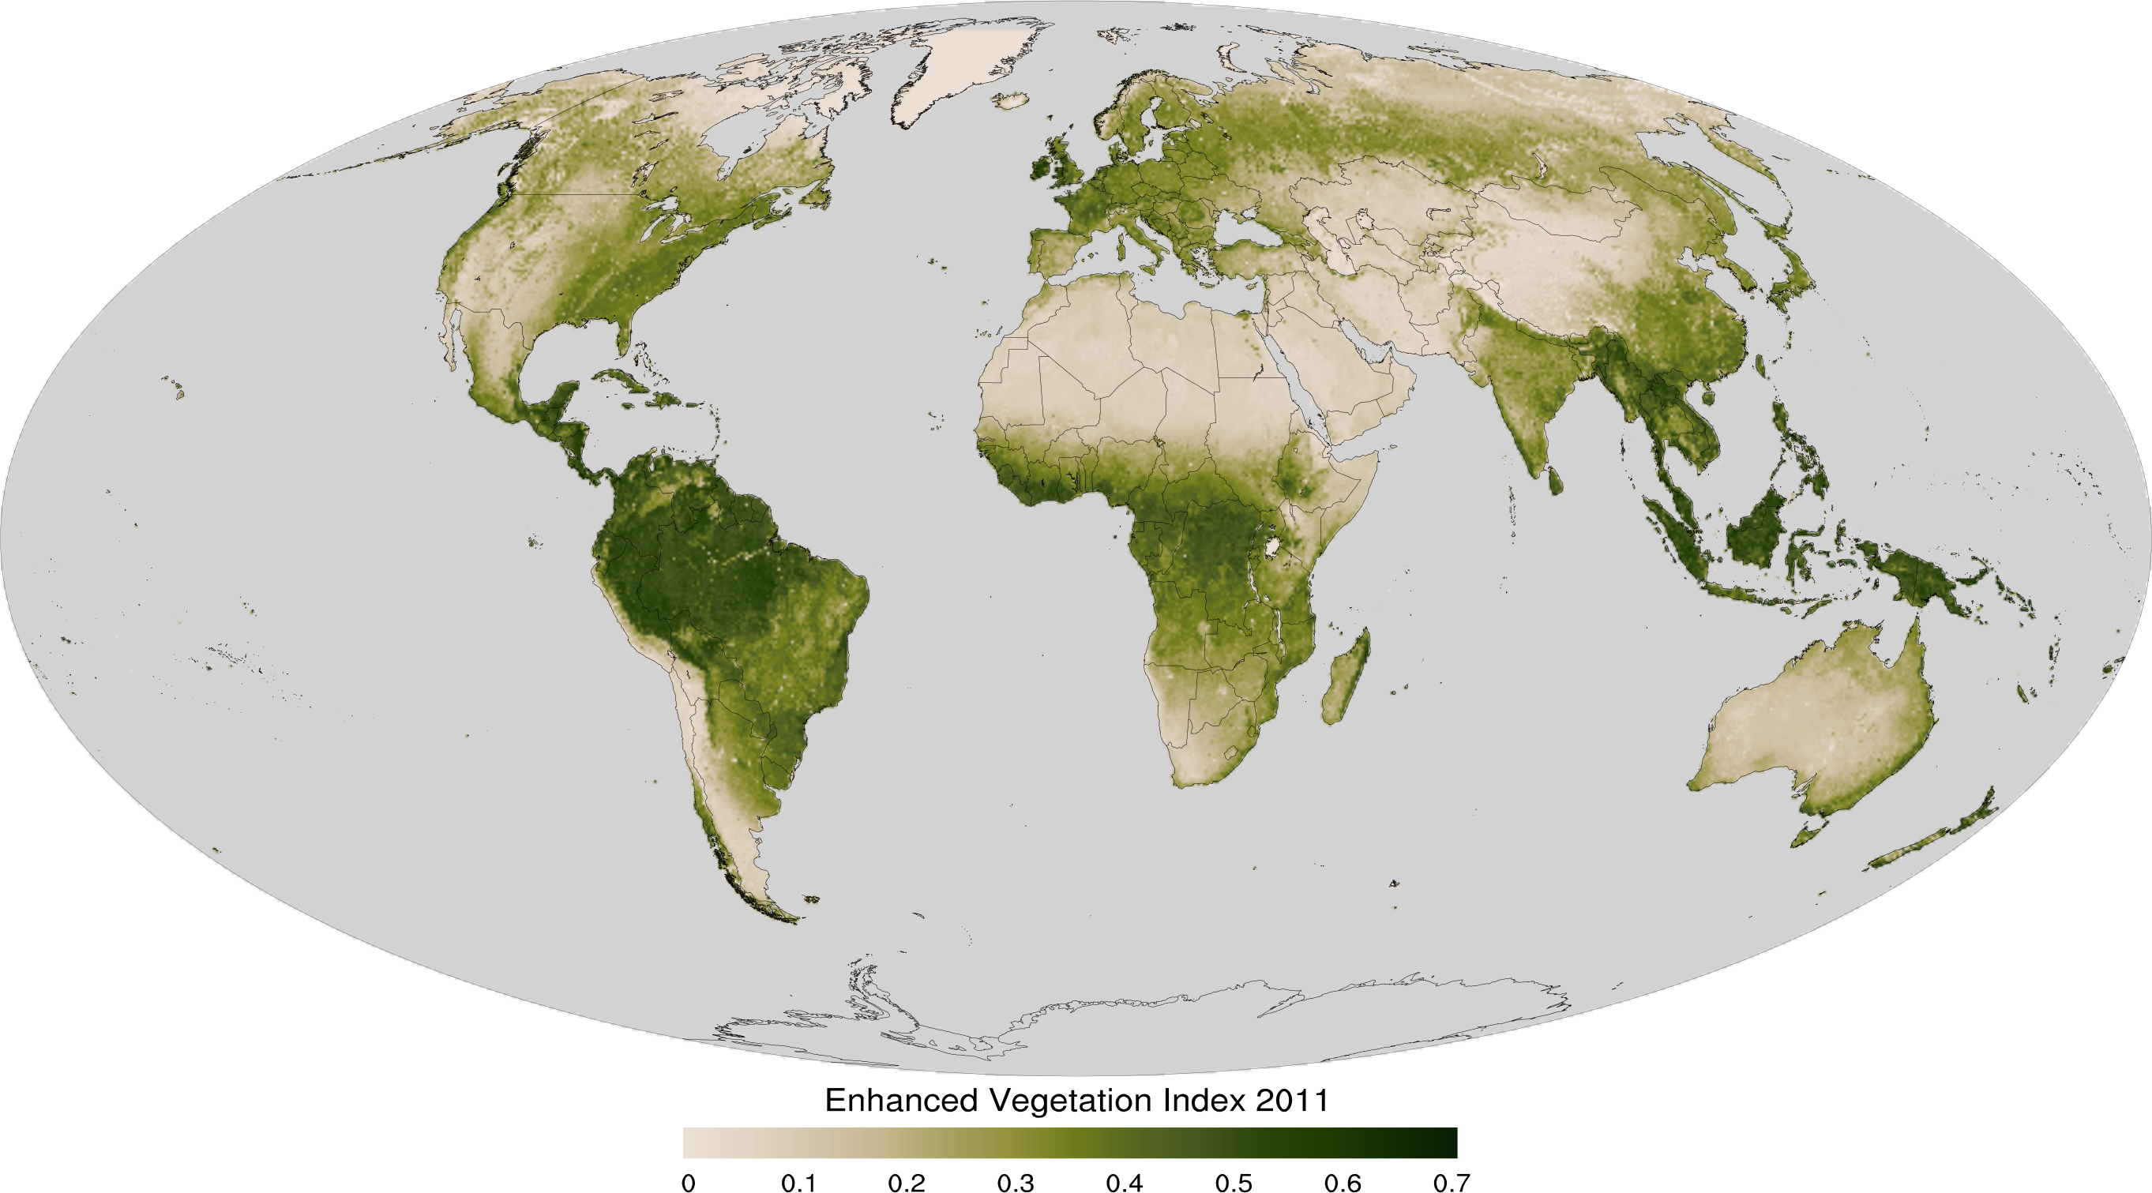
1- Vegetation index
The LPD input data set
EVI: Enhanced vegetation Index
(corrects for atmospheric conditions and canopy background noise, more sensitive in areas with dense vegetation)
SAVI: Soil Adjusted Vegetation Index
(corrects the influence of soil brightness when vegetative cover is low

Slide 12
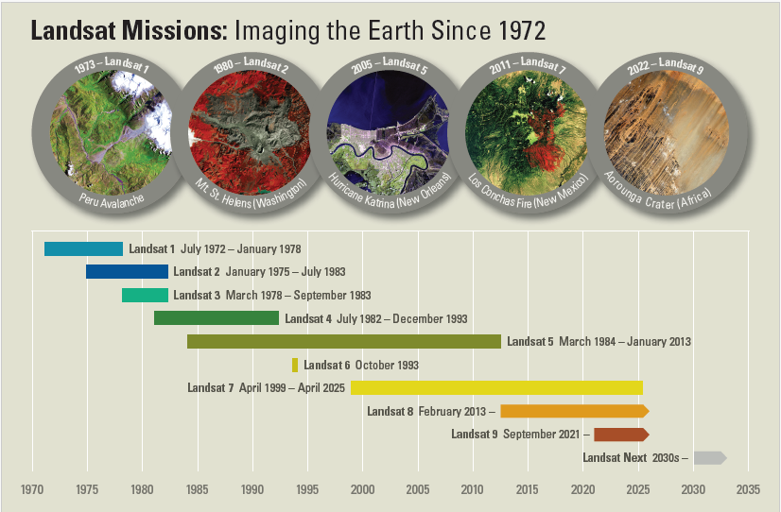



The LPD input data set
2- Satellite imagery dataset

Slide 13
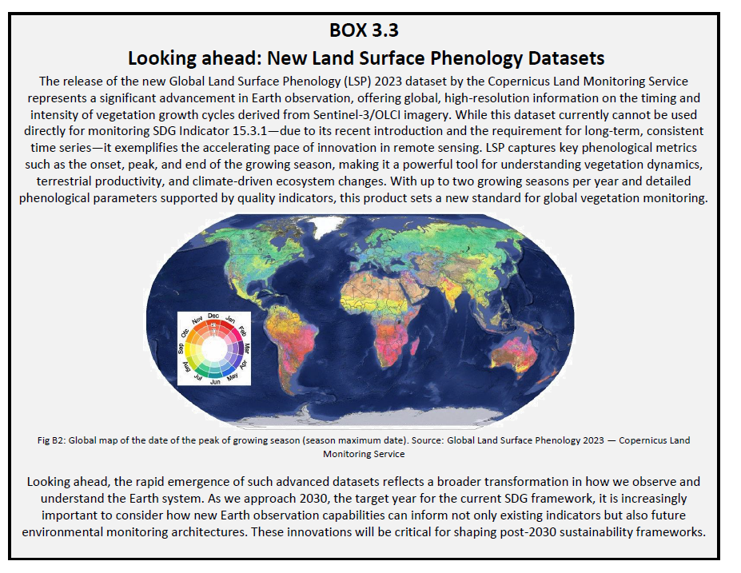
The LPD input data set
3- Annual estimates

Slide 14
For every pixel…
LPD INPUT DATASET
LPD ALGORITHM
LPD class: i.e. STABLE

Slide 15
The LPD algorithm
JRC LPD
Trends.Earth LPD
FAO-WOCAT LPD
Default

Slide 16
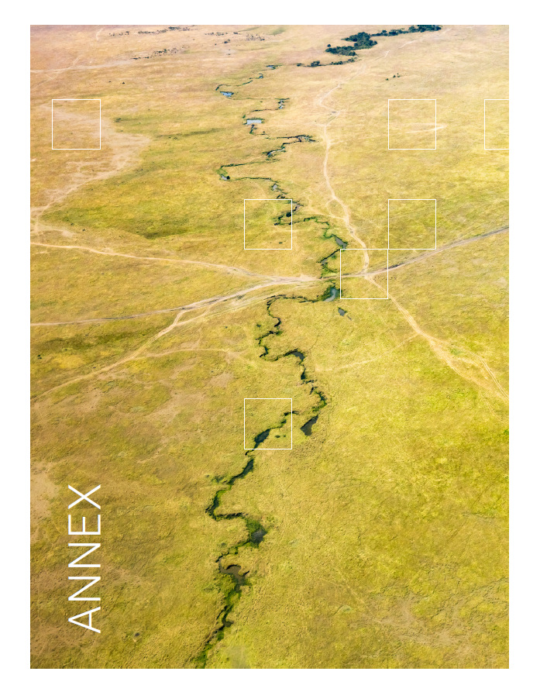
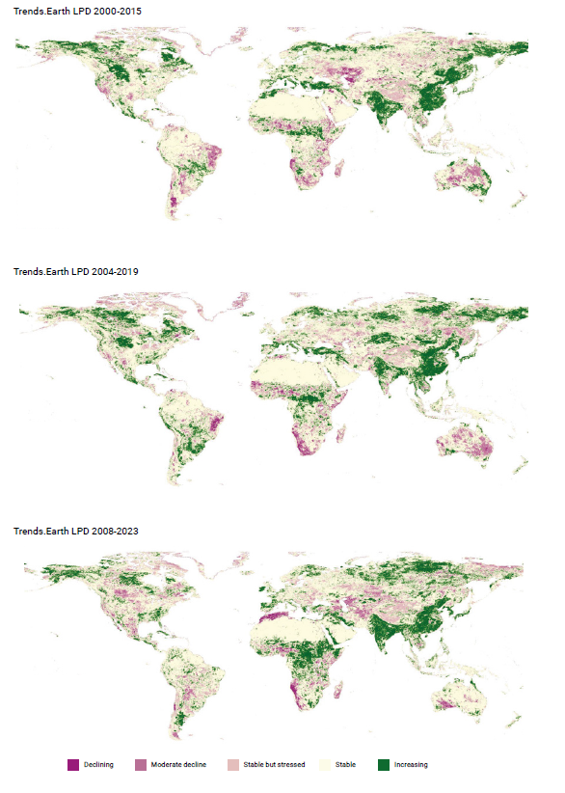
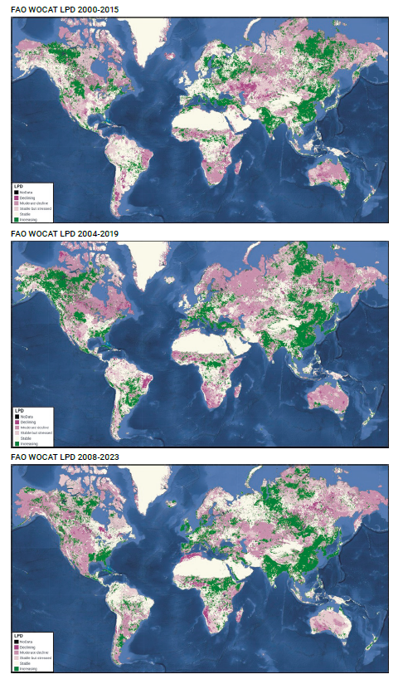
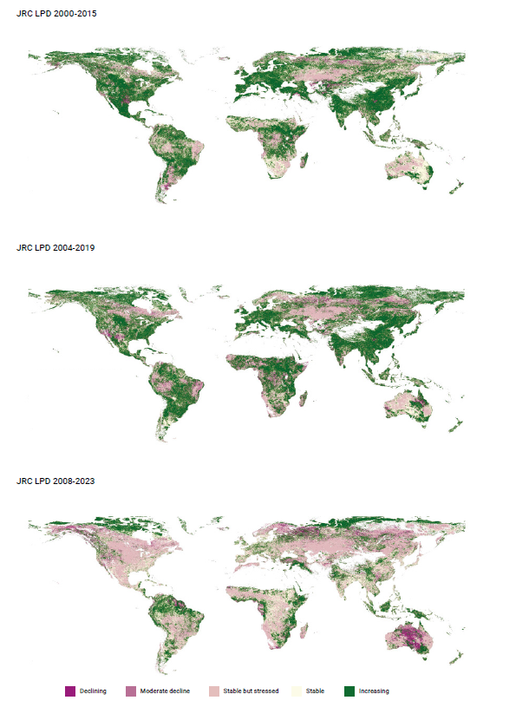
Annex: Default versions of globally available LPD maps
Co-authors:
Andreas Brink, Gabriel Daldegan, Cesar L. Garcia, Federico Gianoli, Ingrid Teich and Alex Zvoleff
FAO-WOCAT LPD default dataset
FAO-WOCAT LPD default dataset
Joint Research Centre default dataset
:

Slide 17


Trends.Earth LPD
TRAJECTORY
STATE
PERFORMANCE
Measures the rate of change in primary productivity over time.
Compares the current productivity level in a given area to historical observations of productivity in that same area. ​
Measures local productivity relative to other similar vegetation types in similar land cover types or bioclimatic regions throughout the study area.

Slide 18
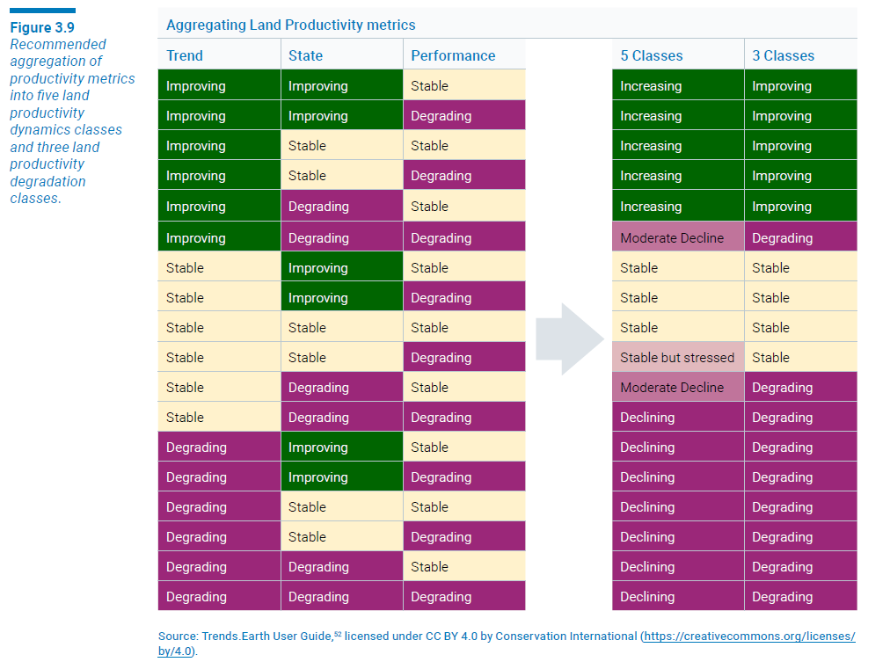
Aggregation of metrics

Slide 19
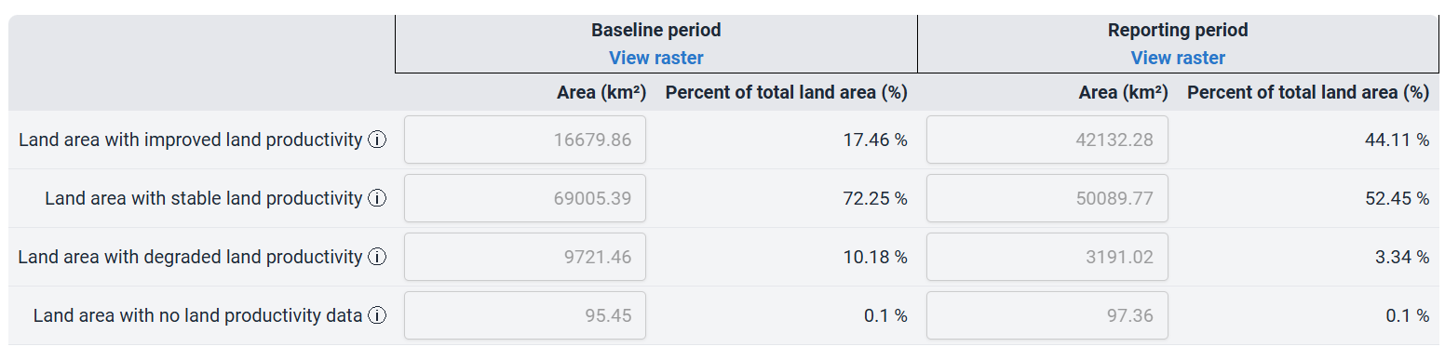

Slide 20
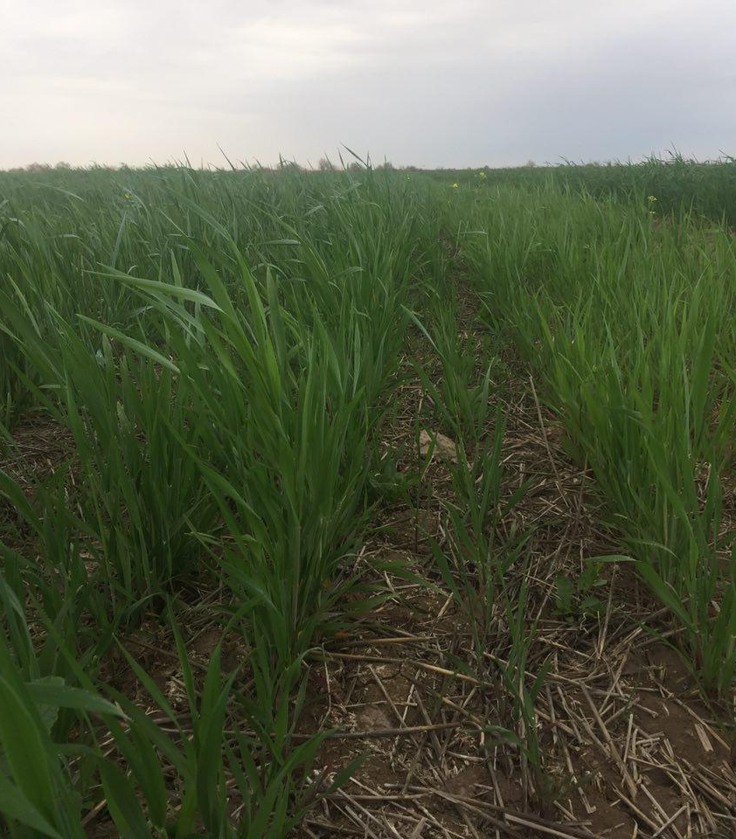
Distinguishing human induced land degradation from the effects of climate variability
WATER, LIGHT, TEMPERATURE
Different factors affect primary productivty
INTERPRETING VARIABILITY
Historical precipitation information as a context
CLIMATE CORRECTION METHODS
Residual Trend Analysis (RESTREND), Rain & Water Use Efficiency (RUE & WUE)

Slide 21
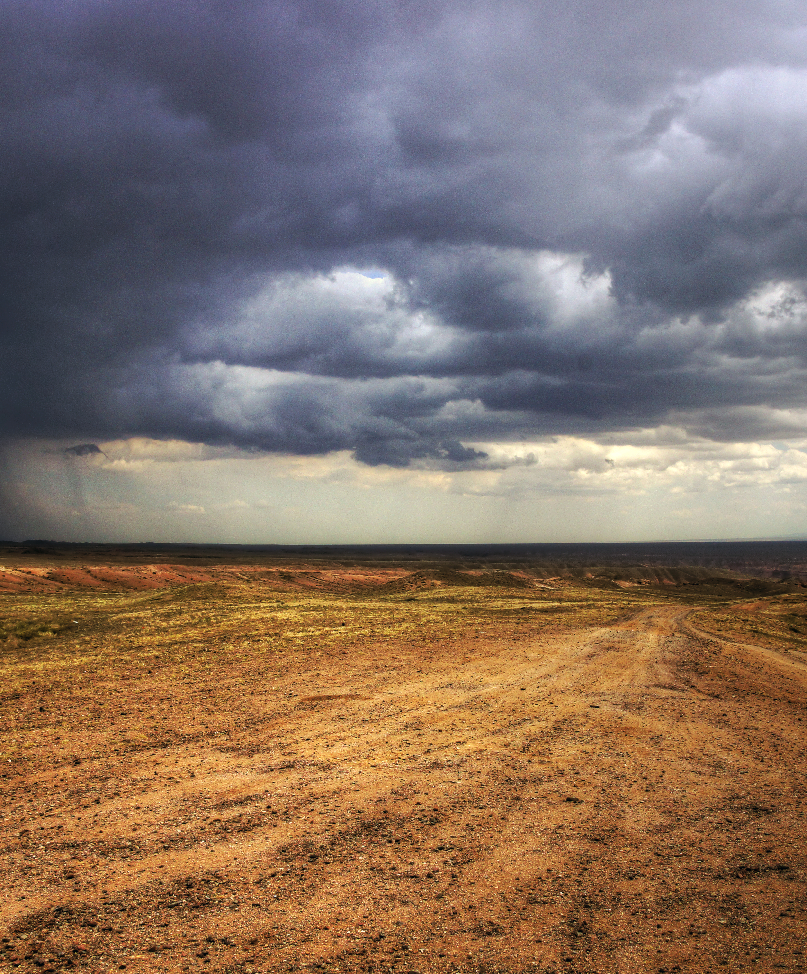
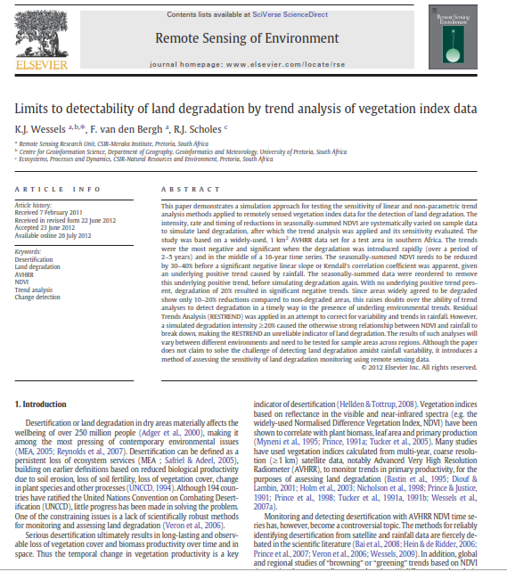
RESIDUAL TREND ANALYSIS
Trends in vegetation production independent of rainfall
Regression
1
between ΣNDVI and growth season sum ln(rainfall) per pixel.
RESIDUALS
2
Difference between observed and predicted ΣNDVI
Residuals Trend
3
RESTREND-residuals’ are regressed on time

Slide 22
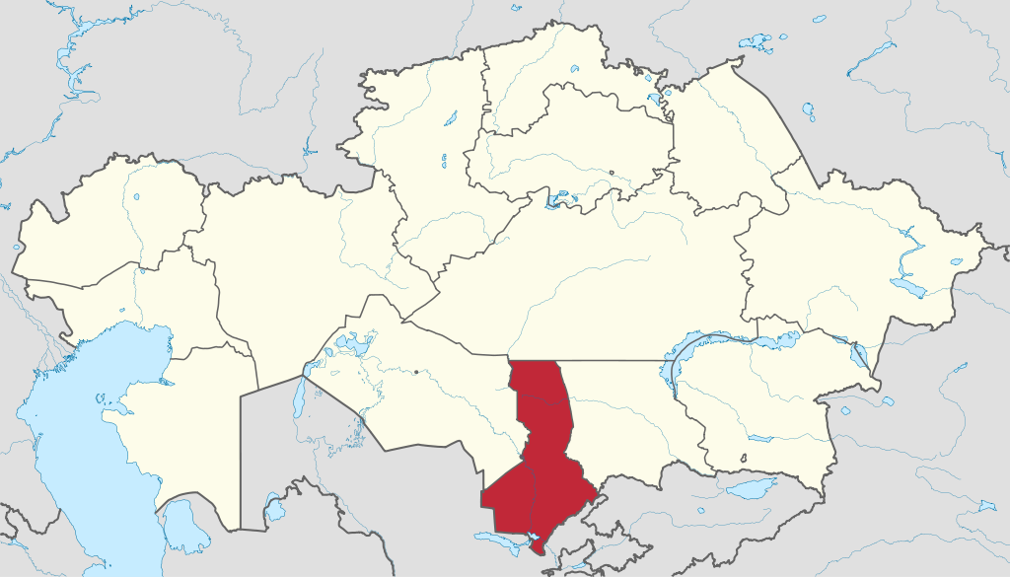



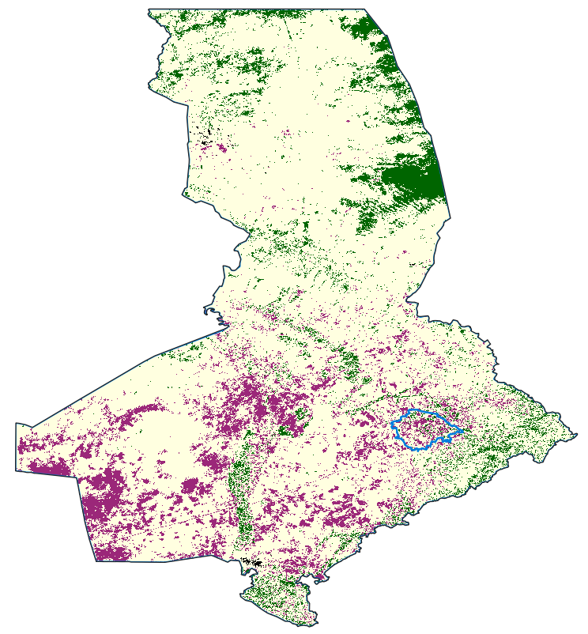
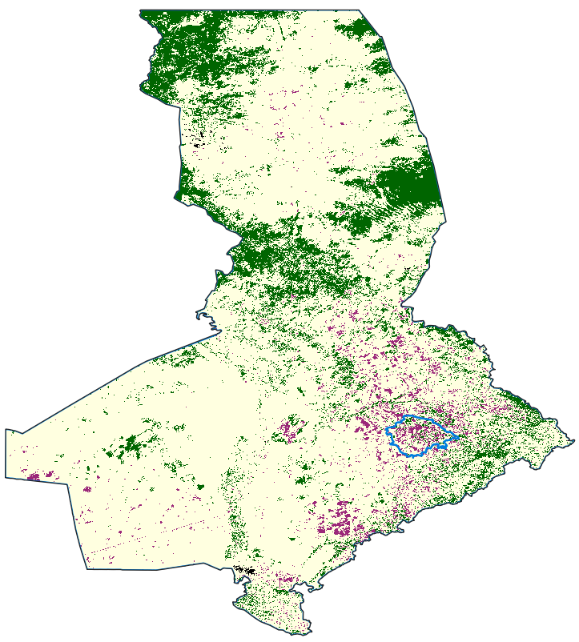
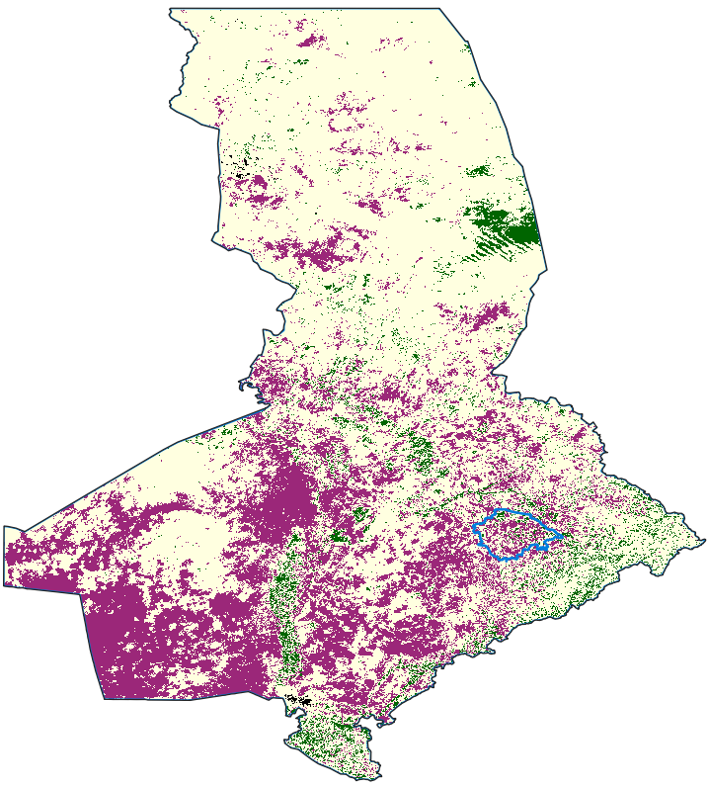
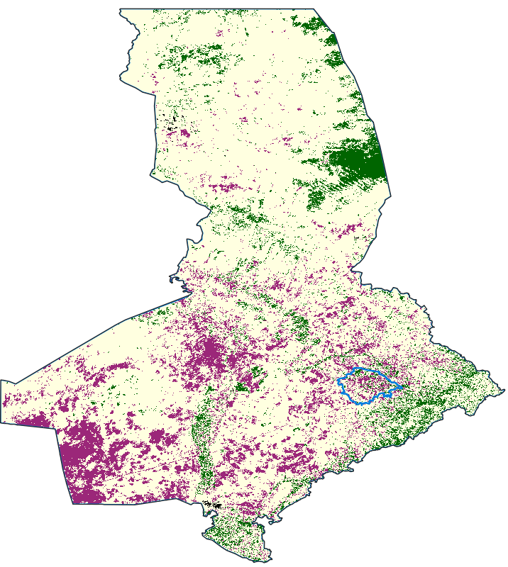
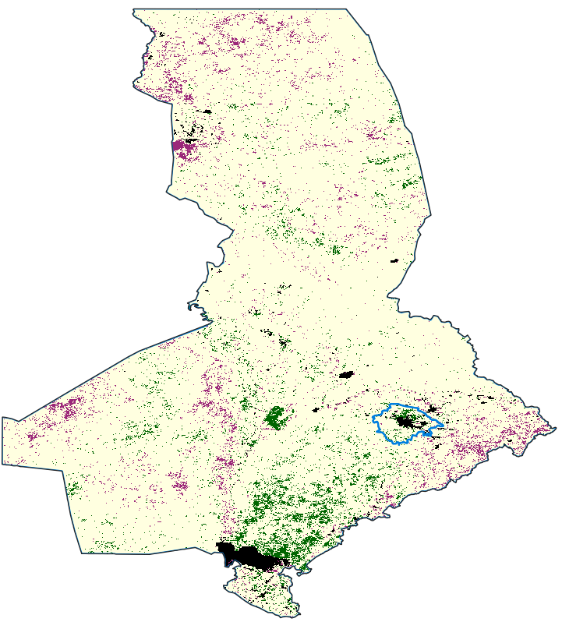
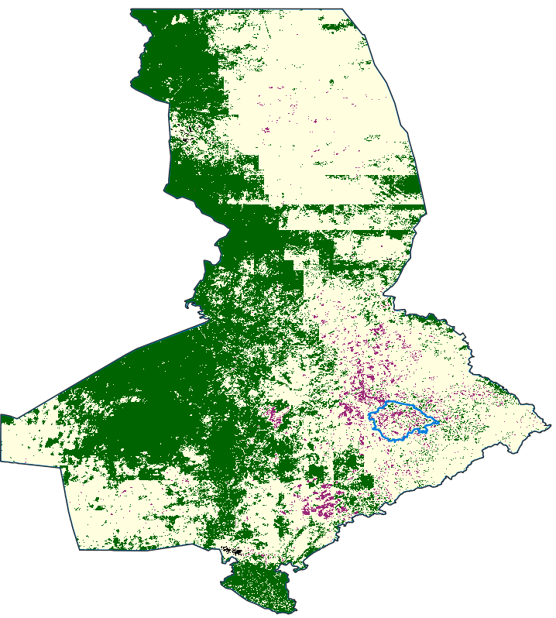
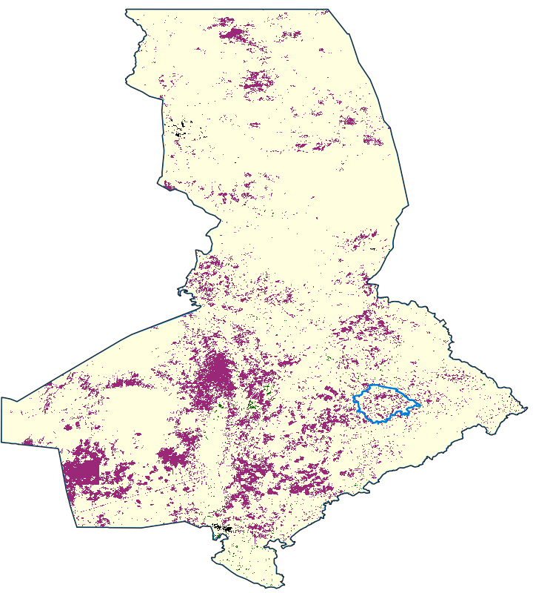
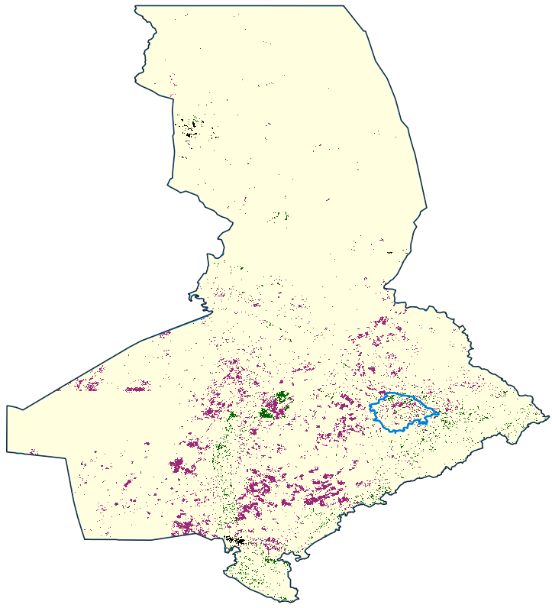
Turkistan Oblast, Kazakhstan
Trend
Restrend Chirps
Restrend Persiann
Restrend GPCP
2001-2018
2001-2018
2001-2018
2001-2018
WUE
RUE Chirps
RUE Persiann
RUE GPCP
2001-2018
2001-2018
2001-2018
2001-2018

Slide 23
The LPD algorithm
JRC LPD
Trends.Earth LPD
FAO-WOCAT LPD

Slide 24
The LPD algorithm
JRC LPD
Trends.Earth LPD
FAO-WOCAT LPD

Slide 25

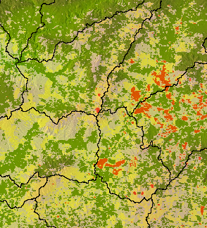


STRATEGY
Use the “official” legend of 5 categories
Produce a flexible approach were users can easily modify parameters
Open code & FAIR data & easy access
Base the development on the JRC simplified GEE code produced by FAO
Integrate ideas implemented of Trends.Earth approach
Co-development with countries and capacity building
Build on previous efforts and lessons learnt

Slide 26

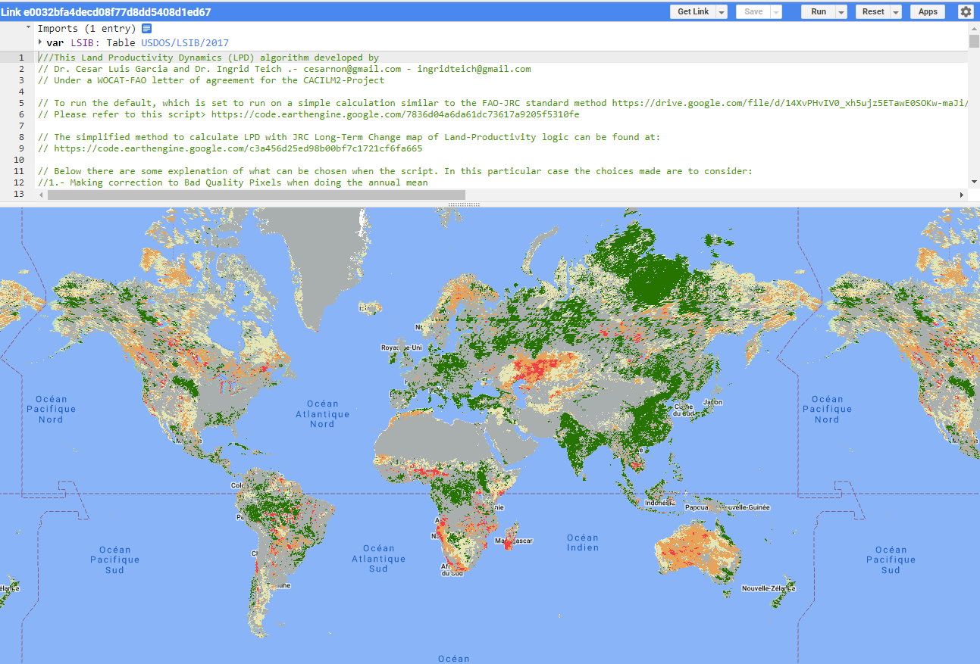
SCRIPT IN GEE
https://code.earthengine.google.com/?accept_repo=users/apacheta/LPD_FWversion2
New Version 2

Slide 27
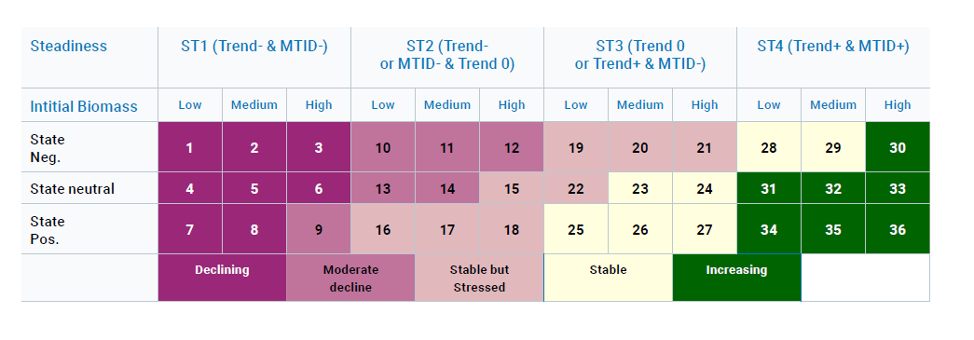
CATEGORIZATION:
03

Slide 28
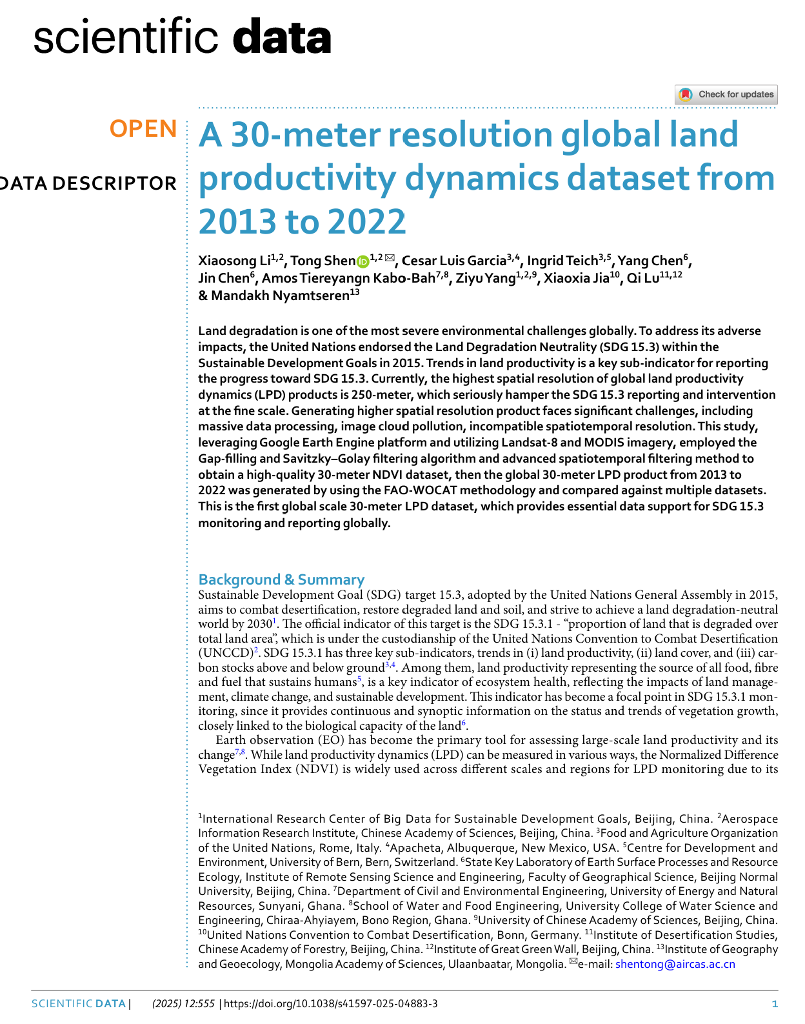



HIGH RESOLUTION FAO-WOCAT LPD
Two 30m input datasets:
1- HiLPD (https://www.nature.com/articles/s41597-025-04883-3 , https://doi.org/10.12237/casearth.686dc91f24e15709b381ae4e)

Slide 29




HIGH RESOLUTION FAO-WOCAT LPD
Two 30m input datasets and LPD products:
2- ML30-LPD (https://doi.org/10.5281/zenodo.15276519)
García, C. L., Pozzi Tay, E. F., Raviolo, E., Maharaj, T., Francis, R., Zvoleff, A., Antunes Daldegan, G., Paredes-Trejo, F., Noon, M. & James, C (2025). Annual 30m NDVI Time Series from Mixed Landsat Images. Zenodo. https://doi.org/10.5281/zenodo.15276535

Slide 30





Different input datasets
Same LPD algorithm
Lon.: -71.59 Lat.: 19.64
ML30
HiLPD
FW 250m

Slide 31

HR LDP Data for SIDS and overflow to the world…
30m NDVI Time Series for SIDS
García, C. L., Pozzi Tay, E. F., Raviolo, E., Maharaj, T., Francis, R., Zvoleff, A., Antunes Daldegan, G., Paredes-Trejo, F., Noon, M. & James, C (2025). Annual 30m NDVI Time Series from Mixed Landsat Images. Zenodo. https://doi.org/10.5281/zenodo.15276535
Li, X., Shen, T., Chen, Y., Chen, J., & Yang, Z. (2025). 30m NDVI dataset of Small Island Developing States from 2000 to 2023. Zenodo. https://doi.org/10.5281/zenodo.15862965
LPD ready to use at 30m for SIDS
García, C. L., Raviolo, E., Francis, R., Maharaj, T., Zvoleff, A., Antunes Daldegan, G.,Pozzi Tay, E. F., Paredes-Trejo, F., Noon, M. & James, C. (2025). A 30m Land Productivity Dynamic Dataset for SIDS computed from Mixed Landsat Time Series and FWv2 model [Data set]. Zenodo. https://doi.org/10.5281/zenodo.15276519
Xiaosong Li & Tong Shen. Land Productivity Dynamics Product of Small Island Developing States (30 meters Resolution), International Research Center of Big Data for Sustainable Development Goals (CBAS). Big Earth Data Center, CAS, 2025. DOI: https://doi.org/10.12237/casearth.686dc91f24e15709b381ae4e
Codes for other interested countries
Mixed Landsat: https://code.earthengine.google.com/?accept_repo=users/apacheta/Mixed_Landsat_NDVI_TS_National
HiLPD: https://github.com/ShenTong53/30m-annual-NDVI-calculation-from-2000-to-2023

Slide 32



3.2 Enhancements for Assessing Trends in Land Productivity
3.2.3 Verifying results and selecting the most representative LPD dataset

Slide 33


3.2 Enhancements for Assessing Trends in Land Productivity
3.2.4 Workflow for selecting the most representative LPD map
Step 1: Establishing a Multidisciplinary Group of Experts
Step 2: Training and Capacity Building
Step 3: Determining the Need for a Subnational Analysis
Step 4: Exploring Alternative LPD Datasets
Step 5: Identifying Verification Data and Expert Knowledge
Step 6: Comparing the Performance of Alternative LPD Maps
Step 7: Selecting the Most Representative LPD Map

Slide 34






BHUTAN - 2022
AVAILABLE LAYERS TO USE IN 2026
Districts
Mines
Landslides-LD sites
Basins
AEZ

Slide 35




Is field verification possible?
Silvopastoral system since 2020, combining tree cover with livestock grazing.
Eucalyptus, planted in different spatial arrangements, including concentric patterns, which help optimize both shade distribution and grazing space.
Before 2020 it was used as pastureland for livestock production.

Slide 36

Hands on!
Which LPD map detects more degradation in Liberia in the Baseline?
In which parts of the country is that degradation located?
Which percentage of Liberia was degraded due to Land Productivity trends in the last reporting period according to FAO WOCAT Balance mode LPD model?
And in NIMBA county?
https://wocatapps.projects.earthengine.app/view/compare-lpd-lbr

Slide 37
Work in groups
Discuss which datasets you could use for verifying the LPD maps.
Using the app explore the different maps and identify the map that better represents Liberia’s land productivity trends. Why did you choose that map?
https://wocatapps.projects.earthengine.app/view/compare-lpd-lbr

Slide 38

Thank you
Do you have any questions?
Ingrid.teich@unibe.ch

