Slide 1

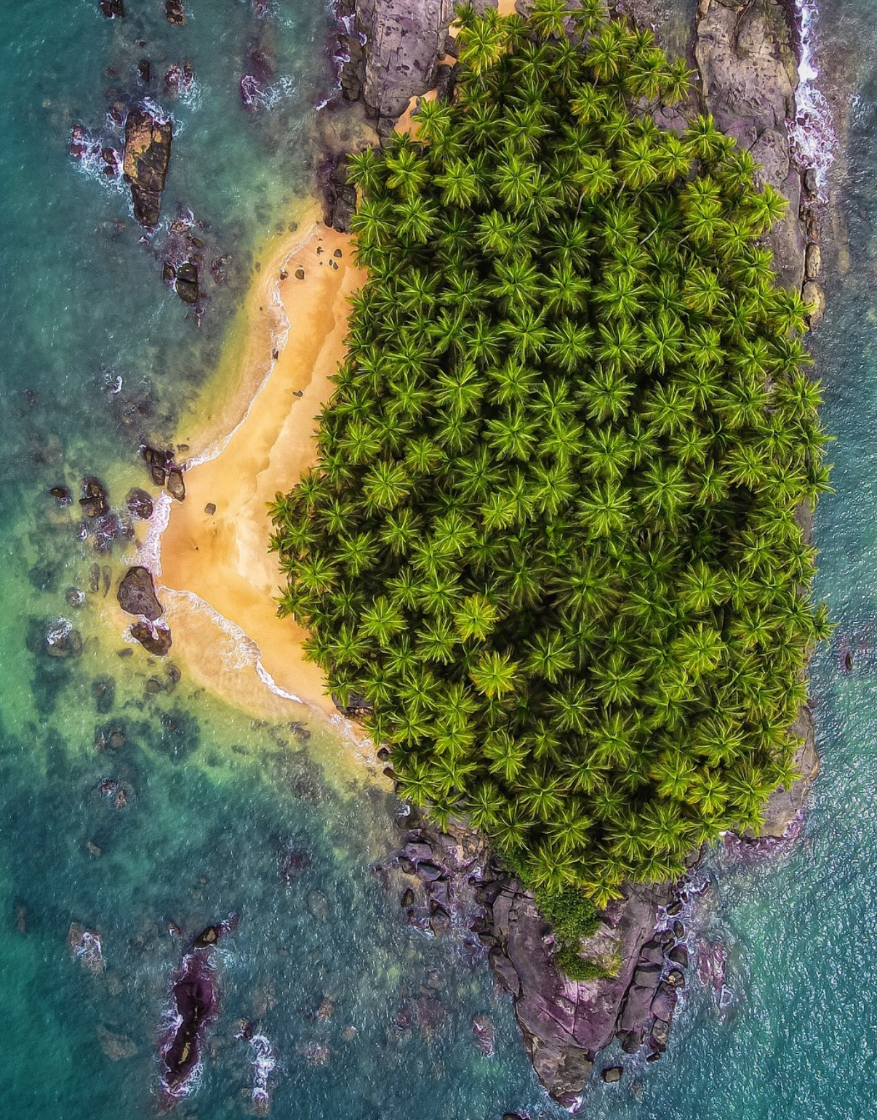




SO1-1
Trends in Land Cover
Inception and Technical Training Workshop on the 2026 UNCCD National Reporting Process
Liberia
June 23th 2026
Dr. Ingrid Teich
Senior Research Scientist (University of Bern)
WOCAT Secretariat

Slide 2

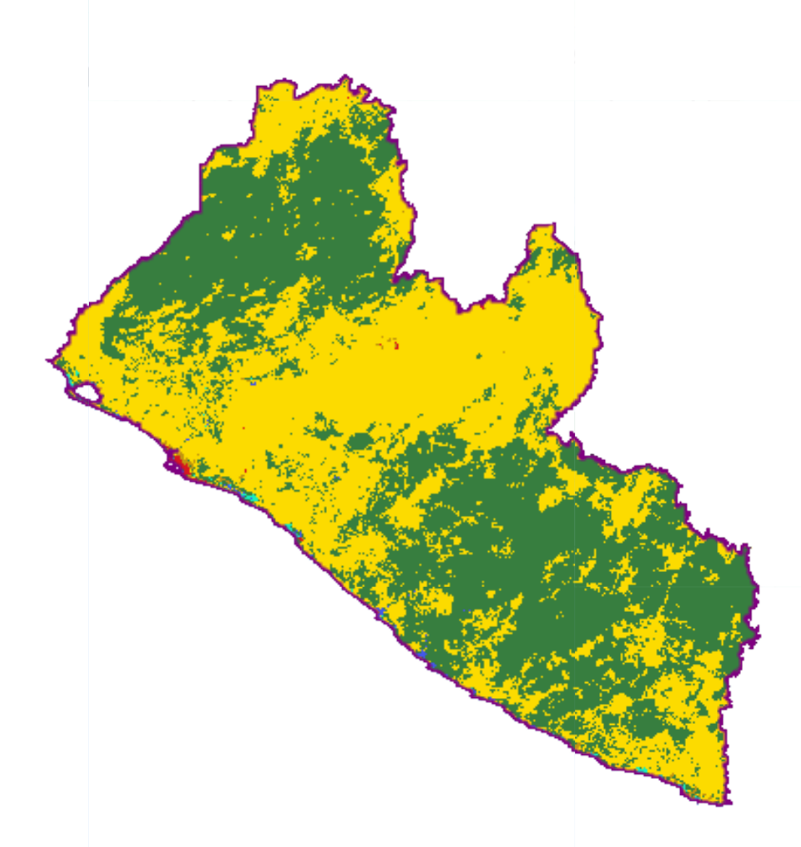
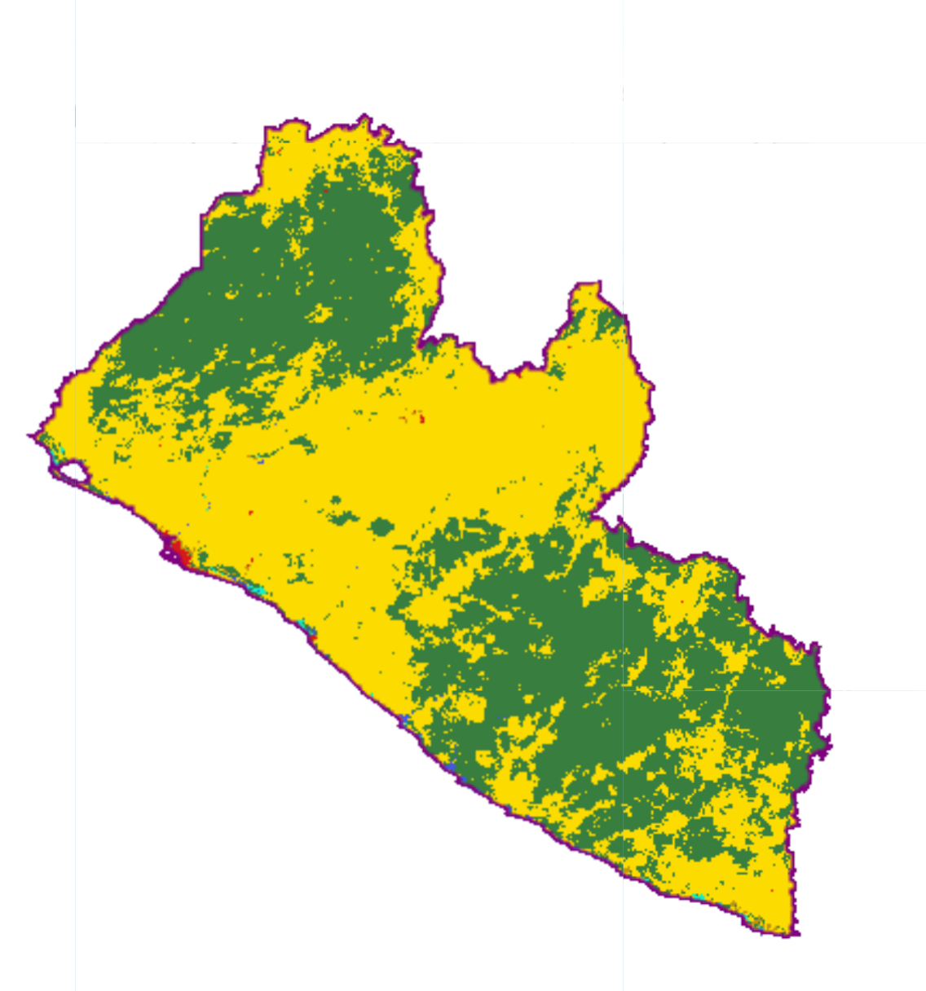
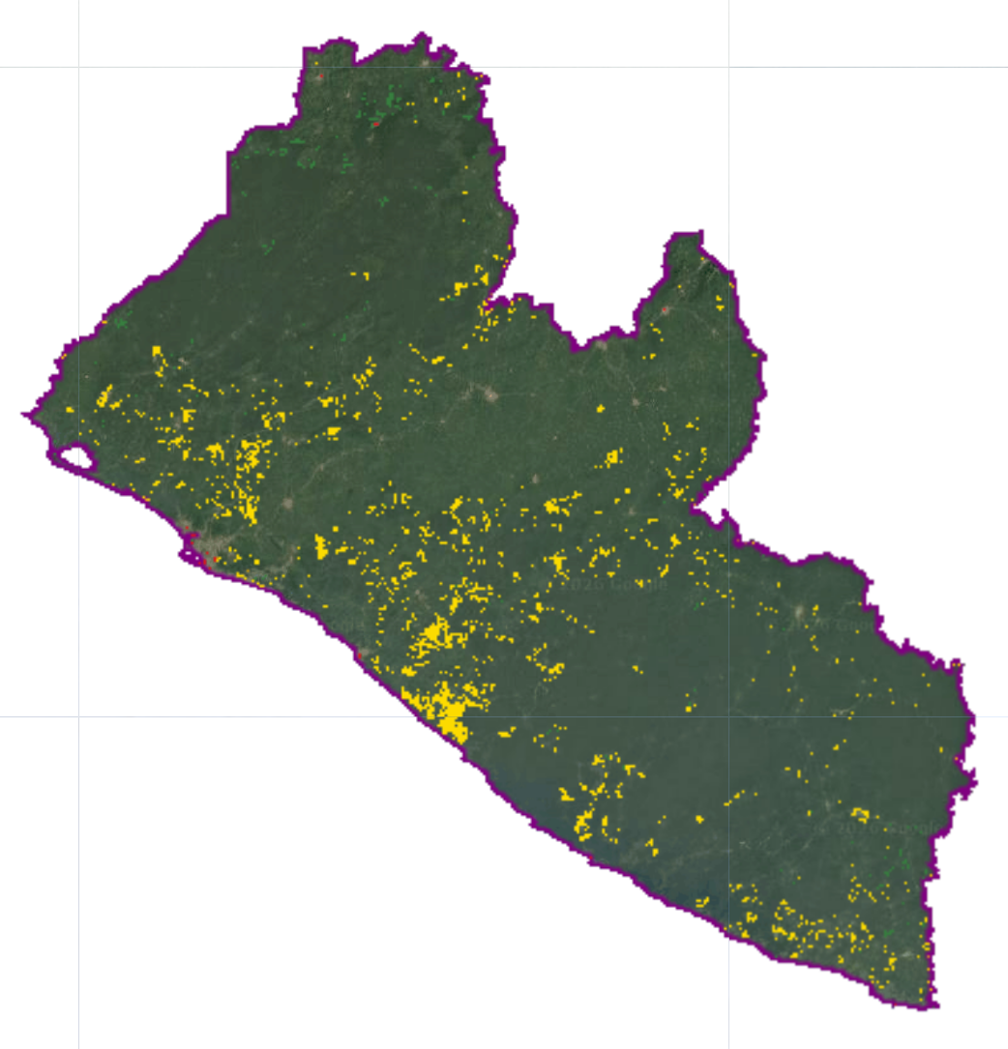
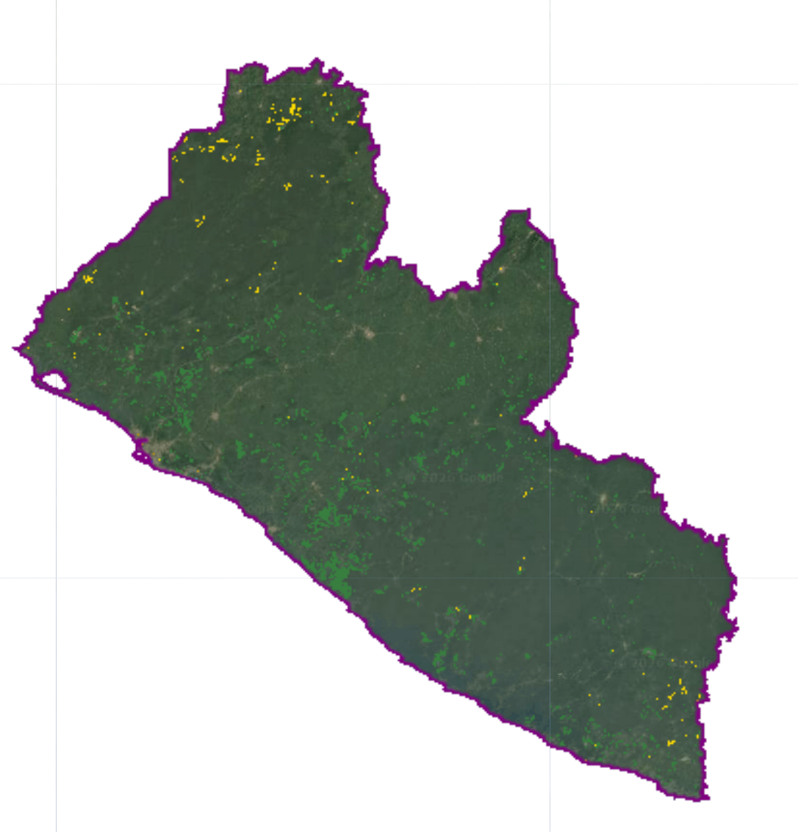
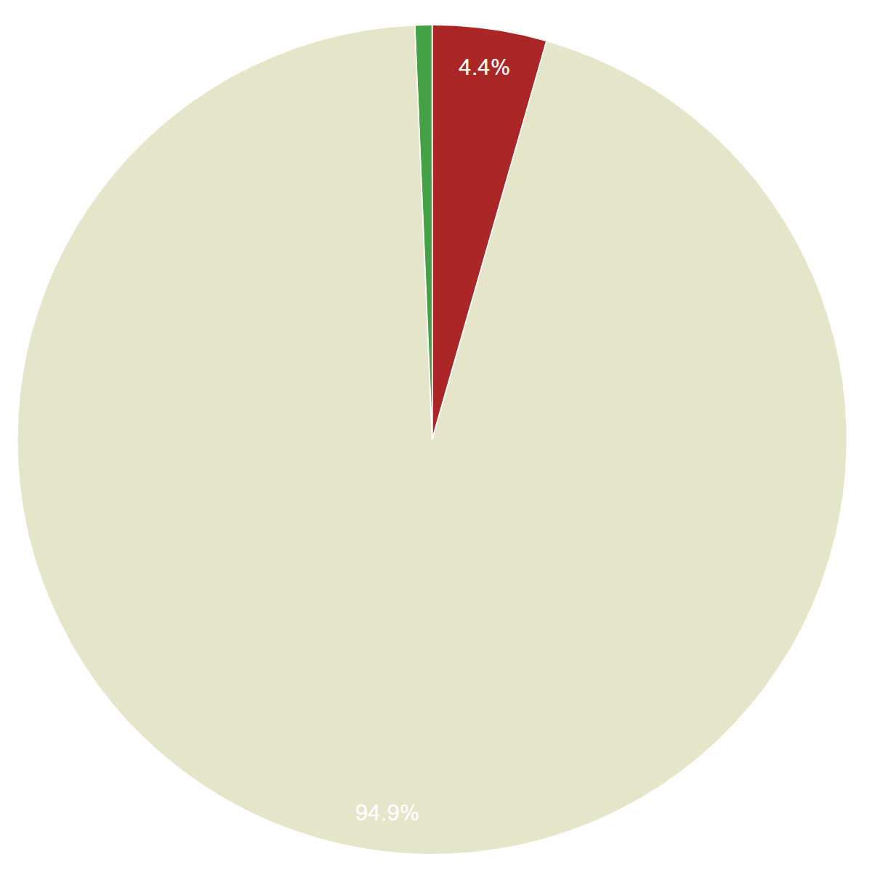
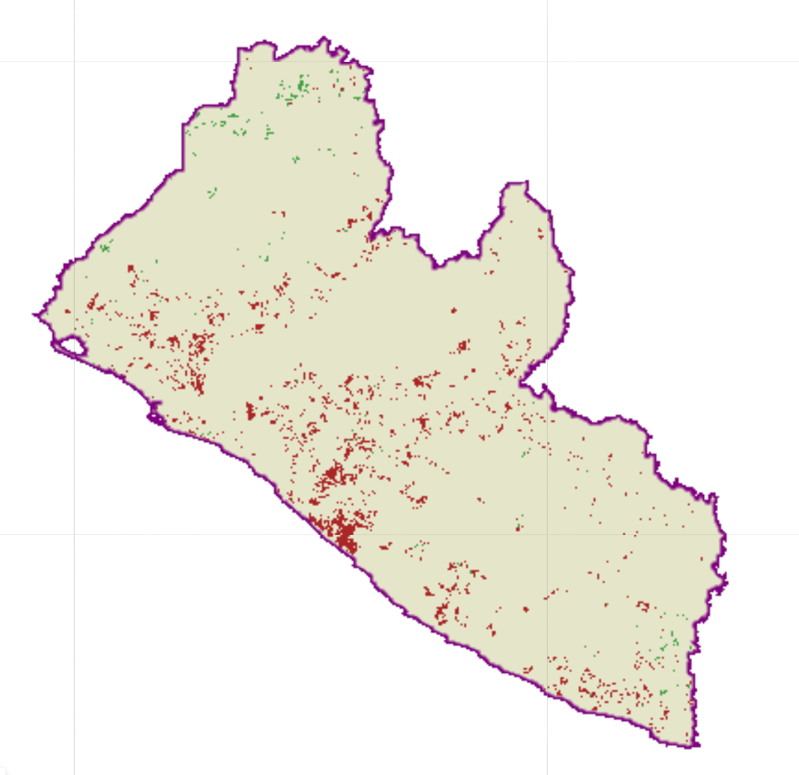
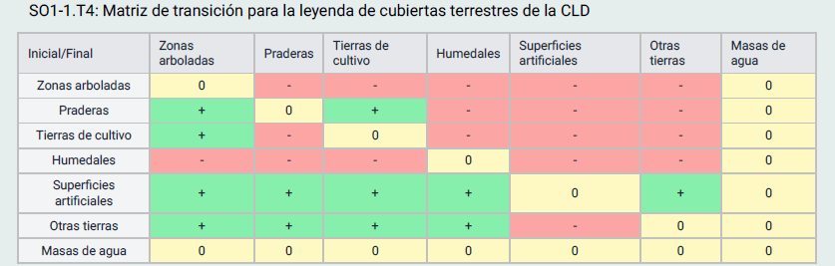
METHODOLOGY
FINAL LAND COVER
TRANSITIONS / CHANGES
INITIAL LAND COVER
GAINS
LOSSES
DEGRADATION DUE TO LAND COVER CHANGE
TRANSITION MATRIX

Slide 3
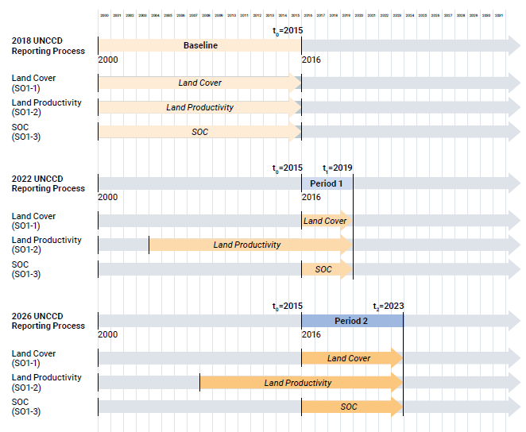
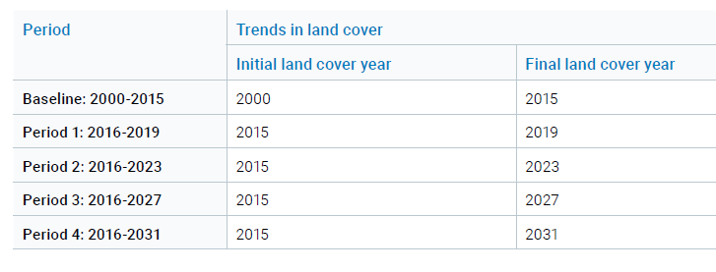
LAND COVER - PERIODS
4 Land Cover Maps
Years: 2000, 2015, 2019, 2023

Slide 4
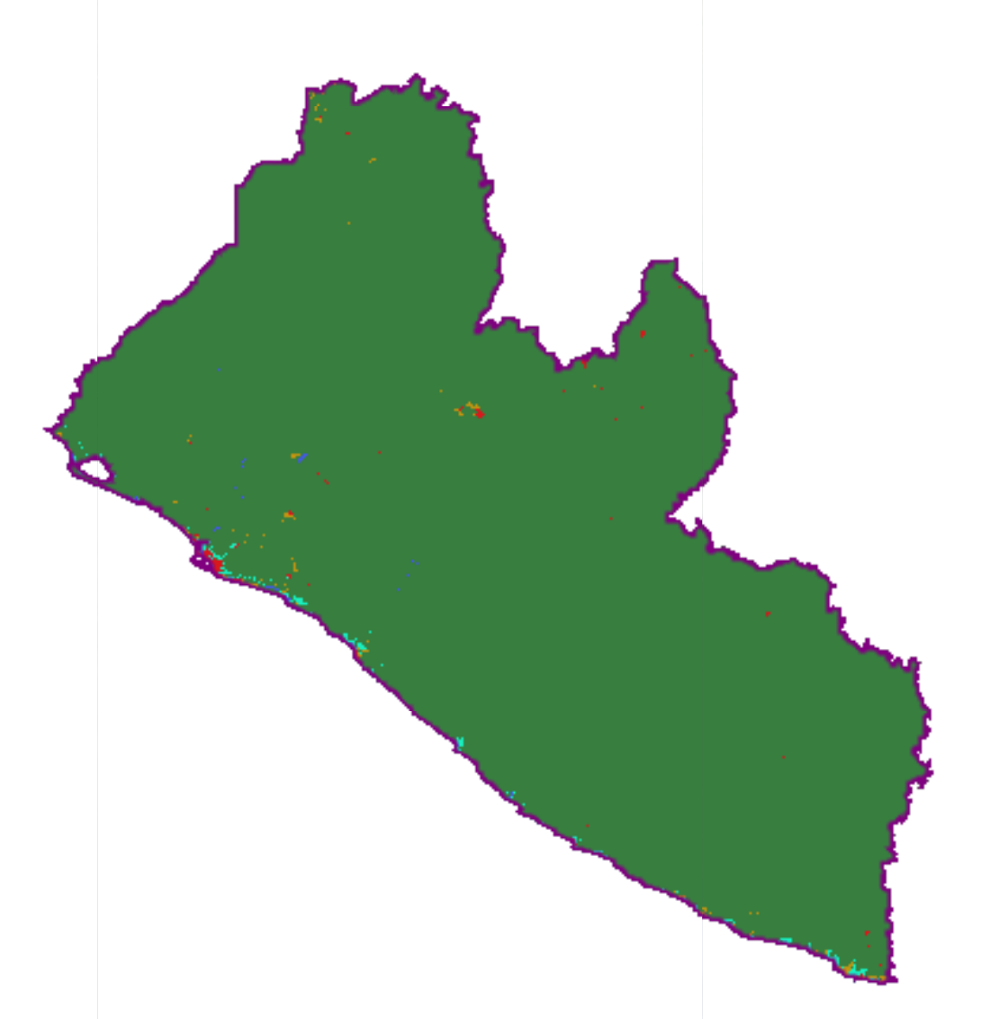
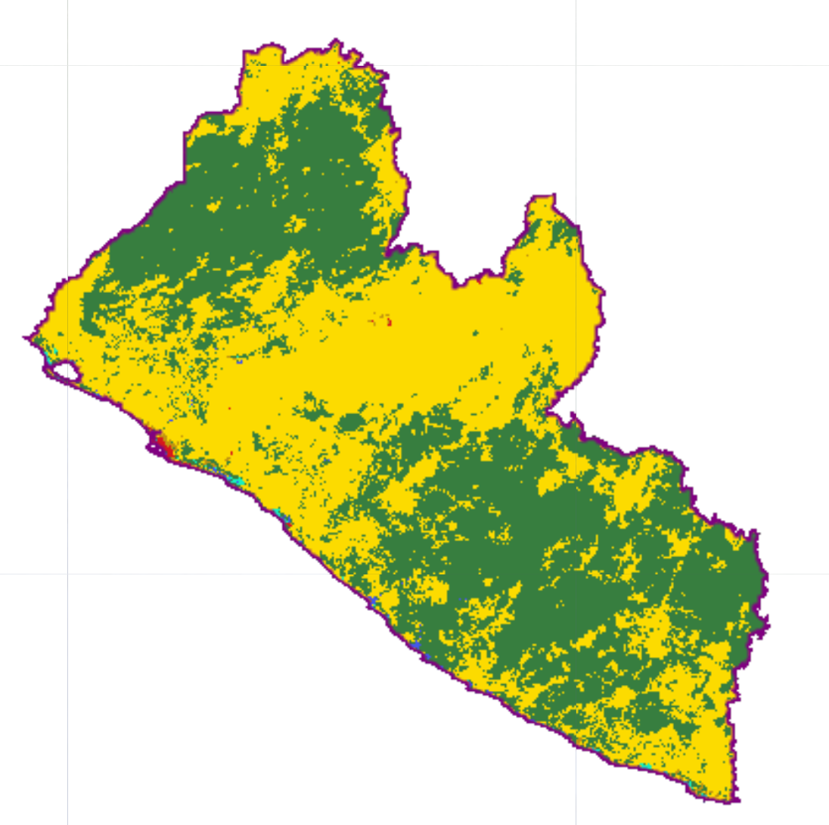

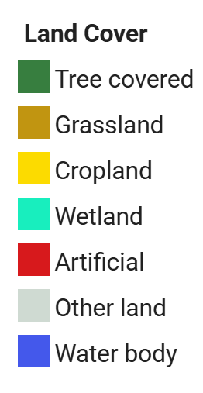
STEP 1: Identification of the best available land cover dataset
DEFAULT DATASET
ALTERNATIVE HIGH-RESOLUTION DATASETS
ESA (European Space Agency)
CCI 300 m
annually 2000-2022
GLAD (University of Maryland)
GLAD GLC 30 m
2000, 2005, 2010, 2015, 2020
CBAS (SDG Center, China)
GLC-FCS30D - 30 m
annually 2000-2022
https://maps.elie.ucl.ac.be/CCI/viewer/download/ESACCI-LC-Ph2-PUGv2_2.0.pdf
https://doi.org/10.3389/frsen.2022.856903
https://doi.org/10.5194/essd-13-2753-2021

Slide 5
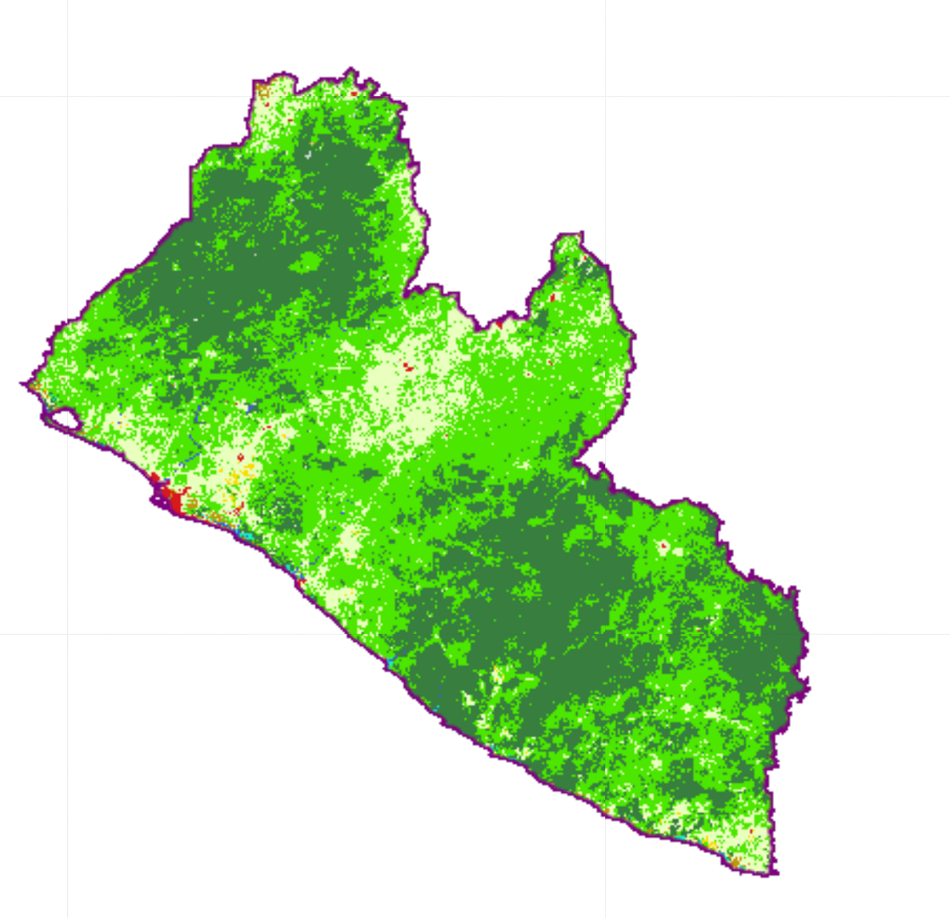
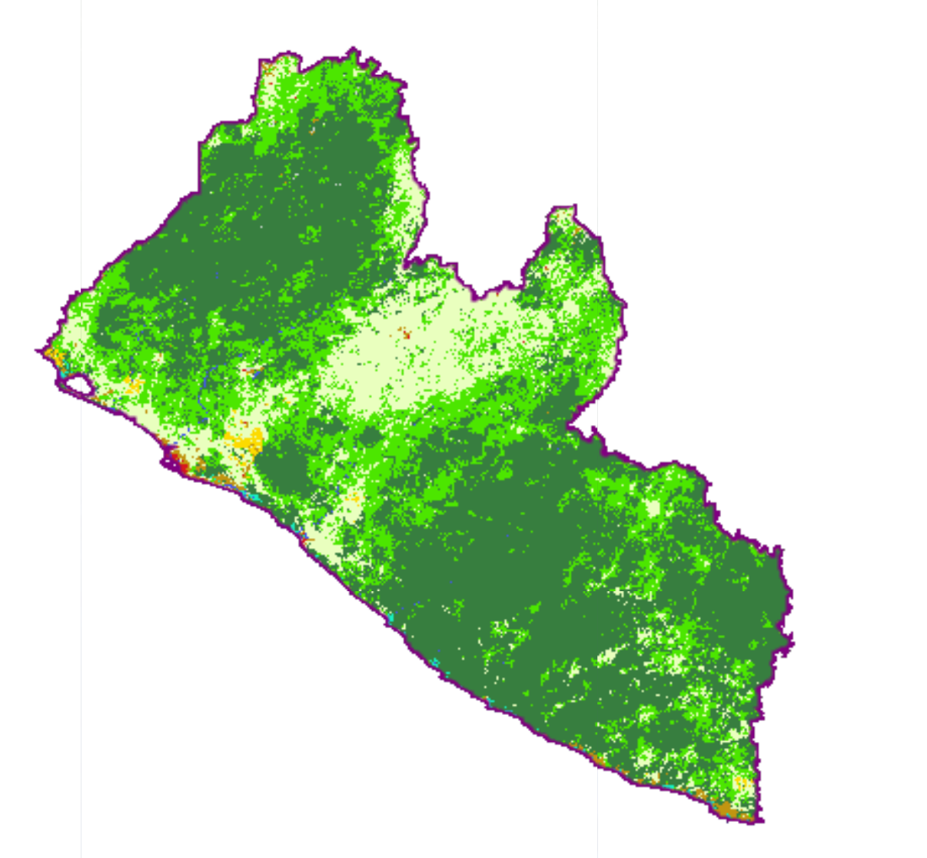
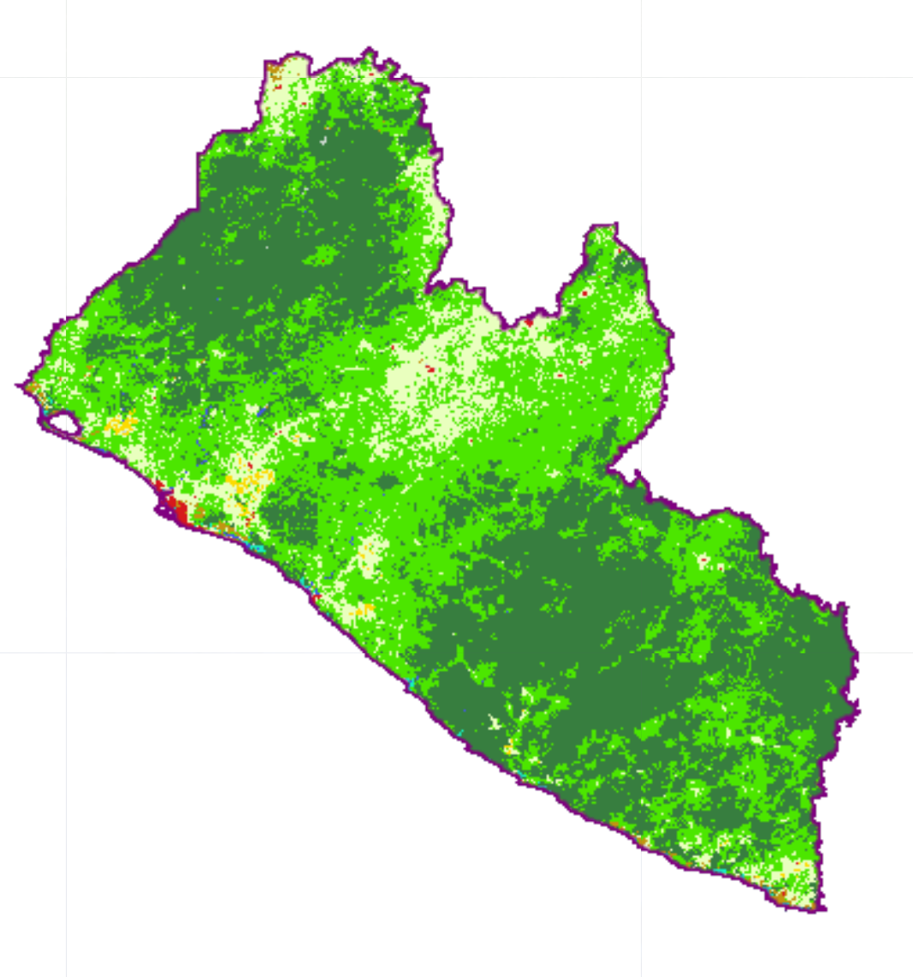
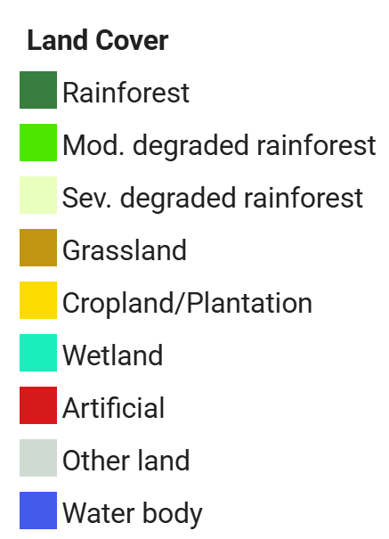
STEP 1: Identification of the best available land cover dataset
NATIONAL DATASET: annually from 2000 to 2028 – 30 m resolution
2023
?
v
2000
2015
2018

Slide 6

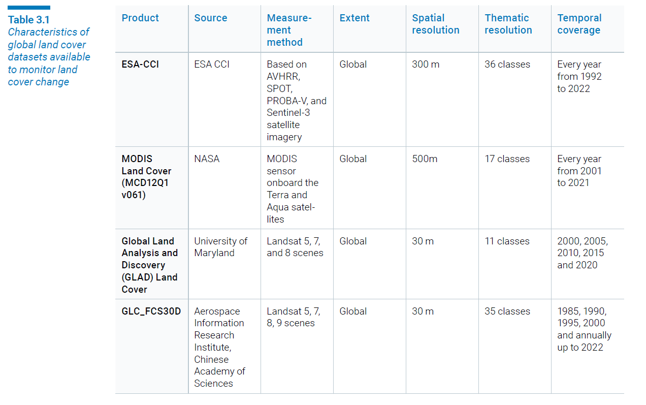

3.1 Enhancements for Assessing Trends in Land Cover
3.1.1 Identification of the best available land cover dataset

Slide 7
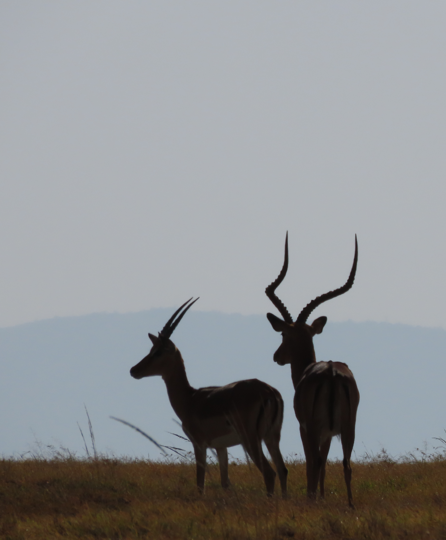
STEP 1: DATA SOURCE
Is it worth it to look for alternative land cover datasets or is the default data good enough?
What other datasets are available?
Is there a national data option that could be used? Or that can be used for improving or validating alternatives options?

Slide 8
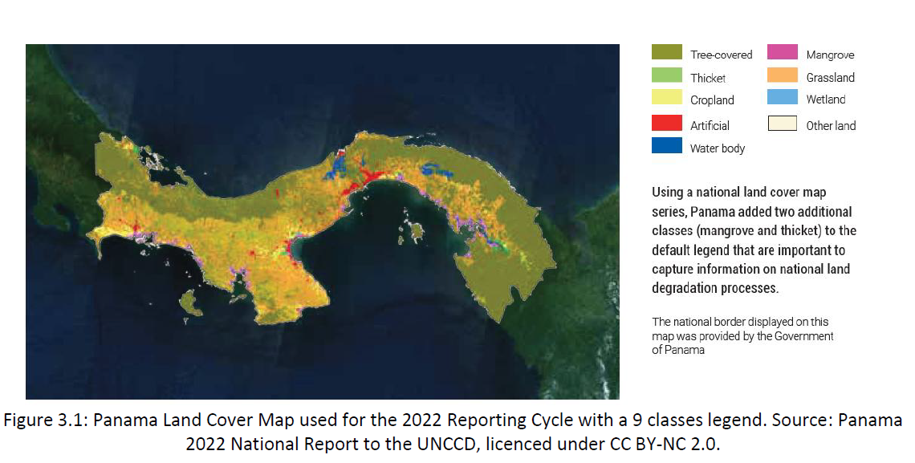
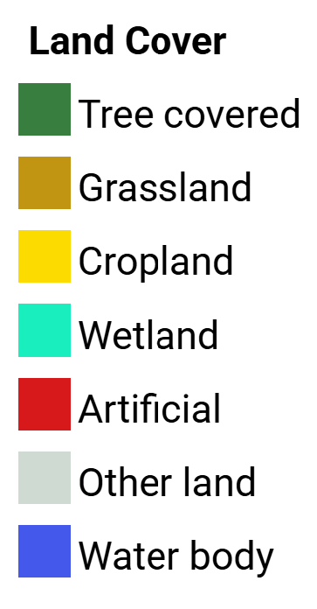
STEP 2: Selecting a land cover legend for monitoring key degradation processes
DEFAULT
ALTERNATIVES

Slide 9
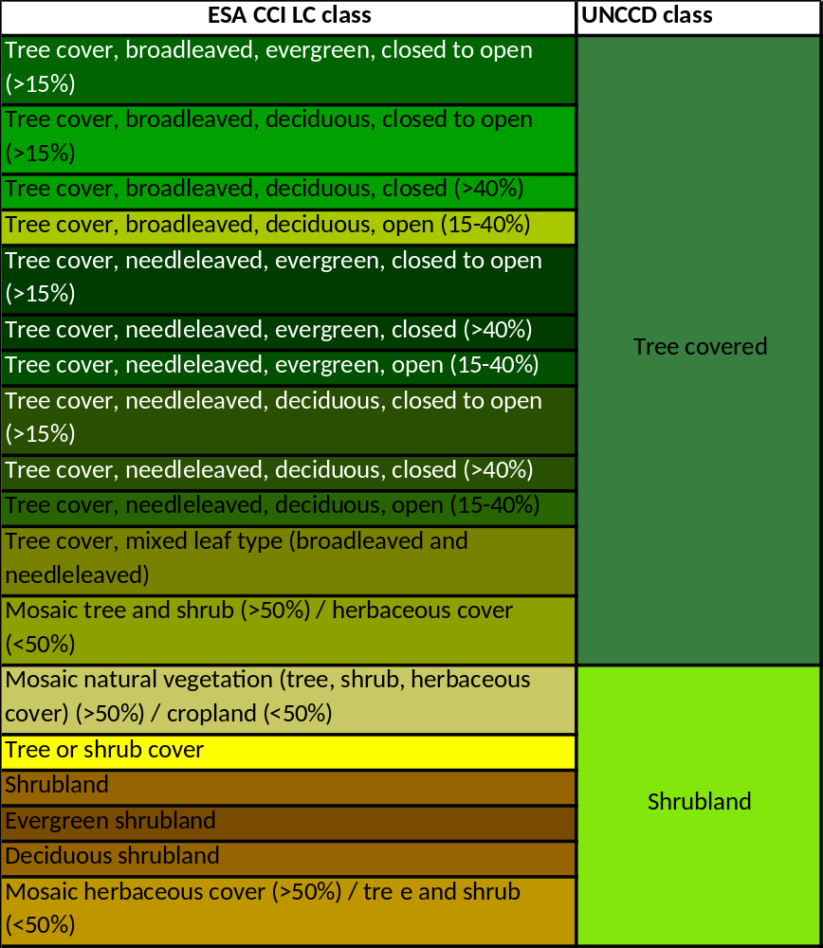
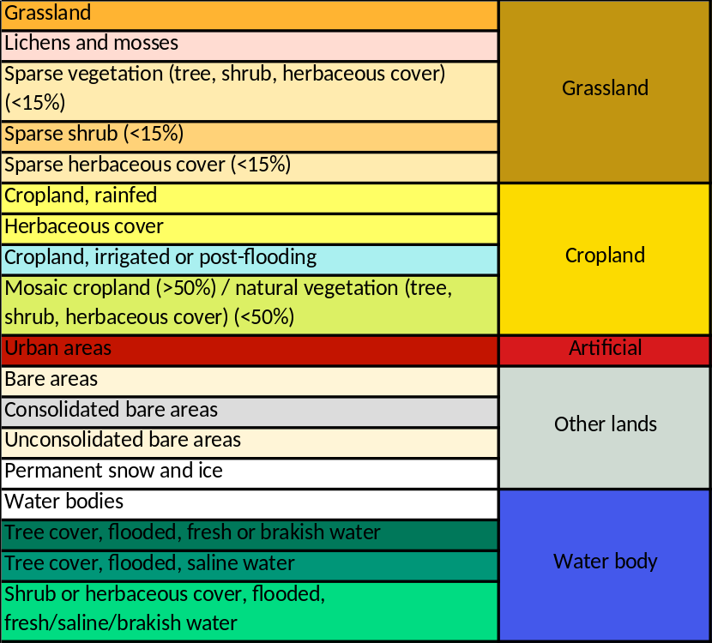
DEFAULT DATA can be recategorized
ESA reclass in 2022

Slide 10
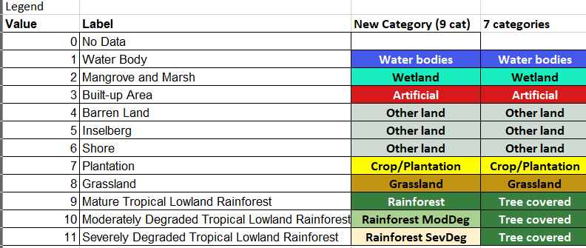
National data recategorization

Slide 11
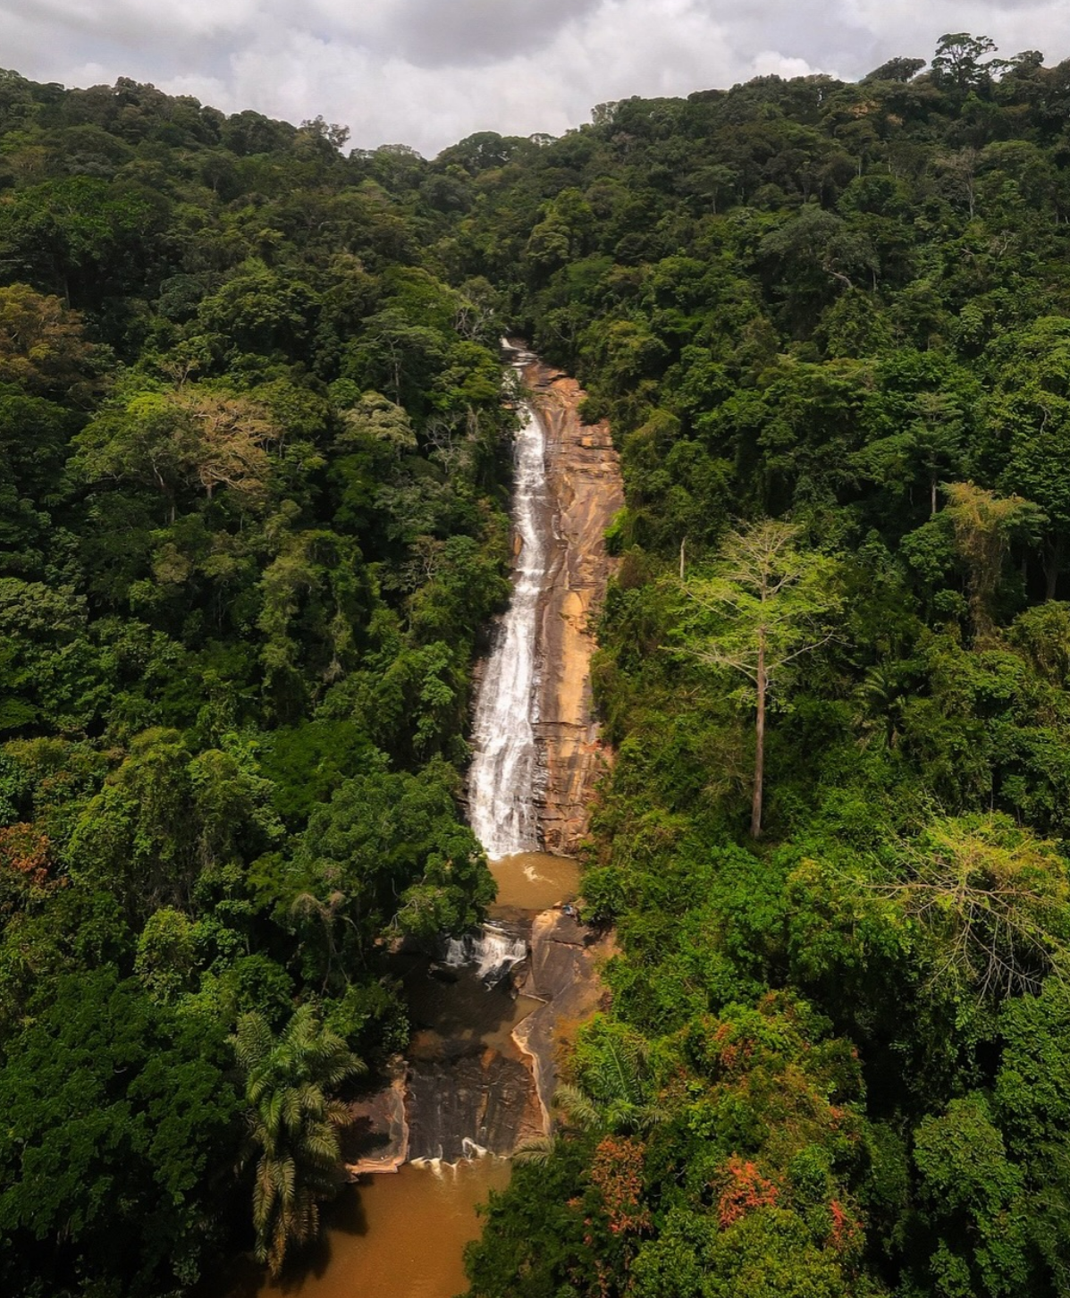
STEP 2: CATEGORIZATION
What are the main land use/cover changes related to degradation and restoration processes?
Is the 7-category legend sufficient to monitor these processes?
What other land classes would be important to monitor?

Slide 12
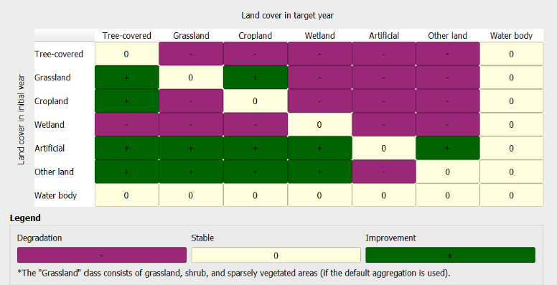
STEP 3:
Defining the land cover transition matrix
KEY: Participatory Decision-Making Process

Slide 13
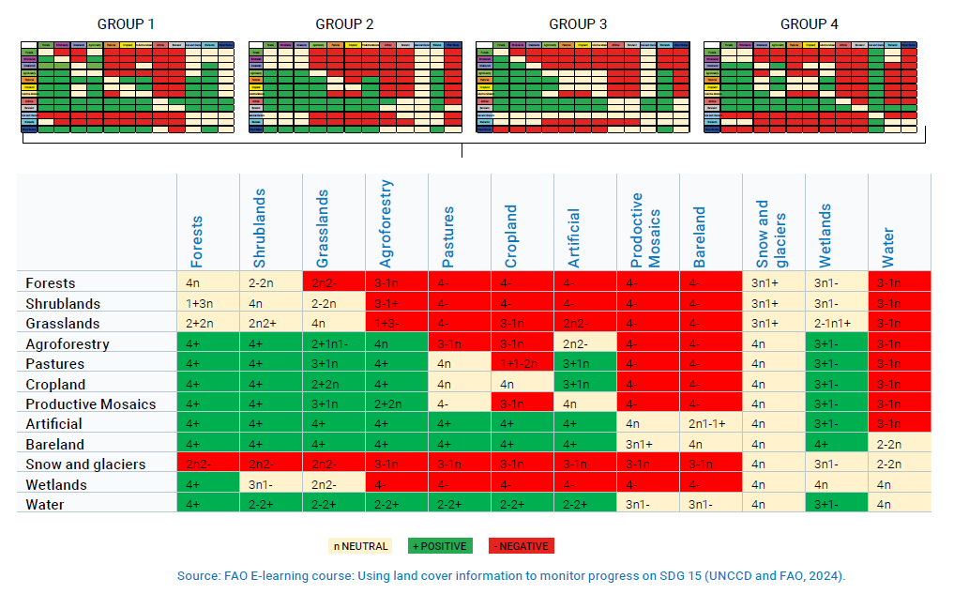
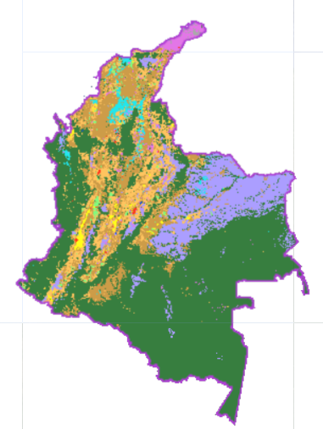
3.1 Enhancements for Assessing Trends in Land Cover
3.1.3 Defining the land cover transition matrix

Slide 14
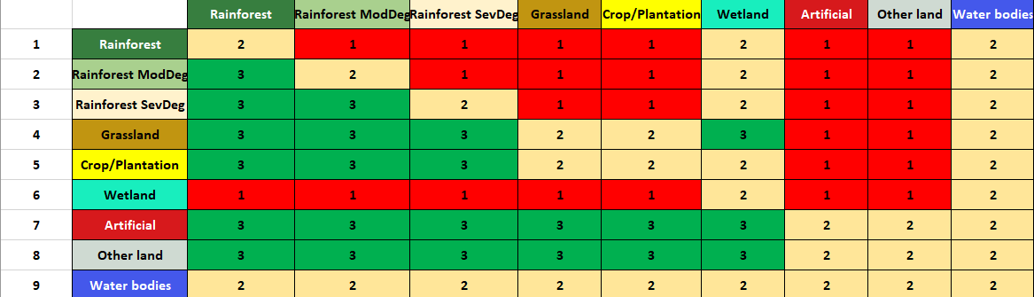
STEP 3:
Defining the land cover transition matrix

Slide 15
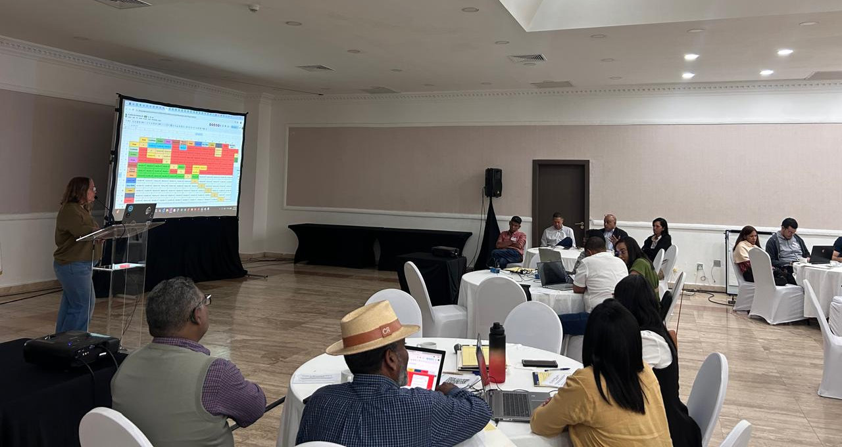
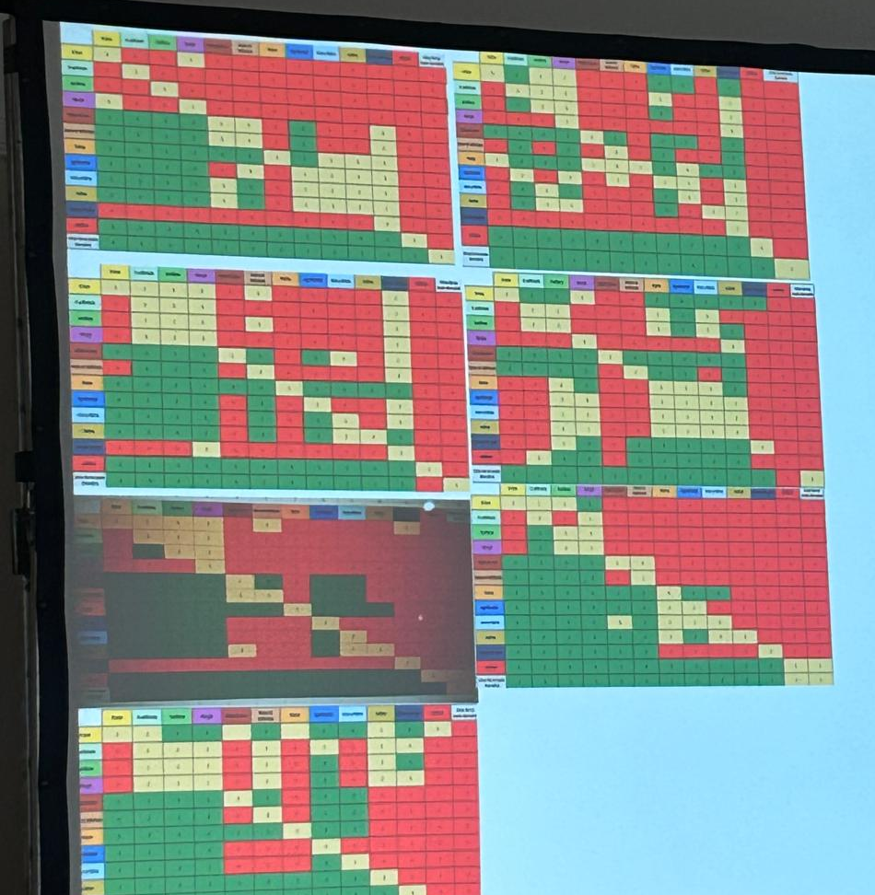
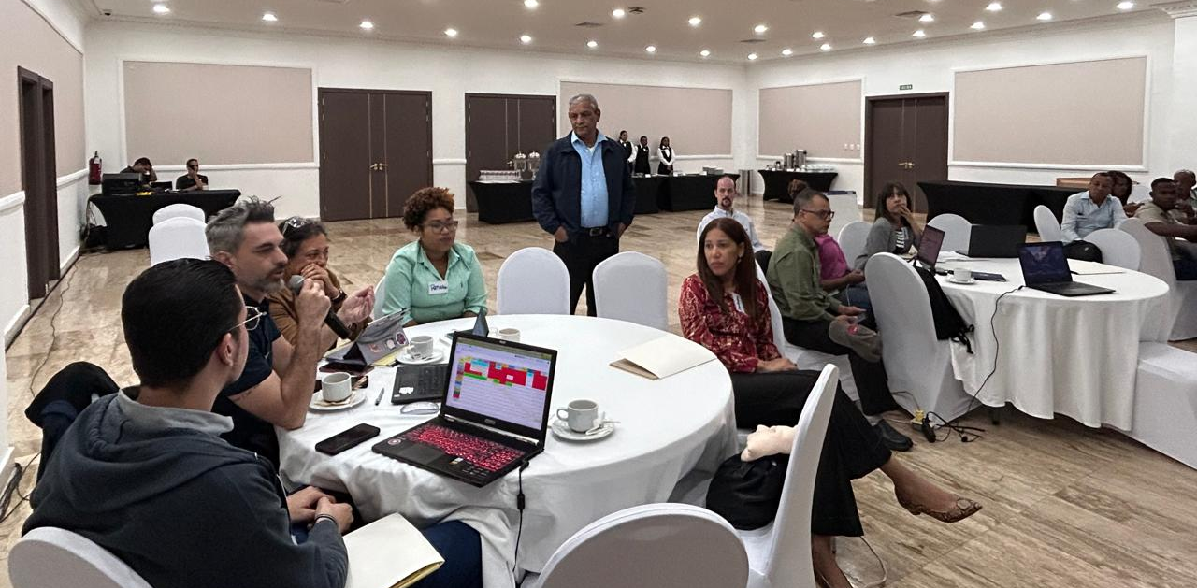
STEP 3: Defining the land cover transition matrix

Slide 16
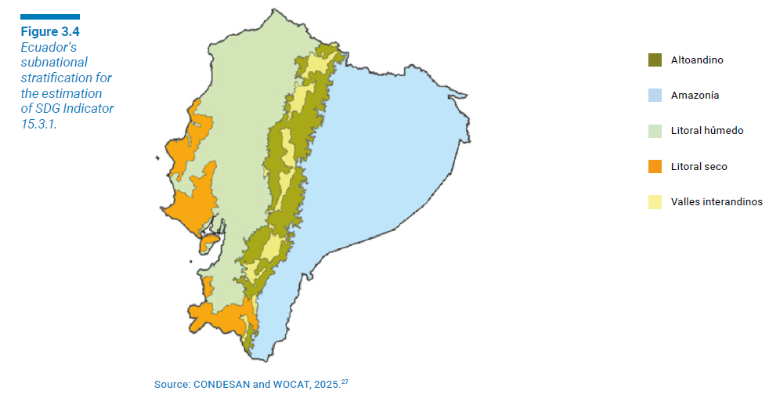
STEP 3:
Defining the land cover transition matrix
In many cases, differences in the interpretation of the same type of land cover transition arise from varying local contexts. A transition that signifies improvement in one area may represent degradation in another, depending on environmental, social, or economic conditions. Some countries are addressing this challenge by adopting a subnational approach to LDN monitoring and SDG Indicator 15.3.1 estimation. This approach acknowledges that a one-size-fits-all transition matrix is not always appropriate, particularly in countries with diverse bioclimatic conditions.

Slide 17
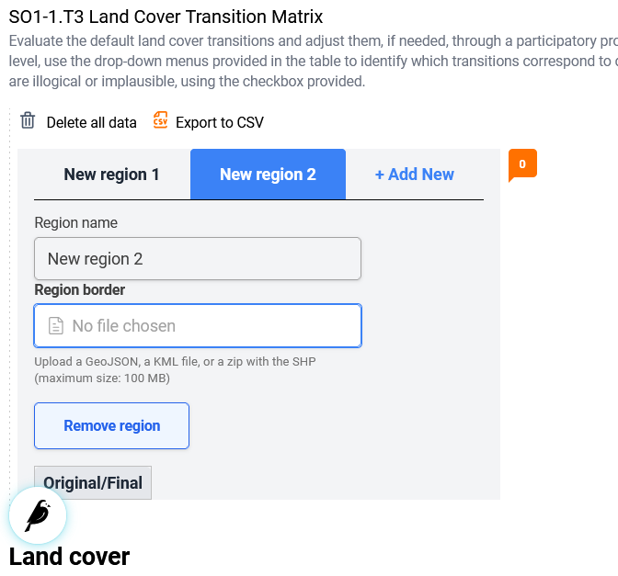
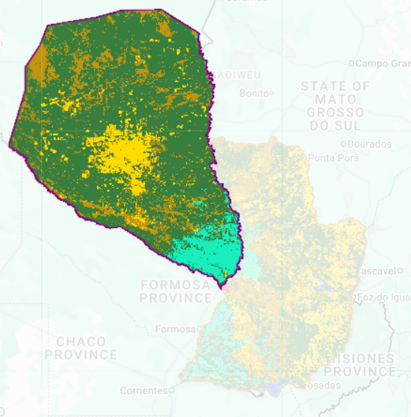
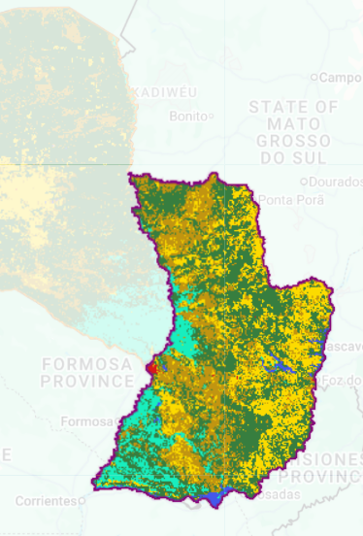
STEP 3:
Defining the land cover transition matrix
REGIÓN OCCIDENTAL
REGIÓN OCCIDENTAL
REGIÓN ORIENTAL
REGIÓN ORIENTAL

Slide 18
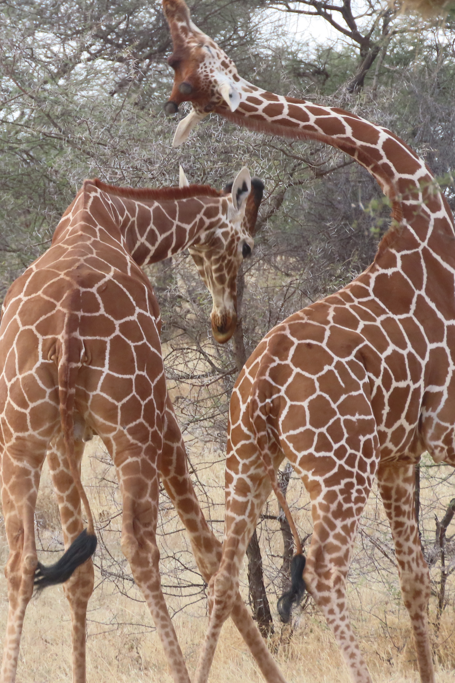
STEP 3: TRANSITION MATRIX
Does the default transition matrix represent the country?
Would it be advisable to have different matrices for different regions?
Which stakeholders should participate in this discussion?

Slide 19


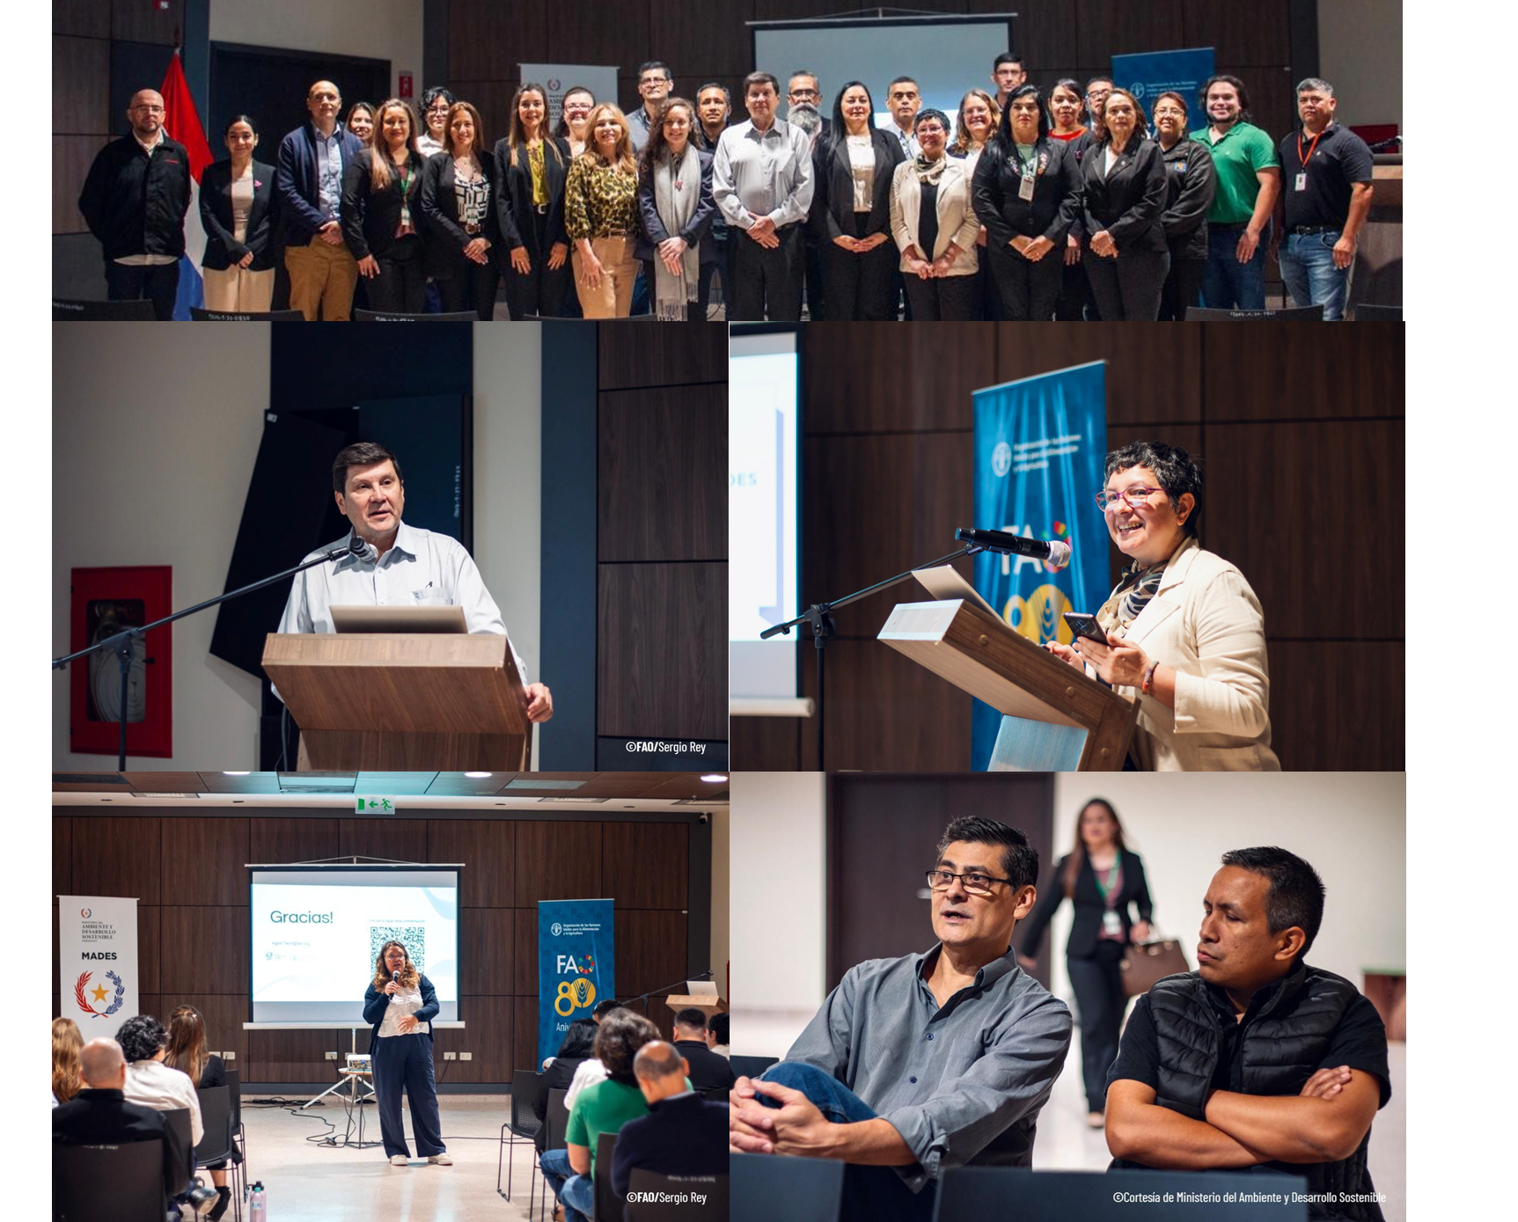
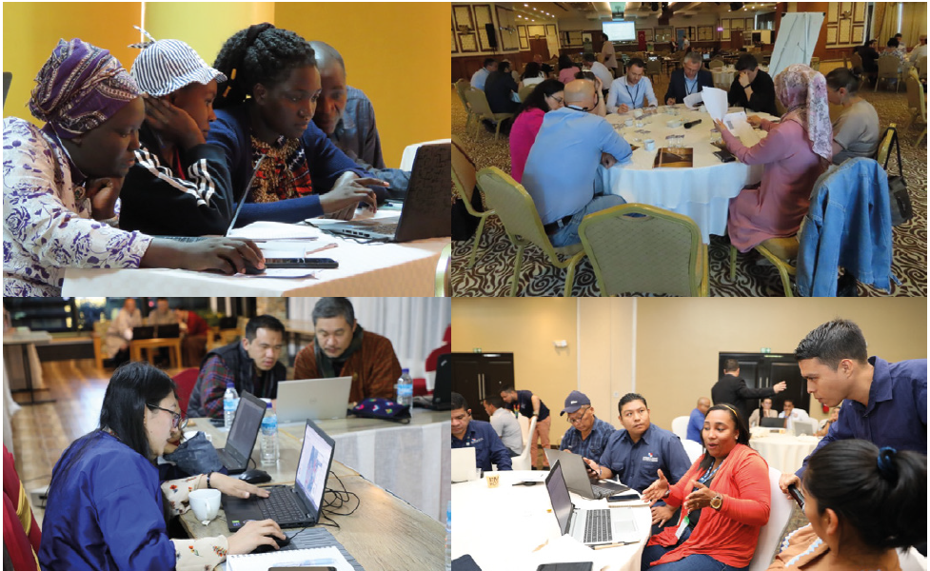
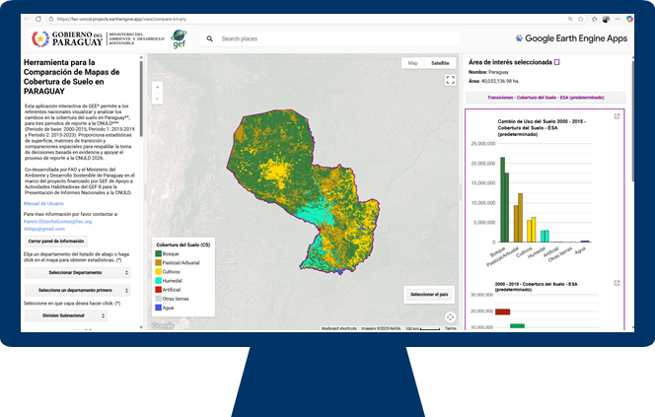
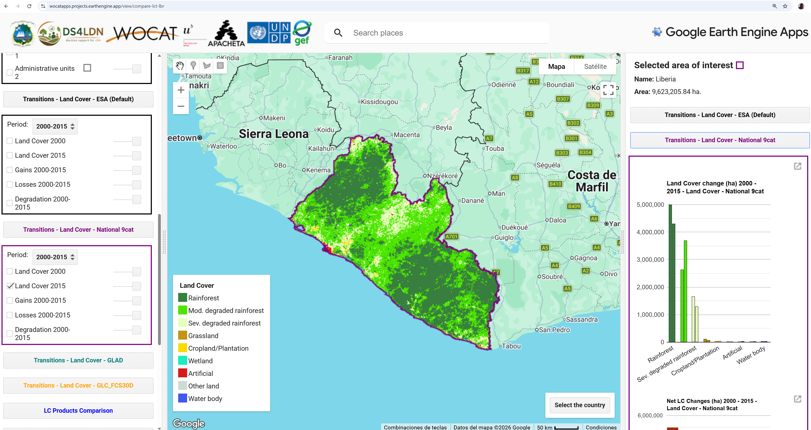
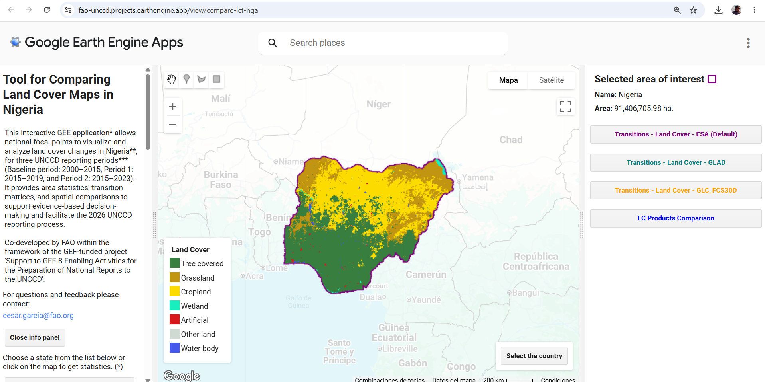
How can countries make these decisions?
FAO WOCAT PARTICIPATORY APPROACH FOR ESTIMATING SDG 15.3.1
FAO WOCAT LCT Apps

Slide 20
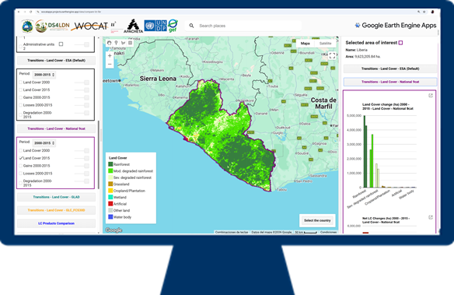
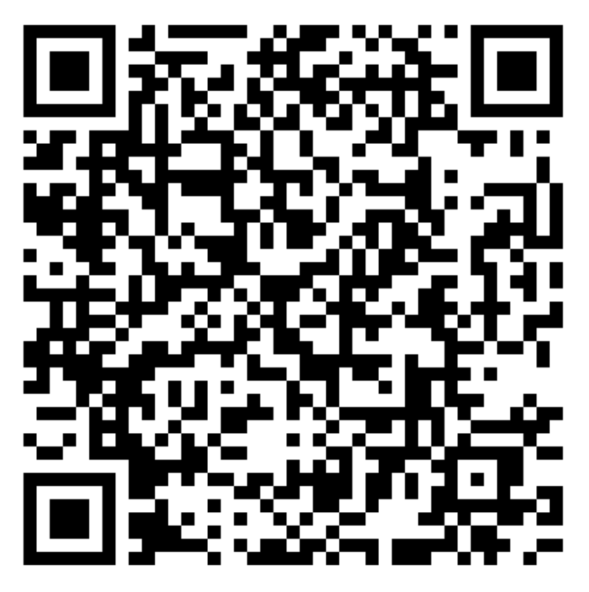
Liberia Land Cover Comparison App
https://wocatapps.projects.earthengine.app/view/compare-lct-lbr

Slide 21
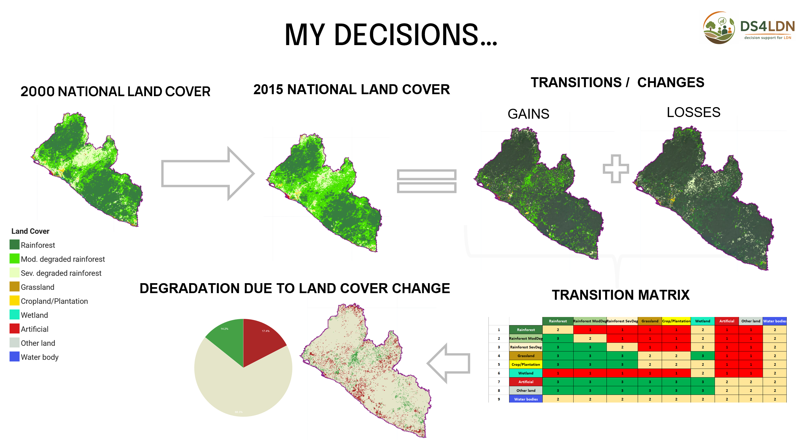
My decisions….
1- National data
2- 9 categories
3- This transition matrix:

Slide 22
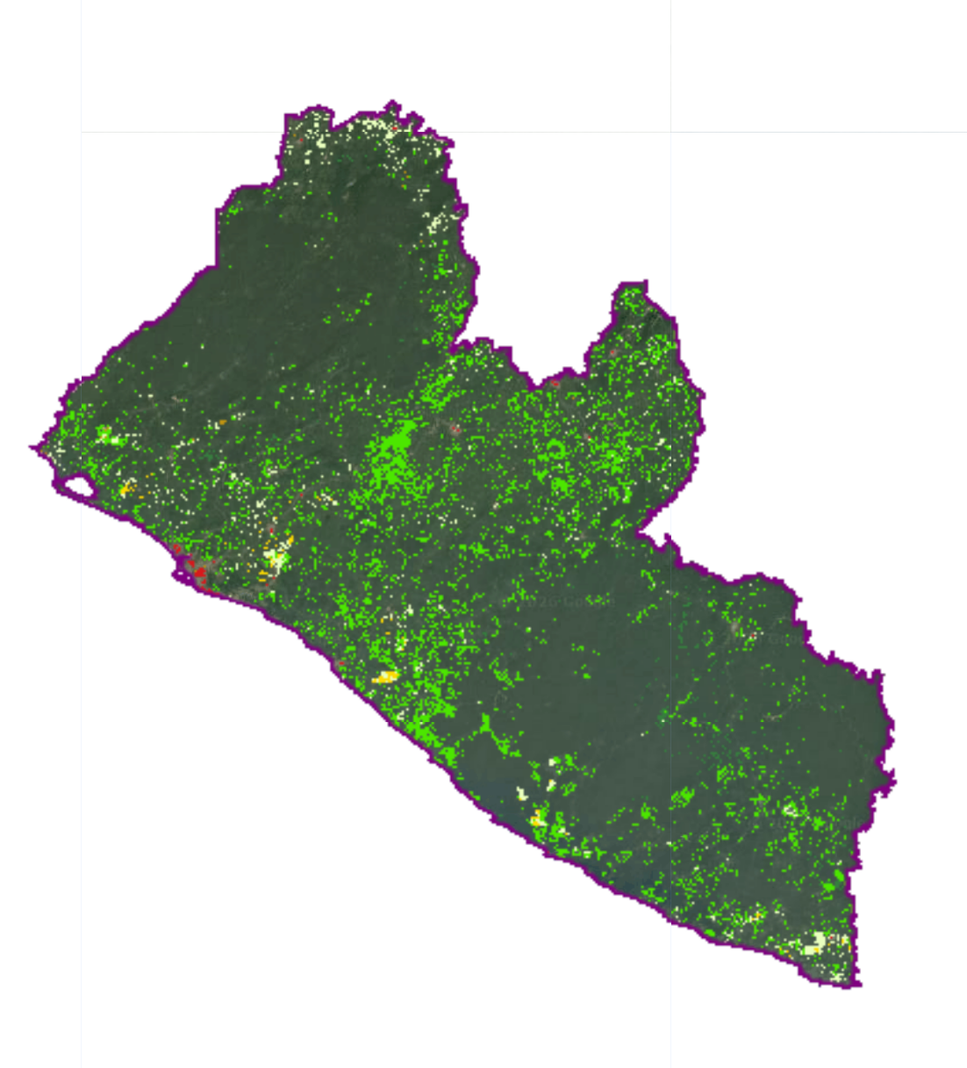
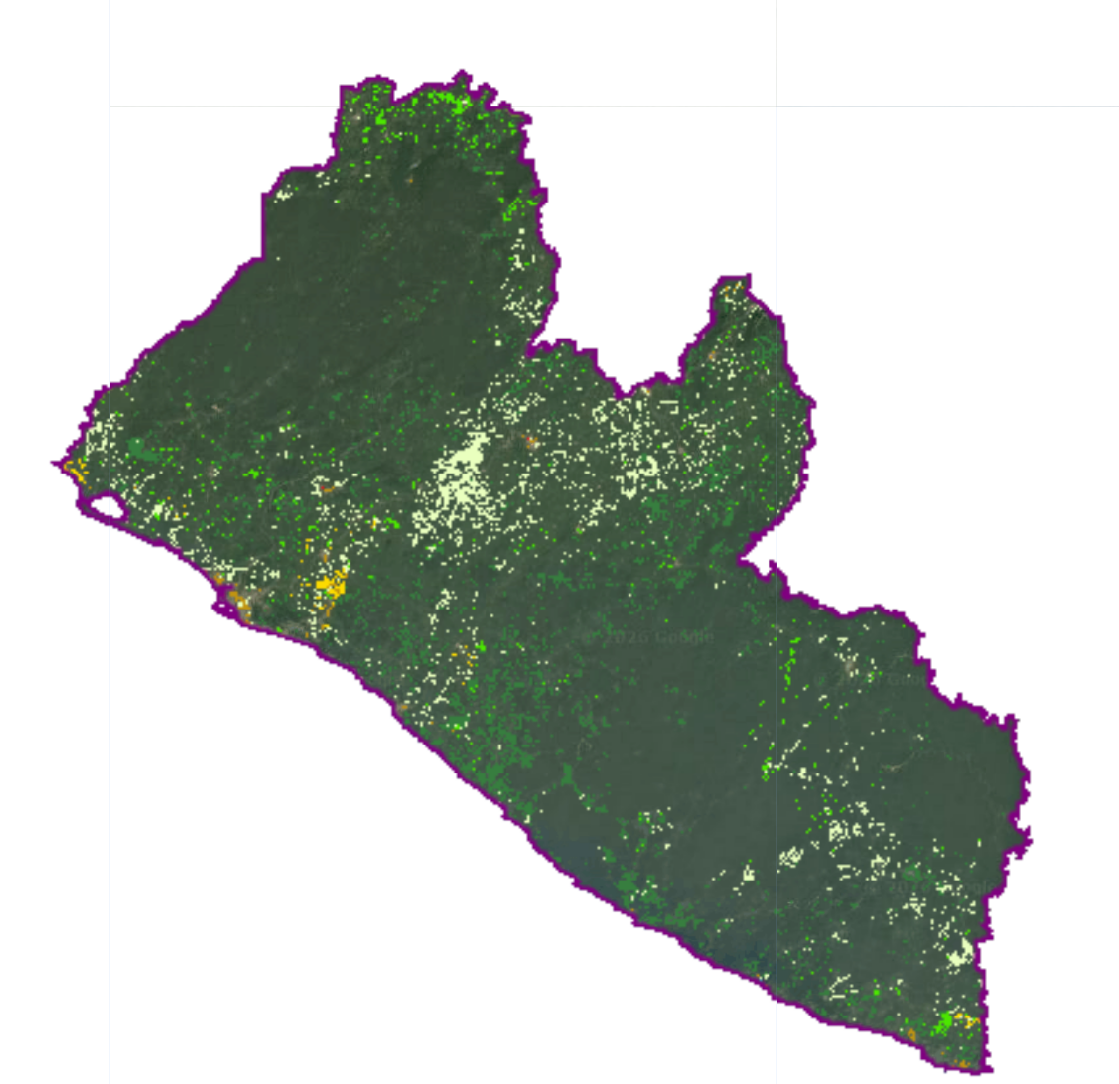
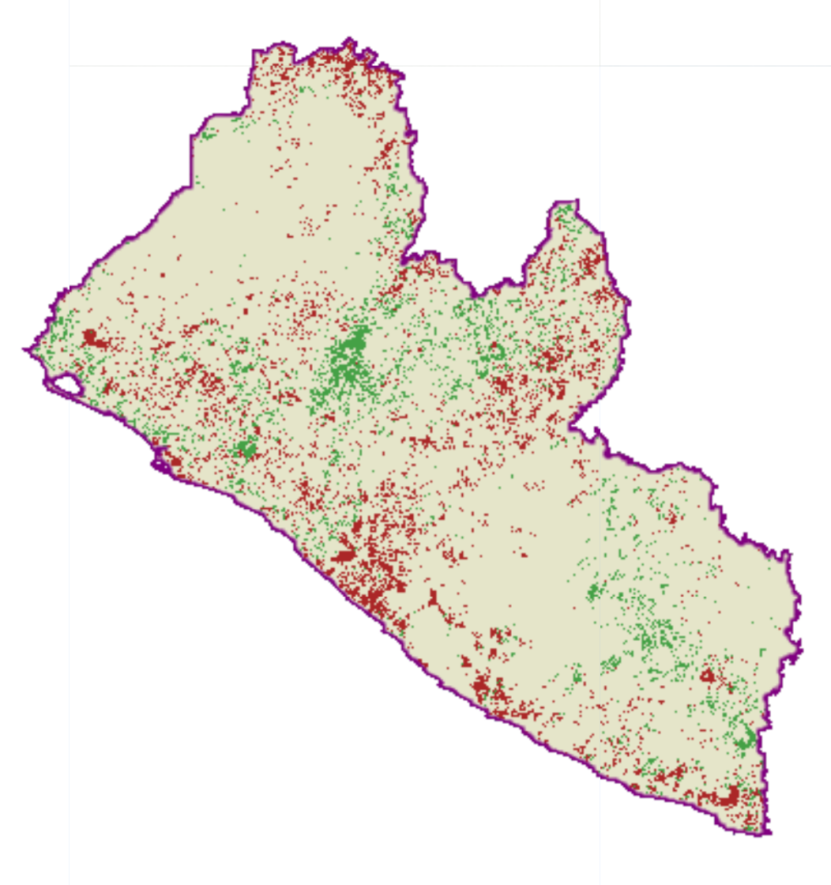
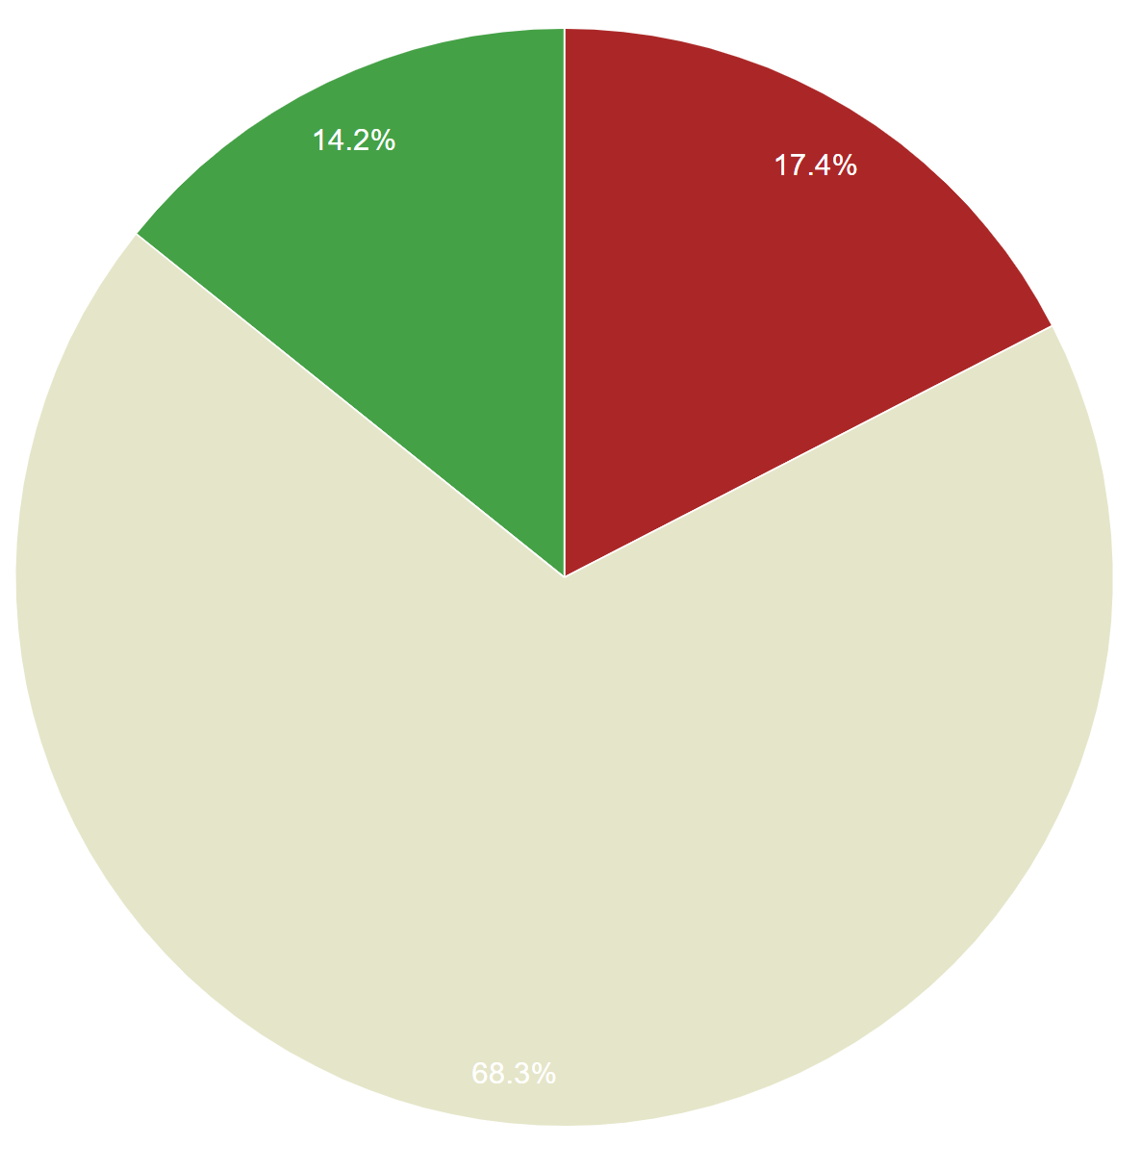
MY DECISIONS…
2015 NATIONAL LAND COVER
TRANSITIONS / CHANGES
2000 NATIONAL LAND COVER
GAINS
LOSSES
DEGRADATION DUE TO LAND COVER CHANGE
TRANSITION MATRIX

Slide 23
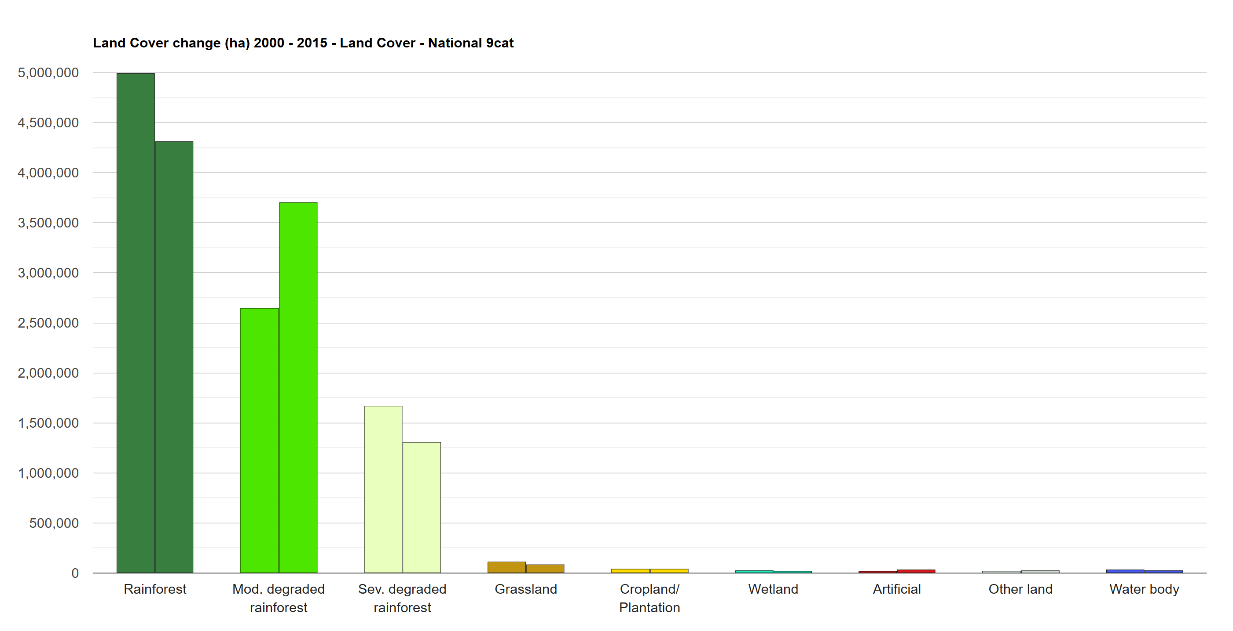

Land Cover changes in the baseline (2000-2015)

Slide 24

Land Cover changes in the baseline (2000-2015)

Slide 25

Land Cover changes in the baseline (2000-2015)

Slide 26

Degradation due to land cover change 2000-2015

Slide 27


Degradation due to land cover change 2015-2018

Slide 28
Let’s explore the app…
https://wocatapps.projects.earthengine.app/view/compare-lct-lbr

Slide 29

Thank you
Do you have any questions?
Ingrid.teich@unibe.ch

