Slide 1
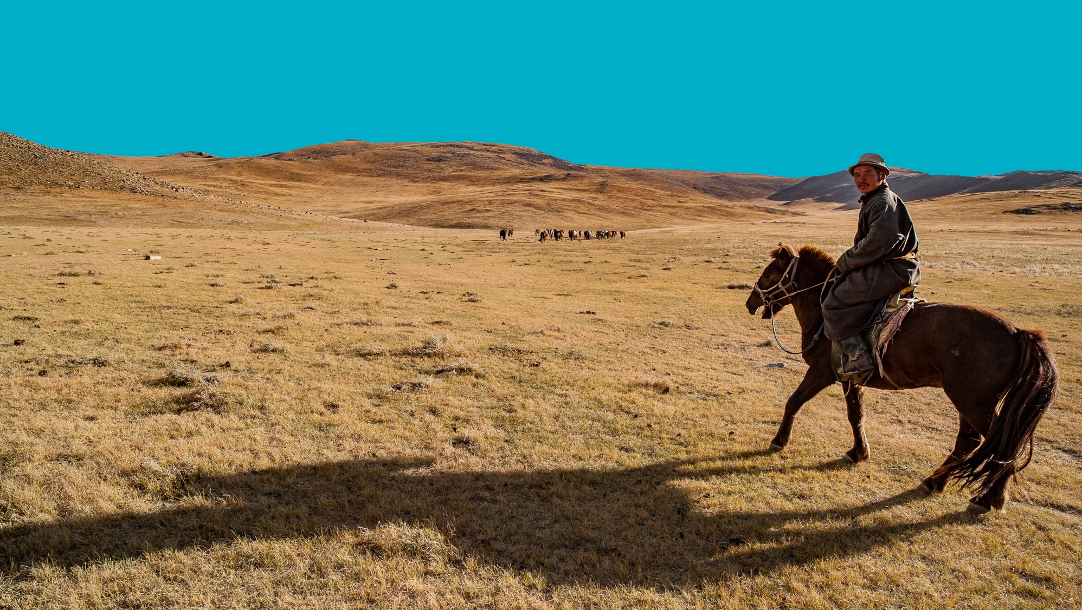






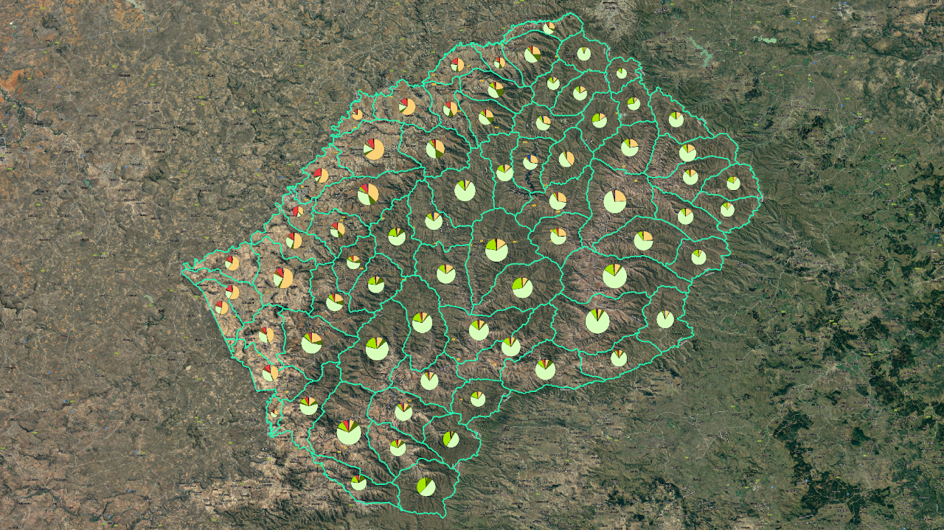
RESTORING LAND
RESTORING HOPE
Building Inclusive, Spatially Explicit Decision Support for LDN in Lesotho
Ministry of Environment and Forestry
Polao Ishmael Moepi,
Principal Soil Scientist, UNCCD STC LESOTHO
17.08.2026

Slide 2
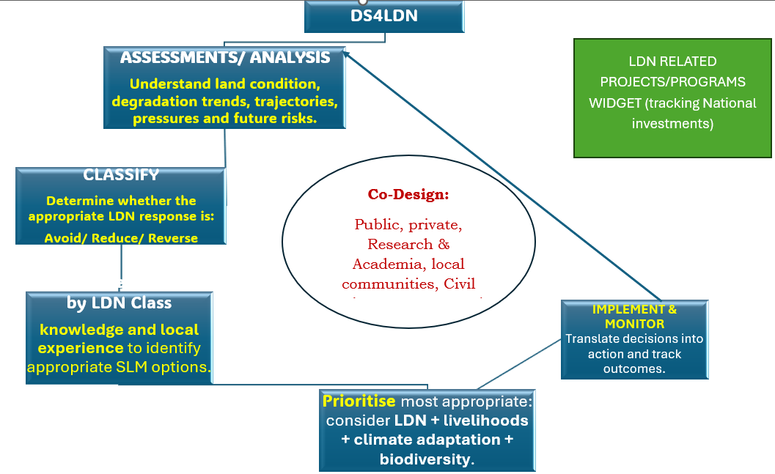
DECISION SUPPORT WORKFLOW
Knowledge sharing locally + Among Implementing Countries

Slide 3
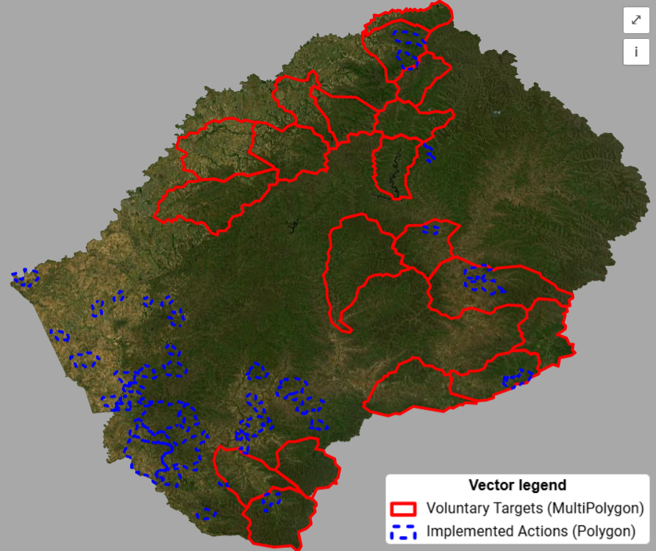
Making LDN Spatially Actionable
AVOID: Where can we prevent degradation before it occurs?
REDUCE: Where can degradation still be halted or reduced?
REVERSE: Where is restoration required to recover land functions?

Slide 4
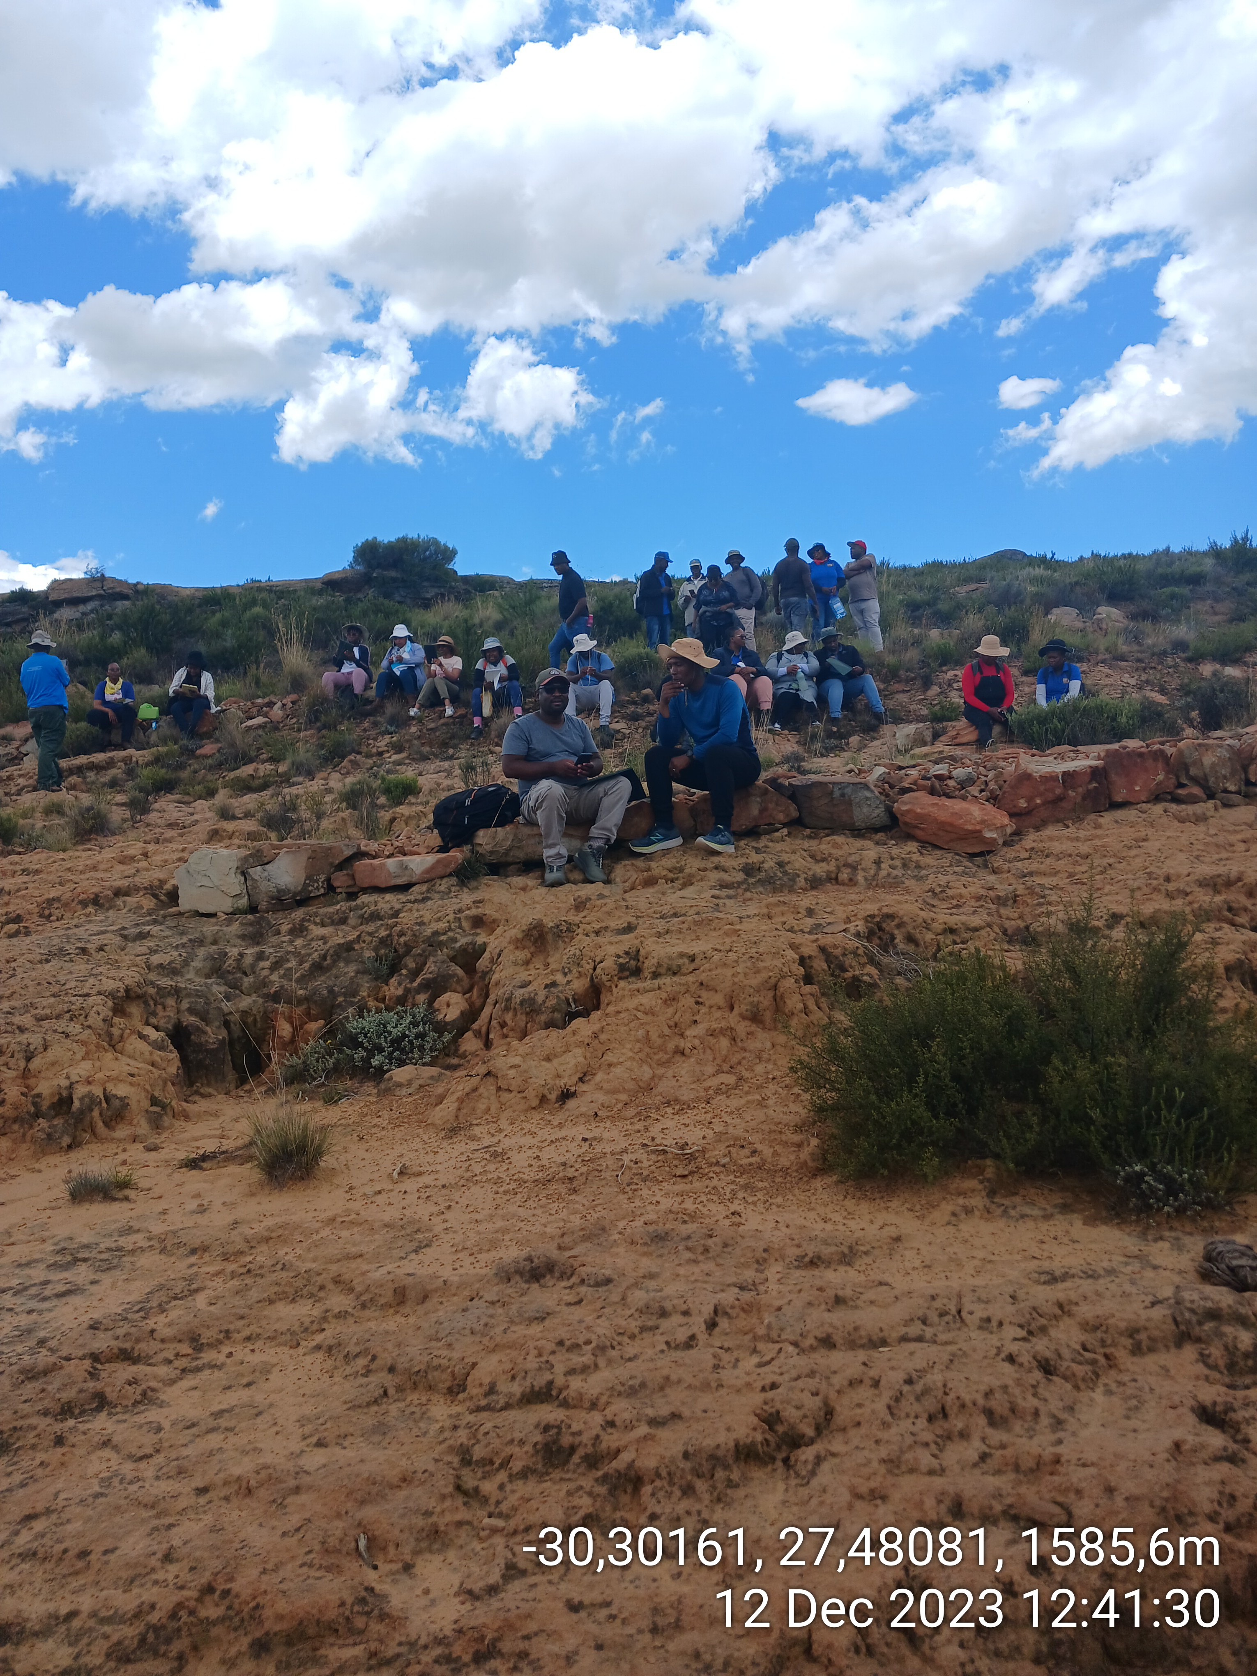
From Land Information to Inclusive Decision Support
Key aspects
CURRENT PERMANENT NATIONAL PRAIS4 TEAM
LDN Layers
National Datasets
Integration of land capability & Suitability classification & Biodiversity spatial planning
National LDN related Projects & Program registration platform.
Synergistic approach
By annual update on Geospatial datasets
Strengthening participatory approach:
Where is degradation?
Why is it happening?
What crosscutting risks does it pose?
What can be done?

Slide 5
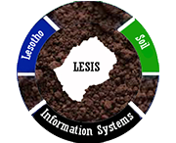
THANK YOU!
SOIL INFORMATION SYSTEM: https://lesis.gov.ls/maps/survey_points/survey.php
NATIONAL GEOSPATIAL LC https://landcoverstats.gov.ls/lslc20172024.

