Slide 1
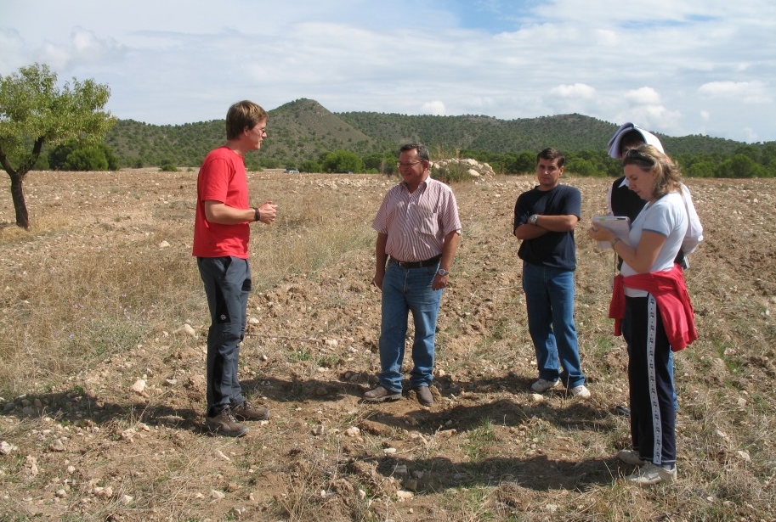
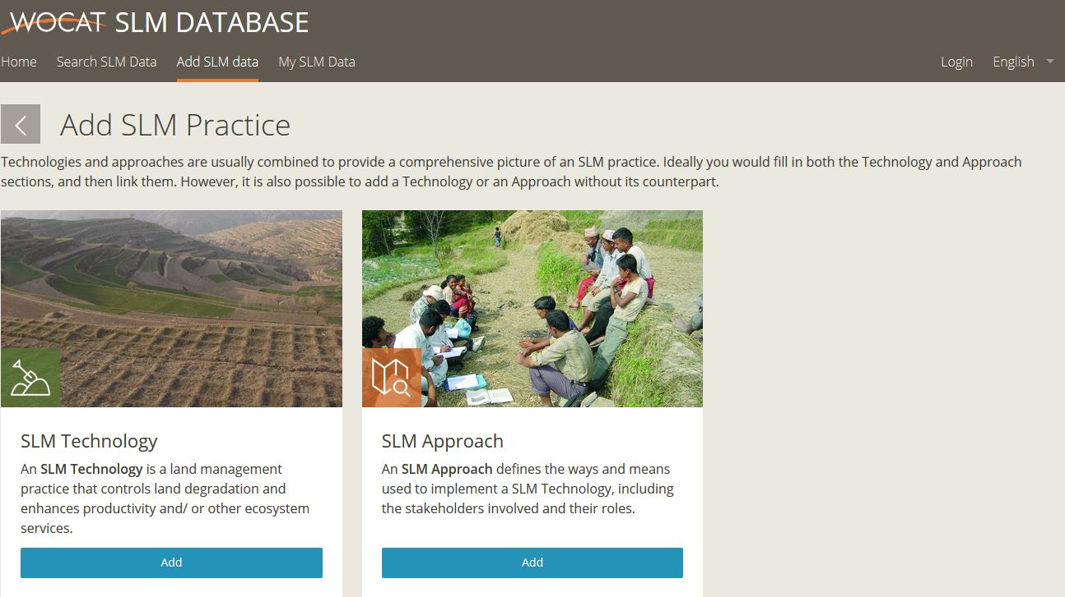
Documenting best practices in SLM with Questionnaires on Technologies (QT) & Approaches(QA)
WOCAT Secretariat
Center for Development and Environment (CDE)
University of Bern
https://qcat.wocat.net/en/wocat/
Notes:
1
Training and Guidelines for assessment and documentation of existing and potential technologies and approaches using WOCAT methods and tools

Slide 2
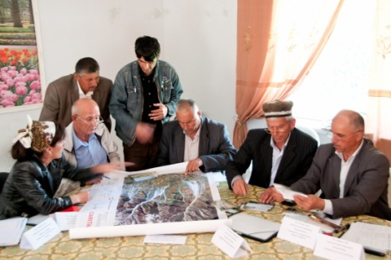
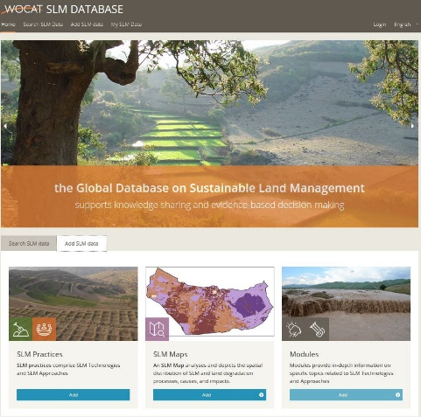
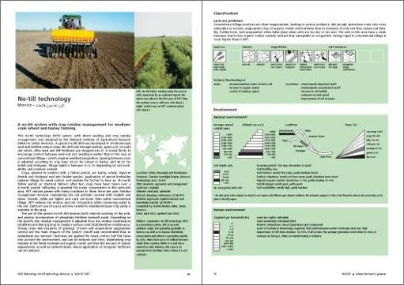
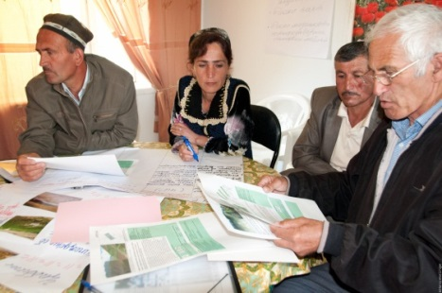
Part I: Identification (stakeholder workshop / participatory learning approach) Problems and possible solutions:
creation of LUS maps
first inventory of LD and SLM practices
Part II: Documentation & Assessment (evidence base)
mapping LD and SLM practices (QM)
thorough inventory of LD and SLM practices (QT/QA)
Part III: Evaluation & Selection (stakeholder workshop): setting criteria → scoring → ranking
selection of most promising SLM Ts&As → regional and local
negotiation

Slide 3
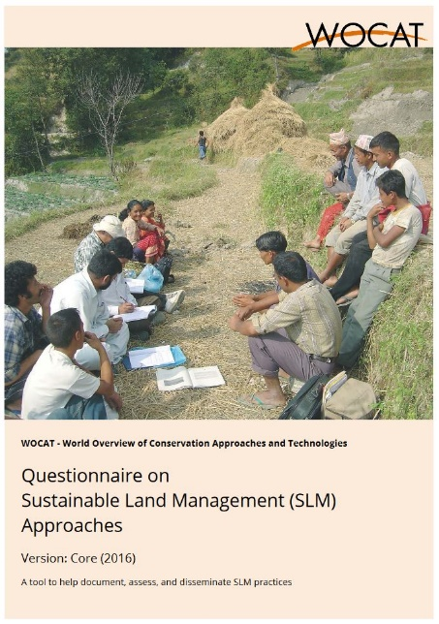
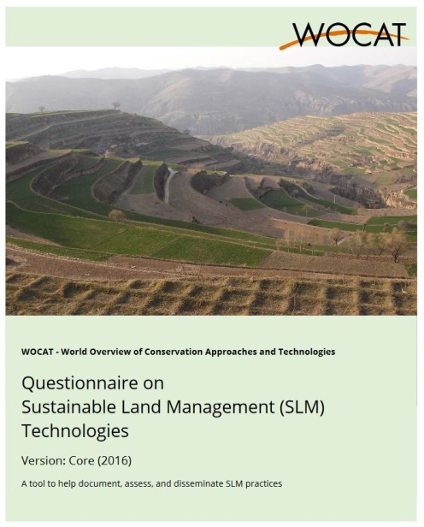
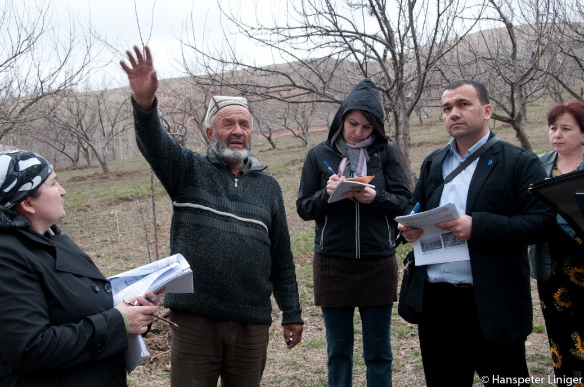
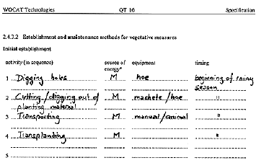
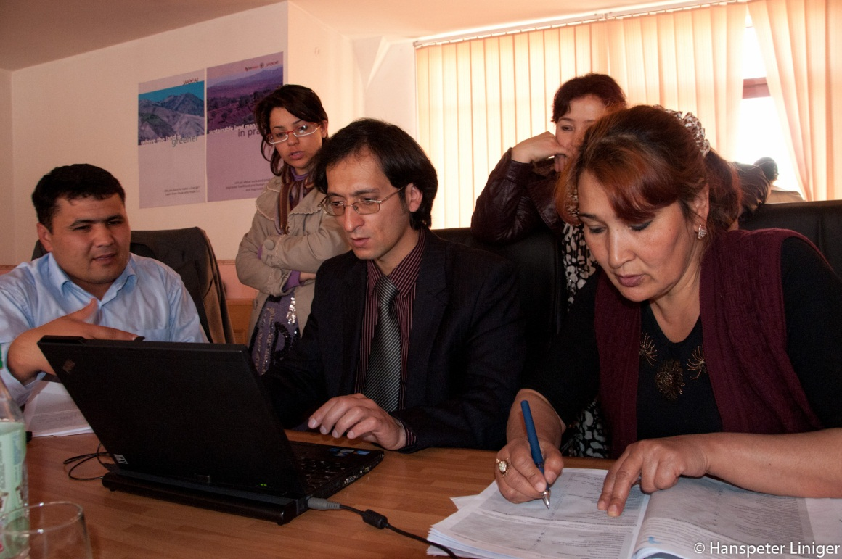
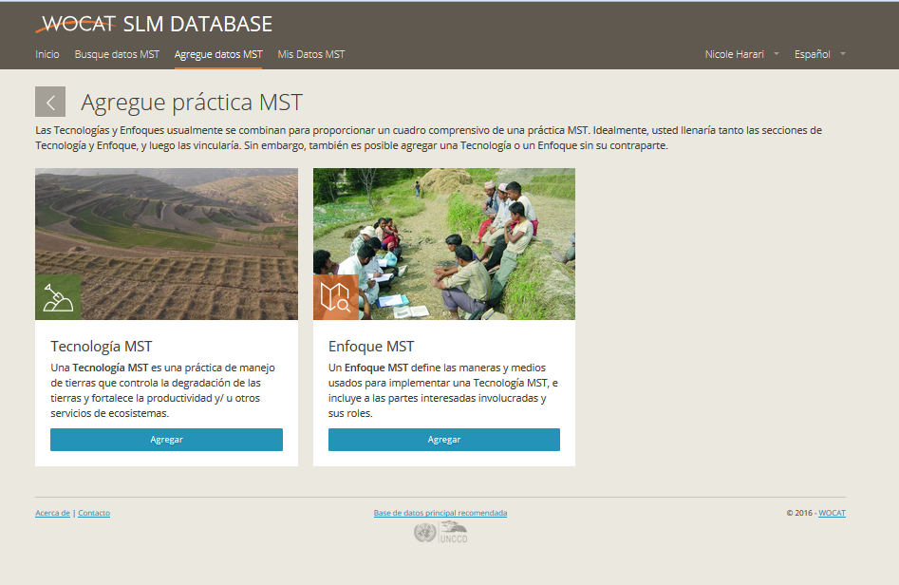
Documenting SLM good practices in the field
Questionnaires on SLM Technologies and Approaches
Documenting information from and with land users
Entering data in questionnaire
Entering data in database
Online database
Notes:
WOCAT provides a proven methodology and a tool to document and evaluate what
one is doing in terms of SLM (technologies and approaches) as
well as a means to compare one’s own experience with that of others. The questionnaires provide a framework for documentation and evaluation and guide
the SLM specialist through all relevant aspects of SLM. By filling in the
questionnaires they not only document knowledge and establish a database, but also
review and evaluate the SLM practice. They tap the know-how from several
sources and stimulate interaction during the documentation and evaluation process.
Get familiar with the questionnaires on technologies and approaches, and
plan the documentation.
Define the technologies and approaches to be assessed and the resource persons to be consulted.
Fill in the questionnaires: consult documents and resource persons.
Enter the data into the database and do self-evaluation: Properly reflected own experiences already show where there are potentials for improvement or for up-scaling. They are also intended to critically review ones often fragmented knowledge, to identify gaps and contradictions in what is already know, to question and evaluate current perceptions and field experiences
4 standardized output pages to summarize technologies and approaches (together comprise a case study)
-> easy and quick to understand and compare!

Slide 4
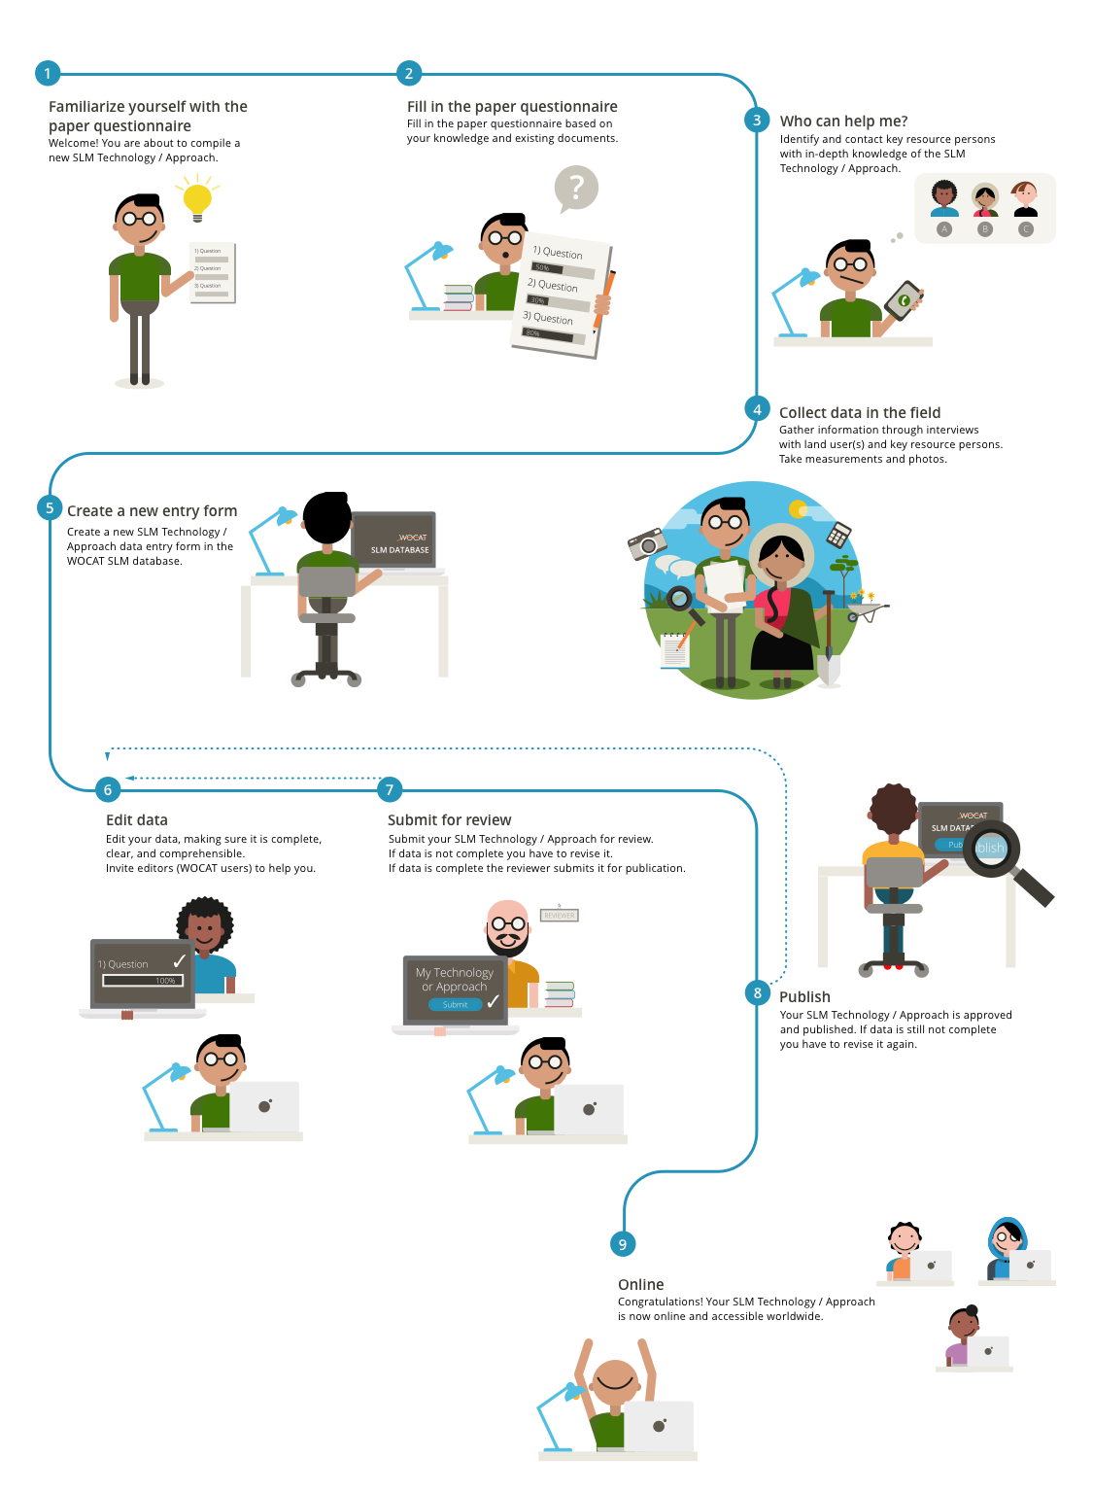

Slide 5
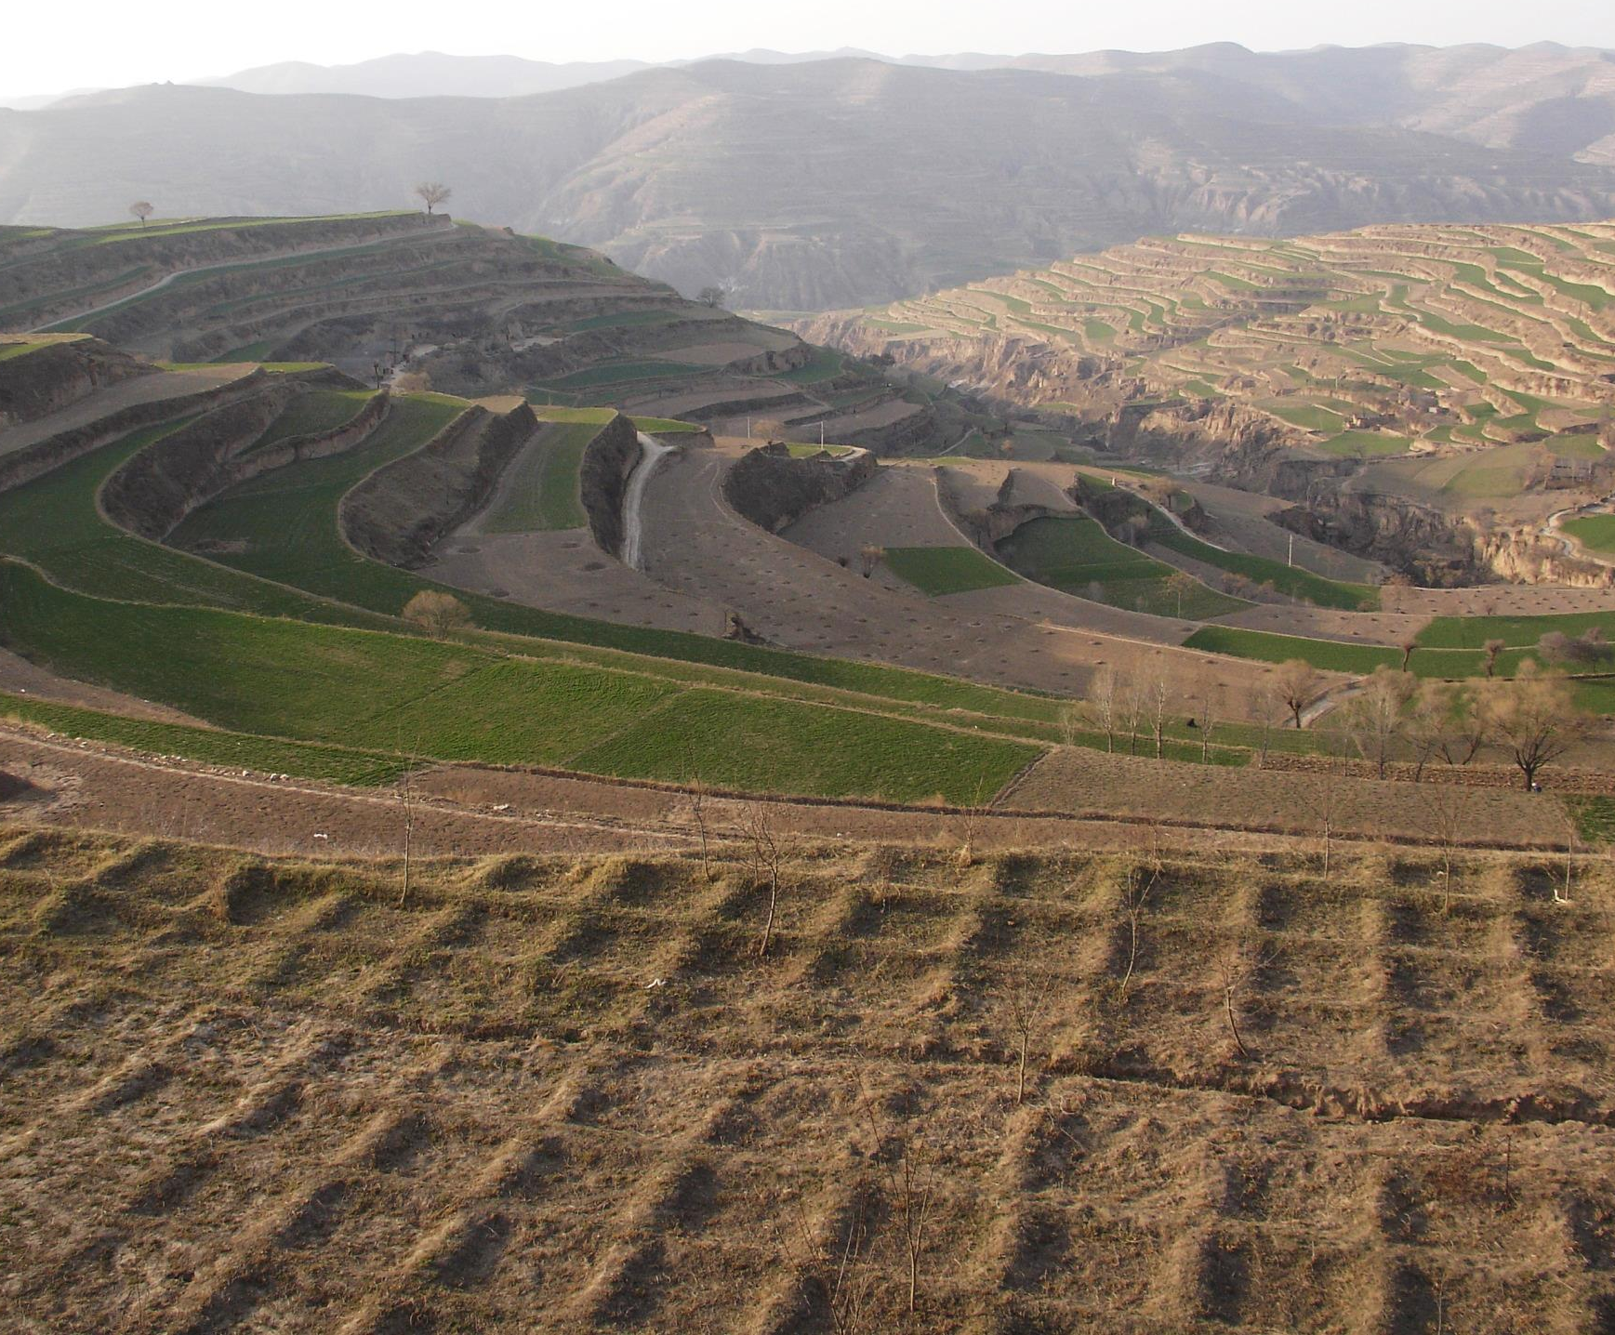
What is an SLM Technology?
An SLM Technology is a practice applied in the field that controls land degradation and enhances productivity and/or other ecosystem services. A Technology consists of one or several measures, such as agronomic, vegetative, structural, and management measures.

Slide 6
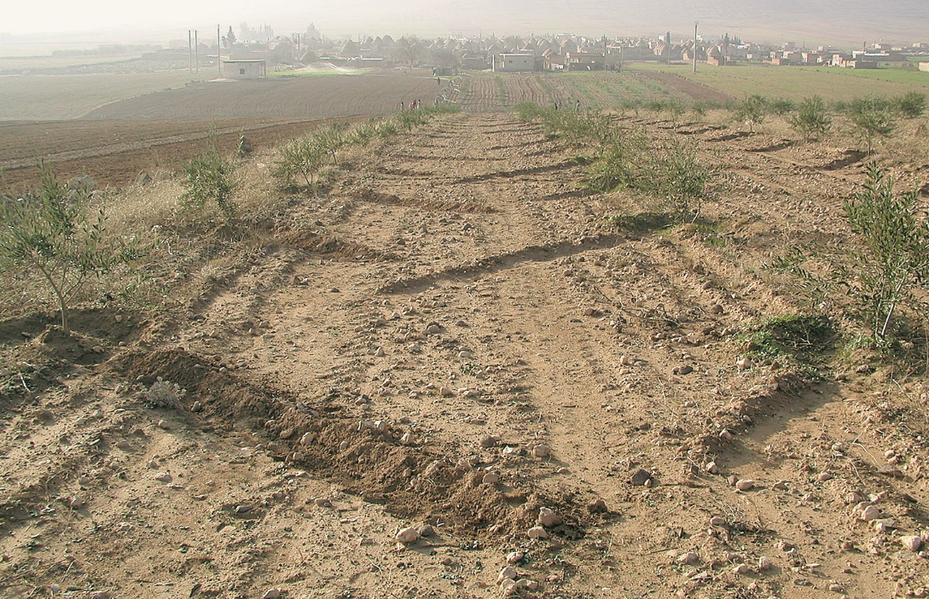
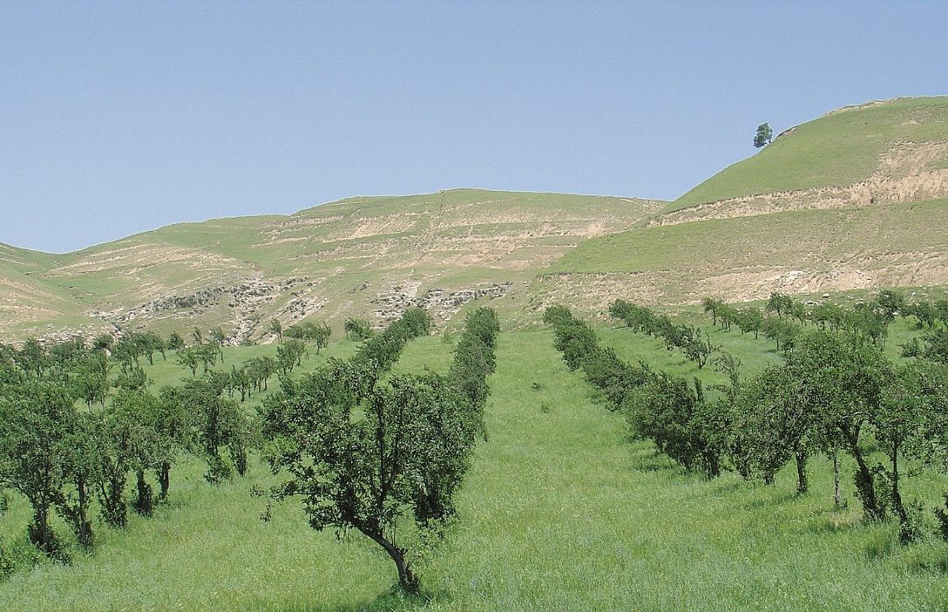
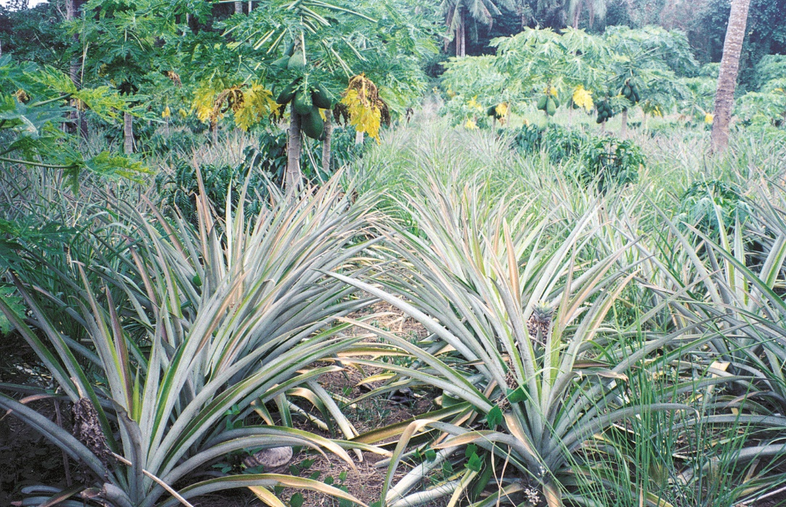
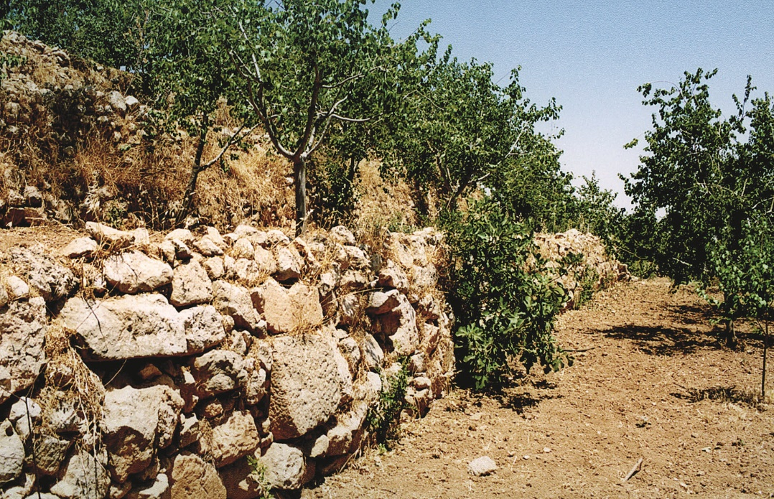
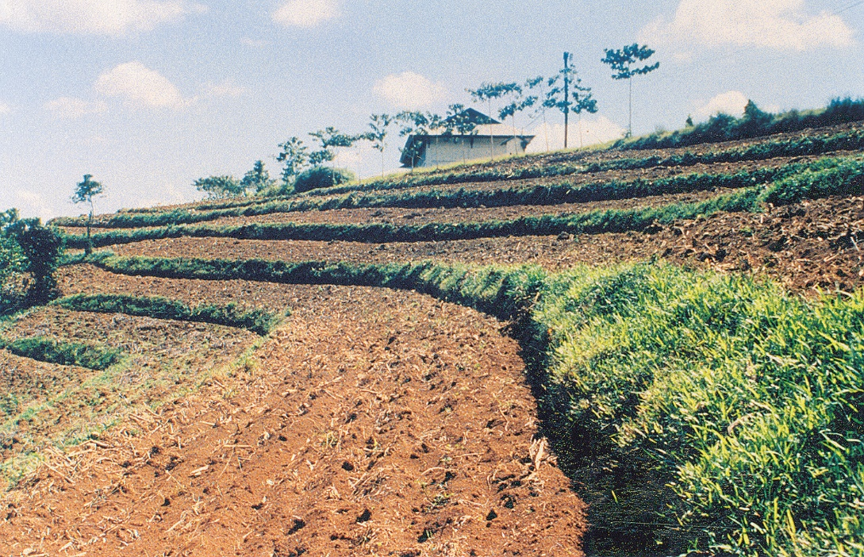
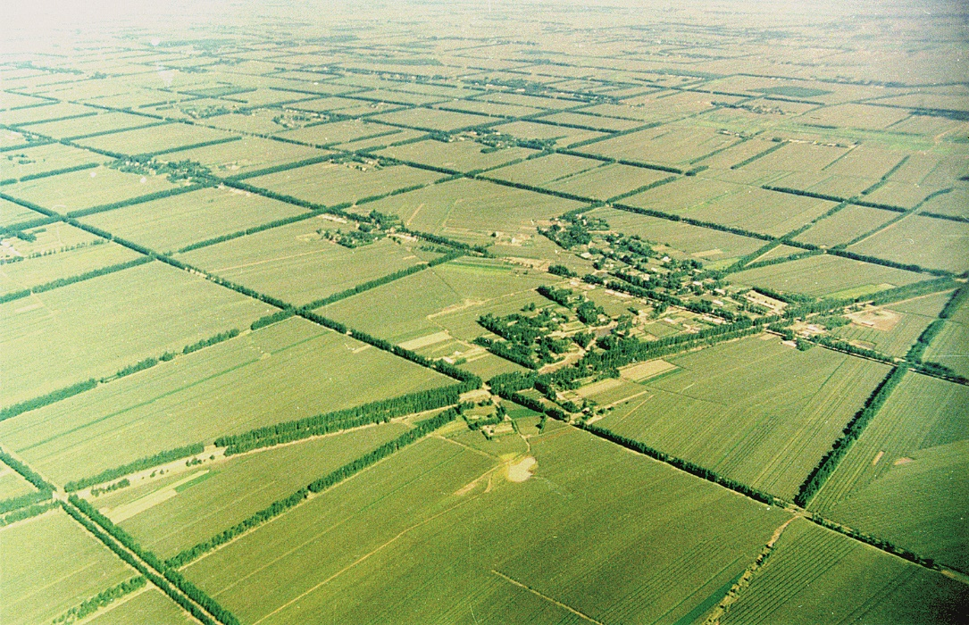
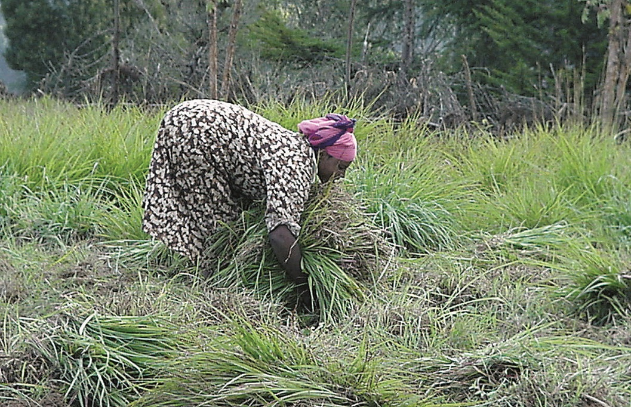
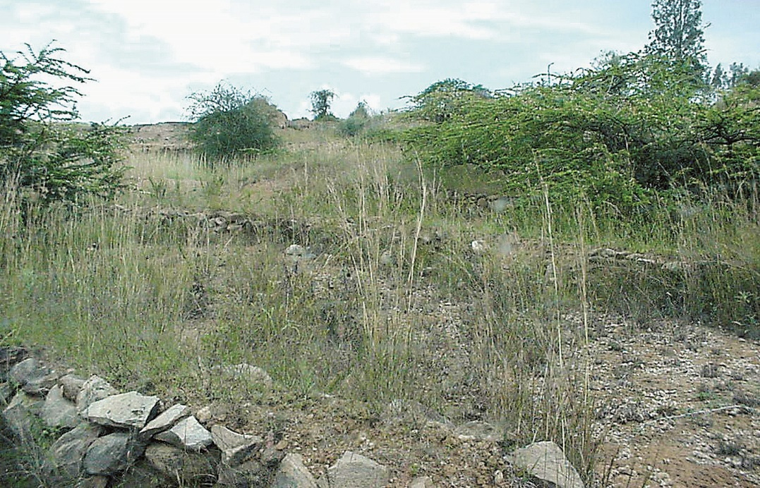
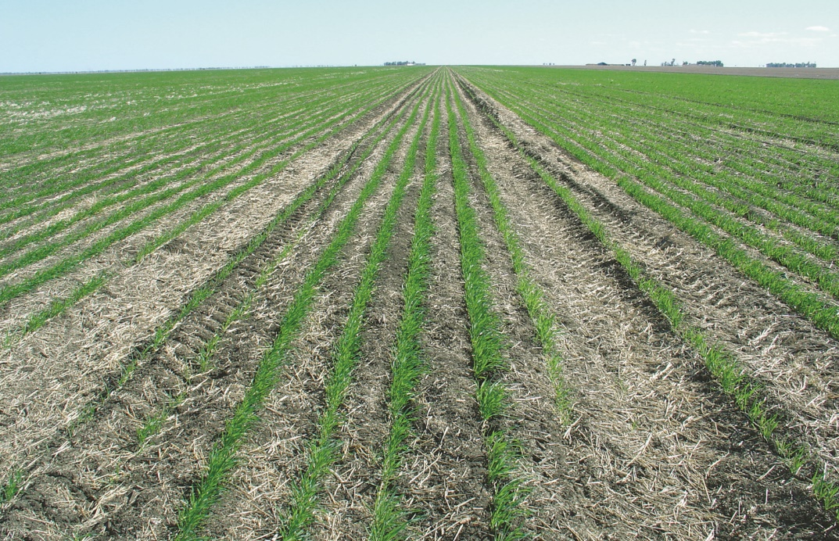
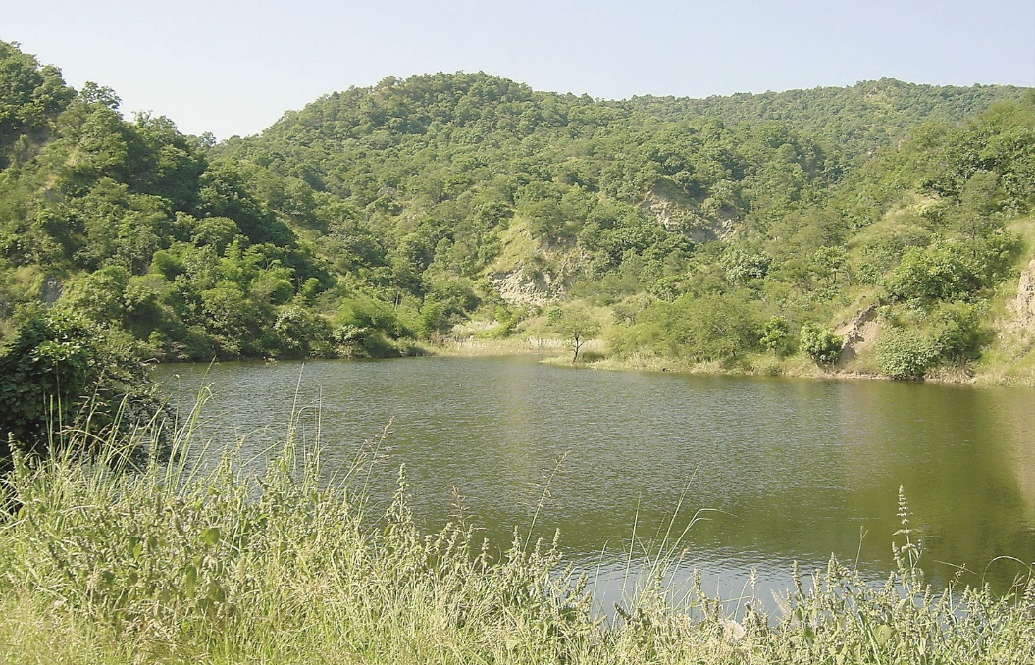
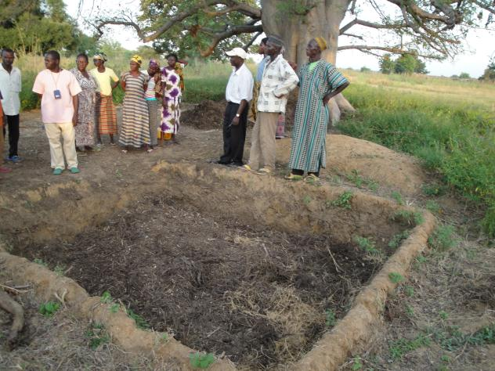
SLM Technologies: examples
stone wall terraces
shelterbelts
multi-storey cropping
grass strips
agroforestry
infiltration
ditches
cut and carry
area closure
forest protection
composting
M. Zöbisch
no-till technology
conversion (from grazing to fruit and fodder production)
F. Turkelboom
HP. Liniger
L. Meng
J. Rondal
A. Mercado
D. Danano
D. Danano
W. Critchley
W. Critchley
HP. Liniger
HP. Liniger

Slide 7
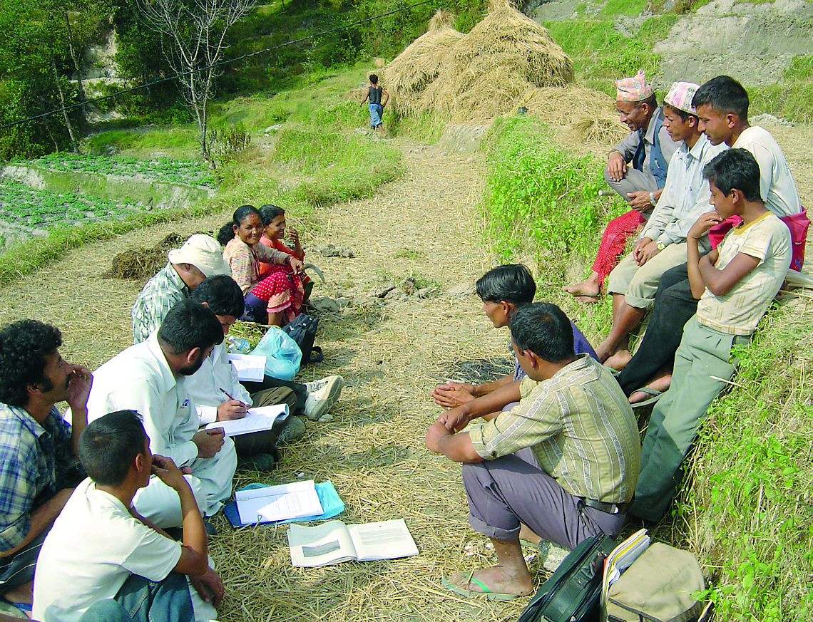
What is an SLM Approach?
An SLM Approach defines the ways and means used to implement one or several SLM Technologies. It includes technical and material support, involvement and roles of different stakeholders etc. An Approach may refer to a project/program or to activities which were initiated by land users themselves.
J. Thomas / FAO

Slide 8
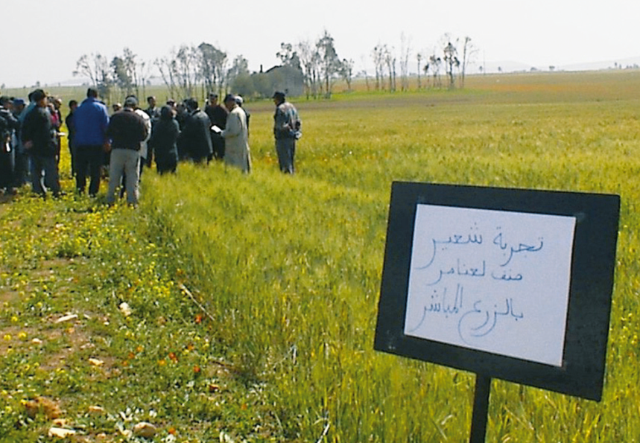
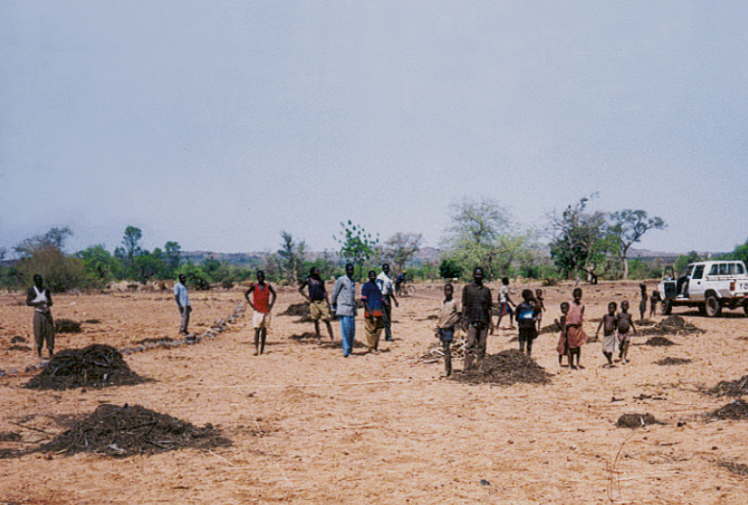
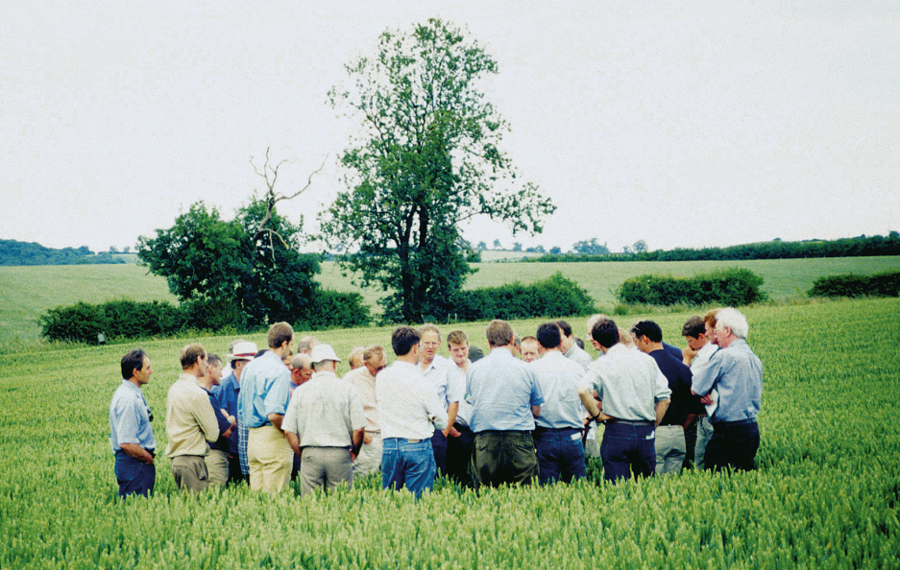
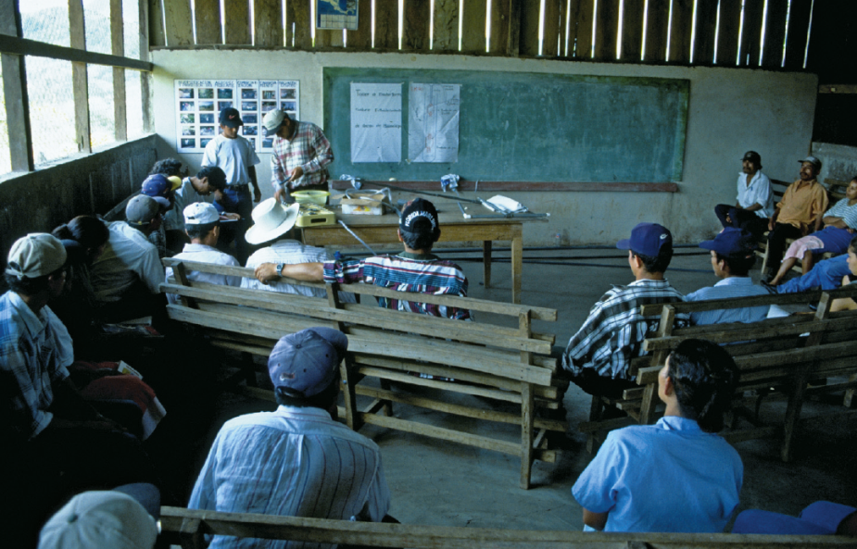
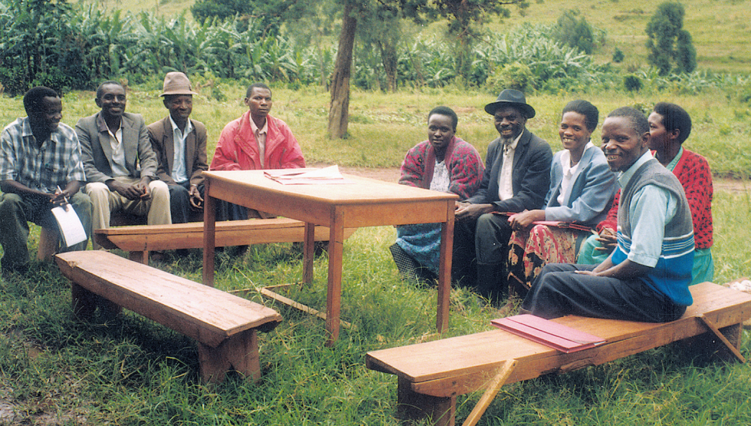
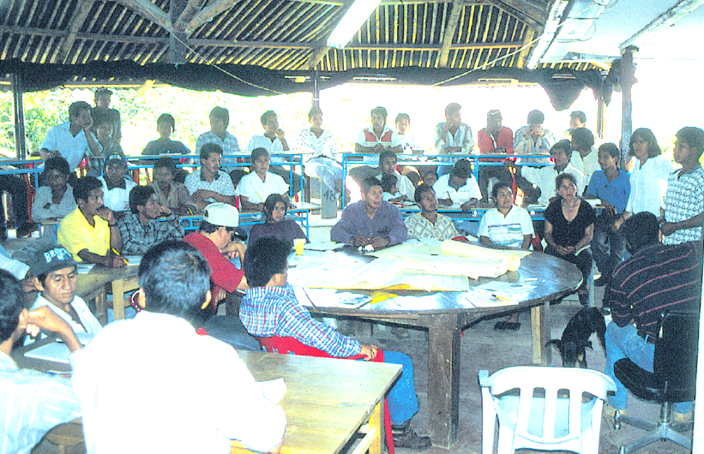
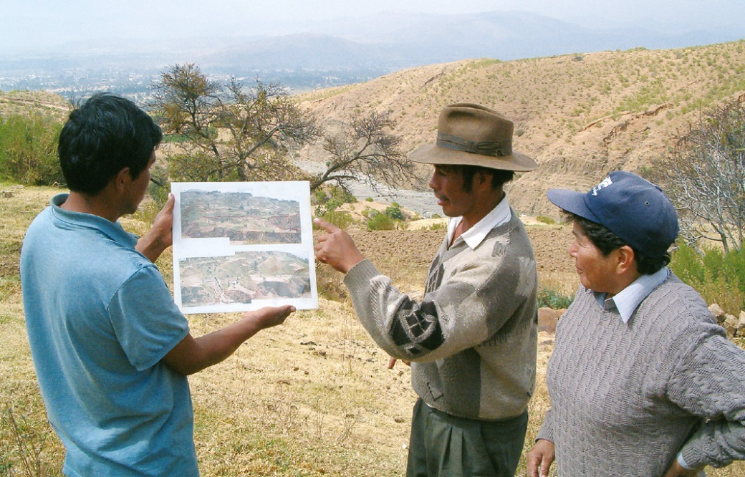
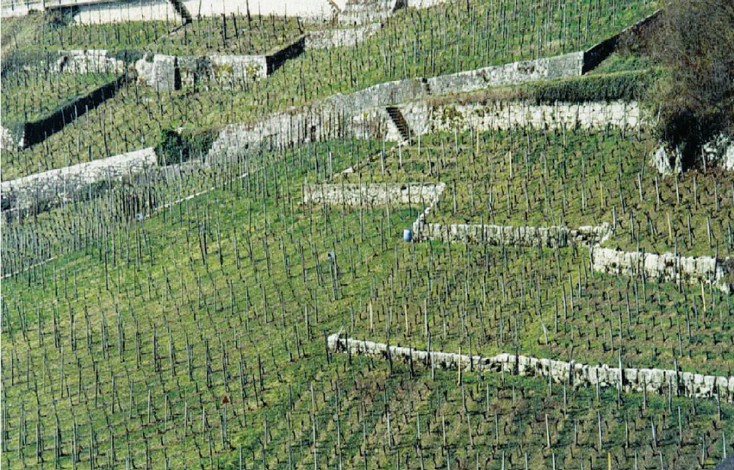
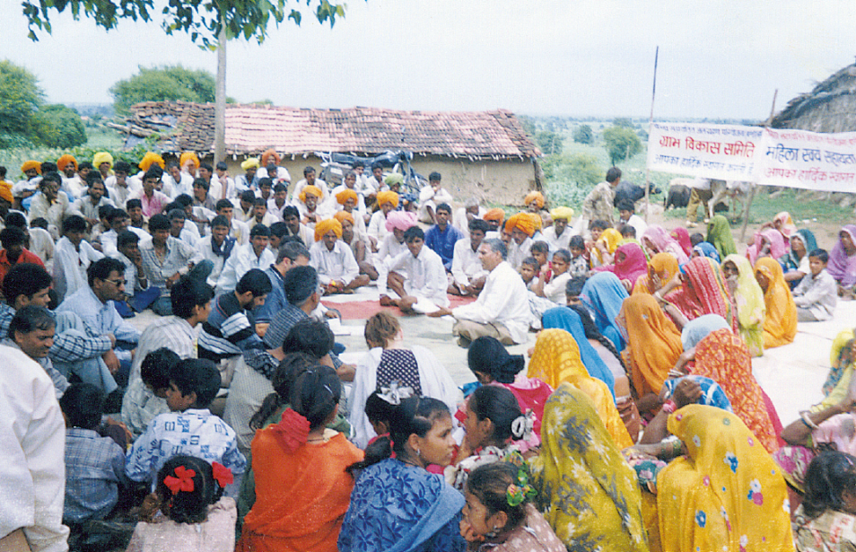
SLM Approach: examples
applied research & knowledge transfer
soil management initiative
productive development & food security programme
zabré women’s
agroecological programme
promoting farmer innovation
Ait Lhaj A.
SOWAP
M. Gurtner
R. Chatelain
W. Critcheley
incentive-based catchment treatment
farmer initiative within enabling environment
integrated rural community development
transition from centralized regime to local initiative
comprehensive watershed development
N. Güdel
M. Gurtner
P. Niederer
D. Gandhi
G. Heim

Slide 9
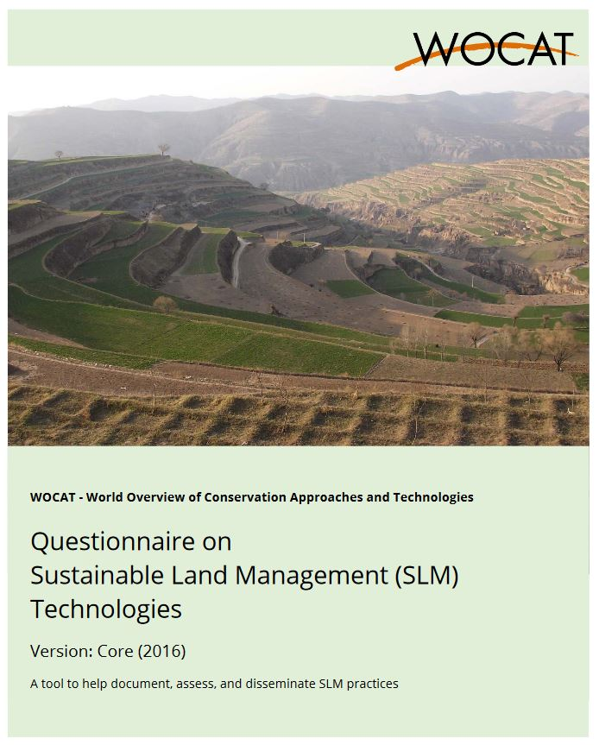
QT & QA - Questionnaires
Notes:
The questionnaires are used to document experiences and examples (case studies) of successful and partly successful SLM as well as failures.
WOCAT questionnaires on technologies and approaches help to describe and analyse the technologies and approaches in a structured and standardized way. The two questionnaires are complementary, asking details about a SWC technology and its implementation in QT and about the broader enabling environment in QA. They cover both the natural and human environment of SLM

Slide 10
QT structure & content
Introduction to the questionnaire
1. General information
2. Description of the SLM Technology
3. Classification of the SLM Technology
4. Technical specifications, implementation activities, inputs, and costs
5. Natural and human environment
6. Impacts and concluding statements
7. References and links

Slide 11
QA structure & content
Introduction to the questionnaire
1. General information
2. Description of the SLM Approach
3. Participation and roles of stakeholders involved
4. Technical support, capacity building and knowledge management
5. Financing and external material support
6. Impact analysis and concluding statements
7. References and links

Slide 12
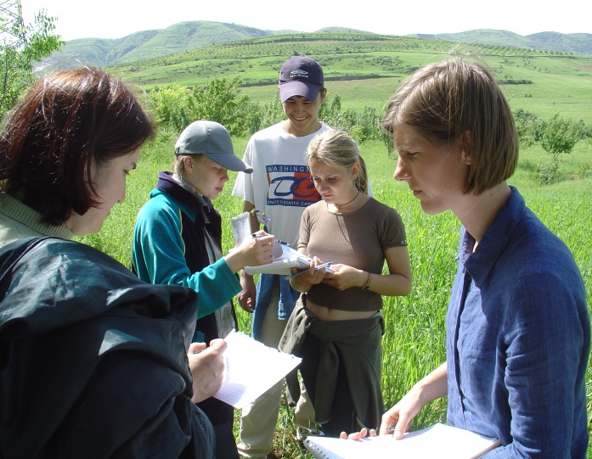
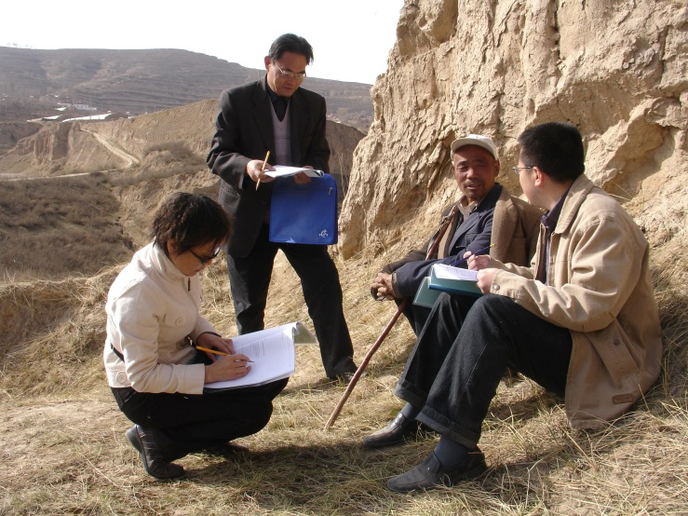
Who should fill the questionnaires?
A team of SLM specialists – including land users – with different backgrounds and experience, who are familiar with the details of the technology/ approach (technical, financial, socio-economic)
… making use of existing documents and seek advice from other SLM specialists and land users as much as possible.
→ If you intend to fill the questionnaire from the desk, there is a tendency to fill the questionnaire according to our preconceptions which are not always correct.
Notes:
Ideally a team of SLM specialists fills in the questionnaires on technologies and approaches. It is recommended that the SLM specialists have different backgrounds and experiences who are familiar with the details of the technology and the approach (technical, financial, socio-economic).
Specialists consult land users and other resource persons, and document as much as possible and needed.
In order to consolidate your information you should try to identify as many resource persons as
needed (project personnel, agricultural advisors, researchers, etc.. It is important to combine project / ministry / advisory people with researchers / scientists, as this is crucial especially for the impact assessment. Experiences show that a good collaboration will also pay back in future.
Identify documents which help you answering the questionnaires. Organise and prepare the
most relevant documents and baseline materials, such as project reports, case studies, photos and maps.
If your team knows the technology and approach very well, you are probably able to fill in a number of questions on your own. But if you undertake it as a purely desk-top exercise, the tendency is to tick the boxes that match your preconceptions, which may or may not be correct.

Slide 13
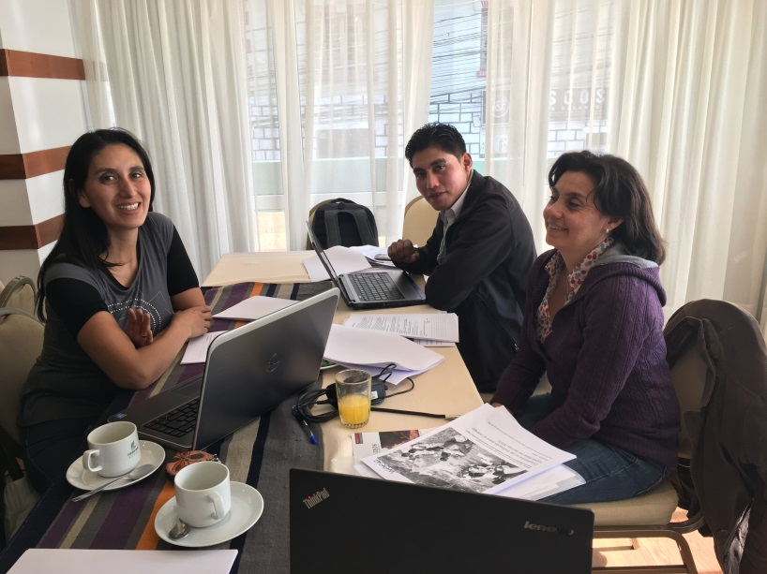
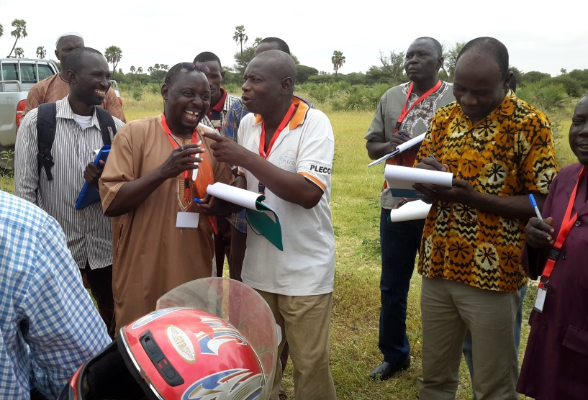
General principles
Get familiar with the questionnaires; read introduction and notes on pages 3-4
Use the definitions given in Qs even when they deviate from your own / national definitions
Answer all questions. If certain questions are not applicable or not relevant indicate n/a
If hard or precise data is not available, provide a best estimate
Notes:
As a general principle first get familiar with the questionnaires on technologies and approaches, and plan the documentation of the selected technologies and approaches. Hence, for optimal preparation read through the questionnaires before you use them the first time.
Don't let the number of pages in the questionnaires discourage you! Certain sections
are redundant for you, i.e. if your technology is applied on cropland only, you don’t need to fill
in the sections on grazing, forest and other land. Or, if your measure is a vegetative one only,
you can skip the questions related to agronomic, structural or management measures.
In some places the information will be simple to obtain which allows you to advance quickly.
In other sections there may be no hard data available and you are asked to provide a best
estimate, based on your professional judgment.
Use the definitions given in this document, even when they deviate from your own/national definitions
Before going to the field the questions that need to be asked to the land users are identified and marked. There are questions in the questionnaires for which we specifically differentiate between your opinion (the expert opinion) and the land users’ view.

Slide 14
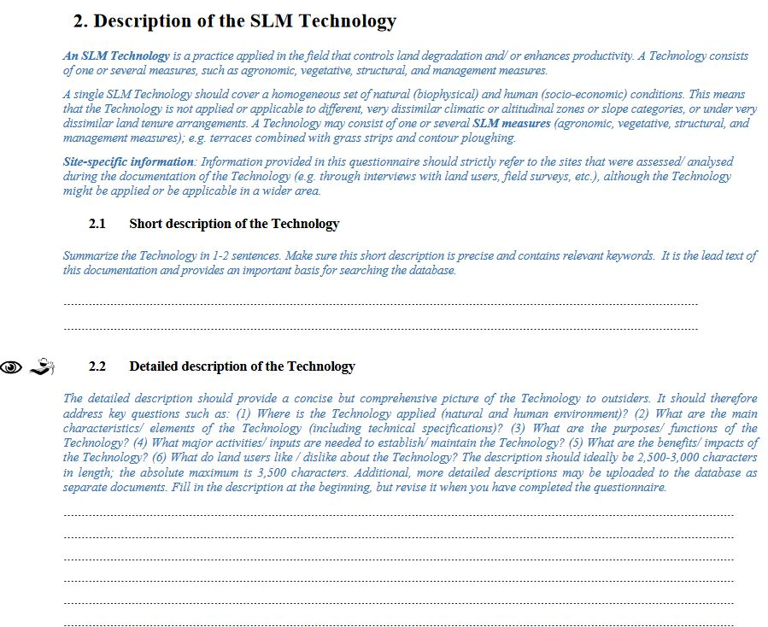
General principles
Black font:
→ questions
Blue font and in italics:
→ definitions, explanations or examples
must be answered in consultation with land users.
require measurements or observations in the field.
Notes:
Shaded parts in the questionnaires are questions to be filled in; not shaded parts are
explanations or examples.

Slide 15
General principles: types of questions
Open questions
Square boxes: must be ticked
→ If ‘several answers possible’ is not indicated, tick only one box
Notes:
If information is not available or if certain questions are not applicable always indicate “n/a”.
Make use of the specify/remark/comments column or line as much as possible!
If you do not have enough space for answers, use the empty pages at the end of the
questionnaire. Please make a footnote in the questionnaire to indicate the exact
question number. Please also attach good technical drawings, photographs,
descriptions, references, etc.

Slide 16
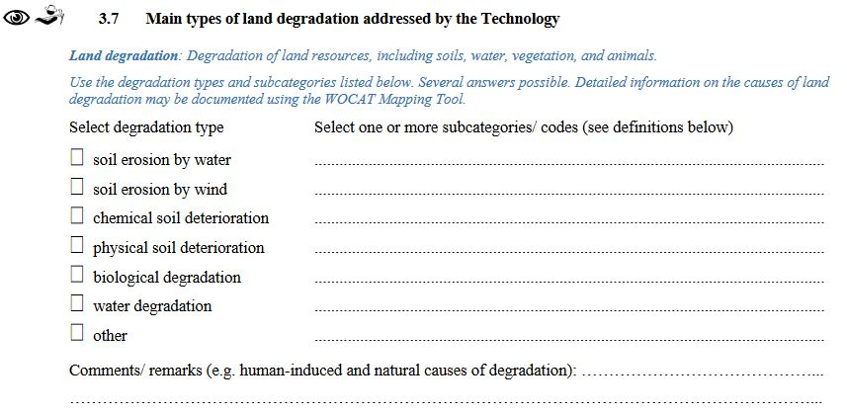
General principles: information not captured
Other (specify): Use “other” when your answer does not fit any of the given categories and specify why
Remarks/ comments: you can add extra information/ explanations under remarks
If you do not have enough space for answers, use the empty pages at the end of the questionnaire for additional information. Please always make proper reference to particular questions and page numbers!
Notes:
If information is not available or if certain questions are not applicable always indicate “n/a”.
Make use of the specify/remark/comments column or line as much as possible!
If you do not have enough space for answers, use the empty pages at the end of the
questionnaire. Please make a footnote in the questionnaire to indicate the exact
question number. Please also attach good technical drawings, photographs,
descriptions, references, etc.

Slide 17
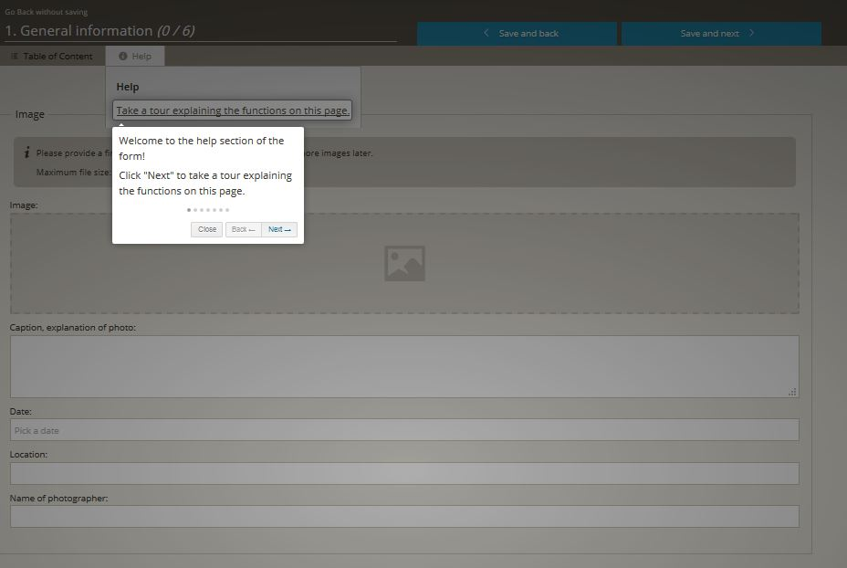
General principles: … Help

Slide 18
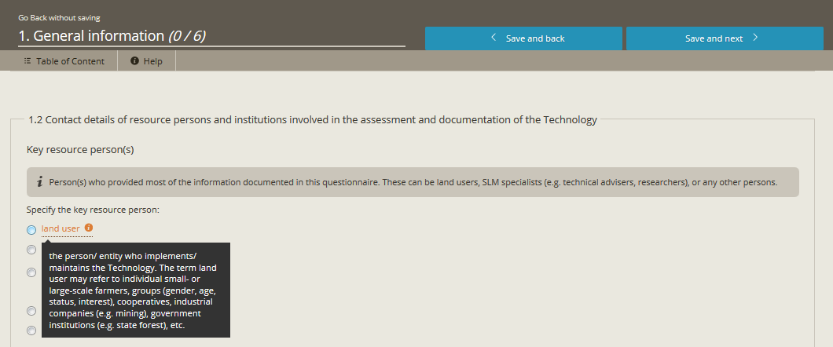
General principles: … Help

Slide 19
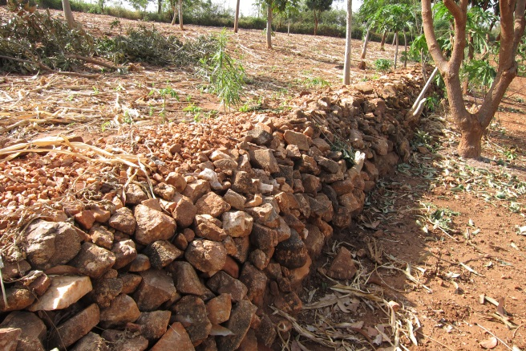
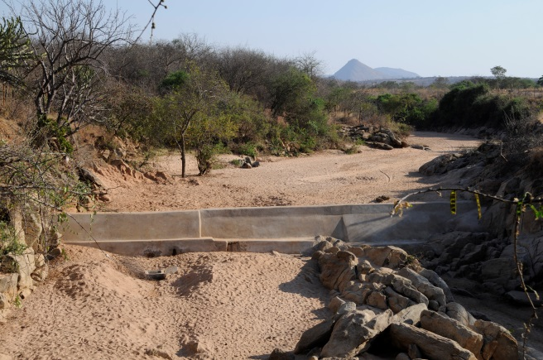
General principles: photos and illustrations
Good photos
photos showing overview/ details/ action of the Technology/ Approach
at least two digital files (JPG, PNG, GIF)
maximum file size: 3 MB.
high quality/ high resolution and not manipulated or distorted.
explanation (description) required for each photo submitted
should match the description given in 2.2, p. 8 of the Technology or the Approach.
Notes:
Good photos and drawings are essential
Good photos are crucial for understanding and illustrating the main feature
of the technology / approach.
Photos should be of high quality. Highest possible resolution is required for digital
photos (300 dpi)
Good drawings will

Slide 20
General Principles: photos and illustrations
Comprehensive & detailed drawings (technology)
Flow chart (approach)
Scan drawing and upload
Supported file types: PDF, JPG, PNG
maximum file size: 3 MB
Notes:
Good photos and drawings are essential
Good photos are crucial for understanding and illustrating the main feature
of the technology / approach.
Photos should be of high quality. Highest possible resolution is required for digital
photos (300 dpi)
Good drawings will

Slide 21
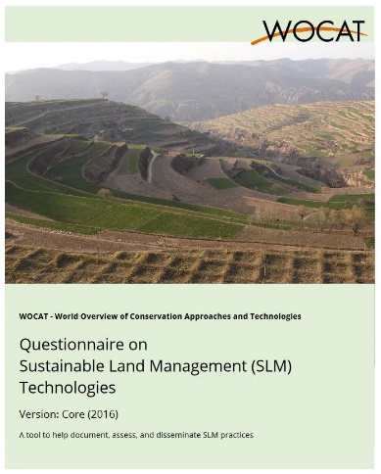
Good to know
Criteria for identification & delineation of a Technology
An SLM Technology should cover a homogeneous set of natural (bio-physical) and human (socio-economic) conditions, hence should not be applied to dissimilar e.g.:
climatic zones (humid, subhumid, semi-arid, arid)
land use types (cropland, grazing land, forest, etc.)
slope categories
or conditions of land tenure
…

Slide 22
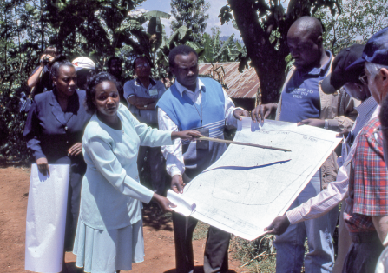
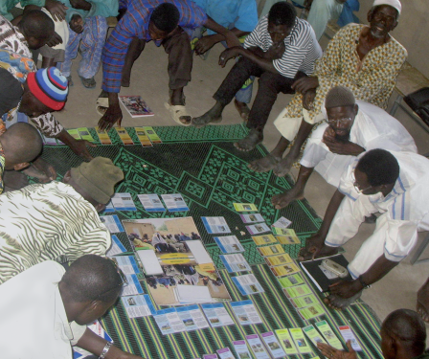
Good to know
Criteria for an Approach
QA addresses the questions of how implementation was achieved and who achieved it.
An SLM Approach consists of the following elements:
all participants (policy-makers, administrators, experts, technicians, land users, i.e. actors at all levels),
inputs and means (financial, material, legislative, etc.),
and know-how (technical, scientific, practical).
An SLM Approach includes different levels of intervention :
from the individual farm, through the community level, the extension / advisory system, the regional or national administration, or the policy level, to the international framework.
besides conservation activities introduced through projects and programs, indigenous conservation measures and spontaneous adoptions or adaptations of SLM Technologies are included.

Slide 23
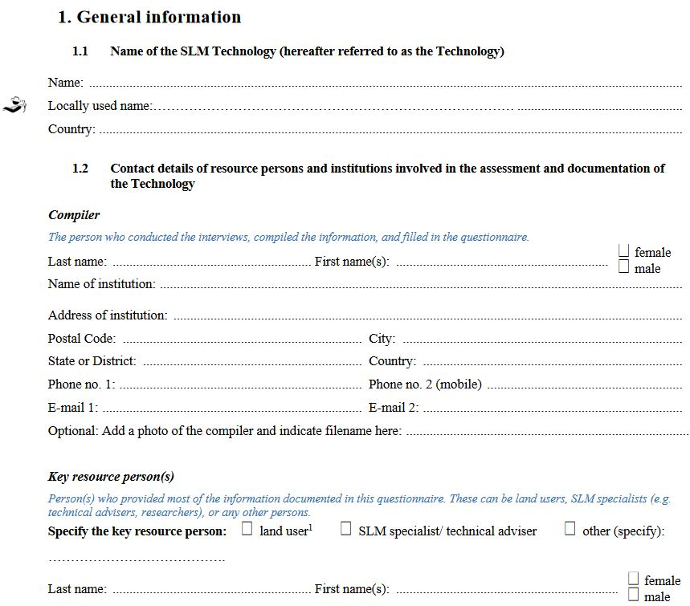
1. General information

Slide 26
2. Description of the SLM Technology

Slide 28
3. Classification of the SLM Technology
Notes:
Medidas MST – los componentes de una Tecnología
Las medidas MST se agrupan en cinco categorías: agronómica, vegetativa, estructural, de manejo y otras: las medidas son componentes de tecnologías. Cada Tecnología se compone de una, o frecuentemente es, una combinación de medidas: por ejemplo, las terrazas – una medida estructural típica – frecuentemente se combinan con otras medidas, tales como pasto en las elevaciones para estabilizar y forraje (medida vegetativa) o labranza de contornos (medida agronómica).

Slide 29
3. Classification of the SLM Technology

Slide 30
3. Classification of the SLM Technology
All in all 27 groups

Slide 31
3. Classification of the SLM Technology

Slide 32
3. Classification of the SLM Technology

Slide 34
3. Classification of the SLM Technology

Slide 35
4. Technical specifications, implementation activities, inputs and costs

Slide 36
4. Technical specifications, implementation activities, inputs and costs

Slide 37
4. Technical specifications, implementation activities, inputs and costs

Slide 38
5. Natural and human environment

Slide 40
6. Impacts and concluding statements

Slide 44
Module Climate Change Adaptation
– January 2017

Slide 45
6. Impacts and concluding statements

Slide 46
2. Description of the SLM Approach
G. Heim

Slide 47
3. Participation and roles of stakeholders involved

Slide 48
4. Technical support, capacity building and knowledge management

Slide 49
5. Financing and external material support

Slide 50
6. Impact analysis and concluding statements

Slide 51
Difficulties
T&A: summary description: sufficient level of detail
T&A: impacts
T: technical drawing
A: flow chart
T: Economics: costs / benefits
Good photos
Notes:
According to the WOCAT experience…

Slide 52
Quality assurance
1. (Auto-) Evaluation
2. External Review

Slide 53
1. (Auto-) Evaluation
Use questionnaire and entering of data into database as a (self-) evaluation tool
→ quality of results entirely depends on the quality of contributors (your) and land users’ answers
→ Serves to identify:
often fragmented knowledge
identify gaps and contradictions
question and evaluate current perceptions and field experiences
reflect own experiences
show potential for improvements

Slide 54
2. External Review
Identify a multidisciplinary review team (national, regional, external) to:
make an assessment of data
completeness,
comprehensiveness,
readability and
quality
counter-check the data
→ cyclical process

Slide 55
1
invite editors
2
send to reviewer
3
WOCAT Secretariat → final review

Slide 56
Possible problems (considerations for quality assurance)
insufficient use of common sense
insufficient critical questioning (over-reliance on assumptions)
preconceptions, biases and wishful thinking
poor understanding of degradation processes and impact of conservation
lack of impact assessments and monitoring
lack of holistic assessment and failure to understand the context
language and cultural barriers

Slide 57
Questions?

Slide 58
Let’s begin…
https://qcat.wocat.net/en/wocat/
Optimized for Chrome and Firefox
English, French, Spanish and others
Menu: Search; Add; My SLM practices; Login

Slide 59
Search
Attention: data from the old WOCAT database is currently being migrated!
UNCCD Prais data is also included in the database
Attention: the advanced filter is still incomplete!

Slide 60
Add
https://qcat.wocat.net/en/wocat/

Slide 61
Do the tour …

Slide 63
The review process is not optimized → you can not see changes of the editors or reviewers…

Slide 64
My SLM data

Slide 65
Questions?

