Slide 1

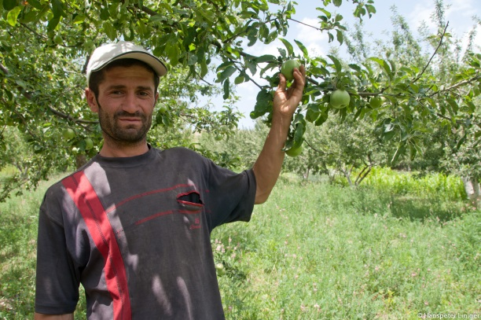
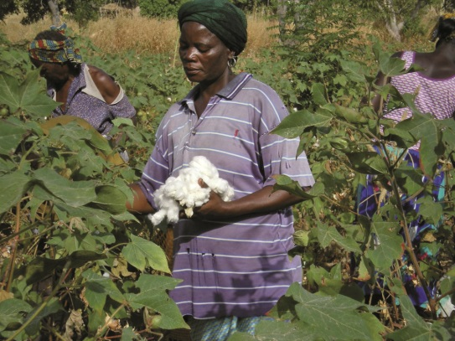
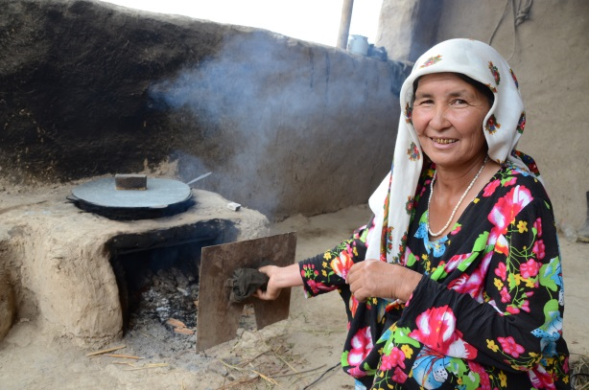
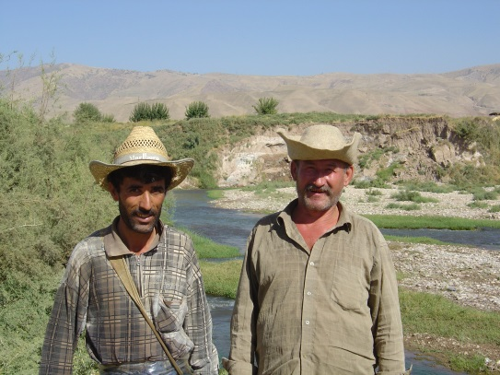
WOCAT Mapping methodology
Introduction
WOCAT Secretariat, Centre for Development and Environment,
University of Bern

Slide 2
Background
Overview of where land degradation takes place at what intensity and how land users are addressing this problem through Sustainable Land Management (SLM)
Land Degradation Assessment in Drylands (LADA), WOCAT and DESIRE projects have streamlined methods to map and document Land degradation (LD) and land improvement
QM Ultimate goal: to obtain a picture of the distribution and characteristics of LD and SLM activities at a given scale.

Slide 3
WOCAT questionnaires
Framework for
documentation, evaluation, dissemination of good SLM practices
SLM Technologies
&
SLM Approaches
Local / field level
(Case studies)
Degradation
&
Conservation Map
Local, national, global scale independent
(overview)

Slide 4
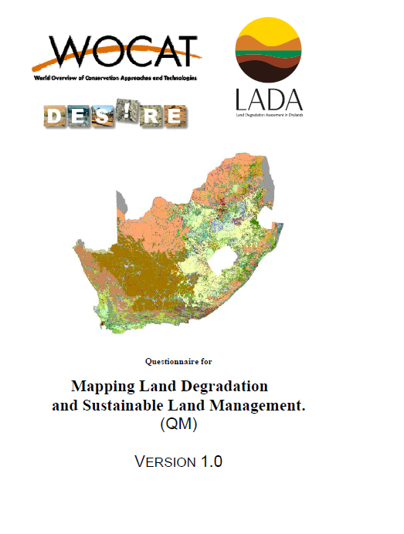
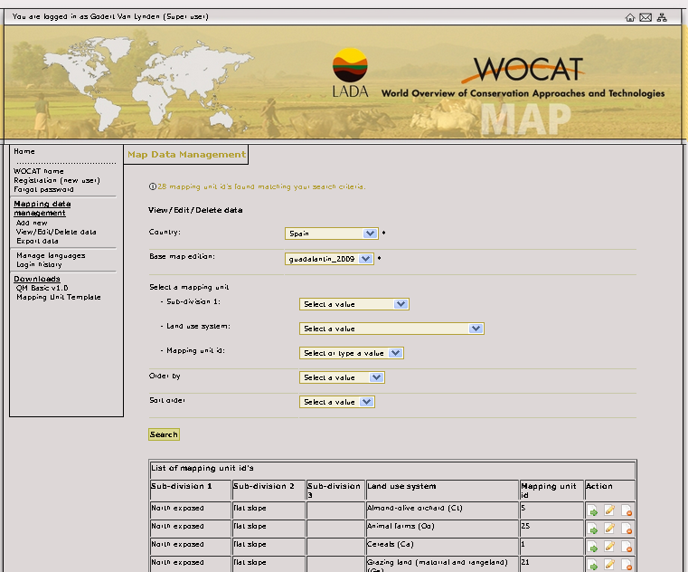
Mapping questionnaire & database
Notes:
LADA

Slide 5
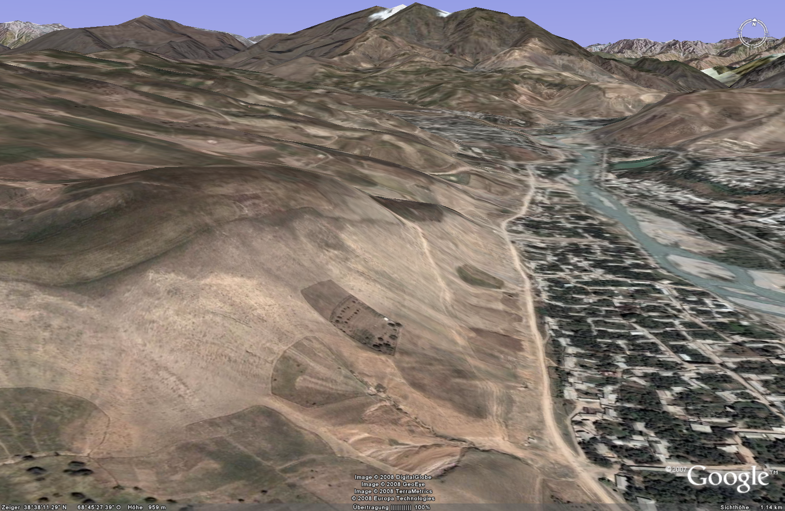
Why mapping?
Starting degradation with strong degradation trend?
SLM applied
Worst degradation?
What is the impact?
Graph: H.P. Liniger

Slide 6
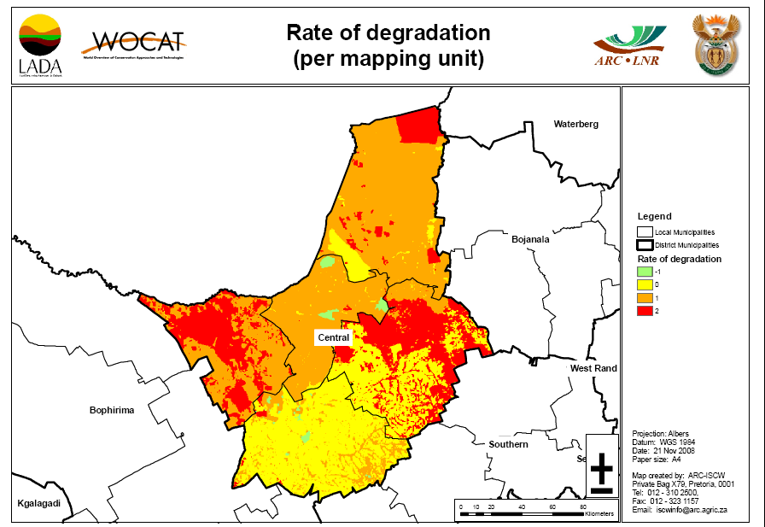


Mapping: Land Degradation/Conservation & impacts
Degradation
Few maps about land degradation
No maps about SLM!
…and LD/SLM impacts!?
→ Where to invest?
Hot spots
Bright spots
SLM

Slide 7
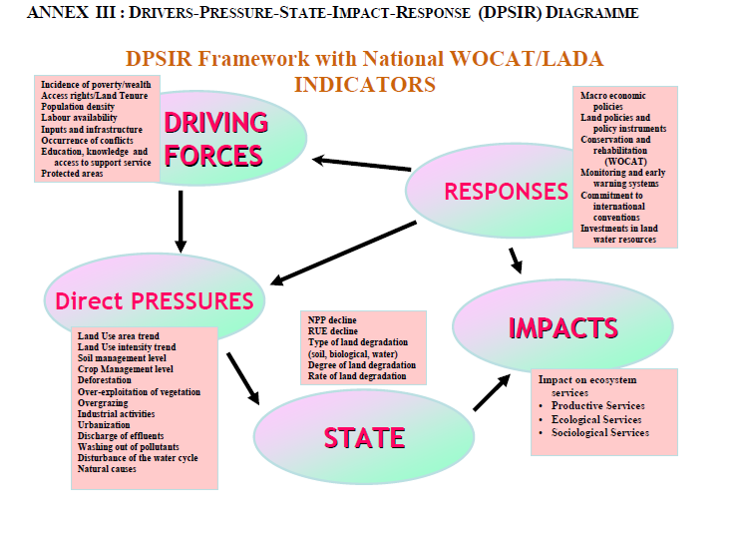
Framework

Slide 8
Land degradation
Not only soil erosion
Types:
  Soil erosion by water
  Soil erosion by wind
  Water degradation
  Physical soil deterioration
  Biological degradation
  Chemical degradation….

Slide 9
Examples
The QM does not provide a single output
It depends on the needs and goals of the government/organisations. E.g.
  Maps showing hot spots of degradation and green/bright spots where good land management is taking place
  Maps for the most prominent LD types
  Maps showing conservation

Slide 10
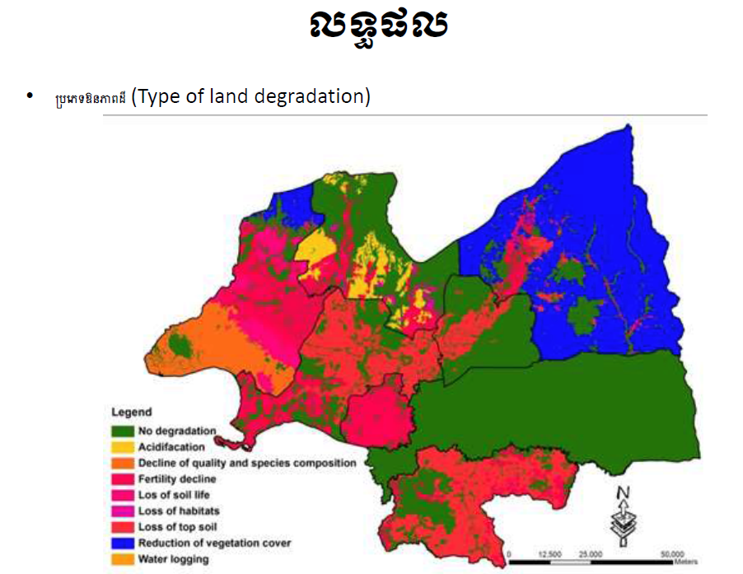
Cambodia. UNCCD reporting
Land degradation types in Kampong Thom (Source: Dr. Koy Ra)

Slide 11
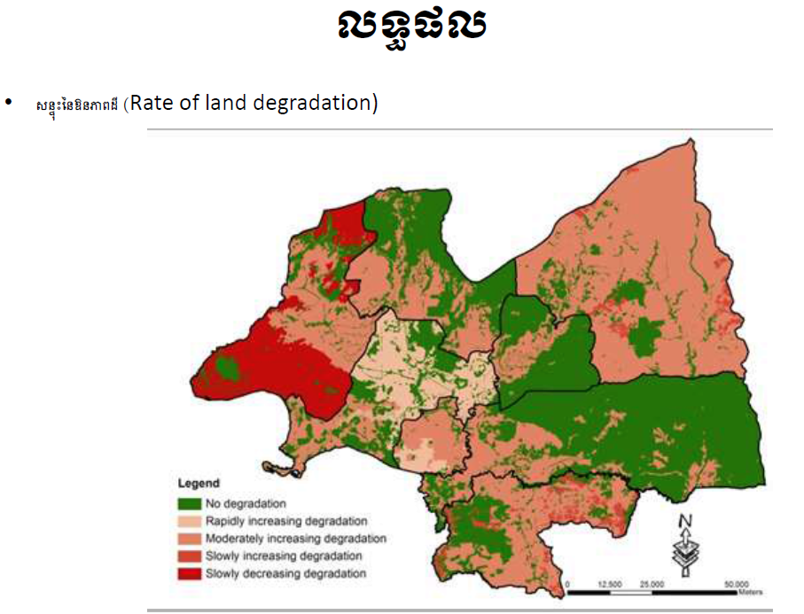

Slide 12
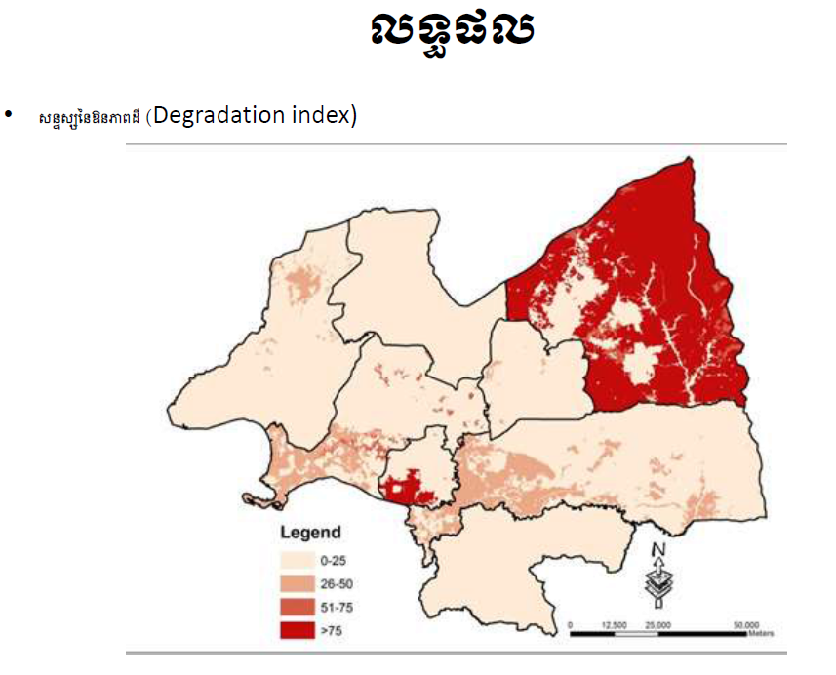

Slide 13
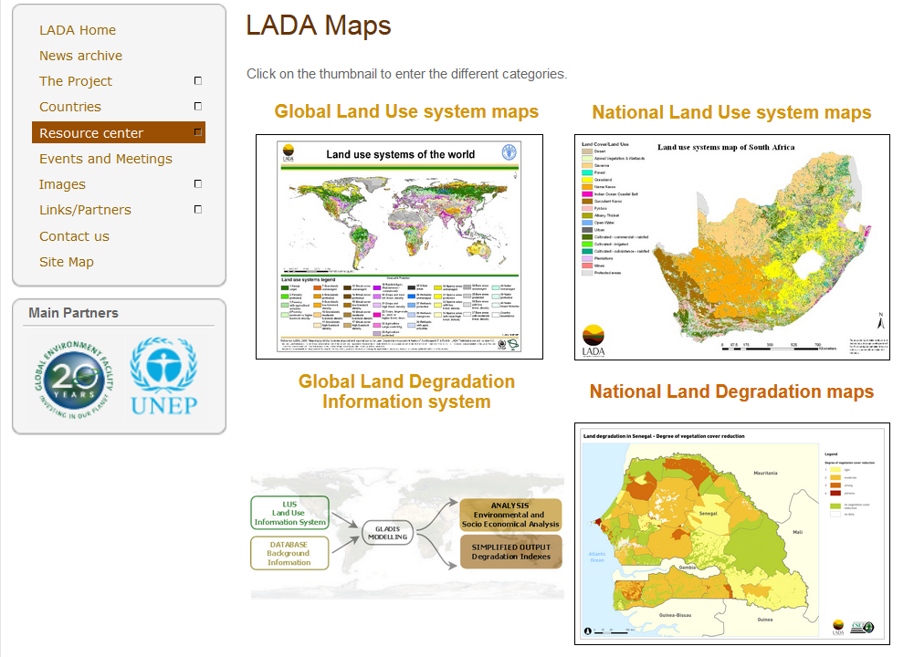
LADA website

Slide 14
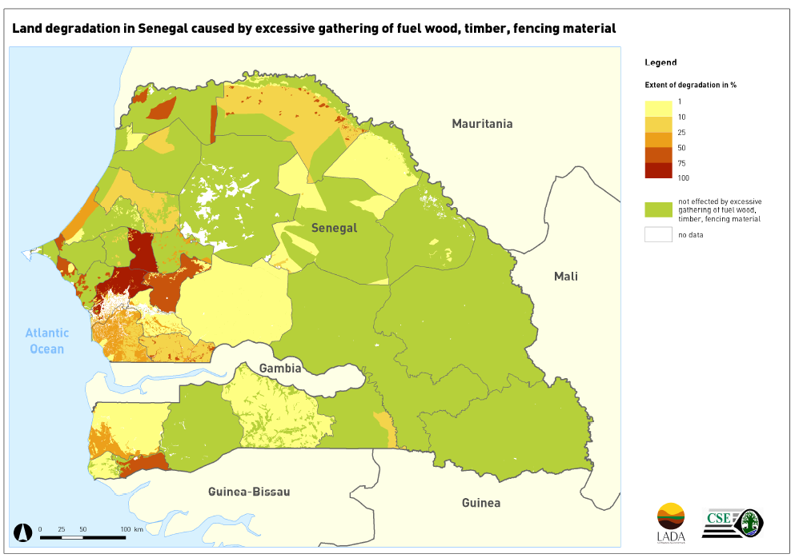
Land degradation in Senegal

Slide 15
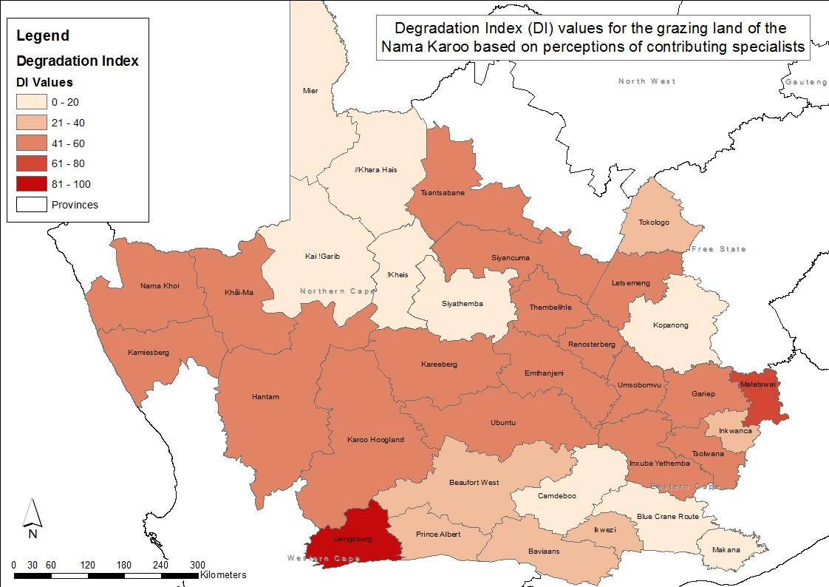
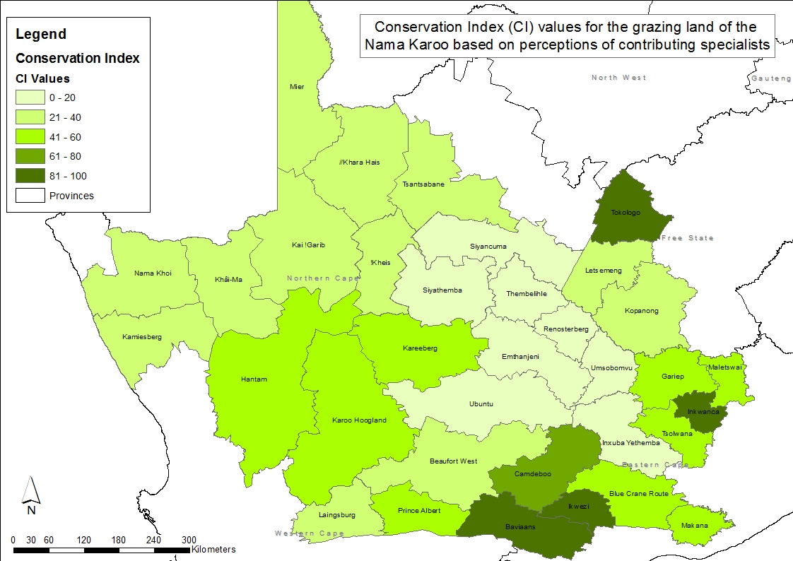
Where are the hotspots or priority areas for intervention?
High DI values
Low CI values
L. Lindeque

Slide 16


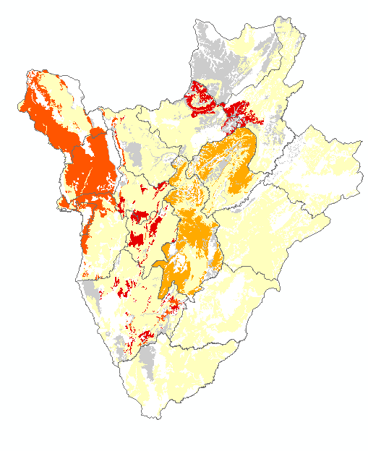
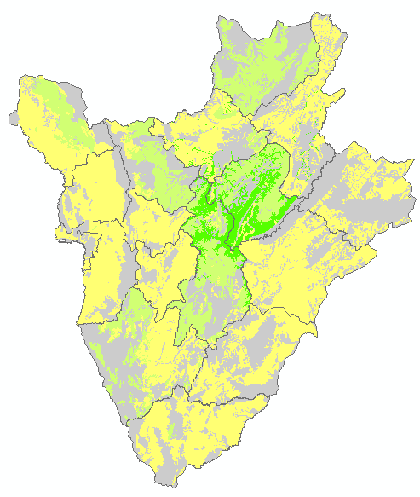


Comparison Degradation vs conservation
Burundi – chemical degradation
Effectiveness of
existing SLM
Land
degradation severity
SLM have low effectiveness and
are not present in certain severely
degraded areas
Weighted (Extent * degree * rate[normalized])
M. Petri

Slide 17
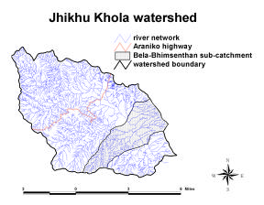
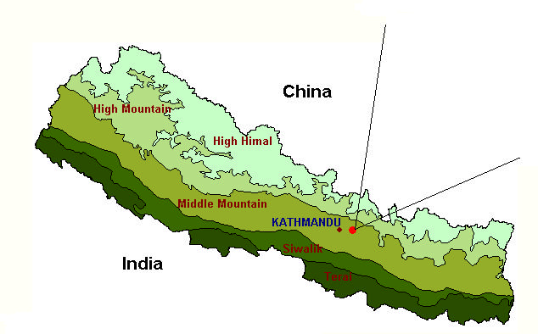
Jhikhu Khola watershed
Nicole Güdel, PARDYP-ICIMOD, 2004

Slide 18
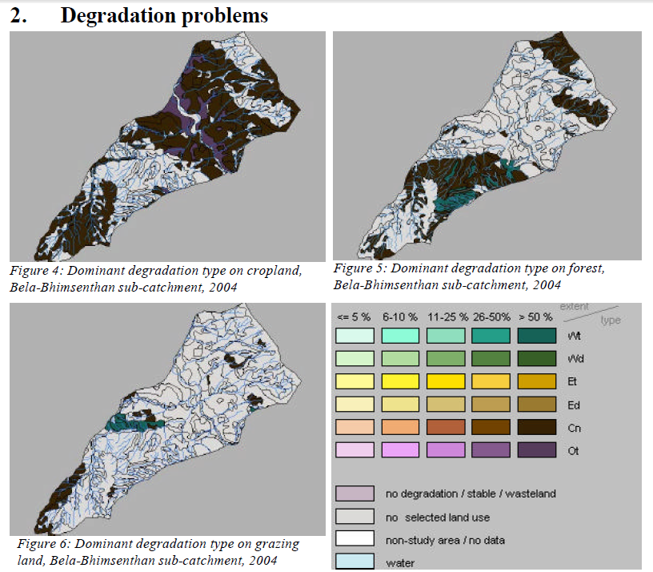

Slide 19
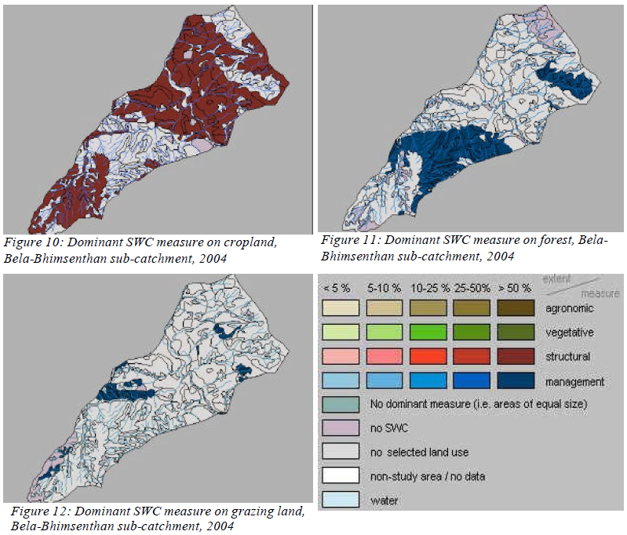
Sustainable Land Management

Slide 20
Harpan watershed, Nepal

Slide 21
Biological degradation

