Slide 1
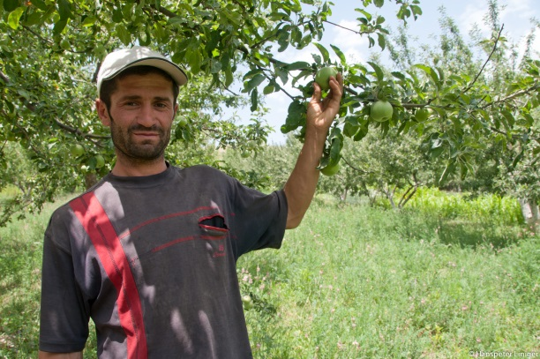
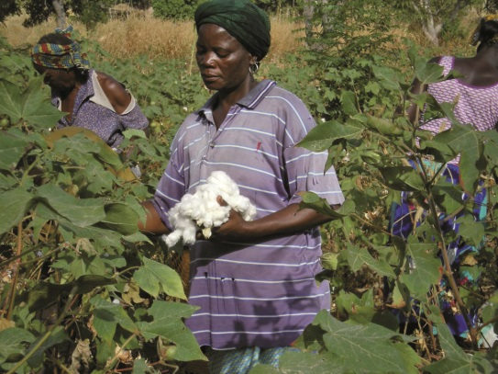
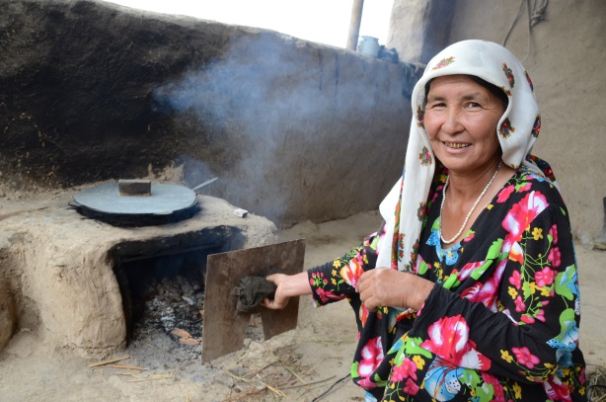
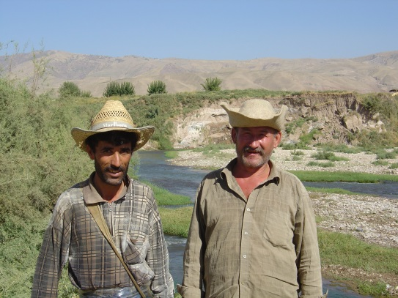
QM in 5 steps
Questionnaire on Mapping Land Degradation and Sustainable Land Management (QM)
WOCAT Secretariat, Centre for Development and Environment, University of Bern

Slide 2
5 Steps
Preparation of the base map
Step 1: Contributing specialists
Step 2: Land Use System (FAO)
Step 3: Land degradation
Step 4: Sustainable Land Management
Step 5: Expert recommendation

Slide 3
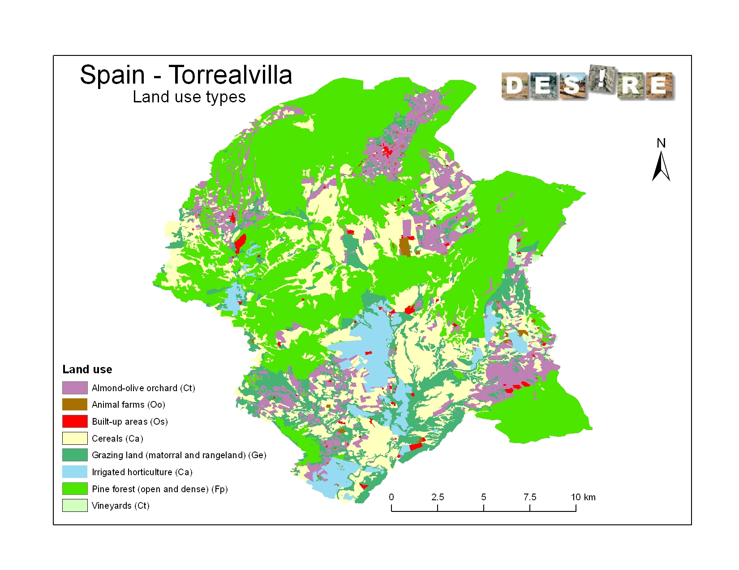
Preparation: Land use as base map

Slide 4
Preparation: Base map with mapping units
Mapping unit: each land use system within an administrative unit
Where no LUS map is available or not at the appropriate scale for a study site, any other land use/land cover map can be used as a base map.
The smaller is the administrative unit, the more detailed the map will be.
Notes:
Land use /land cover

Slide 5
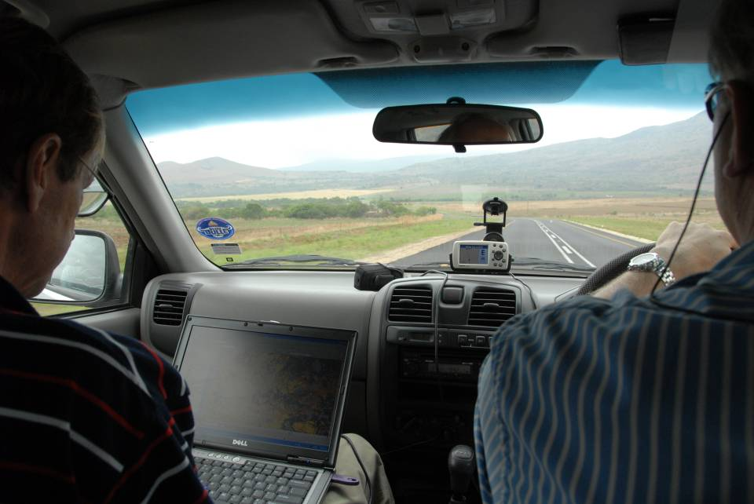
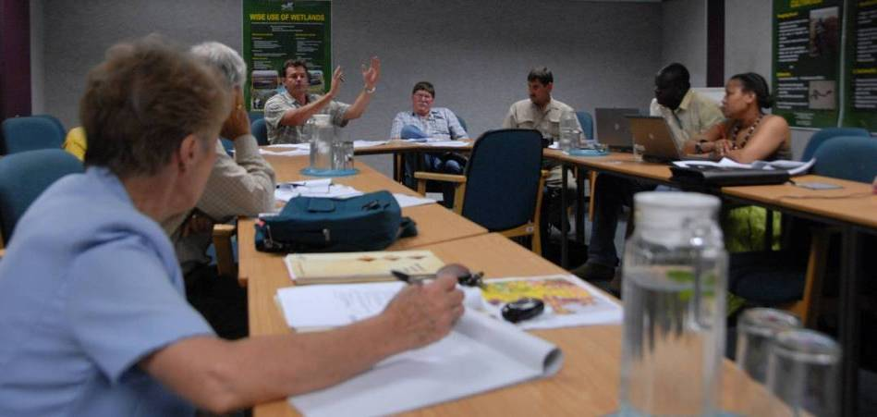
Step 1: Contributing specialists
Team of specialists (related to land degradation, land management, land use and soil and water conservation in the country.)
Participatory expert assessment (supported by documents)
Photos: H.P. Liniger

Slide 6
Step 2: Land Use System (FAO)
Estimation of the increase or decrease in area over the past 10 years
Estimation of the increase or decrease of the intensity of each LUS
Land Use System (LUS)
Type
Area trend
Intensity trend
Area trend 2 = area coverage is rapidly increasing in size; i.e. > 10% of the LUS area/10 years
Intensity trend 1 = Moderate increase

Slide 7
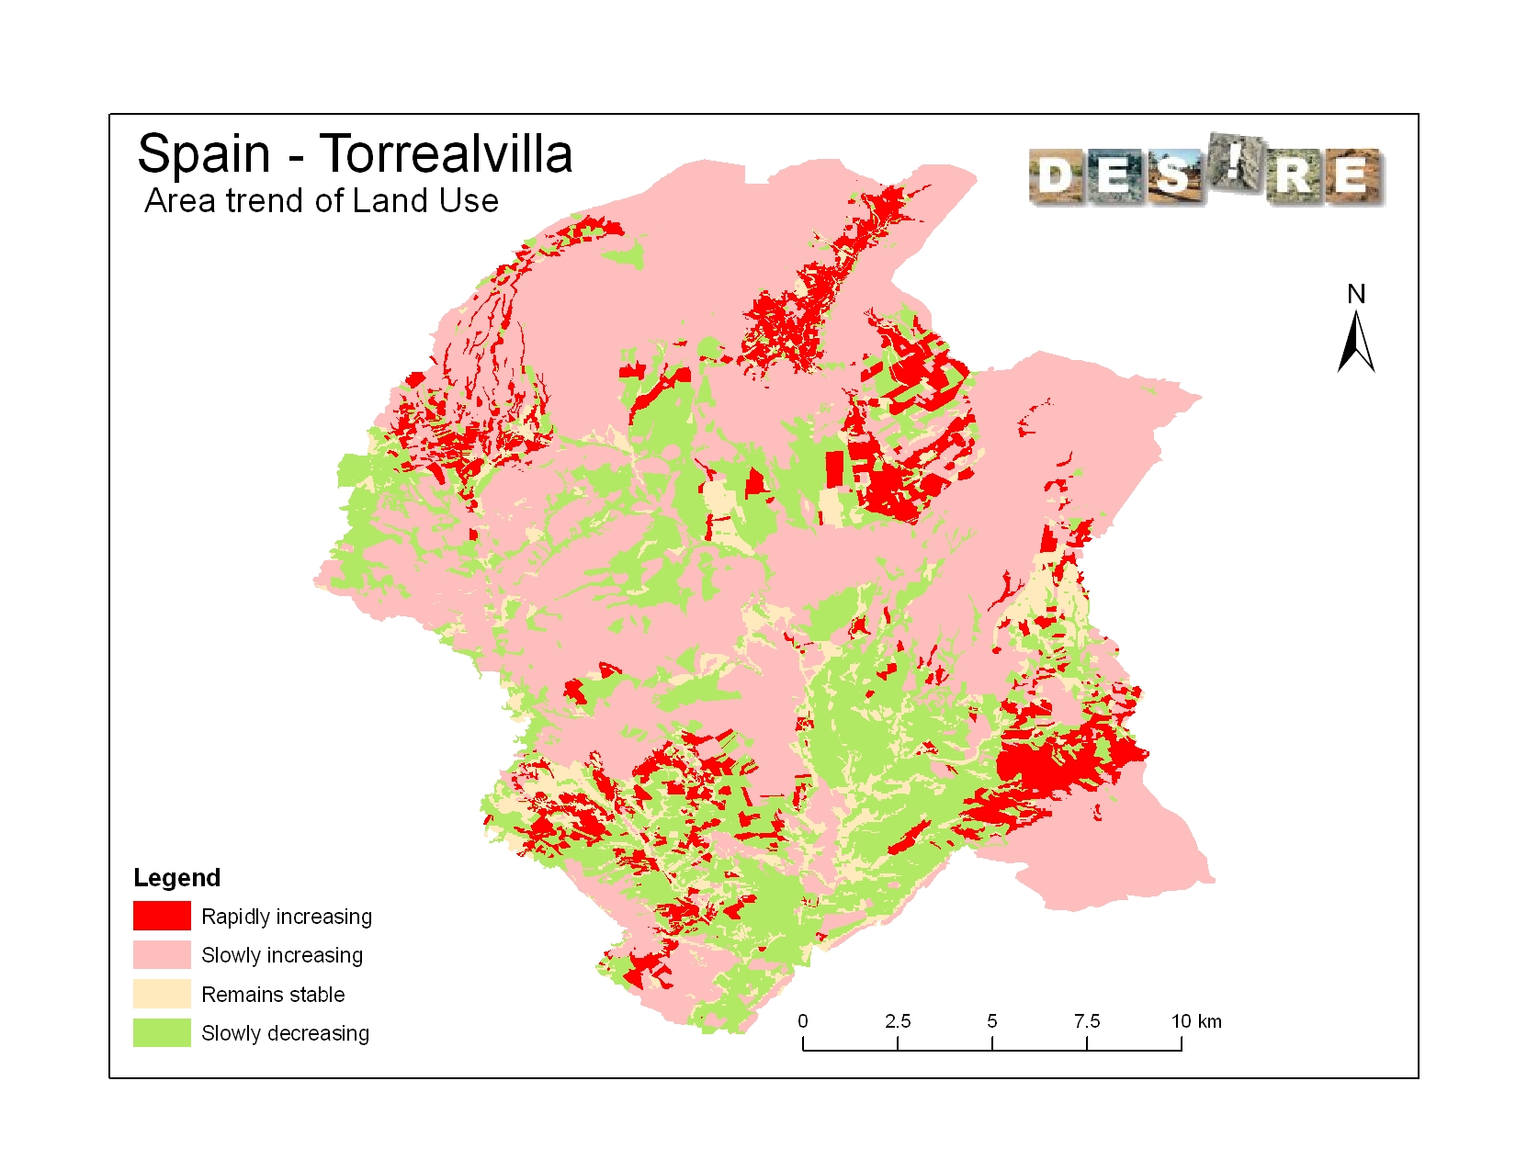
3
Area trend

Slide 8
Step 3: Land degradation
Determine the major types of land degradation presently occurring under each land use system
Degradation per LUS
Type
Extent (area)
Degree
Rate
(Impact on ecosystem services (type and level))
Direct causes
Indirect causes
Recommendation

Slide 9
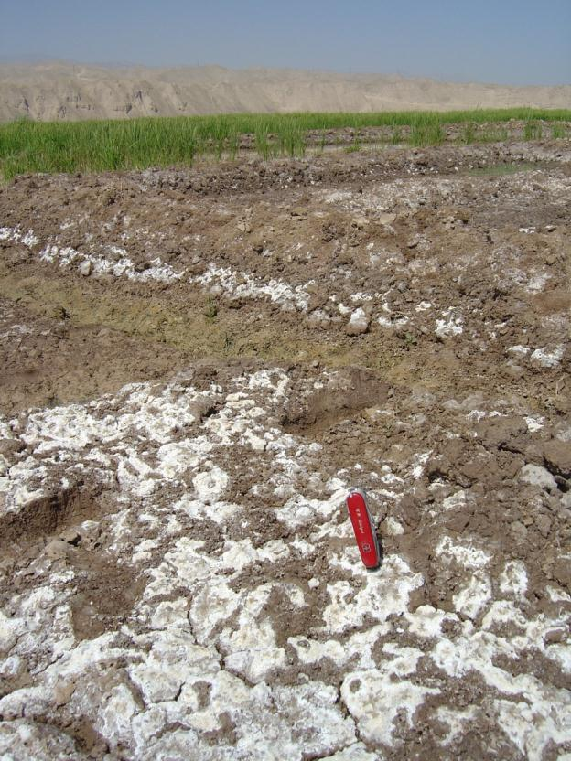
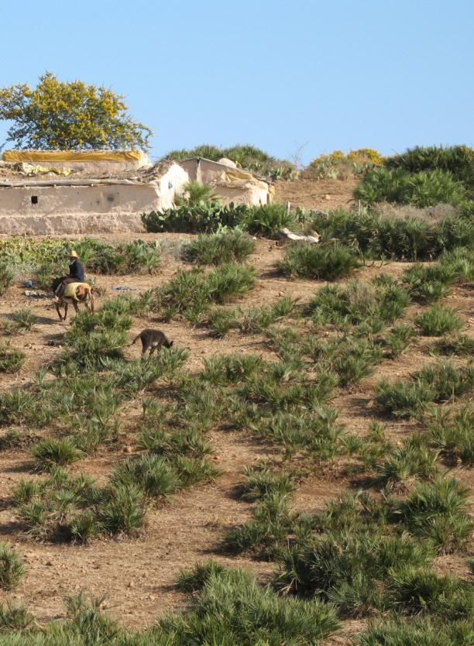
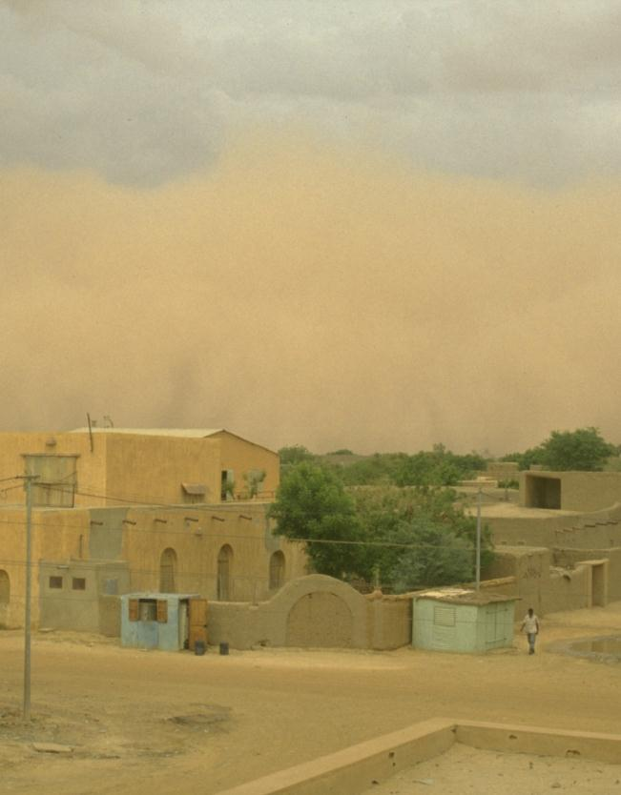
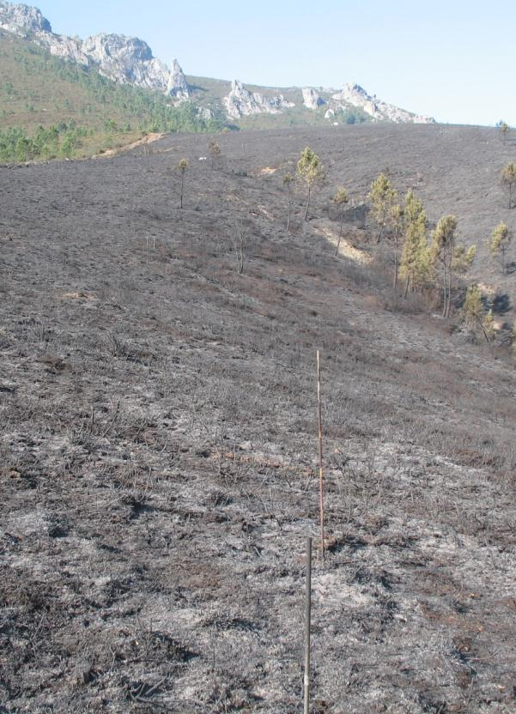
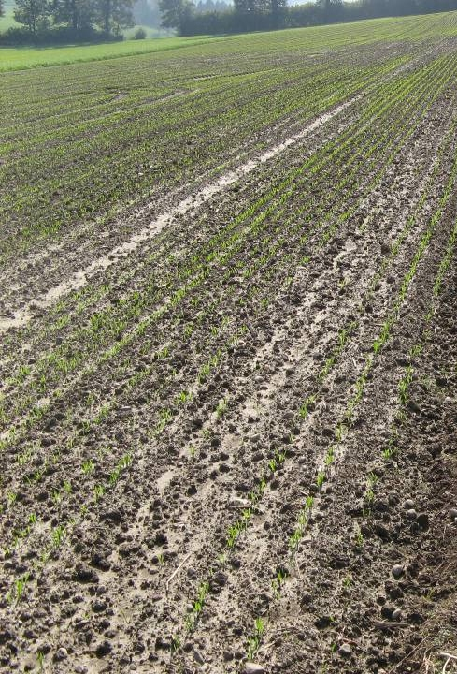
Land degradation types
Salinization
Soil erosion by wind
Vegetation degradation
: Detrimental effects of fires
Soil compaction
HP. Liniger
G. Schwilch
G. Schwilch
G. Schwilch
HP. Liniger
Notes:
Besides water erosion we find numerous other types of soil degradation. To name just a few: salinization, wind erosion, degradation of vegetation cover, forest fires, soil compaction, etc.

Slide 10
Land Degradation types (1) (WOCAT 2008)
W: Soil erosion by water
E: Soil erosion by wind
C: Chemical soil deterioration
P: Physical soil deterioration
B: Biological degradation
H: Water degradation

Slide 11
Land Degradation types (1) (WOCAT 2008)
W: Soil erosion by water
Wt loss of topsoil (surface erosion)
Wg gullying (gully erosion)
Wm mass movements
Wr riverbank erosion
Wc coastal erosion
Wo offsite degradation
E: Soil erosion by wind
Et loss of topsoil
Ed deflation and deposition
Eo offsite effects
C: Chemical soil deterioration
Cn fertility decline and reduced organic matter content
Ca acidification
Cp soil pollution
Cs salinisation/alkalinisation
P: Physical soil deterioration
Pc compaction
Pk sealing and crusting
Pw waterlogging
Ps subsidence of organic soils, settling of soil
Pu loss of bio-productive function due to other activities (eg construction, mining)

Slide 12
Land Degradation types (1) (WOCAT 2008)
B: Biological degradation
Bc reduction of vegetation cover
Bh loss of habitats
Bq quantity / biomass decline
Bf detrimental effects of fires
Bs quality and species composition / diversity decline
Bl loss of soil life
Bp Increase of pest / diseases, loss of predators
H: Water degradation
Ha aridification / soil moisture problem
Hs change in quantity of surface water
Hg change in groundwater / aquifer level
Hp decline of surface water quality
Hq decline of groundwater quality
Hw reduction of the buffering capacity of wetland areas
Notes:
Früher nur Vegetation aber mehr
Wasser: mussten wir in WOCAT kategorisieren und definieren (momentaner Stand!)

Slide 13
Degradation “Degree”
Degree: intensity of the land degradation process
1 Light: there are some indications of degradation, but the process is still in an initial phase. It can be easily stopped and damage repaired with minor efforts.
Moderate: degradation is apparent, but its control and full rehabilitation of the land is still possible with considerable efforts.
Strong: evident signs of degradation. Changes in land properties are significant and very difficult to restore within reasonable time limits.
Extreme: degradation beyond restoration.

Slide 14
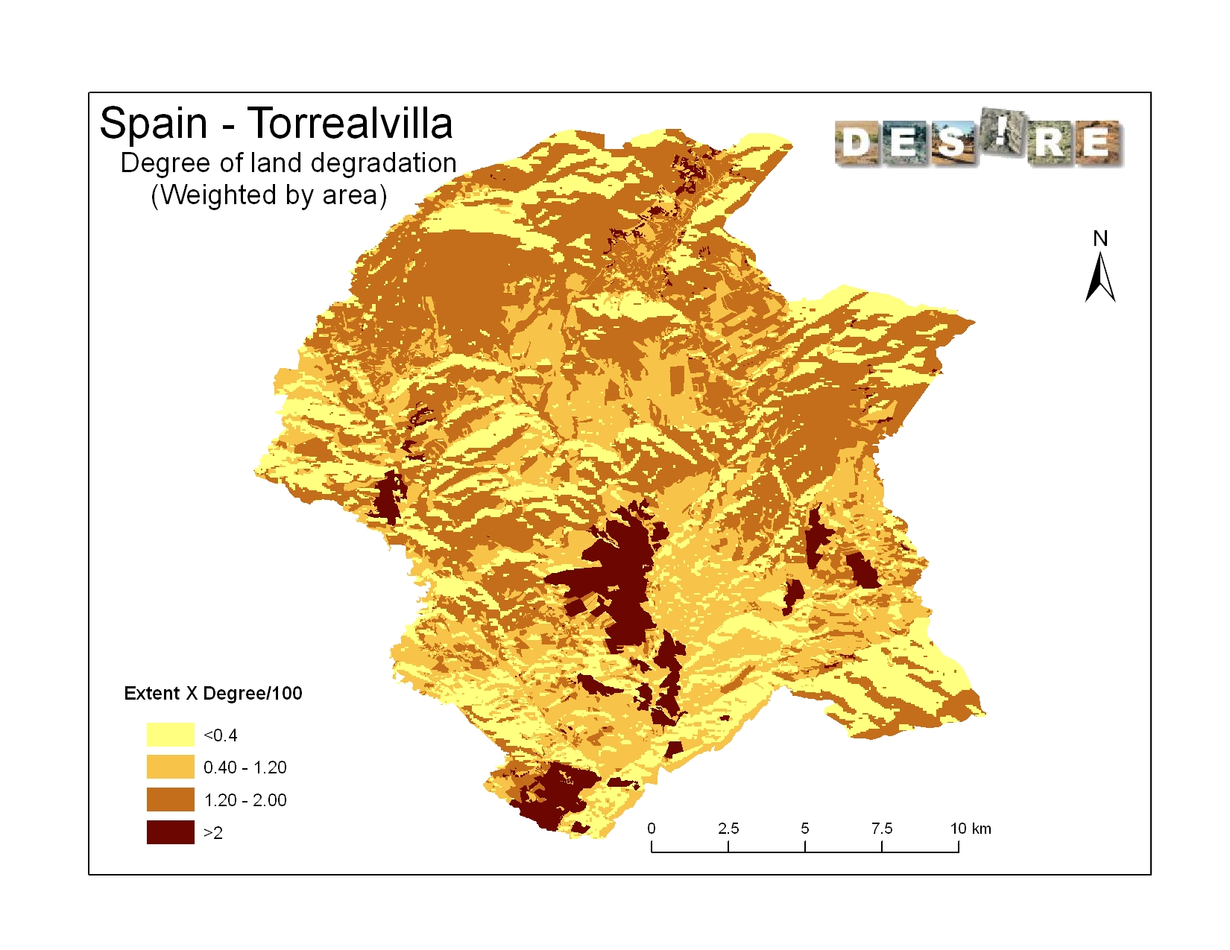
3

Slide 15
Degradation “Rate”
Rate: indicate the trend of degradation over a recent period of time
3: rapidly increasing degradation
2: moderately increasing degradation
1: slowly increasing degradation
0: no change in degradation
-1: slowly decreasing degradation
-2: moderately decreasing degradation
-3: rapidly decreasing degradation

Slide 16
Direct causes of land degradation
s: Soil management: improper / cultivation of unsuitable soils …
a: Crop and rangeland management: improper …
f: Deforestation and removal of natural vegetation
e: Over-exploitation of vegetation for domestic use
g: Overgrazing
i: Industrial activities and mining
u: Urbanisation and infrastructure development
p: Discharges leading to point contamination of surface and ground water resources
q: Causes leading to non-point contamination of surface and ground water resources
w: Disturbance of the water cycle
o: Over abstraction of water
n: Natural causes

Slide 17
Indirect causes of land degradation
p: Population density
t: Land tenure
h: Poverty / wealth
l: Labour availability
r: Inputs and infrastructure
e: Education, access to knowledge and support services
w: War and conflict
g: Governance / institutional
o: Others (specify)

Slide 18
Impact on Ecosystem Services & Indicators
P Productive Services & indicators
(P1) production (of animal / plant quantity and quality including biomass for energy) and risk
(P2) water (quantity and quality ) for human, animal and plant consumption
(P3) land availability
E Ecological services (regulating / supporting) & indicators
(E1) water cycle: floods, storms, excessive rains
(E2) water cycle: drought, dry season flow, availability of water
(E3) organic matter status
(E4) soil cover (vegetation, mulch, etc.)
(E5) soil structure: surface (eg sealing and crusting) and subsoil affecting infiltration, water and nutrient holding capacity, salinity etc.
(E6) nutrient cycle (N, P, K) and the carbon cycle (C)
(E7) soil formation (including wind-deposited soils)
(E8) biodiversity
(E9) greenhouse gas emission
(E10) (micro)-climate (wind, shade, temperature, humidity)
S Socio-cultural services and human well-being & indicators
(S1) spiritual, aesthetic, cultural landscape and heritage values, recreation and tourism,
(S2) education and knowledge (including indigenous knowledge)
(S3) conflicts
(S4) food security, health and poverty
(S5) net income
(S6) private and public infrastructure (buildings, roads, dams, etc.)
(WOCAT 2008)
Notes:
Wasser: mussten wir in WOCAT kategorisieren und definieren (momentaner Stand!)

Slide 19
“Level of impact” (on Ecosystem Services)
-3 high negative influence: land degradation contributes negatively (more than 50%) to changes in ES
-2 negative influence: land degradation contributes negatively (10-50%) to changes in ES
-1 low negative influence: land degradation contributes negatively (0-10-%) to changes in ES.
0 no impact, i.e. no or negligible change ecosystem service
+1 low positive influence: land degradation contributes positively (0-10%) to the changes in ES
+2 positive influence: land degradation contributes positively (10-50%) to the changes in ES
+3 high positive influence: land degradation contributes positively (more than 50%) to changes in ES.

Slide 20
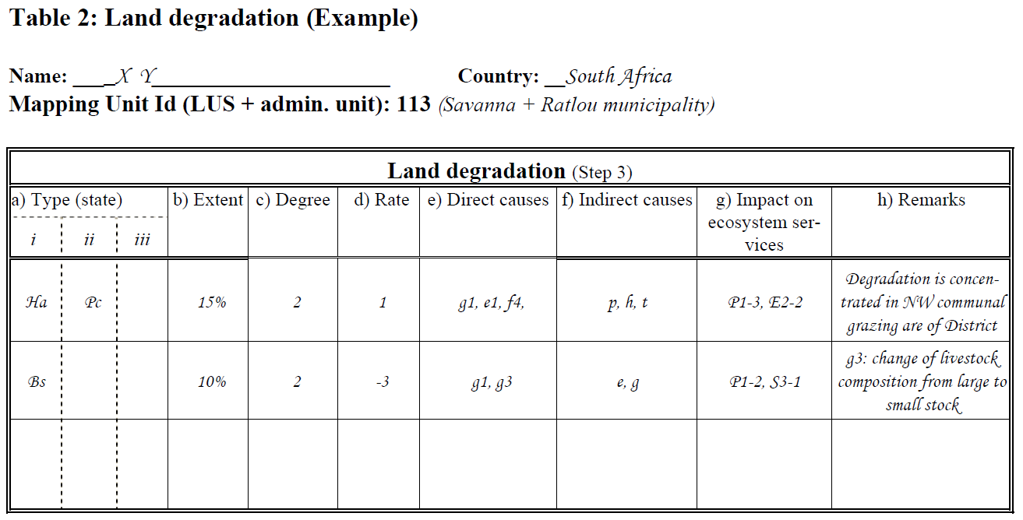
Data entry table

Slide 21
Step 4: Sustainable Land Management
Give the name of the most widespread technologies for each mapping unit
Conservation/SLM per LUS
Name / Group / Measure
Extent (area)
Effectiveness
Effectiveness trend
Impact on ecosystem services (type and level)
Degradation addressed

Slide 22
Conservation Groups
CA: Conservation agriculture / mulching
NM: Manuring / composting / nutrient management
RO: Rotational system / shifting cultivation / fallow /slash and burn
VS: Vegetative strips / cover
AF: Agroforestry
AP: Afforestation and forest protection
RH: Gully control / rehabilitation
TR: Terraces
GR: Grazing land management
WH: Water harvesting
SA: Groundwater / salinity regulation / water use efficiency
WQ: Water quality improvements
SD: Sand dune stabilization
CB: Coastal bank protection
PR: Protection against natural hazards
SC: Storm water control, road runoff
OT: Other: (specify)

Slide 23
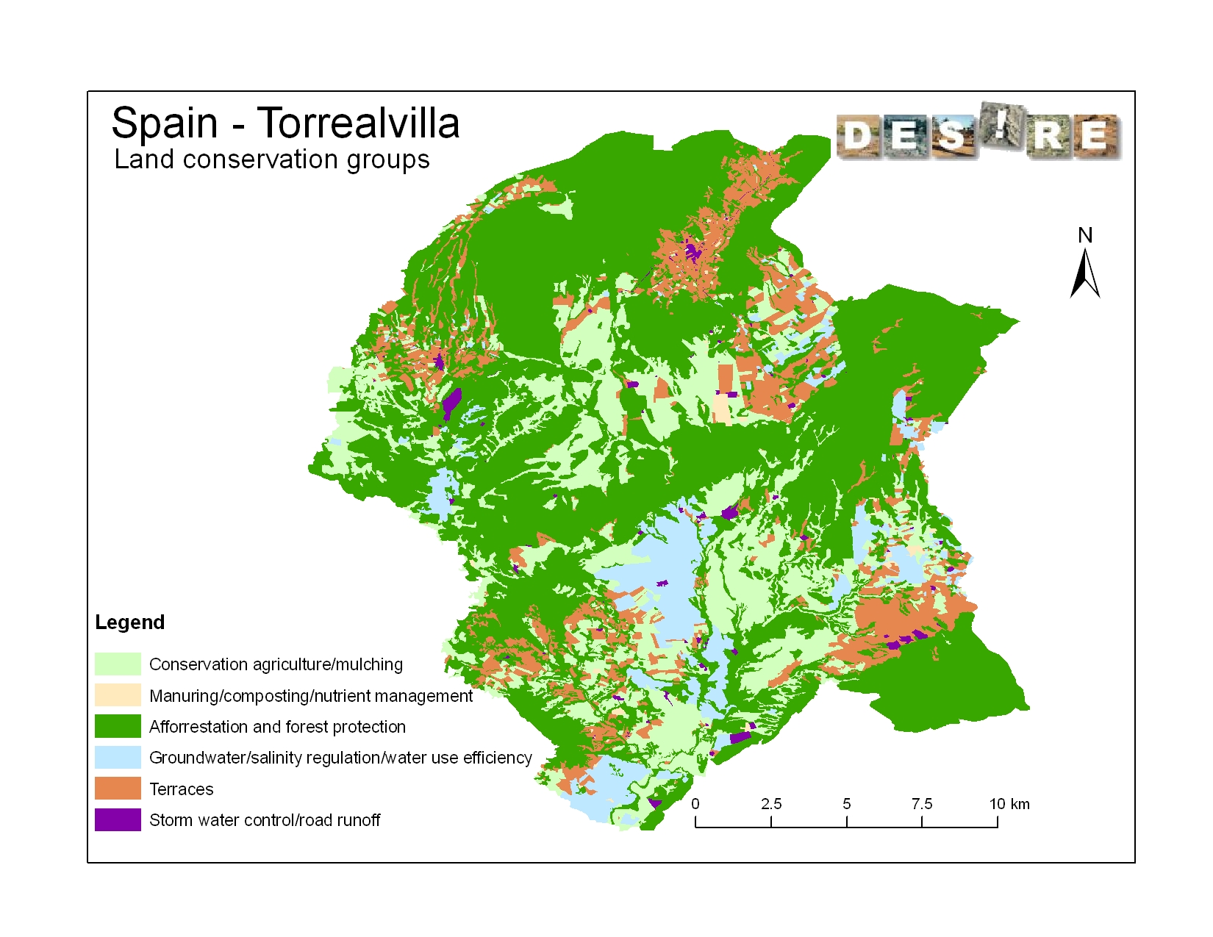
3

Slide 24
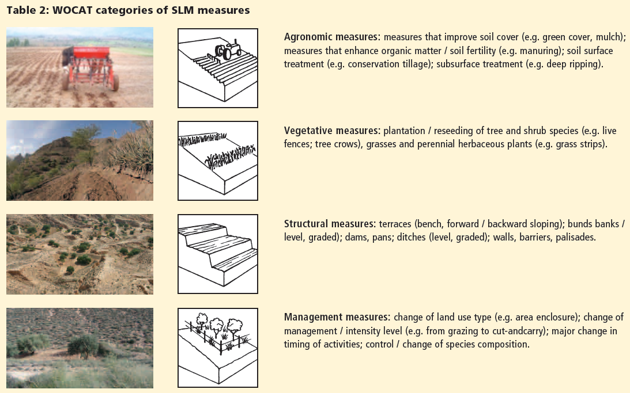
WOCAT categories of SLM measures

Slide 25
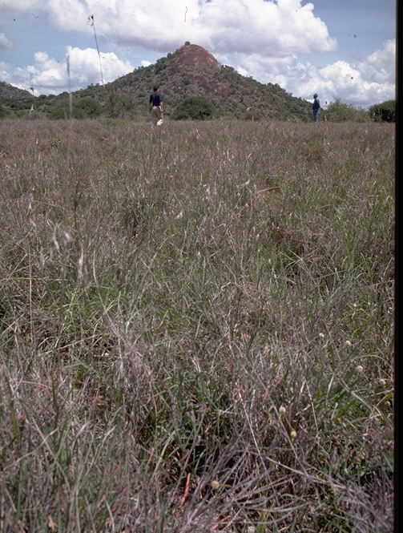
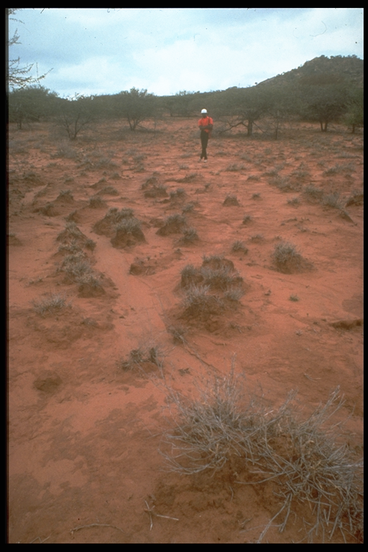
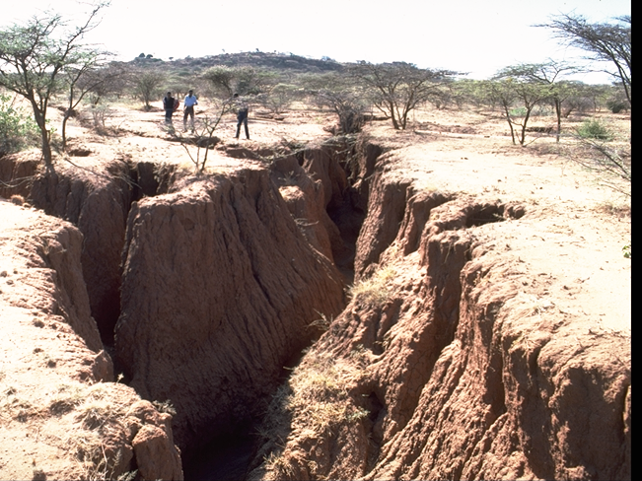
Purpose
The challenge: Stage of SLM intervention
Prevention
Mitigation / „Cure“
Rehabilitation / Restoration
Fotos: H.P. Liniger

Slide 26
Effectiveness of implemented SLM technologies
Effectiveness: how much it reduces the degree of degradation or how well it is preventing degradation
4: Very high: the measures not only control the land degradation problems appropriately, but even improve the situation compared to the situation before degradation occurred.
3: High: the measures control the land degradation problems appropriately. The measures are able to stop further deterioration, but improvements are slow.
2: Moderate: the measures are acceptable for the given situations. However, the measures only slow down the degradation process, but are not sufficient.
1: Low: the measures need local adaptation and improvement in order to reduce land degradation to acceptable limits.

Slide 27
Effectiveness trend
1: increase in effectiveness: the measures have a growing positive impact on the reduction of degradation
0: no change in effectiveness
-1: decrease in effectiveness: the measures have less and less effect in reducing degradation, e.g. due to lack of maintenance

Slide 28
Impact on Ecosystem Services & Indicators
P Productive Services & indicators
(P1) production (of animal / plant quantity and quality including biomass for energy) and risk
(P2) water (quantity and quality ) for human, animal and plant consumption
(P3) land availability
E Ecological services (regulating / supporting) & indicators
(E1) water cycle: floods, storms, excessive rains
(E2) water cycle: drought, dry season flow, availability of water
(E3) organic matter status
(E4) soil cover (vegetation, mulch, etc.)
(E5) soil structure: surface (eg sealing and crusting) and subsoil affecting infiltration, water and nutrient holding capacity, salinity etc.
(E6) nutrient cycle (N, P, K) and the carbon cycle (C)
(E7) soil formation (including wind-deposited soils)
(E8) biodiversity
(E9) greenhouse gas emission
(E10) (micro)-climate (wind, shade, temperature, humidity)
S Socio-cultural services and human well-being & indicators
(S1) spiritual, aesthetic, cultural landscape and heritage values, recreation and tourism,
(S2) education and knowledge (including indigenous knowledge)
(S3) conflicts
(S4) food security, health and poverty
(S5) net income
(S6) private and public infrastructure (buildings, roads, dams, etc.)
-3 : high negative impact
-2 : negative impact
-1 : low negative impact
1 : low positive impact
2 : positive impact
3 : high positive impact
(WOCAT 2008)
Notes:
Wasser: mussten wir in WOCAT kategorisieren und definieren (momentaner Stand!)

Slide 29
Implemented SLM technologies
Period of implementation: Indicate since what year the technology has been implemented
Reference to QT: If more detailed information is available in a the questionnaire of SLM Technologies (QT) please add their reference number.
Remarks

Slide 30
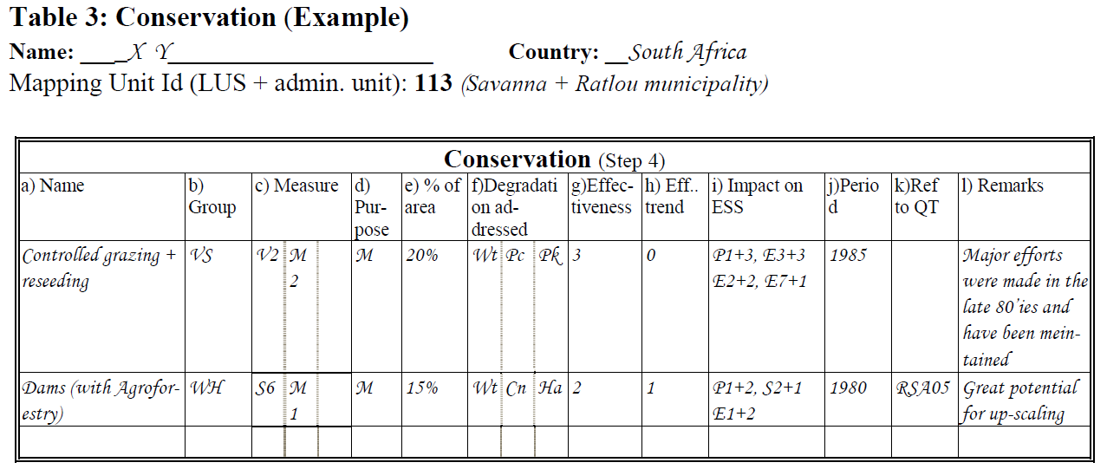
Data entry table

Slide 31
Step 5: Expert recommendation
Recommendation on best intervention
A Adaptation to the problem: the degradation is either too serious to deal with and is accepted as a fact of life, or it is not worthwhile the effort to invest in.
P Prevention implies the use of conservation measures that maintain natural resources and their environmental and productive function on land that may be prone to further degradation
M Mitigation: is intervention intended to reduce ongoing degradation.
R Rehabilitation: is intervention when the land is already degraded to such an extent that the original use is only possible with extreme efforts as land has become practically unproductive.

Slide 32
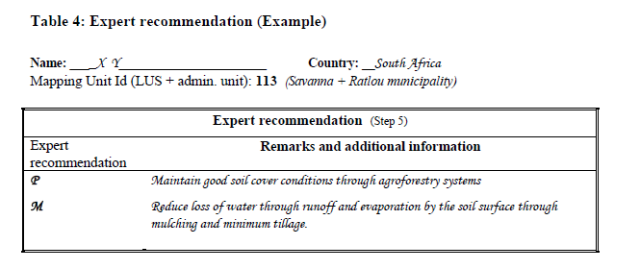
Step 5: Expert recommendation
Suggested interventions on how to address land degradation

