Slide 1
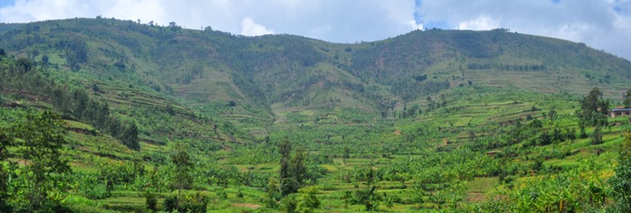
Decision Support for Mainstreaming and Scaling up of
Sustainable Land Management
Global Meeting
DS-SLM implementation focusing on mapping and assessment of SLM options
Country : Uzbekistan
Presentation made by:
Umid Abdullaev, National Project Coordinator
Gulchekhra Khasankhanova
Tatyana Khamzina
FAO, Rome, Italy
24 - 27 April 2018

Slide 2
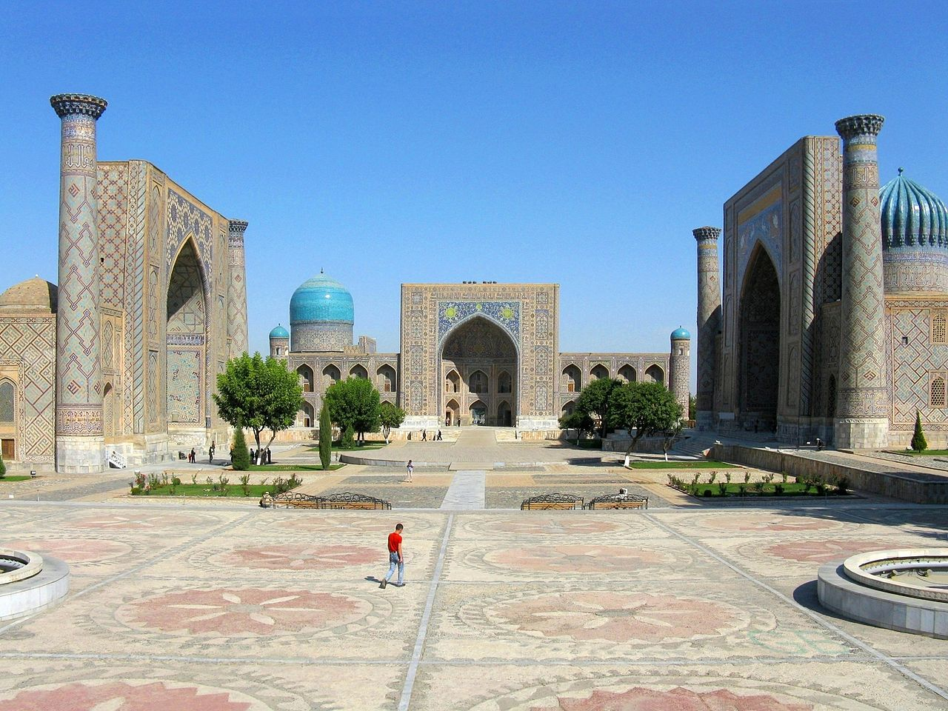
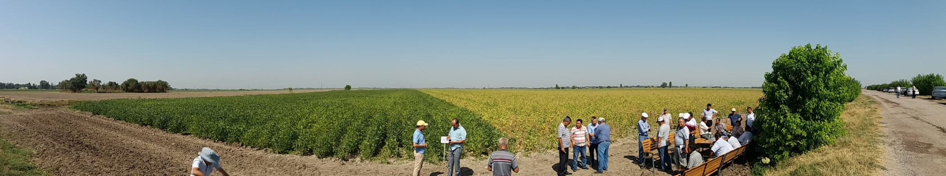
DS-SLM-Uzbekistan
Project Components:
National and local decision-support on combating DLDD and promoting mainstreaming and upscaling of SLM best practices
Global DLDD and SLM knowledge management and decision-support platform
Monitoring and evaluation and dissemination of project results.
Notes:
Objective: To assist the Government of Uzbekistan to increase the provision of ecosystem services and enhance food security in the project area affected by DLDD through the promotion of SLM, integrated management, and efficiency in the use of natural resources.
The project is completely in full accordance with key national priorities to ensure protection of the environment and natural resource use that were articulated in NAP UNCCD (1999), CACILM NPF on SLM (2006, 2009 and Welfare Improvement Strategy until 2015. The project is supports priorities of Strategy of Actions for 5 priority development directions for the period 2017-2021 approved by the President of the Republic of Uzbekistan (2 February, 2018) in line with the Target 3: Modernization and intensification of agricultural development and Concepcion on development of agricultural complex of Uzbekistan 2030.

Slide 3
DS-SLM-Uzbekistan
Institutional arrangements
Responsible institutions:
Ministry of Agriculture and Water Resources jointly with
National Steering Committee (NCC)
Inter-agency National Coordination Council (NCC) of the CACILM UNCCD
Design and Research UZGIP Institute
National lead agency (NLA):
Uzhydromet and NFP of the UNССD

Slide 4
DS-SLM-Uzbekistan
Partners and Partnerships
Level | Institution
National | Soil and Agrochemistry Institute, Tashkent, Uzbekistan NIGMI, Uzhydromet Research Institute of Karakul Sheep Breeding and Desert Ecology (Samarkand), Uzbekistan
Local | Agricultural Departments of the MAWR Hydrogeology Expedition and Keriz WUA of Djizak region, Djizak Agricultural Scientific Center, Local governances – Khokimiats, Rural Citizens Assembly, Farmers, field managers of demo-sites and local communities in project districts.
International | FAO GSP and Eurasian Soil Partnership WOCAT CACILM-II SLM Projects - UNDP, IFAD-ICARDA Moscow University, Dokuchaev Institute, Russia

Slide 5
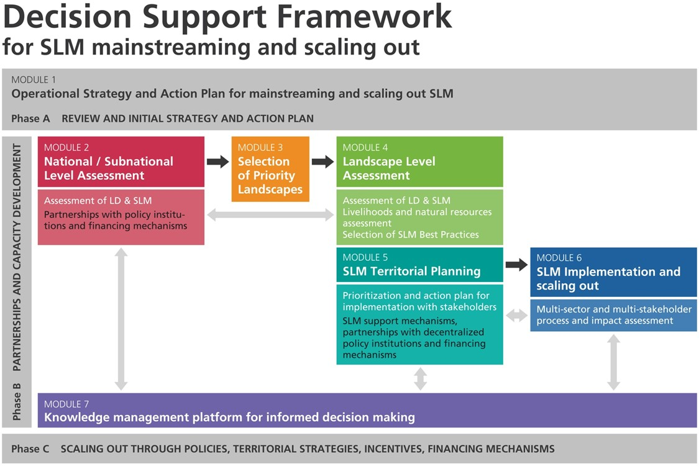
DS-SLM Methodological framework

Slide 6
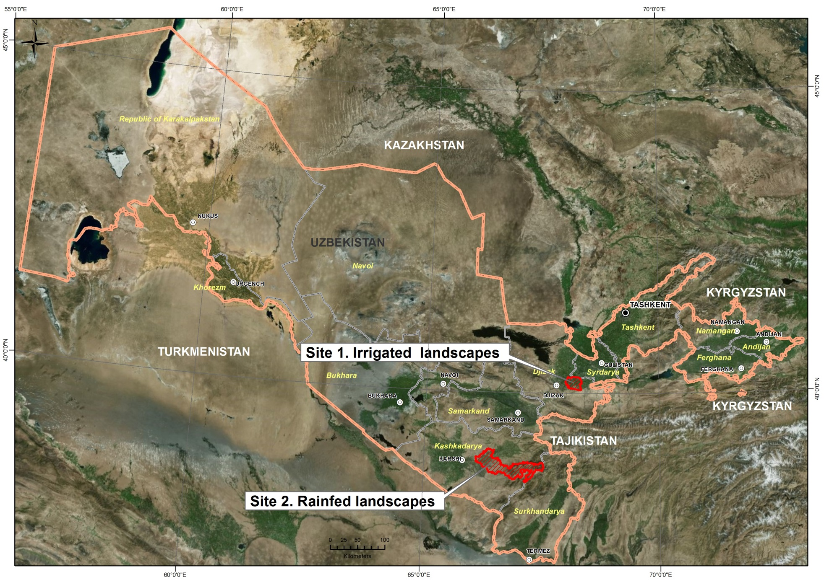
Overall Location of Uzbekistan
Notes:
Republic Uzbekistan is situated in the heart of Central Asia within the Aral Sea basin. Almost 80% of the country area is comprised of deserts and semi-deserts, including Kyzylkum, the largest desert of Central Asia. According to the UNEP aridity indexes, most of Uzbekistan territory, except for the foothills and mountains, is classified as a drought zone and is therefore very susceptible to land degradation and desertification.
Among the most important issues concerning the management of natural resources in Uzbekistan is a need to enhance mainstreaming and scaling out of SLM best practices to mitigate of DLDD and improving of agroecosystem services at all levels.

Slide 7
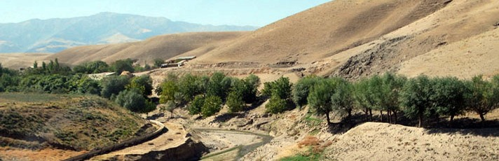
Module 2. National /sub-national assessment
Methods and tools: FAO LADA / WOCAT, DPSIR, PLUD, etc
Results:
Collection secondary information, analysis legal and institutional frameworks, and identify needs and gaps at national and sub-national level
Local field diagnostic to assess and mapping of LD/LUS at sub-national level
Review of SLM policies, programs and projects and financing mechanisms
Progress report, summarizing the results of the DLDD and SLM assessment and mapping at national and sub-national level.
Notes:
National land degradation and SLM assessment has been conducted using the LADA-WOCAT tools and DPSIR, PLUD analysis, which is based on LUS and selected districts/landscapes and local communities.
Activities:
Collection secondary information, analysis legal and institutional frameworks, and identify needs and gaps at national and sub-national level
Local field diagnostic to assess and mapping of LD/LUS at sub-national level
Review of SLM policies, programs and projects and financing mechanisms
Progress report, summarizing the results of the DLDD and SLM assessment and mapping at national and sub-national level.

Slide 8
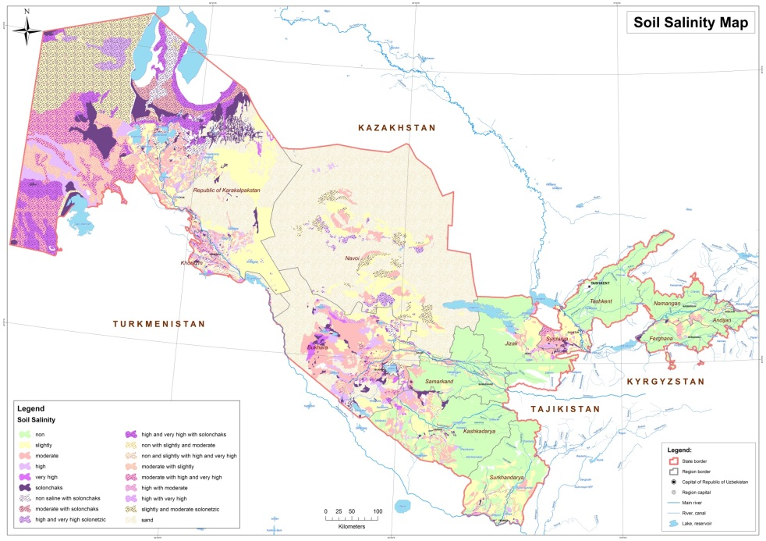
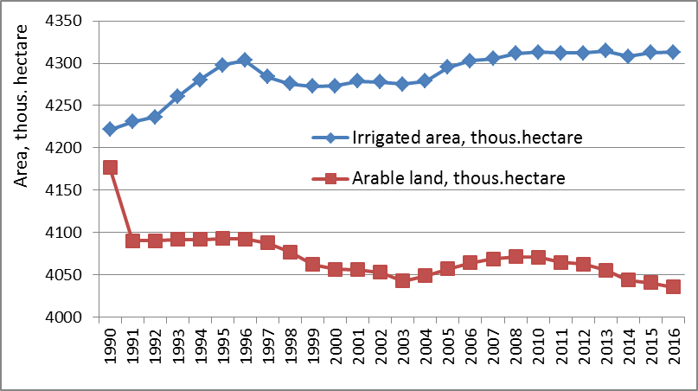
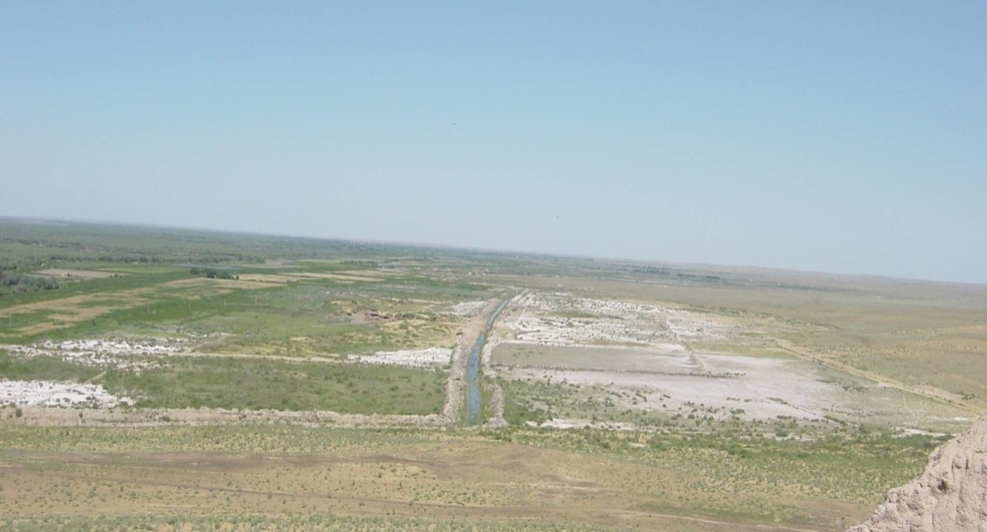
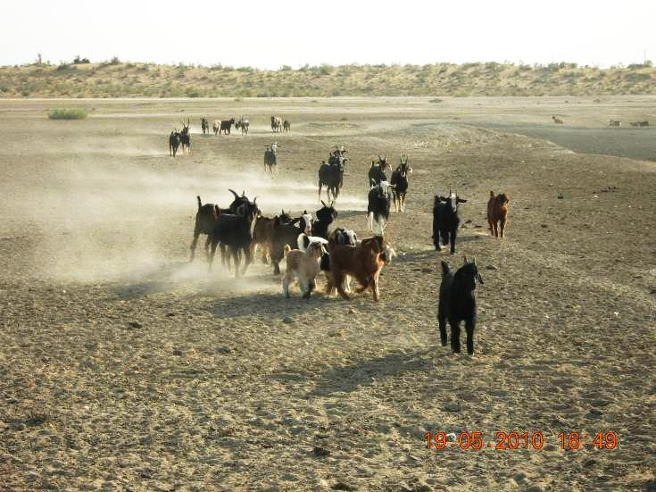
Module 2. National /subnational assessment
Results of DLDD assessments at national and sub-national level
Long-term change of irrigated and arable lands (1991-2016)
About 49% of irrigated lands is affected to secondary salinization, of which more than 17.4% are classified as moderately or highly saline ;
More than 56 % of land area is affected by wind erosion.
Practically all the country’s ecosystems have undergone significant changes.

Slide 9
Module 3. Selection of priority landscapes
Criteria used for the selection of the landscapes
Biophysical indicators: slope, soil type, P/ temperature, length growing system, altitude (DEM/terrain)
Land use attributes: dominant crop type, livestock type density, irrigation type/ scale, farming system, management index
Socio-economic : population density, farmer income , poverty, infrastructure, protected, urban/ rural
  Selected Landscapes
Irrigated salt-affected landscapes in central semi-desert province (Djizak region)
Rainfed drought-prone landscapes in the southern semi-desert zone (Kashkadarya region);
№№ | Agroclimatic province | Administrative district | Land use and soil types | Total area, ‘000 ha |  | Main LD issues
 |  |  |  | Total | Incl. irrigated
1 | Piedmont semi-desert Central, 274 m asl ; P -370 mm; t⁰C annual - 15.6° C | Zarbdar, | Irrigated agriculture. light sierozem, irrigated meadow salt affected soils | 50,7 | 48,2 | About 73% of irrigated area is salt affected soils
2 | Piedmont semi-desert Central, 520 m asl P -327 mm ; t⁰C annual - 15.5° C | Kamashi | Rainfed agriculture typical sierozem, eroded and fertility decline soils | 245,7 | 34,6 | More than 45% of rainfed area is eroded soils

Slide 10
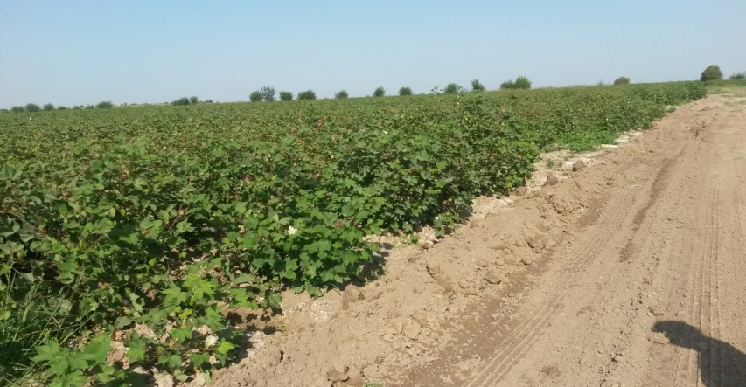
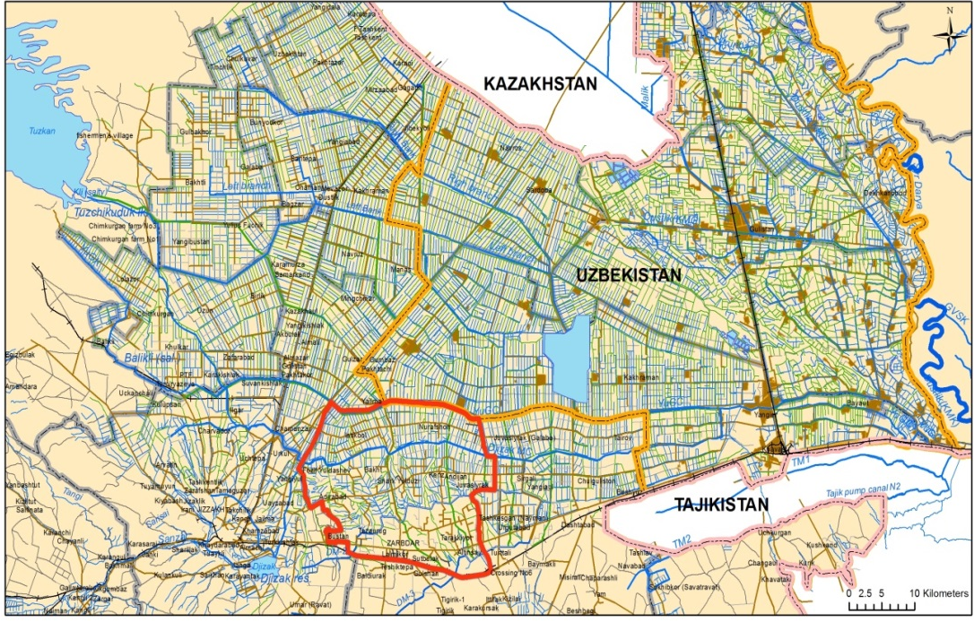
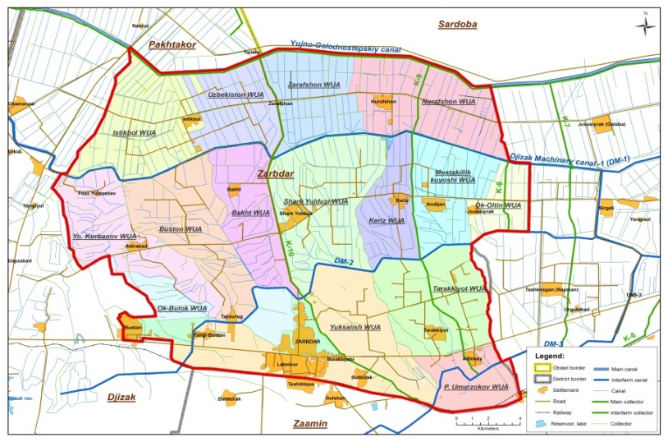
Module 3. Selection of priority landscapes
Site 1. Irrigated salt-affected landscapes in Djizak region (Zarbdar)
Zarbdar Project Area
Water User Associations in Zarbdar Project Area

Slide 11
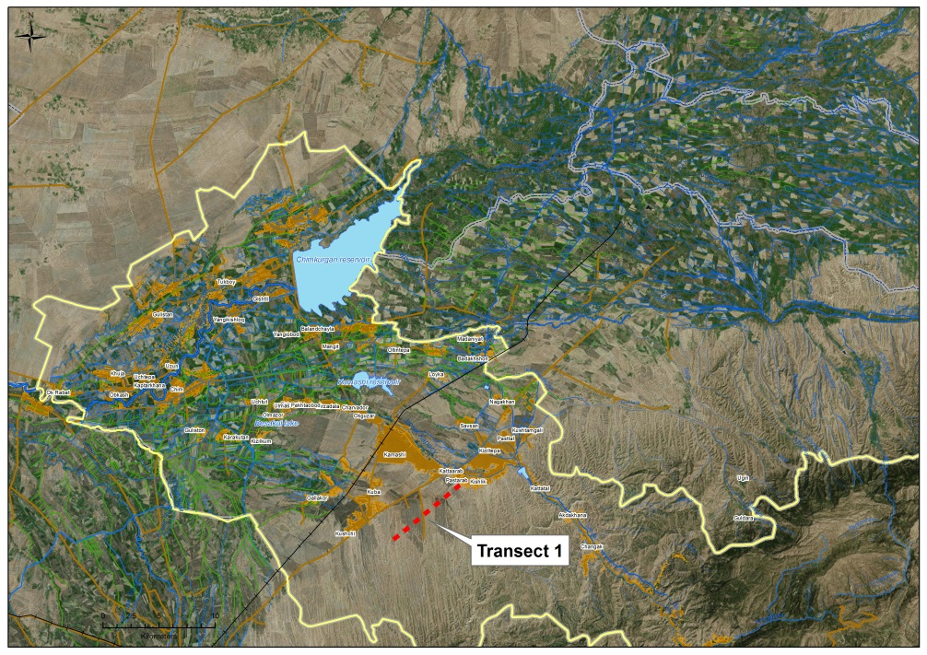
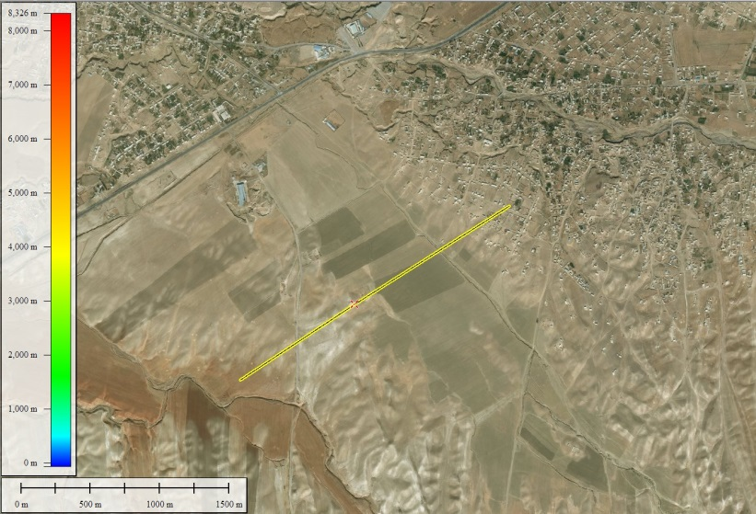
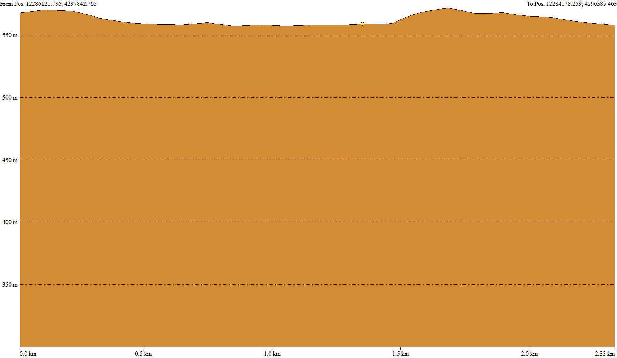
Module 3. Selection of priority landscapes
  Site 2: Rainfed drought-prone landscapes in Kamashi, Kashkadarya

Slide 12
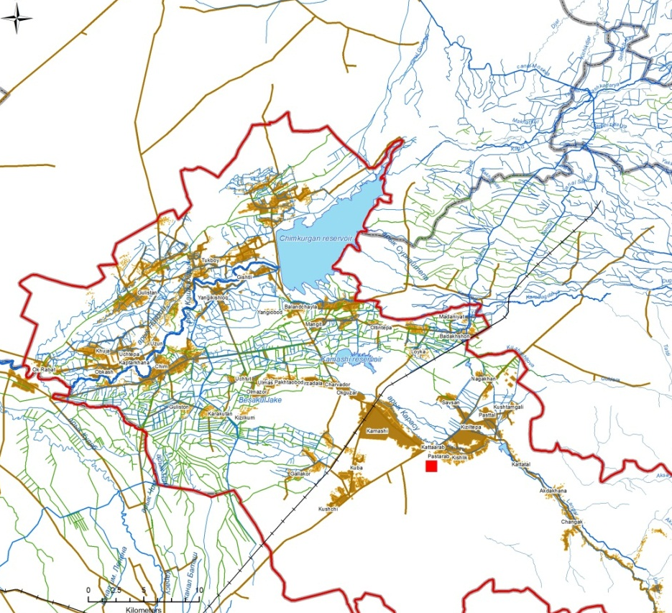
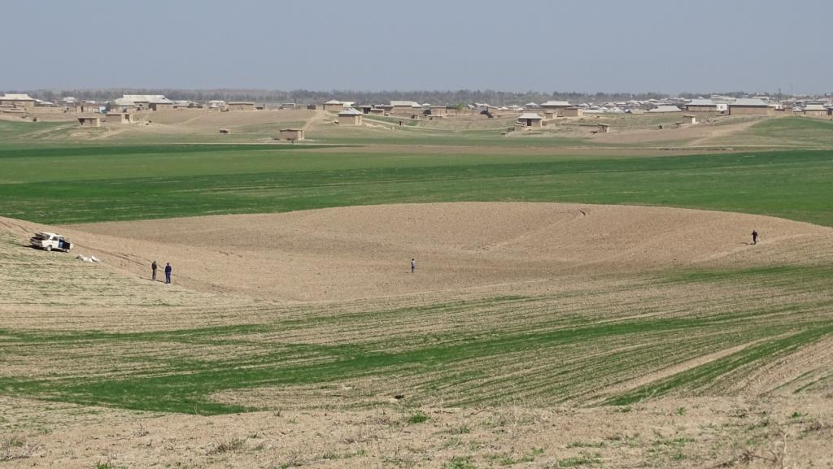
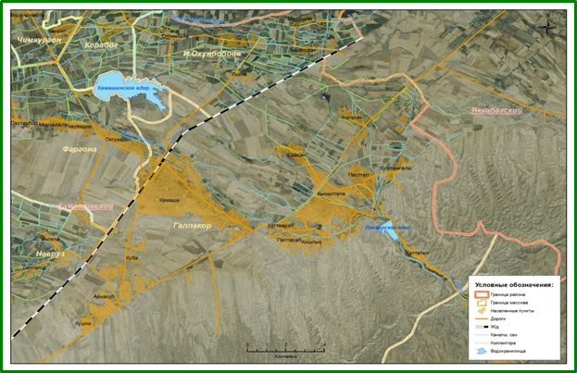
Module 3. Selection of priority landscapes
Site 2: Rainfed drought-prone landscapes in Kamashi, Kashkadarya

Slide 13
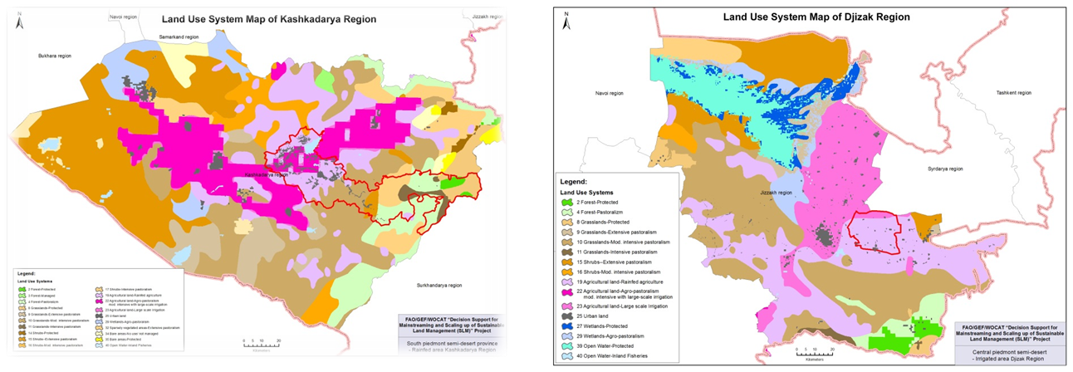
Module 4. Local / landscape assessments
Land use and LUS mapping of selected landscapes
Method and tools: FAO LADA (2009) Guideline on «Mapping of Land Use System (LUS) at global and national scales…» and other global products (GLC-2000, AgroMaps, SRTM data,etc).
Land Use System Maps of Kashkadarya and Djizak regions

Slide 14

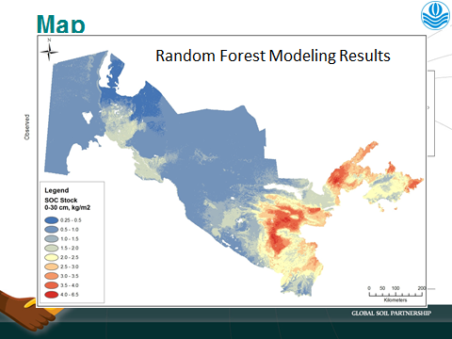
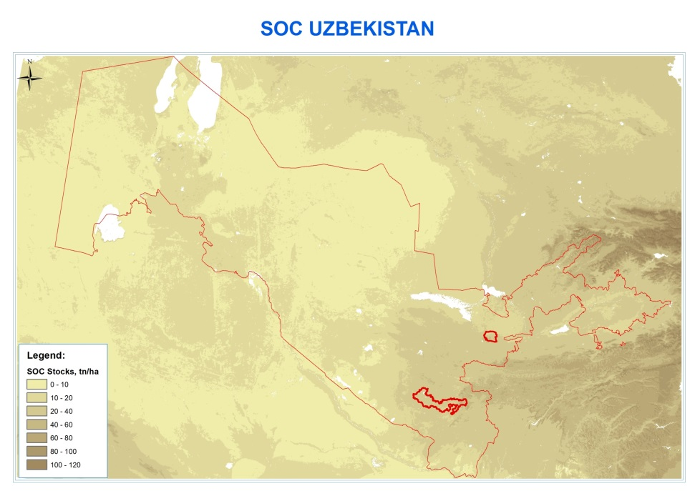
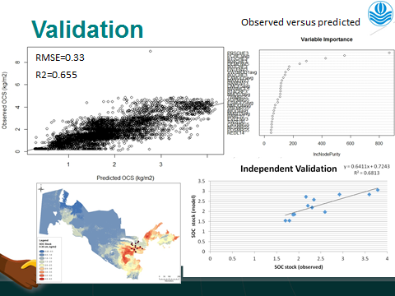
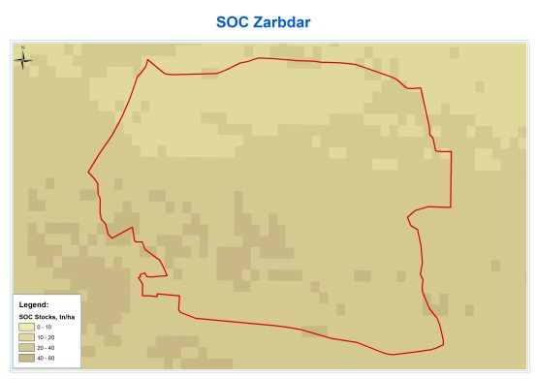
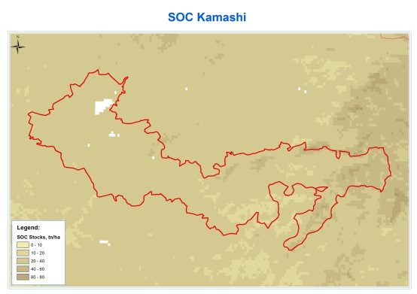
Soil Organic Carbon Map
Module 4. Local/landscape assessments
Notes:
Under the collaboration of Global Soil Partnership of FAO and World Soil Information (ISRIC), a soil organic carbon mapping has been performed by DS-SLM team to evaluate soil carbon of the whole territory of Uzbekistan.

Slide 15
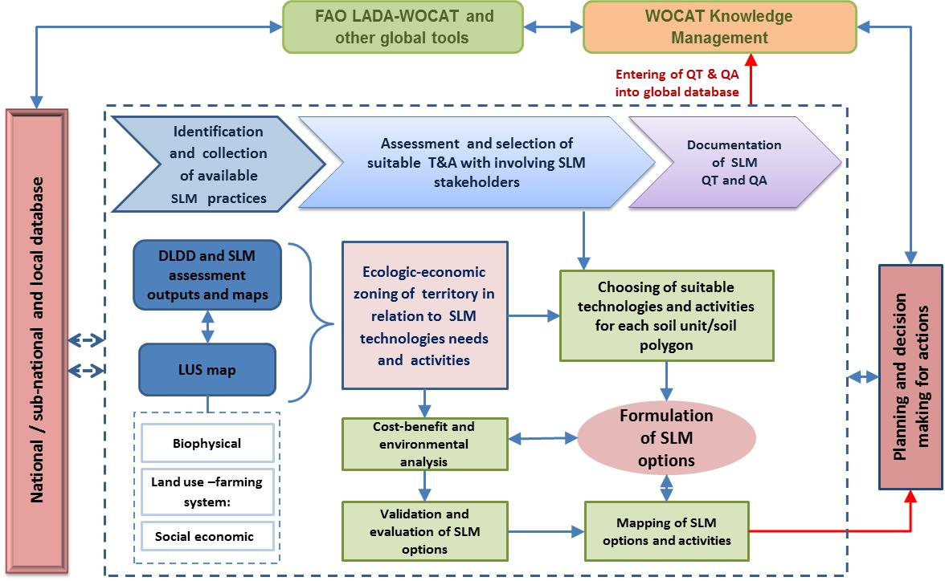
Development of SLM Options for planning and decision making
Module 4. Local / landscape assessments
Notes:
- Preparation of the general list of technologies, which including of 60 SLM technologies and 5 approaches, were based on the systematization of available information and outputs of SLM projects at all levels;
- Screening of the general list of T&A and compiling of selected list of SLM T&A, including (39 T&A) to follow-up evaluation and discussion with target groups;
- Development and prioritization of the final list of SLM technologies and approaches was compiled with national and sub-national experts and organizations in the frame of «National SLM Delivery Capacity Building Workshop».
Participatory analysis of SLM options for implementation, including needs assessment for interventions and investments at different levels and in different fields, are conducted

Slide 16
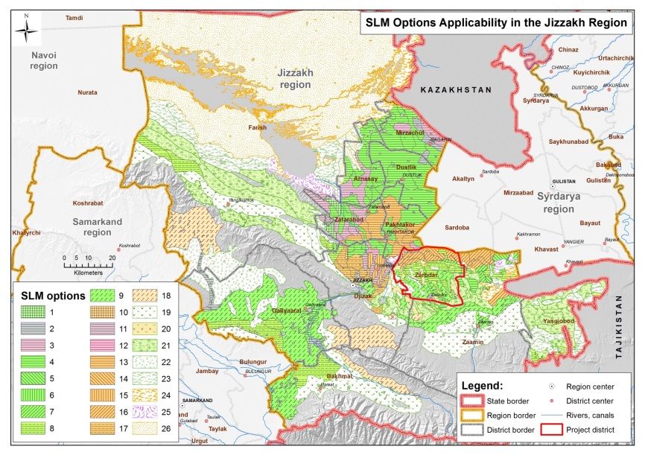
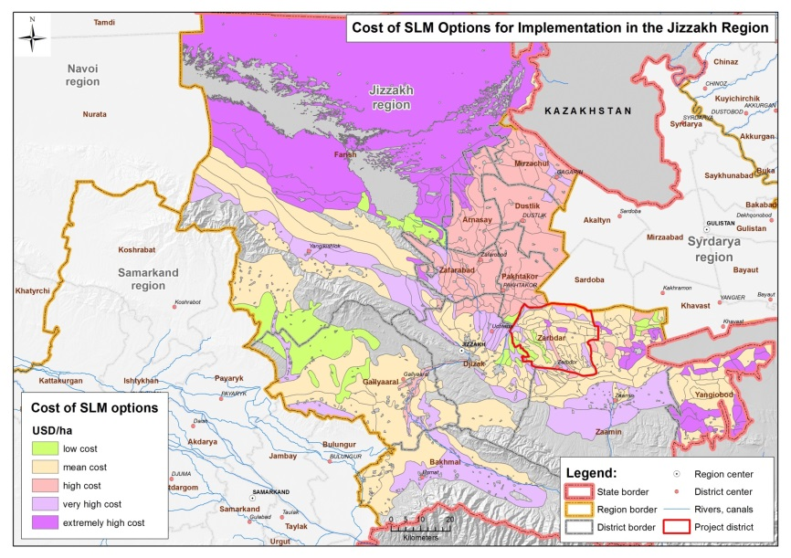
SLM Options mapping to support of planning and decision making
Djizak project area
Cost of SLM Options
SLM options | SLM sub-options | Value (in USD)
 |  | $US / ha
1 | 1-2 | <300 | Low-cost
2 | 3-9 | 400-470 | Mean cost
3 | 10-13 | 750-800 | High-cost
4 | 14-22 | 1100-1540 | Very high-cost
5 | 21-26 | 2150-3990 | Extremely high -cost
Notes:
GIS mapping of SLM technologies options at subnational level
The selected SLM technologies were grouped for Kashkadarya and Djizak regions territory depending on natural and meliorative conditions and specific needs of improvement and reclamation of agricultural lands. Their distributions and costs of SLM options are illustrated in Map 7.1 and 7.2.
Resulted mapping of appropriate and acceptable SLM technology options is essential for management and planning of scaling out activities.

Slide 17
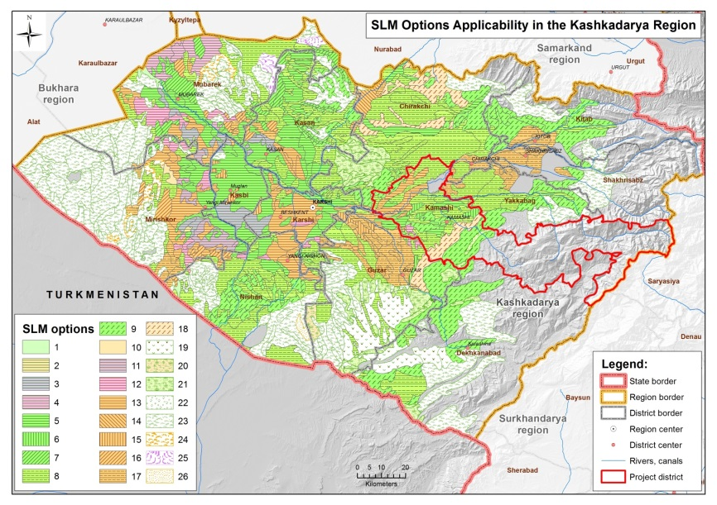
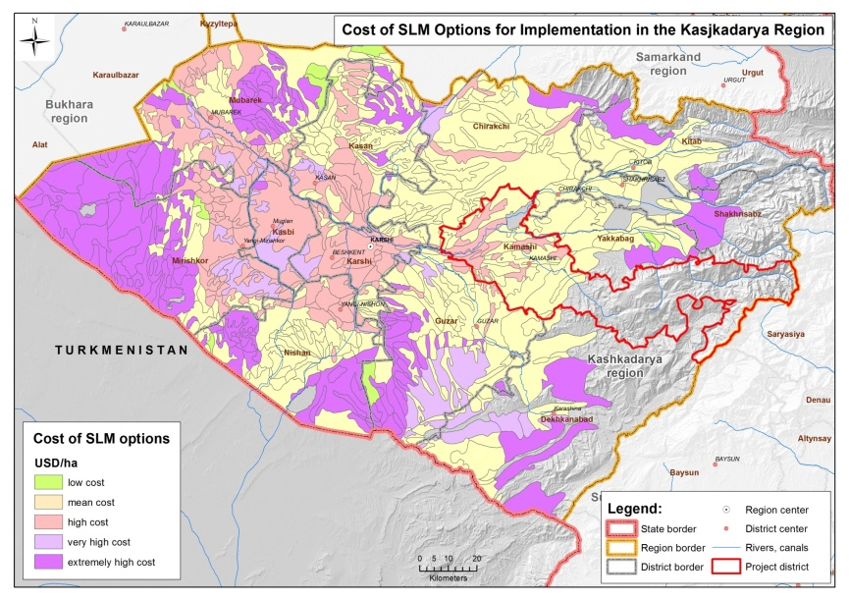
SLM Options mapping to support of planning and decision making
Kashkadarya region
Cost of SLM Options
SLM options | SLM sub-options | Value (in USD)
 |  | $US / ha
1 | 1-2 | <300 | Low-cost
2 | 3-9 | 400-470 | Mean cost
3 | 10-13 | 750-800 | High-cost
4 | 14-22 | 1100-1540 | Very high-cost
5 | 21-26 | 2150-3990 | Extremely high-cost

Slide 18
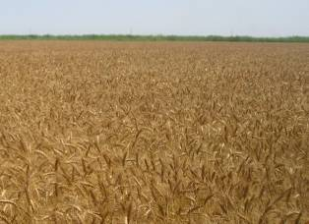
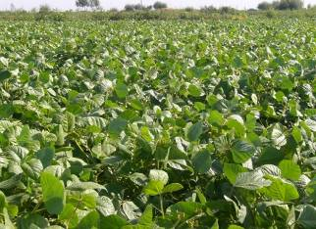
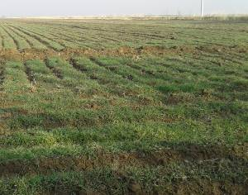
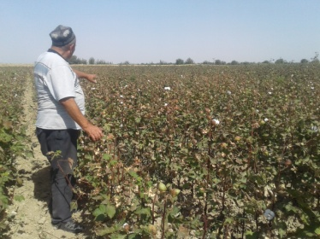
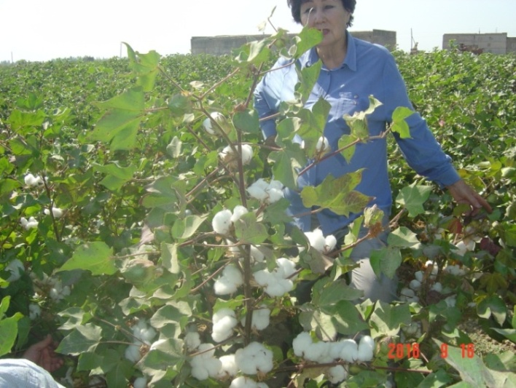
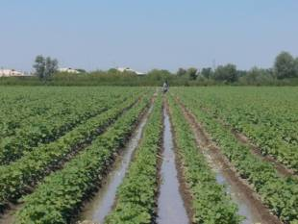
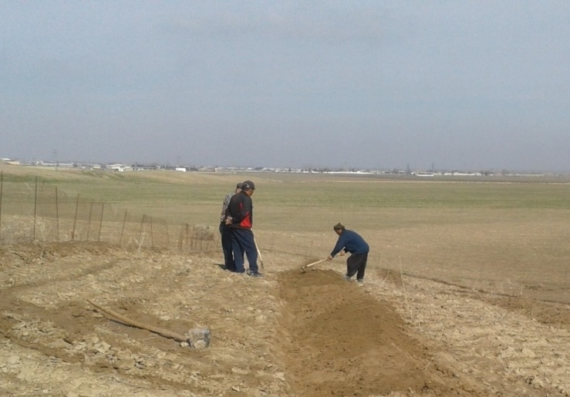
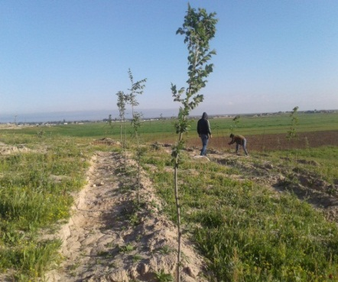
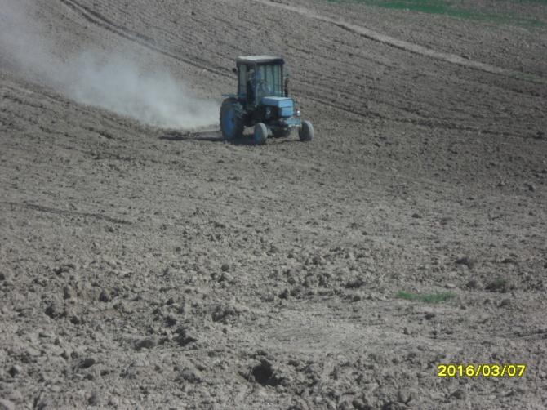
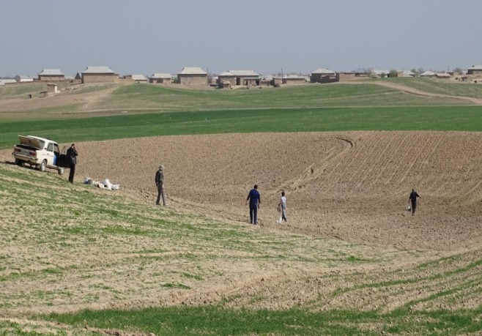
Module 6. SLM best practices implementation
Demonstrated SLM technologies in the Project sites
Site 1. Irrigated salt affected landscapes | Technology 1. Crops diversification with introduction of legumes and green manures on salt affected soils
 | Technology 2. Introduction of new drought and salt tolerant «Gulistan» cotton variety
Site 2. Rainfed drought-prone landscapes | Technology 3. Planting of almonds on small terraces to increase productivity of eroded soils in rainfed landscapes.
 | Technology 4. Cultivation of desert drought-resistant crops on rainfed lands for reduces of soil erosion and provision of fodder production growth.
Notes:
Demonstrated 4 SLM technologies in the project demo sites in selected irrigated and rainfed landscapes.

Slide 19
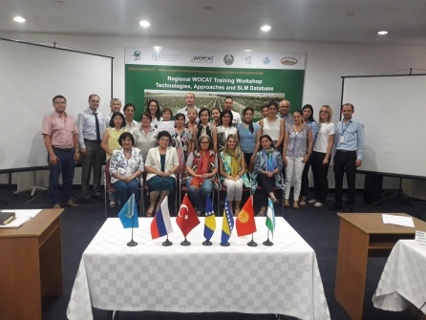
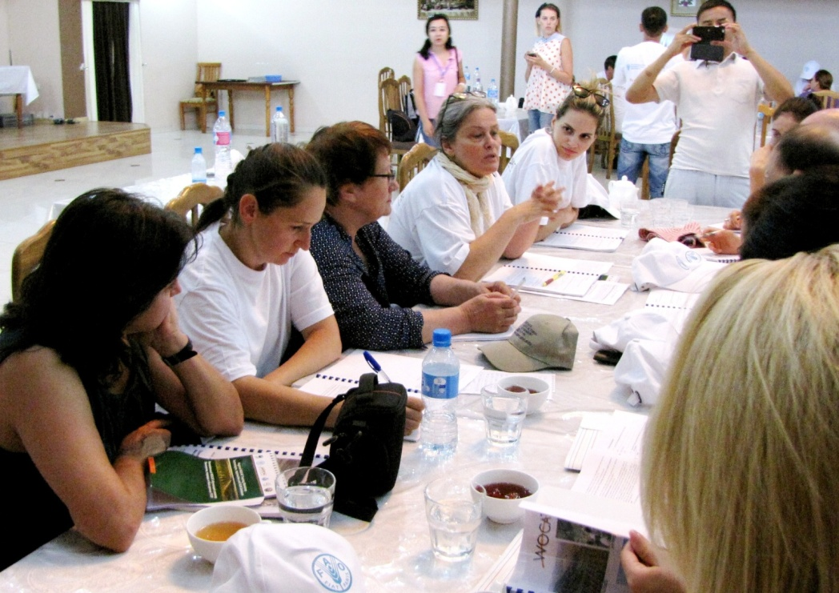
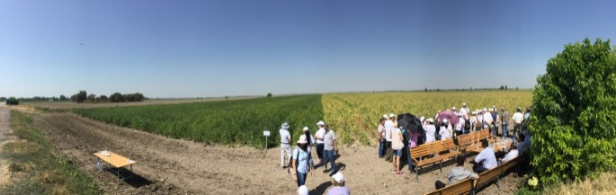
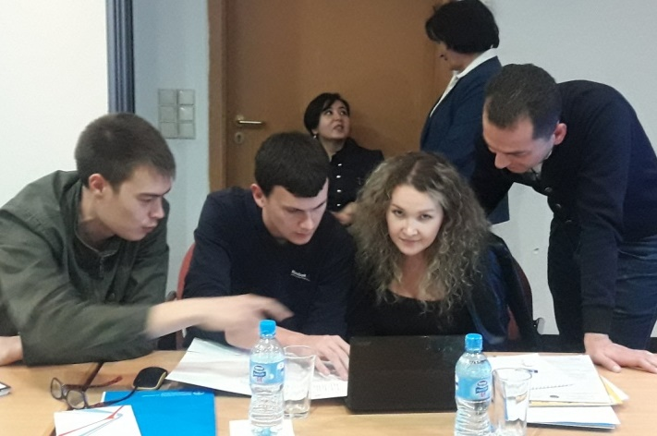
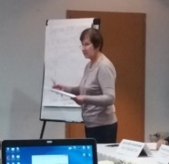
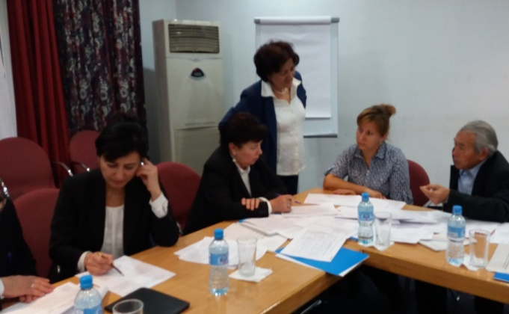
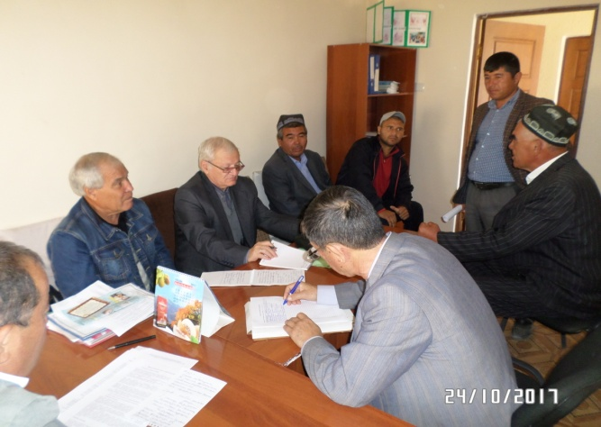
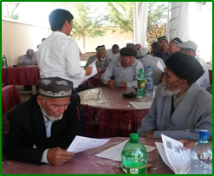
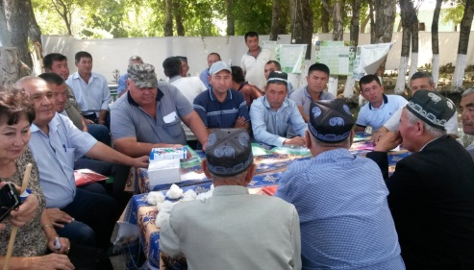
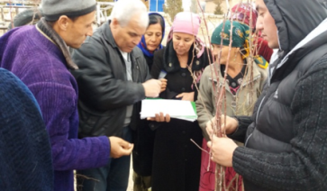


Module 6. SLM best practices identification and implementation
Local Level:
Adaptation of FFS on SLM practices scaling out in project areas, using
PLUD and other tools
Sub-national:
Consultations and meetings with local target groups, incl. local governances, and households.
National level:
Stakeholder meetings SLM Delivery Capacity Building Workshops and round table discussion,
experts meetings, etc
Regional level:
WOCAT–FAO Training, Workshop
Building Capacity and Partnerships for SLM scaling out at all levels
Notes:
Local Level: Developing and up-scaling “learning by doing”/action-oriented approaches such as Farmer Field Schools (FFS) to promote and adapt SLM technologies and practices

Slide 20
Outputs of SLM mainstreaming and scaling out activities during 2016-2017
# | Activity | Total participants | including women
1 | Workshops and stakeholder meetings at national and sub-national level | 168 | 61 (36%)
2 | FFS Trainings on scaling of SLM stakeholders at local level in demo sites | 216 | 62(23%)
3 | Consultative meetings and discussions with local authorities and decision makers | 72 | 8 (11%)
4 | PLUD workshops in Kamashi and Djizak project areas | 151 | 39 (26%)
5 | Stimulation of SLM scaling up activities for 4 communities in Kamashi | 133 | 30 (23%)
6 | Disseminated knowledge products:
 | handbooks on best practices of crop cultivation | 300
 | Leaflets, instructions, manuals, guides | 300
 | posters on biological methods of plant protection | 20
 | presentation of DS-SLM project | 30
 | TOTAL | 740

Slide 21


  Module 7. SLM implementation and scaling out
CACILM-2011: SLM practices integrated into WOCAT SLM Database (SLM-Capacity Building project, 2010-2012)

Slide 22


  Module 7. SLM implementation and scaling out
DS-SLM-2018: SLM practices integrated into WOCAT Database (Uzbekistan, 2018)
Rainfed drought-prone landscapes
Planting of almonds on small terraces to increase productivity of eroded soils in rainfed landscapes.
Cultivation of desert drought-resistant crops on rainfed lands for reduces of soil erosion and provision of fodder production growth.
Use of biogas production wastes to improve soils fertility.
Irrigated salt affected landscapes
Every-other furrow irrigation method with alternation of the dry and watered furrows.
Laser land leveling to rise on-farm water use efficiency
Crops diversification with introduction of legumes and green manures on salt affected soils

Slide 23
Module 1. Mainstreaming strategy
Process for formulating a mainstreaming/upscaling Strategy
Established coordination mechanisms, and formulation of a draft Strategy – to be presented in Annual report.
Method and tools: FAO DS-SLM SLM Tool. Working document FAO CBL, Soledad Bastidad, RC (version 21.07.2017) and specific training courses presented in the regional FAO WOCAT Workshop in Tashkent, Uzbekistan, 2017.
Objectives and activities for mainstreaming SLM
Policy instruments and partnerships are enabled to scale out and mainstream SLM.
National: Assessment of legislative and institutional frameworks, agricultural policy tools and transformations, SLM Delivery Capacity Building Workshop (Nov.2017)
Subnational: Stakeholder workshops, consultations and expert meetings in support of SLM scaling out to be done (June-July 2017);
Local: PLUD field training and consultation process in selected 4 local communities and WUA (Water use association)- May, August 2017 (151 participants, including 39 women).
Regional WOCAT/FAO training workshop, including SLM mainstreaming guidelines – August 2017 - 47 persons.
Notes:
This tool suggests a stepwise process for designing the DS-SLM Mainstreaming Strategy focusing on the key decision making processes, including national policies, planning and financial mechanisms through adoption of the following steps : 1) Barriers for SLM implementation and scaling out, 2) Decision-making processes, 3) Mainstreaming objectives and activities, 4) Stakeholder and institutional mapping, и 5) Action Plan.

Slide 24
DS-SLM-UZB: Successful Case Studies of the SLM scaling out in Uzbekistan
Key success factor | Case study 1 : GEF/UNDP Project «Achieving Ecosystem Stability» (2011-2015) | Case study: GEF/FAO project «Decision Support for Mainstreaming and Scaling out Sustainable Land Management –Uzbekistan» (2016-2018)
Consistently fund and adaptively plan | Communication plan and participatory project on the SLM policies of integrated land use in drought-prone regions are developed. | Strategy and the Action Plan for scaling out of SLM are drafted at project areas for: - irrigated salt affected landscapes - rainfed drought-prone landscapes
2.Select SLM options for scaling up and out, based on best available evidence | SLM practices: Rotation of pastures Enrichment of pastures Mobile sands fixing More than 16000 ha of lands around of settlements were rehabilitated. | SLM technologies for the irrigated lands: diversification of food crops with introduction of green gram (bean), cultivation of innovative drought-resistant and salt-tolerant varieties of cotton; for rainfed lands: planting of almonds on small terraces, desert drought-resistant plants species on rainfed areas.
3. Identify and engage stakeholders at all relevant scales recognizing and appealing to the motives of different groups | Various groups of stakeholders, including women, cattle breeders, shepherds are attracted. Alternative sources of income are created. | Wide range of SLM stakeholder groups, including local authorities, farmers, women, aksakals (old /elder ) of Citizens Assembles, WUA, end land users, households, etc are involved in scaling up and out of SLM.
4. Build capacity for scaling up | Ten educational workshops are held in which 237 people, including 109 women have participated. Local cattle-farmers are trained in methods of agriculture. | Multidisciplinary approach to build SLM scaling up capacity: national, sub-national and local level. Training of various target groups based on FFS approach and other tools. Total number of trained – 740 people, including 200 women

Slide 25
DS-SLM-UZB: Successful Case Studies of the SLM scaling out in Uzbekistan
Key success factor | Case study 1 : GEF/UNDP Project «Achieving Ecosystem Stability» (2011-2015) | Case study: GEF/FAO project «Decision Support for Mainstreaming and Scaling out Sustainable Land Management –Uzbekistan» (2016-2018)
5.Lead: foster institutional leadership and policy change to support scaling up | Two draft standard and legal documents on effective use of pastures are submitted for consideration of the Government | Active partnerships among local and national decision makers, participatory dialogues, discussions and consultations with target groups at all levels are established
6. Mobilize: achieve early tangible benefits and inceptives for as many stakeholders as possible to engage in activities to scale up | Two design communities "Kazakhdarya" and "Kyzyl Ravat" with the population more than 5000 people are mobilized in the project actions Pasture Users Councils are created and pasture rotation is implemented. | Mobilization of local communities to joint decision-making and support of SLM scaling out in the frame of PLUD workshops (4 WCAs in Kamashi and 1 WCA/ WUA in Zabdar). Total number of participants 160 persons.
7. Reflect and communicate | Two project communities and the population of nearby kishlaks have adopted and continue the actions initiated by the project | Farmers and land users of the two project areas have involved into project activities and demonstration of selected SLM technologies as a leaders to enhance of decision making , extension and scaling out processes at local and sub-national level.

Slide 26

Thank you

